Slide 1
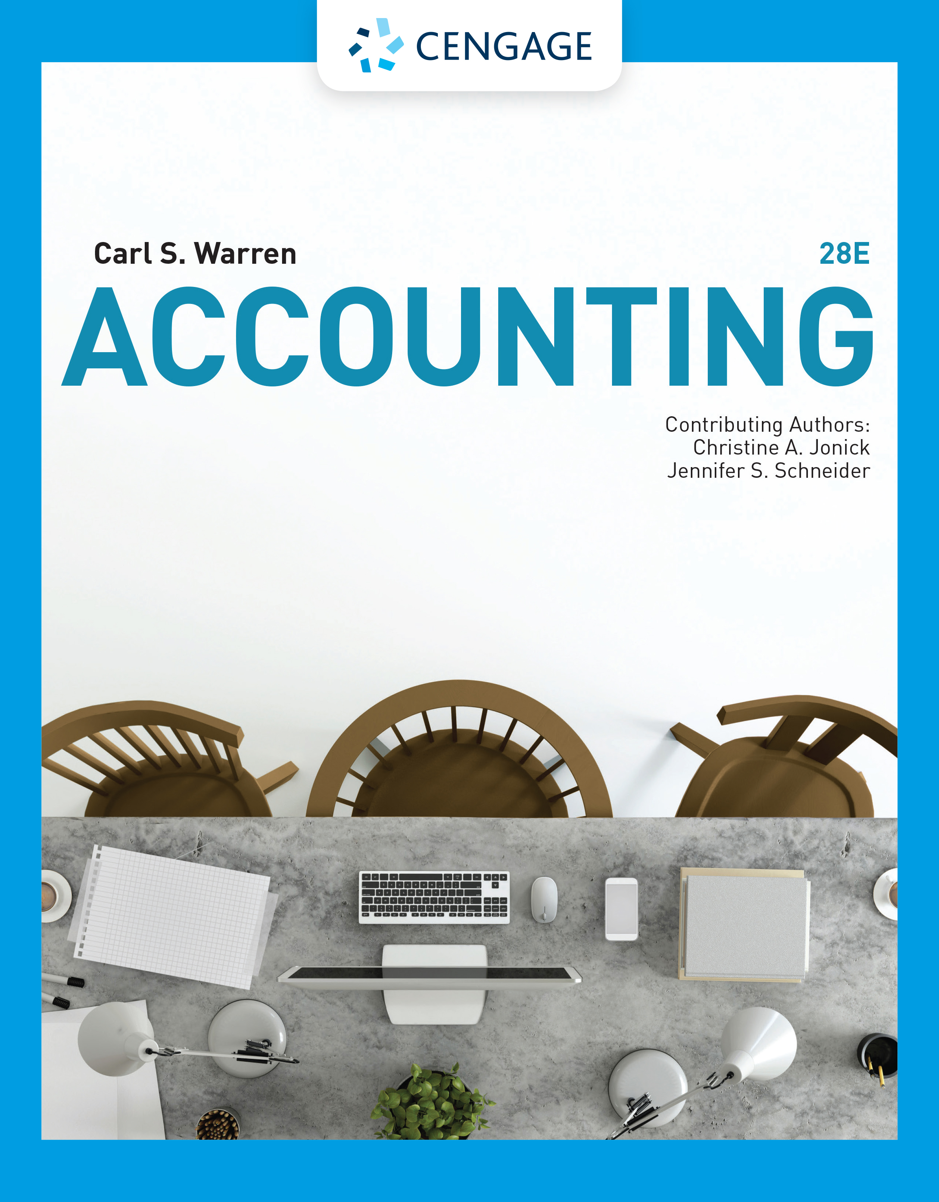
Introduction to Accounting and Business
Chapter 1

Slide 2
Learning Objectives (1 of 2)
LO1: Describe the nature of business and the role of accounting and ethics in business.
LO2: Summarize the development of accounting principles and relate them to practice.
LO3: State the accounting equation and define each element of the equation.
LO4: Describe and illustrate how business transactions can be recorded in terms of the resulting change in the elements of the accounting equation.

Slide 3
Learning Objectives (2 of 2)
LO5: Describe the financial statements of a proprietorship and explain how they interrelate.
LO6: Describe and illustrate the use of the ratio of liabilities to owner’s equity in evaluating a company’s financial condition.

Slide 4
Meaning of Business
A business is an organization in which basic resources (inputs), such as materials and labor, are assembled and processed to provide goods or services (outputs) to customers.
The objective of most businesses is to earn a profit.
  Profit is the difference between the amounts received from customers for goods or services and the amounts paid for the inputs used to provide the goods or services.

Slide 5
Types of Businesses
Service Businesses | Service
Delta Air Lines | Transportation Services
The Walt Disney Company | Entertainment Services
Merchandising Businesses | Product
Wal-Mart Stores, Inc. | General merchandise
Amazon.com | General merchandise
Manufacturing Businesses | Product
Ford Motor Co. | Cars, trucks, vans
Dell Inc. | Personal computers

Slide 6
Role of Accounting in Business
Accounting can be defined as an information system that provides reports to users about the economic activities and condition of a business
  The process by which accounting provides information to users is as follows:
    Identify users
    Assess users’ information needs
    Design the accounting information system to meet users’ needs
    Record economic data about business activities and events
    Prepare accounting reports for users

Slide 7
Accounting as an Information System

Slide 8
Managerial Accounting
The area of accounting that provides internal users with information is called managerial accounting, or management accounting.
Managerial accountants employed by a business are employed in private accounting

Slide 9
Financial Accounting
The area of accounting that provides external users with information is called financial accounting.
The objective of financial accounting is to provide relevant and timely information for the decision-making needs of users outside of the business.
General-purpose financial statements are one type of financial accounting report that is distributed to external users.

Slide 10
Role of Ethics in Accounting and Business (1 of 3)
The objective of accounting is to provide relevant, timely information for user decision making.
Accountants must behave in an ethical manner so that the information they provide users will be trustworthy and, thus, useful for decision making.
Ethics are moral principles that guide the conduct of individuals.

Slide 11
Accounting and Business Frauds

Slide 12
Role of Ethics in Accounting and Business (2 of 3)
What went wrong for these managers and companies?
  The answer to the preceding question normally involved one or both of the following two factors:
    Failure of individual character
    Culture of greed and ethical indifference

Slide 13
Role of Ethics in Accounting and Business (3 of 3)
Guidelines for behaving ethically follow:
  Identify an ethical decision by using your personal ethical standards of honesty and fairness.
  Identify the consequences of the decision and its effect on others.
  Consider your obligations and responsibilities to those who will be affected by your decision.
  Make a decision that is ethical and fair to those affected by it.

Slide 14
Opportunities for Accountants
Accountants who provide services on a fee basis are said to be employed in public accounting.
Accountants employed by companies, government, and not-for-profit entities are said to be employed in private accounting.
Public accountants who have met a state’s education, experience, and examination requirements may become Certified Public Accountants (CPAs).

Slide 15
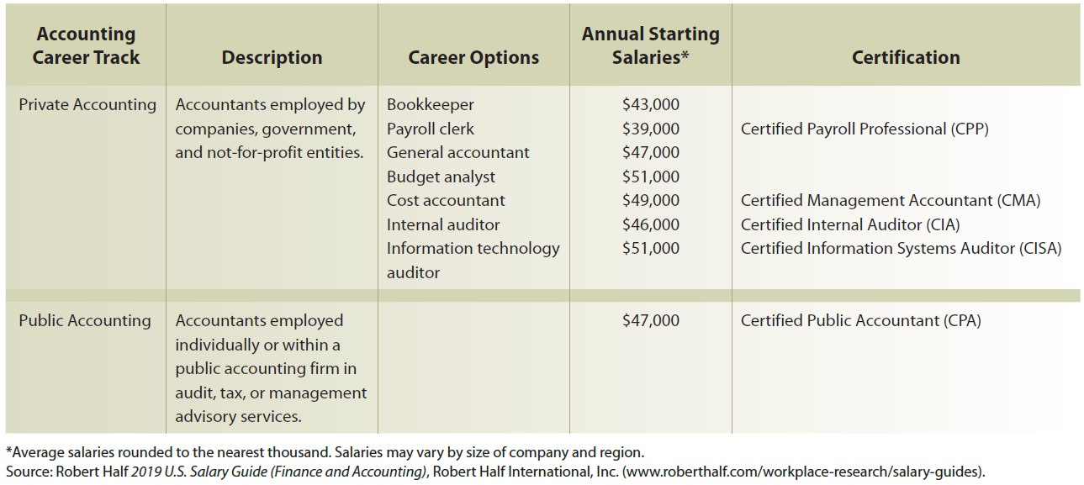
Accounting Career Paths and Salaries

Slide 16
Generally Accepted Accounting Principles (GAAP)
Financial accountants follow generally accepted accounting principles (GAAP) in preparing reports.
Within the U.S., the Financial Accounting Standards Board (FASB) has the primary responsibility for developing accounting principles.
Securities and Exchange Commission (SEC) has authority over the accounting and financial disclosures for companies whose shares of ownership (stock) are traded and sold to the public
Many countries outside the U.S. use generally accepted accounting principles adopted by the International Accounting Standards Board (IASB).

Slide 17
Business Entity Concept
Activities of a business are recorded separately from the activities of its owners, creditors, or other businesses
This concept limits the economic data in an accounting system to data related directly to the activities of the business.

Slide 18
Forms of Business Entities

Slide 19
Time Period Concept (1 of 2)
Requires a company to report its economic activities on a regular basis for a specific period
Annual accounting period adopted by a company is called its fiscal year
  Calendar year is the most commonly used fiscal year
  Corporations may follow other periods as fiscal years

Slide 20
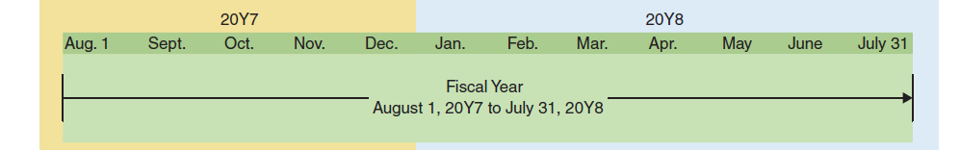
Time Period Concept (2 of 2)
A company’s fiscal year could begin August 1, 20Y7, and end on July 31, 20Y8, as follows:

Slide 21
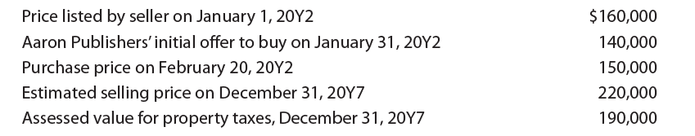
Cost Concept (1 of 3)
Under the cost concept, amounts are initially recorded in the accounting records at their cost or purchase price.
Aaron Publishers purchased a building on February 20, 20Y2, for $150,000. Other amounts related to this purchase are shown below.

Slide 22
Cost Concept (2 of 3)
Aaron Publishers records the purchase of the building on February 20, 20Y2, at the purchase price of $150,000.
Other amounts listed have no effect on the accounting records.

Slide 23
Cost Concept (3 of 3)
The cost concept also involves the objectivity and unit of measure concepts.
  The objectivity concept requires that the amounts recorded in the accounting records be based on objective evidence.
    Only the final agreed-upon amount is objective enough to be recorded in the accounting records.
  The unit of measure concept requires that economic data be recorded in dollars.

Slide 24
Example Exercise: Cost Concept
On August 25, Gallatin Repair Service extended an offer of $400,000 for land that had been priced for sale at $500,000. On September 3, Gallatin Repair Service accepted the seller’s counteroffer of $460,000. On October 20, the land was assessed at a value of $300,000 for property tax purposes. On December 4, a national retail chain offered Gallatin Repair Service $525,000 for the land. At what value should the land be recorded in Gallatin Repair Service’s records?

Slide 25
The Accounting Equation (1 of 2)
The resources owned by a business are its assets.
The rights of creditors are the debts of the business and are called liabilities.
The rights of the owners are called owner’s equity.
Since stockholders own a corporation, the rights of owners of a corporation are called stockholders’ equity.
The equation Assets = Liabilities + Owner’s Equity is called the accounting equation.

Slide 26
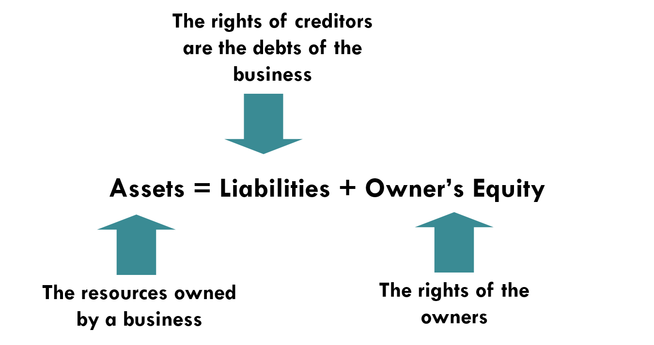
The Accounting Equation (2 of 2)

Slide 27
Example Exercise: Accounting Equation (1 of 2)
John Joos is the owner and operator of You’re A Star, a motivational consulting business. At the end of its accounting period, December 31, 20Y8, You’re A Star has assets of $800,000 and liabilities of $350,000. Using the accounting equation, determine the following amounts:
  Owner’s equity as of December 31, 20Y8.
  Owner’s equity as of December 31, 20Y9, assuming that assets increased by $130,000 and liabilities decreased by $25,000 during 20Y9.

Slide 28
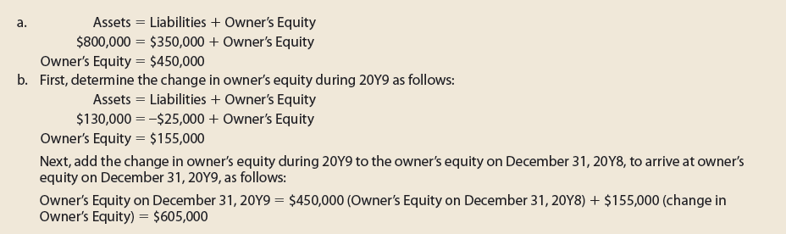
Example Exercise: Accounting Equation (2 of 2)

Slide 29
Business Transactions and the Accounting Equation
A business transaction is an economic event or condition that directly changes an entity’s financial condition or its results of operations.
All business transactions can be stated in terms of changes in the elements of the accounting equation.

Slide 30
Transaction A
On November 1, 20Y3, Chris Clark deposited $25,000 in a bank account in the name of NetSolutions.

Slide 31
Transaction B
On November 5, 20Y3, NetSolutions paid $20,000 for the purchase of land as a future building site.

Slide 32
Transaction C (1 of 2)
On November 10, 20Y3, NetSolutions purchased supplies for $1,350 and agreed to pay the supplier in the near future.

Slide 33
Transaction C (2 of 2)
The liability created by a purchase on account is called an account payable.
Items such as supplies that will be used in the business in the future are called prepaid expenses, which are assets.

Slide 34
Transaction D (1 of 2)
A business earns money by selling goods or services to its customers.
  This amount is called revenue.
On November 18, 20Y3, NetSolutions received cash of $7,500 for providing services to customers.

Slide 35
Transaction D (2 of 2)
Revenue from providing services is recorded as fees earned.
Revenue from the sale of merchandise is recorded as sales.
Other examples of revenue include rent, which is recorded as rent revenue, and interest, which is recorded as interest revenue.
An account receivable, which is an asset, is a claim against a customer.

Slide 36
Transaction E
During the month, NetSolutions spent cash or used up other assets in earning revenue.
  Assets used in this process of earning revenue are called expenses.
On November 30, 20Y3, NetSolutions paid the following expenses: wages, $2,125; rent, $800; utilities, $450; and miscellaneous, $275.

Slide 37
Transaction F
On November 30, 20Y3, NetSolutions paid creditors on account, $950.

Slide 38
Transaction G
On November 30, 20Y3, Chris Clark determined that the cost of supplies on hand at the end of the month was $550.
The cost of the supplies on hand (not yet used) at the end of the month is $550. Thus, $800 ($1,350 – $550) of supplies must have been used during the month. This decrease in supplies is recorded as an expense.

Slide 39
Transaction H
On November 30, 20Y3, Chris Clark withdrew $2,000 from NetSolutions for personal use.

Slide 40
Summary of Transactions for NetSolutions

Slide 41
Types of Transactions
Affecting Owner’s Equity

Slide 42
Example Exercise: Transactions (1 of 2)
Salvo Delivery Service is owned and operated by Joel Salvo. The following selected transactions were completed by Salvo Delivery Service during February:
  Received cash from owner as additional investment, $35,000.
  Paid creditors on account, $1,800.
  Billed customers for delivery services on account, $11,250.
  Received cash from customers on account, $6,740.
  Paid cash to owner for personal use, $1,000.
Indicate the effect of each transaction on the accounting equation elements (Assets, Liabilities, Owner’s Equity, Drawing, Revenue, and Expense). Also indicate the specific item within the accounting equation element that is affected.

Slide 43

Example Exercise: Transactions (2 of 2)

Slide 44
Financial Statements
After transactions have been recorded and summarized, reports are prepared for users.
  The accounting reports providing this information are called financial statements.

Slide 45
Financial Statements Order of Preparation

Slide 46
Income Statement
The income statement reports the revenues and expenses for a period of time, based on the matching concept.
  The matching concept is applied by “matching” the expenses incurred during a period with the revenue that those expenses generated.
    The excess of the revenue over the expenses is called net income, net profit, or earnings.
    If expenses exceed revenue, the excess is a net loss.

Slide 47

Example Exercise: Income Statement (1 of 2)
The revenues and expenses of Chickadee Travel Service for the year ended December 31, 20Y9, follow:

Slide 48
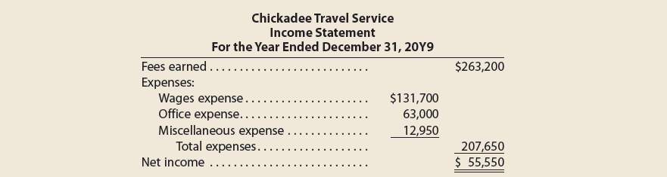
Example Exercise: Income Statement (2 of 2)
Prepare an income statement for the year ended December 31, 20Y9.

Slide 49
Statement of Owner’s Equity
The statement of owner’s equity reports the changes in the owner’s equity for a period of time.
  It is prepared after the income statement because the net income or net loss for the period must be reported in this statement.

Slide 50
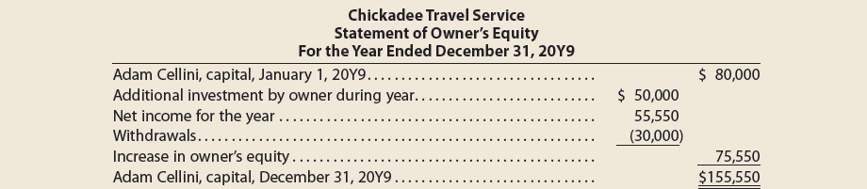
Example Exercise: Statement of Owner’s Equity
Using the income statement for Chickadee Travel Service shown in Example Exercise 1-4, prepare a statement of owner’s equity for the year ended December 31, 20Y9. Adam Cellini, the owner, invested an additional $50,000 in the business and withdrew cash of $30,000 for personal use during the year. The capital of Adam Cellini was $80,000 on January 1, 20Y9.

Slide 51
Balance Sheet
A balance sheet is a list of the assets, liabilities, and owner’s equity as of a specific date.
The account form of a balance sheet lists the assets on the left and the liabilities and owner’s equity on the right.
  It resembles the basic format of the accounting equation.

Slide 52

Example Exercise: Balance Sheet (1 of 2)
Using the following data for Chickadee Travel Service as well as the statement of owner’s equity shown in Example Exercise 1-5, prepare a balance sheet as of December 31, 20Y9.

Slide 53
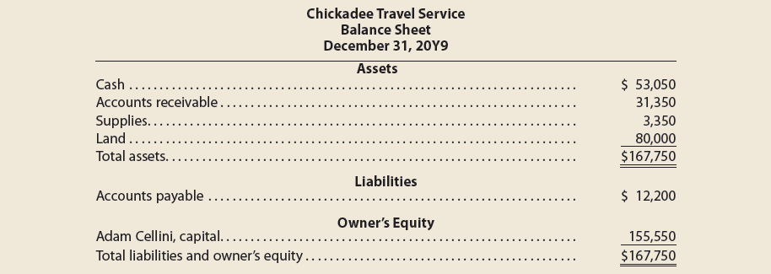
Example Exercise: Balance Sheet (2 of 2)

Slide 54
Statement of Cash Flows (1 of 2)
A statement of cash flows is a summary of the cash receipts and cash payments for a specific period of time.
  It consists of three sections:
    Operating activities
    Investing activities
    Financing activities

Slide 55
Statement of Cash Flows (2 of 2)
Cash Flows from Operating Activities
This section reports a summary of cash receipts and cash payments from operations.
Cash Flows from Investing Activities
This section reports the cash transactions for the acquisition and sale of relatively permanent assets.
Cash Flows from Financing Activities
This section reports the cash transactions related to cash investments by the owner, borrowings, and withdrawals by the owner.

Slide 56
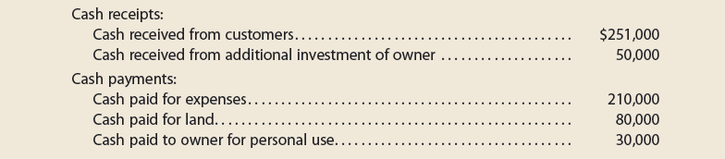
Example Exercise: Statement of Cash Flows (1 of 2)
A summary of cash flows for Chickadee Travel Service for the year ended December 31, 20Y9, follows:
The cash balance as of January 1, 20Y9, was $72,050. Prepare a statement of cash flows for Chickadee Travel Service for the year ended December 31, 20Y9.

Slide 57
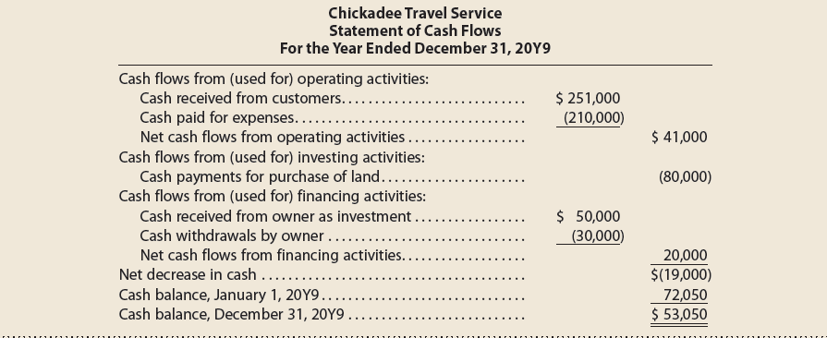
Example Exercise: Statement of Cash Flows (2 of 2)

Slide 58
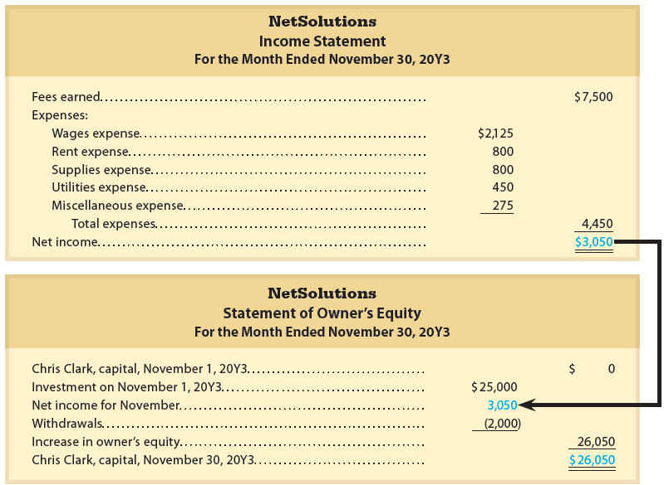
Financial Statements for NetSolutions (1 of 3)

Slide 59
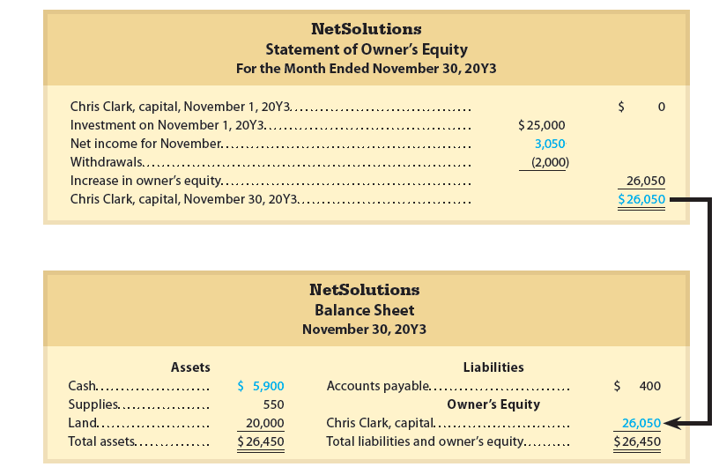
Financial Statements for NetSolutions (2 of 3)

Slide 60
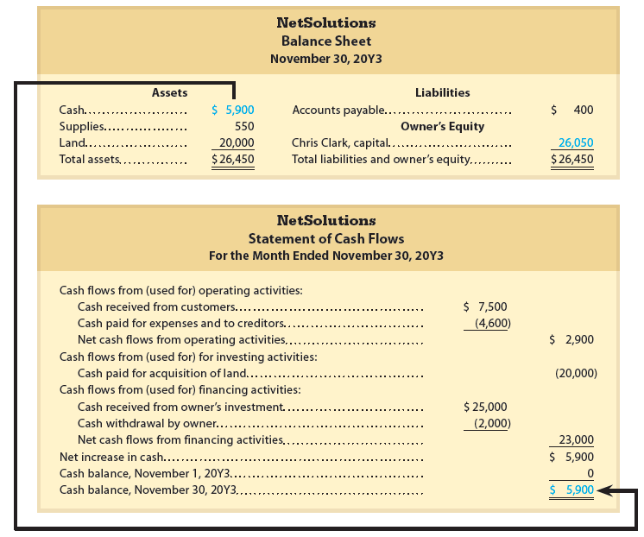
Financial Statements for NetSolutions (3 of 3)

Slide 61
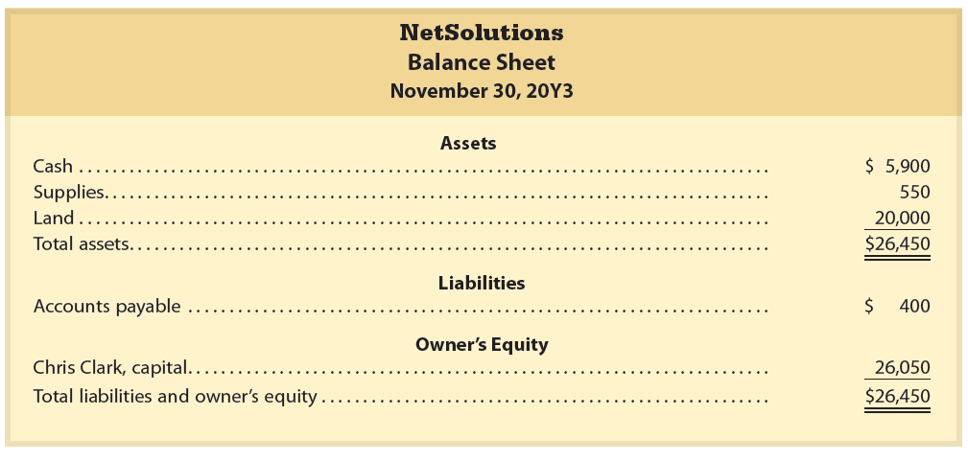
Report Form of Balance Sheet

Slide 62
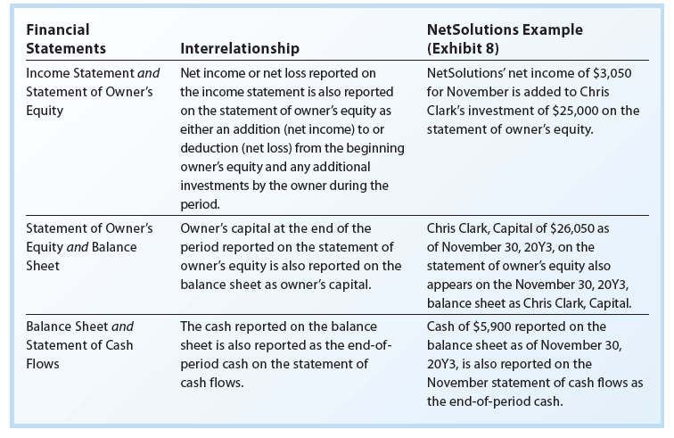
Financial Statement Interrelationships

Slide 63
Financial Analysis and Interpretation:
Ratio of Liabilities to Owner’s Equity (1 of 2)
The ratio of liabilities to owner’s equity is useful in analyzing the ability of a company to pay its creditors.
The ratio of liabilities to owner’s equity is computed as follows:

Slide 64
Financial Analysis and Interpretation:
Ratio of Liabilities to Owner’s Equity (2 of 2)
NetSolutions’ ratio of liabilities to owner’s equity at the end of November is computed as follows:

Slide 65

Example Exercise: Ratio of Liabilities to
Owner’s Equity (1 of 2)
The following data were taken from Hawthorne Company’s balance sheet:
  Compute the ratio of liabilities to owner’s equity.
  Has the creditors’ risk increased or decreased from December 31, 20Y4, to December 31, 20Y5?

Slide 66
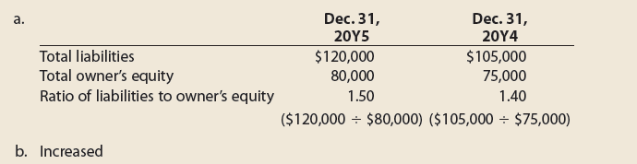
Example Exercise: Ratio of Liabilities to
Owner’s Equity (2 of 2)

