Slide 1
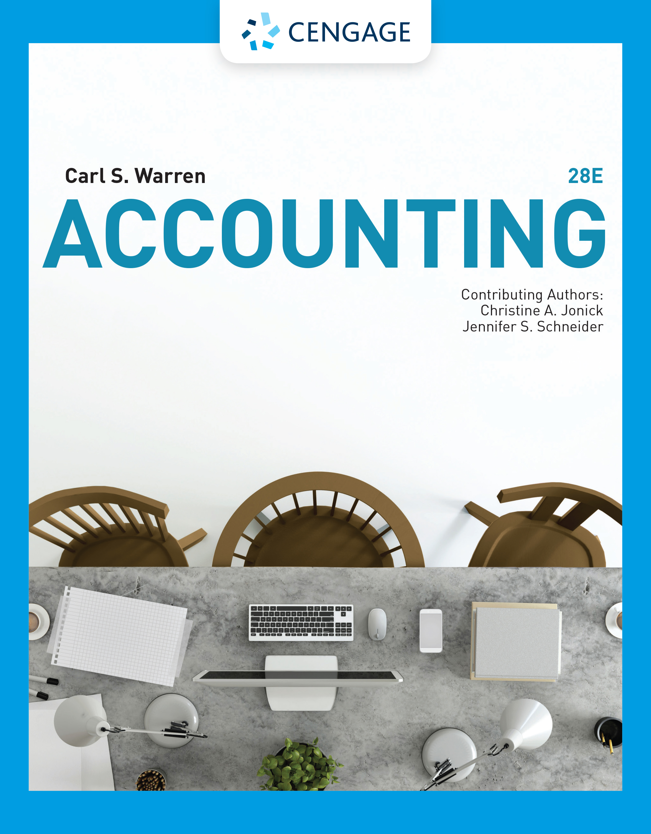
Completing the Accounting Cycle
Chapter 4

Slide 2
Learning Objectives (1 of 2)
LO1: Describe the flow of accounting information from the unadjusted trial balance into the adjusted trial balance and financial statements.
LO2: Prepare financial statements from adjusted account balances.
LO3: Prepare closing entries.
LO4: Describe the accounting cycle.
LO5: Illustrate the accounting cycle for one period.
LO6: Describe and illustrate the use of working capital and the current ratio in evaluating a company’s financial condition.

Slide 3
Learning Objectives (2 of 2)
App. 1: Describe and illustrate the use of an end-of-period spreadsheet for preparing financial statements.
App. 2: Describe and explain why generally accepted accounting principles (GAAP) require the accrual basis of accounting.

Slide 4
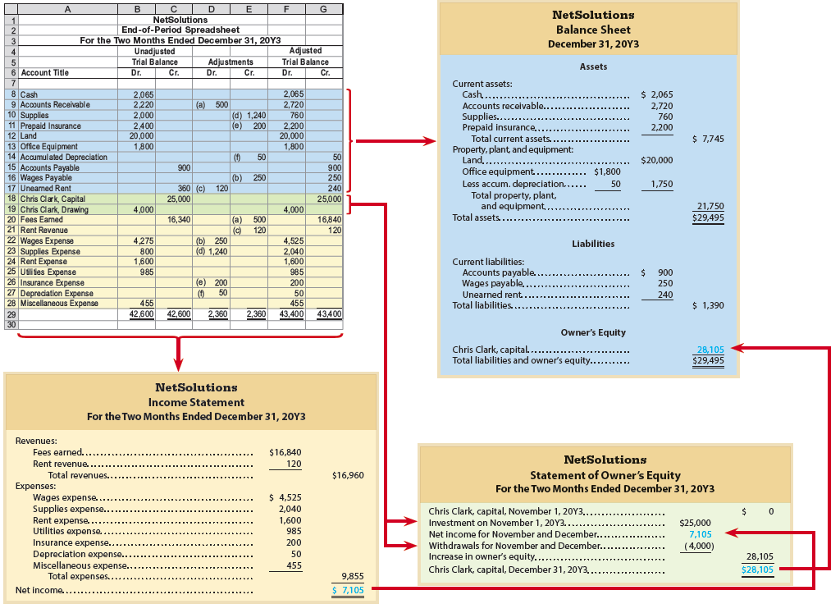
End-of-Period Spreadsheet and
Flow of Accounting Data, NetSolutions

Slide 5
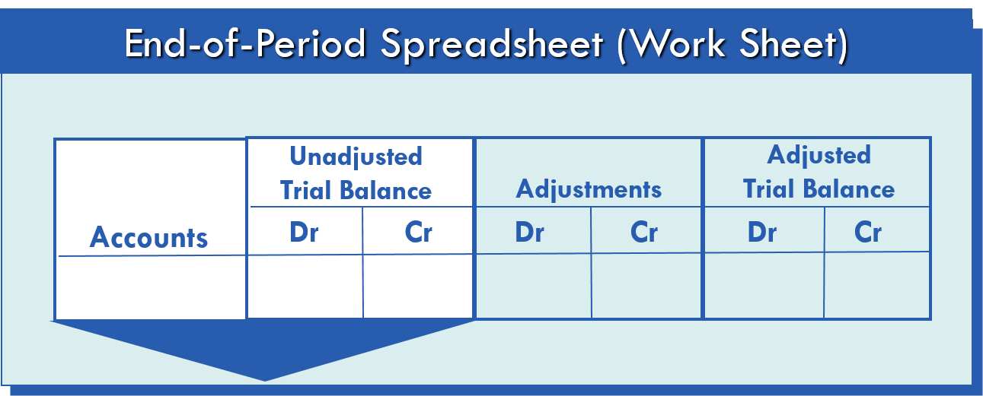
Flow of Accounting Information (1 of 5)
Account balances are listed in the Unadjusted Trial Balance columns using the ending balances found in the general ledger.

Slide 6
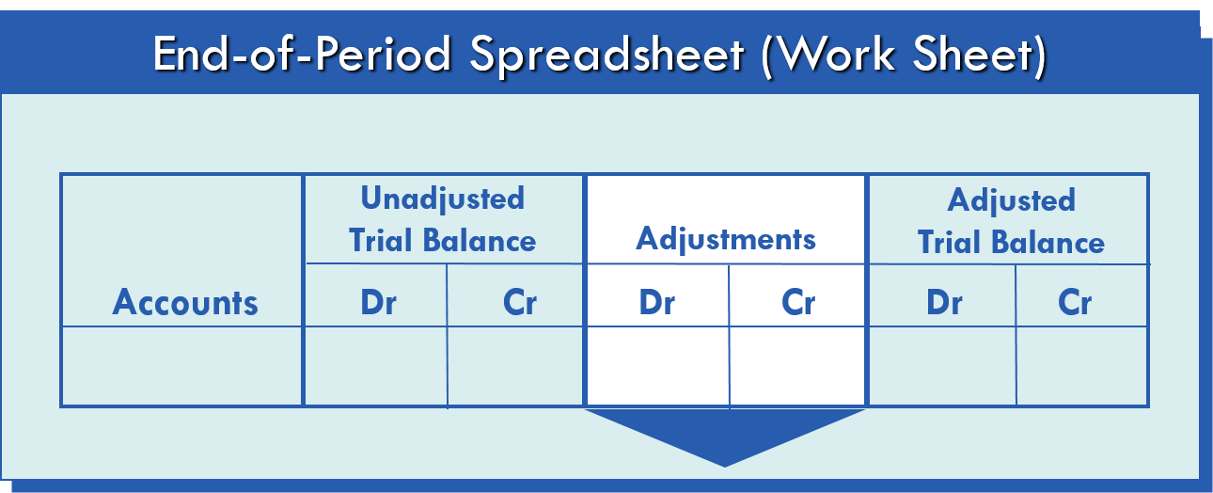
Flow of Accounting Information (2 of 5)
Adjustments are entered here.
Two possibilities:
  Deferrals – Existing balances are changed.
  Accruals – New information is entered.

Slide 7
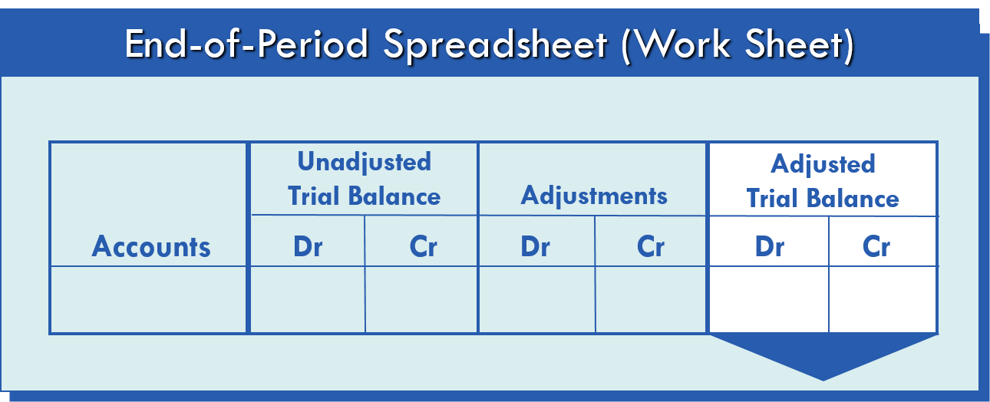
Flow of Accounting Information (3 of 5)
Adjustments are added to or subtracted from the amounts in the Unadjusted Trial Balance columns
Account balances are now adjusted

Slide 8
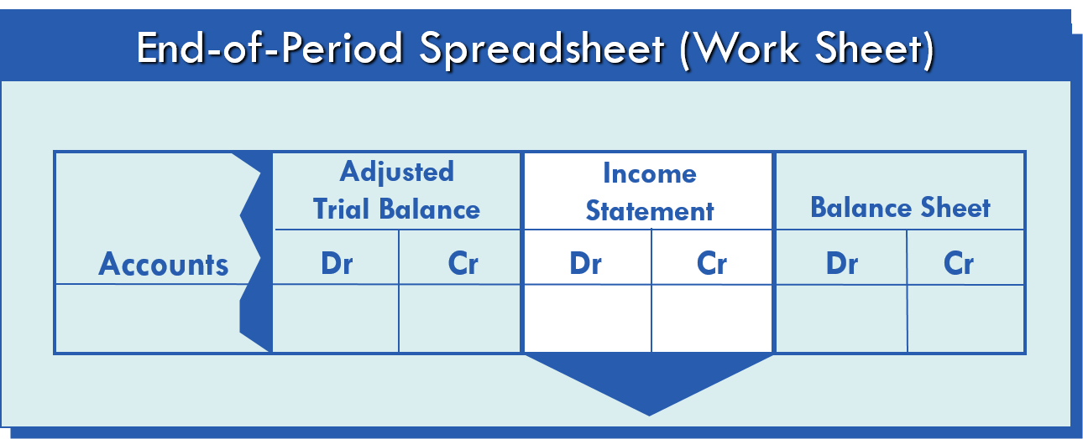
Flow of Accounting Information (4 of 5)
Amounts for revenues and expenses in the Adjusted Trial Balance columns are extended to the Income Statement columns.

Slide 9
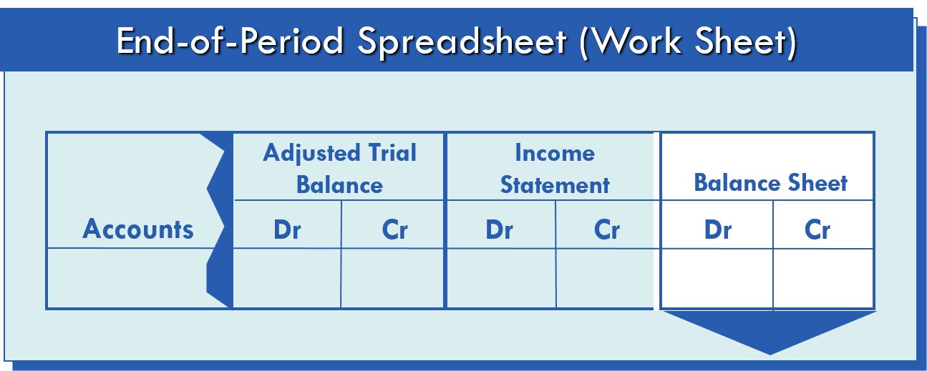
Flow of Accounting Information (5 of 5)
Amounts for assets, liabilities, owner’s capital, and drawing in the Adjusted Trial Balance columns are extended to the Balance Sheet columns

Slide 10
Example Exercise: Flow of Accounts into Financial Statements (1 of 2)
The balances for the accounts that follow appear in the Adjusted Trial Balance columns of the end-of-period spreadsheet. Indicate whether each account would flow into the income statement, statement of owner’s equity, or balance sheet.
Office Equipment
Utilities Expense
Accumulated Depreciation
Unearned Rent
Fees Earned
Doug Johnson, Drawing
Rent Revenue
Supplies

Slide 11

Example Exercise: Flow of Accounts into Financial Statements (2 of 2)

Slide 12
Income Statement
The income statement is prepared directly from the Income Statement or Adjusted Trial Balance columns of the end-of-period spreadsheet (work sheet), beginning with fees earned of $16,840.
The expenses in the income statement are listed in order of size, beginning with the larger items. However, Miscellaneous Expense is always the last account listed, regardless of its amount.

Slide 13
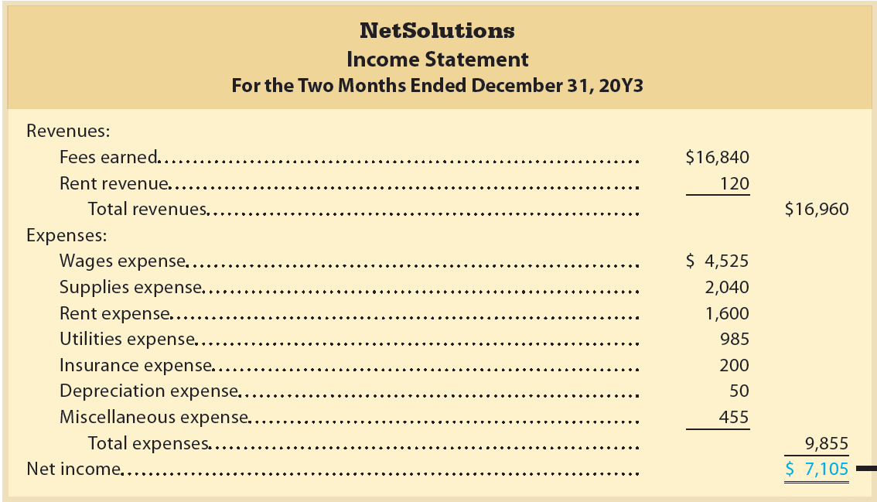

Financial Statements, NetSolutions: Income Statement
to statement of owner’s equity

Slide 14
Statement of Owner’s Equity
The first item presented on the statement of owner’s equity is the balance of the owner’s capital account at the beginning of the period.
Any investments, the net income (or net loss), and the drawing account balance are used to determine the ending owner’s capital account balance.

Slide 15
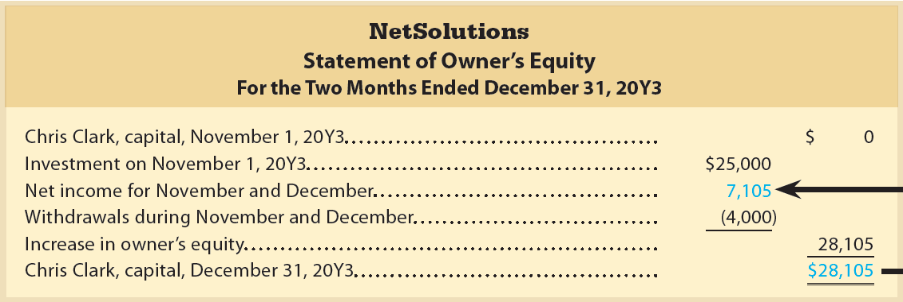

Financial Statements, NetSolutions: Statement of Owner’s Equity
from the income statement
to the balance sheet

Slide 16
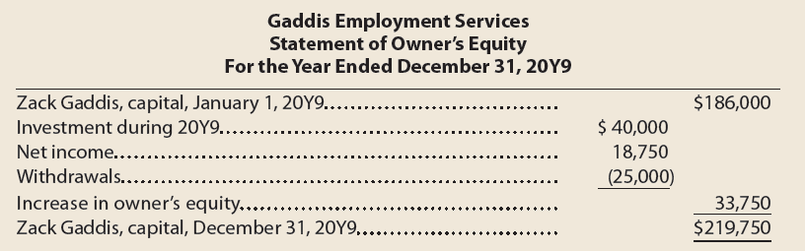
Example Exercise: Statement of Owner’s Equity
Zack Gaddis owns and operates Gaddis Employment Services. On January 1, 20Y9, Zack Gaddis, Capital had a balance of $186,000. During the year, Zack invested an additional $40,000 and withdrew $25,000. For the year ended December 31, 20Y9, Gaddis Employment Services reported a net income of $18,750. Prepare a statement of owner’s equity for the year ended December 31, 20Y9.

Slide 17
Balance Sheet
The balance sheet is prepared directly from the Balance Sheet or Adjusted Trial Balance columns of the end-of-period spreadsheet, beginning with Cash of $2,065.
A classified balance sheet is a balance sheet that is expanded by adding subsections for assets and liabilities.
  Assets are commonly divided into two sections on the balance sheet: (1) current assets and (2) property, plant, and equipment.
  Liabilities are commonly divided into two sections on the balance sheet: (1) current liabilities and (2) long-term liabilities.

Slide 18
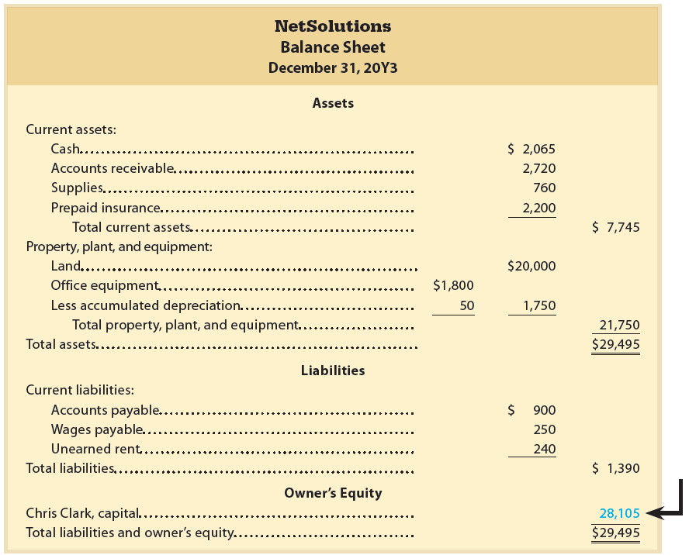
Financial Statements, NetSolutions: Balance Sheet
from the statement of owner’s equity

Slide 19
Current Assets (slide 1 of 3)
Cash and other assets that are expected to be converted into cash or sold or used up usually within one year or less, through the normal operations of the business, are called current assets.

Slide 20





Current Assets (slide 2 of 3)
Cash
Prepaid expenses
Accounts receivable
Common Current Assets
Supplies
Notes receivable

Slide 21
Current Assets (slide 3 of 3)
Notes receivable are written promises by the customer to pay the amount of the note and interest. Like accounts receivable, notes receivable are amounts that customers owe, but they are more formal than accounts receivable.
Notes receivable and accounts receivable are current assets because they are usually converted to cash within one year or less.

Slide 22
Property, Plant, and Equipment
Property, plant, and equipment (also called fixed assets or plant assets) include land and assets that depreciate over a period of time.
  Equipment
  Machinery
  Buildings

Slide 23
Current Liabilities (1 of 2)
Amounts the business owes to creditors that will be due within a short time (usually one year or less) and that are to be paid out of current assets are called current liabilities.

Slide 24
Current Liabilities (2 of 2)
Accounts Payable
Unearned Fees
Notes Payable
Common Current Liabilities
Interest Payable
Wages Payable

Slide 25
Long-Term Liabilities
Amounts the business owes to creditors that will not be due for a long time (usually more than one year) are called long-term liabilities.

Slide 26
Owner’s Equity
Owner’s equity is the owner’s right to the assets of the business.
Owner’s equity is added to the total liabilities, and this combined total must be equal to the total assets.
It is presented on the balance sheet below the liabilities section.

Slide 27
Example Exercise: Classified Balance Sheet
(1 of 2)
The following accounts appear in an adjusted trial balance of Hindsight Consulting. Indicate whether each account would be reported in the (a) current asset; (b) property, plant, and equipment; (c) current liability; (d) long-term liability; or (e) owner’s equity section of the December 31, 20Y1, balance sheet of Hindsight Consulting.
  Jason Corbin, Capital
  Notes Receivable (due in six months)
  Notes Payable (due in 10 years)
  Land
  Cash
  Unearned Rent (three months)
  Accumulated Depreciation—Equipment
  Accounts Payable

Slide 28

Example Exercise: Classified Balance Sheet
(2 of 2)

Slide 29
Permanent Accounts
Accounts that are relatively permanent from year to year are called permanent accounts or real accounts.
The balances of these accounts are carried forward from year to year.
This includes accounts reported on the balance sheet.

Slide 30
Temporary Accounts
Accounts that report amounts for only one period are called temporary accounts or nominal accounts.
Temporary accounts are not carried forward because they relate to only one period.
This includes all accounts reported on the income statement as well as the owner’s drawing account, which is reported on the statement of owner’s equity.

Slide 31
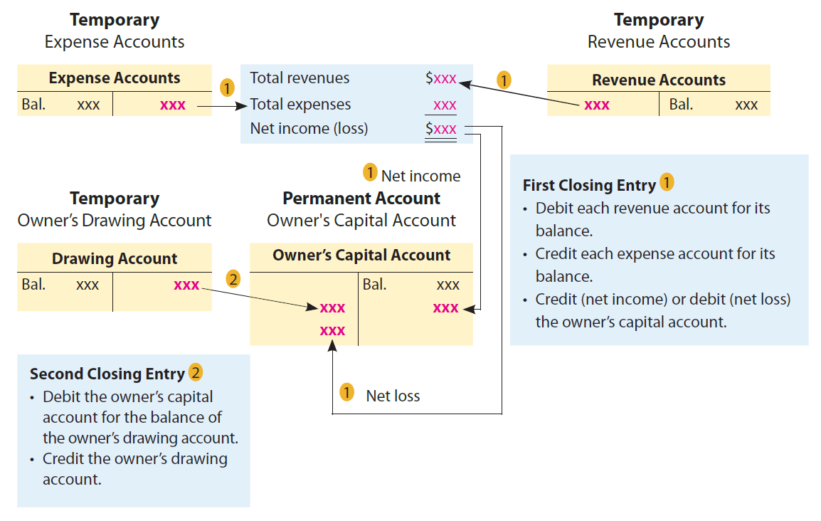
The Closing Process

Slide 32
Closing Entries (1 of 3)
To report amounts for only one period, temporary accounts should have zero balances at the beginning of the next period.
To achieve this, temporary account balances are transferred to permanent accounts at the end of the accounting period through journal entries.
The entries that transfer these balances are called closing entries. The transfer process is called the closing process (or closing the books).
After the closing entries are posted, all of the temporary accounts have zero balances.

Slide 33
Closing Entries (2 of 3)
The closing process involves the following two closing journal entries:
  First Closing Entry
    Revenue and expense account balances are transferred to the owner’s capital account.
  Second Closing Entry
    The balance of the owner’s drawing account is transferred to the owner’s capital account.

Slide 34
Closing Entries (3 of 3)
The two closing entries required in the closing process are as follows:
  Debit each revenue account for its balance, credit each expense account for its balance, and credit (net income) or debit (net loss) the owner’s capital account.
  Debit the owner’s capital account for the balance of the drawing account and credit the drawing account.

Slide 35
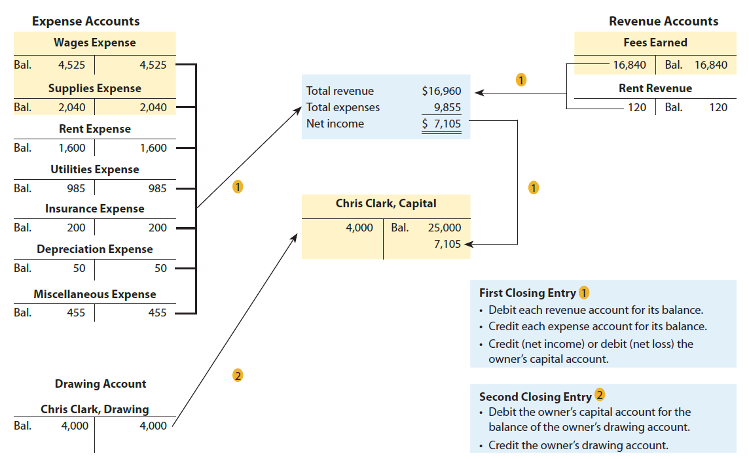
Flowchart of Closing Entries for NetSolutions

Slide 36
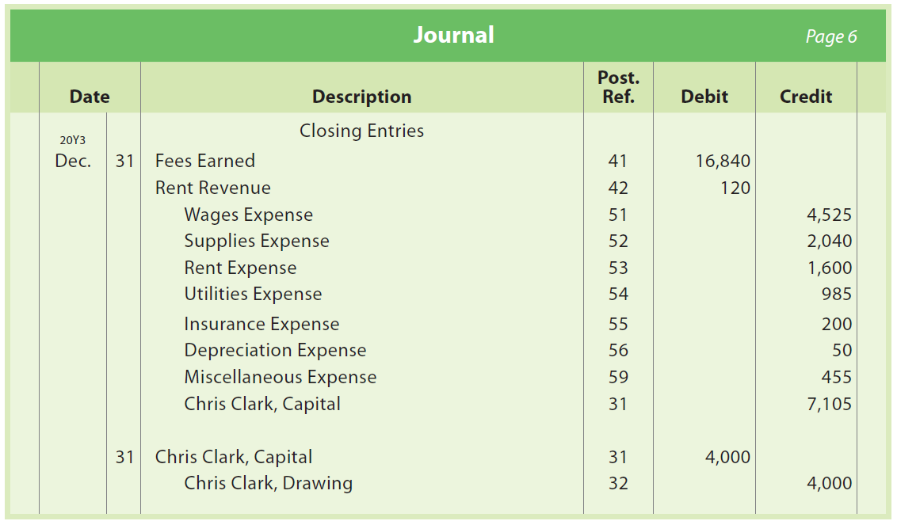
Closing Entries, NetSolutions

Slide 37
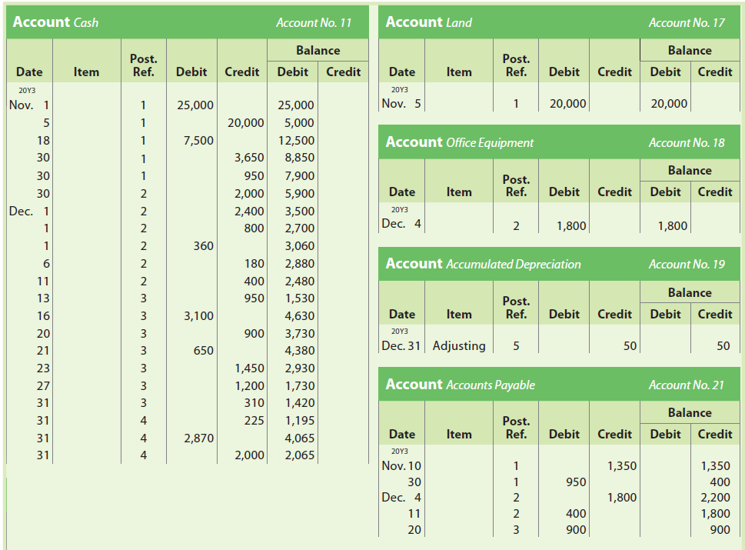
Ledger, NetSolutions (1 of 4)

Slide 38
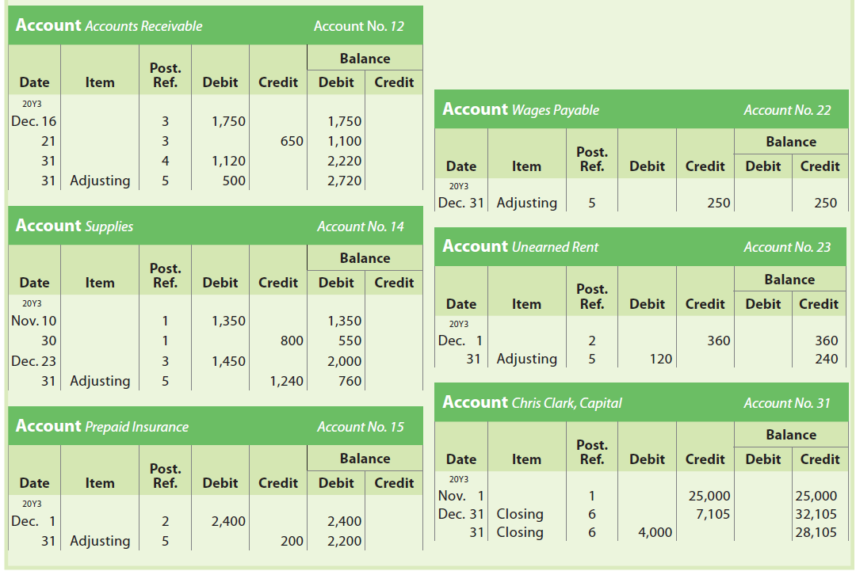
Ledger, NetSolutions (2 of 4)

Slide 39
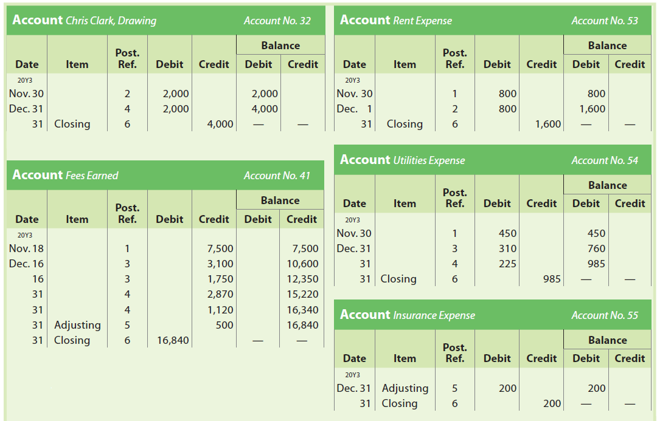
Ledger, NetSolutions (3 of 4)

Slide 40
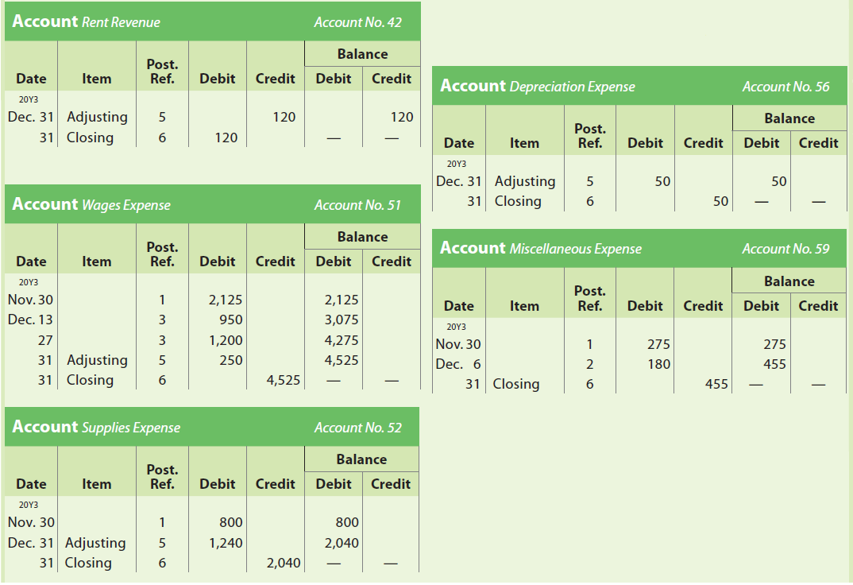
Ledger, NetSolutions (4 of 4)

Slide 41
Example Exercise: Closing Entries (1 of 2)
After the accounts have been adjusted at July 31, the end of the year, the following balances are taken from the ledger of Cabriolet Services Co.:
Journalize the two entries required to close the accounts.

Slide 42
Example Exercise: Closing Entries (2 of 2)

Slide 43
Post-Closing Trial Balance
A post-closing trial balance is prepared after the closing entries have been posted. The purpose of the post-closing (after closing) trial balance is to verify that the ledger is in balance at the beginning of the next period.

Slide 44
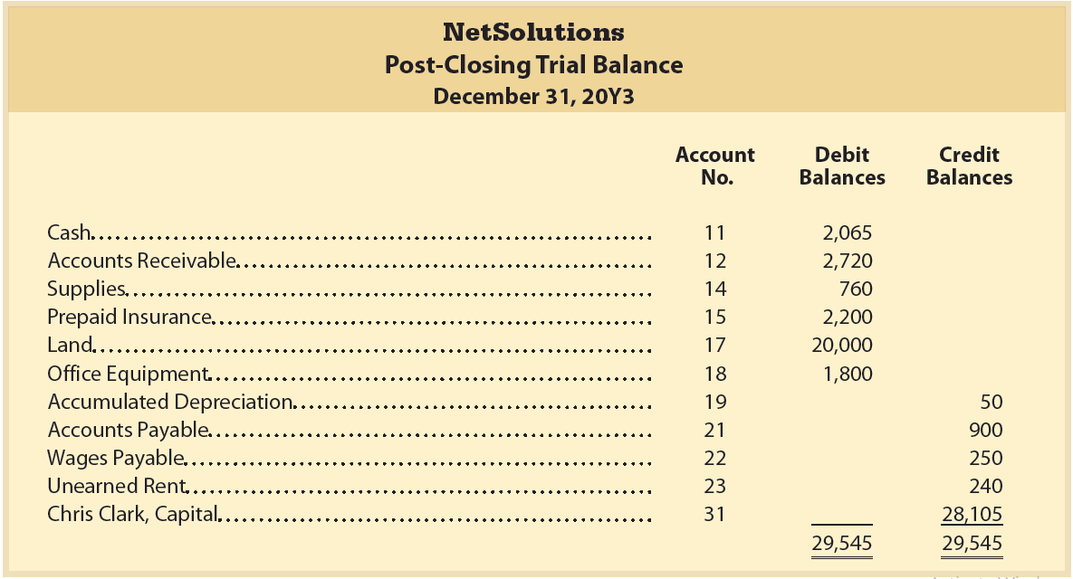
Post-Closing Trial Balance, NetSolutions

Slide 45
Accounting Cycle (1 of 2)
The accounting process that begins with analyzing and journalizing transactions and ends with the post-closing trial balance is called the accounting cycle.

Slide 46
Accounting Cycle (2 of 2)
The steps in the accounting cycle are as follows:
  Step 1: Transactions are analyzed and recorded in the journal.
  Step 2: Transactions are posted to the ledger.
  Step 3: An unadjusted trial balance is prepared.
  Step 4: Adjustment data are assembled and analyzed.
  Step 5: An optional end-of-period spreadsheet (work sheet) is prepared.
  Step 6: Adjusting entries are journalized and posted to the ledger.
  Step 7: An adjusted trial balance is prepared.
  Step 8: Financial statements are prepared.
  Step 9: Closing entries are journalized and posted to the ledger.
  Step 10: A post-closing trial balance is prepared.

Slide 47
Example Exercise: Accounting Cycle (1 of 2)
From the following list of steps in the accounting cycle, identify what two steps are missing:
  Transactions are analyzed and recorded in the journal:
  Transactions are posted to the ledger.
  Adjustment data are assembled and analyzed.
  An optional end-of-period spreadsheet is prepared.
  Adjusting entries are journalized and posted to the ledger.
  Financial statements are prepared.
  Closing entries are journalized and posted to the ledger.
  A post-closing trial balance is prepared.

Slide 48
Example Exercise: Accounting Cycle (2 of 2)
Following two steps are missing:

Slide 49
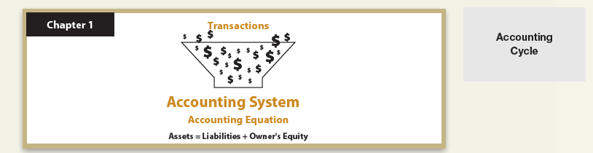
Accounting Cycle (1 of 4)

Slide 50
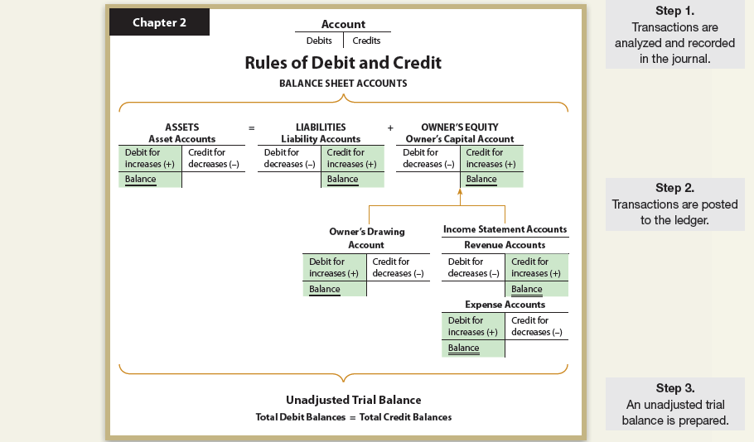
Accounting Cycle (2 of 4)

Slide 51
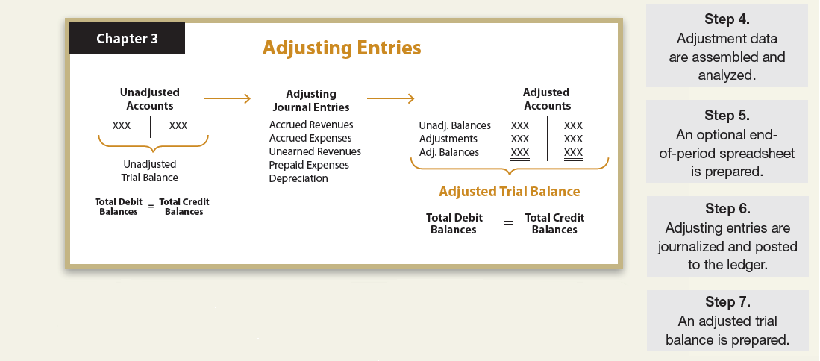
Accounting Cycle (3 of 4)

Slide 52
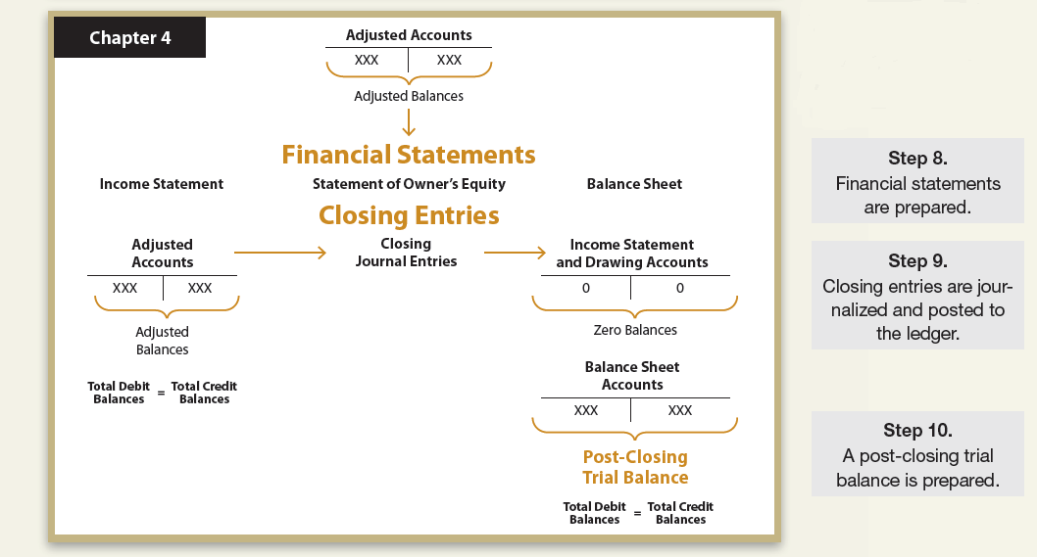
Accounting Cycle (4 of 4)

Slide 53
Illustration of the Accounting Cycle (1 of 2)
The following slides will provide an illustration of the accounting cycle for Kelly Consulting.
  Chart of Accounts
  Journal Entries
  Unadjusted Trial Balance
  End-of-Period Spreadsheet
  Adjusting Entries
  Adjusted Trial Balance

Slide 54
Illustration of the Accounting Cycle (2 of 2)
  Financial Statements
  Closing Entries
  Post-Closing Trial Balance
  Ledger

Slide 55
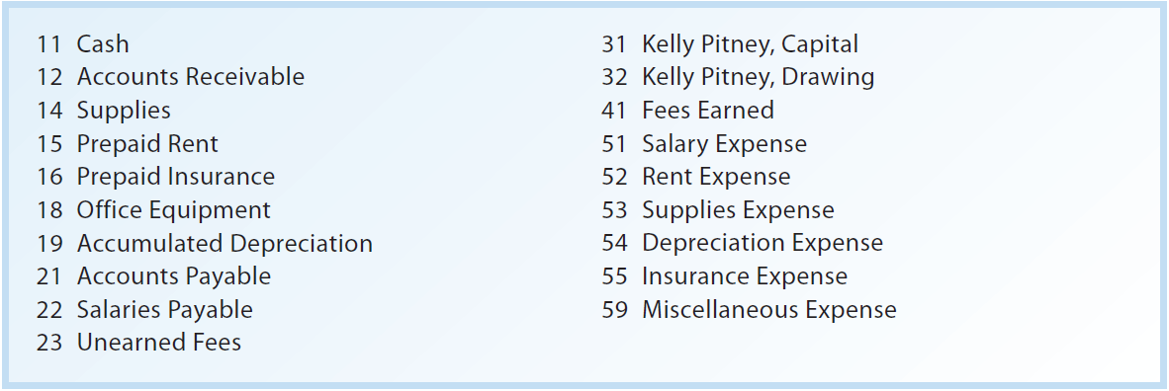
Chart of Accounts for Kelly Consulting

Slide 56
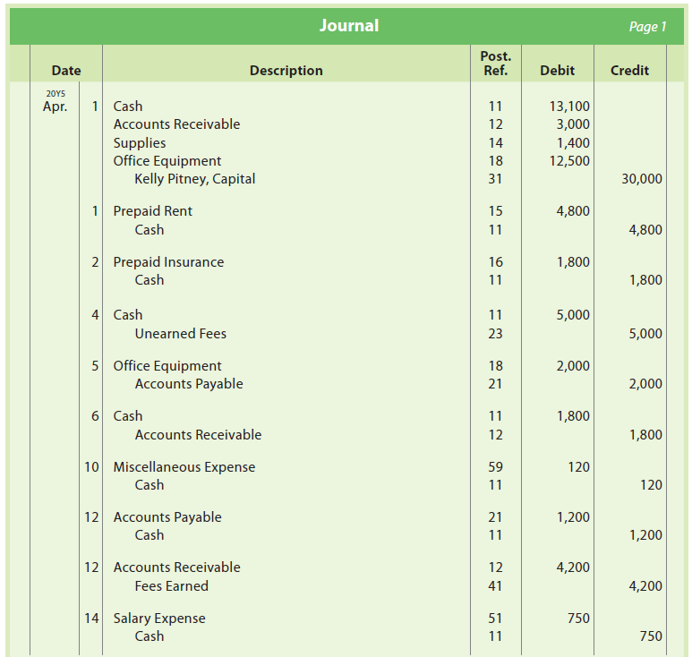
Journal Entries for April, Kelly Consulting
(1 of 3)

Slide 57
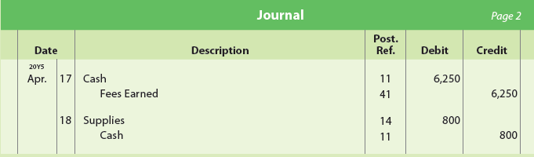
Journal Entries for April, Kelly Consulting
(2 of 3)

Slide 58
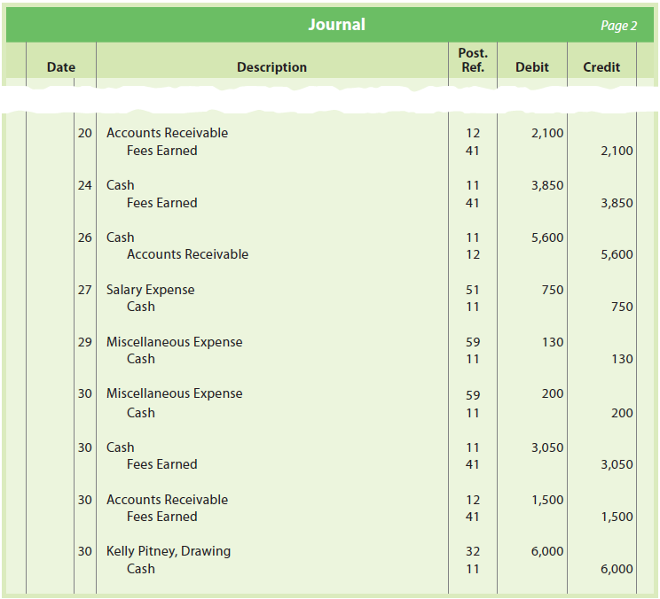
Journal Entries for April, Kelly Consulting
(3 of 3)

Slide 59
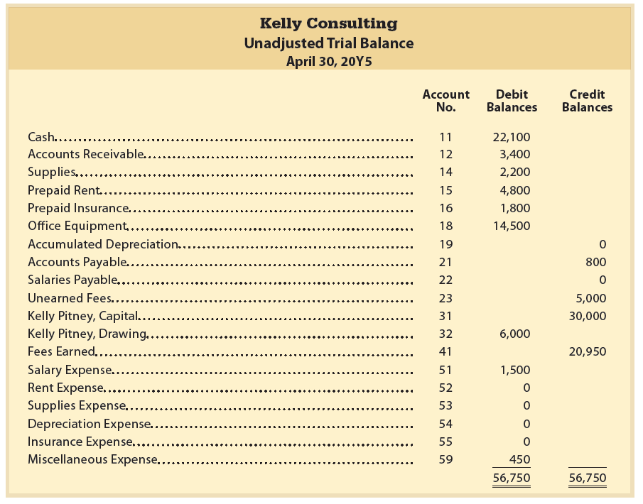
Unadjusted Trial Balance, Kelly Consulting

Slide 60
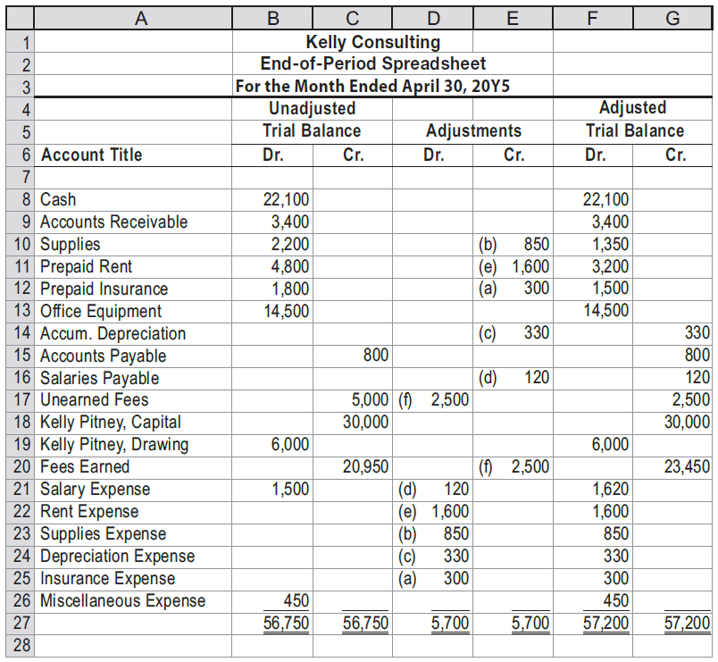
End-of-Period Spreadsheet, Kelly Consulting

Slide 61
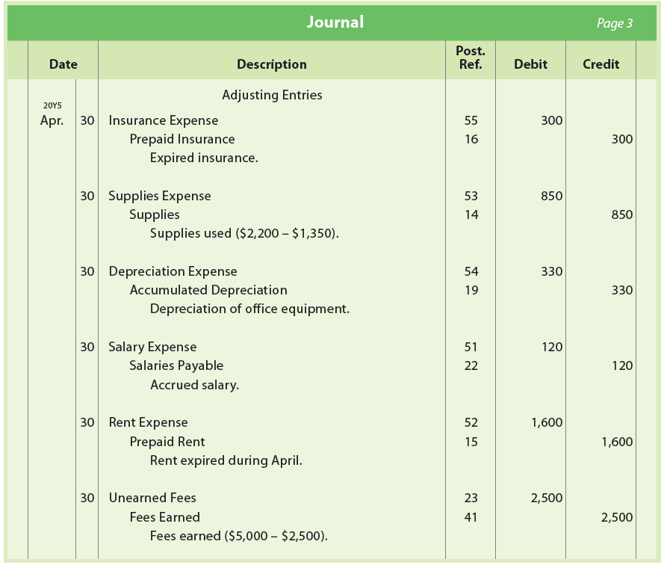
Adjusting Entries, Kelly Consulting

Slide 62
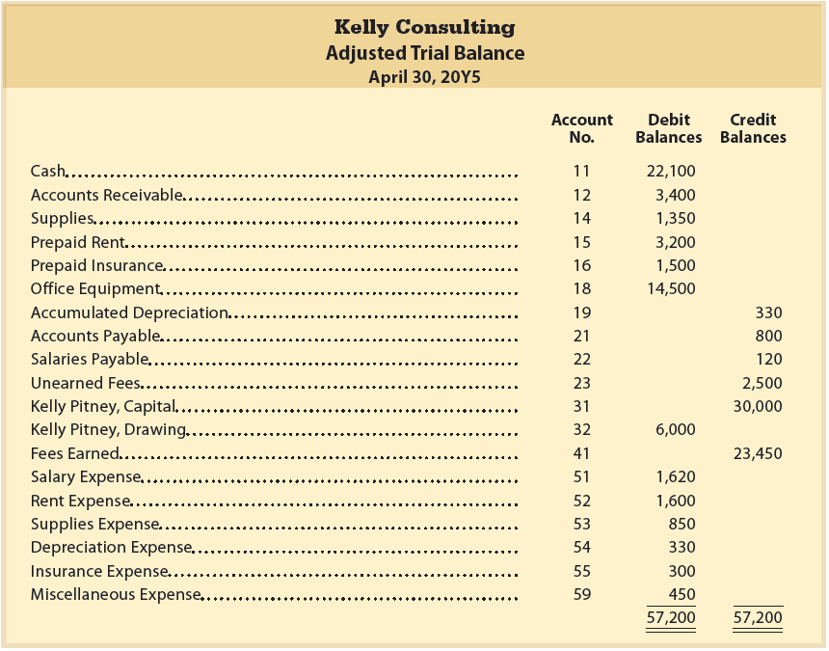
Adjusted Trial Balance, Kelly Consulting

Slide 63
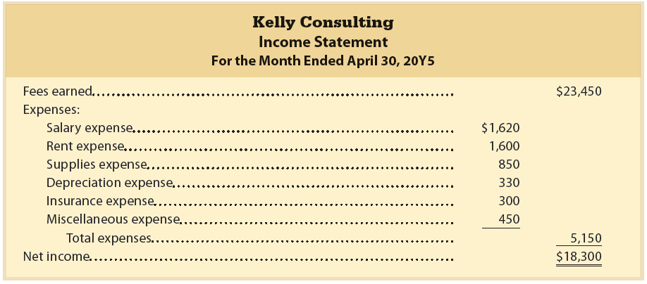
Financial Statements, Kelly Consulting: Income Statement

Slide 64
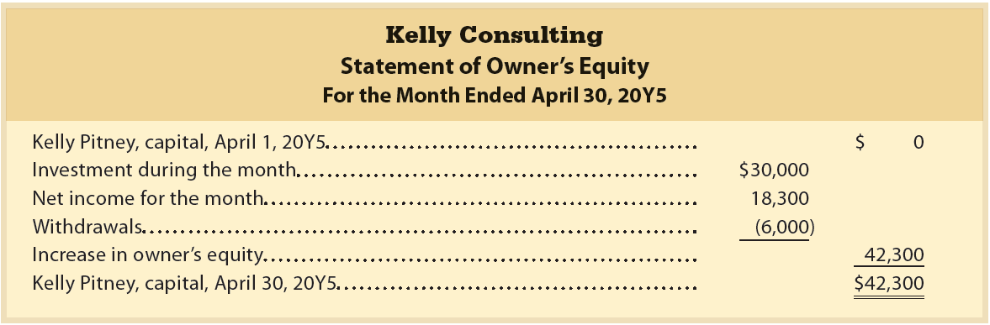
Financial Statements, Kelly Consulting: Statement of Owner’s Equity

Slide 65
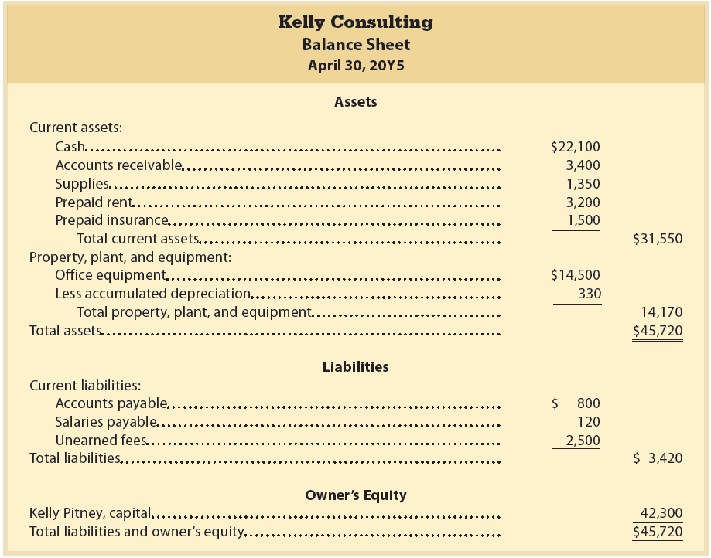
Financial Statements, Kelly Consulting: Balance Sheet

Slide 66
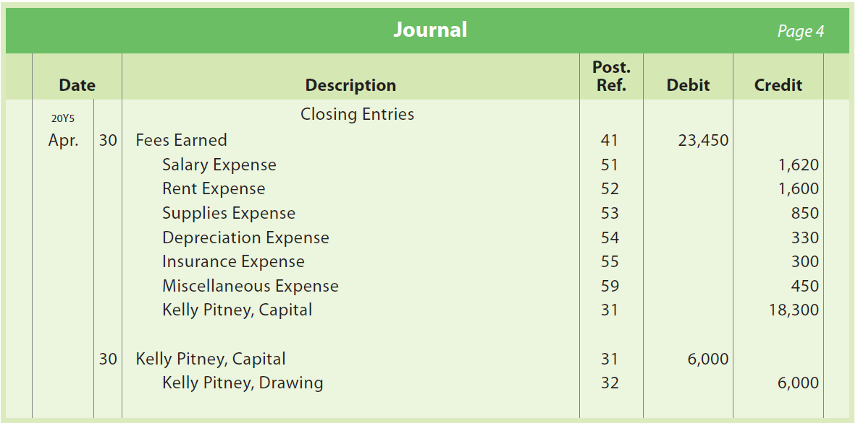
Closing Entries, Kelly Consulting

Slide 67
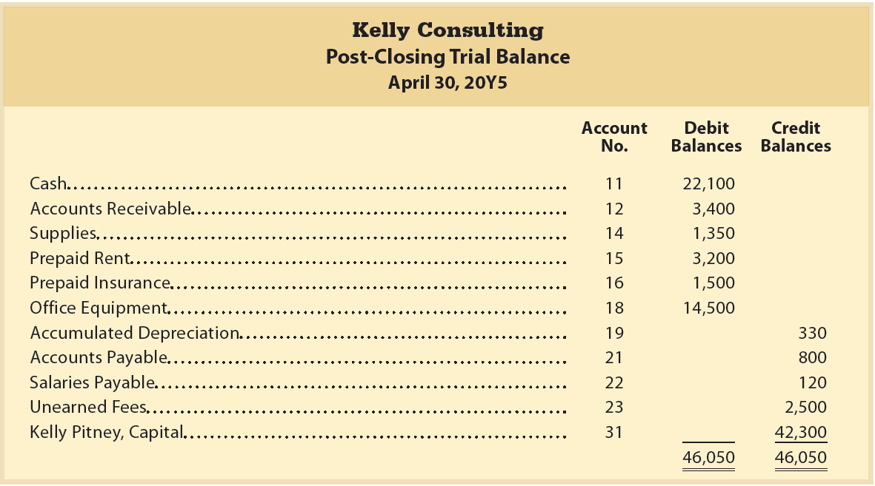
Post-Closing Trial Balance, Kelly Consulting

Slide 68
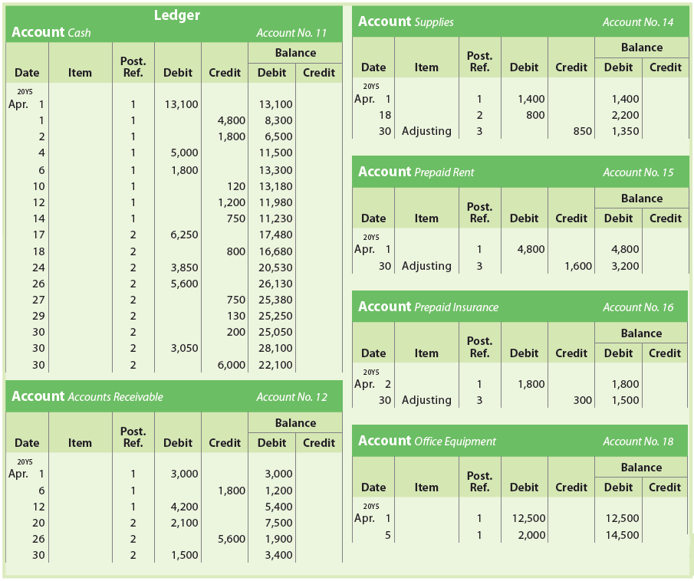
Ledger, Kelly Consulting (1 of 4)

Slide 69
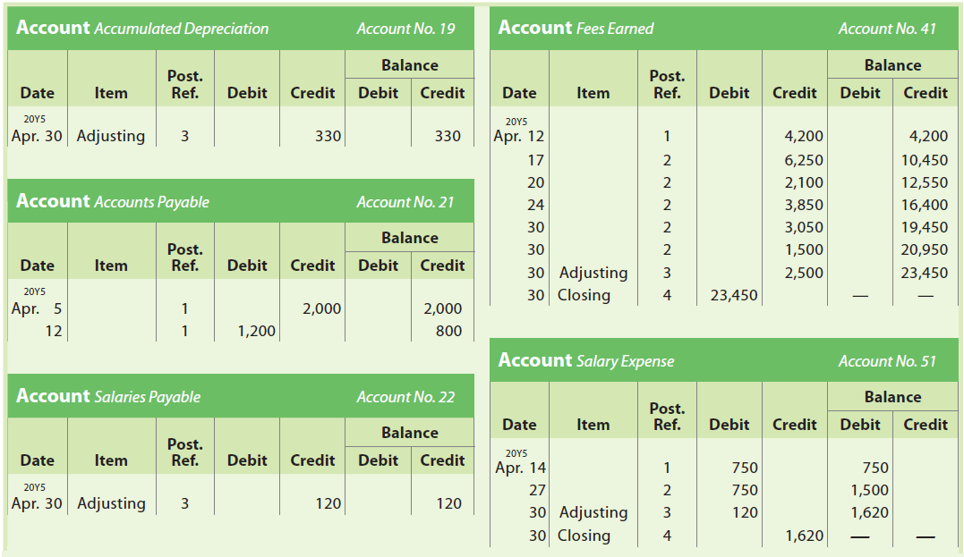
Ledger, Kelly Consulting (2 of 4)

Slide 70
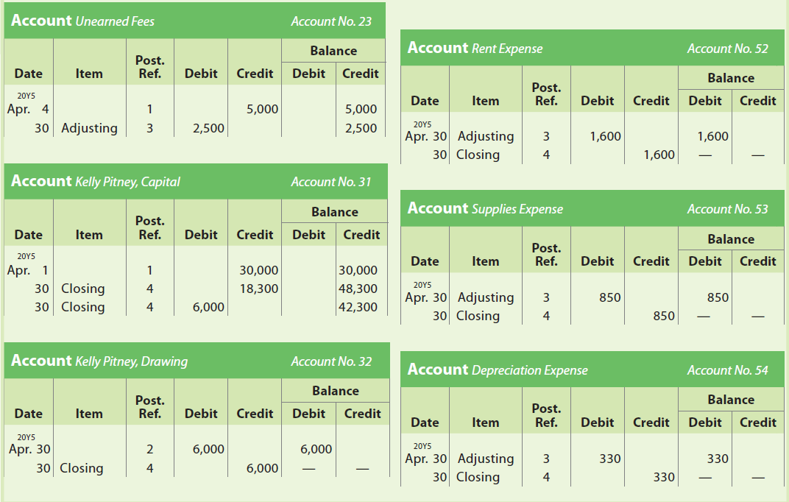
Ledger, Kelly Consulting (3 of 4)

Slide 71
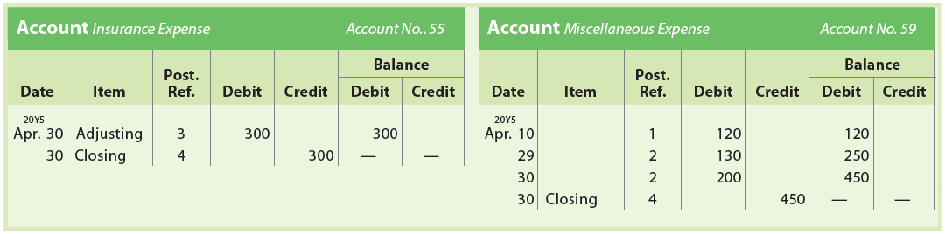
Ledger, Kelly Consulting (4 of 4)

Slide 72
Financial Analysis and Interpretation:
Working Capital and Current Ratio
The ability to convert assets into cash is called liquidity.
The ability of a business to pay its debts is called solvency.
Two financial measures for evaluating a business’s short-term liquidity and solvency are working capital and the current ratio.

Slide 73
Financial Analysis and Interpretation:
Working Capital (1 of 2)
Working capital is the excess of the current assets of a business over its current liabilities.
Computed as follows:
Working Capital = Current Assets – Current Liabilities
A positive working capital implies that the business is able to pay its current liabilities and is solvent

Slide 74
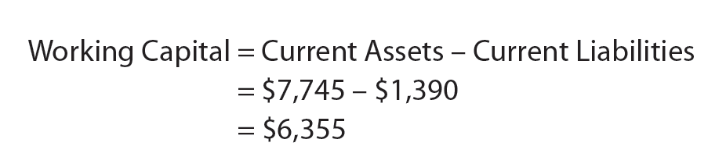
Financial Analysis and Interpretation: Working Capital (2 of 2)
NetSolutions’ working capital at the end of 20Y3 is computed as follows:

Slide 75

Financial Analysis and Interpretation: Current Ratio
(1 of 2)
The current ratio is another means of expressing the relationship between current assets and current liabilities.
Computed by dividing current assets by current liabilities, as follows:

Slide 76
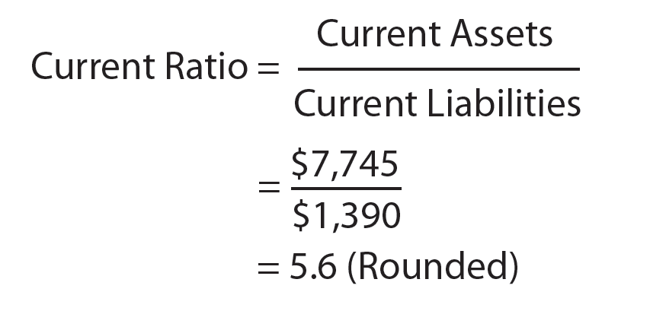
Financial Analysis and Interpretation: Current Ratio
(2 of 2)
The current ratio for NetSolutions at the end of 20Y3 is computed as follows:

Slide 77

Example Exercise: Working Capital and Current Ratio (1 of 2)
Current assets and current liabilities for Fortson Company follow:
  Determine the working capital and current ratio for 20Y7 and 20Y6.
  Does the change in the current ratio from 20Y6 to 20Y7 indicate a favorable or an unfavorable change?

Slide 78
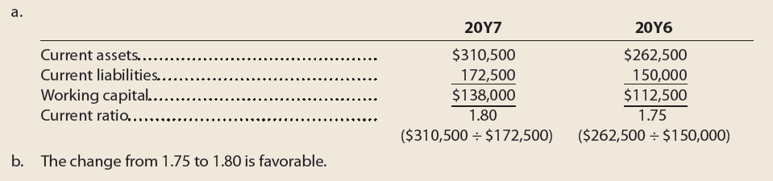
Example Exercise: Working Capital and Current Ratio (2 of 2)

Slide 79
End-of-Period Spreadsheet
Spreadsheets are usually prepared by using a computer program such as Microsoft’s Excel.®
Some accountants prefer to expand the end-of-period spreadsheet to include financial statement columns.

Slide 80
Steps in Preparing an Expanded End-of-Period Spreadsheet
Step 1: Enter the title.
Step 2: Enter the unadjusted trial balance.
Step 3: Enter the adjustments.
Step 4: Enter the adjusted trial balance.
Step 5: Extend the accounts to the Income Statement and Balance Sheet columns.
Step 6: Total the Income Statement and Balance Sheet columns, compute the net income or net loss, and complete the spreadsheet.

Slide 81
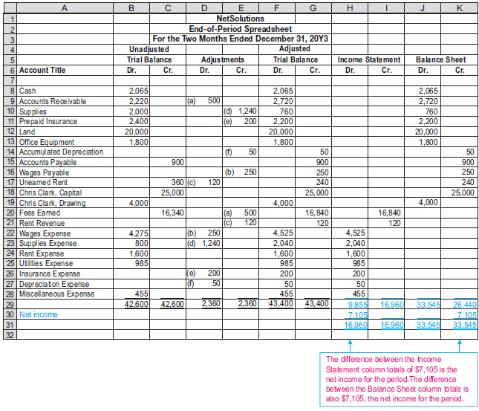
Completed Spreadsheet with Net Income Shown

Slide 82
Preparing the Financial Statements from the Spreadsheet
The spreadsheet can be used to prepare the income statement, the statement of owner’s equity, and the balance sheet.
When a spreadsheet is used, the adjusting and closing entries are normally not journalized or posted until after the spreadsheet and financial statements have been prepared.

Slide 83
Cash Basis of Accounting (1 of 2)
Recorded (recognized) when cash is received or paid
Revenues and expenses
Originate from accruals and deferrals
Not recorded under the cash basis of accounting
Adjusting entries

Slide 84
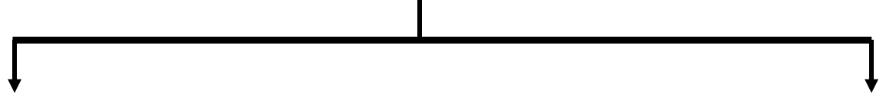

Cash Basis of Accounting (2 of 2)
Cash Basis of Accounting
Used by companies that have few receivables or payables
Not used by almost all large companies
For these companies, the cash basis provides financial statements similar to those under the accrual basis
For most large businesses, the cash basis will not provide adequate financial statements for user needs

Slide 85
Accrual Basis of Accounting
Reports net income using revenue and expense recognition principles
Requires adjusting entries at the end of an accounting period to ensure revenues and expenses are properly matched
Almost all large companies use the accrual basis
Generally accepted accounting principles (GAAP) require the accrual basis of accounting

Slide 86
Revenue and Expense Recognition Principles
Revenue Recognition Principle
Revenues are recorded when earned, which is when the services have been performed or products have been delivered to customers
Revenue is recorded at the amount expected to be received
Expense Recognition Principle
Expenses incurred in generating revenue are recorded in the same period as the related revenue
Also called the matching principle

Slide 87
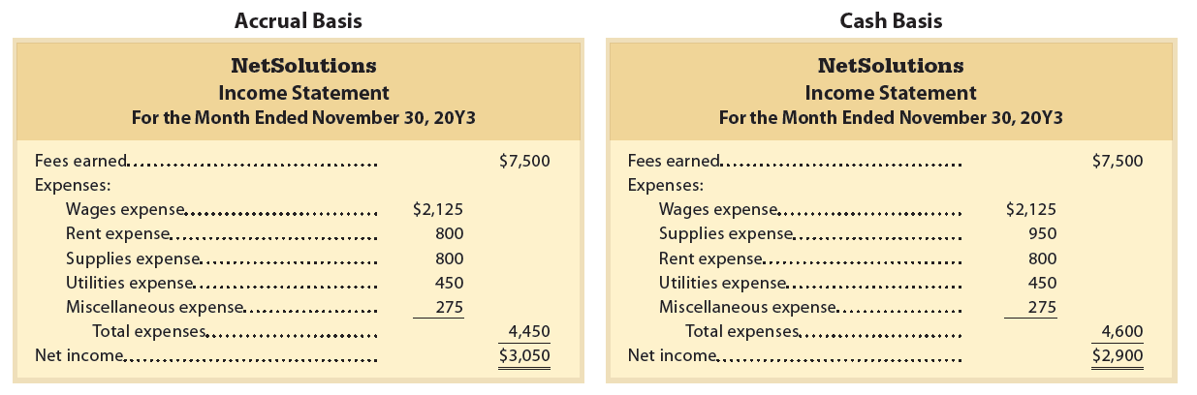
Accrual- and Cash-Basis Income Statements for NetSolutions (1 of 2)

Slide 88
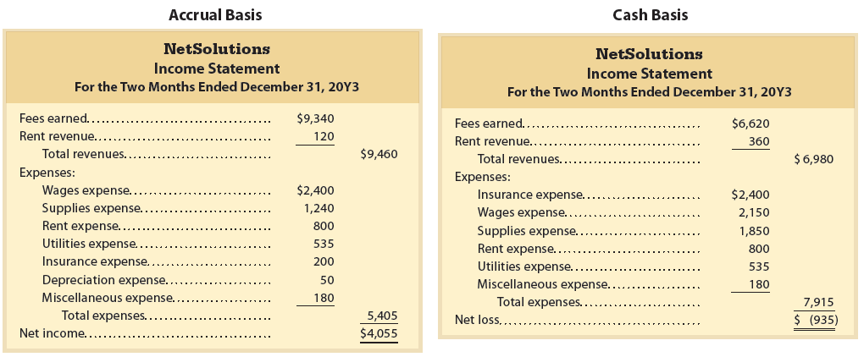
Accrual- and Cash-Basis Income Statements for NetSolutions (2 of 2)

Slide 89
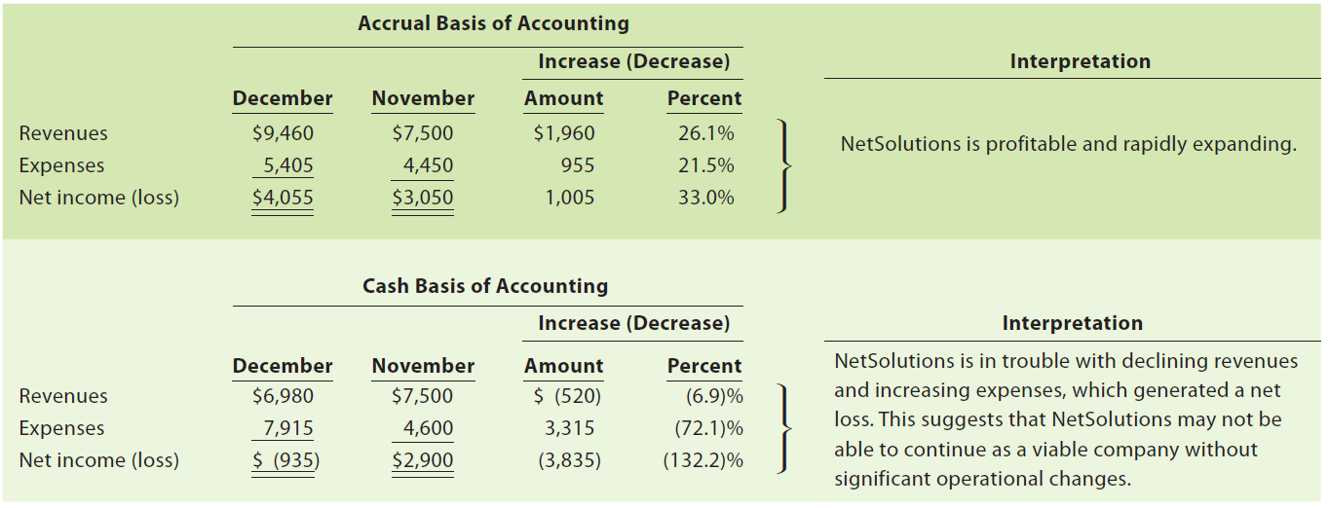
Accrual versus Cash Basis of Accounting, NetSolutions

Slide 90
Why GAAP Require the Accrual Basis of Accounting?
Accrual basis of accounting reflects the underlying operating performance of a company better than cash basis
  Accrual basis of accounting does better recording and matching revenues and expenses
    As a result, accrual accounting is a better indicator of a company’s current and future operating performance

