Slide 1
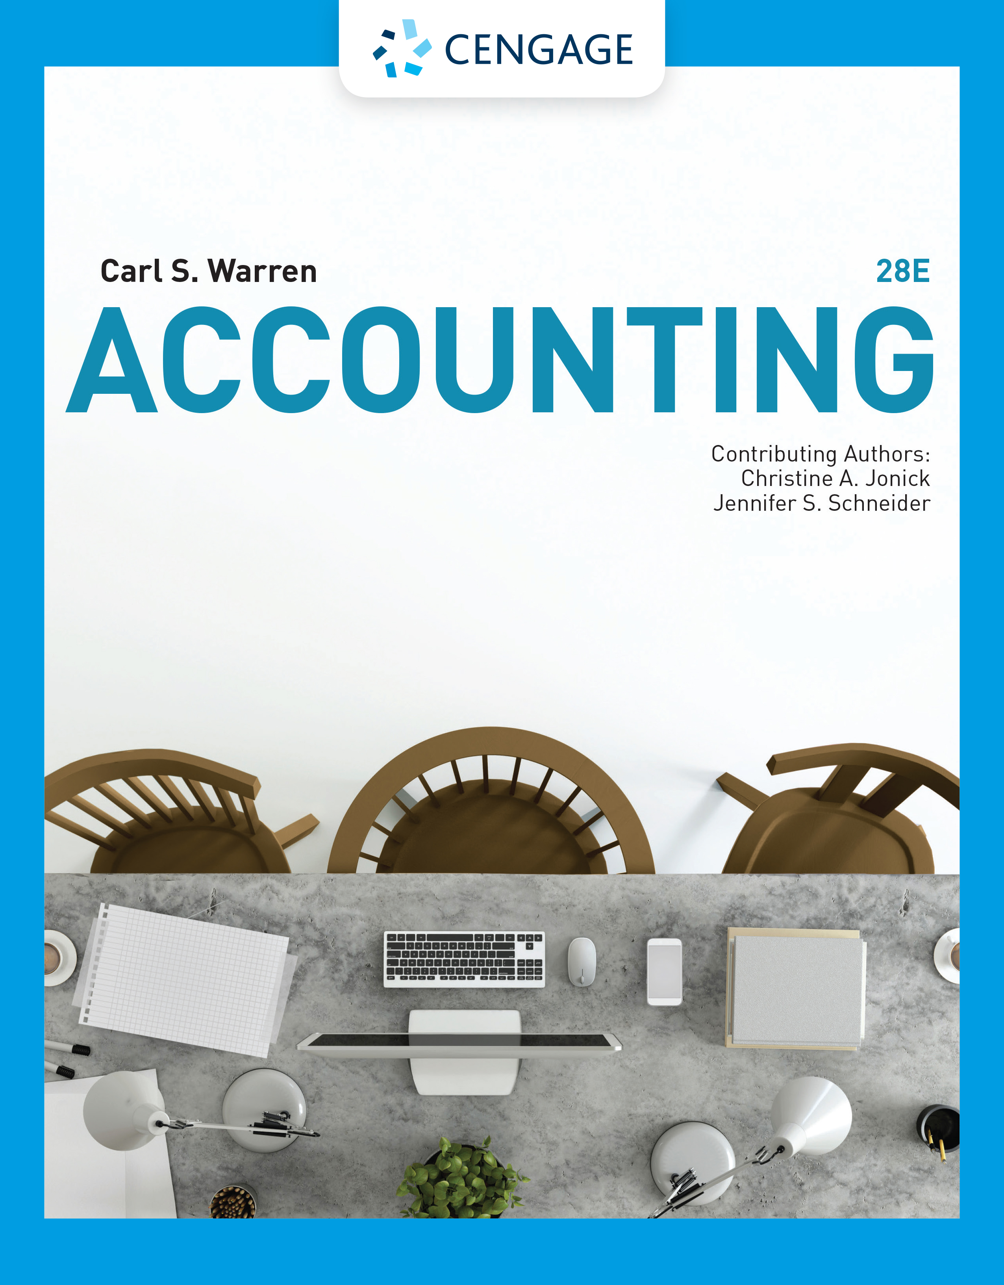
Receivables
Chapter 9

Slide 2
Learning Objectives (1 of 2)
LO1: Describe the common classes of receivables.
LO2: Describe the accounting for uncollectible receivables.
LO3: Describe the direct write-off method of accounting for uncollectible receivables.
LO4: Describe the allowance method of accounting for uncollectible receivables.
LO5: Compare the direct write-off and allowance methods of accounting for uncollectible accounts.

Slide 3
Learning Objectives (2 of 2)
LO6: Describe the accounting for notes receivable.
LO7: Describe the reporting of receivables on the balance sheet.
LO8: Describe and illustrate the use of accounts receivable turnover and days’ sales in receivables to evaluate a company’s efficiency in collecting its receivables.

Slide 4
Classification of Receivables
The term receivables includes all money claims against other entities, including people, companies, and other organizations.
The receivables that result from sales on account are normally accounts receivable or notes receivable.
Notes and accounts receivable that result from sales transactions are sometimes called trade receivables.

Slide 5
Accounts Receivables
The most common transaction creating a receivable is selling merchandise or services on account (on credit).
The receivable is recorded as a debit to Accounts Receivable.
Such accounts receivable are normally collected within a short period, such as 30 or 60 days.
They are classified on the balance sheet as a current asset.

Slide 6
Notes Receivables
Notes receivable are amounts that customers owe for which a formal, written instrument of credit has been issued.
If notes receivable are expected to be collected within a year, they are classified on the balance sheet as a current asset.
Notes are often used for credit periods of more than 60 days.
Notes may also be used to settle a customer’s accounts receivable.

Slide 7
Other Receivables
Include interest receivable, taxes receivable, and receivables from officers or employees
Normally reported separately on the balance sheet
Are they expected to be collected within one year?
No
Classify as noncurrent assets and report under Investments on the balance sheet
Other Receivables
Yes
Classify as current assets on the balance sheet

Slide 8
Uncollectible Receivables (1 of 4)
A major issue of selling merchandise or services on account (on credit) is that some customers will not pay their accounts
  These accounts receivable will be uncollectible
Companies may shift the risk of uncollectible receivables to other companies
  In this case, companies only accept cash or credit cards and do not accept sales on account
    Such policies shift the risk to the credit card companies
Companies may sell their receivables
  This is often the case when a company issues its own credit card
  An advantage of a company selling its receivables is that it immediately receives cash for operating and other needs
  Depending on the sales agreement, some of the risk of uncollectible accounts is shifted to the buyer

Slide 9
Uncollectible Receivables (2 of 4)
Regardless of how careful a company is in granting credit, some credit sales will be uncollectible.
The operating expense recorded from uncollectible receivables is called bad debt expense, uncollectible accounts expense, or doubtful accounts expense.

Slide 10
Uncollectible Receivables (3 of 4)
Some indications that an account may be uncollectible include the following:
  The receivable is past due.
  The customer does not respond to the company’s attempts to collect.
  The customer files for bankruptcy.
  The customer closes its business.
  The company cannot locate the customer.

Slide 11
Uncollectible Receivables (4 of 4)
Two methods of accounting for uncollectible receivables
  Direct Write-off Method
Records bad debt expense only when an account is determined to be worthless
Often used by small companies and companies with few receivables
  Allowance Method
Records bad debt expense by estimating uncollectible accounts at the end of the accounting period
Required to be used by companies with a large amount of receivables as per Generally accepted accounting principles (GAAP)

Slide 12
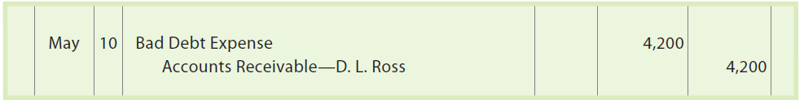
Direct Write-Off Method for Uncollectible Accounts (1 of 3)
On May 10, a $4,200 account receivable from D. L. Ross has been determined to be uncollectible. The entry to write off the account is as follows:

Slide 13
Direct Write-Off Method for Uncollectible Accounts (2 of 3)
An account receivable that has been written off may be collected later.
In such cases, the account is reinstated by an entry that reverses the write-off entry.
The cash received in payment is then recorded as a receipt on account.

Slide 14
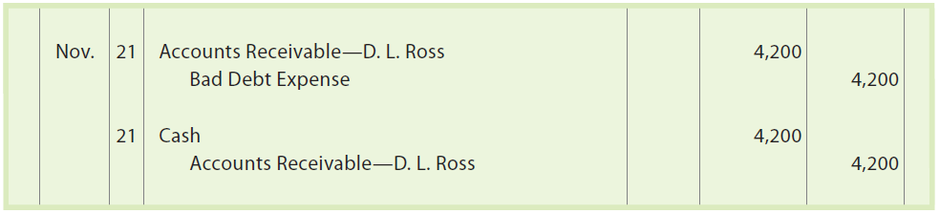
Direct Write-Off Method for Uncollectible Accounts (3 of 3)
Assume that the D. L. Ross account of $4,200 written off on May 10 is later collected on November 21. The reinstatement and receipt of cash is recorded as follows:

Slide 15
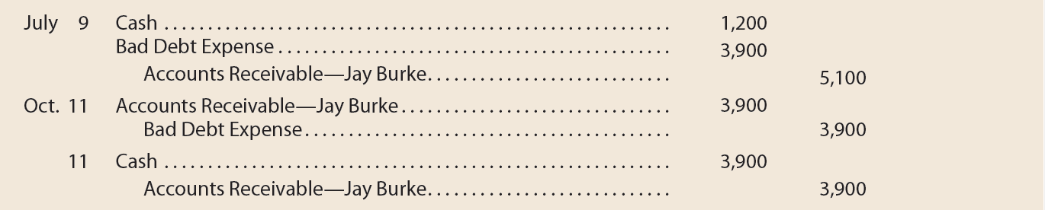
Example Exercise: Direct Write-Off Method
Journalize the following transactions, using the direct write-off method of accounting for uncollectible receivables:
  July 9. Received $1,200 from Jay Burke and wrote off the remainder owed of $3,900 as uncollectible.
  Oct. 11. Reinstated the account of Jay Burke and received $3,900 cash in full payment.

Slide 16
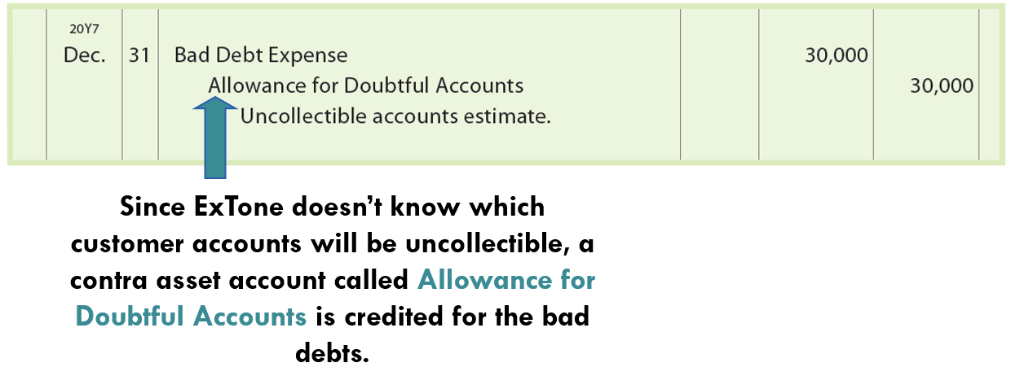
Allowance Method for Uncollectible Accounts (1 of 2)
On December 31, 20Y7, ExTone Company has an accounts receivable balance of $200,000. ExTone estimates that a total of $30,000 of the December 31 accounts receivable will be uncollectible. The following adjusting entry is made on December 31:

Slide 17
Allowance Method for Uncollectible Accounts (2 of 2)
The adjusting entry (in the preceding slide) affects the income statement and the balance sheet.
  On the income statement, the $30,000 of Bad Debt Expense will be matched against the related revenues of the period.
  On the balance sheet, the value of the receivables is reduced to the amount that is expected to be collected or realized.
    This amount, $170,000 ($200,000 − $30,000), is called the net realizable value of the receivables.

Slide 18
Write-Offs to the Allowance Account (1 of 8)
When a customer’s account is identified as uncollectible, it is written off against the allowance account.
This requires the company to remove the specific accounts receivable and an equal amount from the allowance account.

Slide 19
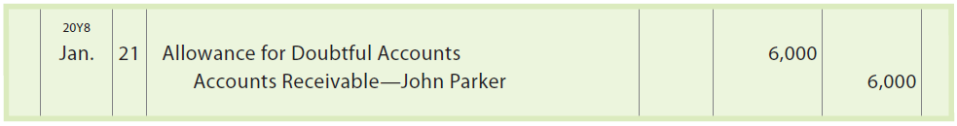
Write-Offs to the Allowance Account (2 of 8)
On January 21, 20Y8, John Parker’s account of $6,000 with ExTone Company is written off as follows:

Slide 20
Write-Offs to the Allowance Account (3 of 8)
Because Allowance for Doubtful Accounts is based on an estimate, it will normally have a balance at the end of a period. The total write-offs to the allowance account during the period will rarely equal the balance of the account at the beginning of the period.
  The allowance account will have a credit balance at the end of the period if the write-offs during the period are less than the beginning balance.
  The allowance account will have a debit balance at the end of the period if the write-offs during the period exceed the beginning balance.

Slide 21
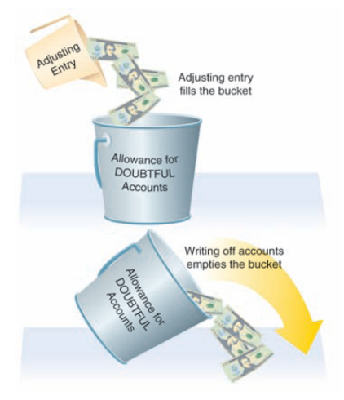
The Allowance Method

Slide 22
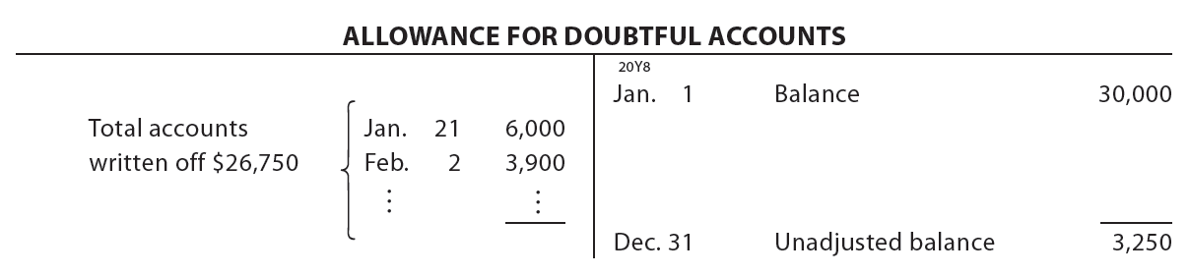
Write-Offs to the Allowance Account (4 of 8)
During 20Y8, ExTone Company writes off $26,750 of uncollectible accounts, including the $6,000 account of John Parker. Allowance for Doubtful Accounts will have a credit balance of $3,250 ($30,000 − $26,750), computed as follows:

Slide 23
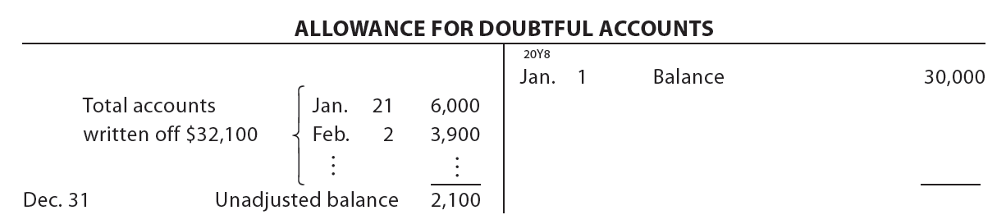
Write-Offs to the Allowance Account (5 of 8)
If ExTone Company had written off $32,100 in accounts receivable during 20Y8, Allowance for Doubtful Accounts would have a debit balance of $2,100, computed as follows:

Slide 24
Write-Offs to the Allowance Account (6 of 8)
The allowance account balances (credit balance of $3,250 and debit balance of $2,100) in the preceding illustrations are before the end-of-period adjusting entry.
After the end-of-period adjusting entry is recorded, Allowance for Doubtful Accounts should always have a credit balance.

Slide 25
Write-Offs to the Allowance Account (7 of 8)
An account receivable that has been written off against the allowance account may be collected later.
Like the direct write-off method, the account is reinstated by an entry that reverses the write-off entry. The cash received in payment is then recorded as a receipt on account.

Slide 26
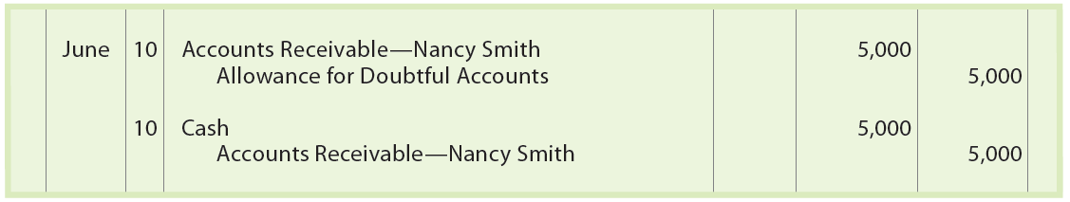
Write-Offs to the Allowance Account (8 of 8)
Nancy Smith’s account of $5,000, which was written off on April 2, is later collected on June 10. ExTone Company records the reinstatement and collection as follows:

Slide 27
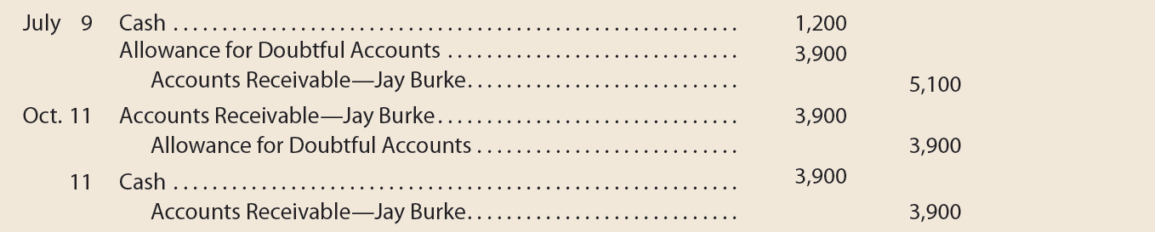
Example Exercise: Allowance Method
Journalize the following transactions, using the allowance method of accounting for uncollectible receivables:
  July 9. Received $1,200 from Jay Burke and wrote off the remainder owed of $3,900 as uncollectible.
  Oct. 11. Reinstated the account of Jay Burke and received $3,900 cash in full payment.

Slide 28
Estimating Uncollectibles (1 of 2)
The allowance method requires an estimate of uncollectible accounts at the end of the period.
  This estimate is normally based on
    Past experience
    Industry averages
    Forecasts of the future

Slide 29
Estimating Uncollectibles (2 of 2)
The two methods used to estimate uncollectible accounts
Percent of Sales Method
Analysis of Receivables Method

Slide 30
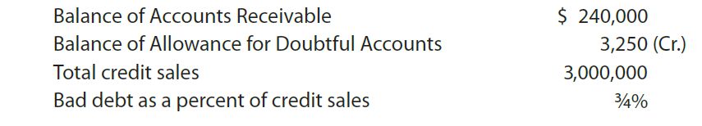
Percent of Sales Method (1 of 3)
Since accounts receivable are created by credit sales, uncollectible accounts can be estimated as a percent of credit sales.
Assume the following data for ExTone Company on December 31, 20Y8, before any adjustments:

Slide 31
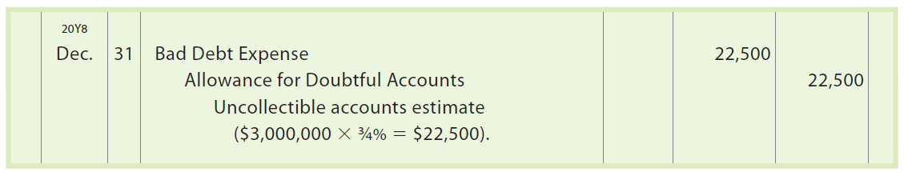
Percent of Sales Method (2 of 3)
Bad Debt Expense of $22,500 is estimated as follows:
The adjusting entry for uncollectible accounts on December 31, 20Y8, is as follows:

Slide 32
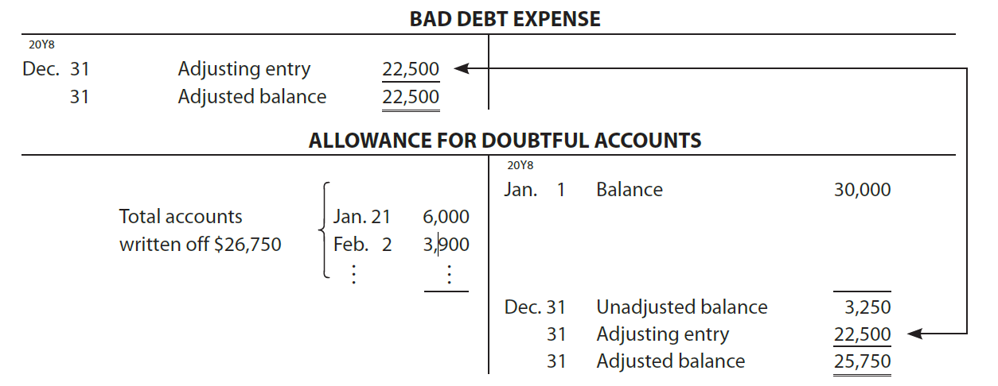
Percent of Sales Method (3 of 3)
After the adjusting entry is posted to the ledger, Bad Debt Expense will have an adjusted balance of $22,500, and Allowance for Doubtful Accounts will have a balance of $25,750 ($3,250 + $22,500).
The amount of the adjusting entry is the amount estimated for Bad Debt Expense. This estimate is credited to whatever the unadjusted balance is for Allowance for Doubtful Accounts.

Slide 33
Example Exercise: Percent of Sales Method (1 of 2)
At the end of the current year, Accounts Receivable has a balance of $800,000; Allowance for Doubtful Accounts has a credit balance of $7,500; and sales for the year total $3,500,000. Bad debt expense is estimated at 1/2% of sales.
Determine (a) the amount of the adjusting entry for uncollectible accounts; (b) the adjusted balances of Accounts Receivable, Allowance for Doubtful Accounts, and Bad Debt Expense; and (c) the net realizable value of accounts receivable.

Slide 34
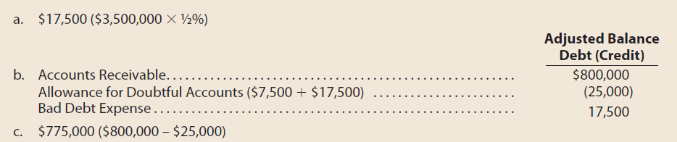
Example Exercise: Percent of Sales Method (2 of 2)

Slide 35
Analysis of Receivables Method (1 of 5)
Based on the assumption that the longer an account receivable is outstanding, the less likely it is that it will be collected
Applied as follows:
  Step 1: The due date of each account receivable is determined.
  Step 2: The number of days each account is past due is determined. This is the number of days between the due date of the account and the date of the analysis.
  Step 3: Each account is placed in an aged class according to its days past due (e.g., 1−30 days past due, 31−60 days past due, 61−90 days past due, and so on)
  Step 4: The totals for each aged class are determined.
  Step 5: The total for each aged class is multiplied by an estimated percentage of uncollectible accounts for that class.
  Step 6: The estimated total of uncollectible accounts is determined as the sum of the uncollectible accounts for each aged class.

Slide 36
Analysis of Receivables Method (2 of 5)
The preceding steps are then summarized in an aging schedule.
This overall process is called aging the receivables.

Slide 37
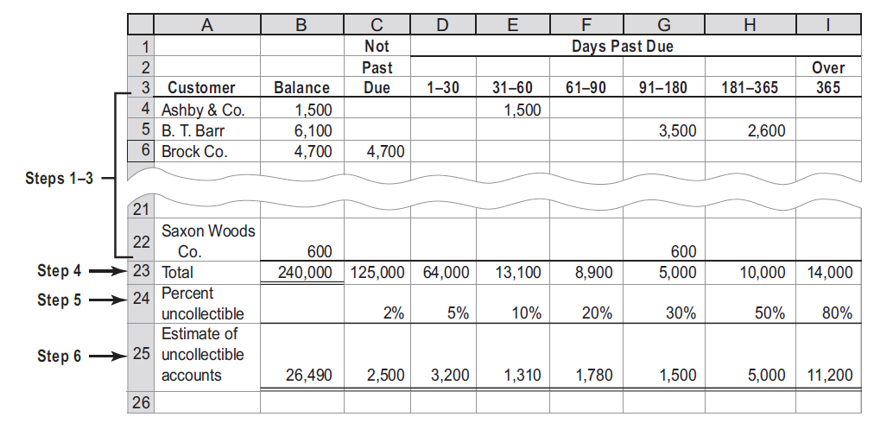
Aging of Receivables Schedule, December 31, 20Y8

Slide 38
Analysis of Receivables Method (3 of 5)
The sum of the estimated uncollectible accounts for each aged class (Step 6) is the estimated uncollectible accounts on December 31, 20Y8.
This is the desired adjusted balance for Allowance for Doubtful Accounts.
Comparing the sum of the estimated uncollectible accounts in the aging schedule with the unadjusted balance of the allowance account determines the amount of the adjustment for Bad Debt Expense.

Slide 39
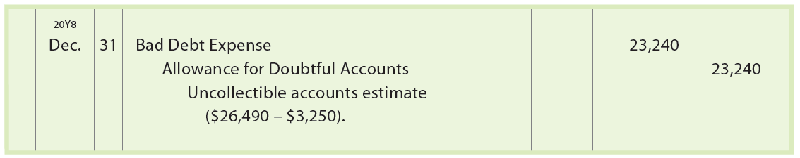
Analysis of Receivables Method (4 of 5)
For ExTone Company, the unadjusted balance of the allowance account is a credit balance of $3,250. The amount to be added to this balance is therefore $23,240 ($26,490 − $3,250). The adjusting entry is as follows:

Slide 40
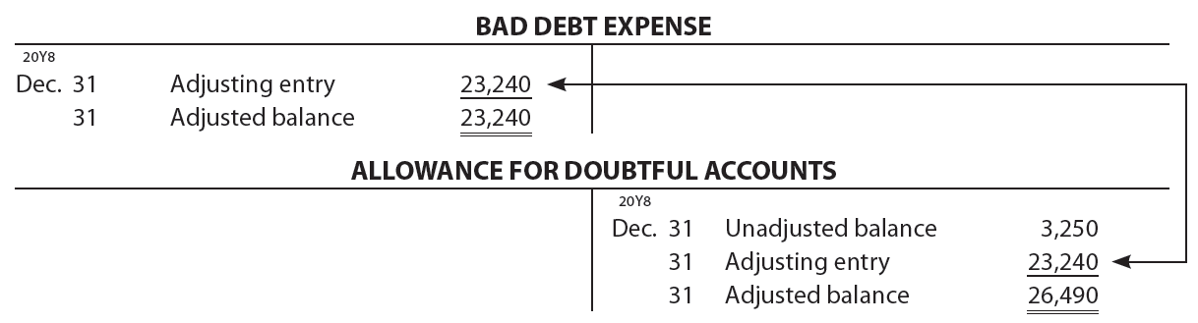
Analysis of Receivables Method (5 of 5)
After the adjusting entry is posted to the ledger, Bad Debt Expense will have an adjusted balance of $23,240, and Allowance for Doubtful Accounts will have a balance of $26,490.
The amount of the adjusting entry is the amount that will yield an adjusted balance for Allowance for Doubtful Accounts equal to that estimated by the aging schedule.

Slide 41
Example Exercise: Analysis of Receivables Method
(1 of 2)
At the end of the current year, Accounts Receivable has a balance of $800,000, Allowance for Doubtful Accounts has a credit balance of $7,500, and sales for the year total $3,500,000. Using the aging method, the balance of Allowance for Doubtful Accounts is estimated as $30,000.
Determine (a) the amount of the adjusting entry for uncollectible accounts; (b) the adjusted balances of Accounts Receivable, Allowance for Doubtful Accounts, and Bad Debt Expense; and (c) the net realizable value of accounts receivable.

Slide 42
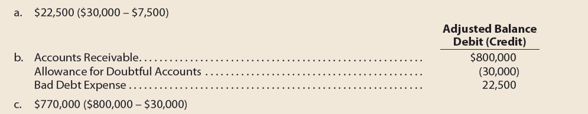
Example Exercise: Analysis of Receivables Method
(2 of 2)

Slide 43
Difference Between Estimation Methods

Slide 44
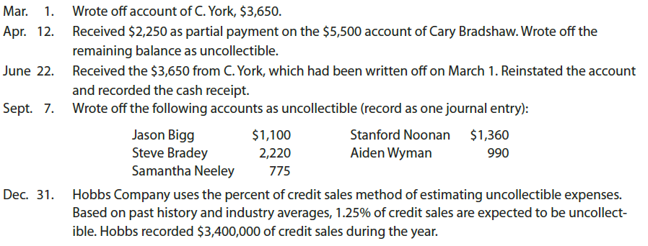
Comparing Direct Write-Off and Allowance Methods (1 of 2)
The following transactions are taken from the records of Hobbs Company for the year ending December 31:

Slide 45
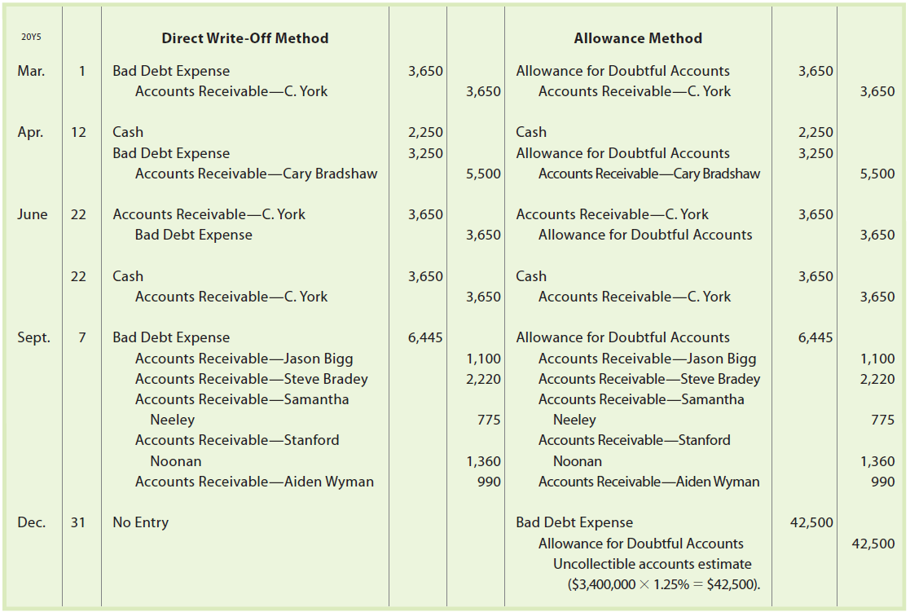
Comparing Direct Write-Off and Allowance Methods (2 of 2)

Slide 46
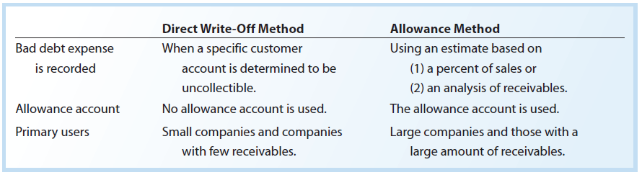
Direct Write-Off and Allowance Methods

Slide 47
Notes Receivable
A note receivable, or promissory note, is a written document containing a promise to pay the face amount, usually with interest, on demand or at a date in the future.
By signing a note, the debtor recognizes the debt and agrees to pay it according to its terms. Thus, a note is a stronger legal claim over an account receivable.

Slide 48
Characteristics of Notes Receivable (1 of 3)
Maker is the party making the promise to pay
Payee is the party to whom the note is payable
Face amount is the amount for which the note is written on its face
Issuance date is the date a note is issued
Due date or maturity date is the date the note is to be paid
Term of a note is the amount of time between the issuance and due dates
Interest rate is the rate of interest that must be paid on the face amount for the term of the note

Slide 49
Promissory Note

Slide 50
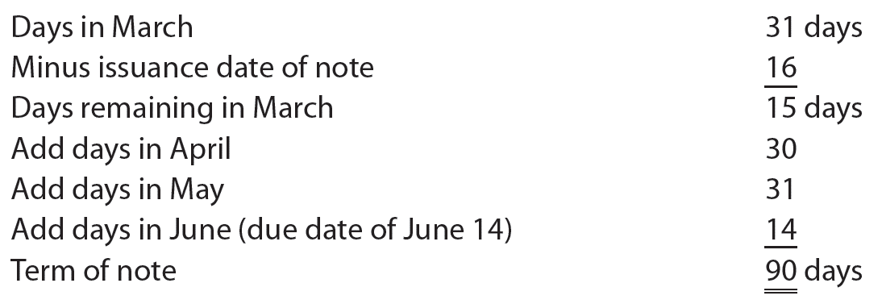
Characteristics of Notes Receivable (2 of 3)
The due date of June 14, 20Y3 is computed as follows:

Slide 51
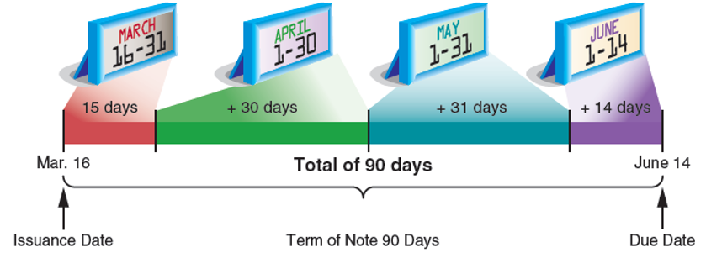
Determining Due Date of Promissory Note

Slide 52

Characteristics of Notes Receivable (3 of 3)
The interest on the note is computed as follows:
The maturity value is the amount that must be paid at the due date of the note, which is the sum of the face amount and the interest. The maturity value of the note is $2,050 ($2,000 + $50).

Slide 53
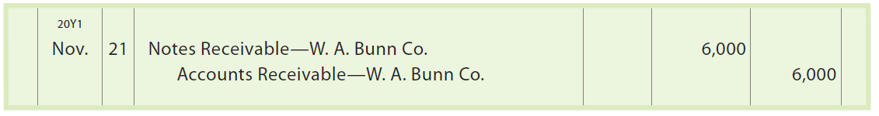
Accounting for Notes Receivable (1 of 6)
A promissory note may be received by a company from a customer to replace an account receivable. In such cases, the promissory note is recorded as a note receivable.
For example, a company accepts a 30-day, 12% note dated November 21, 20Y1, in settlement of the account of W. A. Bunn Co., which is past due and has a balance of $6,000. The company records the receipt of the note as follows:

Slide 54
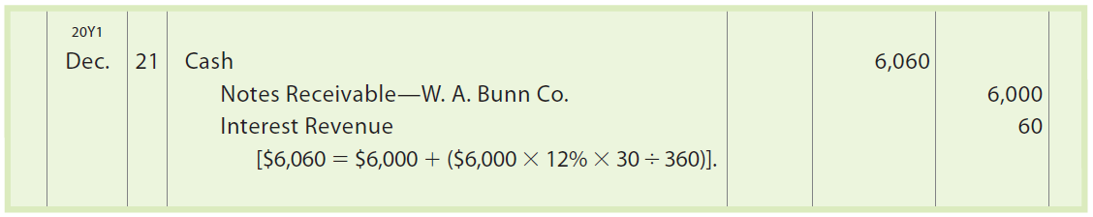
Accounting for Notes Receivable (2 of 6)
At the due date, the company records the receipt of $6,060 ($6,000 face amount plus $60 interest) as follows:

Slide 55
Accounting for Notes Receivable (3 of 6)
If the maker of the note fails to pay the note on the due date, it is considered a dishonored note receivable.
The face amount of the note plus any interest due are then transferred back to the customer’s account receivable account.

Slide 56
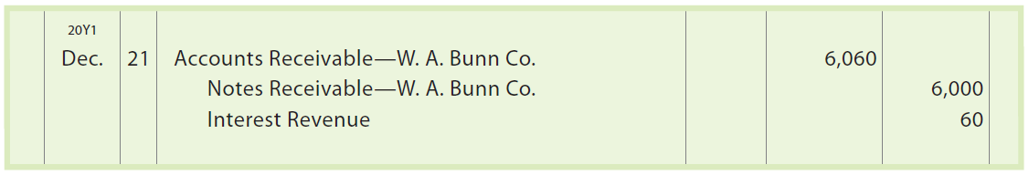
Accounting for Notes Receivable (4 of 6)
For example, the $6,000, 30-day, 12% note received from W. A. Bunn Co. and recorded on November 21 is dishonored. The company holding the note transfers the note and interest back to the customer’s account as follows:

Slide 57
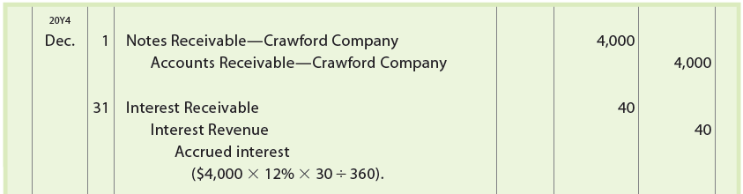
Accounting for Notes Receivable (5 of 6)
A company receiving a note should record an adjusting entry for any accrued interest at the end of the period.
For example, Crawford Company issues a $4,000, 90-day, 12% note dated December 1, 20Y4, to settle its account receivable. If the accounting period ends on December 31, the company receiving the note would record the following entries:

Slide 58
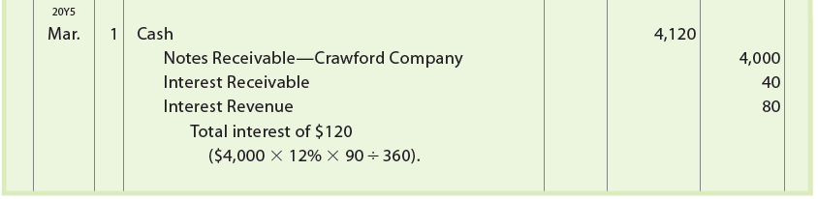
Accounting for Notes Receivable (6 of 6)
On March 1, 20Y5, the company receives $4,120 ($4,000 face amount + $120 interest) from Crawford Company. The company receiving the note would record this entry as follows:

Slide 59
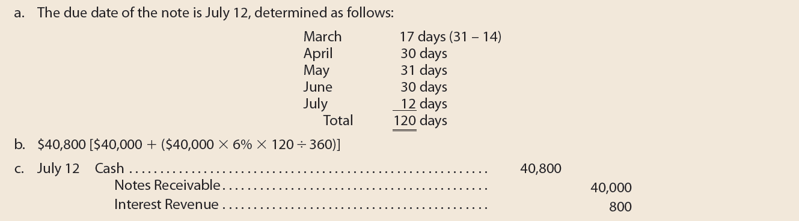
Example Exercise: Note Receivable
Same Day Surgery Center received a 120-day, 6% note for $40,000, dated March 14, from a patient on account.
  Determine the due date of the note.
  Determine the maturity value of the note.
  Journalize the entry to record the receipt of the payment of the note at maturity.

Slide 60
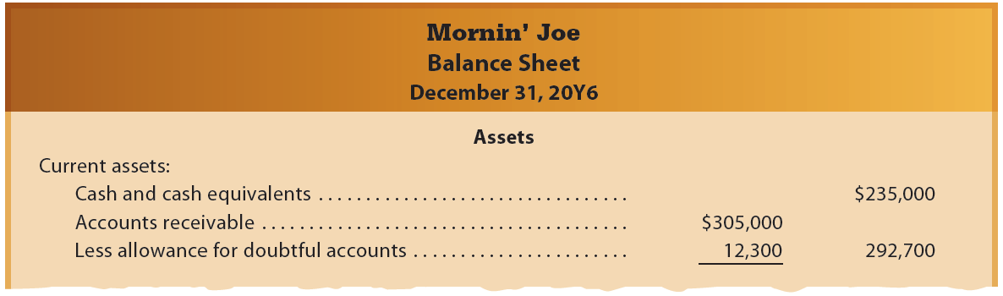
Reporting Receivables on the Balance Sheet
All receivables that are expected to be realized in cash within a year are reported in the Current assets section of the balance sheet.

Slide 61

Financial Analysis and Interpretation: Accounts
Receivable Turnover (1 of 2)
Accounts Receivable Turnover
Measures how frequently during the year the accounts receivable are being converted to cash
Computed as follows:

Slide 62
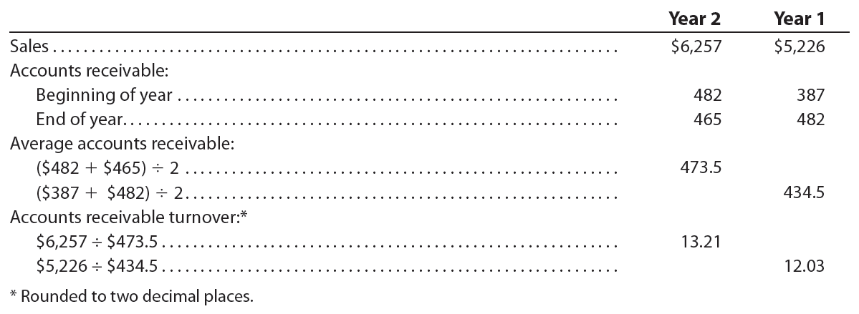
Financial Analysis and Interpretation: Accounts
Receivable Turnover (2 of 2)

Slide 63

Financial Analysis and Interpretation: Days’ Sales in Receivables (1 of 2)
Days’ Sales in Receivables
An estimate of the length of time the accounts receivable have been outstanding
Computed as follows:

Slide 64
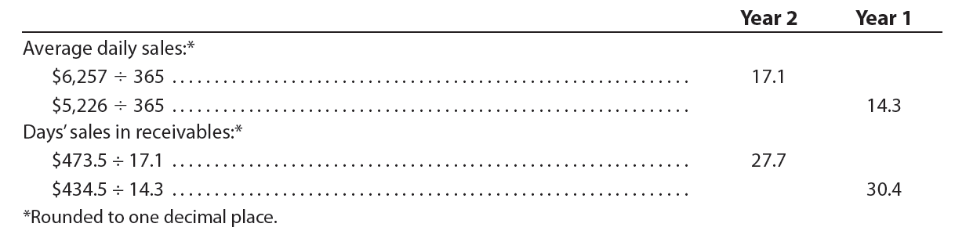
Financial Analysis and Interpretation: Days’ Sales in Receivables (2 of 2)

Slide 65
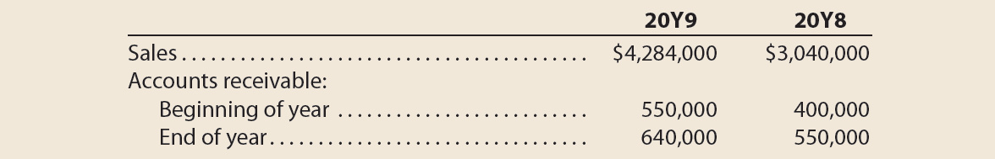
Example Exercise: Accounts Receivable Turnover and
Days’ Sales in Receivables (1 of 2)
Financial statement data for years ending December 31 for Osterman Company follows:
  Determine the accounts receivable turnover for 20Y9 and 20Y8.
  Determine the days’ sales in receivables for 20Y9 and 20Y8. Use 365 days and round to one decimal place.
  Does the change in accounts receivable turnover and the days’ sales in receivables from 20Y8 to 20Y9 indicate a favorable or unfavorable change?

Slide 66
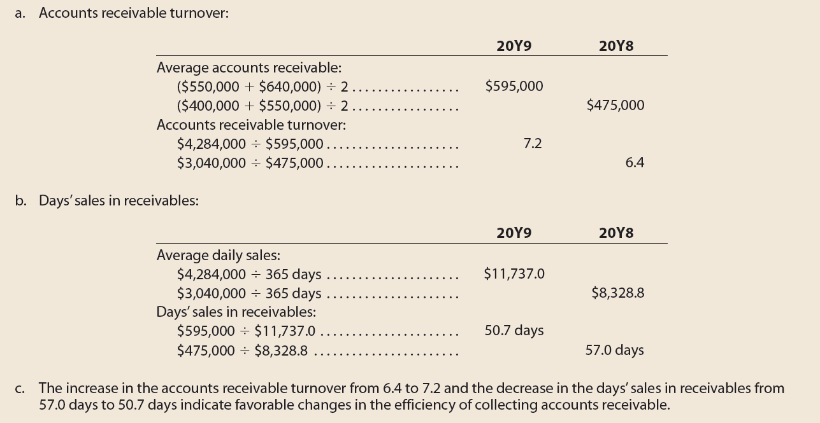
Example Exercise: Accounts Receivable Turnover and
Days’ Sales in Receivables (2 of 2)

