Slide 1

Current Liabilities and Payroll
Chapter 11

Slide 2
Learning Objectives (1 of 2)
LO1: Describe and illustrate current liabilities related to accounts payable, the current portion of long-term debt, and notes payable.
LO2: Determine employer liabilities for payroll, including liabilities arising from employee earnings and deductions from earnings.
LO3: Describe payroll accounting systems that use a payroll register, employee earnings records, and a general journal.
LO4: Journalize entries for employee fringe benefits, including vacation pay and pensions.

Slide 3
Learning Objectives (2 of 2)
LO5: Describe the accounting treatment for contingent liabilities and journalize entries for product warranties.
LO6: Describe and illustrate the use of the quick ratio in analyzing a company’s ability to pay its current liabilities.

Slide 4
Current Liabilities
When a company or a bank advances credit, it is making a loan.
The company or bank is called a creditor (or lender).
The individuals or companies receiving the loans are called debtors (or borrowers).
Debt is recorded as a liability by the debtor.
  Long-term liabilities are debts due beyond one year.
  Current liabilities are debts that will be paid out of current assets and are due within one year.

Slide 5
Accounts Payable
Accounts payable transactions involve a variety of purchases on account, including the purchase of merchandise and supplies.
For most companies, accounts payable is the largest current liability.

Slide 6
Current Portion of Long-Term Debt
Long-term liabilities are often paid back in periodic payments, called installments.
  Such installments that are due within the coming year are classified as a current liability.
  The installments due after the coming year are classified as a long-term liability.

Slide 7

Short-Term Notes Payable (1 of 8)
Notes may be issued to purchase merchandise or other assets. Notes may also be issued to creditors to satisfy an account payable created earlier.
Assume that Nature’s Sunshine Company issued a 90-day, 12% note for $1,000, dated August 1, 20Y7 to Murray Co. for a $1,000 overdue account. The entry to record the issuance of the note is as follows:

Slide 8
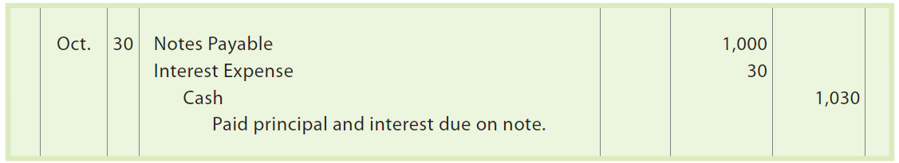
Short-Term Notes Payable (2 of 8)
When the note matures, the entry to record the payment of $1,000 plus $30 interest ($1,000 × 12% × 90 ÷ 360) is as follows:
The interest expense is reported in the Other Expense section of the income statement for the year ended December 31, 20Y7.
The interest expense account is closed at December 31.

Slide 9
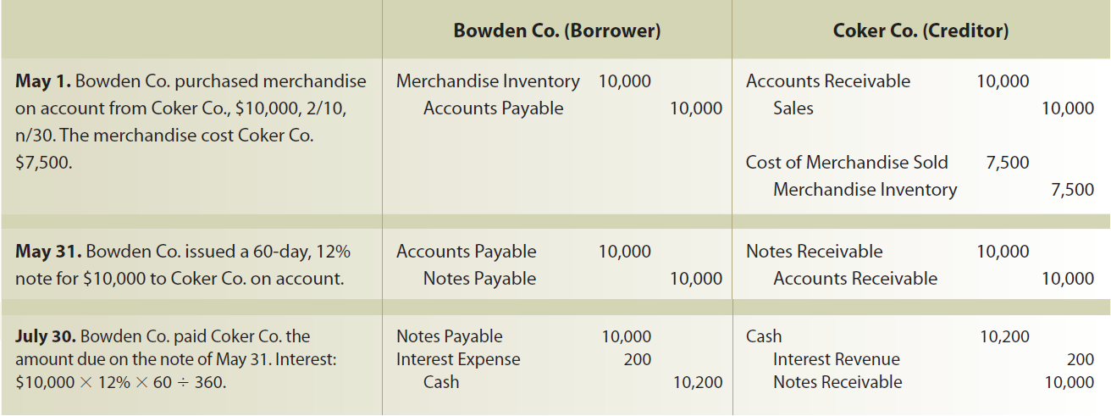
Short-Term Notes Payable (3 of 8)
Each note transaction affects a debtor (borrower) and creditor (lender).

Slide 10

Short-Term Notes Payable (4 of 8)
A company may also borrow from a bank by issuing a note.
Assume that on September 19, Iceburg Company borrowed cash from First National Bank by issuing a $4,000, 90-day, 15% note to the bank. The entry to record the issuance of the note and the cash proceeds is as follows:

Slide 11
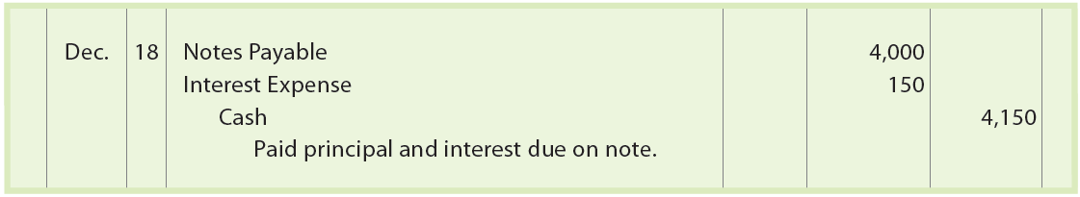
Short-Term Notes Payable (5 of 8)
On the due date of the note (December 18), Iceburg Company owes First National Bank $4,000 plus interest of $150 ($4,000 × 15% × 90 ÷ 360). The entry to record the payment of the note is as follows:

Slide 12
Short-Term Notes Payable (6 of 8)
In some cases, a discounted note may be issued rather than an interest-bearing note.
A discounted note has the following characteristics:
  The interest rate on the note is called the discount rate.
  The amount of interest on the note, called the discount, is computed by multiplying the discount rate times the face amount of the note.
  The debtor (borrower) receives the face amount of the note less the discount, called the proceeds.
  The debtor must repay the face amount of the note on the due date.

Slide 13
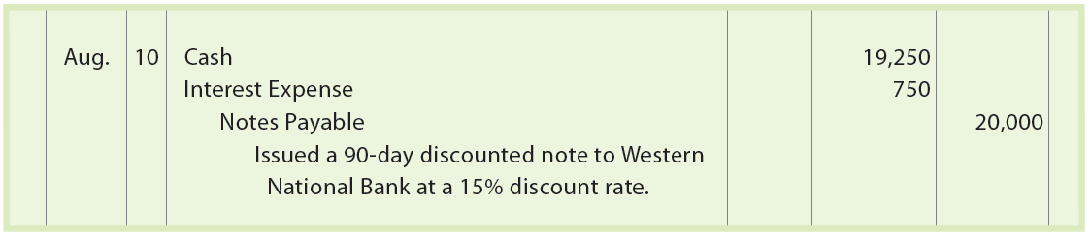
Short-Term Notes Payable (7 of 8)
Assume that on August 10, Cary Company issues a $20,000, 90-day discounted note to Western National Bank. The discount rate is 15%, and the amount of the discount is $750 ($20,000 × 15% × 90 ÷ 360). Thus, the proceeds received by Cary Company are $19,250. The entry by Cary Company is as follows:

Slide 14

Short-Term Notes Payable (8 of 8)
The entry when Cary Company pays the discounted note on November 8 is as follows:

Slide 15
Example Exercise: Proceeds from Notes Payable
On July 1, Bella Salon Company borrowed cash from Best Bank by issuing a 60-day note with a face amount of $60,000.
  Determine the proceeds of the note, assuming that the note carries an interest rate of 6%.
  Determine the proceeds of the note, assuming that the note is discounted at 6%.

Slide 16
Payroll and Payroll Taxes
In accounting, payroll refers to the amount paid to employees for services they provided during the period.
A company’s payroll is important for the following reasons:
  Payroll and related payroll taxes significantly affect the net income of most companies.
  Payroll is subject to federal and state regulations.
  Good employee morale requires payroll to be paid timely and accurately.

Slide 17
Liability for Employee Earnings (1 of 3)
Salary
Usually refers to payment for managerial and administrative services
Normally expressed in terms of a month or a year
Employee’s salary may be increased by bonuses, commissions, profit sharing, or other adjustments
Wages
Usually refer to payments to employees for services that is stated on an hourly or weekly basis
Employee’s wage may be increased by bonuses, commissions, profit sharing, or other adjustments

Slide 18
Liability for Employee Earnings (2 of 3)
Companies engaged in interstate commerce must follow the Fair Labor Standards Act. This act, sometimes called the Federal Wage and Hour Law, requires employers to pay a minimum rate of 1½ times the regular rate for all hours worked in excess of 40 hours per week.

Slide 19
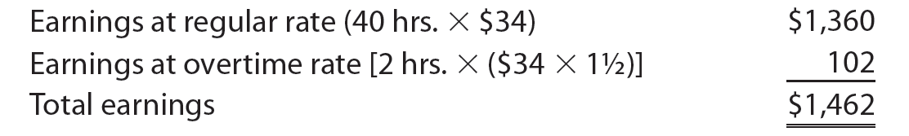
Liability for Employee Earnings (3 of 3)
Assume that John T. McGrath is a salesperson employed by McDermott Supply Co. McGrath’s regular rate is $34 per hour, and any hours worked in excess of 40 hours per week are paid at 1½ times the regular rate. McGrath worked 42 hours for the week ended December 27. His earnings for the week are computed as follows:

Slide 20
Deductions from Employee Earnings
The total earnings of an employee for a payroll period, including any overtime pay, are called gross pay.
From this amount is subtracted one or more deductions to arrive at the net pay.
  The deductions normally include the following:
    Federal income taxes
    State income taxes
    Local income taxes
    Medical insurance
    Pension contributions
  Net pay is the amount the employee receives after deductions are subtracted from gross pay.

Slide 21
Income Taxes (1 of 5)
Employers normally withhold a portion of employee earnings for payment of the employees’ federal income tax.
Each employee authorizes the amount to be withheld by completing an “Employee’s Withholding Allowance Certificate,” called a W-4.

Slide 22
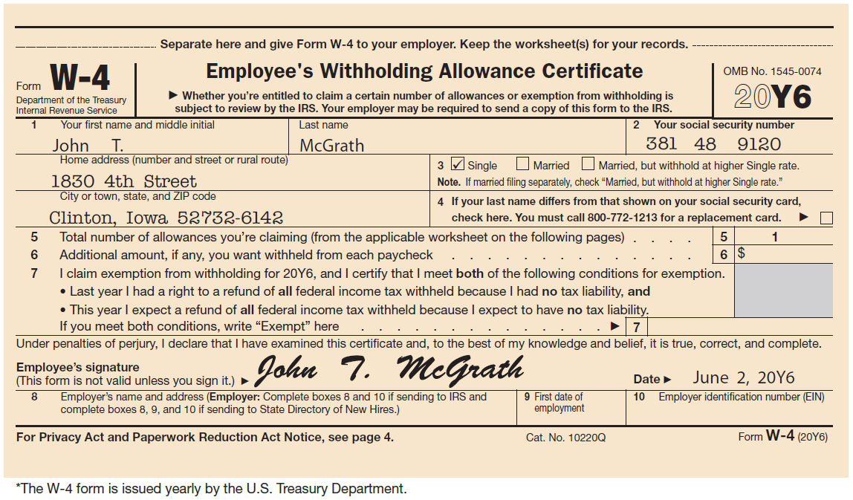
Employee’s Withholding Allowance Certificate (W-4 Form)

Slide 23
Income Taxes (2 of 5)
On the W-4, an employee indicates marital status and the number of withholding allowances.
  A single employee may claim one withholding allowance.
  A married employee may claim an additional allowance for a spouse.
  An employee may also claim an allowance for each dependent other than a spouse.
Each allowance reduces the federal income tax withheld from the employee’s pay.
  The federal income tax withheld depends on each employee’s gross pay and W-4 allowance.

Slide 24
Income Taxes (3 of 5)
Withholding tables issued by the Internal Revenue Service (IRS) are used to determine amounts to withhold.
Each year, the amount of standard withholding allowance is determined by the IRS.
  For ease of computation and because this amount changes each year, we assume that the standard withholding allowance to be deducted for a single person paid weekly is $81.

Slide 25
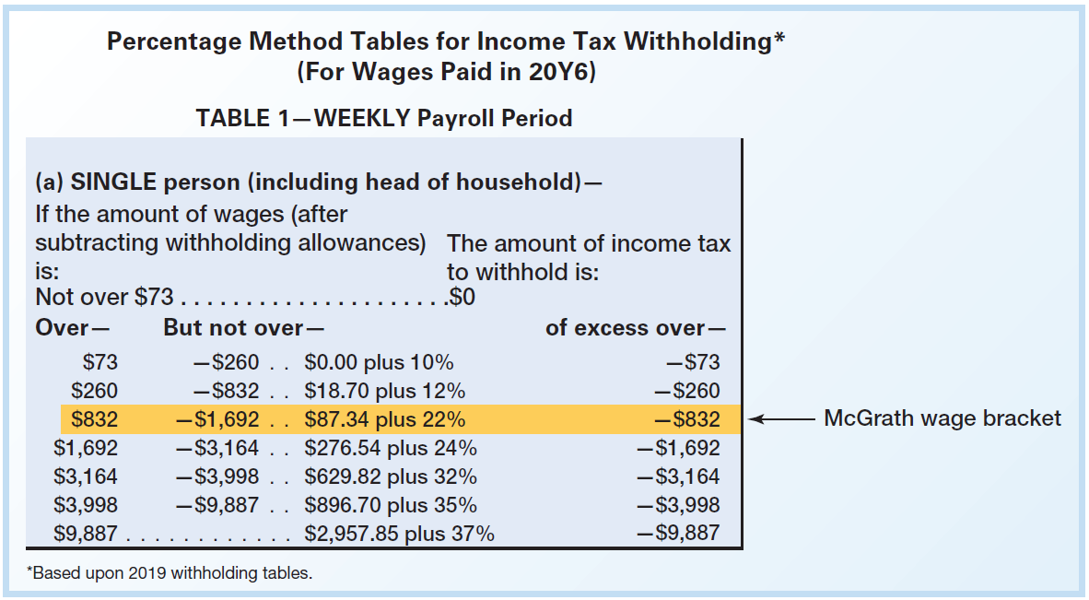
Income Taxes (4 of 5)
Assume that John T. McGrath made $1,462 for the week ended December 27. McGrath’s W-4 claims one withholding allowance of $81.
  Thus, the wages used in determining McGrath’s withholding bracket are $1,381 ($1,462 − $81).

Slide 26
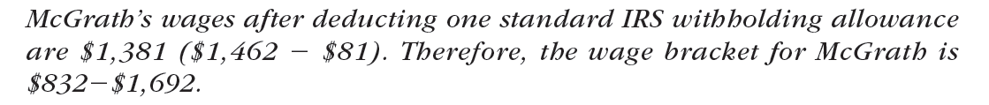
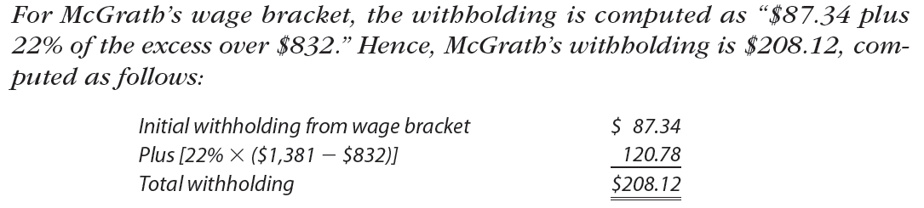
Income Taxes (5 of 5)
After the person’s withholding wage bracket has been computed, the federal income tax to be withheld is determined as follows:
  Step 1. Locate the proper withholding wage bracket in the withholding tables issued by the IRS.
  Step 2. Compute the withholding for the proper wage bracket using the directions in the two-right columns of the withholding table.

Slide 27
Example Exercise: Federal Income Tax Withholding
(1 of 2)
Karen Dunn’s weekly gross earnings for the present week were $2,250. Dunn has two exemptions. Using the wage bracket withholding table below with a $81 standard withholding allowance for each exemption, what is Dunn’s federal income tax withholding?

Slide 28
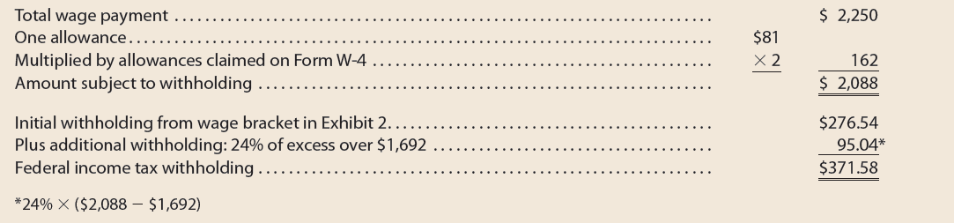
Example Exercise: Federal Income Tax Withholding
(2 of 2)

Slide 29
FICA Tax (1 of 3)
Employers are required by the Federal Insurance Contributions Act (FICA) to withhold a portion of the earnings of each employee.
The FICA tax withheld contributes to the following two federal programs:
  Social security, which provides payments for retirees, survivors, and disability insurance.
  Medicare, which provides health insurance for senior citizens.

Slide 30
FICA Tax (2 of 3)
The amount withheld from each employee is based on the employee’s earnings paid in the calendar year.
The withholding tax rates and maximum earnings subject to tax are often revised by Congress.
  To simplify, this chapter assumes the following rates and earnings subject to tax:
    Social security: 6% on all earnings
    Medicare: 1.5% on all earnings

Slide 31
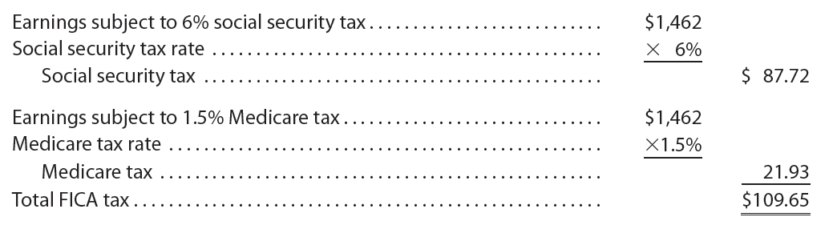
FICA Tax (3 of 3)
Assume that John T. McGrath’s earnings for the week ending December 27 are $1,462. Total FICA tax to be withheld is computed as follows:

Slide 32
Other Deductions
Employees may choose to have additional amounts deducted from their gross pay
For example, an employee may authorize deductions for:
  Retirement savings
  Charitable contributions
  Life insurance
Union contract may also require the deduction of union dues

Slide 33
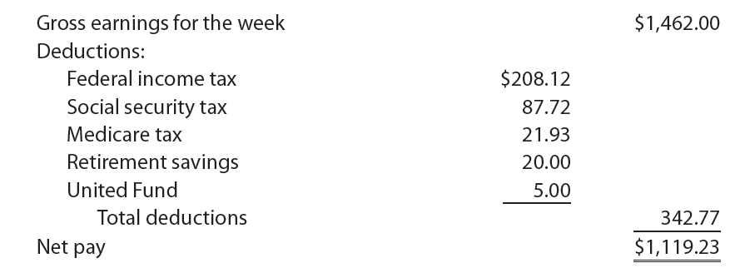
Computing Employee Net Pay
Gross earnings less payroll deductions equals net pay.
Net pay is sometimes called take-home pay.
Assume that John T. McGrath authorized deductions for retirement savings and for a United Fund contribution. McGrath’s net pay for the week ended December 27 is computed as follows:

Slide 34
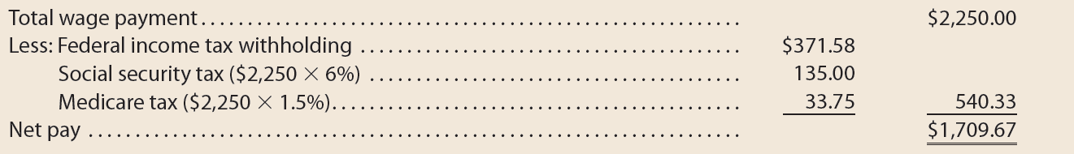
Example Exercise: Employee Net Pay
Karen Dunn’s weekly gross earnings for the week ending December 3 were $2,250, and her federal income tax withholding was $371.58. Assuming that the social security rate is 6% and Medicare is 1.5%, what is Dunn’s net pay?

Slide 35
Liability for Employer’s Payroll Taxes
Employers are subject to the following payroll taxes for amounts paid their employees:
Federal Insurance Contributions Act (FICA) Tax
Employers must match the employee’s FICA tax contribution
Federal Unemployment Compensation Tax (FUTA)
Provides for temporary payments to those who become unemployed
State Unemployment Compensation Tax (SUTA)
Provides temporary payments to those who become unemployed

Slide 36
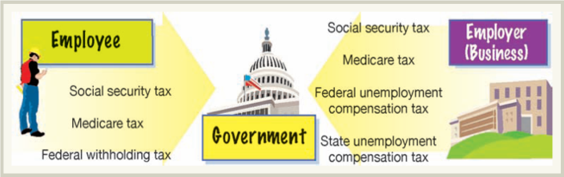
Responsibility for Tax Payments

Slide 37
Accounting Systems for Payroll and Payroll Taxes (1 of 2)
Payroll systems should be designed to:
  Pay employees accurately and timely.
  Meet regulatory requirements of federal, state, and local agencies.
  Provide useful data for management decision-making needs.
Although payroll systems differ among companies, the major elements of most payroll systems are:
  Payroll register
  Employee’s earnings record
  Payroll checks

Slide 38
Accounting Systems for Payroll and Payroll Taxes (2 of 2)
The payroll register is a multicolumn report used for summarizing the data for each payroll period.
Although payroll registers vary by company, a payroll register normally includes the following columns:
  Employee name
  Total hours worked
  Regular earnings
  Overtime earnings
  Total gross earnings
  Social security tax withheld
  Medicare tax withheld
  Federal income tax withheld
  Retirement savings withheld
  Miscellaneous items withheld
  Total withholdings
  Net pay
  Check number of payroll check issued
  Accounts debited for payroll expense

Slide 39
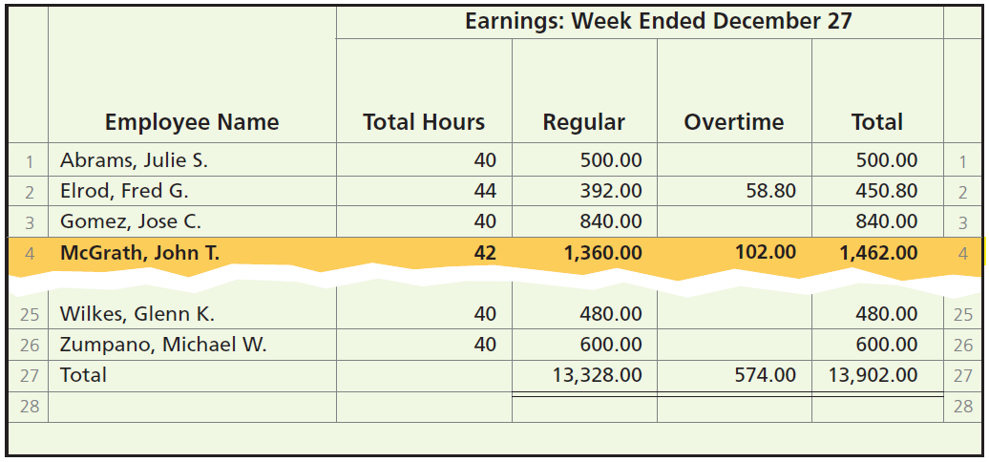
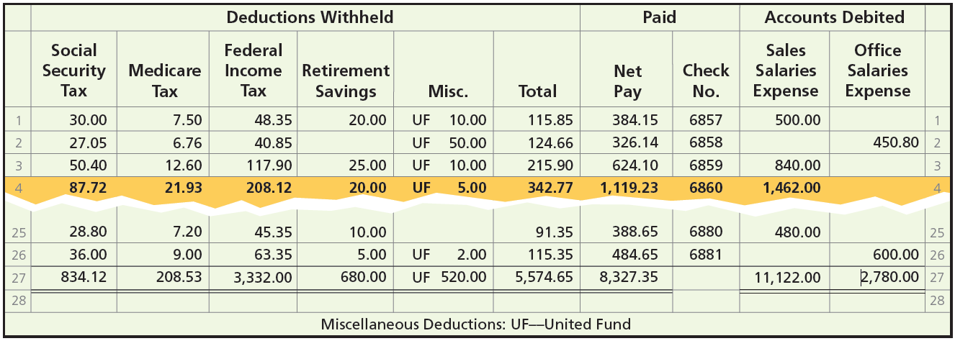
Payroll Register

Slide 40
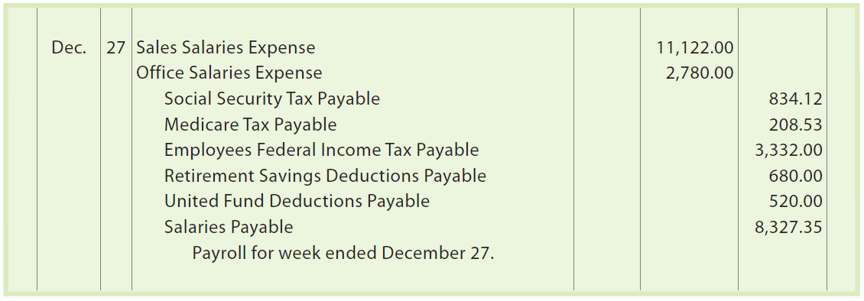
Recording Employees’ Earnings
The column totals of the payroll register provide the basis for recording the journal entry for payroll. The entry based on the payroll register is as follows:

Slide 41
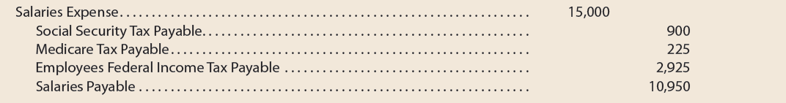
Example Exercise: Journalize Period Payroll
The payroll register of Chen Engineering Services indicates $900 of social security withheld and $225 of Medicare tax withheld on total salaries of $15,000 for the period. Federal withholding for the period totaled $2,925.
  Provide the journal entry for the period’s payroll.

Slide 42
Recording and Paying Payroll Taxes (1 of 4)
Payroll taxes are recorded as liabilities when the payroll is paid to employees.
In addition, employers compute and report payroll taxes on a calendar-year basis, which may differ from the company’s fiscal year.

Slide 43
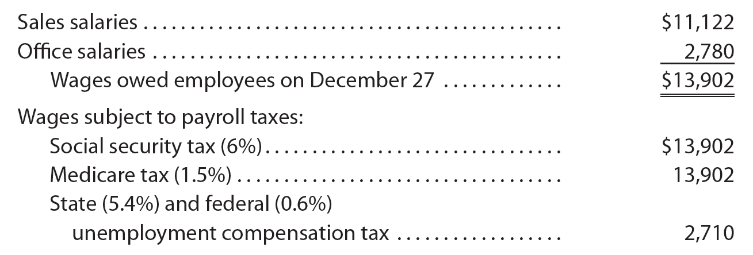
Recording and Paying Payroll Taxes (2 of 4)
On December 27, McDermott Supply has the following payroll data:

Slide 44
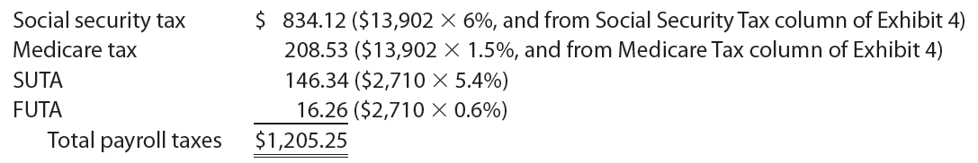
Recording and Paying Payroll Taxes (3 of 4)
Employers must match the employees’ social security and Medicare tax contributions.
In addition, the employer must pay state unemployment compensation tax (SUTA) of 5.4% and federal unemployment compensation tax (FUTA) of 0.6%.
When payroll is paid on December 27, these payroll taxes are computed as follows:

Slide 45
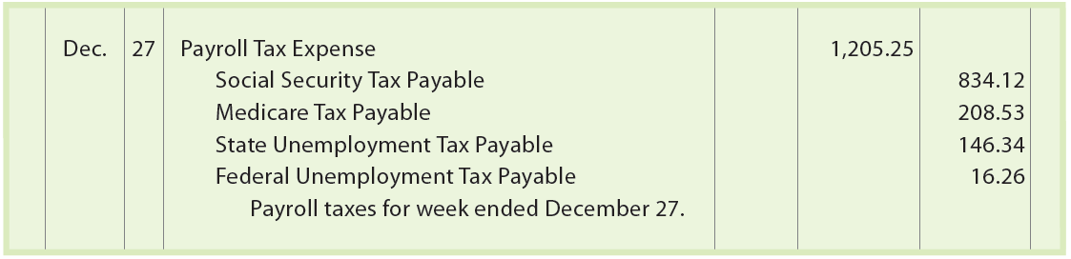
Recording and Paying Payroll Taxes (4 of 4)
The entry to journalize the payroll tax expense for McDermott Supply is as follows:

Slide 46
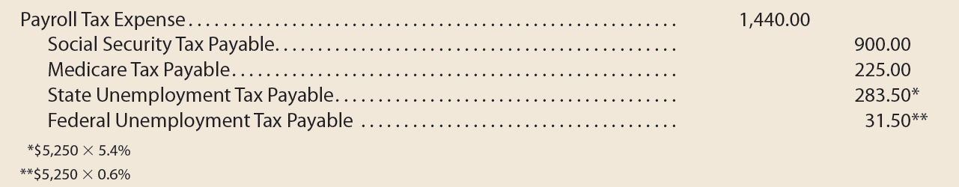
Example Exercise: Journalize Payroll Tax
The payroll register of Chen Engineering Services indicates $900 of social security withheld and $225 of Medicare tax withheld on total salaries of $15,000 for the period. Earnings of $5,250 are subject to state and federal unemployment compensation taxes at the federal rate of 0.6% and the state rate of 5.4%.
  Provide the journal entry to record the payroll tax expense for the period.

Slide 47
Employee’s Earnings Record (1 of 2)
Each employee’s earnings to date must be determined at the end of each payroll period. This total is necessary for computing the employee’s social security tax withholding and the employer’s payroll taxes.
Thus, detailed payroll records must be kept for each employee. This record is called an employee’s earnings record.

Slide 48
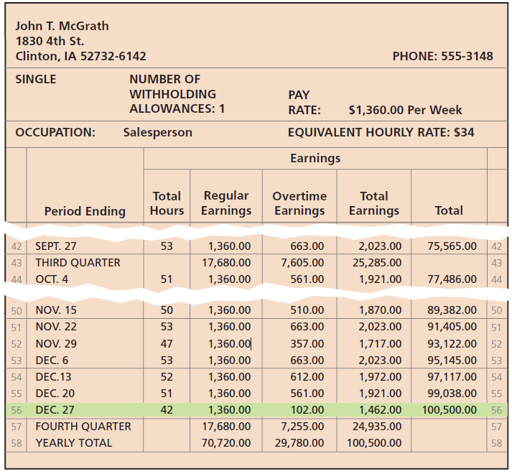
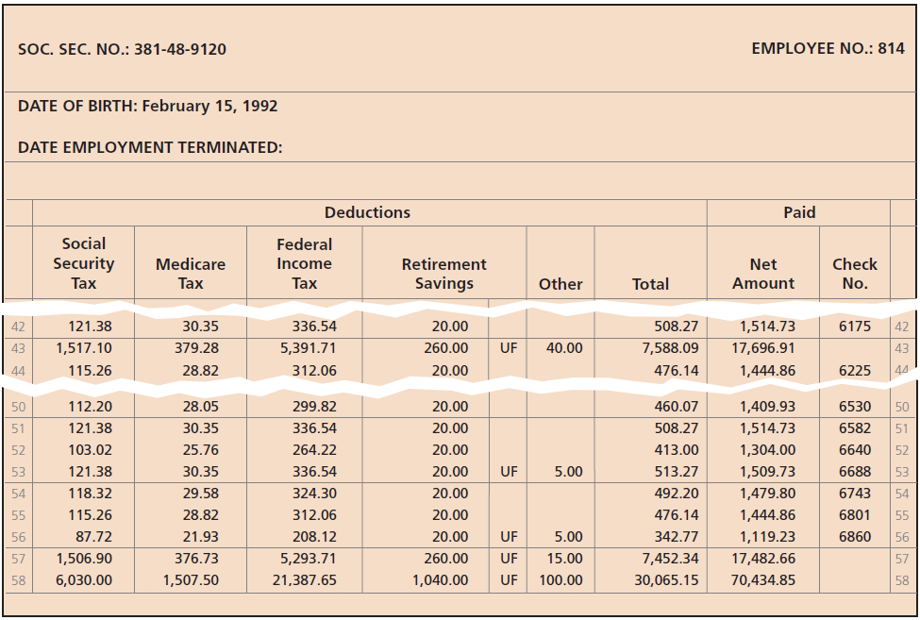
Employee’s Earnings Record (2 of 2)

Slide 49
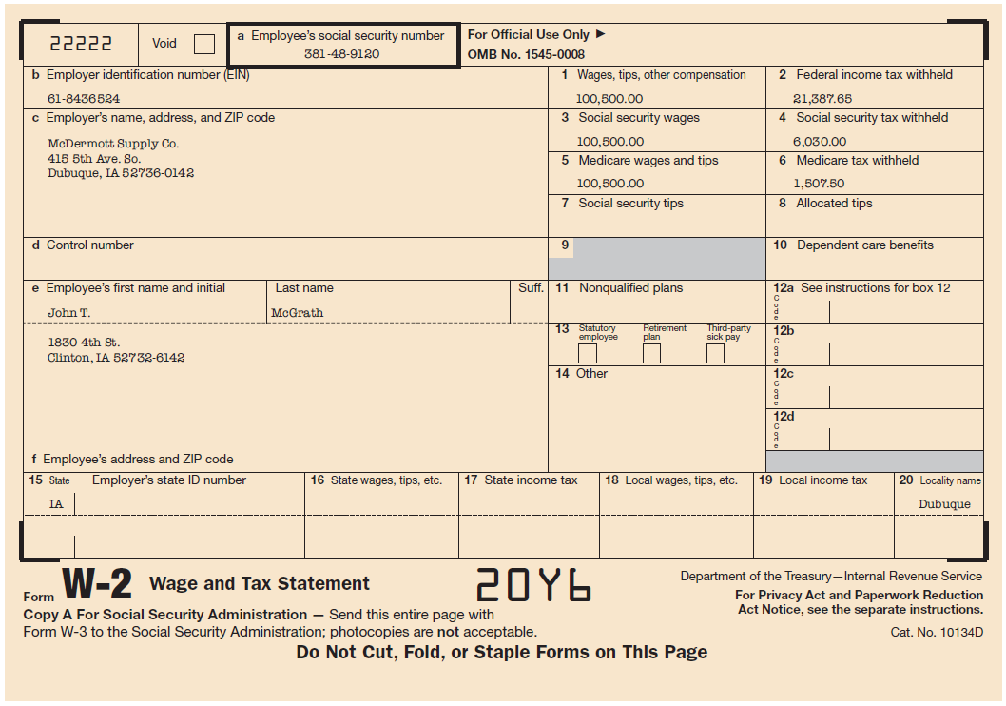
Employee’s Wage and Tax Statement (W-2 Form)

Slide 50
Payroll Checks (1 of 2)
Companies pay employees either by electronic funds transfer or by issuing payroll checks.
  With electronic funds transfers, the employee’s net pay is electronically deposited into their bank account each period. Later, the employees receive a payroll statement summarizing how the net pay was computed.
  Each payroll check includes a detachable statement showing how the net pay was computed, which is typically identical to the payroll statement accompanying electronic funds transfers (EFTs).

Slide 51
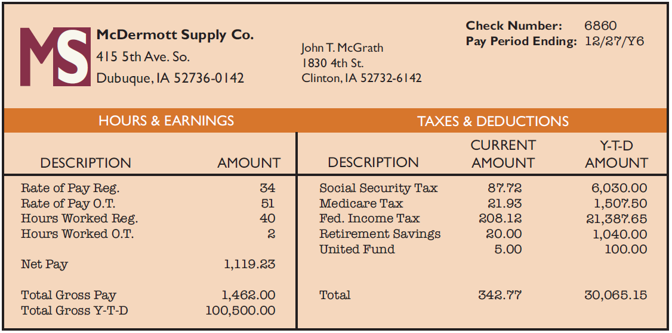
Payroll Statement

Slide 52
Payroll Checks (2 of 2)
Most companies use a special payroll bank account to disburse payroll.
  An advantage of using a separate payroll bank account is that reconciling the bank statements is simplified.
  In addition, a payroll bank account establishes control over payroll checks and, thus, prevents their theft or misuse.

Slide 53
Computerized Payroll System
Classification of the inputs into a payroll system
Constants
  Data that remain unchanged from payroll to payroll
  Examples: Employee names, social security numbers, marital status, number of income tax withholding allowances, rates of pay, tax rates, and withholding tables
Variables
  Data that change from payroll to payroll
  Examples: Number of hours or days worked for each employee, accrued days of sick leave, vacation credits, total earnings to date, and total taxes withheld

Slide 54
Internal Controls for Payroll Systems
Some examples of payroll controls include the following:
  If a check-signing machine is used, blank payroll checks and access to the machine should be restricted to prevent their theft or misuse.
  The hiring and firing of employees should be properly authorized and approved in writing.
  All changes in pay rates should be properly authorized and approved in writing.
  Employees should be observed when arriving for work to verify that employees are “checking in” for work only once and only for themselves. Employees may “check in” for work by using a time card or by swiping their employee ID card.
  Payroll checks should be distributed by someone other than employee supervisors.
  A special payroll bank account should be used.

Slide 55
Employees’ Fringe Benefits
Many companies provide their employees benefits in addition to salary and wages earned. Such fringe benefits may include:
  Vacation pay
  Medical benefits
  Retirement benefits
The cost of employee fringe benefits is recorded as an expense by the employer.

Slide 56
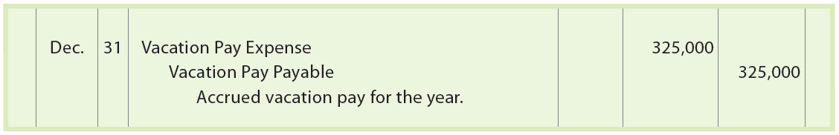
Vacation Pay (1 of 2)
The liability to pay for employee vacations could be accrued as a liability at the end of each pay period. However, many companies wait and record an adjusting entry for accrued vacation at the end of the year.
Assume that employees earn one day of vacation for each month worked. The estimated vacation pay for the year ending December 31 is $325,000. The adjusting entry for the accrued vacation is as follows:

Slide 57

Vacation Pay (2 of 2)
If employees are required to take all their vacation time within one year, the vacation pay payable is reported as a current liability on the balance sheet.
If employees are allowed to accumulate their vacation pay, the estimated vacation pay payable that will not be taken within a year is reported as a long-term liability.
When employees take vacation, the liability for vacation pay is decreased by debiting Vacation Pay Payable. Salaries or Wages Payable and the other related payroll accounts for taxes and withholdings are credited.

Slide 58
Pensions
A pension is a cash payment to retired employees.
Pension benefits are accrued by employees as they work, based on the employer’s pension plan.
Two basic types of pension plans are:
  Defined contribution plan
  Defined benefit plan

Slide 59
Defined Contribution Plans (1 of 3)
In a defined contribution plan, the company invests contributions on behalf of the employee during the employee’s working years.
  Normally, the employee and employer contribute to the plan.
  The employee’s pension depends on the total contributions and the investment returns earned on those contributions.

Slide 60
Defined Contribution Plans (2 of 3)
401K Plan
One of the more popular defined contribution plans
Employees contribute a portion of their gross pay before taxes to investments
Offers employees two advantages:
  Employee contribution is deducted before taxes
  Contributions and related earnings are not taxed until withdrawn at retirement

Slide 61

Defined Contribution Plans (3 of 3)
In most cases, the employer matches some portion of the employee’s contribution.
The employer’s cost is debited to Pension Expense.
Assume that Heaven Scent Perfumes Company contributes 10% of employee monthly salaries to an employee 401K plan. Assuming $500,000 of monthly salaries, the journal entry to record the monthly contribution is as follows:

Slide 62
Defined Benefit Plans (1 of 3)
In a defined benefit plan, the company pays the employee a fixed annual pension based on a formula. The formula is normally based on such factors as the employee’s years of service, age, and past salary.
In a defined benefit plan, the employer is obligated to pay for (fund) the employee’s future pension benefits.
The pension cost of a defined benefit plan is debited to Pension Expense. Cash is credited for the amount contributed (funded) by the employer, and any unfunded amount is credited to Unfunded Pension Liability.

Slide 63
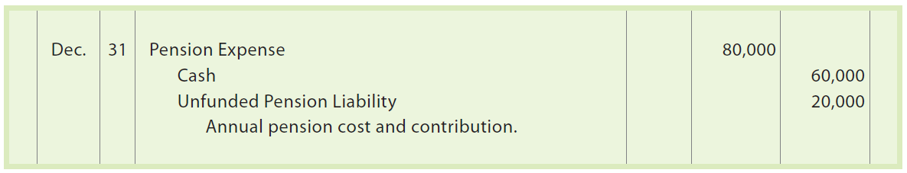
Defined Benefit Plans (2 of 3)
Assume that the defined benefit plan of Hinkle Co. requires an annual pension cost of $80,000. This annual contribution is based on estimates of Hinkle’s future pension liabilities. On December 31, Hinkle Co. pays $60,000 to the pension fund. The entry to record the payment and unfunded liability is as follows:

Slide 64
Defined Benefit Plans (3 of 3)
If the unfunded pension liability is to be paid within one year, it is reported as a current liability on the balance sheet.
Any portion of the unfunded pension liability that will be paid beyond one year is a long-term liability.

Slide 65
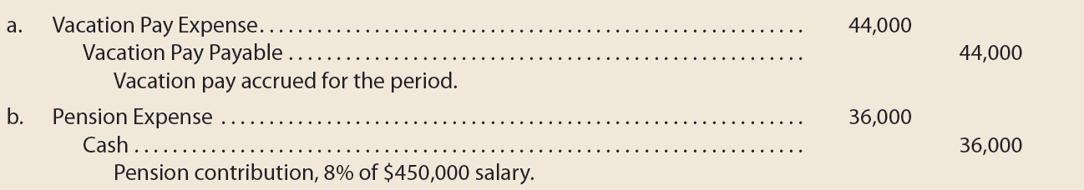
Example Exercise: Vacation Pay and Pension Benefits
Manfield Services Company provides its employees with vacation benefits and a defined contribution pension plan. Employees earned vacation pay of $44,000 for the period. The pension plan requires a contribution to the plan administrator equal to 8% of employee salaries. Salaries were $450,000 during the period.
Provide the journal entry for the (a) vacation pay and (b) pension benefit.

Slide 66
Postretirement Benefits Other than Pensions (1 of 2)
Employees may earn rights to other postretirement benefits from their employer. Such benefits may include the following:
  Dental care
  Eye care
  Medical care
  Life insurance
  Tuition assistance
  Tax services
  Legal services

Slide 67
Postretirement Benefits Other than Pensions (2 of 2)
The estimate of the annual benefits expense is recorded by debiting Postretirement Benefits Expense. If the benefits are fully funded, Cash is credited for the same amount. If the benefits are not fully funded, a postretirement benefits plan liability account is also credited.
The financial statements should disclose the nature of the postretirement benefit liabilities. These disclosures are usually included as notes to the financial statements.

Slide 68
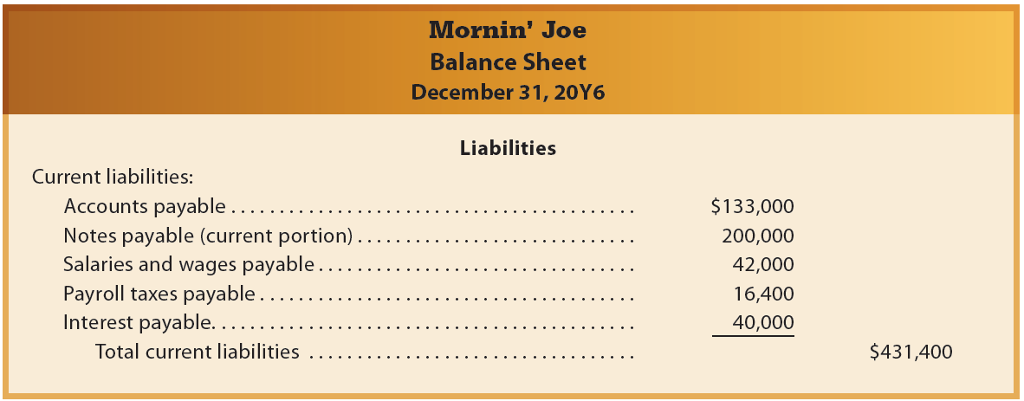
Current Liabilities on the Balance Sheet

Slide 69
Contingent Liabilities
Some liabilities may arise from past transactions only if certain events occur in the future. These potential obligations are called contingent liabilities.
The accounting for contingent liabilities depends on the following two factors:
  Likelihood of occurring
    The likelihood that the event creating the liability occurring is classified as probable, reasonably possible, or remote.
  Measurement
    The ability to estimate the potential liability is classified as estimable or not estimable.

Slide 70

Probable and Estimable (1 of 2)
If a contingent liability is probable and the amount of the liability can be reasonably estimated, it is recorded and disclosed.
The liability is recorded by debiting an expense and crediting a liability.
Assume that during June, a company sold a product for $60,000 that includes a 36-month warranty for repairs. The average cost of repairs over the warranty period is 5% of the sales price. The entry to record the estimated product warranty expense for June is as follows:

Slide 71

Probable and Estimable (2 of 2)
If the product is repaired under warranty, the repair costs are recorded by debiting Product Warranty Payable and crediting Cash, Supplies, Wages Payable, or other accounts.
Assume that a $200 part is replaced under warranty on August 16. The entry to record the replacement of the defective part is as follows:

Slide 72
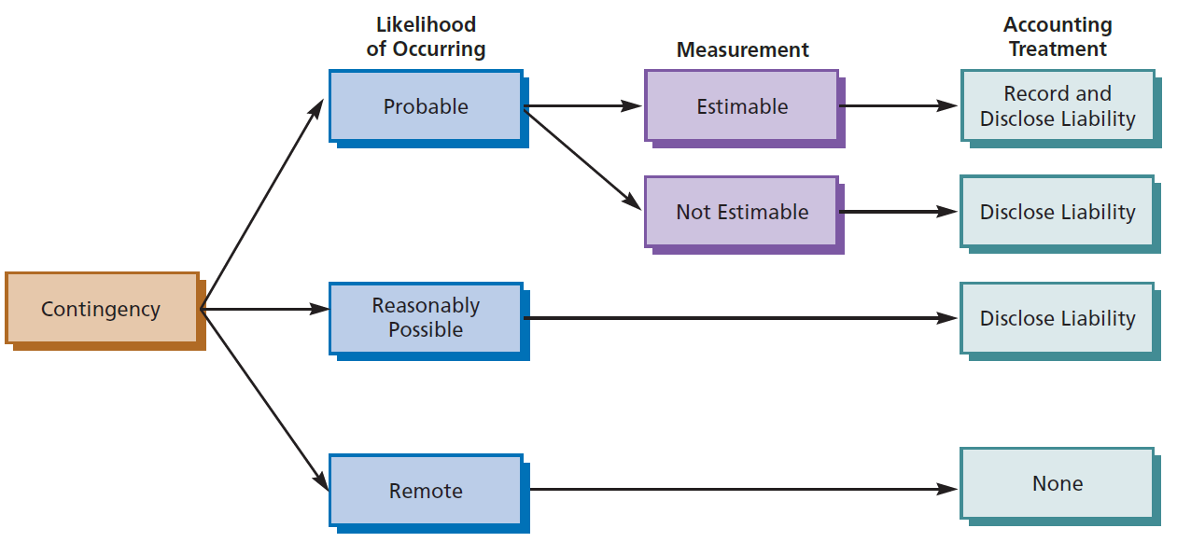
Accounting Treatment of Contingent Liabilities

Slide 73
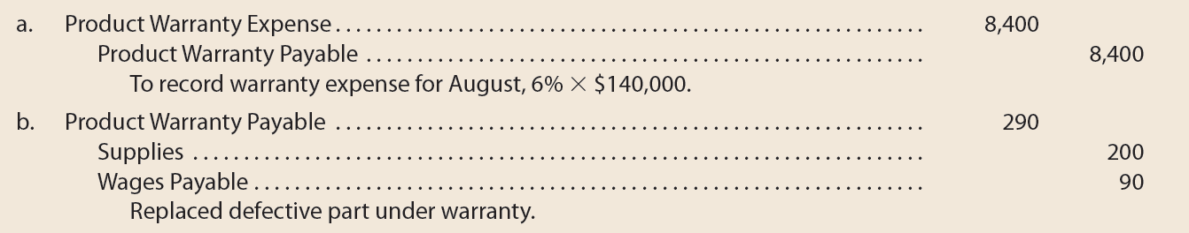
Example Exercise: Estimated Warranty Liability
Cook-Rite Co. sold $140,000 of kitchen appliances during August under a six-month warranty. The cost to repair defects under the warranty is estimated at 6% of the sales price. On September 12, a customer required a $200 part replacement plus $90 of labor under the warranty.
Provide the journal entry for (a) the estimated warranty expense on August 31 for August sales and (b) the September 12 warranty work.

Slide 74
Financial Analysis and Interpretation: Quick Ratio (1 of 6)
Current position analysis helps creditors evaluate a company’s ability to pay its current liabilities. This analysis is based on:
  Working capital
  Current ratio
  Quick ratio

Slide 75

Financial Analysis and Interpretation: Quick Ratio (2 of 6)
Working capital is computed as follows:
The current ratio is computed as follows:

Slide 76
Financial Analysis and Interpretation: Quick Ratio (3 of 6)
While these two measures can be used to a company’s ability to pay its current liabilities, they do not provide insight into the company’s ability to pay these liabilities within a short period of time.
  This is because some current assets cannot be converted into cash as quickly as other current assets.

Slide 77

Financial Analysis and Interpretation: Quick Ratio (4 of 6)
The quick ratio overcomes this limitation by measuring the “instant” debt-paying ability of a company.
It is computed as follows:
Quick assets are cash and other current assets that can be easily be converted to cash.
A quick ratio below 1.0 indicates that the company does not have enough quick assets to cover its current liabilities.

Slide 78
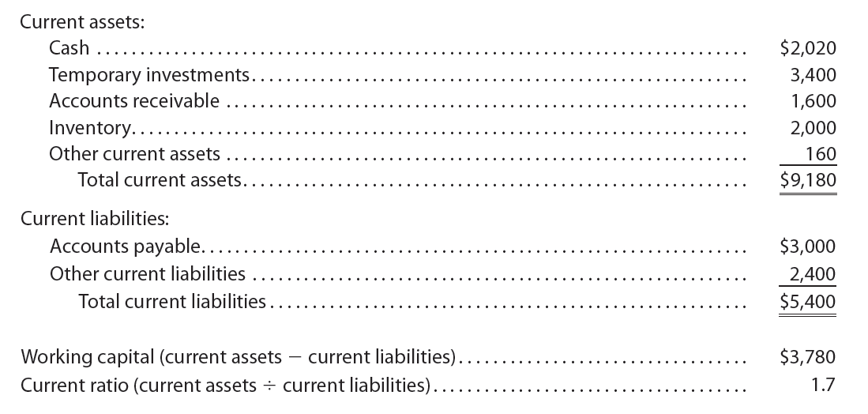
Financial Analysis and Interpretation: Quick Ratio (5 of 6)
Consider the following data for TechSolutions, Inc., at the end of 20Y7:

Slide 79
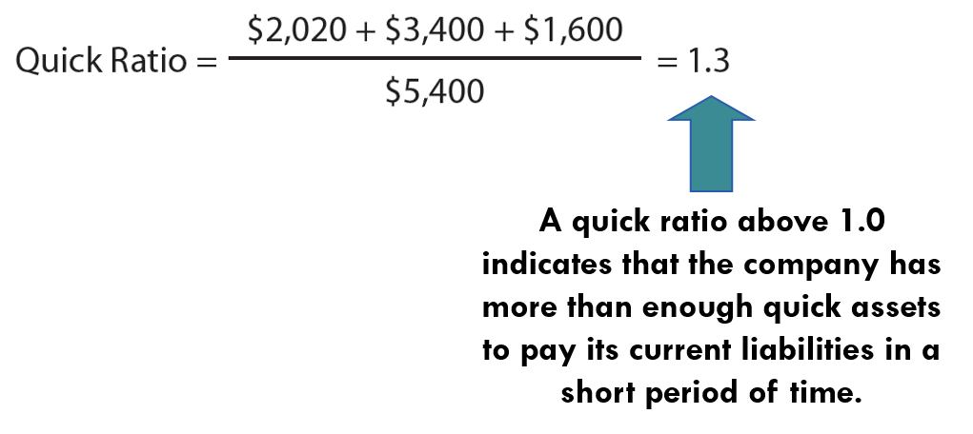
Financial Analysis and Interpretation: Quick Ratio (6 of 6)
The quick ratio for TechSolutions, Inc., is computed as follows:

Slide 80

Example Exercise: Quick Ratio (1 of 2)
Sayer Company reported the following current assets and current liabilities for the years ended December 31, 20Y9 and 20Y8:
  Compute the quick ratio for 20Y9 and 20Y8.
  Interpret the company’s quick ratio across the two time periods.

Slide 81
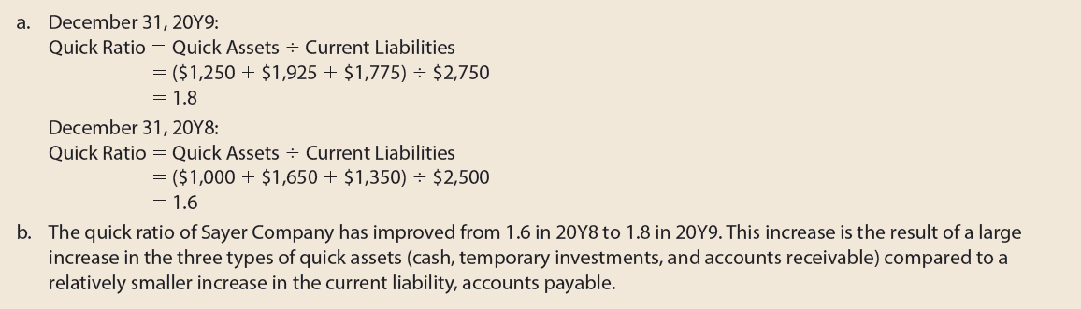
Example Exercise: Quick Ratio (2 of 2)

