Slide 1
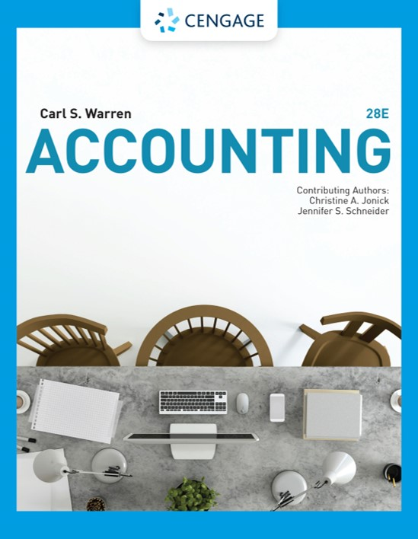
Corporations: Organization, Stock Transactions, and Dividends
Chapter 13

Slide 2
Learning Objectives (1 of 2)
LO1: Describe the nature of the corporate form of organization.
LO2: Describe the two main sources of stockholders’ equity.
LO3: Describe and illustrate the characteristics of stock, classes of stock, and entries for issuing stock.
LO4: Describe and illustrate the accounting for cash dividends and stock dividends.
LO5: Describe the effect of stock splits on corporate financial statements.

Slide 3
Learning Objectives (2 of 2)
LO6: Describe and illustrate the accounting for treasury stock transactions.
LO7: Describe and illustrate the reporting of stockholders’ equity.
LO8: Describe and illustrate the use of earnings per share in evaluating a company’s profitability.

Slide 4
Characteristics of a Corporation (1 of 4)
A corporation is a legal entity, distinct and separate from the individuals who create and operate it.
  As a legal entity, a corporation may acquire, own, and dispose of property in its own name.
  It may also incur liabilities and enter into contracts.
  Most importantly, it can sell shares of ownership, called stock.
    This characteristic gives corporations the ability to raise large amounts of capital.

Slide 5
Characteristics of a Corporation (2 of 4)
The stockholders or shareholders who own the stock own the corporation. They can buy and sell stock without affecting the corporation’s operations or continued existence.
Corporations whose shares of stock are traded in public markets are called public corporations.
Corporations whose shares are not traded publicly are usually owned by a small group of investors and are called nonpublic or private corporations.

Slide 6
Characteristics of a Corporation (3 of 4)
The stockholders of all corporations have limited liability.
  This means that creditors usually may not go beyond the assets of the corporation to satisfy their claims. Thus, the financial loss that a stockholder may suffer is limited to the amount invested.
The stockholders control a corporation by electing a board of directors.
  This board meets periodically to establish corporate policies.
  It also selects the chief executive officer (CEO) and other major officers to manage the corporation’s day-to-day affairs.

Slide 7
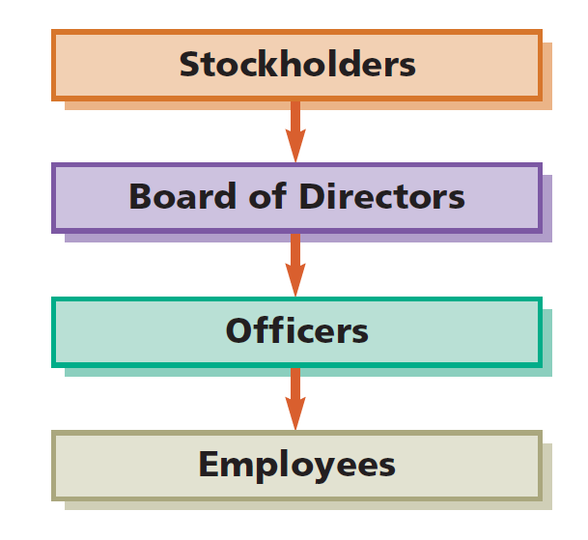
Organizational Structure of a Corporation

Slide 8
Characteristics of a Corporation (4 of 4)
As a separate entity, a corporation is subject to taxes.
  Corporations must pay federal income taxes on their income.
  Stockholders must pay income taxes on the dividends they receive.

Slide 9
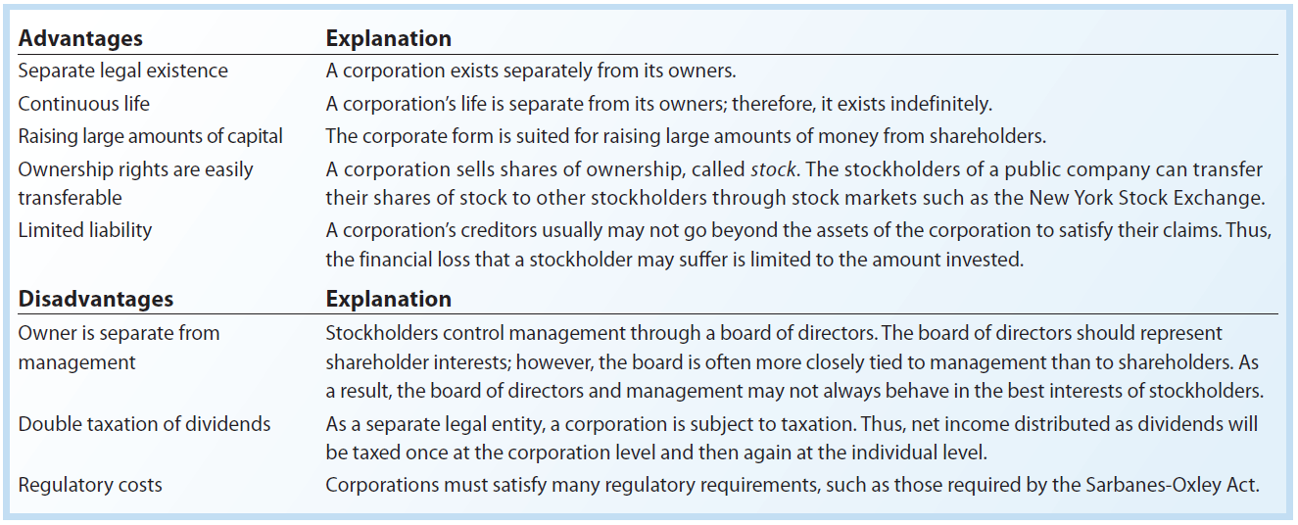
Advantages and Disadvantages of the Corporate Form

Slide 10
Forming a Corporation (1 of 4)
The first step in forming a corporation is to file an application of incorporation with the state.
  State incorporation laws differ, and corporations often organize in those states with the more favorable laws.
    For this reason, more than half of the largest companies are incorporated in Delaware.

Slide 11
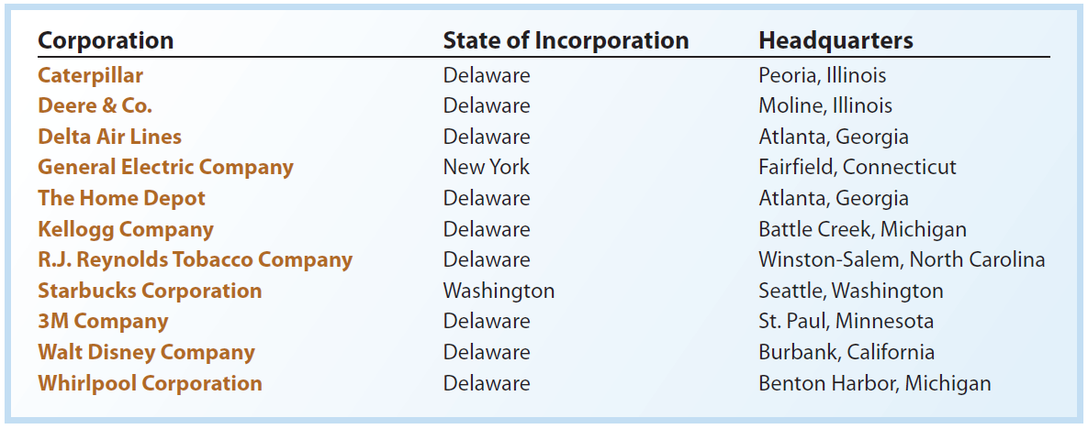
Examples of Corporations and their States of Incorporation

Slide 12
Forming a Corporation (2 of 4)
After the application has been approved, the state grants a charter or articles of incorporation.
  The articles of incorporation formally create the corporation.
The corporate management and board of directors then prepare a set of bylaws, which are the rules and procedures for conducting the corporation’s affairs.

Slide 13
Forming a Corporation (3 of 4)
Costs may be incurred in organizing a corporation. These costs include:
  Legal fees
  Taxes
  State incorporation fees
  License fees
  Promotional costs
Such costs are debited to an expense account entitled Organizational Expenses.

Slide 14
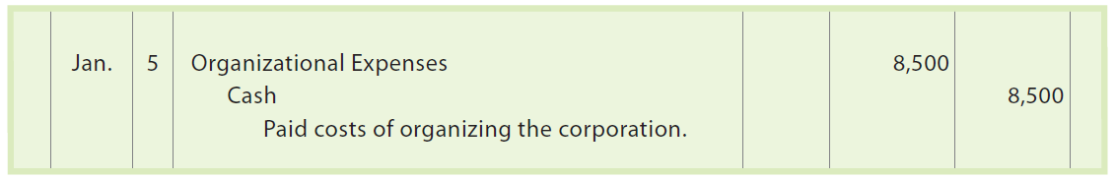
Forming a Corporation (4 of 4)
A corporation’s organizing costs of $8,500 on January 5 are recorded as follows:

Slide 15
Stockholders’ Equity (1 of 4)
The owner’s equity in a corporation is called stockholders’ equity, shareholders’ equity, shareholders’ investment, or capital.
On the balance sheet, stockholders’ equity is reported by its two main sources:
  Capital contributed to the corporation by the stockholders, called paid-in capital or contributed capital.
  Net income retained in the business, called retained earnings.

Slide 16
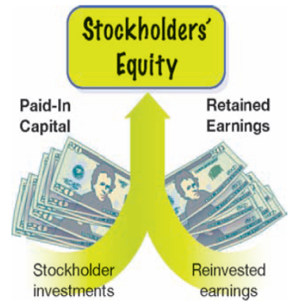
Sources of Stockholders’ Equity

Slide 17
Stockholders’ Equity (2 of 4)
The paid-in capital contributed by the stockholders is recorded in separate accounts for each class of stock.
  If there is only one class of stock, the account is entitled Common Stock or Capital Stock.
Retained earnings is a corporation’s cumulative net income that has not been distributed as dividends.
  Dividends are distributions of a corporation’s earnings to stockholders.

Slide 18
Stockholders’ Equity (3 of 4)
Net income increases retained earnings, while a net loss and dividends decrease retained earnings.
  The net increase or decrease in retained earnings for a period is recorded by the following two closing entries:
    Debit each revenue account for its balance, credit each expense account for its balance, and credit (net income) or debit (net loss) the retained earnings account.
    Debit the retained earnings account for the balance of each dividend account and credit each dividend account.

Slide 19
Stockholders’ Equity (4 of 4)
Retained Earnings normally has a credit balance.
In some cases, a debit balance in Retained Earnings may occur.
  A debit balance in Retained Earnings is called a deficit.
  Such a balance results from accumulated net losses.
  In the Stockholders’ Equity section, a deficit is deducted from paid-in capital in determining total stockholders’ equity.
Because Retained Earnings is unaffected by the investments, its balance does not represent cash or cash available for dividends.

Slide 20
Characteristics of Stock (1 of 3)
The number of shares of stock that a corporation is authorized to issue is stated in its charter.
The term issued refers to the shares sold to the stockholders.
  A corporation may reacquire some of the stock that it has issued.
The stock remaining in the hands of stockholders is then called outstanding stock.

Slide 21
Authorized, Issued, and Outstanding Stock

Slide 22
Characteristics of Stock (2 of 3)
Corporations may issue stock certificates to stockholders to document their ownership
  The stock certificate may also indicate a dollar amount assigned to each share of stock, called par value.
Stock may be issued without par, in which case it is called no-par stock
  In some states, the board of directors of a corporation is required to assign a stated value to no-par stock
Some states require corporations to maintain a minimum amount of paid-in capital to protect creditors.
  This minimum amount, called legal capital, usually includes the par or stated value of the shares issued.

Slide 23

Characteristics of Stock (3 of 3)
Major rights that accompany ownership of a share of stock
Right to vote in matters concerning the corporation
Right to share in distributions of earnings
Right to share in assets upon liquidation

Slide 24
Classes of Stock (1 of 5)
The two primary classes of paid-in capital are common stock and preferred stock.
  When only one class of stock is issued, it is called common stock. Each share of common stock has equal rights.
  When a corporation issues one or more classes of stock with various preference rights, such as a preference to dividends, such a stock is called preferred stock.
    The dividend rights of preferred stock are stated either as dollars per share (e.g., preferred $4 stock, $50 par) or as a percent of par (e.g., preferred 8% stock, $50 par).

Slide 25
Classes of Stock (2 of 5)
Preferred stockholders have first rights (preference) to any dividends; thus, they have a greater chance of receiving dividends than common stockholders.
  However, since dividends are normally based on earnings, a corporation cannot guarantee dividends even to preferred stockholders.

Slide 26
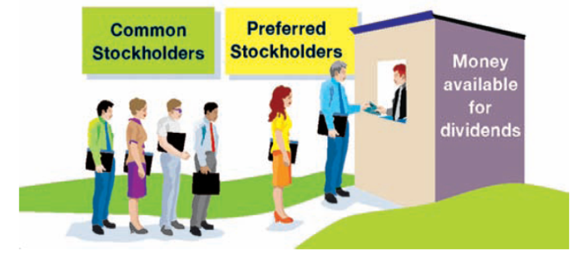
Dividend Preferences

Slide 27
Classes of Stock (3 of 5)
The payment of dividends is authorized by the corporation’s board of directors. When authorized, the directors are said to have declared a dividend.
Cumulative preferred stock has a right to receive regular dividends that were not declared (paid) in prior years.
  Noncumulative preferred stock does not have this right.
  Cumulative preferred stock dividends that have not been paid in prior years are said to be in arrears.
    Any preferred dividends in arrears must be paid before any common stock dividends are paid.
    Any dividends in arrears are normally disclosed in notes to the financial statements

Slide 28
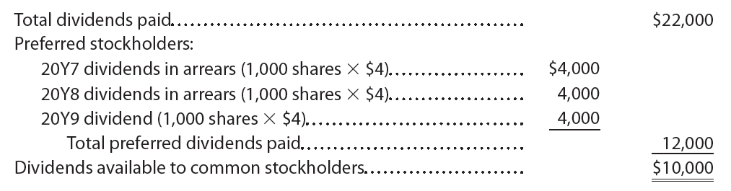
Classes of Stock (4 of 5)
Assume that a corporation has issued 1,000 shares of cumulative preferred $4 stock, $50 par, and 4,000 shares of common stock, $15 par. The corporation was organized on January 1, 20Y7, and paid no dividends in 20Y7 and 20Y8. In 20Y9, the corporation paid $22,000 in dividends, of which $12,000 was paid to preferred stockholders and $10,000 was paid to common stockholders, computed as follows:

Slide 29
Classes of Stock (5 of 5)
As a result, preferred stockholders received $12.00 per share ($12,000 ÷ 1,000 shares) in dividends, while common stockholders received $2.50 per share ($10,000 ÷ 4,000 shares).
In addition to dividend preference, preferred stock may be given preferences to assets if the corporation goes out of business and is liquidated. However, claims of creditors must be satisfied first.

Slide 30
Example Exercise: Dividend per Share (1 of 2)
Sandpiper Company has 20,000 shares of cumulative preferred 1% stock of $100 par and 100,000 shares of $50 par common stock. The following amounts were distributed as dividends:
  Year 1 $10,000
  Year 2 45,000
  Year 3 80,000
Determine the dividends per share for preferred and common stock for each year.

Slide 31
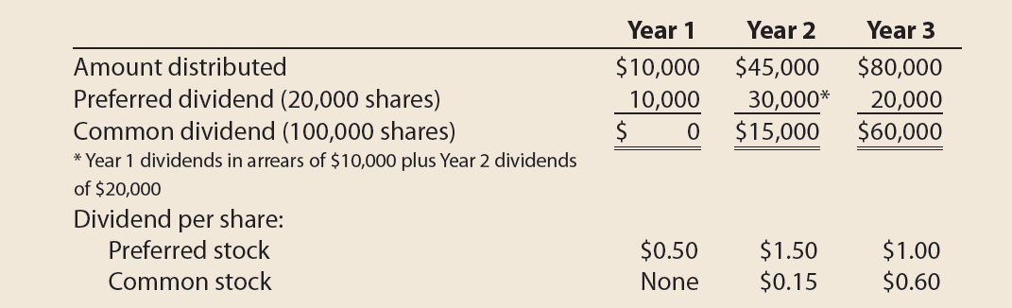
Example Exercise: Dividend per Share (2 of 2)

Slide 32
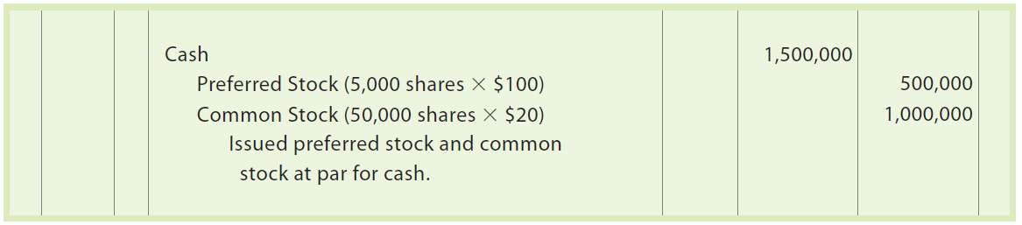
Issuing Stock (1 of 3)
A separate account is used for recording the amount of each class of stock issued to investors in a corporation.
Assume that a corporation is authorized to issue 10,000 shares of $100 preferred stock and 100,000 shares of $20 par common stock. The corporation issued 5,000 shares of preferred stock and 50,000 shares of common stock at par for cash. The corporation’s entry to record the stock issue is as follows:

Slide 33
Issuing Stock (2 of 3)
Stock is often issued by a corporation at a price other than its par. The price at which stock is sold depends on a variety of factors, such as the following:
  The financial condition, earnings record, and dividend record of the corporation
  Investor expectations of the corporation’s potential earning power
  General business and economic conditions and expectations

Slide 34
Issuing Stock (3 of 3)
Premium
If the stock is issued (sold) for a price that is more than its par, the stock has been sold at a premium
Discount
If the stock is issued (sold) for a price that is less than its par, the stock has been sold at a discount

Slide 35
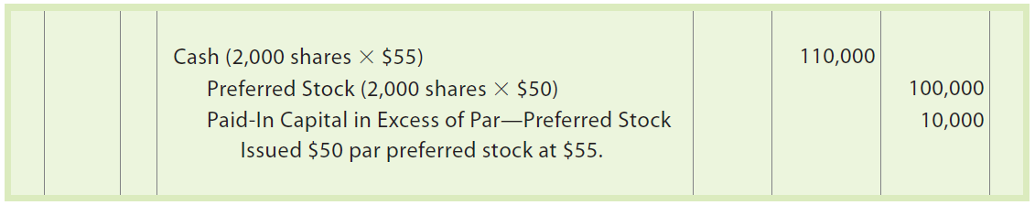
Premium on Stock (1 of 3)
When stock is issued at a premium, Cash is debited for the amount received. Common Stock or Preferred Stock is credited for the par amount. An account entitled Paid-In Capital in Excess of Par is credited for the excess of the amount paid over par.
Assume that Caldwell Company issues 2,000 shares of $50 par preferred stock for cash at $55. The entry to record this transaction is as follows:

Slide 36
Premium on Stock (2 of 3)
When stock is issued in exchange for assets other than cash, such as land, buildings, and equipment, the assets acquired are recorded at their fair market value.
  If this value cannot be determined, the fair market value of the stock issued is used.

Slide 37
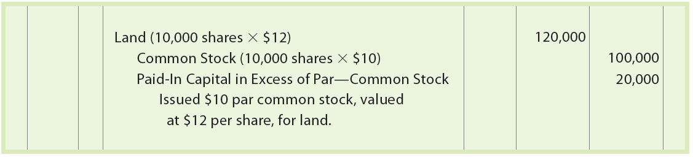
Premium on Stock (3 of 3)
Assume that a corporation acquired land with a fair market value that cannot be determined. In exchange, the corporation issued 10,000 shares of its $10 par common stock. If the stock has a market price of $12 per share, the transaction is recorded as follows:

Slide 38
No-Par Stock (1 of 4)
When no-par stock is issued, Cash is debited and Common Stock is credited for the proceeds.
  As no-par stock is issued over time, this entry is the same even if the issuing price varies.

Slide 39
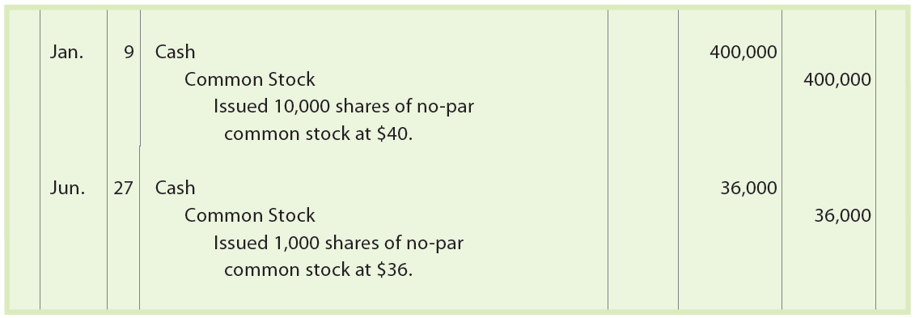
No-Par Stock (2 of 4)
Assume that on January 9, a corporation issues 10,000 shares of no-par common stock at $40 a share. On June 27, the corporation issues an additional 1,000 shares at $36. The entries to record these issuances of the no-par stock are as follows:

Slide 40
No-Par Stock (3 of 4)
In some states, no-par stock may be assigned a stated value per share.
  The stated value is recorded like a par value. Any excess of the proceeds over the stated value is credited to Paid-In Capital in Excess of Stated Value.

Slide 41
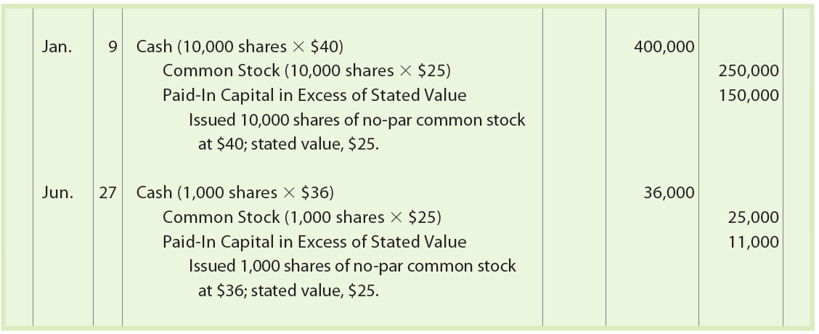
No-Par Stock (4 of 4)
Assume that on January 9, a corporation issues 10,000 shares of no-par common stock at $40 a share. On June 27, the corporation issues an additional 1,000 shares at $36. The no-par common stock is assigned a stated value of $25. The issuance of the stock on January 9 and June 27 is recorded as follows:

Slide 42
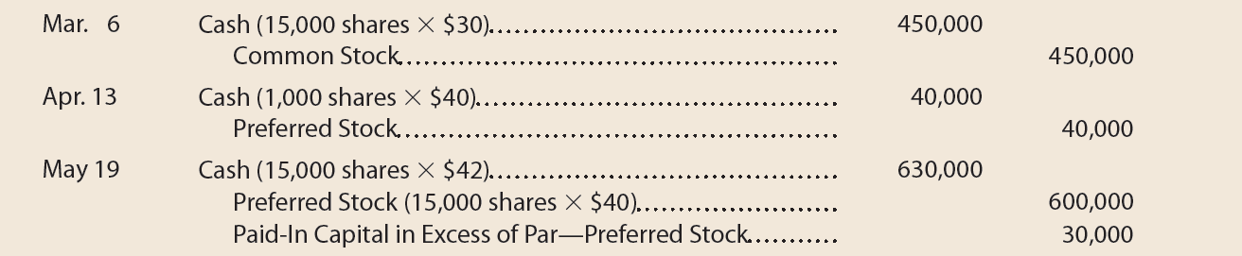
Example Exercise: Entries for Issuing Stock
On March 6, Limerick Corporation issued for cash 15,000 shares of no-par common stock at $30. On April 13, Limerick issued at par 1,000 shares of preferred 4% stock, $40 par for cash. On May 19, Limerick issued for cash 15,000 shares of 4%, $40 par preferred stock at $42.
Journalize the entries to record the March 6, April 13, and May 19 transactions.

Slide 43
Cash Dividends (1 of 6)
A cash distribution of earnings by a corporation to its stockholders is a cash dividend.
Although dividends may be paid in other assets, cash dividends are most common.
Three conditions for a cash dividend are as follows:
  Sufficient retained earnings
  Sufficient cash
  Formal action by the board of directors

Slide 44
Cash Dividends (2 of 6)
There must be a sufficient (large enough) balance in Retained Earnings to declare a cash dividend. That is, the balance of Retained Earnings must be large enough so that the dividend does not create a debit balance in the retained earnings account.
  However, because the balances of Cash and Retained Earnings are often unrelated, a large Retained Earnings balance does not mean that there is cash available to pay dividends.

Slide 45
Cash Dividends (3 of 6)
Three dates included in a dividend announcement
1. Date of declaration
Date the board of directors formally authorizes the payment of the dividend
2. Date of record
Date the corporation uses to determine which stockholders will receive the dividend
3. Date of payment
Date the corporation will pay the dividend to the stockholders who owned the stock on the date of record

Slide 46
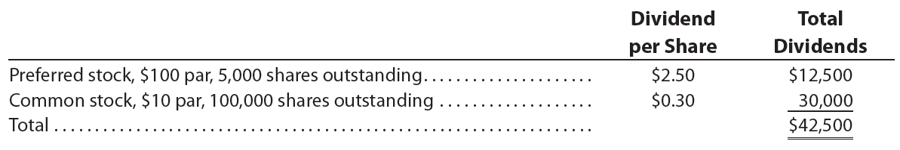
Cash Dividends (4 of 6)
Assume that on October 1, Hiber Corporation declares the following cash dividends with a date of record of November 10 and a date of payment of December 2:

Slide 47
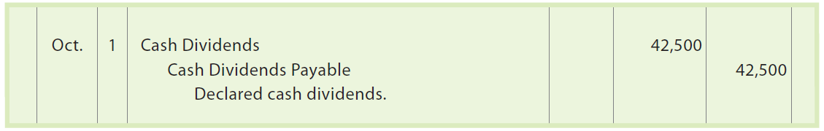
Cash Dividends (5 of 6)
On October 1, the declaration date, Hiber Corporation records the following entry:

Slide 48
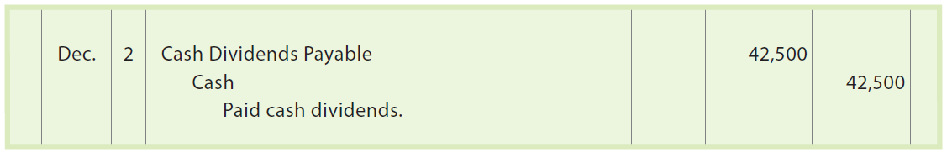
Cash Dividends (6 of 6)
On November 10, the date of record, no entry is necessary as this date merely determines which stockholders will receive the dividends.
On December 2, the date of payment, Hiber Corporation records the payment of the dividends as follows:

Slide 49
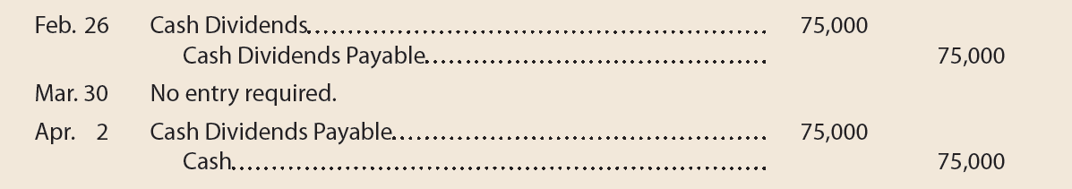
Example Exercise: Entries for Cash Dividends
The important dates in connection with a cash dividend of $75,000 on a corporation’s common stock are February 26, March 30, and April 2. Journalize the entries required on each date.

Slide 50
Stock Dividends (1 of 7)
A stock dividend is a distribution of shares of stock to stockholders.
Stock dividends normally are declared only on common stock and issued to common stockholders.
A stock dividend affects only stockholders’ equity.
  Specifically, the amount of the stock dividend is transferred from Retained Earnings to Paid-In Capital.
    The amount transferred is normally the fair value (market price) of the shares issued in the stock dividend.

Slide 51
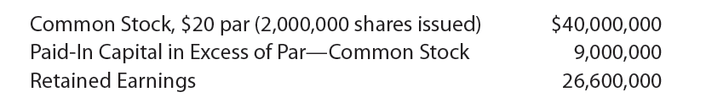
Stock Dividends (2 of 7)
Assume that the stockholders’ equity accounts of Hendrix Corporation as of December 15 are as follows:

Slide 52
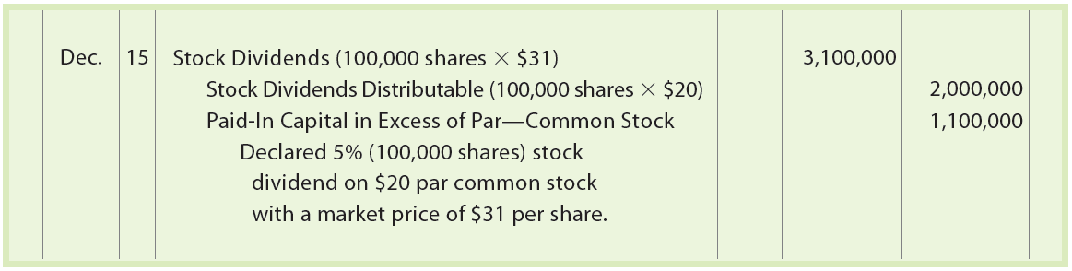
Stock Dividends (3 of 7)
On December 15, Hendrix Corporation declares a stock dividend of 5% or 100,000 shares (2,000,000 shares × 5%) to be issued on January 10 to stockholders of record on December 31. The market price of the stock on December 15 (the date of declaration) is $31 per share.
  The entry to record the stock dividend is as follows:

Slide 53
Stock Dividends (4 of 7)
After the entry is recorded, Stock Dividends will have a debit balance of $3,100,000
  The stock dividends account is closed to Retained Earnings at the end of the accounting period.
    This closing entry debits Retained Earnings and credits Stock Dividends.
The stock dividends distributable and paid-in capital in excess of par—common stock accounts are reported in the Paid-In Capital section of the balance sheet.
    The effect of the preceding stock dividend is to transfer $3,100,000 of retained earnings to paid-in capital.

Slide 54
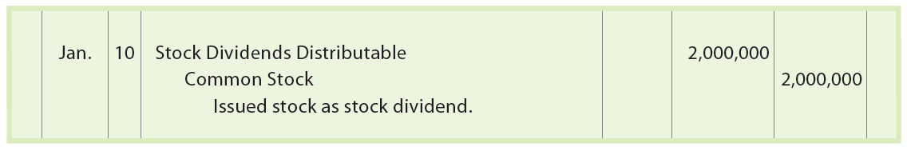
Stock Dividends (5 of 7)
On January 10, the stock dividend is distributed to stockholders by issuing 100,000 shares of common stock. The issuance of the stock is recorded by the following entry:

Slide 55
Stock Dividends (6 of 7)
A stock dividend does not change the assets, liabilities, or total stockholders’ equity of a corporation.
Likewise, it does not change an individual stockholder’s proportionate interest (equity) in the corporation.

Slide 56
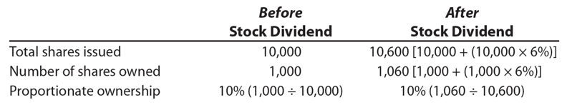
Stock Dividends (7 of 7)
Assume a stockholder owns 1,000 of a corporation’s 10,000 shares outstanding. If the corporation declares a 6% stock dividend, the stockholder’s proportionate interest will not change, computed as follows:

Slide 57
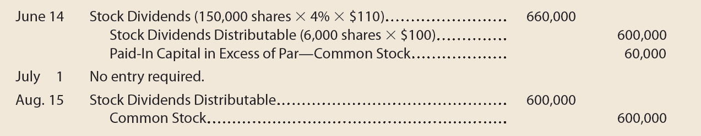
Example Exercise: Entries for Stock Dividends
Vienna Highlights Corporation has 150,000 shares of $100 par common stock outstanding. On June 14, Vienna Highlights declared a 4% stock dividend to be issued August 15 to stockholders of record on July 1. The market price of the stock was $110 per share on June 14.
Journalize the entries required on June 14, July 1, and August 15.

Slide 58
Stock Splits (1 of 3)
A stock split is a process by which a corporation reduces the par or stated value of its common stock and issues a proportionate number of additional shares.
  A stock split applies to all common shares including the unissued, issued, and treasury shares.
A major objective of a stock split is to reduce the market price per share of the stock.
  This attracts more investors and broadens the types and numbers of stockholders.

Slide 59
Stock Splits (2 of 3)
Assume that Rojek Corporation has 10,000 shares of $100 par common stock outstanding with a current market price of $150 per share. The board of directors declares the following stock split:
  Each common shareholder will receive 5 shares for each share held. This is called a 5-for-1 stock split. As a result, 50,000 shares (10,000 shares × 5) will be outstanding.
  The par of each share of common stock will be reduced to $20 ($100 ÷ 5).

Slide 60
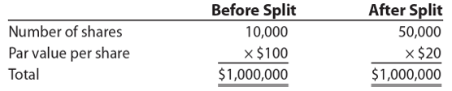
Stock Splits (3 of 3)
The par value of the common stock outstanding is $1,000,000 before and after the stock split, computed as follows:
In addition, each Rojek Corporation shareholder owns the same total par amount before and after the stock split.
  Only the number of shares and the par value per share have changed.
Stock splits do not require a journal entry because only the par (or stated) value and number of shares outstanding have changed
  Details are normally disclosed in the notes to the financial statements

Slide 61
Stock Split: Before and After

Slide 62
Treasury Stock Transactions (1 of 8)
Treasury stock is stock that a corporation has issued and then reacquired.
  A corporation may reacquire (purchase) its own stock for a variety of reasons, including the following:
    To provide shares for resale to employees
    To reissue as bonuses to employees
    To support the market price of the stock

Slide 63
Treasury Stock Transactions (2 of 8)
The cost method is normally used for recording the purchase and resale of treasury stock.
Using the cost method, Treasury Stock is debited for the cost (purchase price) of the stock. When the stock is resold, Treasury Stock is credited for its cost. Any difference between the cost and the selling price is debited or credited to Paid-In Capital from Sale of Treasury Stock.

Slide 64
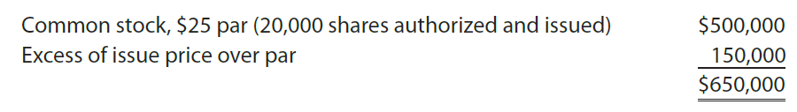
Treasury Stock Transactions (3 of 8)
Assume that a corporation has the following paid-in capital on January 1

Slide 65
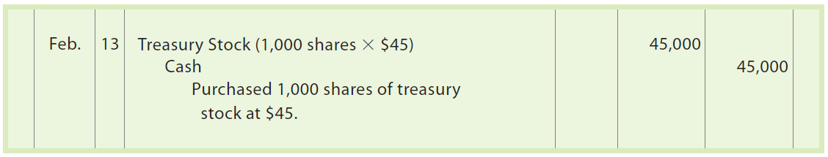
Treasury Stock Transactions (4 of 8)
On February 13, the corporation purchases 1,000 shares of its common stock at $45 per share. The entry to record the purchase of the treasury stock is as follows:

Slide 66
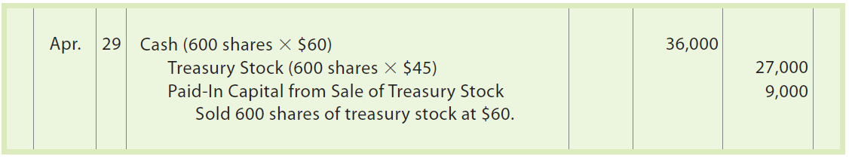
Treasury Stock Transactions (5 of 8)
On April 29, the corporation sells 600 shares of the treasury stock for $60. The entry to record the sale is as follows:

Slide 67
Treasury Stock Transactions (6 of 8)
A sale of treasury stock may result in a decrease in paid-in capital.
  To the extent that Paid-In Capital from Sale of Treasury Stock has a credit balance, it is debited for any such decrease.
  Any remaining decrease is then debited to the retained earnings account.

Slide 68
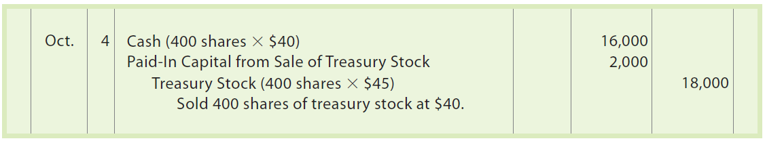
Treasury Stock Transactions (7 of 8)
Assume that on October 4, the corporation sells the remaining 400 shares of treasury stock for $40 per share. The entry to record the sale is as follows:
The preceding October 4 entry decreases paid-in capital by $2,000. Because Paid-In Capital from Sale of Treasury Stock has a credit balance of $9,000, the entire $2,000 was debited to Paid-In Capital from Sale of Treasury Stock.

Slide 69
Treasury Stock Transactions (8 of 8)
No dividends (cash or stock) are paid on the shares of treasury stock.
  To do so would result in the corporation earning dividend revenue from itself.

Slide 70
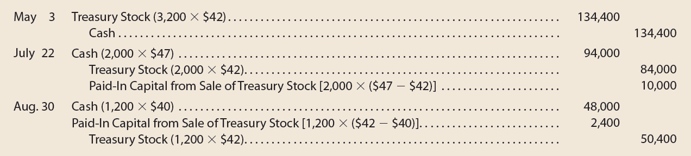
Example Exercise: Entries for Treasury Stock
On May 3, Buzz Off Corporation reacquired 3,200 shares of its common stock at $42 per share. On July 22, Buzz Off sold 2,000 of the reacquired shares at $47 per share. On August 30, Buzz Off sold the remaining shares at $40 per share.
Journalize the transactions of May 3, July 22, and August 30.

Slide 71
Stockholders’ Equity on the Balance Sheet
Two methods can be used for reporting stockholders’ equity on the balance sheet:
  Method 1. Each class of stock is reported, followed by its related paid-in capital accounts. Retained earnings is then reported, followed by a deduction for treasury stock.
  Method 2. The stock accounts are reported, followed by the paid-in capital reported as a single item, Additional paid-in capital. Retained earnings is then reported followed by a deduction for treasury stock.

Slide 72
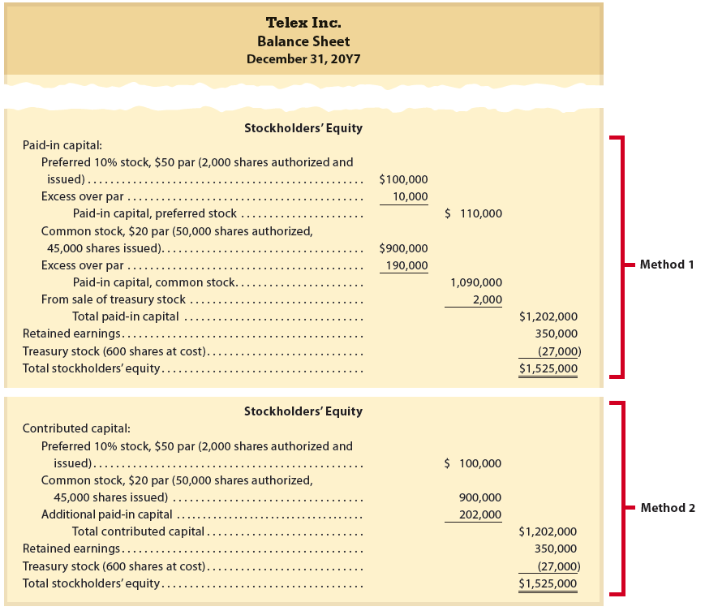
Stockholders’ Equity Section of a Balance Sheet

Slide 73
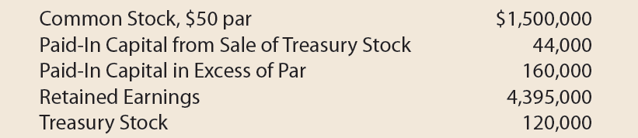
Example Exercise: Reporting Stockholders’ Equity (1 of 2)
Using the following accounts and balances, prepare the Stockholders’ Equity section of the balance sheet using Method 1 of Exhibit 8. Forty thousand shares of common stock are authorized, and 5,000 shares have been reacquired.

Slide 74
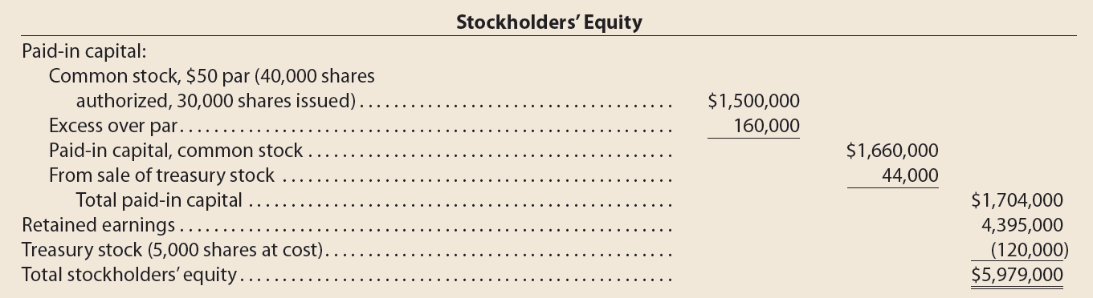
Example Exercise: Reporting Stockholders’ Equity (2 of 2)

Slide 75
Reporting Retained Earnings (1 of 2)
Changes in retained earnings may be reported using one of the following:
Separate retained earnings statement
Combined income and retained earnings statement
Statement of stockholders’ equity

Slide 76
Reporting Retained Earnings (2 of 2)
When a separate retained earnings statement is prepared, the beginning balance of retained earnings is reported.
  The net income is then added (or net loss is subtracted) and any dividends are subtracted to arrive at the ending retained earnings for the period.

Slide 77
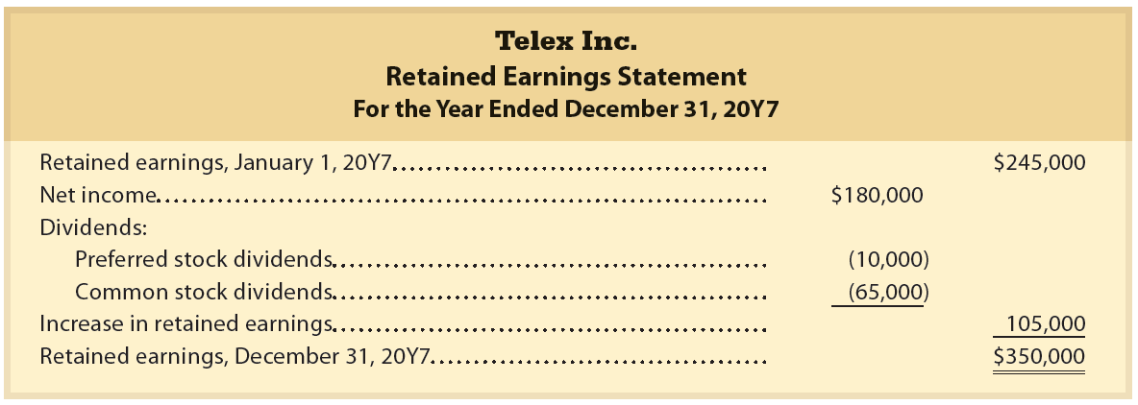
Retained Earnings Statement

Slide 78

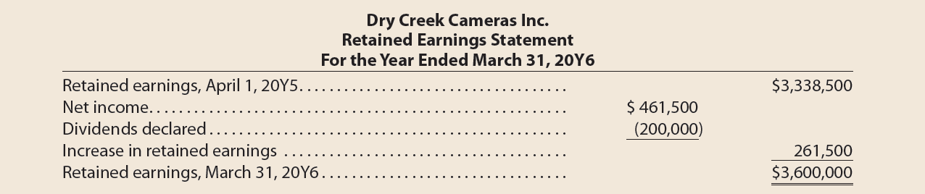
Example Exercise: Retained Earnings Statement
Dry Creek Cameras Inc. reported the following results for the year ending March 31, 20Y6:
Prepare a retained earnings statement for the fiscal year ended March 31, 20Y6.

Slide 79
Restrictions (1 of 2)
The use of retained earnings for payment of dividends may be restricted by action of a corporation’s board of directors.
Such restrictions, sometimes called appropriations, remain part of the retained earnings.
  These restrictions are usually disclosed in the notes to the financial statements.

Slide 80
Restrictions (2 of 2)
Restrictions of retained earnings are classified as follows:
Legal
Contractual
Discretionary
  State laws may require a restriction of retained earnings
  Example: States may restrict retained earnings by the amount of treasury stock purchased. In this way, legal capital cannot be used for dividends.
Corporation may enter into contracts that require restrictions of retained earnings
Example: A bank loan may restrict retained earnings so that the amount for repaying the loan cannot be used for dividends.
Corporation’s board of directors may restrict retained earnings voluntarily
Example: The board may restrict retained earnings and, thus, limit dividend distributions so that earnings are available for expanding the business.

Slide 81
Prior Period Adjustments
Error may arise from a mathematical mistake or from a mistake in applying accounting principles
  Such errors may not be discovered within the same period in which they occur.
    In such cases, the effect of the error should not affect the current period’s net income.
Instead, the correction of the error, called a prior period adjustment, is reported in the retained earnings statement as an adjustment to the beginning balance of retained earnings.

Slide 82
Statement of Stockholders’ Equity (1 of 2)
When the only change to stockholders’ equity is due to net income or net loss and dividends, a retained earnings statement is sufficient.
However, when a corporation also has changes in stock and paid-in capital accounts, a statement of stockholders’ equity is normally prepared.

Slide 83
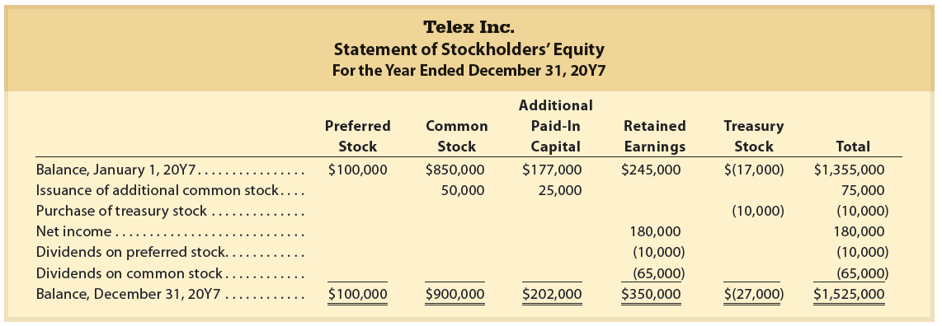
Statement of Stockholders’ Equity (2 of 2)

Slide 84
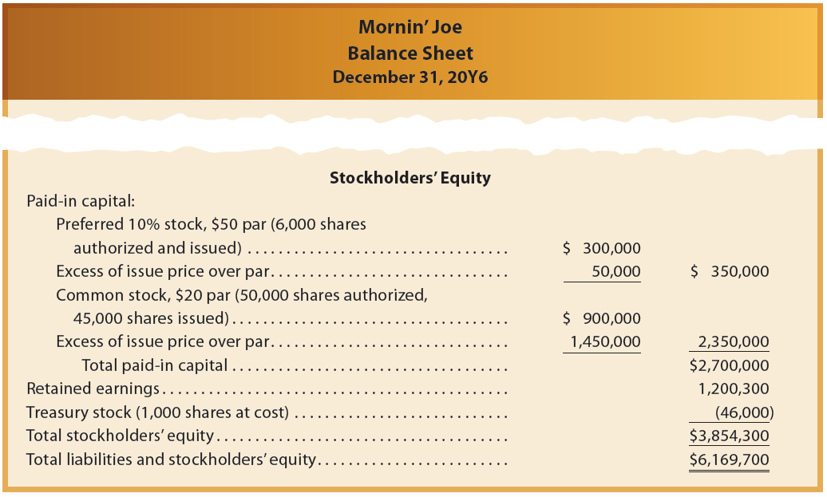
Reporting Stockholders’ Equity for Mornin’ Joe (1 of 3)

Slide 85
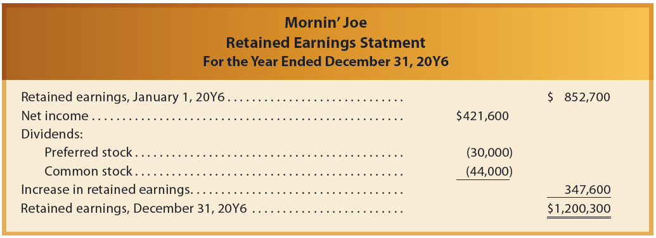
Reporting Stockholders’ Equity for Mornin’ Joe (2 of 3)

Slide 86
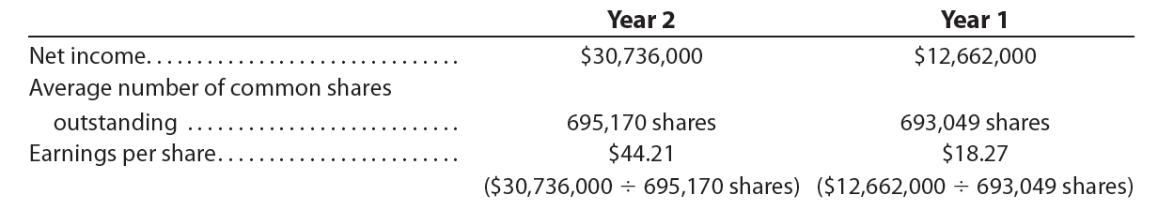
Financial Analysis and Interpretation: Earnings per Share
(2 of 3)
If a company has preferred stock outstanding, any preferred dividends are subtracted from net income.
    This is because the numerator represents only those earnings available to the common shareholders.
Following data (in thousands) were taken from recent financial statements of Alphabet:

Slide 87
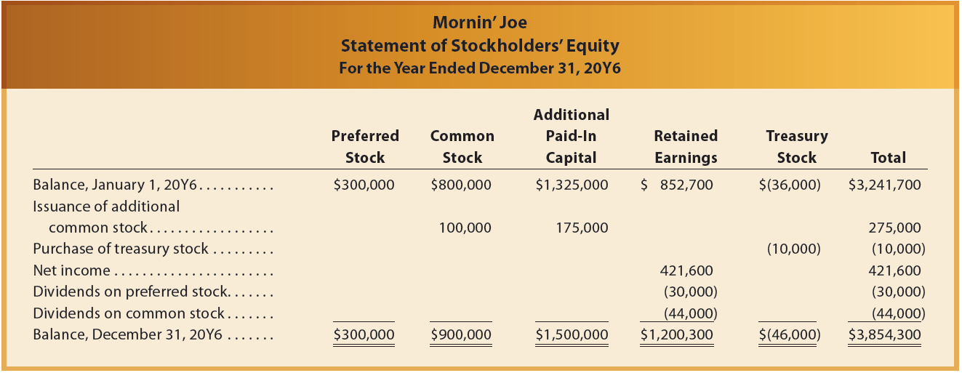
Reporting Stockholders’ Equity for Mornin’ Joe (3 of 3)

Slide 88

Financial Analysis and Interpretation: Earnings per Share
(1 of 3)
Earnings per share (EPS), sometimes called earnings per common share or basic earnings per share, is the net income per share of common stock outstanding during a period.
Corporations whose stock is traded in a public market must report earnings per share on their income statements.
Earnings per share is computed as follows:

Slide 89
Financial Analysis and Interpretation: Earnings per Share
(3 of 3)
Alphabet had no preferred stock outstanding; thus, no preferred dividends were subtracted in computing earnings per share.
  Alphabet’s earnings per share increased from $18.27 in Year 1 to $44.21 in Year 2. An increase in earnings per share is generally considered a favorable change.

Slide 90
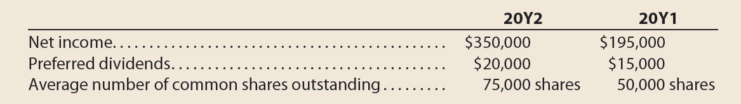
Example Exercise: Earnings per Share (1 of 2)
Financial statement data for years ending December 31 for Finnegan Company follow:
  Determine earnings per share for 20Y2 and 20Y1.
  Does the change in the earnings per share from 20Y1 to 20Y2 indicate a favorable or unfavorable trend?

Slide 91
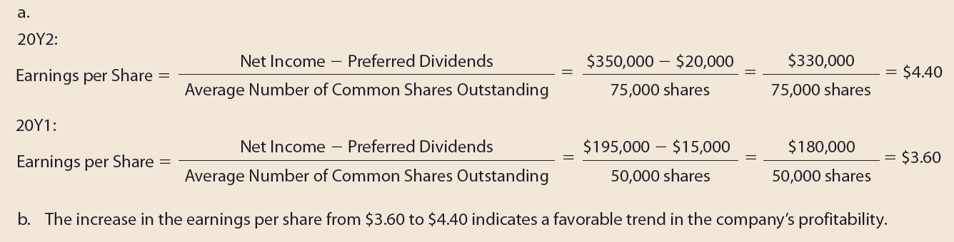
Example Exercise: Earnings per Share (2 of 2)

