Slide 1
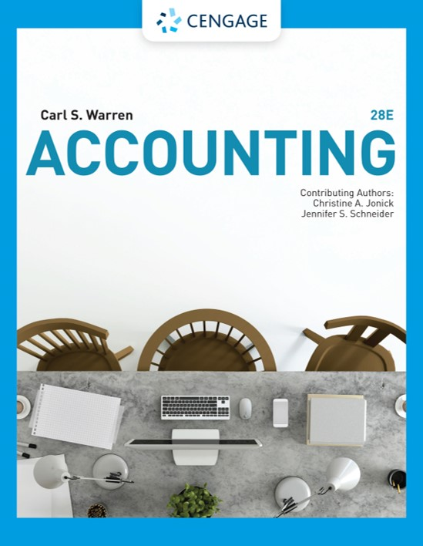
Statement of Cash Flows
Chapter 16

Slide 2
Learning Objectives (1 of 2)
LO1: Describe the cash flow activities reported on the statement of cash flows.
LO2: Prepare the Cash Flows from (used for) Operating Activities section of the statement of cash flows using the indirect method.
LO3: Prepare the Cash Flows from (used for) Investing Activities section of the statement of cash flows.
LO4: Prepare the Cash Flows from (used for) Financing Activities section of the statement of cash flows.

Slide 3
Learning Objectives (2 of 2)
LO5: Prepare a statement of cash flows.
LO6: Describe and illustrate the use of free cash flow in evaluating a company’s cash flow.
App.1: Use a spreadsheet to prepare a statement of cash flows using the indirect method.
App.2: Prepare a statement of cash flows using the direct method.

Slide 4
Reporting Cash Flows (1 of 5)
The statement of cash flows reports a company’s cash inflows and outflows for a period.
Information provided by the statement of cash flows
A company’s ability to do the following:
  Generate cash from operations
  Maintain and expand its operating capacity
  Meet its financial obligations
  Pay dividends

Slide 5
Reporting Cash Flows (2 of 5)
The statement of cash flows is used by managers in evaluating past operations and in planning future investing and financing activities.
It is also used by external users such as investors and creditors to assess a company’s profit potential and ability to pay its debt and pay dividends.

Slide 6
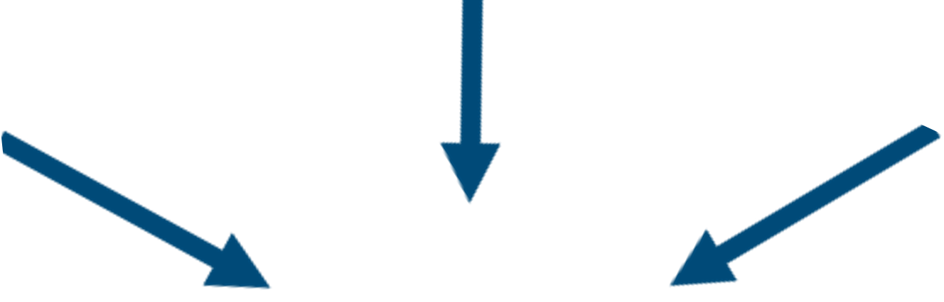
Reporting Cash Flows (3 of 5)
Cash flows from (used for) investing activities
Cash flows received from or used for transactions that affect investments in the noncurrent assets of the company
Cash flows from (used for) operating activities
Cash flows from transactions that affect the net income of a company
Cash flows from (used for) financing activities
Cash flows received from or used for transactions that affect the debt and equity of the company
Statement of cash flows

Slide 7
Reporting Cash Flows (4 of 5)
Cash flows from (used for) investing activities
Example: Purchase and sale of fixed assets, such as equipment and buildings
Cash flows from (used for) operating activities
Example: Purchase and sale of merchandise by a retailer
Cash flows from (used for) financing activities
Example: Issuing or retiring equity and debt securities
Statement of cash flows

Slide 8
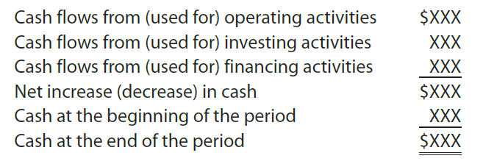
Reporting Cash Flows (5 of 5)
The cash flows are reported in the statement of cash flows as follows:
  The ending cash on the statement of cash flows equals the cash reported on the company’s balance sheet at the end of the year.

Slide 9
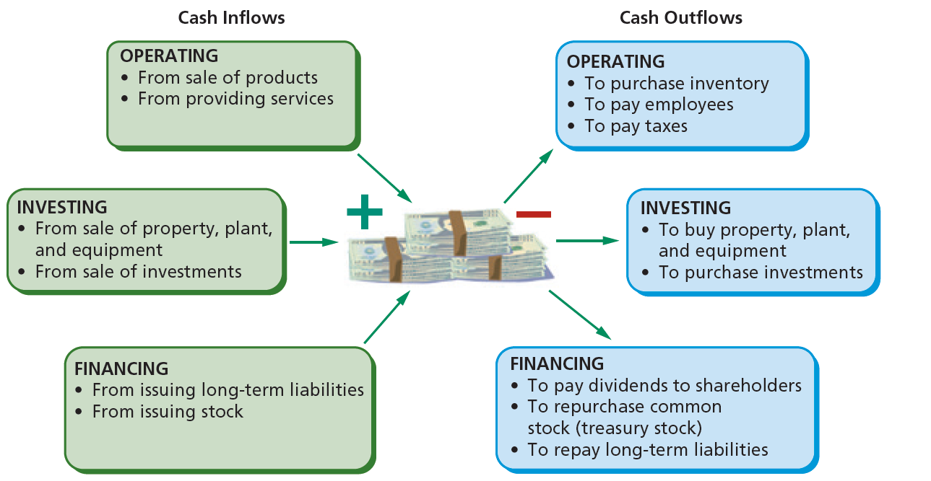
Sources and Uses of Cash

Slide 10
Cash Flows from (used for) Operating Activities
Cash flows from operating activities reports the cash inflows and outflows from a company’s day-to-day operations.
Companies may select one of two alternative methods for reporting cash flows from operating activities in the statement of cash flows:
  The direct method
  The indirect method
Both methods result in the same amount of cash flow from operating activities. They differ in the way they report cash flows from operating activities.

Slide 11
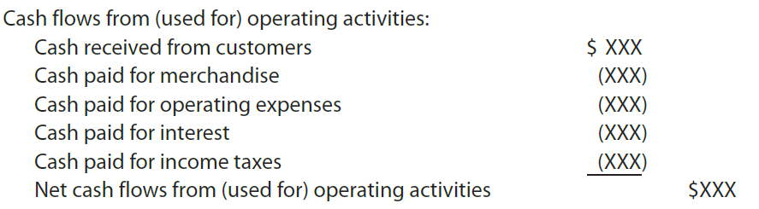
Cash Flows from (used for) Operating Activities: The Direct Method (1 of 2)
The direct method reports operating cash inflows (receipts) and cash outflows (payments) as follows:
    The primary operating cash inflow is cash received from customers.
    The primary operating cash outflows are cash payments for merchandise, operating expenses, interest, and income tax payments.
    The cash received from operating activities less the cash payments for operating activities is the net cash flow from operating activities.

Slide 12
Cash Flows from (used for) Operating Activities: The Direct Method (2 of 2)
Primary advantage
Directly reports cash receipts and cash payments in the statement of cash flows
Primary disadvantage
Normally more costly to prepare as data related to cash receipts and cash payments may not be readily available; used infrequently in practice

Slide 13
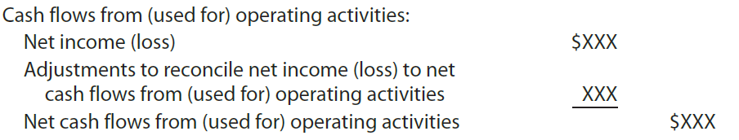
Cash Flows from (used for) Operating Activities: The Indirect Method (1 of 2)
The indirect method reports cash flows from operating activities by beginning with net income (loss) and adjusting it for revenues and expenses that do not involve the receipt of cash or payment of cash, as follows:
    The adjustments to reconcile net income to net cash flow from operating activities include such items as depreciation and gains or losses on fixed assets.
    Changes in current operating assets and liabilities such as accounts receivable or accounts payable are also added or deducted, depending on their effect on cash flows.

Slide 14
Cash Flows from (used for) Operating Activities: The Indirect Method (2 of 2)
Primary advantage
Reconciles the differences between net income and net cash flows from operations
Other advantage
Less costly to prepare than the direct method as data are readily available; most commonly used in practice

Slide 15
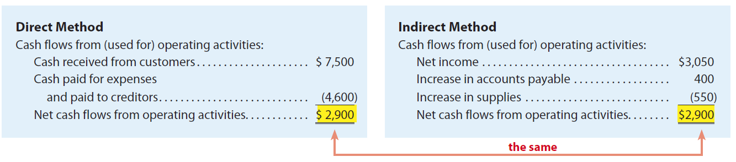
Cash Flow from Operations:
Direct and Indirect Methods—NetSolutions

Slide 16
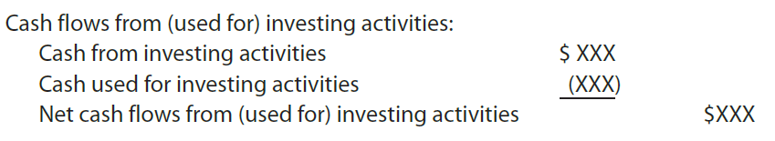
Cash Flows from (used for) Investing Activities
Cash flows from (used for) investing activities show the cash inflows and outflows related to changes in a company’s long-term assets.
Cash flows from (used for) investing activities are reported on the statement of cash flows as follows:
    Cash inflows from investing activities normally arise from selling fixed assets, investments, and intangible assets.
    Cash outflows normally include payments to purchase fixed assets, investments, and intangible assets.

Slide 17
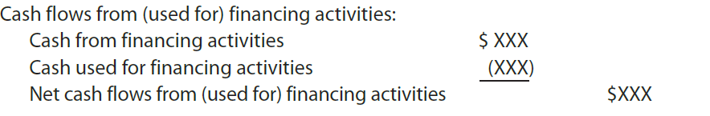
Cash Flows from (used for) Financing Activities (1 of 2)
Cash flows from (used for) financing activities show the cash inflows and outflows related to changes in a company’s long-term liabilities and stockholders’ equity.
Cash flows from (used for) financing activities are reported on the statement of cash flows as follows:

Slide 18
Cash Flows from (used for) Financing Activities (2 of 2)
Cash inflows from financing activities normally arise from issuing long-term debt or equity securities.
  For example, issuing bonds, notes payable, preferred stock, and common stock creates cash inflows from financing activities.
Cash outflows from financing activities normally include paying cash dividends, repaying long-term debt, and acquiring treasury stock.

Slide 19
Noncash Investing and Financing Activities
A company may enter into transactions involving investing and financing activities that do not directly affect cash.
  For example, a company may issue common stock to retire long-term debt.
Because such transactions indirectly affect cash flows, they are reported in a separate section that usually appears at the bottom of the statement of cash flows.

Slide 20
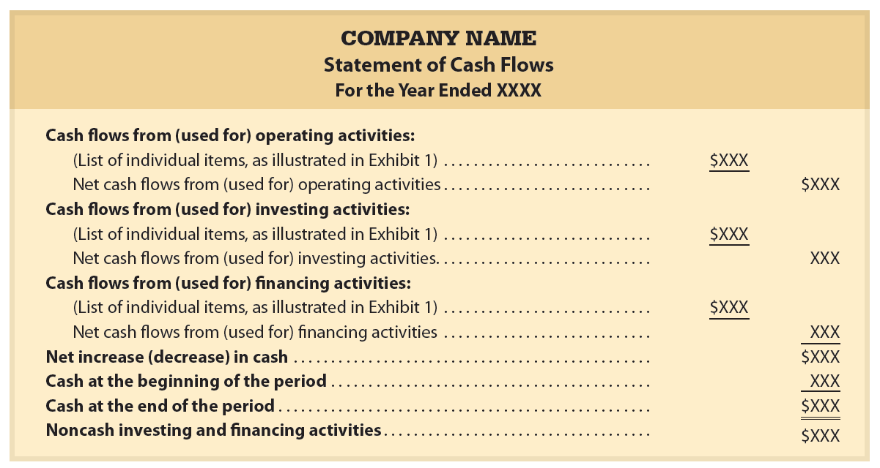
Format of the Statement of Cash Flows

Slide 21
Cash Flow per Share
Sometimes reported in the financial press
  Normally computed as net cash flows from operating activities divided by the number of common shares outstanding
    However, such reporting may be misleading because of the:
      Users may misinterpret cash flow per share as the per-share amount available for dividends
      Users may misinterpret cash flow per share as equivalent to (or better than) earnings per share

Slide 22
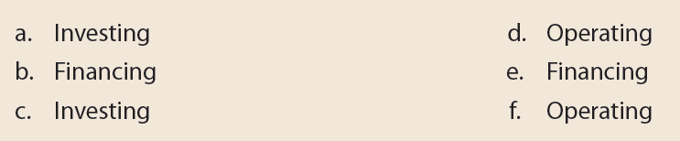
Example Exercise: Classifying Cash Flows
Identify whether each of the following would be reported as an operating, investing, or financing activity in the statement of cash flows:
  Purchase of patent
  Payment of cash dividend
  Disposal of equipment
  Cash sales
  Purchase of treasury stock
  Payment of wages expense

Slide 23
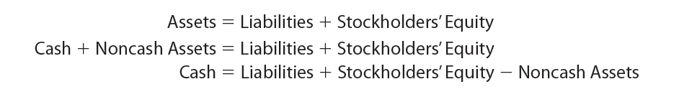
Cash Flows from (used for) Operating Activities Section (1 of 2)
The indirect method of reporting cash flows from operating activities uses the logic that a change in any balance sheet account (including cash) can be analyzed in terms of changes in other balance sheet accounts:
  Thus, any change in the cash account can be determined by analyzing changes in the liability, stockholders’ equity, and noncash asset accounts as follows:

Slide 24
Cash Flows from (used for) Operating Activities Section (2 of 2)
Under the indirect method, there is no order in which the balance sheet accounts must be analyzed.
  However, net income (or net loss) is the first amount reported on the statement of cash flows.
  Because net income (or net loss) is a component of any change in Retained Earnings, the first account normally analyzed is Retained Earnings.

Slide 25
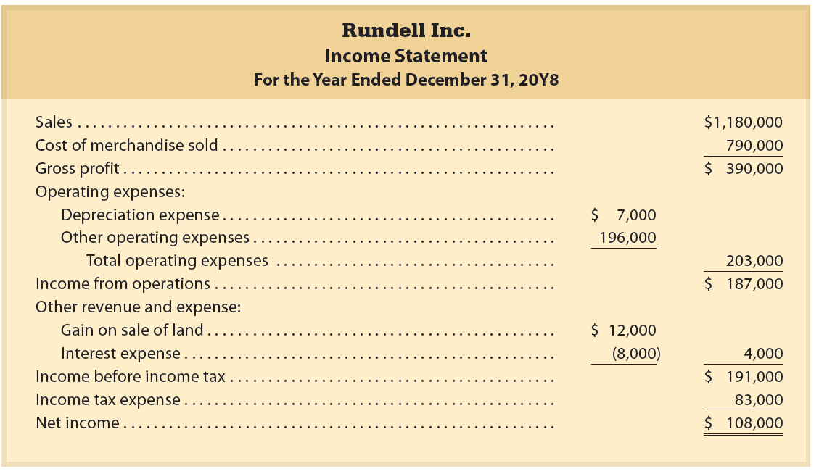
Income Statement and Comparative Balance Sheet (1 of 2)

Slide 26
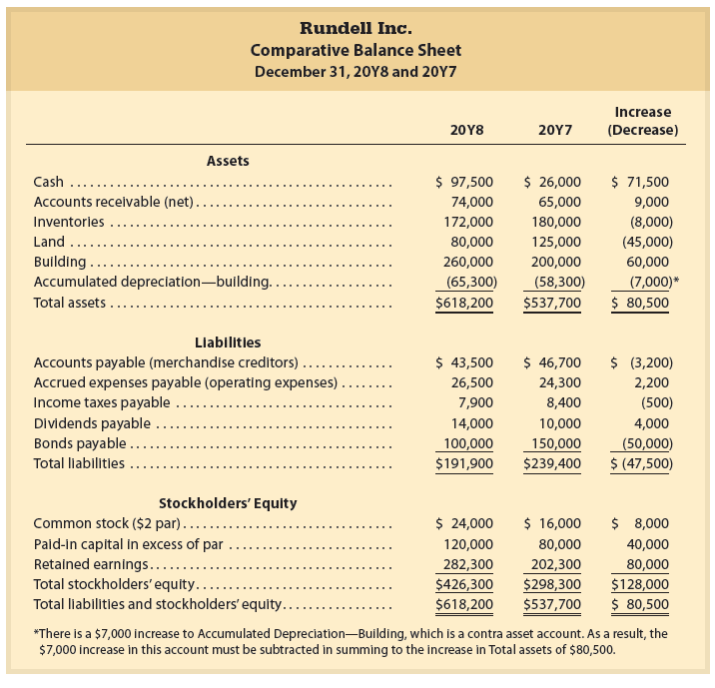
Income Statement and Comparative Balance Sheet (2 of 2)

Slide 27
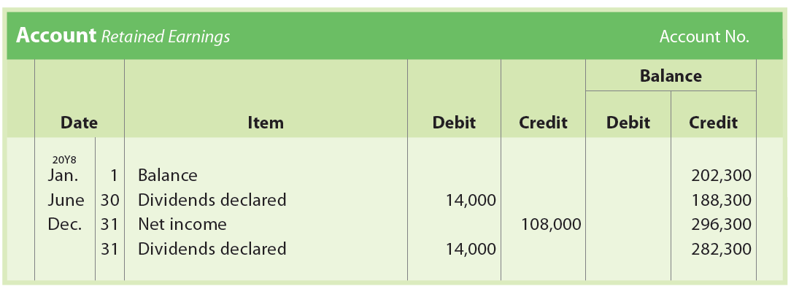
Net Income (1 of 2)
Rundell Inc.’s net income for 20Y8 is $108,000, as shown on the income statement. Since net income is closed to Retained Earnings, net income also helps explain the change in retained earnings during the year. The retained earnings account for Rundell is as follows:

Slide 28
Net Income (2 of 2)
The retained earnings account indicates that the $80,000 ($108,000 – $28,000) change resulted from net income of $108,000 and cash dividends of $28,000.
  The net income of $108,000 is the first amount reported in the Cash flows from operating activities section.
  The impact of the dividends of $28,000 on cash flows will be included as part of financing activities.

Slide 29
Adjustments to Net Income (1 of 9)
The net income of $108,000 reported by Rundell Inc. does not equal the cash flows from operating activities for the period.
  This is because net income is determined using the accrual method of accounting.
    Under the accrual method of accounting, revenues and expenses are recorded at different times from when cash is received or paid.
    Thus, under the indirect method, adjustments to net income must be made to determine cash flows from operating activities.

Slide 30
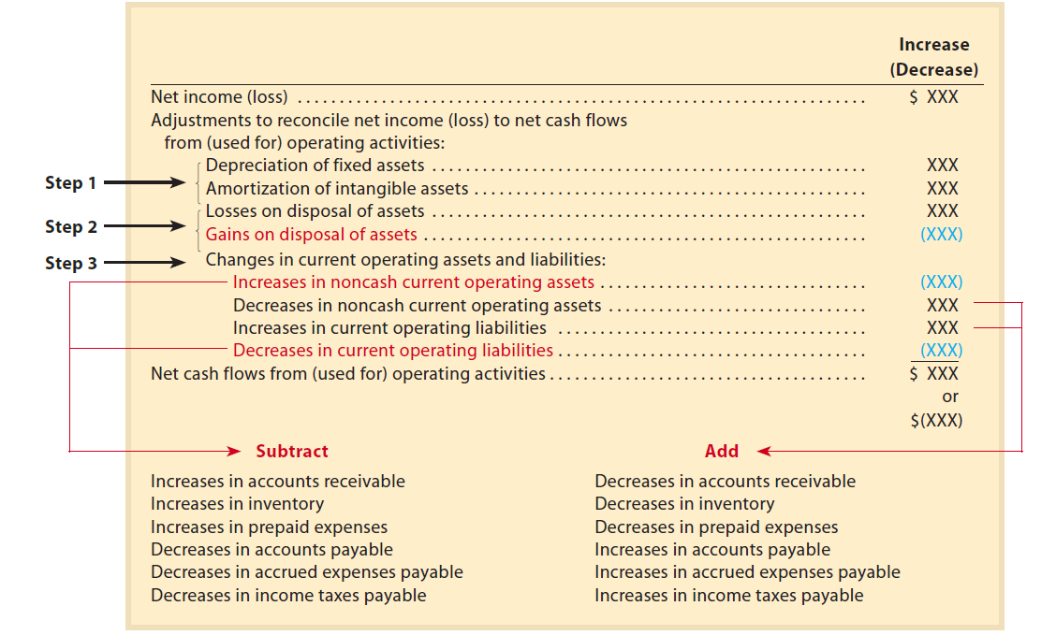
Adjustments to Net Income (Loss)
Using the Indirect Method

Slide 31
Adjustments to Net Income (2 of 9)
Net income is normally adjusted to cash flows from operating activities, using the following steps:
  Step 1. Expenses that do not affect cash are added. Such expenses decrease net income but not involve cash payments and, thus, are added to net income.
  Step 2. Losses on the disposal of assets are added and gains on the disposal of assets are deducted.
  Step 3. Changes in current operating assets and liabilities are added or deducted as follows:
    Increases in noncash current operating assets are deducted.
    Decrease in noncash current operating assets are added.
    Increases in current operating liabilities are added.
    Decreases in current operating liabilities are deducted.

Slide 32
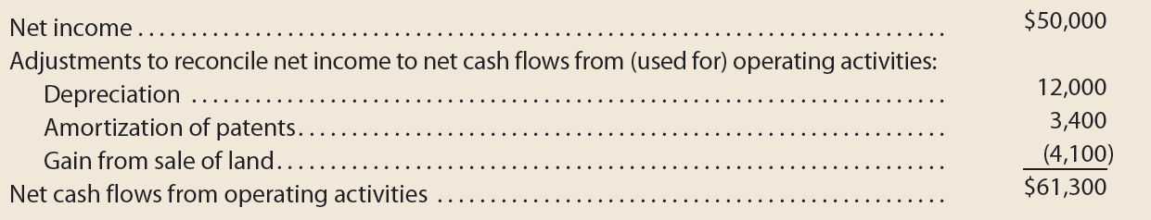
Example Exercise: Adjustments to Net Income
Omni Corporation’s accumulated depreciation increased by $12,000, while $3,400 of patent amortization was recognized between balance sheet dates. There were no purchases or sales of depreciable or intangible assets during the year. In addition, the income statement showed a gain of $4,100 from the sale of land. Reconcile Omni’s net income of $50,000 to net cash flow from operating activities.

Slide 33
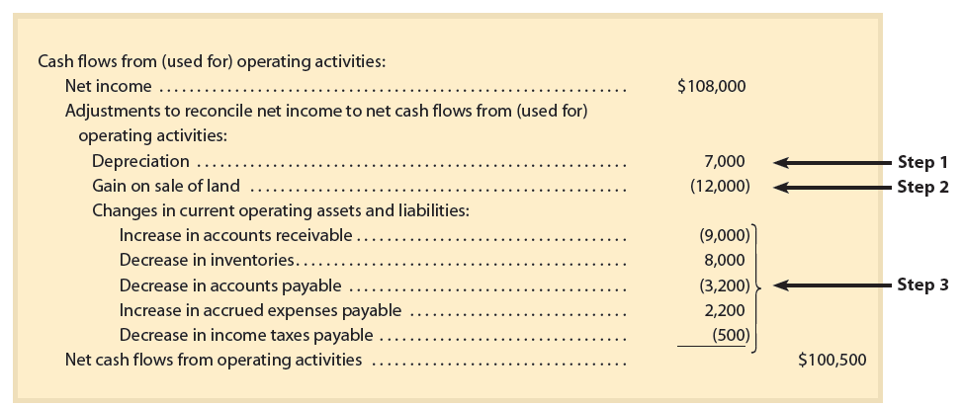
Net Cash Flow From Operating Activities—Indirect Method

Slide 34
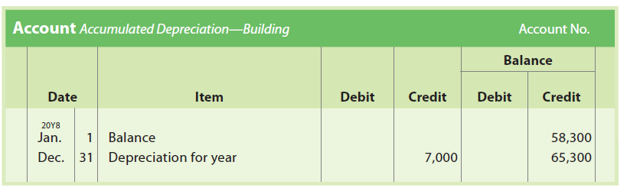
Adjustments to Net Income (3 of 9)
The next few slides will show how Rundell’s net income is converted to cash flows from operating activities of $100,500.
Step 1: Add depreciation of $7,000.
    Analysis: The comparative balance sheet indicates that Accumulated Depreciation—Building increased by $7,000. The following account indicates that depreciation for the year was $7,000 for the building:

Slide 35
Adjustments to Net Income (4 of 9)
Step 2: Deduct the gain on the sale of land of $12,000.
  Analysis: The income statement reports a gain of $12,000 from the sale of land. The proceeds, which include the gain, are reported in the Investing section of the statement of cash flows. Thus, the gain of $12,000 is deducted from net income in determining cash flows from operating activities.

Slide 36
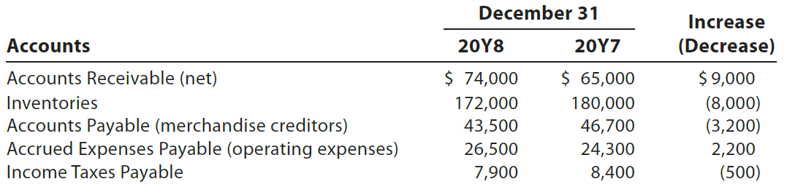
Adjustments to Net Income (5 of 9)
Step 3: Add and deduct changes in current operating assets and liabilities excluding cash.
  Accounts receivable (net): The $9,000 increase is deducted from net income.
    This is because the $9,000 increase in accounts receivable indicates that sales on account were $9,000 more than the cash received from customers.
      Thus, sales (and net income) includes $9,000 that was not received in cash during the year.

Slide 37
Adjustments to Net Income (6 of 9)
Step 3: Add and deduct changes in current operating assets and liabilities excluding cash.
  Inventories: The $8,000 decrease is added to net income.
    This is because the $8,000 decrease in inventories indicates that the cost of merchandise sold exceeds the cost of merchandise purchased during the year by $8,000.
      In other words, the cost of merchandise sold includes $8,000 of goods from inventory that were not purchased (used cash) during the year.

Slide 38
Adjustments to Net Income (7 of 9)
Step 3: Add and deduct changes in current operating assets and liabilities excluding cash.
  Accounts payable (merchandise creditors): The $3,200 decrease is deducted from net income.
    This is because a decrease in accounts payable indicates that the cash payments to merchandise creditors exceed the merchandise purchased on account by $3,200.
      Therefore, the cost of merchandise sold is $3,200 less than the cash paid to merchandise creditors during the year.

Slide 39
Adjustments to Net Income (8 of 9)
Step 3: Add and deduct changes in current operating assets and liabilities excluding cash.
  Accrued expenses payable (operating expenses): The $2,200 increase is added to net income.
    This is because an increase in accrued expenses payable indicates that operating expenses exceed the cash payments for operating expenses by $2,200.
      In other words, operating expenses reported on the income statement include $2,200 that did not require a cash outflow during the year.

Slide 40
Adjustments to Net Income (9 of 9)
Step 3: Add and deduct changes in current operating assets and liabilities excluding cash.
  Income taxes payable: The $500 decrease is deducted from net income.
    This is because a decrease in income taxes payable indicates that taxes paid exceed the amount of taxes incurred during the year by $500.
      In other words, the amount reported on the income statement for income tax expense is less than the amount paid by $500.

Slide 41
Example Exercise: Changes in Current Operating Assets and Liabilities (1 of 2)
Victor Corporation’s current operating assets and liabilities from the company’s comparative balance sheet were as follows:
Adjust Victor’s net income of $70,000 for changes in current operating assets and liabilities to arrive at net cash flow from operating activities.

Slide 42
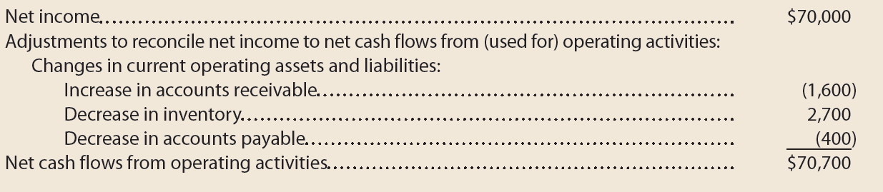
Example Exercise: Changes in Current Operating Assets and Liabilities (2 of 2)

Slide 43
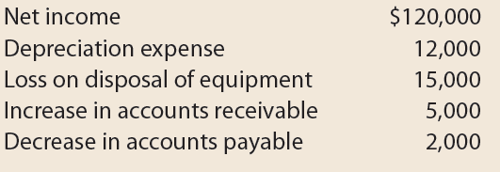
Example Exercise: Determining Cash Flows from (used for)
Operating Activities (1 of 2)
Omicron Inc. reported the following data:

Slide 44
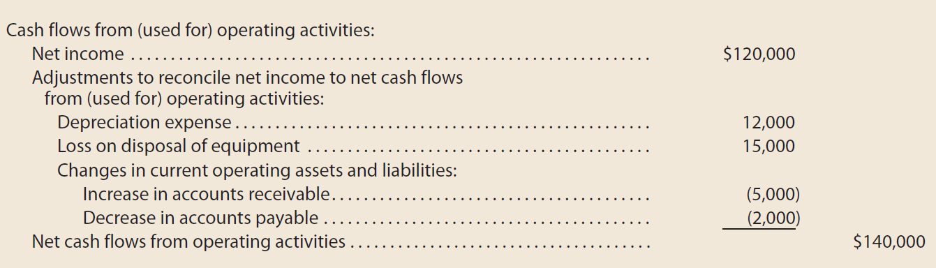
Example Exercise: Determining Cash Flows from (used for)
Operating Activities (2 of 2)
Prepare the Cash flows from operating activities section of the statement of cash flows, using the indirect method.

Slide 45
Cash Flows from (used for) Investing Activities Section
Reports the cash inflows and outflows related to changes in a company’s long-term assets.
Similar to preparing the Cash Flows from (used for) Operating Activities section, the change in each long-term asset account is analyzed for its effect on cash flows from investing activities
Rundell Inc.’s comparative balance sheet lists land, building, and accumulated depreciation—building as long-term assets

Slide 46
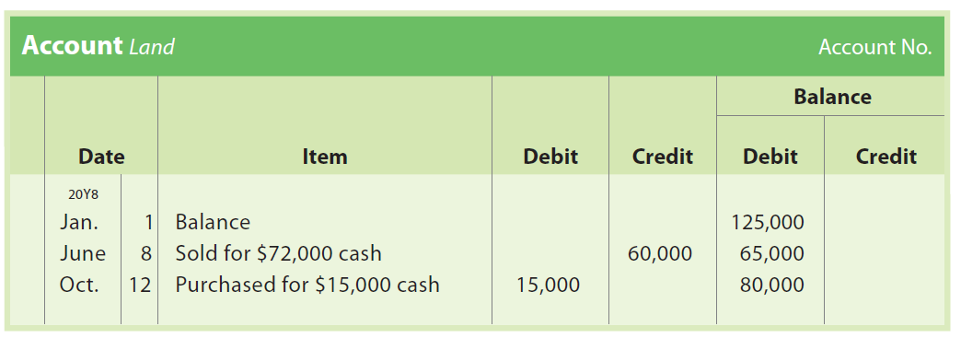
Land (1 of 2)
The $45,000 decline in the land account of Rundell Inc. was from two transactions, as follows:

Slide 47
Land (2 of 2)
The June 8 transaction is the sale of land with a cost of $60,000 for $72,000 in cash. The $72,000 proceeds from the sale are reported in the Investing Activities section as follows:
The October 12 transaction is the purchase of land for cash of $15,000. This transaction is reported as an outflow of cash in the Investing Activities section as follows:

Slide 48
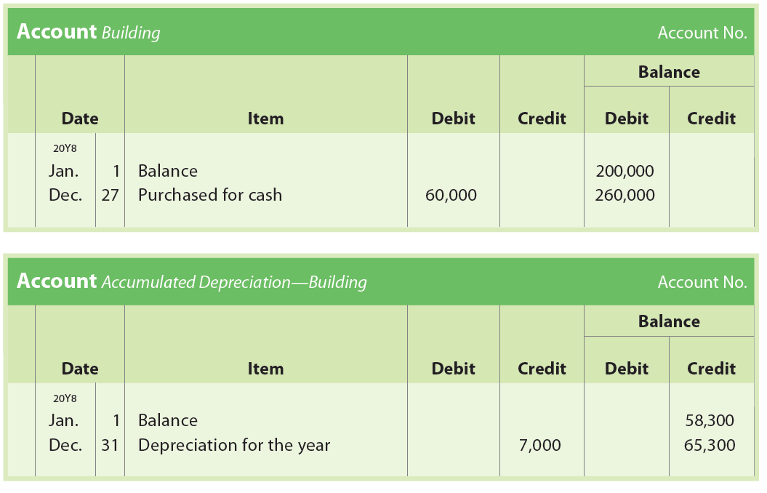
Building and Accumulated Depreciation—Building (1 of 2)
The building account of Rundell Inc. increased by $60,000, and the accumulated depreciation—building account increased by $7,000, as follows:

Slide 49
Building and Accumulated Depreciation—Building (2 of 2)
The purchase of a building for cash of $60,000 is reported as an outflow of cash in the Investing Activities section as follows:

Slide 50
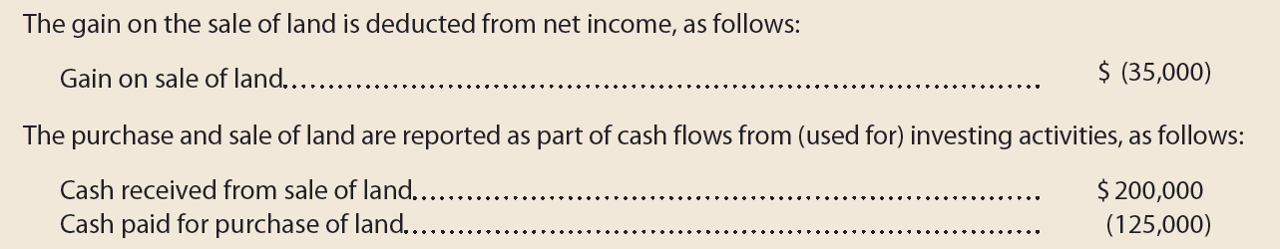
Example Exercise: Land Transactions on the Statement of Cash Flows
Alpha Corporation purchased land for $125,000. Later in the year, the company sold a different piece of land with a book value of $165,000 for $200,000. How are the effects of these transactions reported on the statement of cash flows?

Slide 51
Cash Flows from (used for) Financing Activities Section
Reports the cash inflows and outflows related to changes in a company’s long-term liabilities and stockholders’ equity
Rundell Inc.’s comparative balance sheet reports changes in bonds payable, common stock, and paid-in capital in excess of par
  In addition, dividends payable has changed, which impacts retained earnings.
  Each change must be analyzed to determine its effect on cash flows from financing activities.

Slide 52
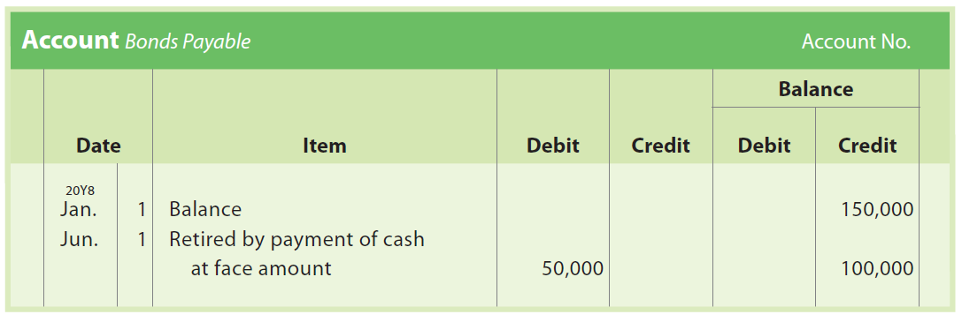
Bonds Payable (1 of 2)
The Bonds Payable account of Rundell Inc. decreased by $50,000, as follows:

Slide 53
Bonds Payable (2 of 2)
This decrease is from retiring the bonds by a cash payment for their face amount. This cash outflow is reported in the Financing Activities section as follows:

Slide 54
Common Stock (1 of 2)
The common stock account of Rundell Inc. increased by $8,000, and the paid-in capital in excess of par—common stock account increased by $40,000, as follows:

Slide 55
Common Stock (2 of 2)
These increases were from issuing 4,000 shares of common stock for $12 per share. This cash inflow is reported in the Financing Activities section as follows:

Slide 56
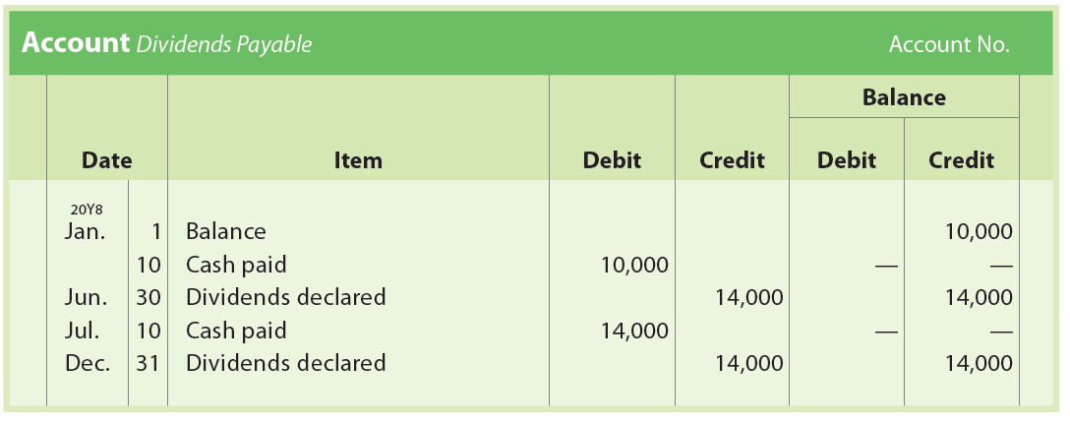
Dividends and Dividends Payable (1 of 4)
The retained earnings account of Rundell Inc. indicates cash dividends of $28,000 were declared during the year. However, the following dividends payable account indicates that only $24,000 of dividends were paid during the year:

Slide 57
Dividends and Dividends Payable (2 of 4)
Cash dividends paid during the year can also be computed by adjusting the dividends declared during the year for the change in the dividends payable account as follows:

Slide 58
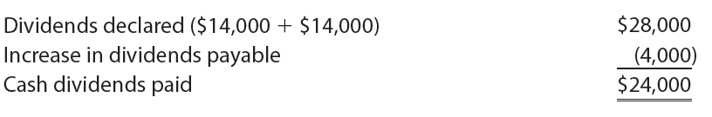
Dividends and Dividends Payable (3 of 4)
The cash dividends paid by Rundell Inc. during 20Y8 are $24,000, computed as follows:

Slide 59
Dividends and Dividends Payable (4 of 4)
Because dividend payments are a financing activity, the dividend payment of $24,000 is reported in the Financing Activities section of the statement of cash flows, as follows:

Slide 60
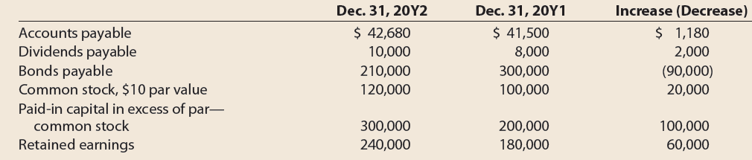
Example Exercise: Financing Activities on the Statement of Cash Flows (1 of 2)
Mohroman Inc. reported net income of $80,000 for 20Y2. The liability and equity accounts from the company’s comparative balance sheet are as follows:

Slide 61
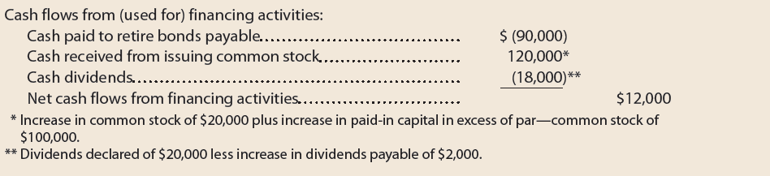
Example Exercise: Financing Activities on the Statement of Cash Flows (2 of 2)
During the year, the company retired bonds payable at their face amount, declared dividends of $20,000, and issued 2,000 shares of common stock for $60 per share. Prepare the Cash Flows from (used for) Financing Activities section of the statement of cash flows.

Slide 62
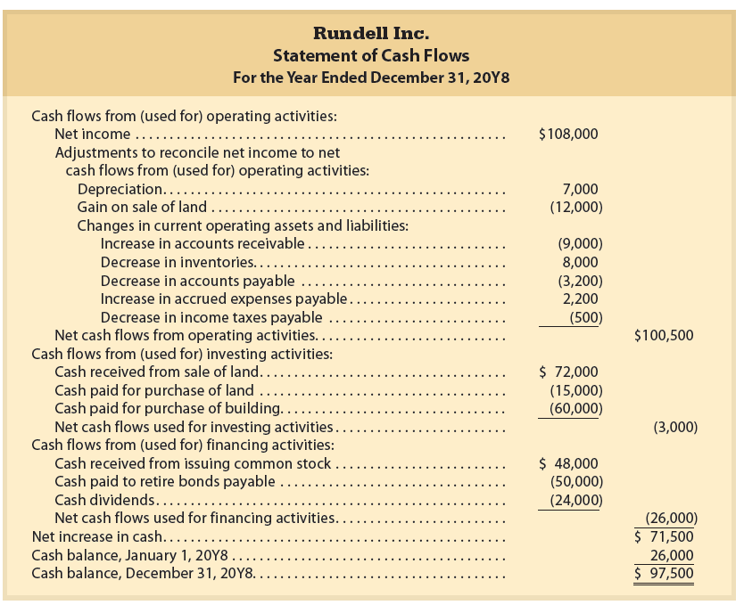
Statement of Cash Flows—Indirect Method

Slide 63
Financial Analysis and Interpretation: Free Cash Flow (1 of 3)
Free cash flow measures the operating cash flow available to a company to use after purchasing the property, plant, and equipment (PP&E) necessary to maintain its current operations.
Since the investments in PP&E necessary to maintain current operations cannot often be determined from financial statements, analysts estimate this amount using the cash used to purchase PP&E, as shown in the statement of cash flows.

Slide 64
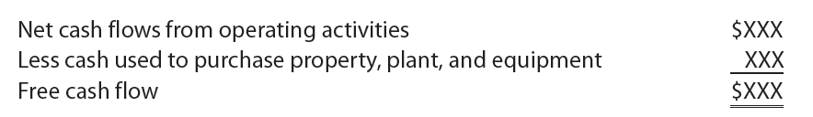
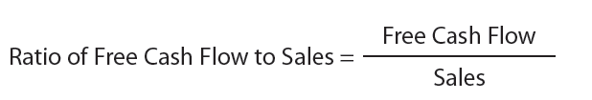
Financial Analysis and Interpretation: Free Cash Flow (2 of 3)
Free cash flow is computed as follows:
The free cash flow can be expressed as a percentage of sales in order to provide a relative measure that can be compared over time or to other companies. This ratio is computed as follows:

Slide 65
Financial Analysis and Interpretation: Free Cash Flow (3 of 3)
Positive free cash flow is considered favorable.
A company that has free cash flow is able to fund growth and acquisitions, retire debt, purchase treasury stock, and pay dividends.
A company with no free cash flow may have limited financial flexibility, potentially leading to liquidity problems.

Slide 66
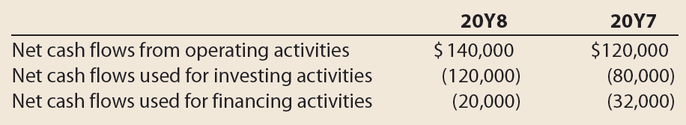
Example Exercise: Free Cash Flow (1 of 2)
Omnicron Inc. reported the following on the company’s cash flow statement in 20Y8 and 20Y7:
Seventy-five percent of the net cash flow used for investing activities was used to replace existing capacity.
  Determine Omnicron’s free cash flow for both years.
  Has Omnicron’s free cash flow improved or declined from 20Y7 to 20Y8?

Slide 67
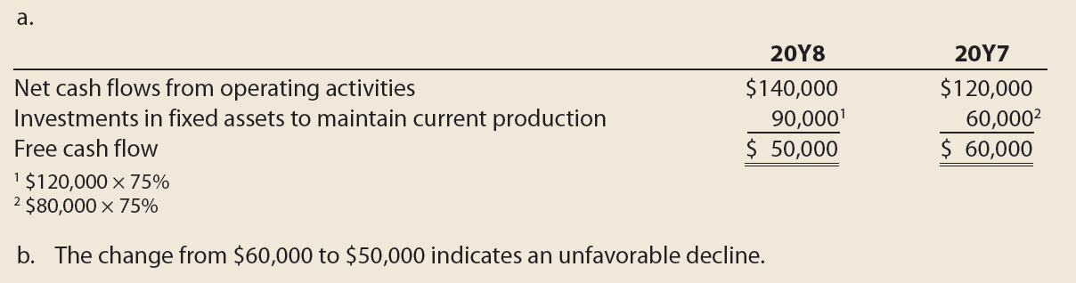
Example Exercise: Free Cash Flow (2 of 2)

Slide 68
Appendix: Spreadsheet (Work Sheet) for Statement of Cash Flows—The Indirect Method (1 of 3)
A spreadsheet (work sheet) may be used in preparing the statement of cash flows. However, whether or not a spreadsheet (work sheet) is used, the concepts presented in this chapter are not affected.

Slide 69
Appendix: Spreadsheet (Work Sheet) for Statement of Cash Flows—The Indirect Method (2 of 3)
The steps in preparing this spreadsheet (work sheet) are as follows:
  Step 1. List the title of each balance sheet account in the Accounts column.
  Step 2. For each balance sheet account, enter its balance in the two Balance columns. Place the credit balances in parentheses.
  Step 3. Add both of the Balance columns, which should total zero.
  Step 4. Analyze the change during the year in each noncash account to determine its net increase (decrease) and classify the change as affecting cash flows from operating activities, investing activities, financing activities, or noncash investing and financing activities.

Slide 70
Appendix: Spreadsheet (Work Sheet) for Statement of Cash Flows—The Indirect Method (3 of 3)
  Step 5. Indicate the effect of the change on cash flows by making entries in the Transactions columns.
  Step 6. After all noncash accounts have been analyzed, enter the net increase (decrease) in cash during the period.
  Step 7. Add the Debit and Credit Transactions columns. The total should be equal.

Slide 71
Analyzing Accounts
In analyzing the noncash accounts (Step 4), try to determine the type of cash flow activity (operating, investing, or financing) that led to the change in the account
As each noncash account is analyzed, an entry (Step 5) is made on the spreadsheet (work sheet) for the type of cash flow activity that caused the change
After all noncash accounts have been analyzed, an entry (Step 6) is made for the increase (decrease) in cash during the period
The entries made on the spreadsheet are not posted to the ledger
The order in which the accounts are analyzed is not important

Slide 72
Retained Earnings (1 of 3)
The spreadsheet (work sheet) in the following slide shows a Retained Earnings balance of $202,300 at December 31, 20Y7, and $282,300 at December 31, 20Y8
  Retained Earnings increased $80,000 during the year due to the following:
    Net income of $108,000
    Declaring cash dividends of $28,000
    To identify the cash flows from these activities, two entries are made on the spreadsheet

Slide 73
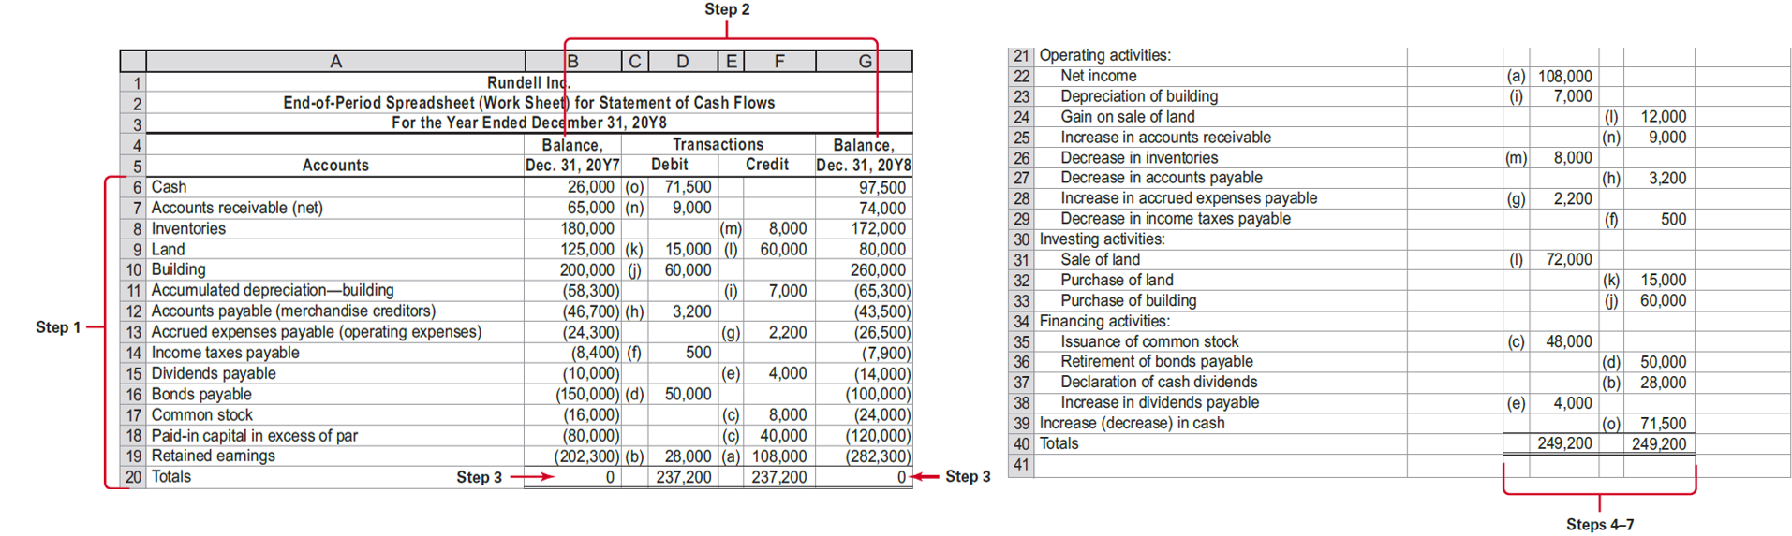
End-of-Period Spreadsheet (Work Sheet) for Statement of Cash Flows—Indirect Method

Slide 74
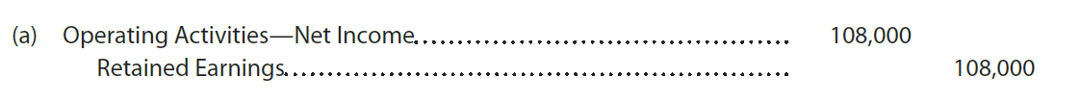
Retained Earnings (2 of 3)
The $108,000 is reported on the statement of cash flows as part of cash flows from operating activities
  Entry is made in the Transactions columns on the spreadsheet, as follows:
The preceding entry accounts for the net income portion of the change to Retained Earnings
  Identifies the cash flow in the bottom portion of the spreadsheet as related to operating activities

Slide 75
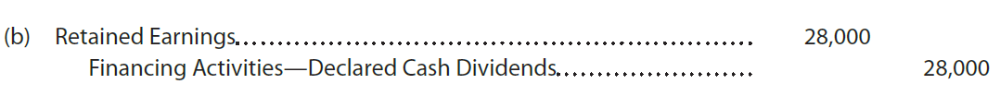
Retained Earnings (3 of 3)
The $28,000 of dividends is reported as a financing activity on the statement of cash flows
  Entry is made in the Transactions columns on the spreadsheet, as follows:
The preceding entry accounts for the dividends portion of the change to Retained Earnings
  Identifies the cash flow in the bottom portion of the spreadsheet as related to financing activities

Slide 76
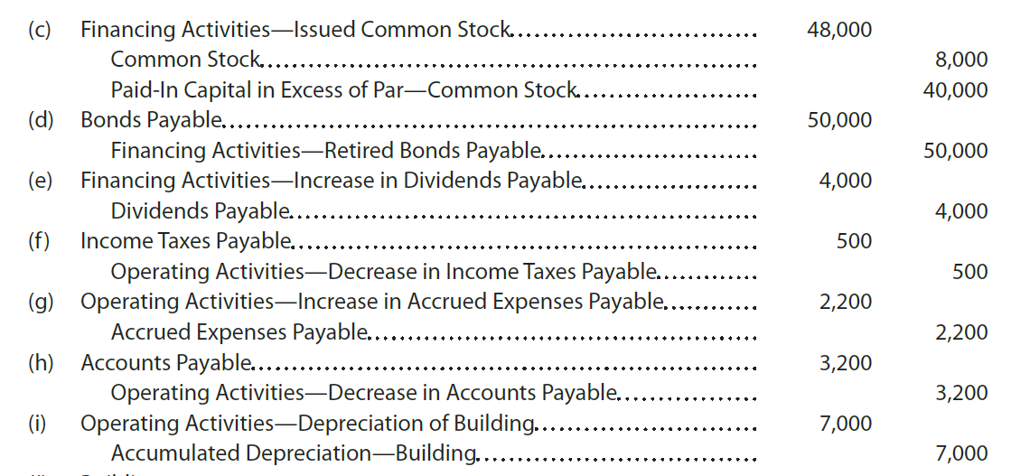
Other Accounts (1 of 2)
A summary of the other noncash accounts made in the spreadsheet follows:

Slide 77
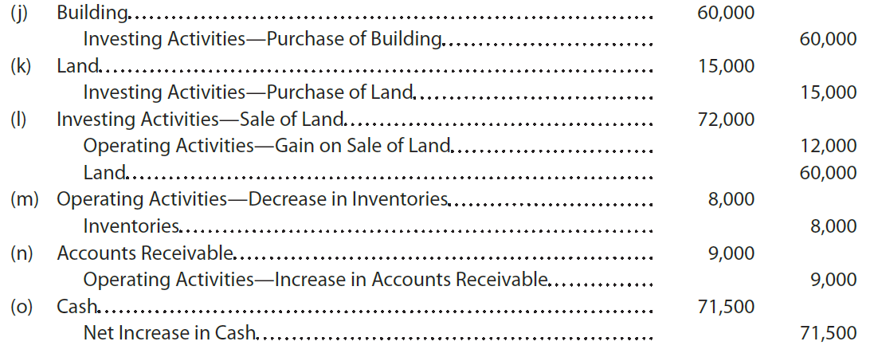
Other Accounts (2 of 3)

Slide 78
Other Accounts (3 of 3)
After all the balance sheet accounts are analyzed and the entries made on the spreadsheet (work sheet)
  All the operating, investing, and financing activities are identified in the bottom portion of the spreadsheet
  The accuracy of the entries is verified by totaling the Debit and Credit Transactions columns
    The totals of the columns should be equal

Slide 79
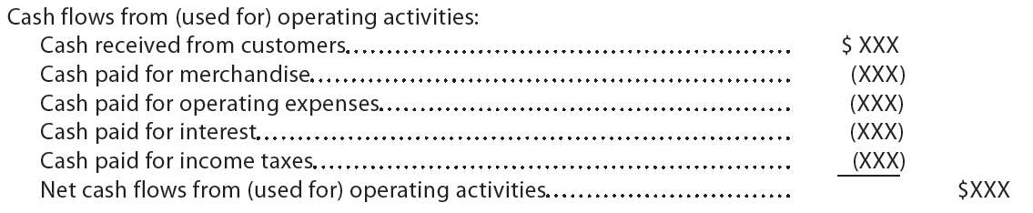
Preparing the Statement of Cash Flows—
The Direct Method (1 of 2)
The direct method reports cash flows from operating activities as follows:

Slide 80
Preparing the Statement of Cash Flows—
The Direct Method (2 of 2)
The Cash Flows from Investing and Financing Activities sections of the statement of cash flows are the same under both the direct and indirect methods.
The amount of net cash flow from operating activities is also the same, but the way it is reported is different.
  Depreciation expense is not adjusted or reported as part of cash flows from operating activities.
    This is because depreciation expense does not involve a cash outflow.
  The gain on the sale of the land is also not adjusted and is not reported as part of cash flows from operating activities.
    This is because the cash flow from operating activities is determined directly, rather than by reconciling net income. The cash proceeds from the sale of the land are reported as an investing activity.

Slide 81
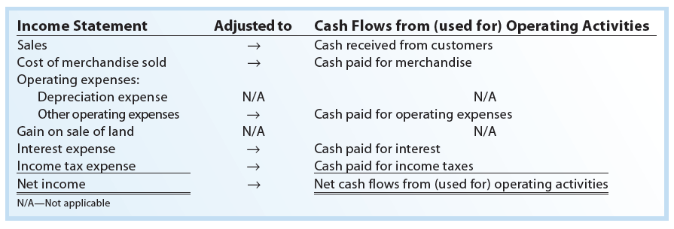
Converting Income Statement to Cash Flows from (used for) Operating Activities using the Direct Method

Slide 82
Cash Received from Customers (1 of 2)
The income statement of Rundell Inc. reports sales of $1,180,000. To determine the cash received from customers, the $1,180,000 is adjusted for any increase or decrease in accounts receivable.

Slide 83
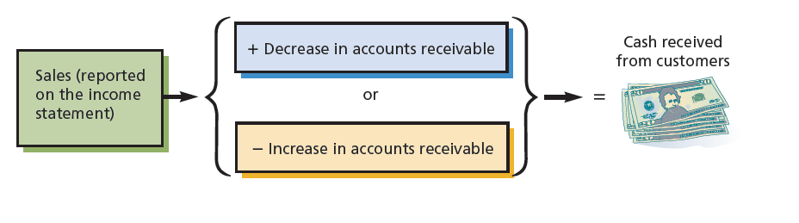
Determining the Cash Received from Customers

Slide 84
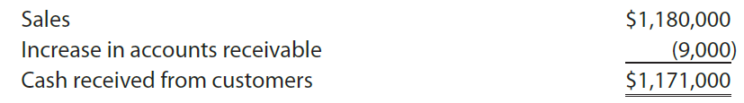
Cash Received from Customers (2 of 2)
The cash received from customers is computed as follows:
  The increase of $9,000 in accounts receivable during 20Y8 indicates that sales on account exceeded cash received from customers by $9,000.
  In other words, sales include $9,000 that did not result in a cash inflow during the year.

Slide 85
Cash Paid for Merchandise (1 of 2)
The income statement of Rundell Inc. reports cost of merchandise sold of $790,000. To determine the cash payments for merchandise, the $790,000 is adjusted for any increases or decreases in inventories and accounts payable.

Slide 86
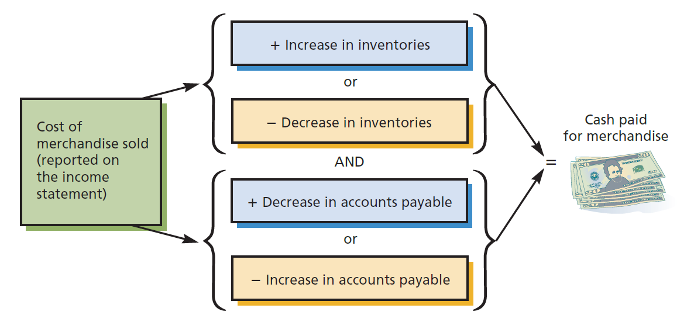
Determining Cash Paid for Merchandise

Slide 87
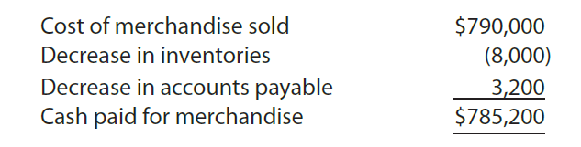
Cash Paid for Merchandise (2 of 2)
The cash payments for merchandise is computed as follows:
  The $8,000 decrease in inventories indicates that the merchandise sold exceeded the cost of the merchandise purchased by $8,000.
    In other words, the cost of merchandise sold includes $8,000 of goods sold from inventory that did not require a cash outflow during the year.
  The $3,200 decrease in accounts payable indicates that cash payments for merchandise were $3,200 more than the purchases on account during 20Y8.

Slide 88
Cash Paid for Operating Expenses (1 of 2)
The income statement of Rundell Inc. reports total operating expenses of $203,000, which includes depreciation expense of $7,000.
  Because depreciation expense does not require a cash outflow, it is omitted from cash payments for operating expenses.
To determine the cash payments for operating expenses, the other operating expenses (excluding depreciation) of $196,000 ($203,000 – $7,000) are adjusted for any increase or decrease in prepaid expenses and accrued expenses.

Slide 89
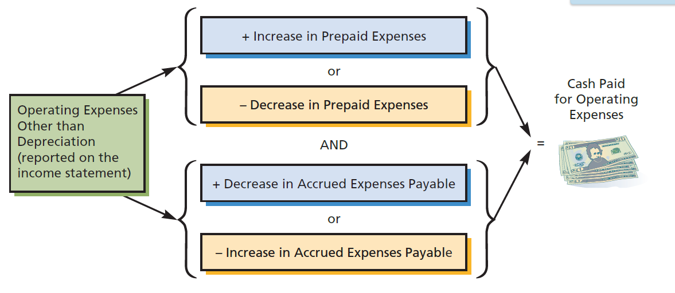
Determining the Cash Paid for Operating Expenses

Slide 90
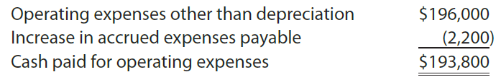
Cash Paid for Operating Expenses (2 of 2)
The cash payments for operating expenses are computed as follows:
The increase in accrued expenses payable indicates that the cash payments for operating expenses were $2,200 less than the amount reported for operating expenses during the year.

Slide 91
Gain on Sale of Land
The income statement for Rundell Inc. reports a gain of $12,000 on the sale of land.
  The sale of land is an investing activity. Thus, the proceeds from the sale, which include the gain, are reported as part of the cash flows from investing activities.

Slide 92
Interest Expense (1 of 2)
The income statement of Rundell Inc. reports interest expense of $8,000.
To determine the cash payments for interest, the $8,000 is adjusted for any increases or decreases in interest payable.

Slide 93
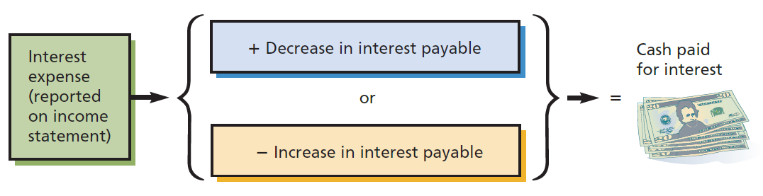
Determining the Cash Paid for Interest

Slide 94
Interest Expense (2 of 2)
The comparative balance sheet of Rundell indicates no interest payable.
  This is because the interest expense on the bonds payable is paid on June 1 and December 31.
Therefore, no adjustment of the interest expense of $8,000 is necessary.

Slide 95
Cash Paid for Income Taxes (1 of 2)
The income statement of Rundell Inc. reports income tax expense of $83,000.
To determine the cash payments for income taxes, the $83,000 is adjusted for any increases or decreases in income taxes payable.

Slide 96

Determining the Cash Paid for Income Taxes

Slide 97

Cash Paid for Income Taxes (2 of 2)
The cash payments for income taxes are computed as follows:
  The $500 decrease in income taxes payable indicates that the cash payments for income taxes were $500 more than the amount reported for income tax expense during 20Y8.

Slide 98

Statement of Cash Flows—Direct Method

