Slide 1
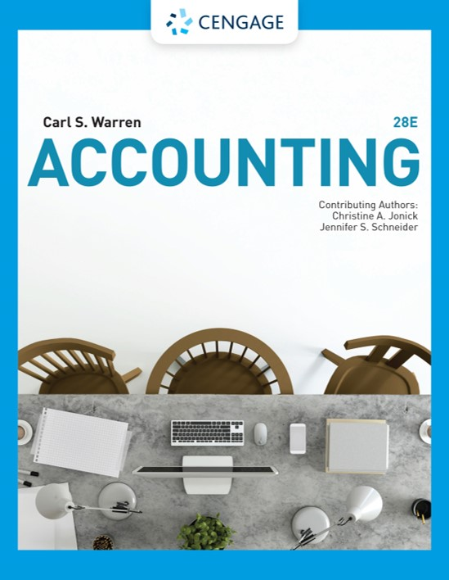
Process Cost Systems
Chapter 20

Slide 2
Learning Objectives
LO1: Describe process cost systems.
LO2: Prepare a cost of production report.
LO3: Journalize entries for transactions using a process cost system.
LO4: Describe and illustrate the use of cost of production reports for decision making.
LO5: Compare lean manufacturing with traditional manufacturing processing.
App: Describe and illustrate a process cost system using the weighted average cost method.

Slide 3
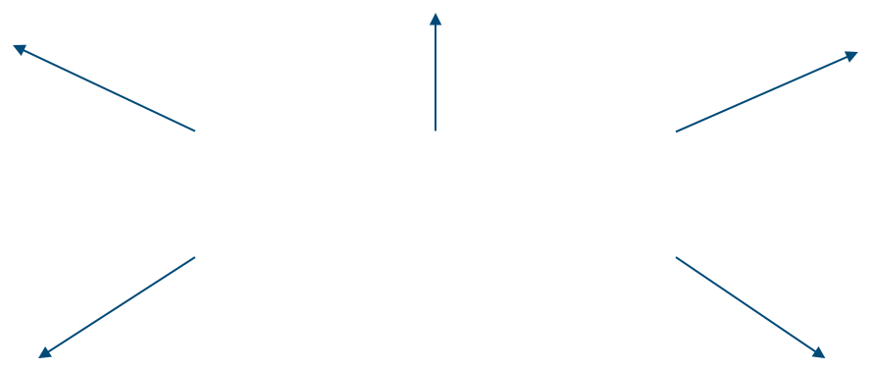
Process Cost Systems (1 of 4)
A process manufacturer produces products that are indistinguishable from each other using a continuous production process.
Oil refineries
Food processors
Paper producers
Examples of Process Manufacturers
Aluminum smelters
Chemical processors

Slide 4
Process Cost Systems (2 of 4)
The cost accounting system used by process manufacturers is called the process cost system.
  A process cost system records product costs for each manufacturing department or process.

Slide 5
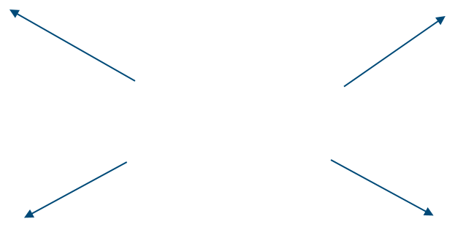
Process Cost Systems (3 of 4)
A job order manufacturer produces custom products for customer or batches of similar products.
Home builders
Custom printers
Examples of Job Order Manufacturers
Shipbuilders
Furniture manufacturers

Slide 6
Process Cost Systems (4 of 4)
The cost accounting system used by job order manufacturers is called the job order cost system.
  A job order cost system records product cost for each job, using job cost sheets.

Slide 7
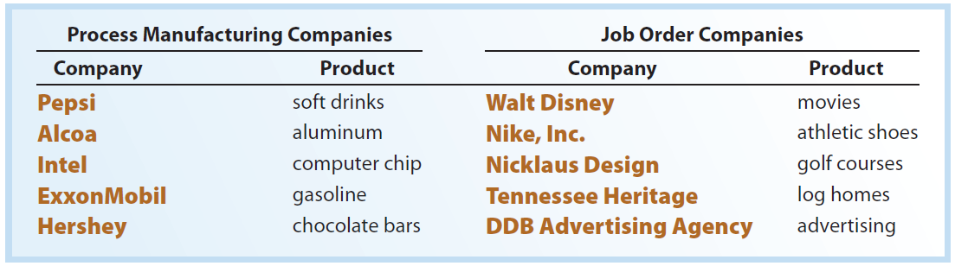
Examples of Process Cost and Job Order Companies

Slide 8

Comparing Job Order and Process Cost Systems
(1 of 2)
Process and job order cost systems are similar in that each system:
Records and summarizes product costs
Classifies product costs as direct materials, direct labor, and factory overhead
Allocates factory overhead costs to products
Uses a perpetual inventory system for materials, work in process, and finished goods
Provides useful product cost information for decision making

Slide 9
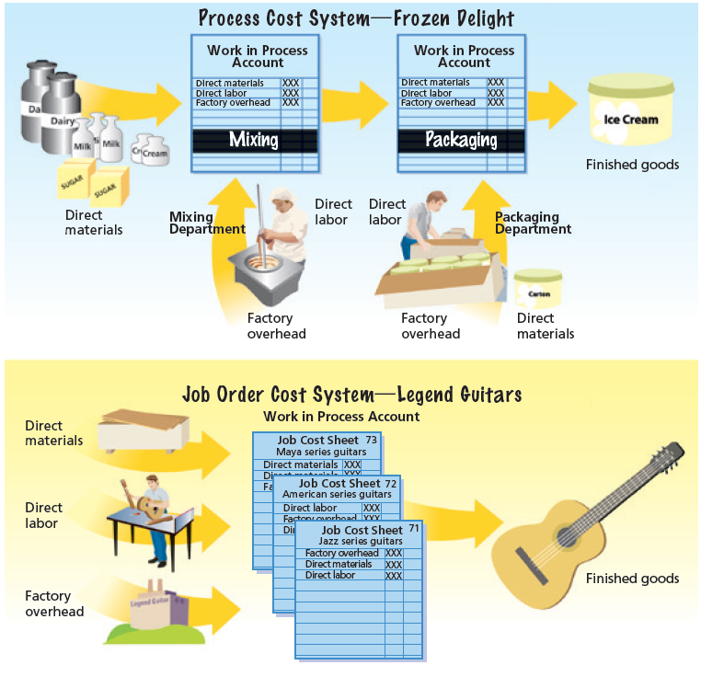
Process Cost and Job Order Cost Systems

Slide 10
Comparing Job Order and Process Cost Systems
(2 of 2)
Process and job order cost systems are different in several ways:
  A process cost system accumulates (records) product costs in work in process accounts for each department.
  In contrast, a job order cost system accumulates (records) product costs by jobs, using job cost sheets.
  In a job order cost system, the work in process at the end of the period is the sum of the job cost sheets for partially completed jobs.
  In a process cost system, the work in process at the end of the period is the sum of the costs remaining in each department account at the end of the period.

Slide 11

Example Exercise: Job Order versus Process Costing
Which of the following industries would normally use job order costing systems, and which would normally use process costing systems?
  Home construction
  Beverages
  Military aircraft
  Computer chips
  Cookies
  Video game design and production

Slide 12
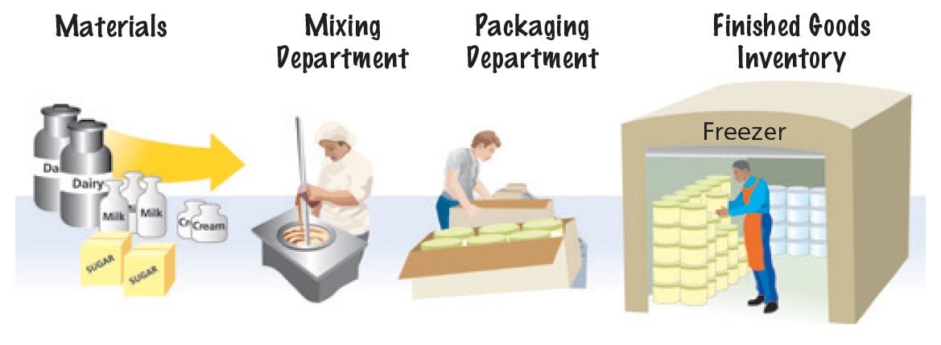
Physical Flows for a Process Manufacturer

Slide 13
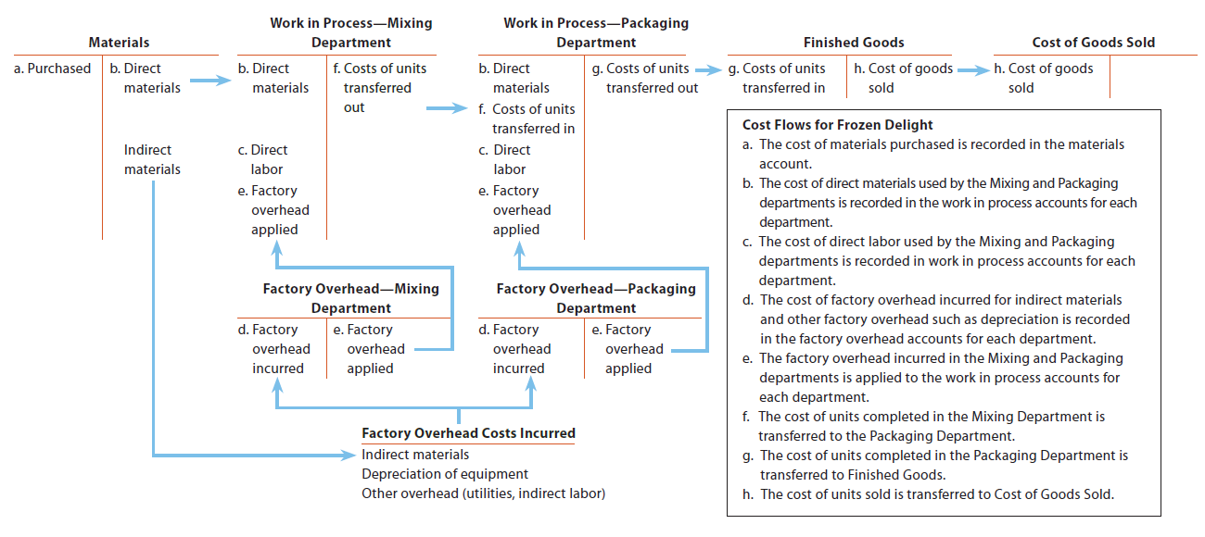
Cost Flows for a Process Manufacturer—Frozen Delight

Slide 14
Cost of Production Report (1 of 4)
In a process cost system, the cost of units transferred out of each processing department must be determined along with the cost of any partially completed units remaining in the department. The report that summarizes these costs is a cost of production report.
  The cost of production report summarizes the production and cost data for a department as follows:
    The units the department is accountable for and the disposition of those units.
    The product costs incurred by the department and the allocation of those costs between completed (transferred out) and partially completed units.

Slide 15
Cost of Production Report (2 of 4)
A cost of production report is prepared using the following four steps:
Step 1. Determine the units to be assigned costs.
Step 2. Compute equivalent units of production.
Step 3. Determine the cost per equivalent unit.
Step 4. Allocate costs to units transferred out and partially completed units.

Slide 16
Cost of Production Report (3 of 4)
Preparing a cost of production report requires making a cost flow assumption.
Like merchandise inventory, costs can be assumed to flow through the manufacturing process using the first-in, first-out (FIFO), last-in, first-out (LIFO), or average cost methods.
  Because the first-in, first-out (FIFO) method is often the same as the physical flow of units, the FIFO method is used in this chapter.

Slide 17
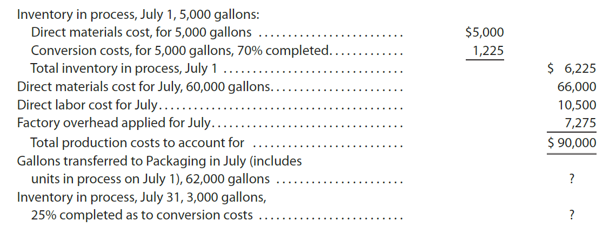
Cost of Production Report (4 of 4)
To illustrate, a cost of production report for the Mixing Department of Frozen Delight for July is prepared. The July data for the Mixing Department are as follows:
  The cost of the gallons transferred to the Packaging Department in July and the ending work in process inventory in the Mixing Department are determined by preparing this report.

Slide 18
Step 1: Determine the Units to Be Assigned Costs
(1 of 4)
The first step is to determine the units to be assigned costs.
  A unit can be any measure of completed production, such as tons, gallons, pounds, barrels, or cases.
    For Frozen Delight, a unit is a gallon of ice cream.

Slide 19
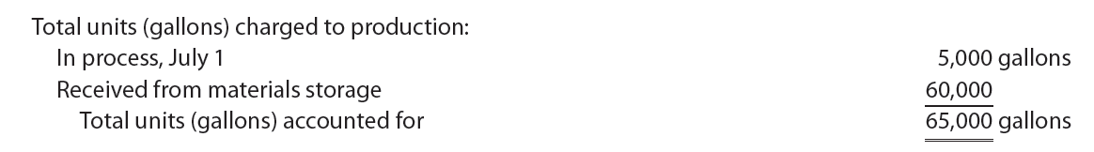
Step 1: Determine the Units to Be Assigned Costs
(2 of 4)
The Mixing Department is accountable for 65,000 gallons of direct materials during July, computed as follows:

Slide 20
Step 1: Determine the Units to Be Assigned Costs
(3 of 4)
For July, the following three groups of units (gallons) are assigned costs:
  Group 1. Units (gallons) in beginning work in process inventory on July 1
  Group 2. Units (gallons) started and completed during July.
  Group 3. Units (gallons) in ending work in process inventory on July 31.

Slide 21
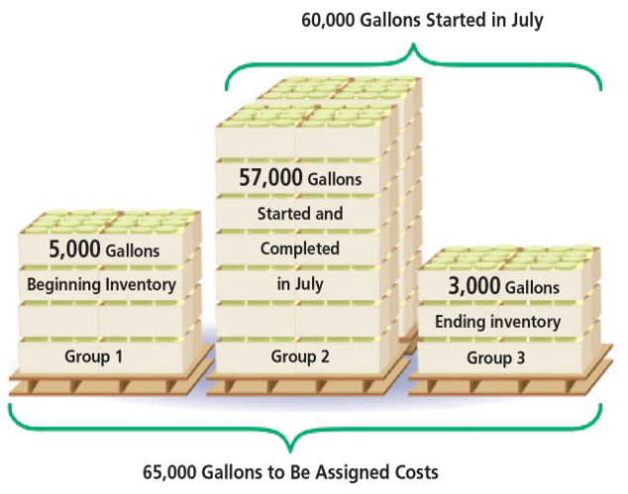
July Units to Be Costed—Mixing Department

Slide 22
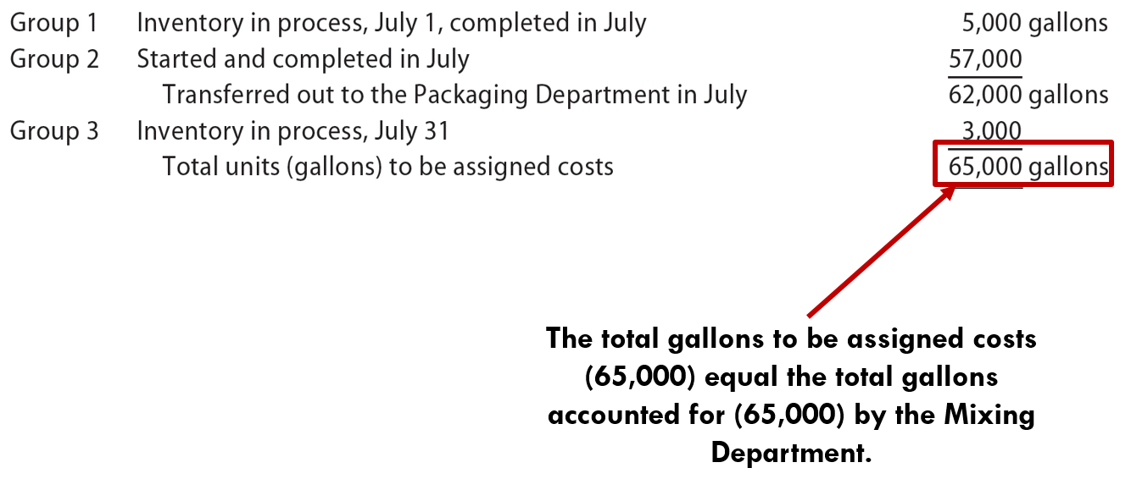
Step 1: Determine the Units to Be Assigned Costs
(4 of 4)
The total units (gallons) to be assigned costs for July are summarized as follows:

Slide 23
Example Exercise: Units to Be Assigned Costs
Rocky Springs Beverage Company has two departments, Blending and Bottling. The Bottling Department received 57,000 liters from the Blending Department. During the period, the Bottling Department completed 58,000 liters, including 4,000 liters of work in process at the beginning of the period. The ending work in process was 3,000 liters.
How many liters were started and completed during the period?

Slide 24
Step 2: Compute Equivalent Units of Production
(1 of 5)
Whole units
Number of units in production during a period, whether completed or not
Equivalent units of production
Portion of whole units that are complete with respect to either materials or conversion (direct labor and factory overhead) costs

Slide 25
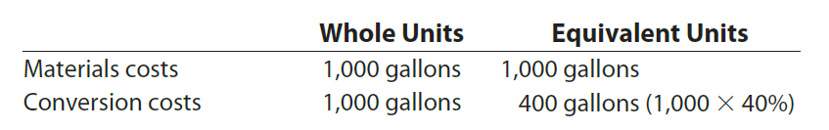
Step 2: Compute Equivalent Units of Production
(2 of 5)
Assume that a 1,000-gallon batch (vat) of ice cream at Frozen Delight is only 40% complete in the mixing process on May 31. Thus, the batch is only 40% complete as to conversion costs such as power. In this case, the whole units and equivalent units of production are as follows:

Slide 26
Step 2: Compute Equivalent Units of Production
(3 of 5)
Equivalent units for materials and conversion costs are usually determined separately.
  This is because materials and conversion costs normally enter production at different times and rates.
    In contrast, direct labor and factory overhead normally enter production at the same time and rate. For this reason, direct labor and factory overhead are combined as conversion costs in computing equivalent units.

Slide 27
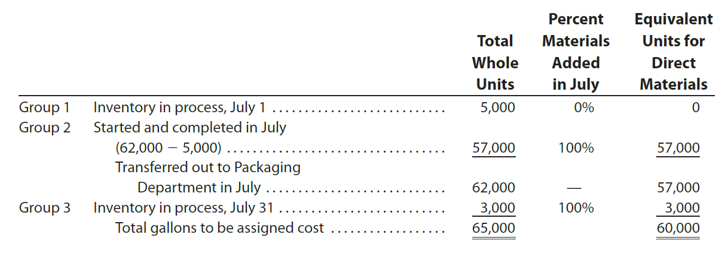
Step 2: Compute Equivalent Units of Production
(4 of 5)
To compute equivalent units for materials, it is necessary to know how materials are added during the manufacturing process.
    In the case of Frozen Delight, all the materials are added at the beginning of the mixing process. Thus, the equivalent units for materials in July are computed as follows:

Slide 28
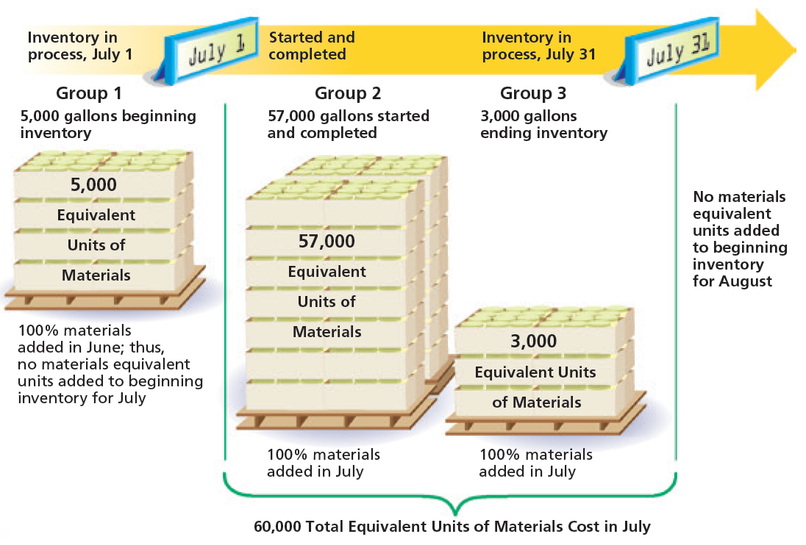
Direct Materials Equivalent Units

Slide 29
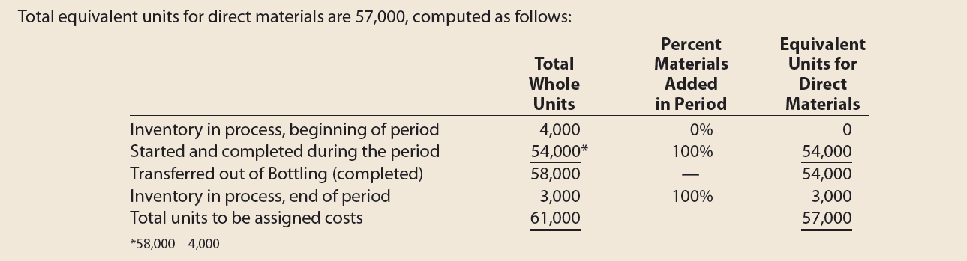
Example Exercise: Equivalent Units of Materials Cost
The Bottling Department of Rocky Springs Beverage Company had 4,000 liters in the beginning work in process inventory (30% complete). During the period, 58,000 liters were completed. The ending work in process inventory was 3,000 liters (60% complete). What are the total equivalent units for direct materials if materials are added at the beginning of the process?

Slide 30
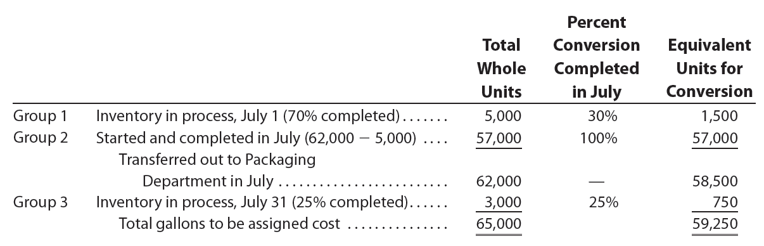
Step 2: Compute Equivalent Units of Production
(5 of 5)
To compute equivalent units for conversion costs, it is necessary to know how direct labor and factory overhead enter the manufacturing process.
    Direct labor, utilities, and equipment depreciation are often incurred uniformly during processing. For this reason, it is assumed that Frozen Delight incurs conversion costs evenly throughout its manufacturing process. Thus, the equivalent units for conversion costs in July are computed as follows:

Slide 31
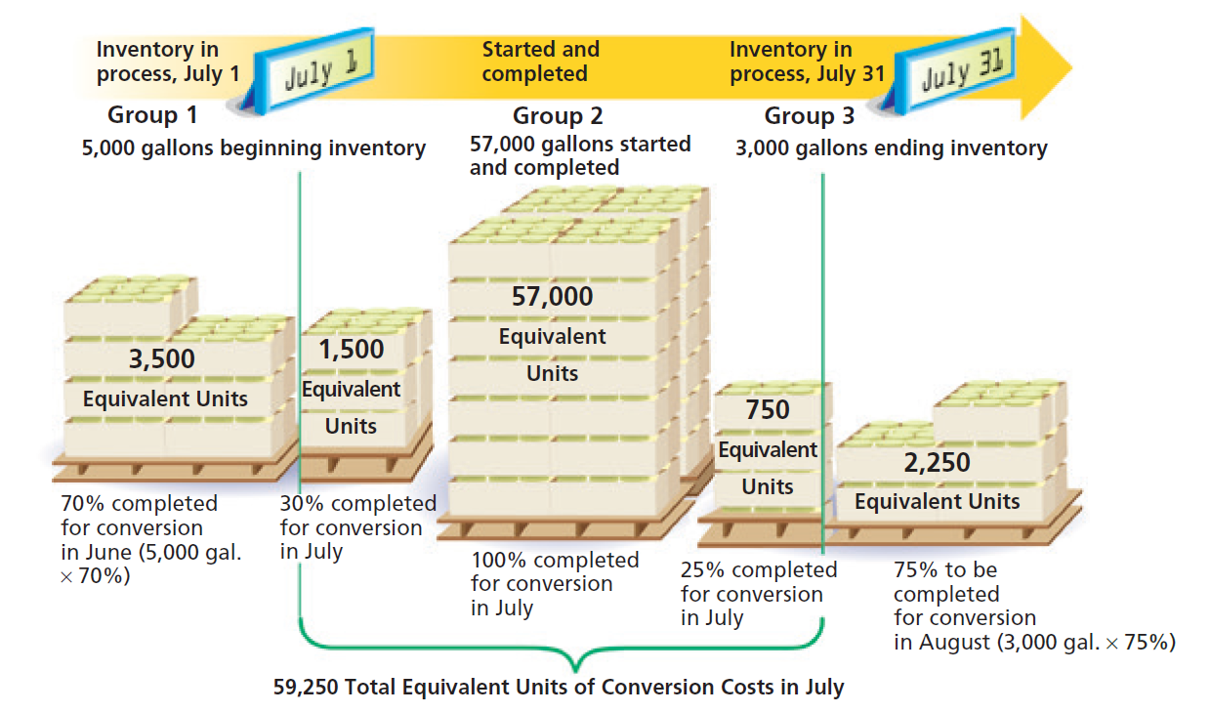
Conversion Equivalent Units

Slide 32
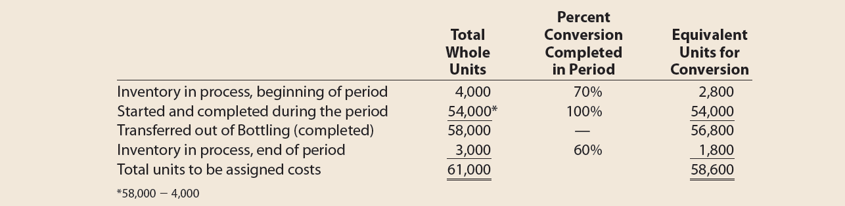
Example Exercise: Equivalent Units of Conversion Costs
The Bottling Department of Rocky Springs Beverage Company had 4,000 liters in the beginning work in process inventory (30% complete). During the period, 58,000 liters were completed. The ending work in process inventory was 3,000 liters (60% complete). What are the total equivalent units for conversion costs?

Slide 33
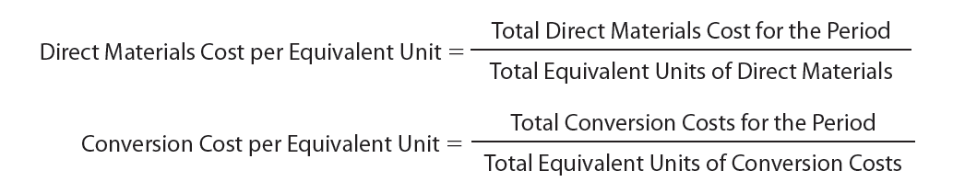
Step 3: Determine the Cost per Equivalent Unit
(1 of 4)
The cost per equivalent unit for direct materials and conversion costs is computed as follows:

Slide 34
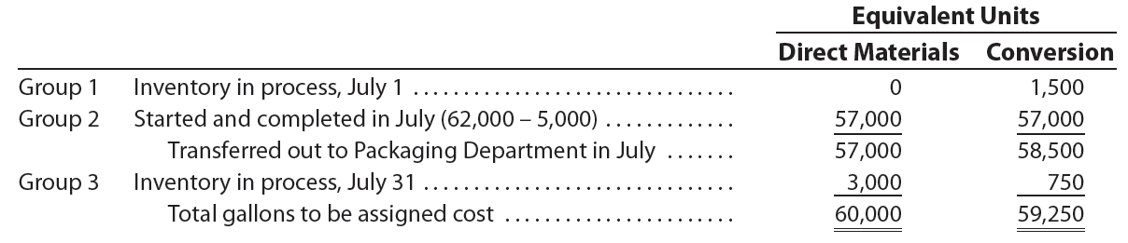
Step 3: Determine the Cost per Equivalent Unit
(2 of 4)
The July direct materials and conversion cost equivalent units for Frozen Delight’s Mixing Department from Step 2 are as follows:

Slide 35
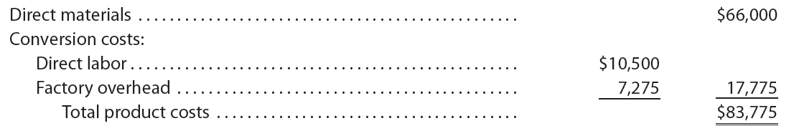
Step 3: Determine the Cost per Equivalent Unit
(3 of 4)
The direct materials and conversion costs incurred by Frozen Delight in July are as follows:

Slide 36
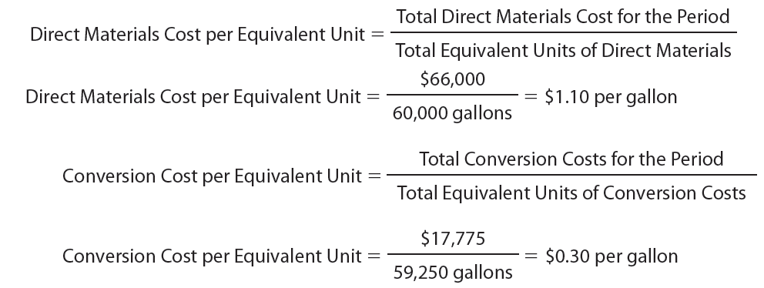
Step 3: Determine the Cost per Equivalent Unit
(4 of 4)
The direct materials and conversion costs per equivalent unit are computed as follows:

Slide 37

Example Exercise: Cost per Equivalent Unit
The cost of direct materials transferred into the Bottling Department of Rocky Springs Beverage Company is $22,800. The conversion cost for the period in the Bottling Department is $8,790. The total equivalent units for direct materials and conversion are 57,000 liters and 58,600 liters, respectively. Determine the direct materials and conversion costs per equivalent unit.

Slide 38
Step 4: Allocate Costs to Units Transferred Out and Partially Completed Units (1 of 8)
Product costs must be allocated to the units transferred out and the partially completed units on hand at the end of the period.
  The product costs are allocated using the costs per equivalent unit for materials and conversion costs that were computed in Step 3.

Slide 39
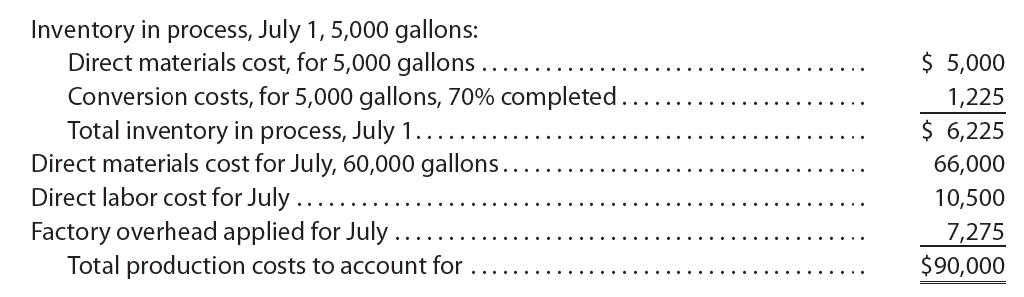
Step 4: Allocate Costs to Units Transferred Out and Partially Completed Units (2 of 8)
The total production costs to be assigned for Frozen Delight in July are $90,000, computed as follows:

Slide 40
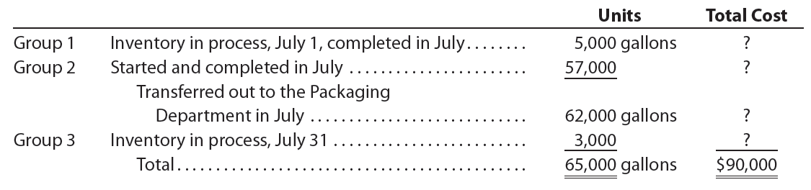
Step 4: Allocate Costs to Units Transferred Out and Partially Completed Units (3 of 8)
The units to be assigned these costs follow. The costs to be assigned these units are indicated by question marks.

Slide 41
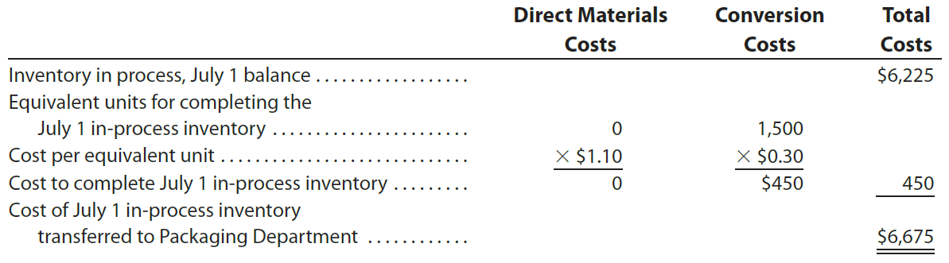
Step 4: Allocate Costs to Units Transferred Out and Partially Completed Units (4 of 8)
The 5,000 gallons of inventory in process on July 1 (Group 1) were completed and transferred out to the Packaging Department in July. The cost of these units is determined as follows:

Slide 42
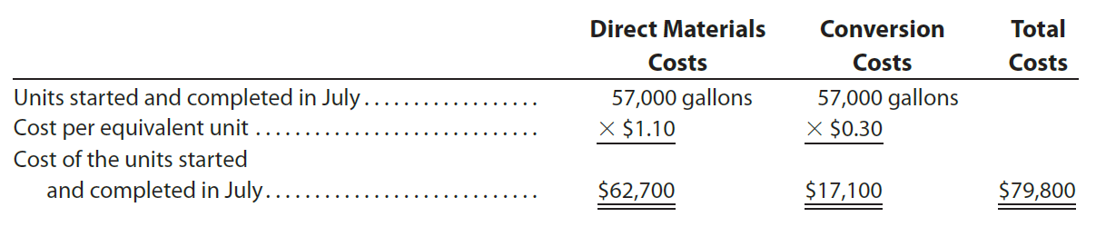
Step 4: Allocate Costs to Units Transferred Out and Partially Completed Units (5 of 8)
The 57,000 units started and completed in July (Group 2) incurred all (100%) of their direct materials and conversion costs in July. Thus, the cost of the 57,000 gallons started and completed is computed by multiplying 57,000 gallons by the costs per equivalent unit for materials and conversion costs as follows:

Slide 43
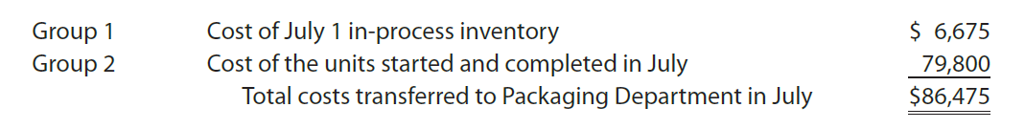
Step 4: Allocate Costs to Units Transferred Out and Partially Completed Units (6 of 8)
The total cost transferred to the Packaging Department in July is the sum of the beginning inventory cost and the costs of the units started and completed in July, computed as follows:

Slide 44
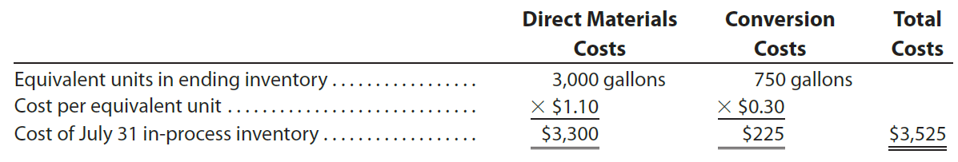
Step 4: Allocate Costs to Units Transferred Out and Partially Completed Units (7 of 8)
The 3,000 gallons in process on July 31 (Group 3) incurred all their direct materials costs and 25% of their conversion costs in July. The cost of these partially completed units is computed as follows:

Slide 45
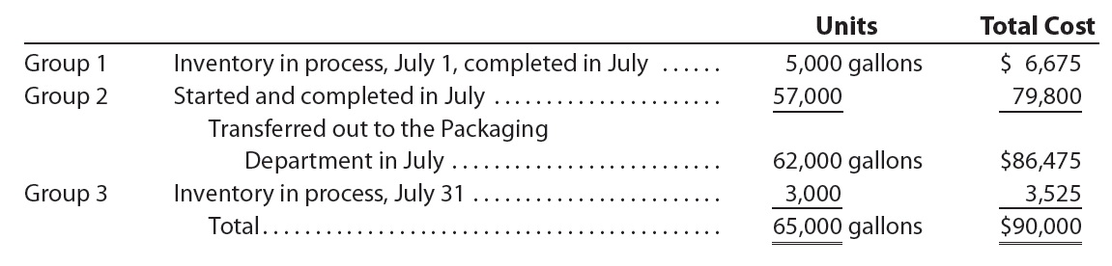
Step 4: Allocate Costs to Units Transferred Out and Partially Completed Units (8 of 8)
To summarize, the total manufacturing costs for Frozen Delight in July were assigned as follows:

Slide 46
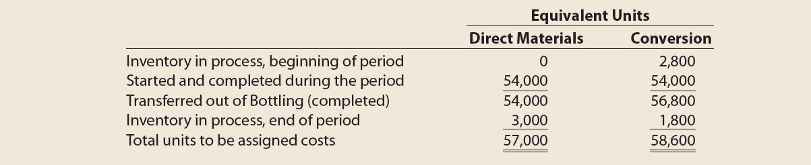
Example Exercise: Cost of Units Transferred Out and Ending Work in Process (1 of 2)
The costs per equivalent unit of direct materials and conversion in the Bottling Department of Rocky Springs Beverage Company are $0.40 and $0.15, respectively. The equivalent units to be assigned costs are as follows:
The beginning work in process inventory had a cost of $1,860. Determine the cost of units transferred out and the ending work in process inventory.

Slide 47
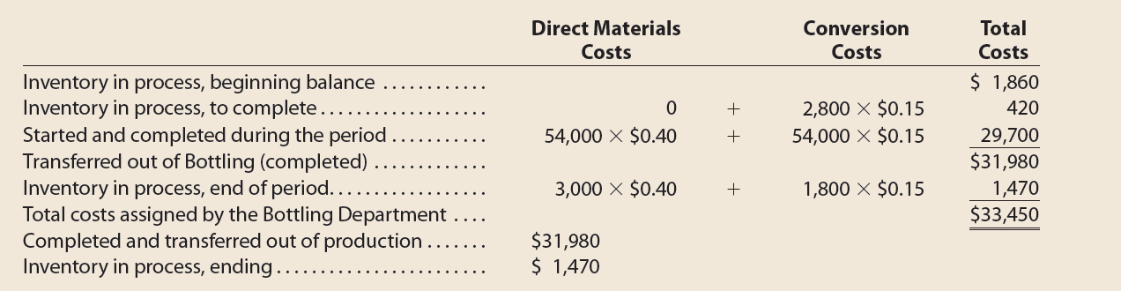
Example Exercise: Cost of Units Transferred Out and Ending Work in Process (2 of 2)

Slide 48
Preparing the Cost of Production Report
A cost of production report is prepared for each processing department at periodic intervals.
The report summarizes the following production quantity and cost data:
  The units for which the department is accountable and the disposition of those units
  The production costs incurred by the department and the allocation of those costs between completed (transferred out) and partially completed units

Slide 49
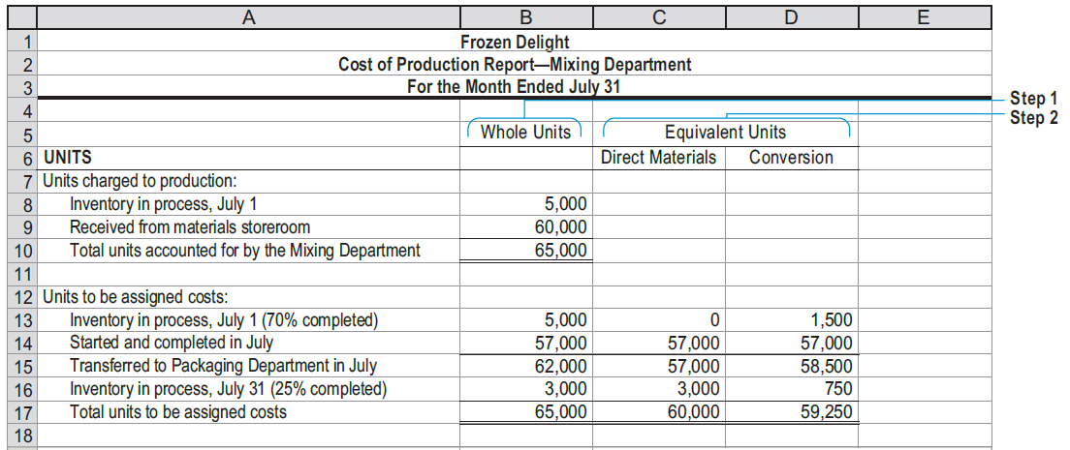
Cost of Production Report for Frozen Delight’s Mixing Department—FIFO (1 of 2)

Slide 50
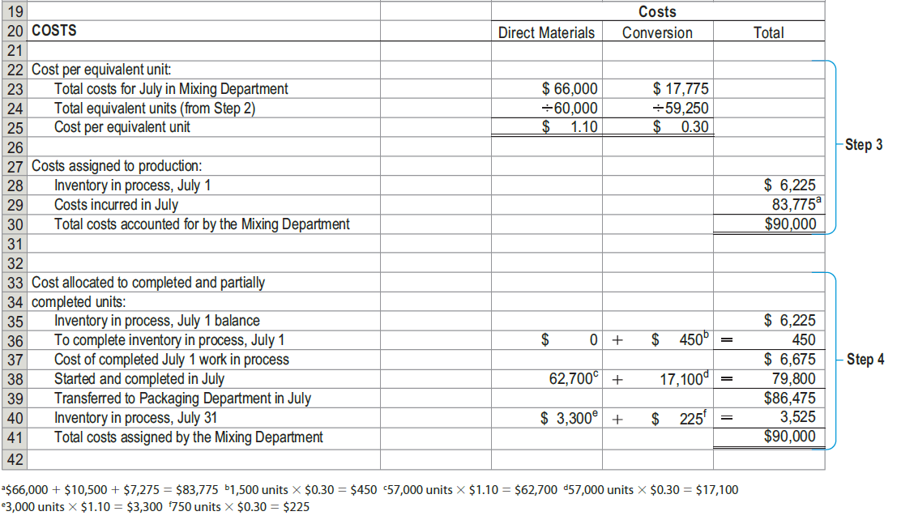
Cost of Production Report for Frozen Delight’s Mixing Department—FIFO (2 of 2)

Slide 51
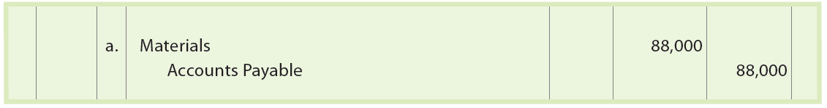
Journal Entries for a Process Cost System (1 of 6)
The journal entries to record the cost flows and transactions for a process cost system are illustrated for Frozen Delight’s July transactions. (To simplify, the entries are shown in summary form, even though many of the transactions would be recorded daily.)
Purchased materials, including milk, cream, sugar, packaging, and indirect materials on account, $88,000.

Slide 52
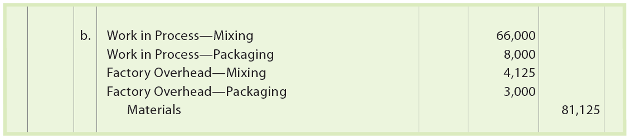
Journal Entries for a Process Cost System (2 of 6)
The Mixing Department requisitioned milk, cream, and sugar, $66,000. This is the total amount from the original July data. Packaging materials of $8,000 were requisitioned by the Packaging Department. Indirect materials for the Mixing and Packaging departments were $4,125 and $3,000, respectively.

Slide 53
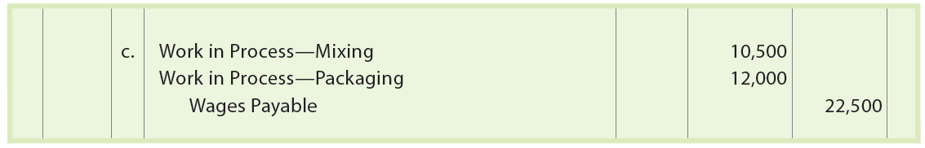
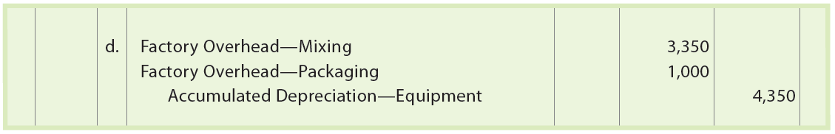
Journal Entries for a Process Cost System (3 of 6)
Incurred direct labor in the Mixing and Packaging departments of $10,500 and $12,000, respectively.
Recognized equipment depreciation for the Mixing and Packaging departments of $3,350 and $1,000, respectively.

Slide 54
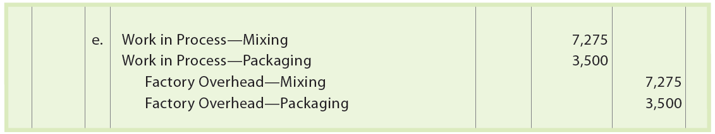
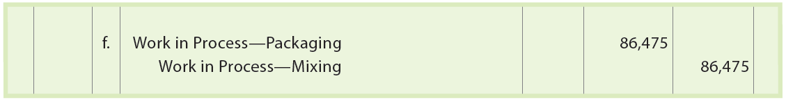
Journal Entries for a Process Cost System (4 of 6)
Applied factory overhead to Mixing and Packaging departments of $7,275 and $3,500, respectively.
Transferred costs of $86,475 from the Mixing Department to the Packaging Department per the cost of production report.

Slide 55
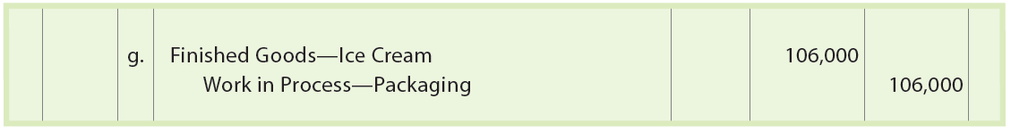
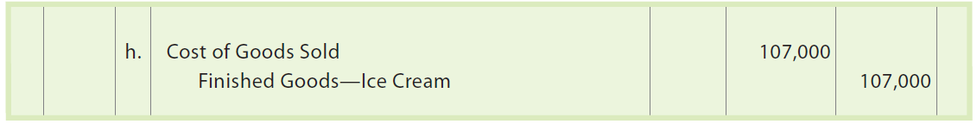
Journal Entries for a Process Cost System (5 of 6)
Transferred goods of $106,000 out of the Packaging Department to Finished Goods according to the Packaging Department cost of production report.
Recorded the cost of goods sold out of the finished goods inventory of $107,000.

Slide 56
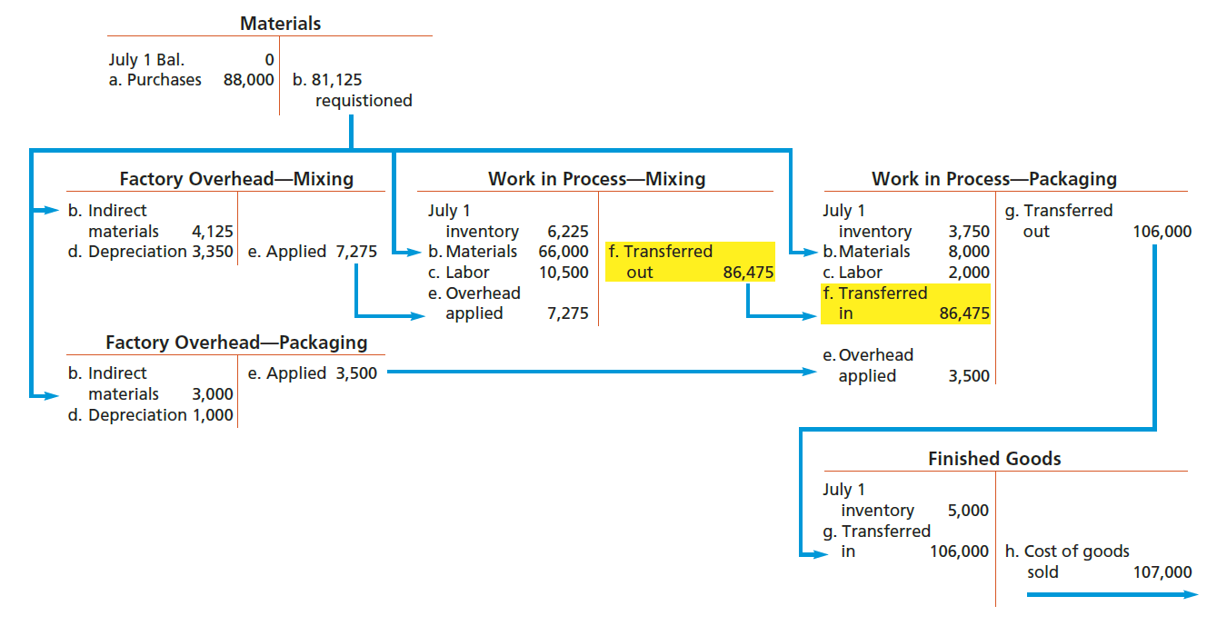
Frozen Delight’s Cost Flows

Slide 57
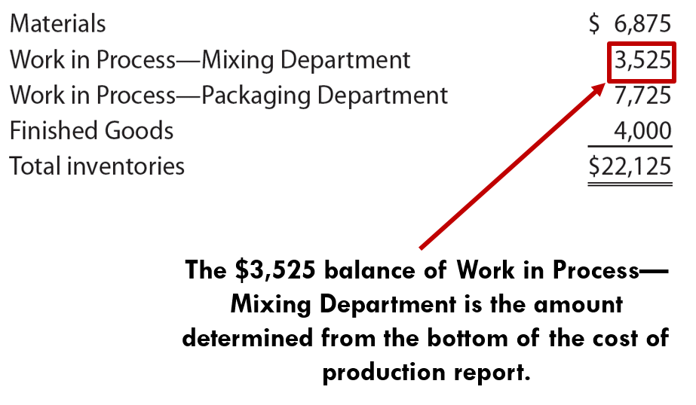
Journal Entries for a Process Cost System (6 of 6)
The ending inventories for Frozen Delight are reported on the July 31 balance sheet as follows:

Slide 58
Example Exercise: Process Cost Journal Entries
(1 of 2)
The cost of materials transferred into the Bottling Department of Rocky Springs Beverage Company is $22,800, including $20,000 from the Blending Department and $2,800 from the materials storeroom. The conversion cost for the period in the Bottling Department is $8,790 ($3,790 factory overhead applied and $5,000 direct labor). The total cost transferred to Finished Goods for the period was $31,980. The Bottling Department had a beginning inventory of $1,860.
  Journalize (1) the cost of transferred-in materials, (2) conversion costs, and (3) the costs transferred out to Finished Goods.
  Determine the balance of Work in Process—Bottling at the end of the period.

Slide 59
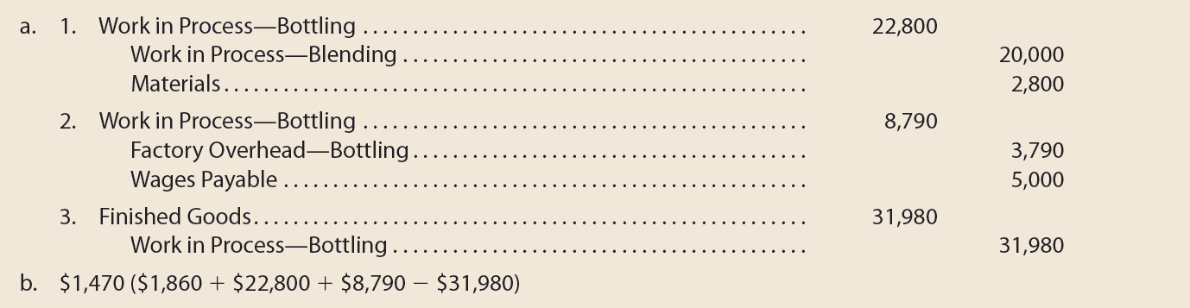
Example Exercise: Process Cost Journal Entries
(2 of 2)

Slide 60
Using the Cost of Production Report for Decision Making
The cost of production report is often used by managers for decisions involving the control and improvement of operations.

Slide 61
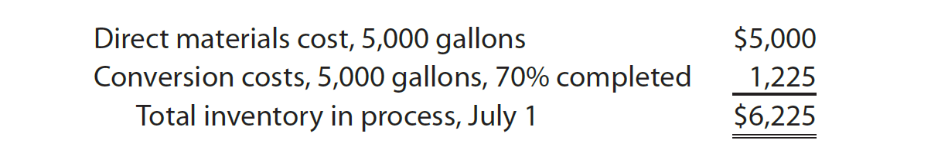
Cost per Equivalent Unit Between Periods (1 of 3)
Frozen Delight’s cost of production report for the Mixing Department shows that beginning inventory for July is $6,225. The July 1 inventory in process of $6,225 consists of the following costs:

Slide 62
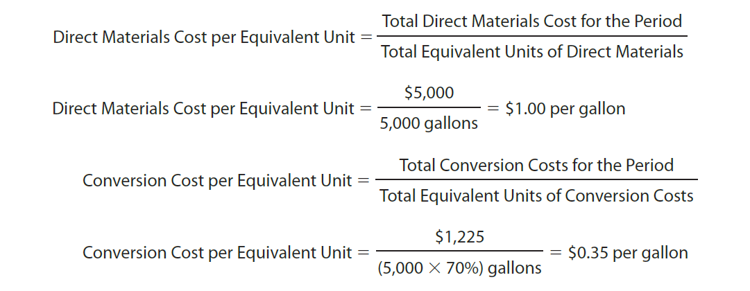
Cost per Equivalent Unit Between Periods (2 of 3)
Using the preceding data, the June costs per equivalent unit of materials and conversion costs can be determined as follows:

Slide 63
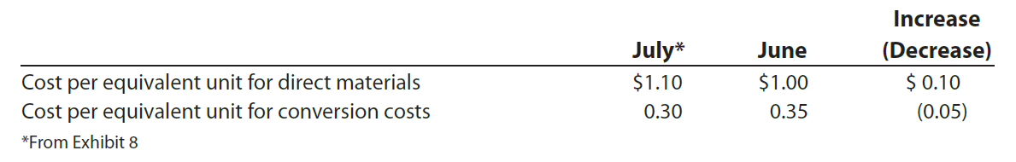
Cost per Equivalent Unit Between Periods (3 of 3)
In July, the cost per equivalent unit of materials increased by $0.10 per gallon, while the cost per equivalent unit for conversion costs decreased by $0.05 per gallon, computed as follows:

Slide 64
Cost Category Analysis (1 of 3)
A cost of production report may be prepared showing more cost categories beyond just direct materials and conversion costs.
To illustrate, the Blending Department of Holland Beverage Company prepared cost of production reports for April and May showing multiple cost categories, as follows:

Slide 65
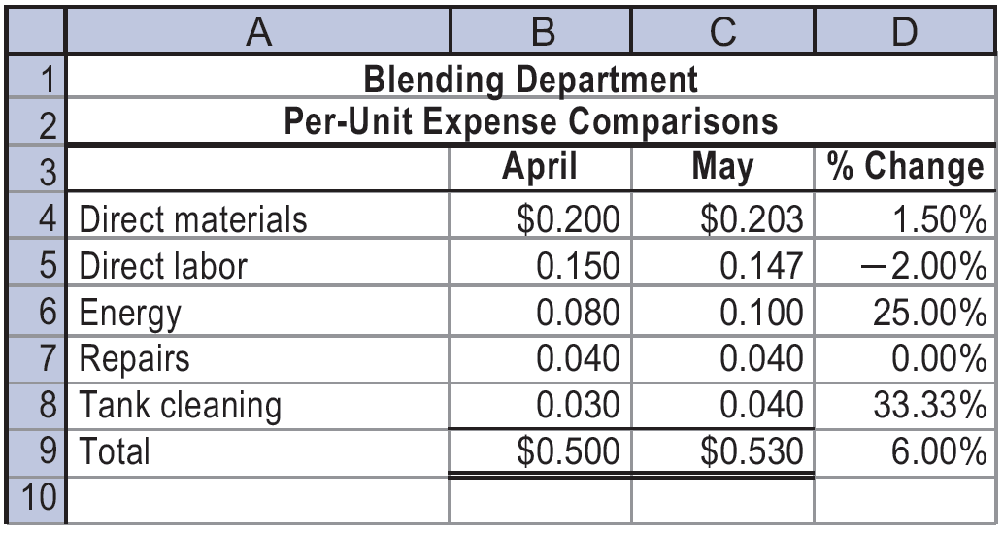
Cost Category Analysis (2 of 3)
The May results indicate that total unit costs have increased from $0.50 to $0.53, or 6% in May.
To determine the possible causes for this increase, the cost of production report is restated in per-unit terms by dividing the costs by the number of units completed, as follows:

Slide 66
Cost Category Analysis (3 of 3)
Both energy and tank cleaning per-unit costs have increased significantly in May.
  These increases should be further investigated.
    For example, the increase in energy may be due to the machines losing fuel efficiency.
      This could lead management to repair the machines.
  The tank cleaning costs could be investigated in a similar fashion.

Slide 67

Yield (1 of 2)
In addition to unit costs, managers of process manufacturers are also concerned about yield.
The yield is computed as follows:

Slide 68
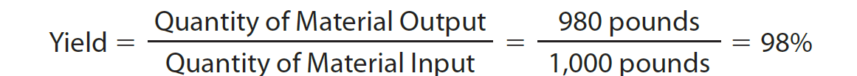
Yield (2 of 2)
Assume that 1,000 pounds of sugar enter the Packaging Department, and 980 pounds of sugar were packed. The yield is computed as follows:
  Two percent (100% – 98%) or 20 pounds of sugar were lost or spilled during
  the packing process.
    Managers can investigate significant changes in yield over time or significant differences in yield from industry standards.

Slide 69
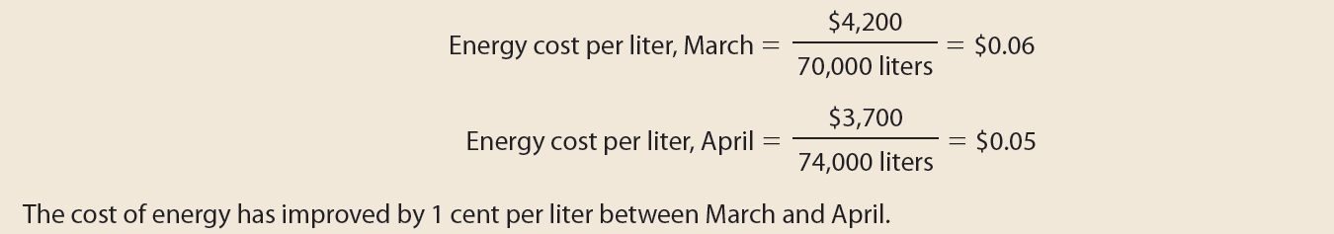
Example Exercise: Using Process Costs for Decision Making
The cost of energy consumed in producing units in the Bottling Department of Rocky Springs Beverage Company was $4,200 and $3,700 for March and April, respectively. The number of equivalent units produced in March and April was 70,000 liters and 74,000 liters, respectively. Evaluate the change in the cost of energy between the two months.

Slide 70
Lean Manufacturing
Lean manufacturing is a management approach that produces products with high quality, low cost, fast response, and immediate availability.
Lean manufacturing obtains efficiencies and flexibility by reorganizing the traditional production process.

Slide 71
Traditional Production Process (1 of 2)
A traditional manufacturing process involves several processes.
  In each process, workers are assigned a specific job, which is performed repeatedly as unfinished products are received from the preceding department.
  The product moves from process to process as each function or step is completed.

Slide 72
Traditional Production Process (2 of 2)
Example: For a furniture maker, the product (chair) moves through the following processes:
  In the Cutting Department, the wood is cut to design specifications
  In the Drilling Department, the wood is drilled to design specifications.
  In the Sanding Department, the wood is sanded.
  In the Staining Department, the wood is stained.
  In the Varnishing Department, varnish and other protective coatings are applied.
  In the Upholstery Department, fabric and other materials are added.
  In the Assembly Department, the product (chair) is assembled.

Slide 73

Traditional Production Line

Slide 74
Lean Production Process (1 of 4)
In lean manufacturing, processing functions are combined into work centers, sometimes called manufacturing cells.
  Unlike traditional manufacturing, where one worker typically performs only one function, lean work centers complete several functions.
    Thus, workers are often cross-trained to perform more than one function.

Slide 75
Lean Production Process (2 of 4)
For example, a furniture manufacturer might reorganize the seven steps (traditional production process) used to produce a chair into the following three work centers:
  Work Center 1 performs the cutting, drilling, and sanding functions.
  Work Center 2 performs the staining and varnishing functions.
  Work Center 3 performs the upholstery and assembly functions.

Slide 76

Lean Production Line

Slide 77
Lean Production Process (3 of 4)
The activities supporting the manufacturing process are called service activities.
  For example, repair and maintenance of manufacturing equipment are service activities.
In lean manufacturing, service activities may be assigned to individual work centers, rather than to centralized service departments.

Slide 78
Lean Production Process (4 of 4)
In lean manufacturing, the product is often placed on a movable carrier that is centrally located in the work center. After the workers have completed their activities with the product, the entire carrier and any additional materials are moved just in time to satisfy the demand or need of the next work center.
  In this sense, the product is said to be “pulled through.”
Each work center is connected to other work centers through information contained on a Kanban, which is a Japanese term for cards.
The primary objective of lean manufacturing is to increase the efficiency
of operations.

Slide 79
Weighted Average Cost Method
The weighted average cost method assigns costs to products based on the average of the accumulated costs.

Slide 80

Determining Costs Using the Weighted Average Cost Method (1 of 2)
Assume that S&W Ice Cream Company (S&W) mixes direct materials (milk, cream, sugar) in refrigerated vats and has two manufacturing departments, Mixing and Packaging. The manufacturing data for the Mixing Department for July are as follows:

Slide 81
Determining Costs Using the Weighted Average Cost Method (2 of 2)
To simplify, assume all of S&W's production costs (materials and conversion costs) occur at the same rate.
  By doing so, all production costs are combined together in determining the number of equivalent units and cost per equivalent unit.

Slide 82
Step 1: Determine the Units to Be Assigned Costs
(1 of 4)
The first step is to determine the units to be assigned costs.
  A unit can be any measure of completed production, such as tons, gallons, pounds, barrels, or cases.
    For S&W, a unit is a gallon of ice cream.

Slide 83

Step 1: Determine the Units to Be Assigned Costs
(2 of 4)
S&W’s Mixing Department had 65,000 gallons of direct materials to account for during July, as shown here:

Slide 84
Step 1: Determine the Units to Be Assigned Costs
(3 of 4)
There are two groups of units to be assigned costs for the period:
  Group 1: Units completed and transferred out
  Group 2: Units in the July 31 ending work in process inventory.

Slide 85

Step 1: Determine the Units to Be Assigned Costs
(4 of 4)
The total units (gallons) to be assigned costs for S&W can be summarized as follows:

Slide 86

Step 2: Compute Equivalent Units of Production
S&W has 3,000 gallons of whole units in the work in process inventory for the Mixing Department on July 31. Because these units are 25% complete, the number of equivalent units in process in the Mixing Department on July 31 is 750 gallons (3,000 gallons × 25%). Because the units transferred to the Packaging Department have been completed, the whole units (62,000 gallons) transferred are the same as the equivalent units transferred.
The total equivalent units of production for the Mixing Department are determined by adding the equivalent units in the ending work in process inventory to the units transferred and completed during the period:

Slide 87

Step 3: Determine the Cost per Equivalent Unit
Because materials and conversion costs are combined under the weighted average cost method, the cost per equivalent unit is determined by dividing the total production costs by the total equivalent units of production as follows:

Slide 88

Step 4: Allocate Costs to Transferred Out and Partially Completed Units
The cost of transferred and partially completed units is determined by multiplying the cost per equivalent unit times the equivalent units of production. For S&W’s Mixing Department, these costs are determined as follows:

Slide 89
The Cost of Production Report
The July cost of production report for S&W’s Mixing Department summarizes the following:
  The units for which the department is accountable and the disposition of those units
  The production costs incurred by the department and the allocation of those costs between completed and partially completed units

Slide 90

Cost of Production Report for S&W’s Mixing Department—Weighted Average Cost (1 of 2)

Slide 91

Cost of Production Report for S&W’s Mixing Department—Weighted Average Cost (2 of 2)

