Slide 1
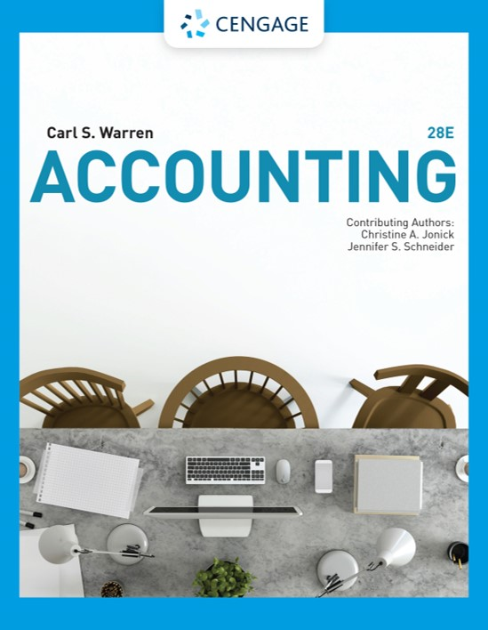
Decentralized Operations
Chapter 24

Slide 2
Learning Objectives
LO1: Describe the advantages and disadvantages of decentralized operations.
LO2: Prepare a responsibility accounting report for a cost center.
LO3: Prepare responsibility accounting reports for a profit center.
LO4: Compute and interpret the return on investment, the residual income, and the balanced scorecard for an investment center.
LO5: Describe and illustrate how the market price, negotiated price, and cost price approaches to transfer pricing may be used by decentralized segments of a business.

Slide 3
Centralized and Decentralized Operations
Centralized company
All major planning and operating decisions are made by top management
Decentralized company
Managers of separate divisions or units are delegated operating responsibility
  The division (unit) managers are responsible for planning and controlling the operations of their divisions, which are often structured around products, customers, or regions

Slide 4
Advantages of Decentralization (1 of 2)
For large companies, it is difficult for top management to:
  Maintain daily contact with all operations, and
  Maintain operating expertise in all product lines and services
In such cases, delegating authority to managers closest to the operations usually results in better decisions.

Slide 5
Advantages of Decentralization (2 of 2)
Decentralized operations provide excellent training for managers.
Delegating responsibility allows managers to develop managerial experience early in their careers.
  This helps a company retain managers, some of whom may be later promoted to top management positions.
Managers of decentralized operations often work closely with customers.
  As a result of, they tend to identify with customers and, thus, are often more creative in suggesting operating and product improvements.
    This helps create good customer relations.

Slide 6
Disadvantages of Decentralization
A primary disadvantage of decentralized operations is that decisions made by one manager may negatively affect the profits of the company.
Another disadvantage of decentralized operations is that assets and expenses may be duplicated across divisions.

Slide 7
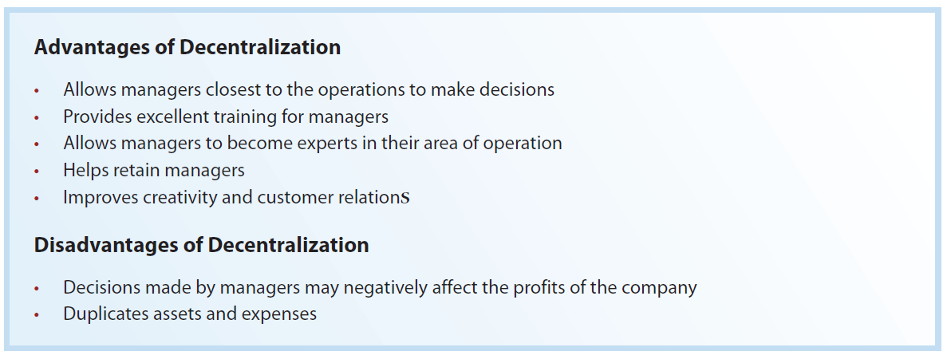
Advantages and Disadvantages of Decentralized Operations

Slide 8
Responsibility Accounting (1 of 2)
In a decentralized business, accounting assists managers in evaluating and controlling their areas of responsibility, called responsibility centers.
  Responsibility accounting is the process of measuring and reporting operating data by responsibility center.

Slide 9
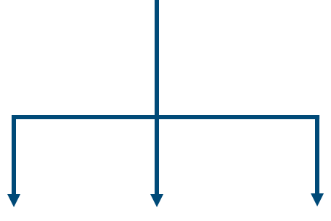
Responsibility Accounting (2 of 2)
Responsibility centers
Cost centers
Have responsibility over costs
Profit centers
Have responsibility over revenues and costs
Investment centers
Have responsibility over revenues, costs, and investment in assets

Slide 10
Responsibility Accounting for Cost Centers (1 of 2)
A cost center manager has responsibility for controlling costs.
  However, a cost center manager does not make decisions concerning sales or the amount of fixed assets invested in the center.
Cost centers may vary in size from a small department to an entire manufacturing plant.
Cost centers may exist within other cost centers.

Slide 11
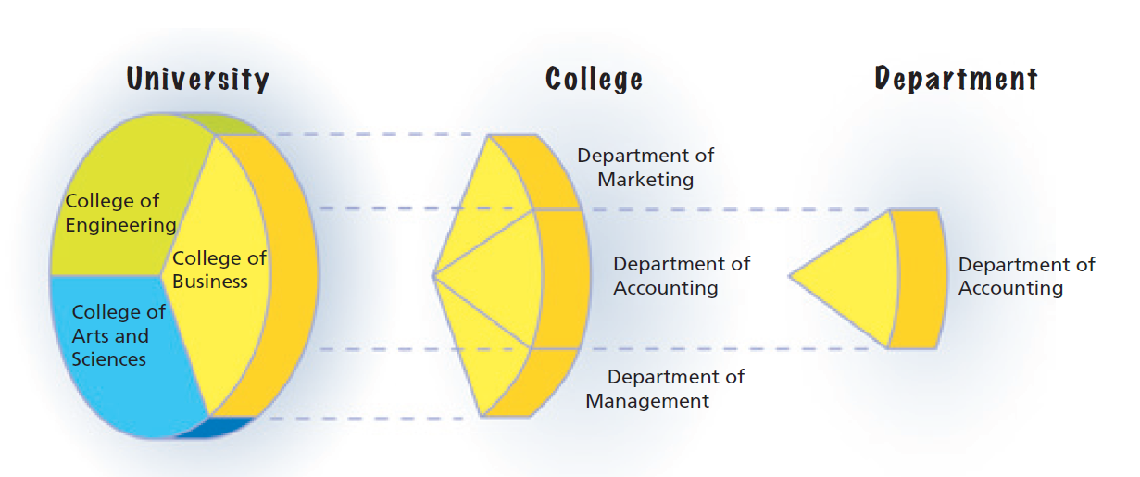
Cost Centers in a University

Slide 12
Responsibility Accounting for Cost Centers (2 of 2)
Responsibility accounting for cost centers focuses on the controlling and reporting of costs.
Budget performance reports that report budgeted and actual costs are normally prepared for each cost center.

Slide 13
Responsibility Accounting Reports for Cost Centers (1 of 2)

Slide 14
Example Exercise: Budgetary Performance for Cost Center
Nuclear Power Company’s costs were over budget by $24,000. The company is divided into North and South regions. The North Region’s costs were under budget by $2,000. Determine the amount the South Region’s costs were over or under budget.

Slide 15
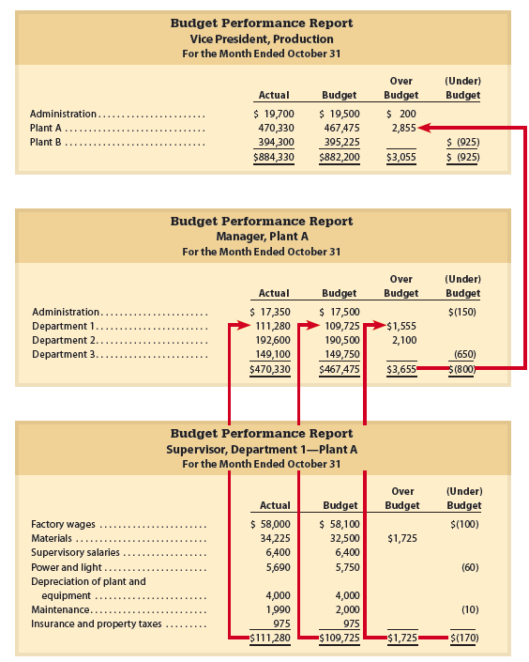
Responsibility Accounting Reports for Cost Centers (2 of 2)

Slide 16
Responsibility Accounting for Profit Centers (1 of 3)
A profit center manager has the responsibility and authority for making decisions that affect both revenues and costs and, thus, profits.
  Profit centers may be divisions, departments, or products.
  The manager does not make decisions concerning the fixed assets invested in the center.

Slide 17
Responsibility Accounting for Profit Centers (2 of 3)
Responsibility accounting for profit center focuses on reporting revenues, expenses, and income from operations.
  Thus, responsibility accounting reports for profit centers take the form of income statements.

Slide 18
Responsibility Accounting for Profit Centers (3 of 3)
The profit center income statement should include only revenues and expenses that are controlled by the manager.
Controllable revenues
Controllable expenses
Revenues earned by the profit center
Costs that can be influenced (controlled) by the decisions of the profit center managers

Slide 19
Service Department Cost Allocations (1 of 11)
The controllable expenses of profit centers include direct operating expenses such as sales salaries and utility expenses.
In addition, a profit center may incur expenses provided by internal centralized service departments.

Slide 20
Service Department Cost Allocations (2 of 11)
  Examples of such service departments include the following:
    Research and Development
    Legal
    Telecommunications
    Information and Computer Systems
    Facilities Management
    Purchasing
    Advertising
    Payroll Accounting
    Transportation
    Human Resources

Slide 21
Service Department Cost Allocations (3 of 11)
Service department allocations are indirect expenses to a profit center.
  They are similar to the expenses that would be incurred if the profit center purchased the services from outside the company.
A profit center manager has control over service department expenses if the manager is free to choose how much service is used.
  In such cases, service department costs are allocated to profit centers based on the usage of the service by each profit center.

Slide 22
Service Department Cost Allocations (4 of 11)
Nova Entertainment Group (NEG), a diversified entertainment company, has the following two operating divisions organized as profit centers:
  Theme Park Division
  Movie Production Division

Slide 23
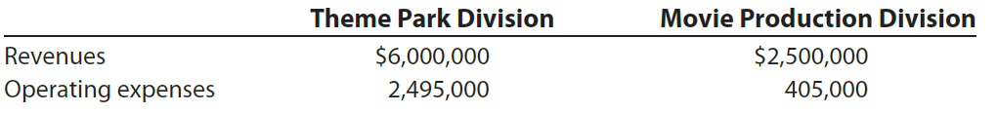
Service Department Cost Allocations (5 of 11)
The revenues and direct operating expenses for the two divisions follow:
  The operating expenses consist of direct expenses, such as the wages and salaries of a division’s employees

Slide 24
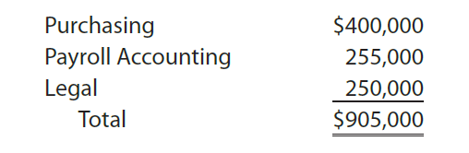
Service Department Cost Allocations (6 of 11)
NEG’s service departments and the expenses they incurred for the year ended December 31 are as follows:

Slide 25
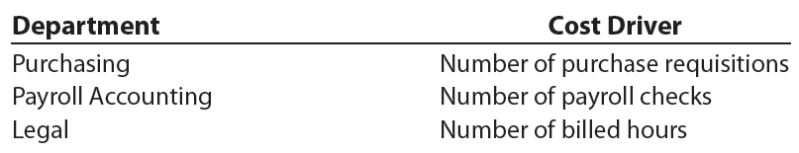
Service Department Cost Allocations (7 of 11)
A cost driver for each service department is used to allocate service department costs to the Theme Park and Movie Production divisions.
  The cost driver for each service department is a measure of the services performed.
  For NEG, the service department cost drivers are as follows:

Slide 26
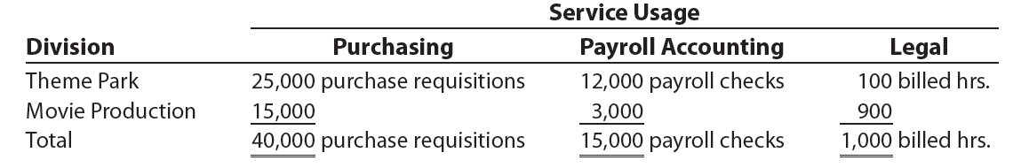
Service Department Cost Allocations (8 of 11)
The use of services by the Theme Park and Movie Production divisions is as follows:

Slide 27
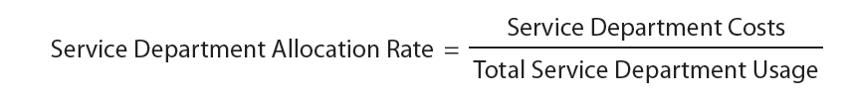
Service Department Cost Allocations (9 of 11)
The rates at which services are applied to each division are called department allocation rates. These rates are computed as follows:

Slide 28


Service Department Cost Allocations (10 of 11)
  NEG’s service department allocation are computed as follows:

Slide 29
Service Department Cost Allocations (11 of 11)
The services used by each division are multiplied by the service department allocation rates to determine the service costs for each division, computed as follows:

Slide 30
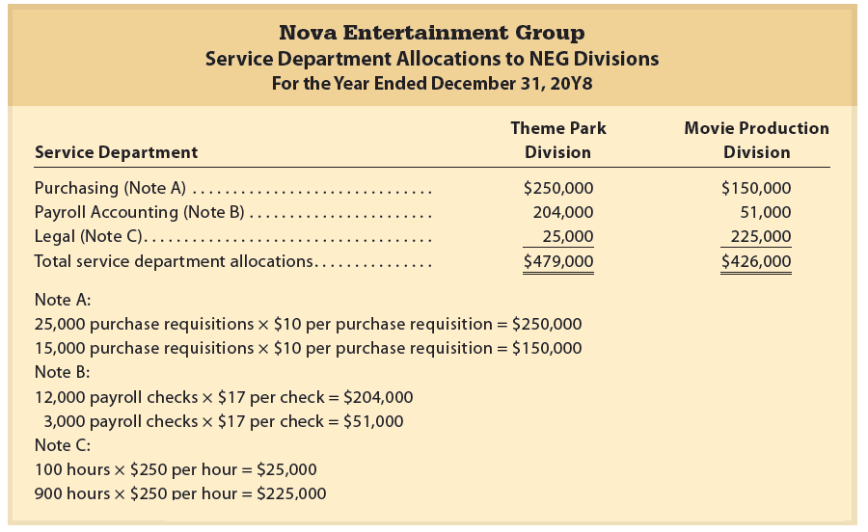
Service Department Allocations to NEG Divisions

Slide 31
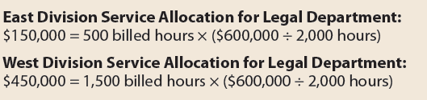
Example Exercise: Service Department Allocations
The centralized legal department of Johnson Company has costs of $600,000. The department has provided a total of 2,000 hours of service for the period. The East Division has used 500 hours of legal service during the period, and the West Division has used 1,500 hours. How much should each division be allocated for legal services?

Slide 32
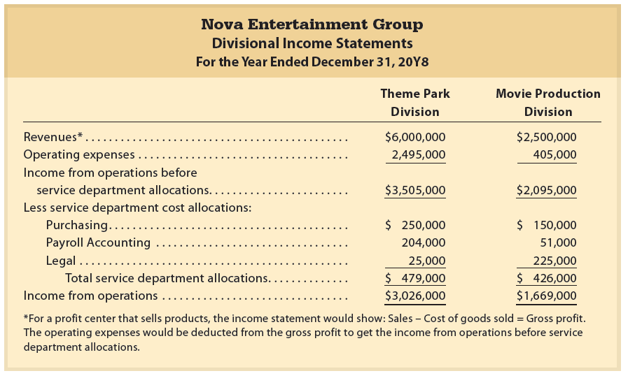
Divisional Income Statements—NEG

Slide 33
Profit Center Reporting
In evaluating the profit center manager, the income from operations should be compared over time to a budget.
However, it should not be compared across profit centers, because the profit centers are usually different in terms of size, products, and customers.

Slide 34
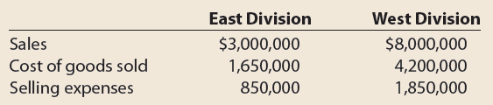
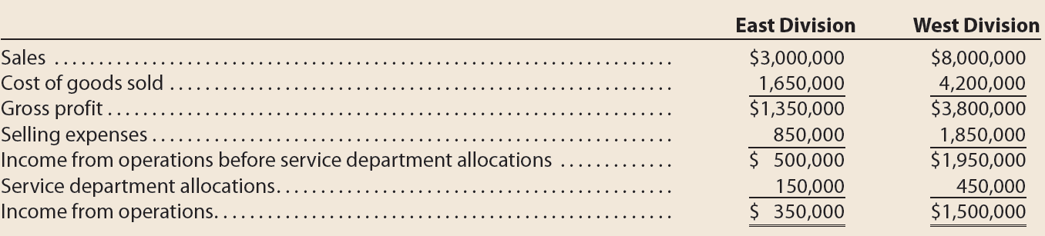
Example Exercise: Income for Profit Center
Using the data for Johnson Company below, determine the divisional income from operations for the East and West divisions. The internal service allocation for the Legal Department was $150,000 for the East Division and $450,000 for the West Division.

Slide 35
Responsibility Accounting for Investment Centers
(1 of 2)
An investment center manager has the responsibility and the authority to make decisions that affect not only costs and revenues but also the assets invested in the center.
Investment centers are often used in diversified companies by divisions.
  In such cases, the divisional manager has authority similar to that of a chief operating officer or president of a company.

Slide 36
Responsibility Accounting for Investment Centers
(2 of 2)
Because investment center managers have responsibility for revenues and expenses, income from operations is part of investment center reporting.
In addition, because the manager has responsibility for the assets invested in the center, the following two additional measures of performance are used:
  Rate of return on investment
  Residual income

Slide 37
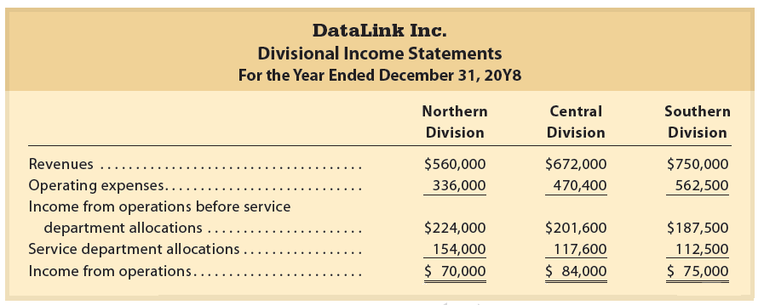
Divisional Income Statements—DataLink Inc.

Slide 38

Return on Investment (1 of 14)
Because investment center managers control the amount of assets invested in their centers, they should be evaluated on the use of these assets.
One measure that considers the amount of assets invested is the return on investment (ROI) or return on assets.
The return on investment (ROI) is computed as follows:

Slide 39
Return on Investment (2 of 14)
The return on investment is useful because the three factors subject to control by divisional managers (revenues, expenses, and invested assets) are considered.
The higher the return on investment, the better the division is using its assets to generate income.
In effect, the return on investment measures the income (return) on each dollar invested.
As a result, the return on investment can be used as a common basis for comparing divisions with each other.

Slide 40
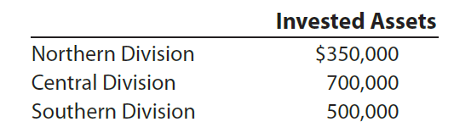
Return on Investment (3 of 14)
The invested assets of DataLink’s three divisions are as follows:

Slide 41
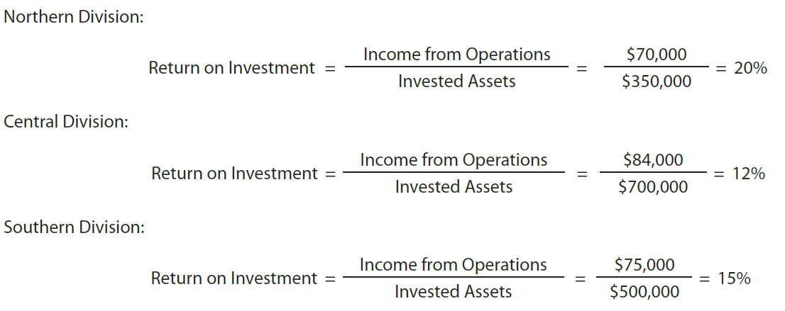
Return on Investment (4 of 14)
Using the income from operations for each division, the return on investment for each division is computed as follows:

Slide 42
Return on Investment (5 of 14)
To analyze differences in the return on investment across divisions, the DuPont formula for the return on investment is often used.
The DuPont formula views the return on investment as the product of the following two factors:
Profit margin
Investment turnover
Ratio of income from operations to sales
Ratio of sales to invested assets

Slide 43
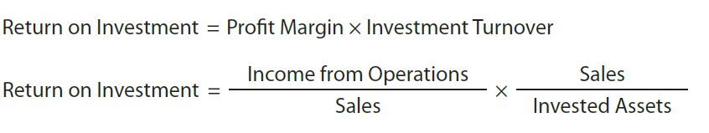
Return on Investment (6 of 14)
Using the DuPont formula, the return on investment is expressed as follows:

Slide 44
Return on Investment (7 of 14)
The DuPont formula is useful in evaluating divisions.
  This is because the profit margin and the investment turnover reflect the following underlying operating relationships of each division:
    Profit margin indicates operating profitability by computing the rate of profit earned on each sales dollar.
      If a division’s profit margin increases, and all other factors remain the same, the division’s rate of return on investment will increase.
    Investment turnover indicates operating efficiency by computing the number of sales dollars generated by each dollar of invested assets.
      If a division’s investment turnover increases, and all other factors remain the same, the division’s rate of return on investment will increase.

Slide 45
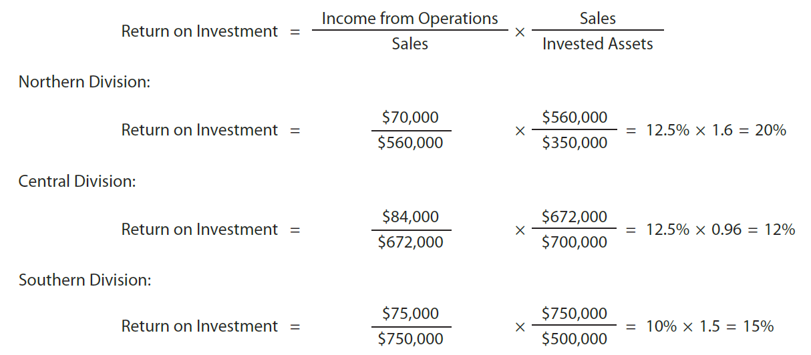
Return on Investment (8 of 14)
Using the DuPont formula yields the same return on investment for each of DataLink’s divisions, computed as follows:

Slide 46
Return on Investment (9 of 14)
To increase the return on investment, the profit margin and investment turnover for a division may be analyzed.
  For example, assume that the Northern Division is in a highly competitive industry in which the profit margin cannot be easily increased
    As a result, the division manager might focus on increasing the investment turnover

Slide 47
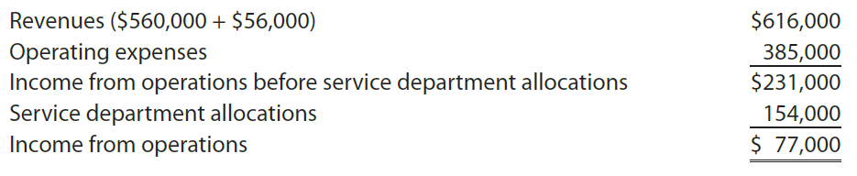
Return on Investment (10 of 14)
Assume that the revenues of the Northern Division could be increased by $56,000 through increasing operating expenses, such as advertising, to $385,000.
  The Northern Division’s income from operations will increase from $70,000 to $77,000, computed as follows:

Slide 48

Return on Investment (11 of 14)
  The rate of return on investment for the Northern Division, using the DuPont formula, is recomputed as follows:

Slide 49
Return on Investment (12 of 14)
The return on investment is also useful in deciding where to invest additional assets or expand operations.
  For example, DataLink should give priority to expanding operations in the Northern Division because it earns the highest return on investment.
    In other words, an investment in the Northern Division will return 20 cents (20%) on each dollar invested. In contrast, investments in the Central and Southern divisions will earn only 12 cents (12%) and 15 cents (15%), respectively, per dollar invested.

Slide 50
Return on Investment (13 of 14)
A disadvantage of the return on investment as a performance measure is that it may lead divisional managers to reject new investments that could be profitable for the company as a whole.

Slide 51
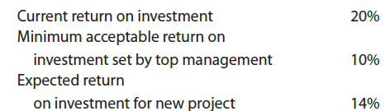
Return on Investment (14 of 14)
Assume the following returns for the Northern Division of DataLink:
  If the manager of the Northern Division invests in the new project, the Northern Division’s overall return will decrease from 20% due to averaging.
    Thus, the division manager might decide to reject the project, even though the new project’s expanded rate of return of 14% exceeds DataLink’s minimum acceptable rate of return of 10%.

Slide 52
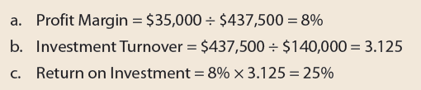
Example Exercise: Profit Margin, Investment Turnover, and ROI
Campbell Company has income from operations of $35,000, invested assets of $140,000, and sales of $437,500. Use the DuPont formula to compute the return on investment and show (a) the profit margin, (b) the investment turnover, and (c) the return on investment.

Slide 53
Residual Income (1 of 5)
Residual income is useful in overcoming some of the disadvantages of the return on investment.
Residual income is the excess of income from operations over a minimum acceptable income from operations.
  The minimum acceptable income from operations is computed by multiplying the company minimum return by the invested assets
    The minimum return is set by top management, based on such factors as the cost of financing.

Slide 54
Residual Income (2 of 5)

Slide 55
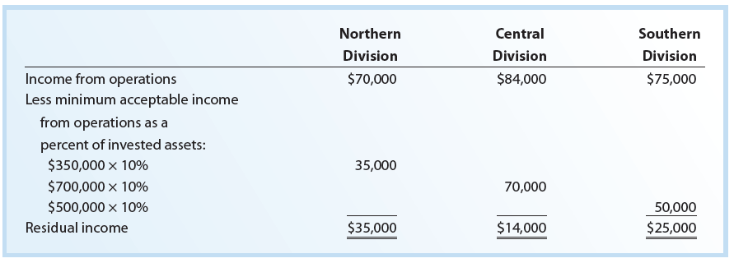
Residual Income—DataLink, Inc.

Slide 56
Residual Income (3 of 5)
The major advantage of residual income as a performance measure is that it considers both the minimum acceptable return, invested assets, and the income from operations for each division.
  In doing so, residual income encourages division managers to maximize income from operations in excess of the minimum.
    This provides an incentive to accept any project that is expected to have a return in excess of the minimum.

Slide 57
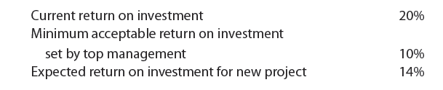
Residual Income (4 of 5)
Assume the following return for the Northern Division of DataLink:

Slide 58
Residual Income (5 of 5)
  If the manager of the Northern Division is evaluated on new projects using only return on investment, the division manager might decide to reject the new project.
    This is because investing in the new project will decrease Northern’s current return of 20%.
      While this helps the division maintain its high ROI, it hurts the company as a whole because the expected return of 14% exceeds DataLink’s minimum acceptable return of 10%.
  In contrast, if the manager of the Northern Division is evaluated using residual income, the new project would probably be accepted.
    This is because investing in the new project will increase the Northern Division’s residual income.
      In this way, residual income supports both divisional and overall company objectives.

Slide 59
Example Exercise: Residual Income
The Wholesale Division of PeanutCo has income from operations of $87,000 and assets of $240,000. The minimum acceptable return on assets is 12%. What is the residual income for the division?

Slide 60
The Balanced Scorecard (1 of 3)
The balanced scorecard is a set of multiple performance measures for a company.
  In addition to financial performance, a balanced scorecard normally includes performance measures for the following:
    Customer service
    Innovation and learning
    Internal processes

Slide 61
The Balanced Scorecard (2 of 3)

Slide 62
The Balanced Scorecard (3 of 3)
The balanced scorecard attempts to identify the underlying nonfinancial drivers, or causes, of financial performance related to innovation and learning, customer service, and internal processes.
  In this way, the financial performance may be improved.

Slide 63
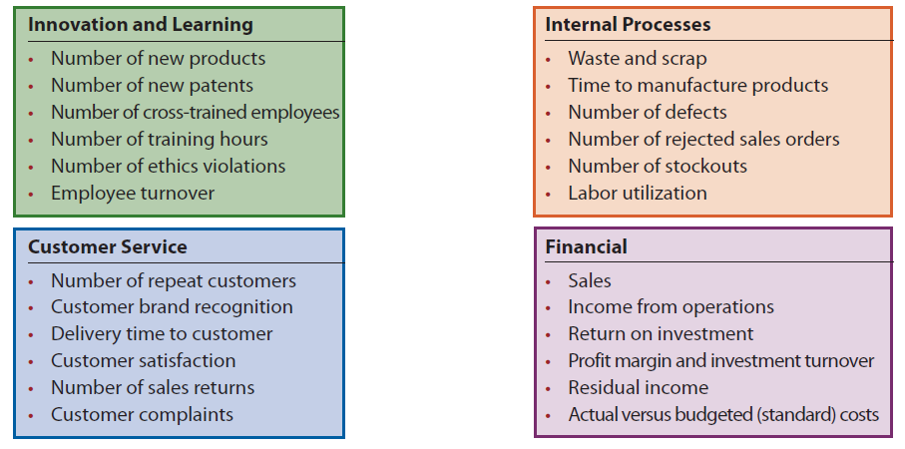
Balanced Scorecard Performance Measures

Slide 64
Transfer Pricing (1 of 3)
When divisions transfer products or render services to each other, a transfer price is used to charge for the products or services.
Because transfer prices will affect a division’s financial performance, setting a transfer price is a sensitive matter for the managers of both the selling and buying divisions.

Slide 65

Transfer Pricing (2 of 3)
Common approaches to setting transfer prices
Market price approach
Cost approach
Negotiated price approach

Slide 66
Transfer Pricing (3 of 3)
The objective of setting a transfer price is to motivate managers to behave in a manner that will increase the overall company income.
Transfer prices can be set as low as the variable cost per unit or as high as the market price. Often, transfer prices are negotiated at some point between these two.

Slide 67
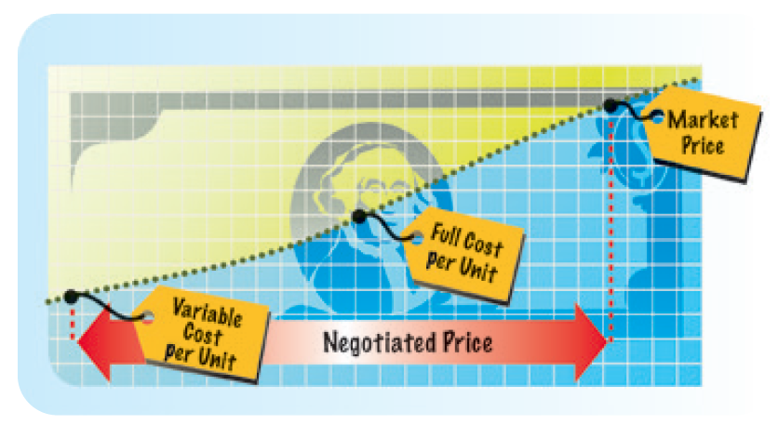
Commonly Used Transfer Prices

Slide 68
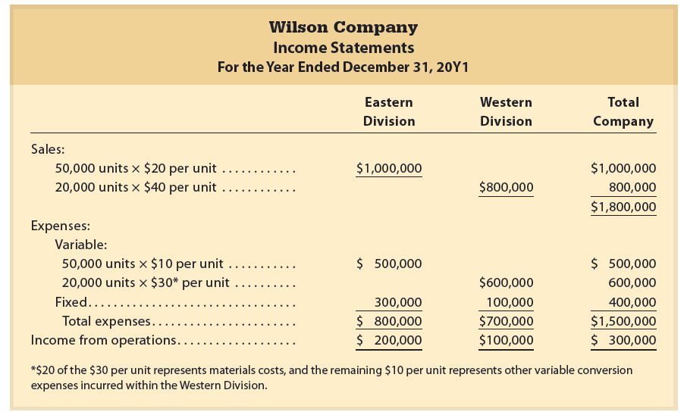
Income Statements—No Transfers Between Divisions

Slide 69
Market Price Approach (1 of 3)
Using the market price approach, the transfer price is the price at which the product or service transferred could be sold to outside buyers.
If an outside market exists for the product or service transferred, the current market price may be a proper transfer price.
Transfer Price = Market Price

Slide 70
Market Price Approach (2 of 3)
Assume that materials used by Wilson in producing snack food in the Western Division are currently purchased from an outside supplier at $20 per unit.
The same materials are produced by the Eastern Division.
The Eastern Division is operating at full capacity of 50,000 units and can sell all it produces to either the Western Division or to outside buyers.

Slide 71
Market Price Approach (3 of 3)
A transfer price of $20 per unit (the market price) has no effect on the Eastern Division’s income or total company income.
  The Eastern Division will earn revenues of $20 per unit on all its production and sales, regardless of who buys its product.
  The Western Division will pay $20 per unit for materials (the market price).
In this situation, the use of the market price as the transfer price is proper.

Slide 72
Negotiated Price Approach (1 of 7)
If unused or excess capacity in the supplying division (the Eastern Division) and the transfer price is equal to the market price, total company profit may not be maximized.
  That is because the manager of the Western Division will be indifferent toward purchasing materials from the Eastern Division or from outside suppliers.
    That is, in both cases the Western Division manager pays $20 per unit (the market price). Therefore, the Western Division may purchase the materials from outside suppliers.

Slide 73
Negotiated Price Approach (2 of 7)
If, however, the Western Division purchases the materials from the Eastern Division, the difference between the market price of $20 and the variable costs of the Eastern Division of $10 per unit can cover fixed costs and contribute to overall company profits.
  Thus, the Western Division manager should be encouraged to purchase the materials from the Eastern Division.

Slide 74
Negotiated Price Approach (3 of 7)
The negotiated price approach allows the managers to agree (negotiate) among themselves on a transfer price.
The only constraint is that the transfer price be less than the market price, but greater than the supplying division’s variable costs per unit, as follows:
Variable Costs per Unit < Transfer Price < Market Price

Slide 75
Negotiated Price Approach (4 of 7)
Assume that instead of a capacity of 50,000 units, the Eastern Division’s capacity is 70,000 units.
In addition, assume that the Eastern Division can continue to sell only 50,000 units to outside buyers.

Slide 76
Negotiated Price Approach (5 of 7)
A transfer price of less than $20 would encourage the manager of the Western Division to purchase from the Eastern Division.
  This is because the Western Division is currently purchasing its materials from outside suppliers at a cost of $20 per unit.
    Thus, its materials cost would decrease, and its income from operations would increase.
At the same time, a transfer price above the Eastern Division’s variable costs per unit of $10 would encourage the manager of the Eastern Division to supply materials to the Western Division.
  In doing so, the Eastern Division’s income from operations would also increase.

Slide 77
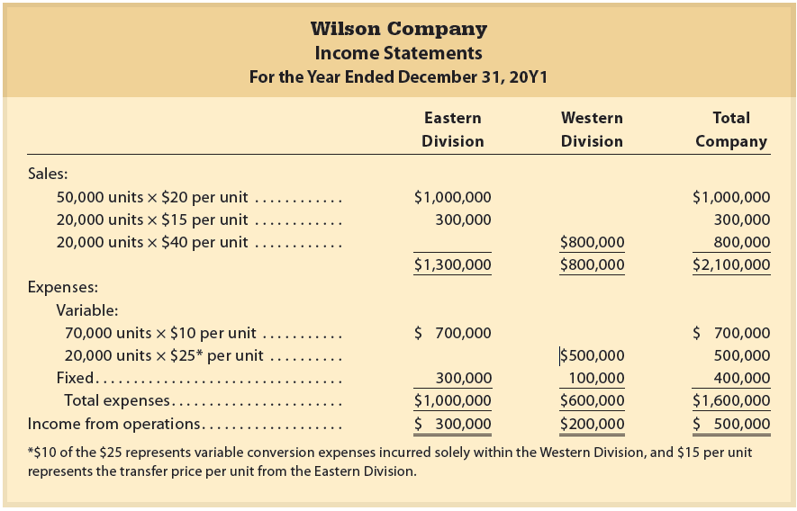
Income Statements—Negotiated Transfer Price

Slide 78

Negotiated Price Approach (6 of 7)
Any negotiated transfer price between $10 and $20 is acceptable, as shown in the following formula:

Slide 79
Negotiated Price Approach (7 of 7)
As shown, a negotiated price provides each division manager with an incentive to negotiate the transfer of materials.
At the same time, the overall company’s income from operations will also increase.
However, the negotiated approach only applies when the supplying division has excess capacity.

Slide 80
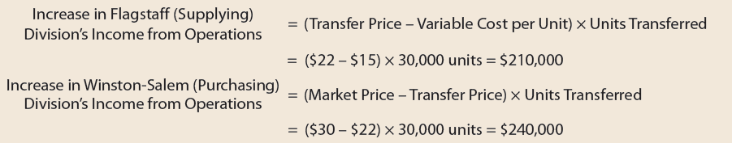
Example Exercise: Transfer Pricing
The materials used by the Winston-Salem Division of Fox Company are currently purchased from outside suppliers at $30 per unit. These same materials are produced by Fox’s Flagstaff Division. The Flagstaff Division can produce the materials needed by the Winston-Salem Division at a variable cost of $15 per unit. The division is currently producing 70,000 units and has capacity of 100,000 units. The two divisions have recently negotiated a transfer price of $22 per unit for 30,000 units. By how much will each division’s income increase as a result of this transfer?

Slide 81
Cost Price Approach (1 of 3)
Under the cost price approach, cost is used to set transfer prices.
A variety of costs may be used in this approach, including:
  Total product cost per unit
    If total product cost per unit is used, direct materials, direct labor, and factory overhead are included in the transfer price.
  Variable product cost per unit
    If variable product cost per unit is used, the fixed factory overhead cost is excluded from the transfer price.

Slide 82
Cost Price Approach (2 of 3)
Actual costs or standard (budgeted) costs may be used in applying the cost price approach.
  If actual costs are used, inefficiencies of the purchasing (supplying) division are transferred to the purchasing division.
    Thus, there is little incentive for the producing (supplying) division to control costs.
  Most companies use standard costs in the cost price approach.
    In this way, differences between actual and standard costs remain with the producing (supplying) division for cost control purposes.

Slide 83
Cost Price Approach (3 of 3)
The cost price approach is most often used when the responsibility centers are organized as cost centers.
  When the responsibility centers are organized as profit or investment centers, the cost price approach is normally not used
    For example, using the cost price approach when the supplying division is organized as a profit center ignores the supplying division manager’s responsibility for earning profits
      In this case, using the cost price approach prevents the supplying division from reporting any profit (revenues – costs) on the units transferred
        As a result, the division manager has little incentive to transfer units to another division, even though it may be in the best interests of the company

