Slide 1
Computerized Accounting with QuickBooks 2019

Slide 2
QuickBooks 2019
Overview, Open a Company File, Create a Backup Copy, Restore a Backup Copy, and Change the Company Name

Slide 3
Objectives
Describe the differences and similarities between manual and computerized accounting
Identify the four levels of operation within QuickBooks
Open QuickBooks
Open a company file
Make a backup copy of a company file
Restore a backup copy of a company file
Change the company name in a company file

Slide 4
Introduction
QuickBooks 2019 is an accounting software package used to record business and accounting activities and prepare reports.
It is designed with the non-accountant in mind.
Many data entry windows are described in everyday, non-accounting terms.
Behind the scenes QuickBooks uses traditional accounting procedures to record, summarize, and report financial information.

Slide 5
QuickBooks v. Manual Accounting
Computerized accounting software packages follow the procedures used in a manual accounting system.
QuickBooks does not do its recording in special journals; therefore, it is not necessary to understand the special journals.
Transactions are identified by business function:
Vendors
Customers
Employees
Banking

Slide 6
QuickBooks v. Manual Accounting Cont.
Forms are used to enter bills, pay bills, create an invoice, receive payments, and so on.
Behind the scenes, QuickBooks updates:
the appropriate accounting reports
the journal
general ledger
trial balance
financial statements, based on activity entered in the system

Slide 7
Four Levels of Operation
QuickBooks can be classified into four levels of operation: New Company Setup, Lists/Centers, Activities, and Reports

Slide 8
Four Levels of Operation Cont.
Level 1: creating and setting up a new company file with the background information for the new company
involves recording the company name, address, identification numbers, fiscal periods of time, nature of business, accounts, and balances

Slide 9
Four Levels of Operation Cont.
Level 2: recording background information in Lists/Centers
Lists include:
Chart of Accounts
Item
Fixed Asset Item
Price Level
Billing Rate Level
Sales Tax Code
Payroll Item
Centers include:
Customer
Vendor
Employee
Lists/Centers function similar to a database.

Slide 10
Four Levels of Operation Cont.
Level 3: recording daily business (routine) activity in QuickBooks
activities identified with common language such as enter bills, write checks, create invoices, receive payments, and so on
information in Lists/Centers frequently used to eliminate repetitive keying of data

Slide 11
Four Levels of Operation Cont.
Level 4: using QuickBooks to display and print an assortment of Reports, such as:
management reports related to each activity:
Vendor
Customer: job
Inventory
Payroll
accounting reports:
Journal
General ledger
Trial balance
financial statements:
Income statement
Balance sheet

Slide 12
Quick Check
Chart of Accounts, Customer, and Items are examples of QuickBooks _____
Lists/Centers.
Activities.
Reports.
Accounts.

Slide 13
Installing QuickBooks
A software card provides access to the Student Trial Edition of QuickBooks 2019.
The Student Trial Edition:
is a complete version of the software
allows you to use software for 5 months
The software card:
includes License Number and Product number that are entered as part of the installation process
should be stored in a safe place
See the text for steps to install the Student Trial Edition of QuickBooks 2019.

Slide 14
Installing Company Files
Install QuickBooks on your computer.
Follow instructions in the textbook to download student company files.
Company files are used to complete the chapter problem and case problems presented in each chapter.
Install company files onto the hard drive or network directory.
By default, the operating system on your computer determines where QuickBooks stores company files.

Slide 15
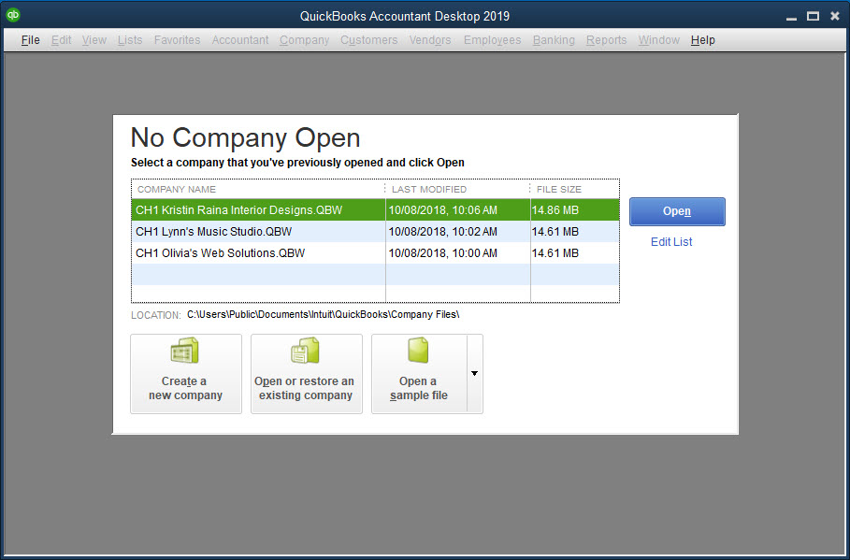
Opening QuickBooks
QuickBooks is opened and the QuickBooks main window appears.
A window titled No Company Open also appears.
In the No Company Open window, there are several choices:
Create a new company (Chapters 6 and 7)
Open or restore an existing company (Chapters 1–5 and 8–12)
Open a sample file
If someone has already used QuickBooks on this computer and not closed their file, the last company file used is automatically opened.

Slide 16
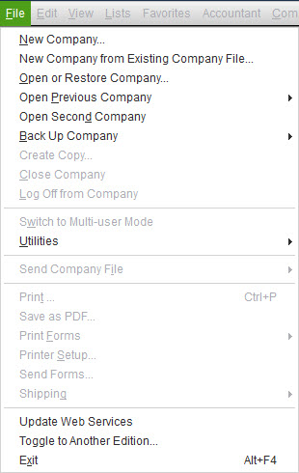
Using Drop-Down Menus and Dialog Boxes
The main menu bar includes the menu choices of File, Edit, View, etc.
When no company is open, only the menus File and Help are active and can be chosen.
Choose a menu by clicking the menu name or by pressing the Alt key and the underlined letter from the menu name on the keyboard.
When you choose a command followed by:
an ellipsis (…), a dialog box appears
an arrow, a submenu appears

Slide 17
Versions of QuickBooks
Intuit, the maker of QuickBooks, offers several versions of QuickBooks software:
Pro
used by small business owners
Premier and Enterprise Solutions
used by larger businesses, businesses that have large industries, or specific industries
QuickBooks also offers four online versions of the software for a monthly fee:
QuickBooks Online Self-Employed
QuickBooks Online Simple Start
QuickBooks Online Essentials
QuickBooks Online Plus

Slide 18
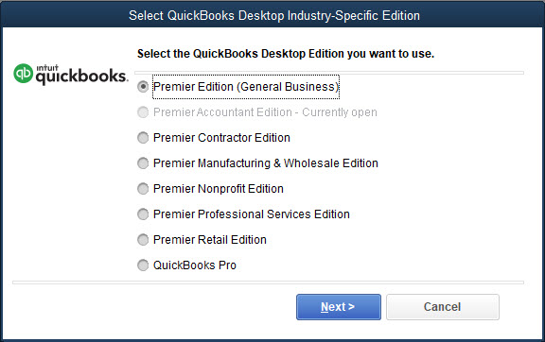
Versions of QuickBooks Cont.
To toggle to other versions or editions of QuickBooks in the QuickBooks Premier Accountant Edition:
Click File and then click Toggle to Another Edition.
In the Select QuickBooks Desktop Industry-Specific Edition dialog box, click the desired version or edition of QuickBooks.
Click Next. If you click Toggle, QuickBooks will close and reopen in the version/edition of QuickBooks you chose.

Slide 19
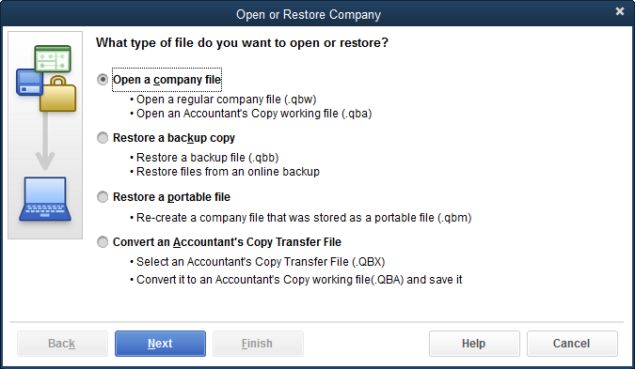
Opening a Company File
To open a company file:
At the No Company Open window, click the Open or restore an existing company button, or click File and then click Open or Restore Company.
Select Open a company file and click Next.
In the Open a Company Dialog box in the Look in text box, choose the subfolder that contains the company files.
Select and open the desired company file.
Enter the password.

Slide 20
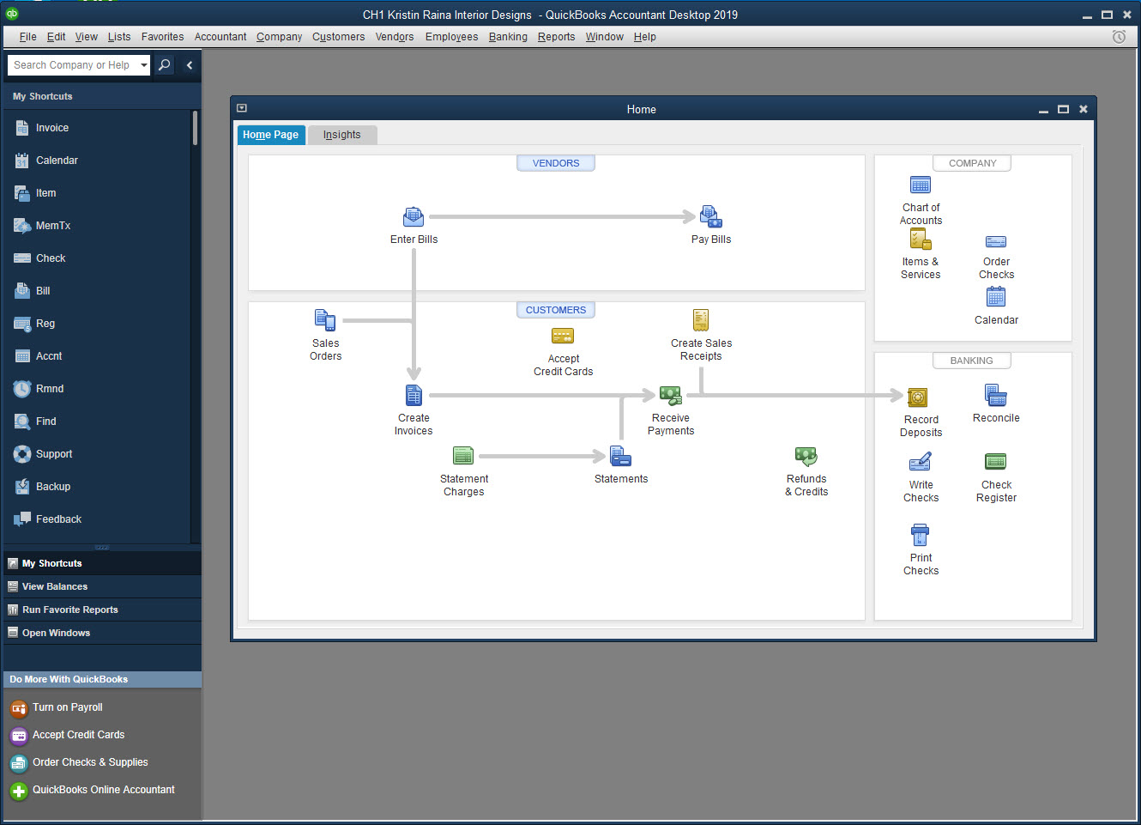
Opening a Company File Cont.
The Left Icon bar and the Home page can be used to access information in QuickBooks as an alternative to using the main menu bar.
Close the Left Icon bar and the Home page to allow more screen space for the windows.

Slide 21
Multi-User and Single-User Mode
Multi-user mode:
when many people use one company file at the same time
users work individually, but at the same time, the company file updated as a whole
up to five users at one time
Single-user mode:
when a QuickBooks company file is used only on a single computer

Slide 22
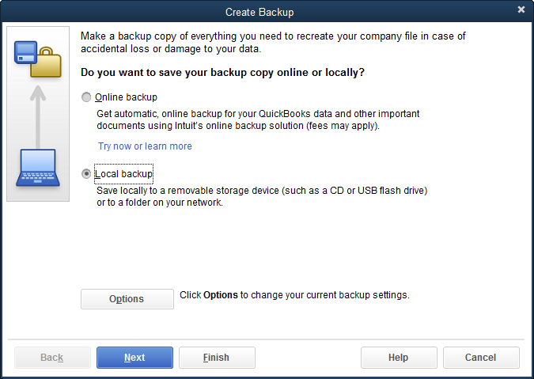
Backing Up a Company File
The Back Up command is used for two purposes:
to make a copy of the original company file
to make backup copies of company files on a removable storage device or network

Slide 23
Backing Up a Company File Cont.
Naming Backup Files
Two types of names are used in QuickBooks to identify a company file:
file name
company name
QuickBooks automatically assigns the extension .QBB to a backup copy and condenses the file.
cannot be used for work
strictly for use as stored copies
can be saved to the Company Files subfolder, to a subfolder of your choice, or to a removable storage device
To work on the backup copy of the company file, you must restore the backup copy.

Slide 24
Backing Up a Company File Cont.
To make a backup copy of a company file:
Click File and then click Back Up Company.
Click Create Local Backup.
Local backup should be selected. Click Next.
Click the Browse button.
Choose your subfolder and then click OK.
Remove the check mark to the left of Add the date and time of the backup to the file name and then click OK.
Click Use this Location.
Choose Save it now and then click Next.
Choose the appropriate subfolder, name your file, and click Save.
Click OK at the message.

Slide 25
Restoring a Company File
The Restore command is used to open a backup copy of a company file.
Backup copies are automatically assigned the extension .QBB.
condensed copies of a company file
QuickBooks gives the restored copy a .QBW extension.
working copies of the company file
Restoring a backup file is a two-step process:
Step 1: Determine which backup copy you wish to open (Open backup copy).
Step 2: Indicate where you wish to restore the backup copy to (Save Company File as).

Slide 26
Restoring a Company File Cont.
To restore the backup copy of the company file:
Click File and then click Open or Restore Company.
Select Restore a backup copy and then click Next.
Choose Local backup and then click Next.
In the Look in text box, choose the location where you saved your backup copy.
Select the company file, open it, and then click Next.
Choose the subfolder where you will be opening and working on your copies of the company files, name your file, and click Save.
If the QuickBooks Desktop Login window appears, enter the password (Student1 for this textbook).

Slide 27
Quick Check
QuickBooks automatically gives a restored copy of a backup the _____ extension.
.QBB
.NEW
.RES
.QBW

Slide 28
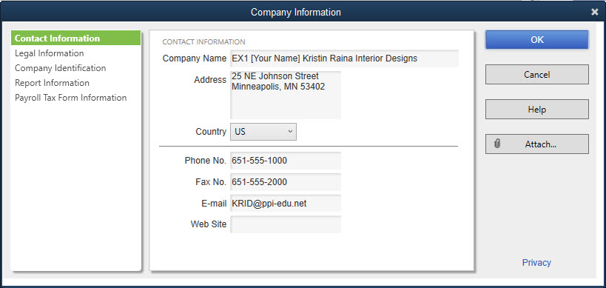
Restoring a Company File Cont.
Changing the Company Name
After the backup copy is successfully restored, your exercise copy of the company file appears in the QuickBooks window, but the title bar indicates the original company file name.
Before you begin working, change the company name in the My Company window to match the exercise company file name.

Slide 29
Restoring a Company File Cont.
Changing the Company Name
The name of the company file in the Open a Company dialog box is based on the file name typed in the Backup and Restore dialog boxes.
type same name in both places to keep track of files
In business, backup is used to maintain a copy of company financial records.
backup on regular basis
restore backup copy only if damaged files or upgraded computer system
accountant may use backup and restore procedures when reviewing clients’ accounting records

Slide 30
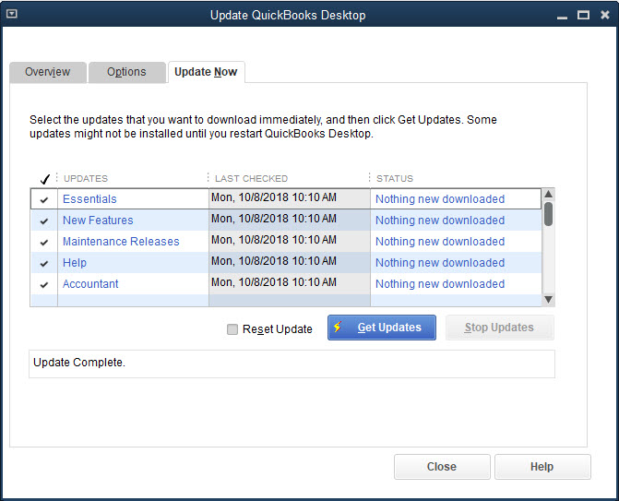
QuickBooks Updates
QuickBooks provides product updates to the software.
Product updates:
are delivered via the internet
can be automatically downloaded by your computer

Slide 31
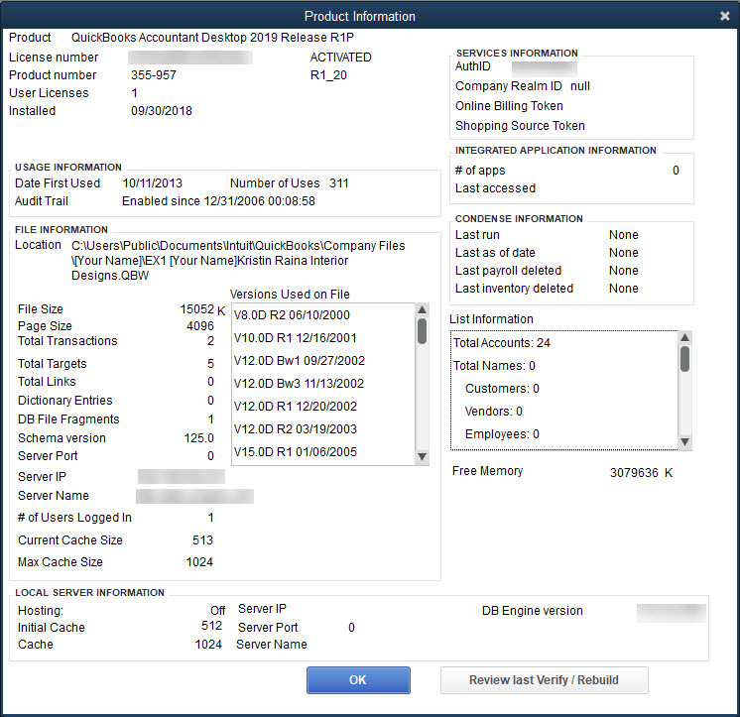
QuickBooks Updates Cont.
To determine the most recent update downloaded onto your computer:
press the F2 key on the keyboard,
or, press Ctrl + 1, to display the Product Information window

Slide 32
Exiting QuickBooks
Most work is automatically saved in QuickBooks when the correct command button is chosen.
At the end of a session, use the Back Up command to save work onto a USB or network.
To leave QuickBooks, go to the File menu and select Exit.

Slide 33
Terms
accounting The process of recording, summarizing, and presenting financial information of a company in the form of financial statements.
financial statements Summaries of the financial information of a company. The most common are the income statement and the balance sheet.
general journal The document in which transactions are initially recorded chronologically. At the end of the month, transactions in the general journal are posted (rewritten) to the general ledger.
general ledger The document in which transactions are summarized by account.
multi-user mode A setting in QuickBooks that allows up to five users to access a company file at the same time, each on their own computer.

Slide 34
Terms Cont.
single-user mode A setting in QuickBooks that allows only one user on a single computer to access a company file.
special journals Journals such as the purchases journal, sales journal, cash receipts journal, and cash payments journal that can be used instead of the general journal to chronologically record similar transactions. Transactions in the special journals are posted (rewritten) to the general ledger at the end of the month.
transaction A monetary business event or activity.
trial balance A report containing all the general ledger account names, their respective debit and credit balances, and the total debits and total credits.

