Slide 1
Computerized Accounting with QuickBooks 2019

Slide 2
Vendors
Adding Vendors and Creating and Paying Bills

Slide 3
Objectives
Identify the system default accounts for vendors
Update the Vendor Center
Record purchases on account in the Enter Bills window
Process credit memos in the Enter Bills window
Record payments of accounts payable in the Pay Bills window
Record cash purchases in the Write Checks window
Display and print vendor-related reports

Slide 4
Introduction
QuickBooks allows you to track all vendor transactions.
A vendor is someone from whom the company buys goods or services, either on account or for cash.
You should establish a file for each vendor prior to entering transactions for that vendor.
The collection of all the vendor files comprises the Vendor Center (Lists/Centers).

Slide 5
Introduction Cont.
Once a vendor file is established, transactions (Activities) such as receiving a bill from a vendor, paying that bill, or making a cash purchase can be entered in these windows:
Enter Bills
Pay Bills
Write Checks
As transactions are recorded in the activities windows, QuickBooks will simultaneously update with the information about the transactions for the particular vendor.
Vendor Center
Any related reports (Reports)

Slide 6
QuickBooks v. Manual Accounting
Below is a comparison of a manual accounting ledger and journals with QuickBooks functions:
Manual Accounting System | QuickBooks
Accounts Payable Subsidiary Ledger | Vendor Center
Purchases Journal | Enter Bills window
Cash Payments Journal | Write Checks window

Slide 7
System Default Accounts
When you enter transactions, QuickBooks automatically increases or decreases certain account balances.
When you enter a vendor invoice in the Enter Bills window, QuickBooks automatically credits the Accounts Payable to record purchases on account.
When you write a check in the Pay Bills window, QuickBooks automatically debits the Accounts Payable account.

Slide 8
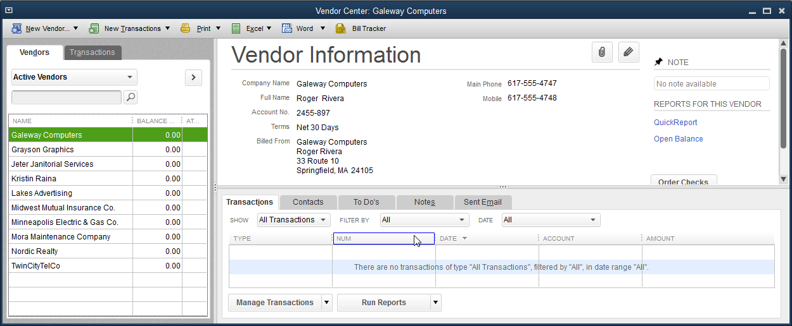
The Vendor Center
The Vendor Center contains important information on each vendor, such as company name, address, contact person, type of vendor, terms, credit limit, tax ID, and current balance owed.

Slide 9
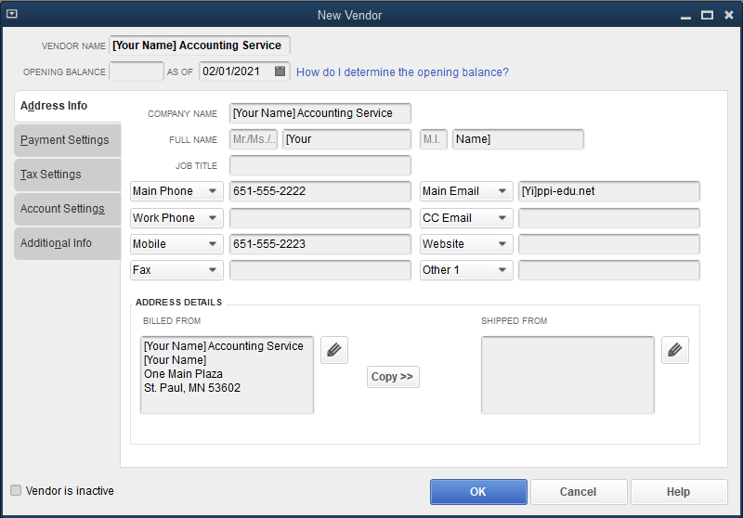
The Vendor Center Cont.
To add a new vendor:
Click the New Vendor button and select New Vendor.
In the Vendor Name field, enter the name of the vendor and additional details.

Slide 10
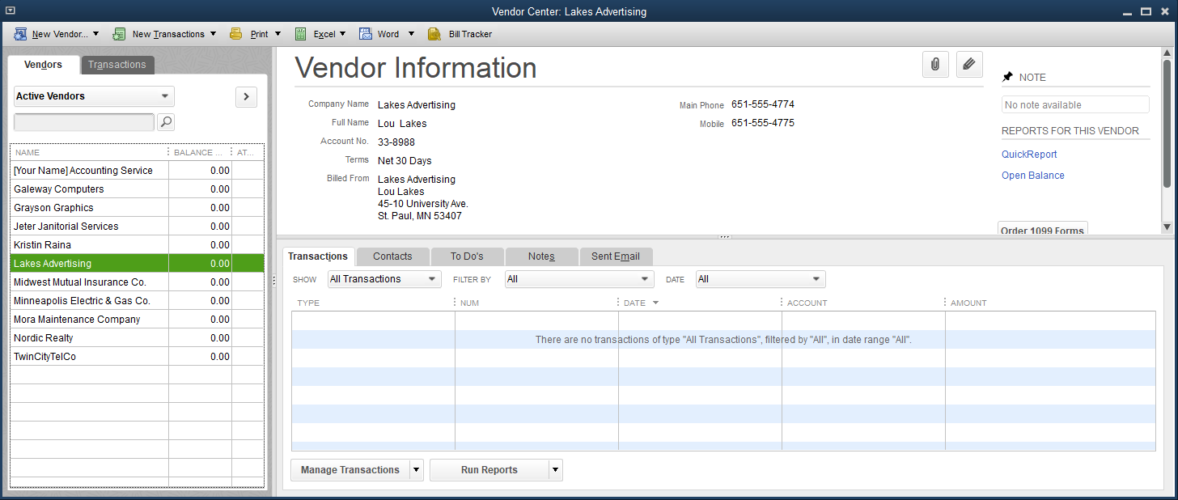
The Vendor Center Cont.
To delete a vendor:
Click Edit and then click Delete Vendor.
QuickBooks cannot delete a vendor who has a balance or who has been part of a transaction for the fiscal period.
If a vendor will no longer be used but there has been activity to the file for the fiscal period, you can mark the vendor inactive.

Slide 11
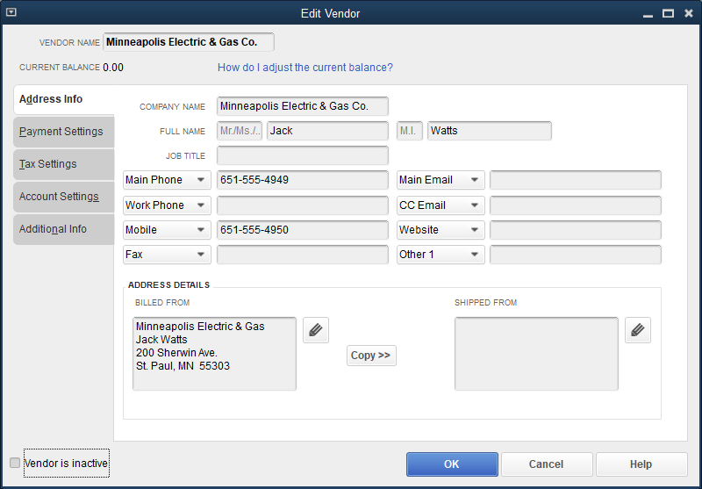
The Vendor Center Cont.
To edit a vendor:
Open the Vendor Center.
Open the vendor’s file.
Click the Edit icon to edit the information shown.
Click OK.

Slide 12
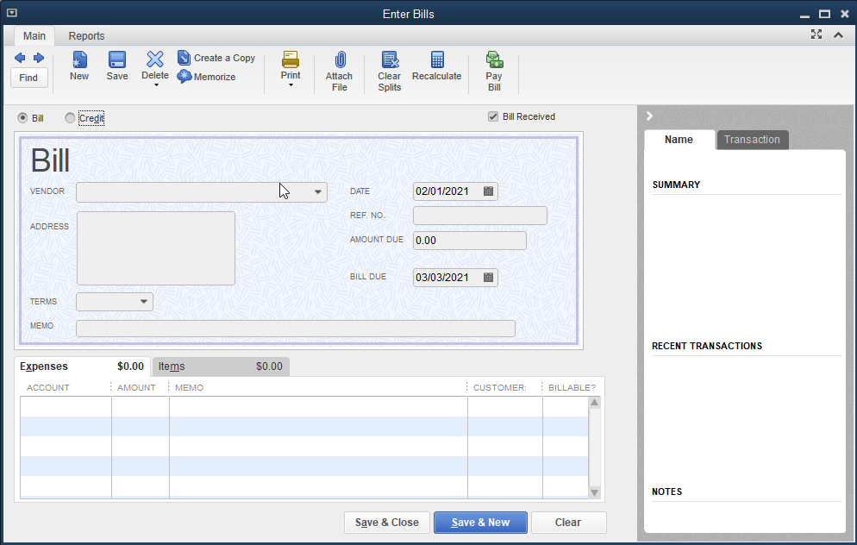
The Enter Bills Window

Slide 13
The Enter Bills Window Cont.
The Enter Bills window is used to:
record purchases on account
identify the vendor sending the bill, the invoice date, due date, terms of payment, and nature of purchase
record credit memos
Behind the scenes:

Slide 14
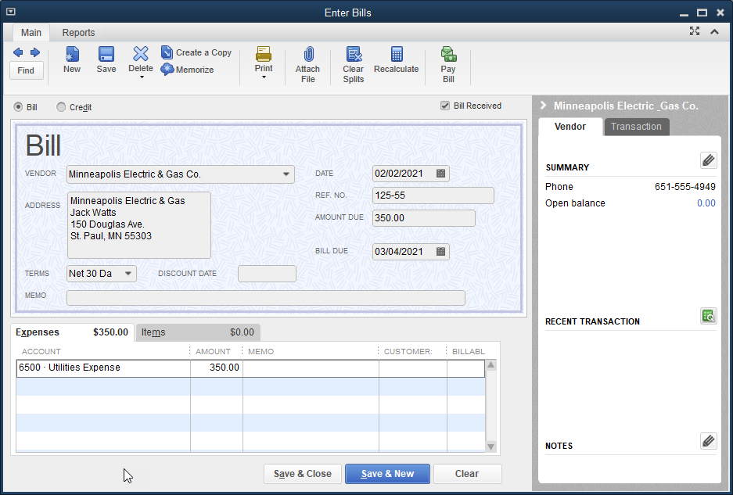
The Enter Bills Window Cont.
To enter a bill:
Click Vendors and then click Enter Bills.
Click the Bill option and the Bill Received check box.
Choose vendor, dates, payment terms, enter a reference no. and/or memo.
Choose expense account.
Enter amount.
Save bill.

Slide 15
The Enter Bills Window Cont.
To update the Vendor Center while in an Activities Window:
Click Vendors and then click Enter Bills.
At the VENDOR drop-down list, click < Add New >.
The New Vendor window appears. This is the same window that appears after choosing the New Vendor button in the Vendor Center window.
Enter the information for the new vendor.
Click OK to save.

Slide 16
The Enter Bills Window Cont.
To correct errors:
Open the window that contains the transaction and make the correction.
Use the Find button to view the transaction, correct the error, and the click the Save button.
An alternative is to delete the transaction.
Click Edit, click Delete Bill, and reenter the transaction correctly.

Slide 17
The Enter Bills Window Cont.
To process a credit memo:
Click Vendors and then click Enter Bills.
At the VENDOR drop-down list, choose the company.
Click the Credit option. When this option is chosen, the default entry is a debit to Accounts Payable.
Enter the appropriate information in the DATE, REF. NO., CREDIT AMOUNT, and MEMO fields.
Choose an account on the Expenses tab.
Click Save & Close.

Slide 18
Quick Check
What is the Vendor Center used for?
to record purchases on account
to identify the vendor sending the bill, the invoice date, due date, terms of payment, and nature of purpose
to record credit memos
to add, edit, or delete vendors

Slide 19
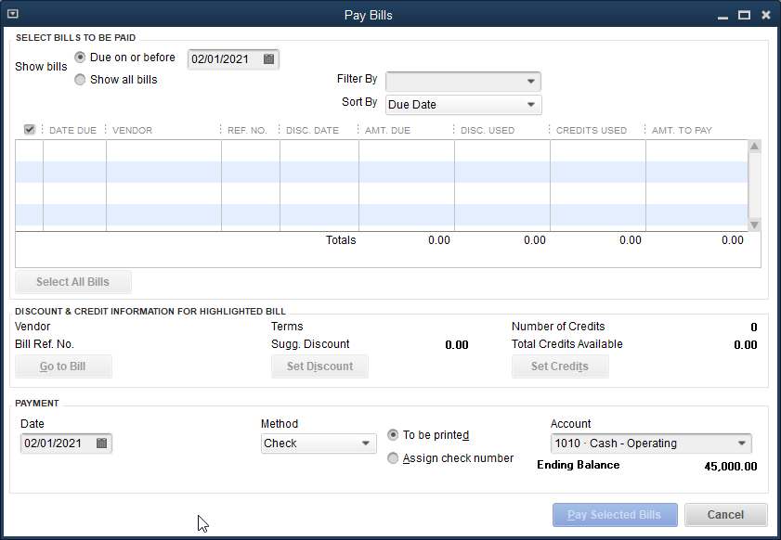
The Pay Bills Window

Slide 20
The Pay Bills Window Cont.
The Pay Bills window:
is used to record a payment on account
allows you to select bill(s) to be paid, pay all or part of each bill, and designate checks to be printed by the computer
displays all open bills as of a selected date
is designed only for payments of existing bills

Slide 21
The Pay Bills Window Cont.
These are the bills previously recorded in the Enter Bills window.
Bills can be paid in full or a partial payment can be made.
Payment can be in the form of check, credit card, or online payment.
Several bills can be paid at one time.
The Pay Bills window default accounts are Accounts Payable and Cash.
A transaction is recorded as follows:

Slide 22
The Pay Bills Window Cont.
To pay a bill in full:
Click Vendors and then click Pay Bills.
Click Show all bills.
At the Filter by field, choose the vendor.
Set the payment date.
Choose a payment method.
For example, you could choose Check and then Assign check number.
Select the appropriate payment account.
Choose the bill from the company by clicking in the box (❑) to place a check mark.
Click the Pay Selected Bills button, click the Let me assign the check numbers below option, then assign a check number.
Click OK.

Slide 23
The Pay Bills Window Cont.
To make a partial payment of a bill:
Click Vendors and then click Pay Bills.
Click Show all bills to display all bills.
At the Filter By field, choose the vendor.
Set the payment date.
At the PAYMENT Method field, choose Check; the Assign check no. option should be selected.
In the AMT. TO PAY field, on the line for the bill, enter the partial payment amount.
Click the Pay Selected Bills button and then click the Let QuickBooks assign check numbers option.
Click OK.

Slide 24
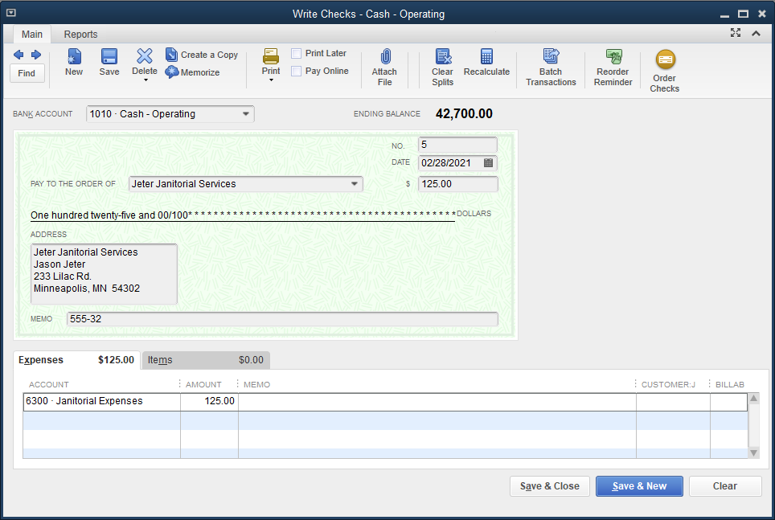
The Write Checks Window

Slide 25
The Write Checks Window Cont.
The Write Checks window is used to record cash purchases that have not been previously entered into the system.
This window is useful for companies that usually pay on account but occasionally receive bills and remit payments immediately.
Accounts Payable is not used, which allows for recording of a cash purchase in one step (not tracked in Accounts Payable or Vendor reports).

Slide 26
The Write Checks Window Cont.
Data fields in this window are similar to those of the Enter Bills window.
PAY TO THE ORDER OF (vendor name)
DATE
Expenses
Asset, or item purchased
The Write Checks window is used for all cash purchases, whether the payment is by check, PayPal, electronic transfer, or debit card.
The default account is Cash.
The transaction is recorded as follows:

Slide 27
Vendor Reports and Accounting Reports
Accounts Payable and vendor-related reports help a company:
manage its liability payments
ensure timely and correct remittances
control cash flow
retain an accurate record of all vendor-related transactions

Slide 28
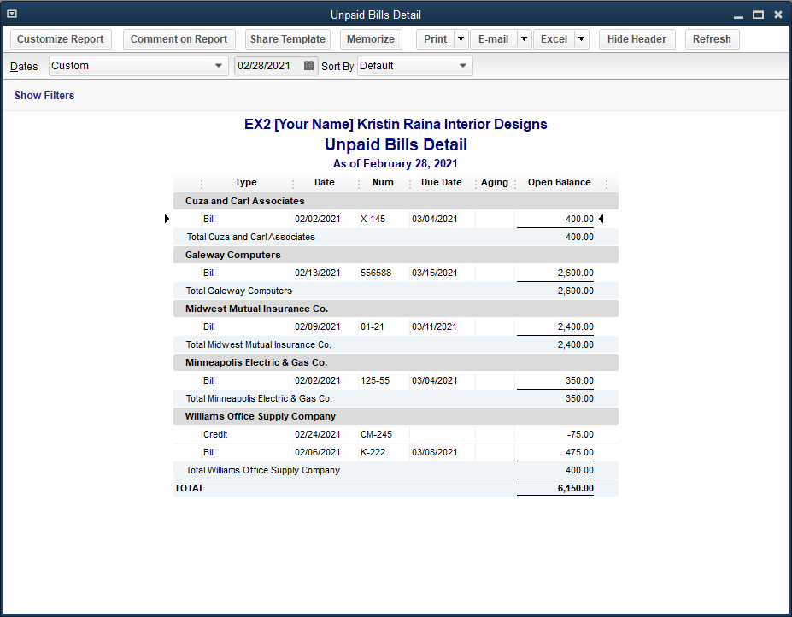
Vendor Reports and Accounting Reports Cont.
Unpaid Bills Detail Report
lists all unpaid bills for each vendor at a specific date
lists each open bill (with date and invoice number), along with any credit memos applied

Slide 29
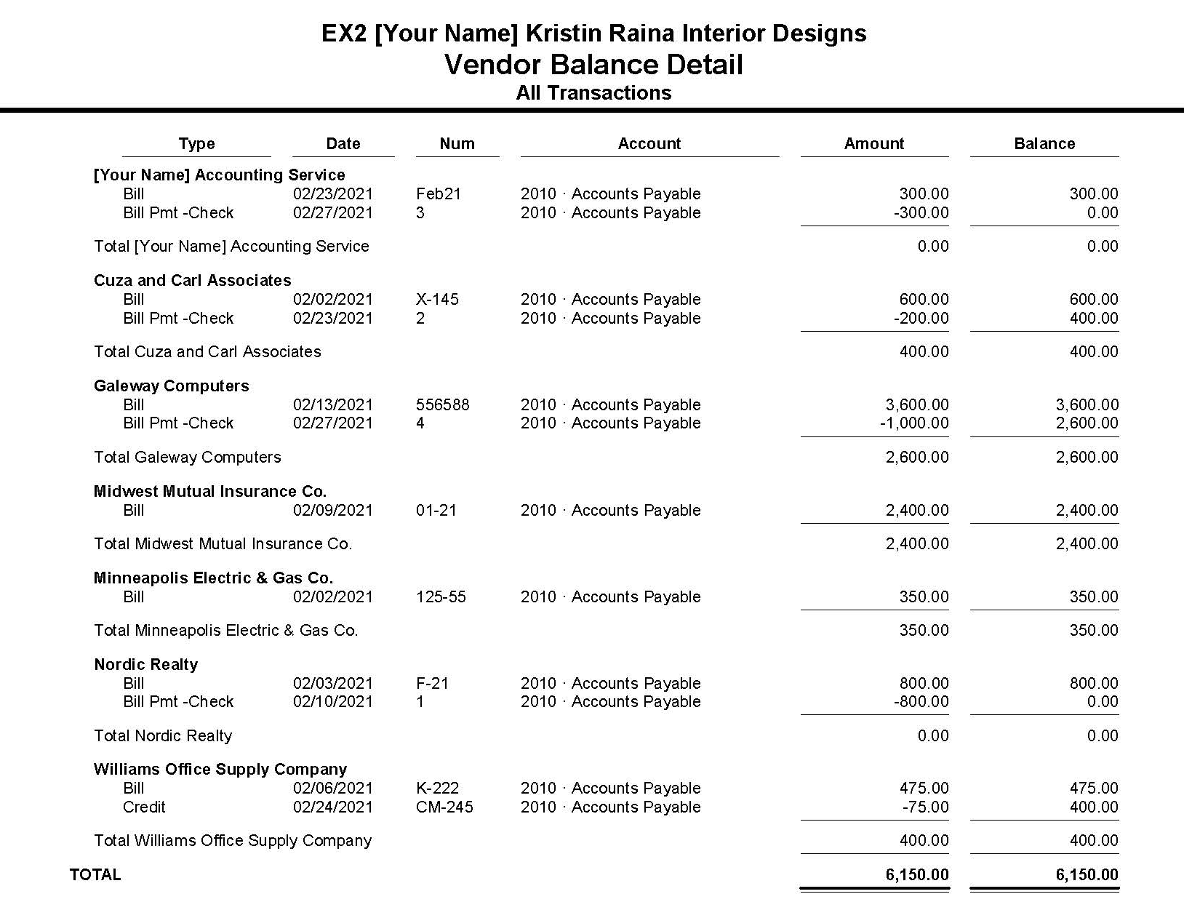
Vendor Reports and Accounting Reports Cont.
Vendor Balance Detail Report
displays all transactions for each vendor with the remaining balance owed
is similar to an accounts payable subsidiary ledger in a manual system

Slide 30
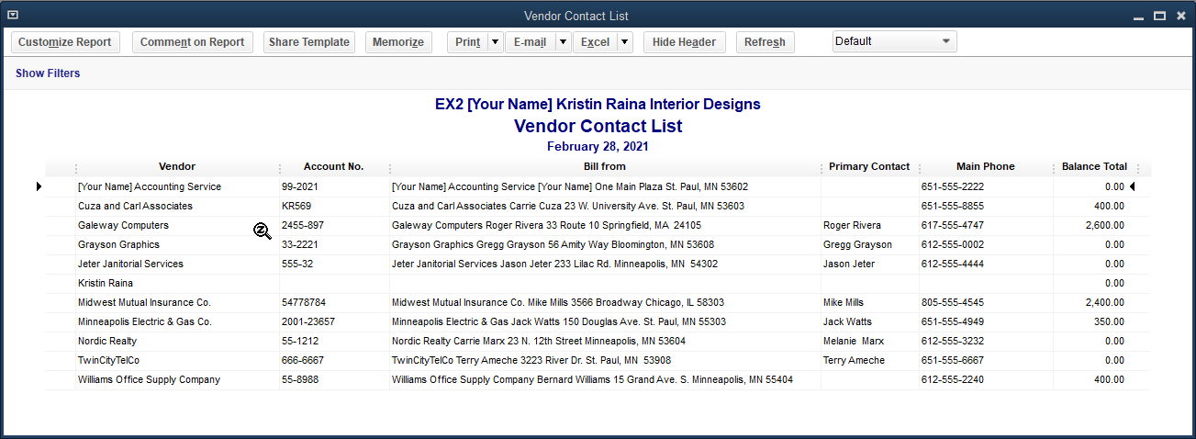
Vendor Reports and Accounting Reports Cont.
Vendor Contact List Report
displays information for all vendors that has been entered in each vendor’s file
displays the name of each vendor, account number, address, contact person, telephone and mobile numbers, and the present balance owed

Slide 31
Vendor Reports and Accounting Reports Cont.
Most reports provide a drill-down feature.
When reviewing a report, QuickBooks allows you to “drill down” from a report to the original window where data has been entered.
If the transaction is incorrect, you can edit or remove the transaction at that time.
Look for your cursor to turn into a magnifying glass symbol with a Z in the center.
called the zoom glass

Slide 32
Vendor Reports and Accounting Reports Cont.
The drill down feature:
provides the opportunity to review the information and make corrections if necessary
enables you to see the originating transaction or document that gave rise to the report figures
allows you to move quickly from a report to the related transaction windows and back to the report again

Slide 33
Vendor Reports and Accounting Reports Cont.
When you enter activities in the windows, behind-the-scenes accounting activity:
is recorded in general journal format
is posted to the general ledger
flows into the financial statements
QuickBooks can display and print these standard accounting reports.

Slide 34
Quick Check
Vendor Reports in QuickBooks
a. include the Unpaid Bills Detail report, the Vendor Balance Detail report, and the Vendor Contact List report.
b. include only the Vendor Balance Detail and Vendor Contact List reports.
c. reflect the information and activities recorded in all Activities windows.
d. are not customizable.

Slide 35
Chapter Review
Type | Activity Window | System Default Account
 |  | Debit | Credit
Bill | Enter Bills |  | Accounts Payable
Bill Pmt – Check | Pay Bills | Accounts Payable | Cash
Check | Write Checks |  | Cash
Credit | Enter Bills | Accounts Payable
The Type column indicates windows where activity was recorded.
Bill type entries represent the transactions entered in the Enter Bills window.
Each of these transactions has a credit to Accounts Payable because this is the default for that account.
The Credit type entry represents the credit memo entered in the Enter Bills window.

Slide 36
Chapter Review Cont.
When the credit memo option is chosen, the default account becomes a debit to Accounts Payable.
Bill Pmt – Check type entries represent transactions entered in the Pay Bills window.
All of these transactions are a debit to A/P and a credit to Cash, which are the default accounts for this window.
Check type entries are from the Write Checks window.
All have a credit to Cash because that is the default account for this window.

Slide 37
Terms
cash payments journal A multi-column journal used to record all cash payment activities, including payment of accounts payable.
cash purchase Payment of any bill or item other than accounts payable.
Chart of Accounts List A list of accounts a company uses as it conducts its business.
credit memo A reduction of Accounts Payable as a result of a return or an allowance by a vendor.
Net 30 Days Full payment of an invoice within 30 days of the invoice date is requested.

Slide 38
Terms Cont.
payment on account Payment of an outstanding accounts payable.
purchase on account When a company receives a bill for goods or services from a vendor but plans to pay it at a later date.
purchases journal A journal used to record all purchases of goods on account; can be in a single-column or multi-column format.
vendor Someone from whom the company buys goods or services, either on account or for cash.

