Slide 1
Computerized Accounting with QuickBooks 2019

Slide 2
Customers
Adding Customers, Creating Invoices, and Receiving and Depositing Payments

Slide 3
Objectives
Identify the system default accounts for customers
Update the Customer Center
Record sales on account in the Create Invoices window
Record collections of accounts receivable in the Receive Payments window
Record cash sales in the Enter Sales Receipts window
Record deposits in the Make Deposits window
Display and print customer-related reports

Slide 4
Introduction
QuickBooks allows you to track customer transactions.
You should establish a file for each customer before entering transactions for that customer.
The collection of all the Customer files comprises the customer list.
The customer list is contained in the Customer Center (Lists/Centers).

Slide 5
Introduction Cont.
Once a customer file is established, transactions can be entered in the activities windows:
Create Invoices
Receive Payments
Enter Sales Receipts
Make Deposits
As transactions are recorded, QuickBooks simultaneously updates the customer’s file with information about the transactions.
updates Customer Center
updates related reports (Reports)

Slide 6
QuickBooks v. Manual Accounting
Below is a comparison of a manual accounting ledger and journals with QuickBooks functions:
Manual Accounting System | QuickBooks
Accounts Receivable Subsidiary Ledger | Customer Center
Sales Journal | Create Invoices window
Cash Receipts Journal | Receive Payments window Enter Sales Receipts window

Slide 7
System Default Accounts
When you enter transactions, QuickBooks automatically increases or decreases certain account balances.
When the Create Invoices window is used, QuickBooks automatically increases (debits) the Accounts Receivable account.
When the Receive Payments window is used, QuickBooks automatically decreases (credits) the Accounts Receivable account.

Slide 8
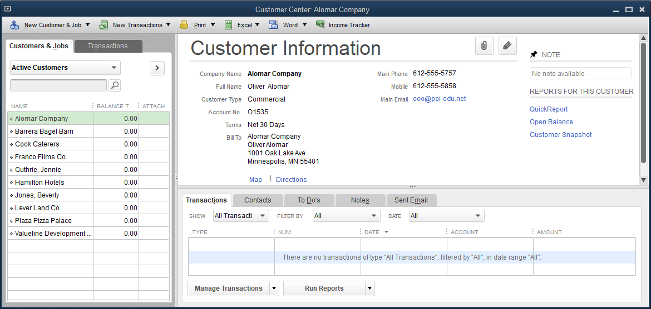
The Customer Center
The Customer Center contains a file for each customer. Each file contains important information, such as:
company name
address
contact person
type of customer
terms
credit limit
preferred payment method
current balance owed

Slide 9
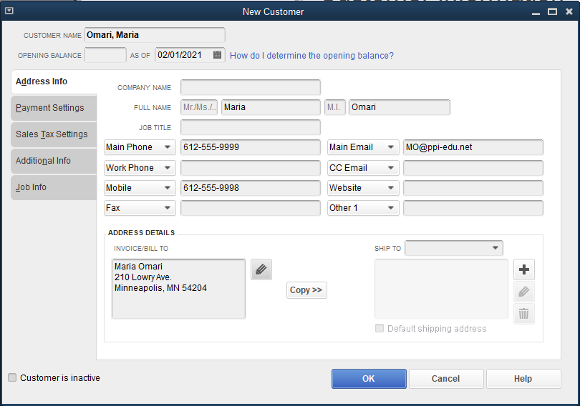
The Customer Center Cont.
To add a new customer:
Click Customers and then click Customer Center.
Click the New Customer & Job button and select New Customer.
Enter the name of the customer and additional details.

Slide 10
The Customer Center Cont.
To delete a customer:
Open the Customer Center and highlight the customer.
Click Edit and then click Delete Customer:Job.
If a customer has a balance or has been part of the current accounting period, the customer cannot be deleted.
If the customer will no longer be used, an alternative is to mark the file inactive.
customer name no longer displays, but information still accessible if needed

Slide 11
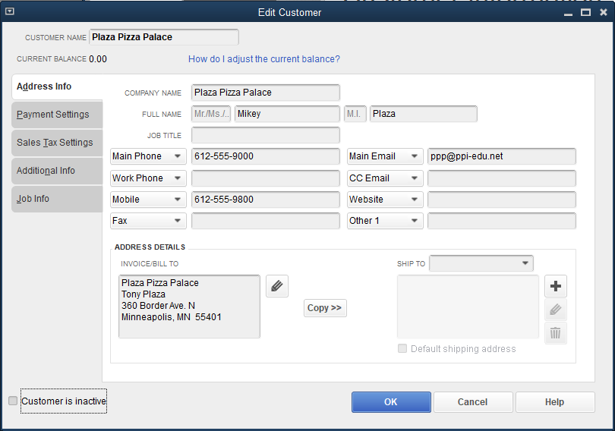
The Customer Center Cont.
To edit a customer:
Open the Customer Center and double-click the customer you want to edit.
Make changes as necessary and then click OK.

Slide 12
Quick Check
What is the Customer Center used for?
to record purchases on account
to identify the customer sending the bill, the invoice date, due date, terms of payment, and nature of purpose
to record credit memos
to add, edit, or delete customers

Slide 13
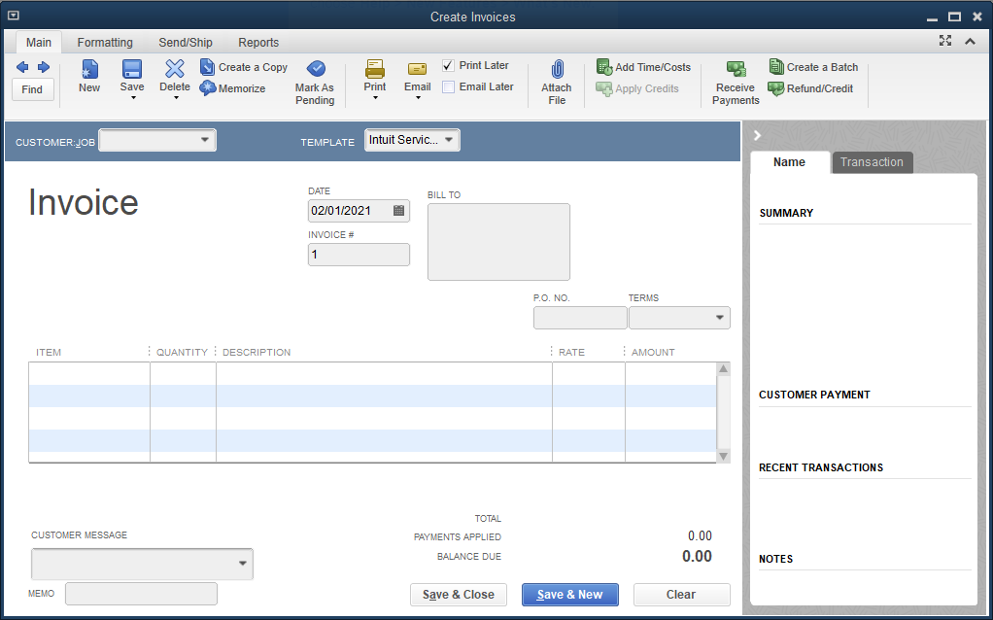
The Create Invoices Window

Slide 14
The Create Invoices Window Cont.
The Create Invoices window is used to record sales on account.
All transactions entered in this window will result in a debit to the Accounts Receivable account.
The account to be credited, usually a revenue account, is determined based on the item chosen.
Behind the scenes:

Slide 15
The Create Invoices Window Cont.
The Create Invoices window has four tabs:
Main
select a customer from the Customer Center, enter an invoice number and terms of payment, identify items sold or services provided
Formatting
customize the design and presentation of invoices
Send/Ship
select a carrier for shipment
Reports
access various reports

Slide 16
The Create Invoices Window Cont.
Suppose Kristin Raina Interior Designs has established two service revenue items in the Item List.
To view the items, click Lists and then click Item List. Double click an item to edit the information (e.g., description, rate, type, default accounts).

Slide 17
The Create Invoices Window Cont.
To create an invoice:
Click Customers and then click Create Invoices.
At the CUSTOMER:JOB drop-down list, click the customer’s name.
At the TEMPLATE drop-down list, accept the default Intuit Service Invoice.
Enter the invoice date and number in the appropriate fields.
Select the terms.
Select the appropriate item(s) at the Item List.
Enter the quantity.
Make sure the Print Later and Email Later boxes are not checked. The Your customer can’t pay this invoice online command should remain off .
Click Save & Close.

Slide 18
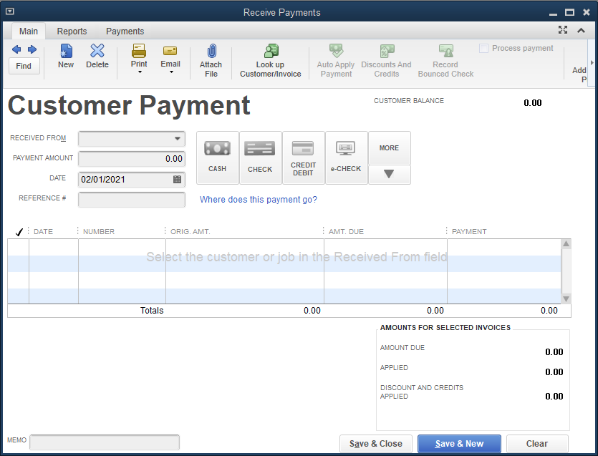
The Receive Payments Window

Slide 19
The Receive Payments Window
The Receive Payments window:
records the collection of accounts receivable from customers previously invoiced in the Create Invoices window
displays all open invoices for a specific customer
is only for collection of existing invoices
Payment can be in the form of cash, check, credit/debit card, or e-check.
Default accounts are Accounts Receivable and Cash or Undeposited Funds.
Behind the scenes:

Slide 20
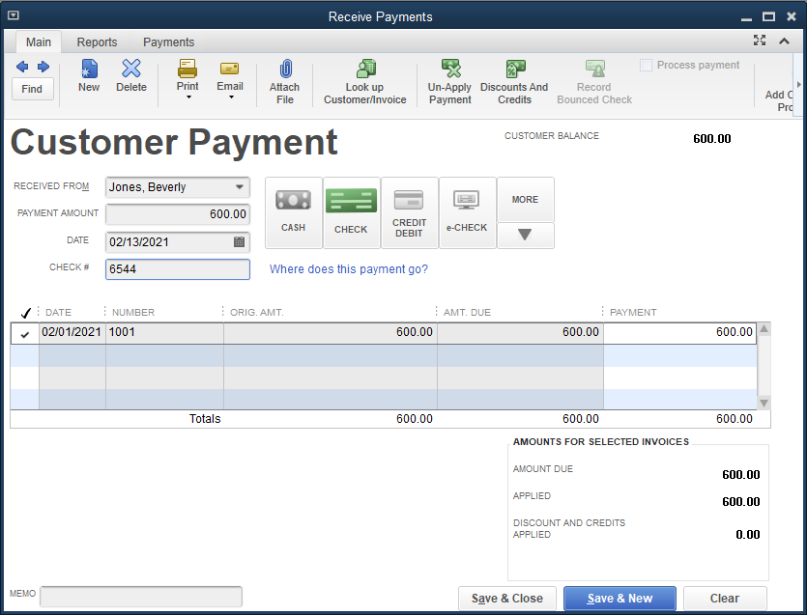
The Receive Payments Window Cont.
To receive a payment in full:
Click Customers and then click Receive Payments.
Click the customer’s name.
Enter the payment amount and the date.
Click the CHECK button.
Enter the check number.
Click Save & Close.

Slide 21
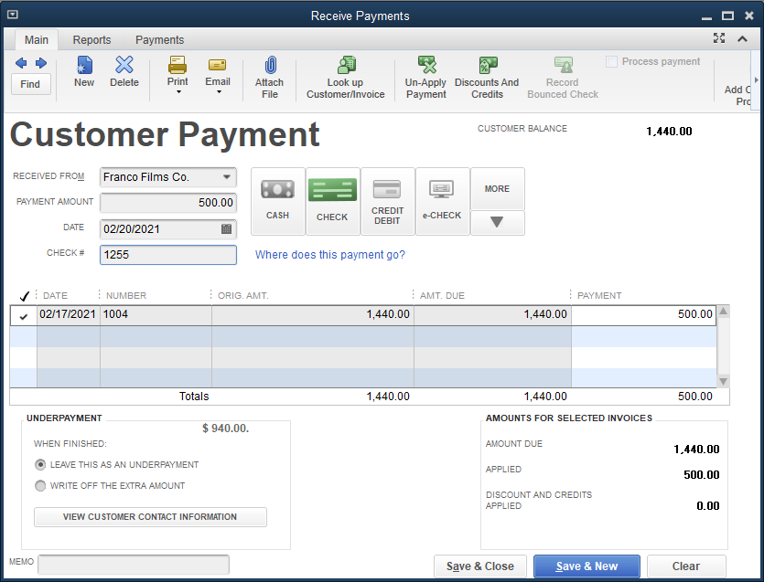
The Receive Payments Window Cont.
To enter a partial payment of an invoice:
Click Customers and then click Receive Payments.
Click the customer’s name.
Enter the payment amount.
In the UNDERPAYMENT box, choose the LEAVE THIS AS AN UNDERPAYMENT option.
Choose the date.
Click the CHECK button.
Enter the check number.
Click Save & Close.

Slide 22
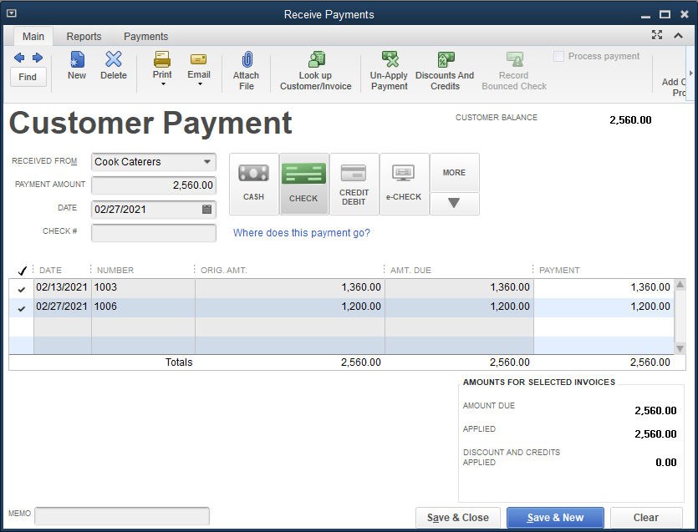
The Receive Payments Window Cont.
To record payment of more than one invoice:
Click Customers and then click Receive Payments.
Click the customer’s name. All open invoices are displayed.
Enter the payment amount. When you move to the next field, the amount is applied to all the invoices.
Choose the date.
Click the CHECK button.
Enter the check number.
Click Save & Close.

Slide 23
The Enter Sales Receipts Window
The Enter Sales Receipts window:
records sales for which payment is received immediately
records cash sale in one step
is used for all cash sales of goods and services
All transactions:
are not tracked through Accounts Receivable or Customer reports
Debit the Undeposited Funds account (account to be credited is based on item selected)
The default account is Cash or Undeposited Funds.

Slide 24
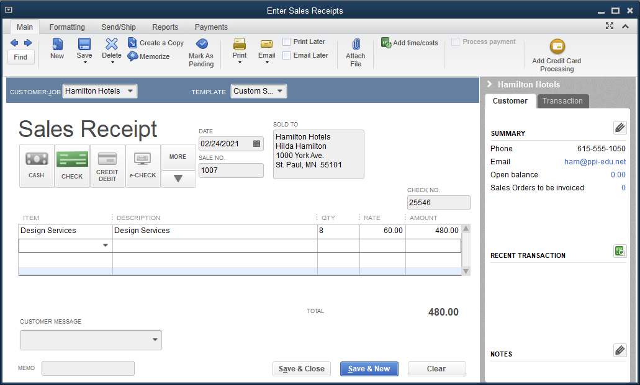
The Enter Sales Receipts Window Cont.
To record a cash sale:
Click Customers and then click Enter Sales Receipts.
At the CUSTOMER:JOB drop-down list, select the customer.
Enter the date and the invoice number.
Click the CHECK button and enter the check number.
Select the items and quantity.
Click Save & Close.

Slide 25
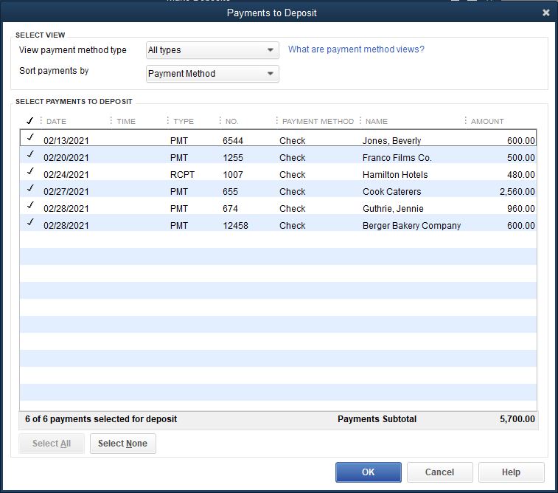
The Make Deposits Window

Slide 26
The Make Deposits Window Cont.
Cash is not immediately posted to the Cash account; many businesses post to the Cash account only when funds are actually deposited in the checking account.
The receipt of funds is posted to the Undeposited Funds account only until the deposit is made.
At that point, a second transaction is recorded to show the undeposited funds transferred to the Cash - Operating account.

Slide 27
The Make Deposits Window Cont.
To deposit all receipts collected and previous recorded as Undeposited Funds:
Click Banking and then click Make Deposits.
At the Sort payments by drop-down list, click Date.
Select the receipts to deposit or click the Select All button.
Click OK.
At the Deposit To drop-down list, select the Cash – Operating account.
Enter the date.
Click Save & Close

Slide 28
Customer Reports and Accounting Reports
Reports, the fourth level of operation, display the information and activities recorded in the various Lists/Centers and Activities windows.
QuickBooks can display and print internal management reports as well as typical accounting and financial reports.
Many reports should be printed monthly.

Slide 29
Customer Reports
Accounts Receivable and customer-related reports help a company:
manage its collections
control cash flow
retain an accurate record of all customer-related transactions
Reports include:
Open Invoices report
Customer Balance Detail report
Customer Contact List report

Slide 30
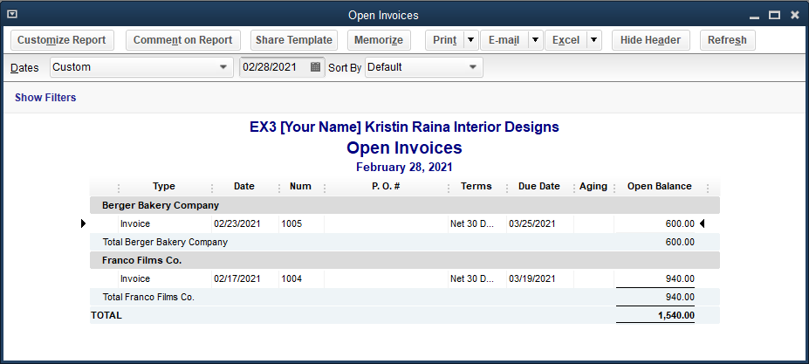
Customer Reports Cont.
Open Invoices Report
lists all unpaid invoices for each customer at a specific date
may be customized to show all customers or only those with outstanding bills

Slide 31
Customer Reports Cont.
Customer Balance Detail Report
displays all transactions for each customer with the remaining balance owed
similar to an accounts receivable subsidiary ledger in a manual accounting system

Slide 32
Customer Reports Cont.
Customer Contact List Report
displays information for all customers that have been entered in the Customer Center

Slide 33
Accounting Reports
As activities are entered in the windows, behind-the-scenes accounting activity is:
recorded in general journal format
posted to the general ledger
flowed into the financial statements
Transaction numbers are assigned by QuickBooks and cannot be changed.
Make sure the journal entries are correct.

Slide 34
Accounting Reports Cont.
The Type column on the Journal report indicates the window where activity was recorded.
Invoice type
from Create Invoices window
transactions debit Accounts Receivable
Payment type
from Receive Payments window
transactions debit Undeposited Funds and credit Accounts Receivable
Sales Receipt type
from Enter Sales Receipts window
transactions debit Undeposited Funds
Deposit type
from Make Deposits window
transactions debit Cash and credit Undeposited Funds

Slide 35
Accounting Reports Cont.
The following chart summarizes the general journal transaction types:
Type | Activity Window | System Default Account
 |  | Debit | Credit
Invoice | Create Invoices | Accounts Receivable
Payment | Receive Payments | Undeposited Funds | Accounts Receivable
Sales Receipt | Enter Sales Receipts | Undeposited Funds
Deposit | Make Deposits | Cash | Undeposited Funds

Slide 36
Quick Check
Tracking customer transactions should be completed in which order?
update Customer Center, enter invoices, receive payments, and generate reports
enter invoices, update Customer Center, receive payments, and generate reports
update Customer Center, generate reports, enter invoices, and receive payments
enter invoices, receive payments, update Customer Center, and generate reports

Slide 37
Terms
cash receipts journal A multi-column journal used to record all cash receipt activities including collection of accounts receivable.
cash sale A sale for which payment is received immediately.
collection of accounts receivable Occurs when a customer pays part or all of the outstanding balance due the company; sometimes referred to as payment of accounts receivable.

Slide 38
Terms Cont.
customer A person or business that the company sells goods or services to, either on account or for cash.
sale on account Occurs when a company sells goods or services to a customer but does not receive payment until a future date.
sales journal A journal used to record all sales of goods or services on account; can be in single-column or multi-column format.

