Slide 1
Computerized Accounting with QuickBooks 2019

Slide 2
Period-End Procedures
Making General Journal Entries

Slide 3
Objectives
Update the Chart of Accounts List
Record adjustments in the Make General Journal Entries window
View the effect of period-end adjustments on the trial balance
Display and print period-end accounting reports
Change the reports display using the Customize Report button
Display and print accounting reports and financial statements

Slide 4
Introduction
QuickBooks allows you to record journal entries in general journal format.
Daily activities are recorded in windows, such as:
Enter Bills
Pay Bills
Write Checks
Create Invoices
Receive Payments
QuickBooks records the activities in general journal format by:
using debits and credits
using accounts from the Chart of Accounts

Slide 5
Introduction Cont.
Some account balances need to be adjusted based on information that does not appear in the daily activities.
enables financial statements to be prepared in accordance with generally accepted accounting principles (GAAP)
Adjusting journal entries are recorded in the Make General Journal Entries window.
As daily activities and adjusting journal entries are recorded, QuickBooks simultaneously updates the accounting records and financial statements.

Slide 6
QuickBooks v. Manual Accounting
Below is a comparison of a manual accounting ledger and journals with QuickBooks functions:
Manual Accounting System | QuickBooks
Chart of Accounts | Chart of Accounts List
General Ledger | General Ledger Report
General Journal | Make General Journal Entries window

Slide 7
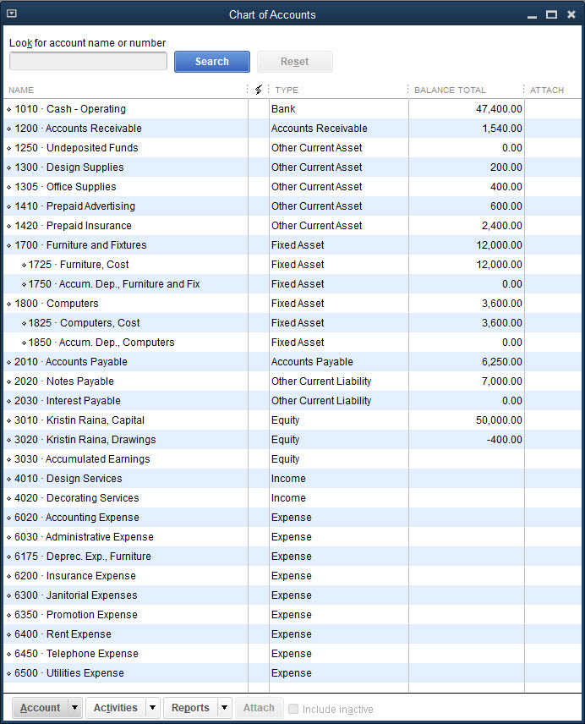
The Chart of Accounts List

Slide 8
The Chart of Accounts List Cont.
Lists and Centers need to be revised periodically when:
new accounts need to be added
accounts not used need to be deleted
modifications need to be made to an account
When you make these revisions, you are updating the Chart of Accounts List.

Slide 9
The Chart of Accounts List Cont.
In an accounting system, all the individual accounts are placed together in the general ledger, which shows:
debits
credits
the balance in each account
The Chart of Accounts List displays the balance next to each account name and consists of the following:
account number
name
types
balance

Slide 10
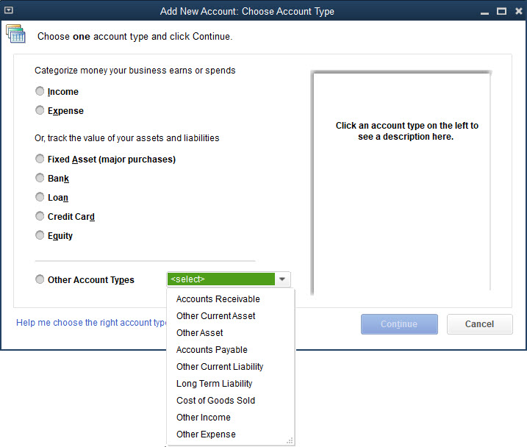
The Chart of Accounts List Cont.
To add a new account:
Click Lists and then click Chart of Accounts.
Click the Account menu button.
Click New.
Select the account type and then click Continue.
At the Add New Account window, enter the data for the account.
Click Save & Close.

Slide 11
The Chart of Accounts List Cont.
To delete an account:
Click Lists and then click Chart of Accounts.
Select the account you wish to delete.
Click the Account menu button.
At the Account button drop-down menu, click Delete Account. Note that you cannot delete an account that has a balance.
Click OK at the warning.
If you delete the wrong account, click Edit and then click Undo Delete Account.

Slide 12
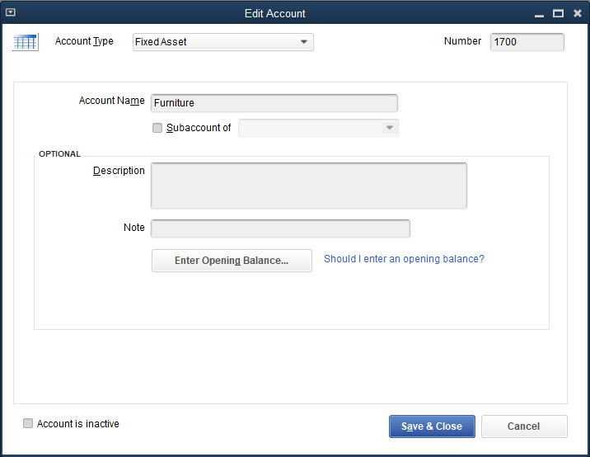
The Chart of Accounts List Cont.
To edit an account:
Click Lists and then click Chart of Accounts.
Select the account you wish to edit.
Click the Account menu button.
Click Edit Account.
Change the appropriate information.
Click Save & Close.

Slide 13
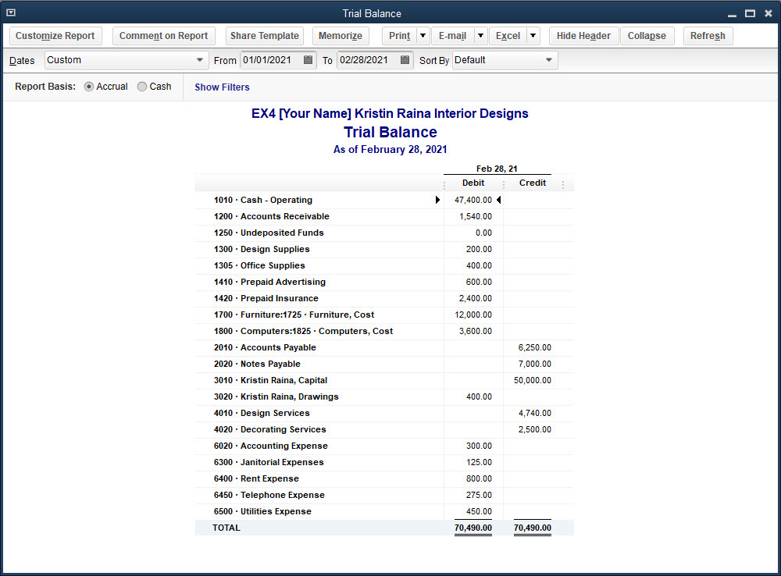
The Trial Balance

Slide 14
The Trial Balance Cont.
The trial balance:
is used to verify that the total debits equal the total credits (i.e., the general ledger is in balance)
allows you to view the accounts and their debit or credit balances without having to look at detail in the general ledger
is used to review the trial balance prior to making adjusting journal entries
Once you record adjusting journal entries, you will no longer be able to view and print a preadjusted trial balance.

Slide 15
The Trial Balance Cont.
To view and print the trial balance:
Click Reports and then click Accountant & Taxes.
At the Accountant & Taxes submenu, click Trial Balance.
Select the dates for the trial balance and then click the Refresh button.
Print the report.

Slide 16
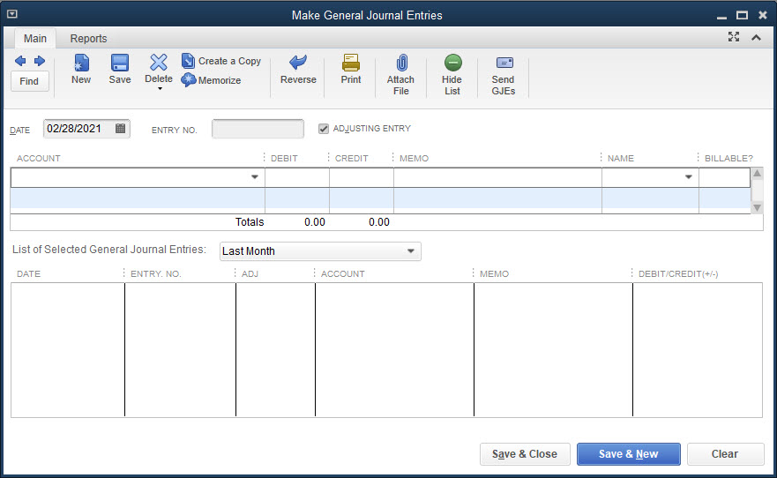
The Make General Journal Entries Window

Slide 17
The Make General Journal Entries Window Cont.
To adjust account balances, enter adjusting journal entries before preparing financial statements.
Adjusting journal entries are recorded in the Make General Journal Entries window.
The Make General Journal Entries window lists:
the account and amount of debit entry
the account and amount of credit entry
an explanation

Slide 18
The Make General Journal Entries Window Cont.
The Make General Journal Entries window contains the following fields:
Adjusting entry
Account
Debit
Credit
Memo
List of Selected General Journal Entries
Hide List button

Slide 19
The Make General Journal Entries Window Cont.
To record an adjusting journal entry:
Click Company and then click Make General Journal Entries.
Choose the date.
In the ENTRY NO. field, key in the unique journal entry number.
Place a check mark in the box to the left of ADJUSTING ENTRY.
In the first line of the ACCOUNT field, click the account to debit.
Enter the amount to debit.
In the second line of the ACCOUNT field, click the account to credit.
Enter the amount to credit.
In the MEMO field, key a brief explanation.
Click Save & Close.

Slide 20
The Make General Journal Entries Window Cont.
In all journal entries, the total dollar value of debits must equal the total dollar value of credits.
If you attempt to save an entry that is not in balance:
A warning window will give you the opportunity to correct the journal entry.
You will not be able to save it until the journal entry is corrected.

Slide 21
Quick Check
Adjusting journal entries are
made after the end of the month or the end of the fiscal year.
adjustments made to accounts at certain periods of time to bring the balances up to date.
only used in manual accounting.
recorded in the Customer Center and Vendor Center.

Slide 22
Period-End Accounting Reports and Financial Statements
Reports:
the fourth level of operation in QuickBooks
reflect activities and adjustments recorded in the windows, and information compiled in the Lists/Centers
After completing the adjusting journal entries, display and print the period-end accounting reports and the financial statements.

Slide 23
Accounting Reports
The period-end accounting reports consist of the following reports:
Journal
General Ledger
Adjusted Trial Balance
Print these reports at the end of the month.

Slide 24
Accounting Reports Cont.
To view and print accounting reports from the Reports menu:
Click Reports and then click Accountant & Taxes.
Click a report.
Choose the appropriate dates for the report and then click the Refresh button at the top of the report.
Click the Print button at the top of the report and then click Report.
Check the settings and then click Print.
Close the report.

Slide 25
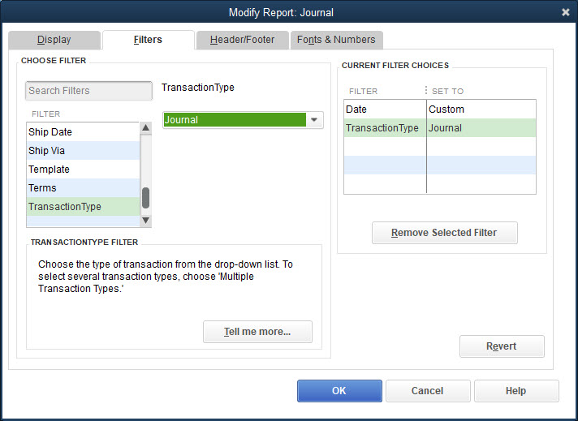
Accounting Reports Cont.
Journal Report
When you wish to view only the adjusting journal entries:
It is not necessary to print all the journal entries.
Use the Filter feature to modify the appearance of the report or the fields of information to be displayed.

Slide 26
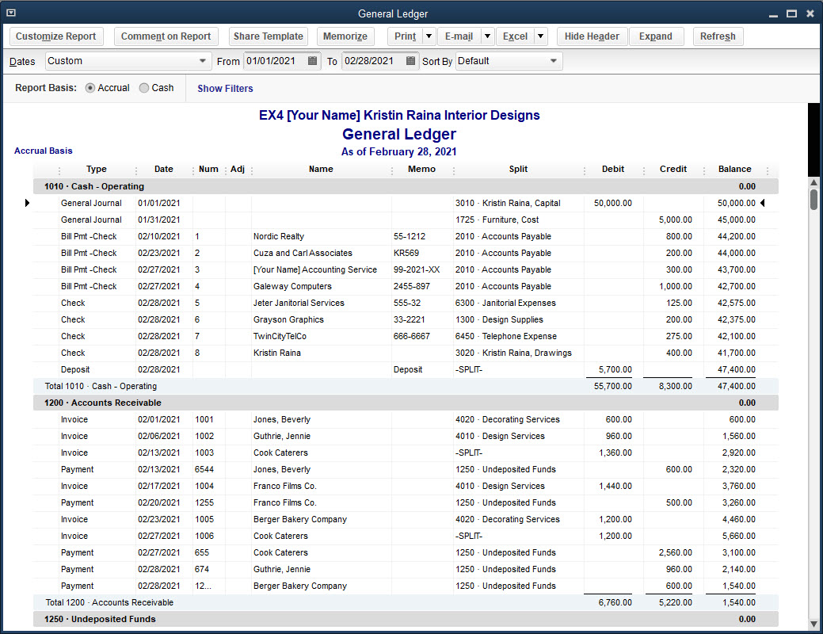
Accounting Reports Cont.
General Ledger Report
contains all transactions recorded in any of the windows
displays all activity in each account and lists the balance after each activity

Slide 27
Accounting Reports Cont.
Adjusted Trial Balance Report
Trial balance:
reviewed prior to preparing adjusting journal entries; printed again after adjusting journal entries have been recorded
Second trial balance:
called the Adjusted Trial Balance report
To distinguish between them, change the name in the heading of the second trial balance to Adjusted Trial Balance.
Once you record the adjusting journal entries, you can no longer create a pre-adjusted trial balance.

Slide 28
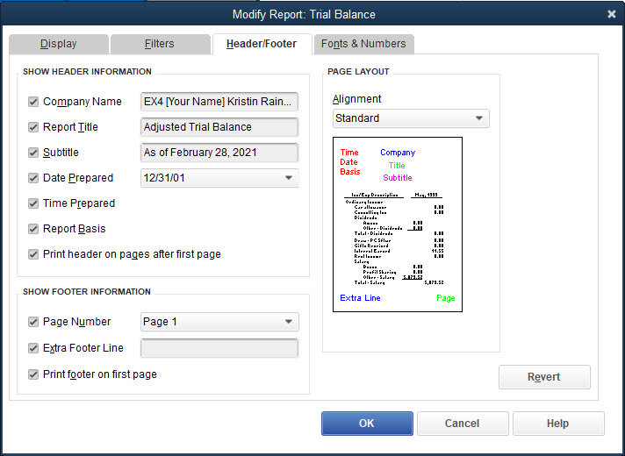
Accounting Reports Cont.
To change the name of a report:
Open the report.
At the top of the report, click the Customize Report button.
Click the Header/Footer Tab.
Change the report name in the Report Title field.
Click OK.

Slide 29
Financial Statements
Financial statements include:
income statement
(Profit & Loss report)
balance sheet
(Balance Sheet report)
Companies must prepare financial statements at least once a year.

Slide 30
Financial Statements Cont.
To view and print financial statements from the Reports menu:
Click Reports and then click Company & Financial.
Click a report.
Choose the appropriate dates for the report and then click the Refresh button on the top of the report.
Click the Print button on the top of the report and then click Report.
Check the settings and then click Print.
Close the report.

Slide 31
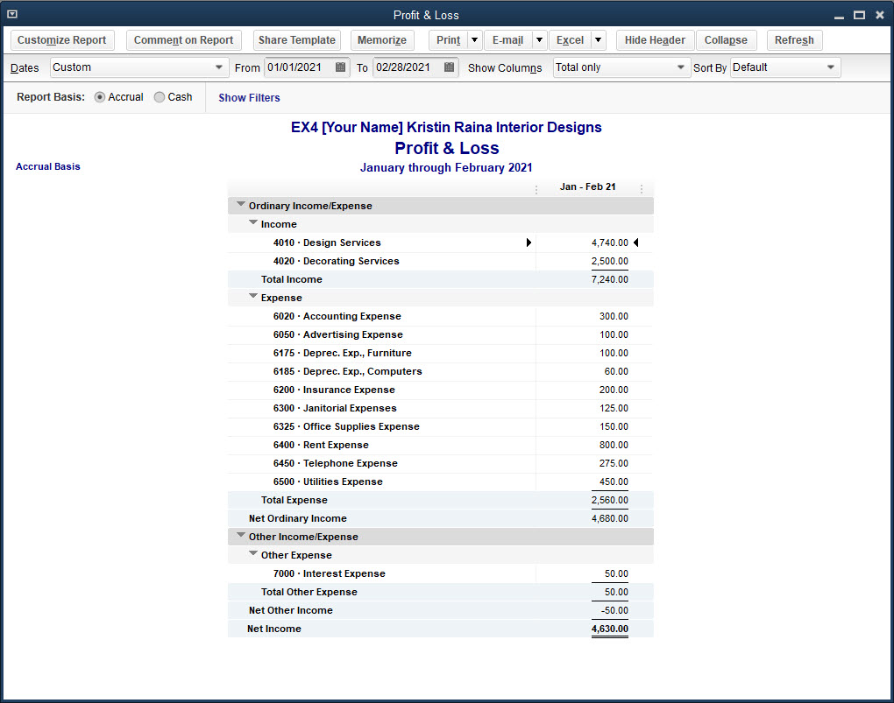
Financial Statements Cont.
Profit & Loss Report
(Income Statement)
displays revenue and expenses for specified period of time
can be displayed in standard and comparative format
if detailed report produced, can list all transactions affecting a particular item on the report

Slide 32
Financial Statements Cont.
Balance Sheet Report
shows assets, liabilities, and equity as of a certain date
may be displayed in standard, summary, or comparative format
if detailed report produced, can show all transactions affecting balance sheet accounts

Slide 33
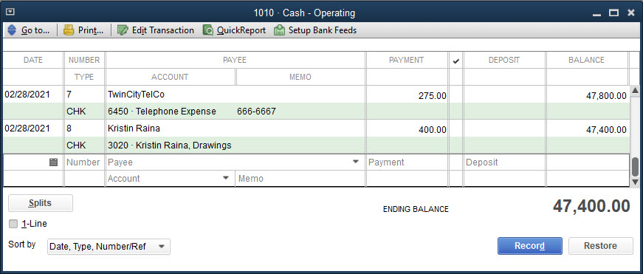
Registers
Registers are available for any balance sheet account (i.e., any asset, liability, or equity account).
The information displayed in the register is similar to the information displayed in the general ledger.
Double-click an account from the Chart of Accounts List window to display the register.

Slide 34
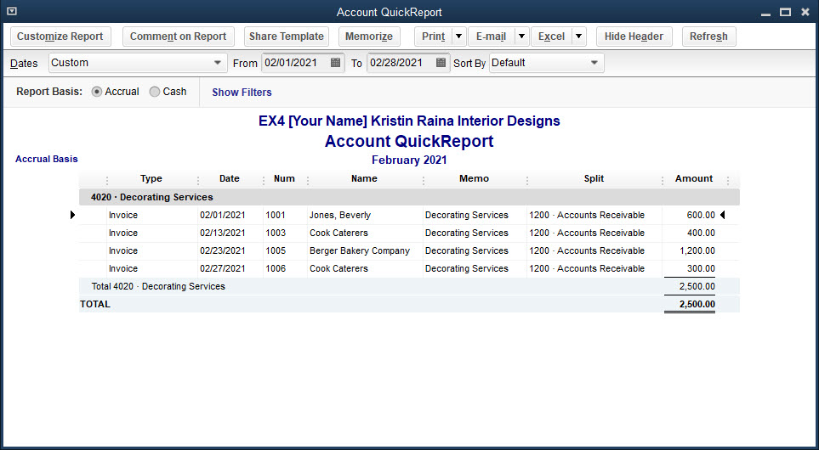
Registers Cont.
Registers are not available for income and expense accounts.
An Account QuickReport is available that displays all the activity to the account.

Slide 35
Registers Cont.
To view an income Account QuickReport:
Click Lists and then click Chart of Accounts.
Double-click the desired account.
Choose the appropriate dates and then click the Refresh button at the top of the report.
The Account QuickReport is displayed, listing all of the activity to this account during the time period chosen.

Slide 36
Quick Check
Financial statements include the
income statement and balance sheet.
income statement and trial balance.
balance sheet and trial balance.
income statement, balance sheet, trial balance, and adjusted trial balance reports.

Slide 37
Terms
adjusting journal entries Adjustments made to accounts at certain periods of time, such as the end of the month or the end of the fiscal year, to bring the balances up to date.
Chart of Accounts List The list of accounts a company uses as it conducts its business.
credit Dollar amount recorded in the right column of an account Depending on the account, it either increases or decreases the balance in the account.
debit Dollar amount recorded in the left column of an account. Depending on the account, it either increases or decreases the balance in the account.

Slide 38
Terms Cont.
general ledger The document in which transactions are summarized by account.
generally accepted accounting principles (GAAP) Principles used to prepare a company’s financial statements, which consist of both formal accounting regulations and procedures mandated by regulatory agencies, and traditionally used accounting procedures.
trial balance A report containing all the general ledger account names, their respective debit or credit balances, and the total debits and total credits.

