Slide 1
Computerized Accounting with QuickBooks 2019

Slide 2
Inventory
Receiving and Selling Items, Processing Sales Discounts, Adjusting Quantity/Value on Hand, and Paying Sales Tax

Slide 3
Objectives
Identify the two inventory systems
Update the Item List
Record purchases of inventory items in the Enter Bills and Write Checks windows
Identify transactions requiring sales tax
Process sales discounts
Record adjustments to inventory items in the Adjust Quantity/Value on Hand window
Record payment of sales tax in the Pay Sales Tax window
Display and print inventory-related reports
Display and print accounting reports and financial statements

Slide 4
Introduction
QuickBooks allows you to track inventory transactions.
Before you can enter inventory transactions, you must establish a file for each inventory item.
Inventory item files are included in the Item List (Lists/Centers).
Once you establish an inventory item file, transactions for the item can be entered in the following activity windows:
Enter Bills
Write Checks
Create Invoices
Enter Sales Receipts
Adjust Quantity/Value on Hand

Slide 5
Introduction Cont.
QuickBooks records information on the Item List every time the company:
receives merchandise for resale
sells merchandise
adjusts the inventory because of loss or damage
This allows you to accurately determine inventory quantity, value, and profit on sales.
QuickBooks automatically changes balance sheet and income statement accounts based on the inventory information on the Item List (Reports).

Slide 6
QuickBooks v. Manual Accounting
In a manual accounting system:
purchases on account are recorded in a purchases journal
sales on account are recorded in a sales journal
In QuickBooks, the Item List serves as an inventory subsidiary ledger for the company.
includes all items the company sells
includes relevant information for each inventory item, such as:
name/number
type
description
cost
sales price
related general ledger accounts

Slide 7
QuickBooks v. Manual Accounting Cont.
In QuickBooks, the windows below perform the following functions:
Write Checks: records cash purchases of inventory
Enter Sales Receipts: records cash sales of inventory
Adjust Quantity/Value on Hand: records changes in inventory that are not a result of a sale or purchase
In all instances where inventory items are purchased, sold, or adjusted, the Item List is updated to reflect the new inventory quantity and value.
Below is a comparison of a manual accounting ledger and journals with QuickBooks functions:
Manual Accounting System | QuickBooks
Inventory Subsidiary Ledger | Item List (inventory part items)

Slide 8
Accounting for Inventory Transactions
There are two types of inventory systems: periodic and perpetual.
Under the periodic inventory system:
separate records are not maintained for inventory items; no attempt is made to adjust the inventory account for purchases and sales
inventory is counted periodically to determine inventory quantity, value, cost of goods sold, and gross profit

Slide 9
Accounting for Inventory Transactions Cont.
Under the perpetual inventory system:
accounting records are maintained that continuously show the current inventory quantity and value
when inventory is purchased, inventory (asset) account is increased
when inventory is sold, inventory account is reduced
cost of goods sold is simultaneously computed to arrive at gross profit
QuickBooks uses the perpetual system for two reasons:
allows user to know current inventory quantity and value at any given moment
calculates cost of goods sold and gross profit after each sale without the need for a periodic physical inventory count

Slide 10
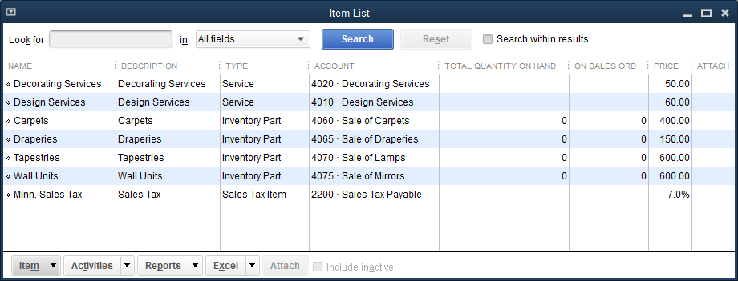
The Item List

Slide 11
The Item List Cont.
The Item List contains a file for each type of service or inventory item sold by the company.
If the item sold is an inventory product, QuickBooks calls this an inventory part as opposed to a service item.
Enter the information for each inventory item in the Item List prior to recording transactions.
If you omit an item, you can add that item later with minimal disruption.

Slide 12
The Item List Cont.
The Item List contains important information on each product, such as:
type of item
number
descriptions
cost
general ledger posting accounts for inventory asset, cost of goods sold, and sales
preferred vendor
sales tax status
All products or services sold by the company should be included in the Item List.

Slide 13
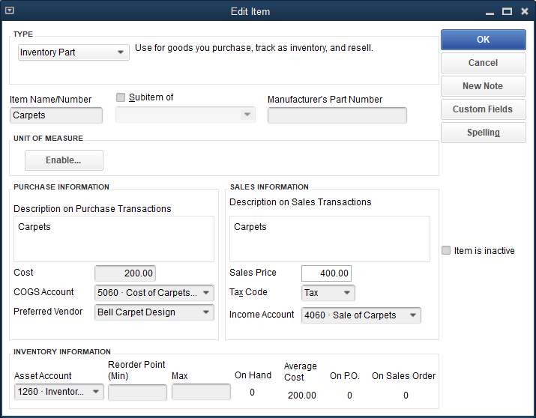
The Item List Cont.
To view a specific inventory item file, hover the mouse pointer over the item name and double-click.

Slide 14
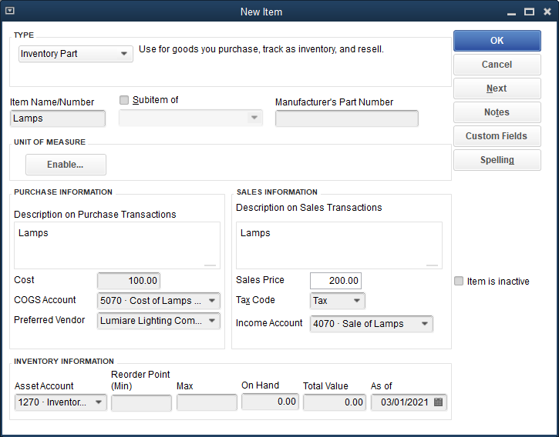
The Item List Cont.
To add an item:
Click Lists and then click Item List.
Click the Item menu button.
Click New.
Enter the background data for the item.
Click OK.
Close the Item List window.

Slide 15
The Item List Cont.
To delete an item:
Click Lists and then click Item List.
Select the item you wish to delete but do not open the file.
Click the Item menu button.
Click Delete Item.
You cannot delete an item with a balance or that has been part of a transaction.
Click OK at the warning screen.
Close the Item List window.

Slide 16
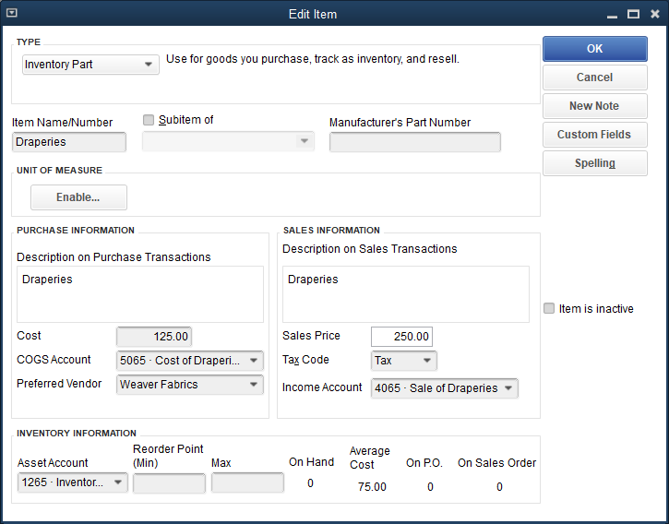
The Item List Cont.
To edit an item:
Click Lists and then click Item List.
Double-click the item you wish to edit.
Change the appropriate information.
Click OK.
Close the Item List window.

Slide 17
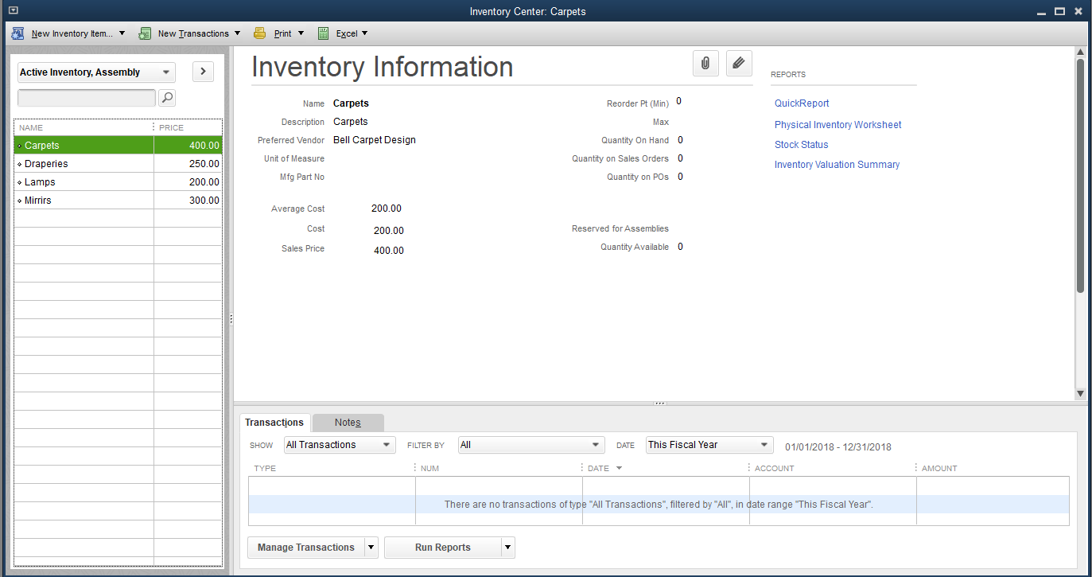
The Item List Cont.
Inventory Center
contains a file for each inventory item
duplicates the information contained in the Item List, but does not display non-inventory part items.

Slide 18
Purchasing Inventory
Activities identified as purchases of inventory items on account are recorded in the Enter Bills window.
Activities identified as purchases of inventory items for cash are recorded in the Write Checks window.

Slide 19
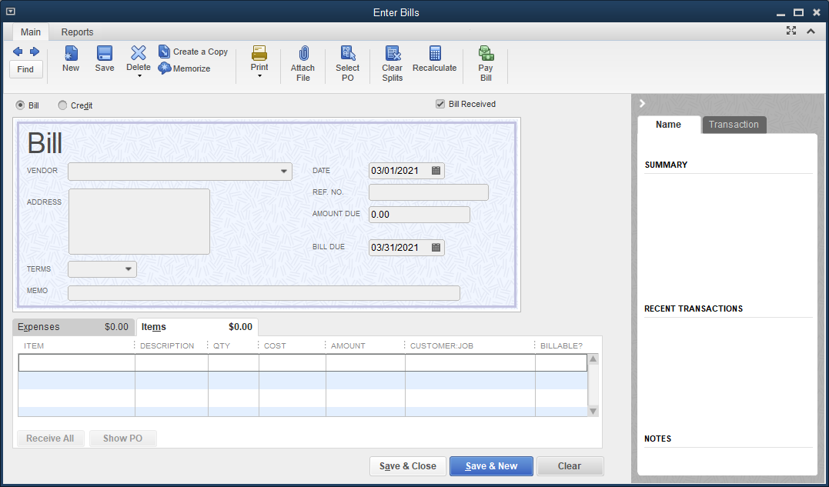
Purchasing Inventory Cont.
Record inventory purchases using the Enter Bills window—Items tab.

Slide 20
Purchasing Inventory Cont.
There are two sub-tabs on the Main tab of the Enter Bills window:
Expenses
Items
Expenses tab:
used to record non-inventory purchases
Items tab:
used to record inventory purchases
similar to Expenses tab but provides for additional fields (Item and Quantity) that relate to inventory

Slide 21
Purchasing Inventory Cont.
The Enter Bills window—Items tab is designed for purchases of inventory items on account.
The default accounts include:
Inventory asset account
Accounts Payable account
QuickBooks uses the information on the Item List to correctly record the amount and account for the inventory asset.
The transaction is recorded as follows:

Slide 22
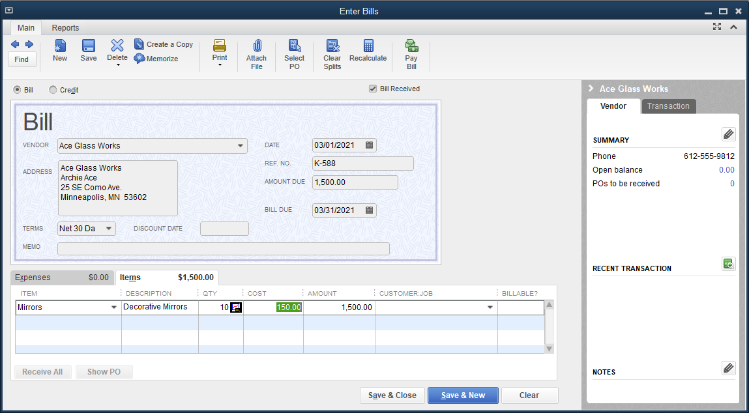
Purchasing Inventory Cont.
To record a purchase and receipt of inventory items on account:
Click Vendors and then click Receive Items and Enter Bill.
At the VENDOR drop-down list, click the appropriate vendor.
Complete the fields in the same way you would for non-inventory purchases.
Complete the Items tab.
Click Save & Close.

Slide 23
Purchasing Inventory Cont.
Like the Enter Bills window, the Write Checks window has the following two tabs:
Expenses
Items
For purchase of inventory items for cash, switch to the Items tab after opening the Write Checks window.
The fields to enter information are similar to those in the Enter Bills window—Items tab.

Slide 24
Purchasing Inventory Cont.
The Write Checks window—Items tab is designed for purchases of inventory items for cash
The default accounts include:
Inventory asset account
Cash account
QuickBooks uses the information on the Item List to record the amount and account for the inventory asset.
The transaction is recorded as follows:

Slide 25
Purchasing Inventory Cont.
To record a purchase and receipt of inventory items for cash:
Click Banking and then click Write Checks.
Make sure the correct bank account is displayed.
Choose the date.
At the PAY TO THE ORDER OF drop-down list, click the appropriate company.
Click the Items tab.
Click the item.
Enter the quantity and then move to the next field. QuickBooks completes the AMOUNT fields.

Slide 26
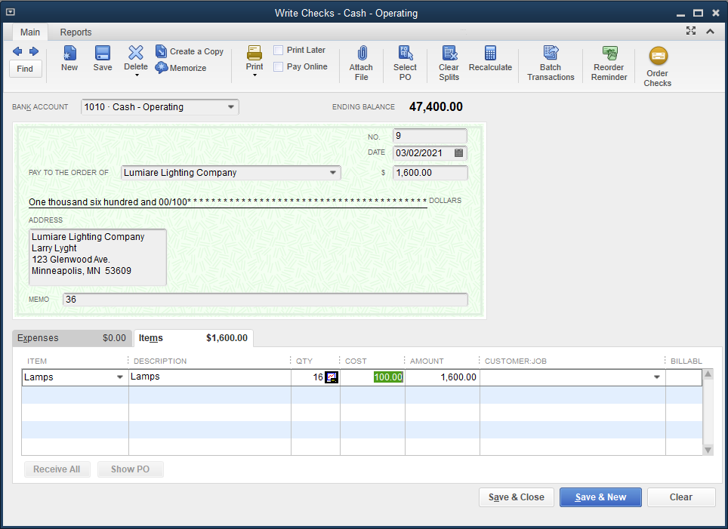
Purchasing Inventory Cont.
Use the Write Checks window to record a purchase and receipt of an inventory item for cash.

Slide 27
Sales Tax
When a company sells a product to a customer, it is usually required to collect sales tax on the sale.
sales tax amount charged is added to invoice price of the product
later, retailer will remit the tax collected from customers to the appropriate state sales tax collection agency

Slide 28
Sales Tax Cont.
The Create Invoices window:
records a sale on account
default account is a debit to Accounts Receivable
The Enter Sales Receipts window:
records a sale for cash
default account is a debit to Cash or Undeposited Funds
When sales tax is charged on the sale of an item, a default Sales Tax Payable account is credited in both the Create Invoices and Enter Sales Receipts windows.
Example general ledger posting:

Slide 29
Quick Check
When sales tax is charged on the sale of an item, a default Sales Tax Payable account is _____
optional in the Create Invoices and Enter Sales Receipts windows.
not necessary and so not used.
credited in the Create Invoices and Enter Sales Receipts windows.
debited in the Create Invoices and Enter Sales Receipts windows.

Slide 30
Sale of Inventory
Sale of inventory involves two windows:
Create Invoices window records activities identified as sales of inventory items on account
Enter Sales Receipts window records activities identified as sales of inventory items for cash
These windows use additional fields that relate to inventory.

Slide 31
Sale of Inventory Cont.
When recording the sale of inventory items in the Create Invoices window, use a template to access the additional fields needed for inventory items.
Intuit Service Invoice Template: used for sale of services (Chapter 3)
Intuit Product Invoice Template: used for sale of inventory items on account
The Create Invoices window - Intuit Product Invoice is designed for the sale of inventory items on account.
The default accounts include:
Accounts Receivable
Cost of Goods Sold
Inventory
Sales Tax Payable
Sales

Slide 32
Sale of Inventory Cont.
QuickBooks uses the inventory Item List to determine the correct amount and account for the following accounts:
Cost of Goods Sold
Inventory
Sales
If an item is marked taxable, the Item List determines the correct amount of sales tax to be recorded in the Sales Tax Payable account.
The transaction is recorded as follows:

Slide 33
Sale of Inventory Cont.
To record a sale of inventory on account:
Click Customers and then click Create Invoices.
Select the appropriate customer/job.
At the TEMPLATE drop-down list, click Intuit Product Invoice. Additional fields for inventory item information appear.
Enter the date and invoice number.
Choose the terms.
Enter the quantity of items sold.
Click the ITEM CODE field and click the appropriate item. QuickBooks automatically fills the remaining fields.
Note that the word Tax should appear in the TAX field for taxable items, and Non should appear for non-taxable items.
At the TAX drop-down list, select the tax authority, if necessary.
Click Save & Close.

Slide 34
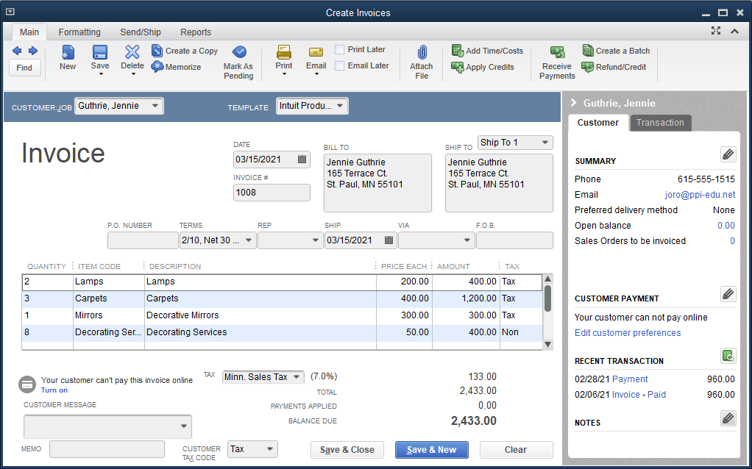
Sale of Inventory Cont.
Example of completed Create Invoices window:

Slide 35
Sale of Inventory Cont.
The Enter Sales Receipts window is designed for cash received:
for the sale of services
for the sale of inventory items for cash
Information from the Item List is used to correctly record the following accounts:
Cost of Goods Sold
Inventory
Sales
If an item is marked taxable, the Item List determines the correct amount of sales tax to be recorded in the Sales Tax Payable account.
The transaction is recorded as follows:

Slide 36
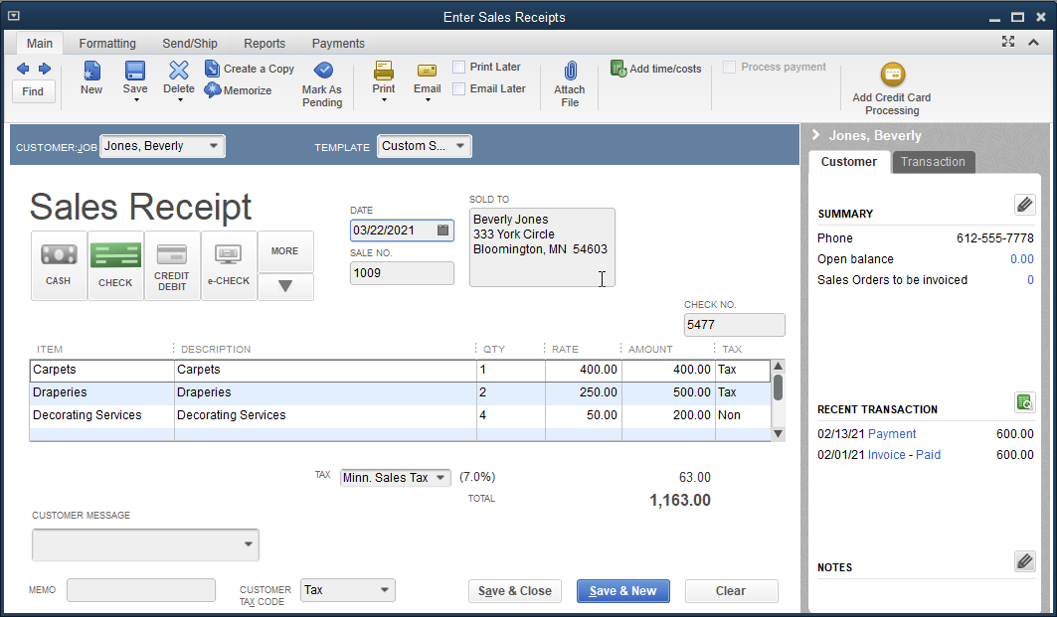
Sale of Inventory Cont.
To record a sale of inventory for cash:
Click Customers and then click Enter Sales Receipts.
Click the customer/job.
Enter the date, the sales number, and the check number.
Complete the balance of the window for each item.
Note: Companies that have a cash sales of numerous low-cost items enter these sales in batches on a period basis, such as weekly or semi-monthly.

Slide 37
Sales Discounts
Sales discounts are offered to customers to encourage early payment of outstanding invoices.
Companies may reduce the invoice amount:
generally a 1% or 2% reduction
only if payment is made within 10 days of the invoice date
Receipt of payment within the discount period can be recorded in the Receive Payments window.

Slide 38
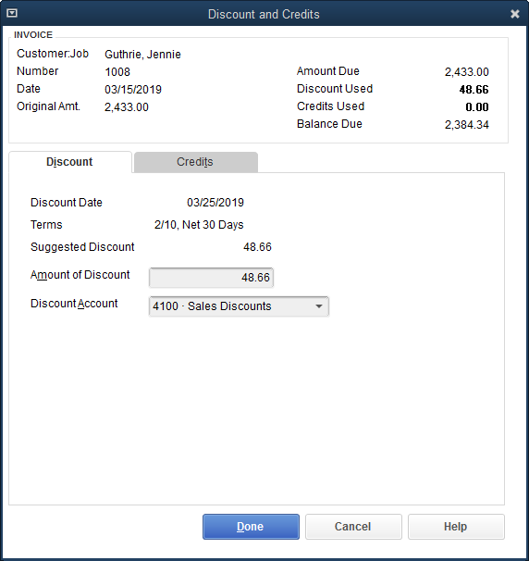
Sales Discounts Cont.
To record a receipt of payment within the discount period:
Click Customers and then click Receive Payments.
Select the customer.
Choose the date, select the payment method, and enter the check number.
Select the invoice.
Click the Discounts and Credits button.
Select the discount account.
Click Done.
Place a check mark next to the selected invoice, if necessary.
Click Save & Close.

Slide 39
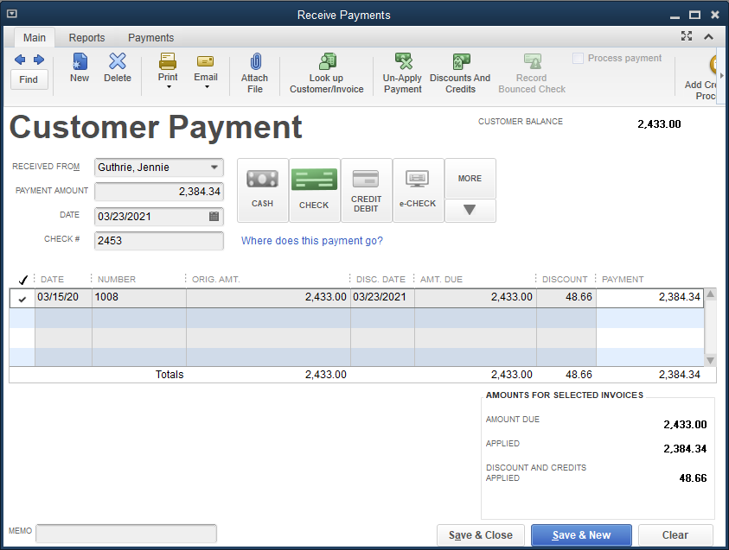
Sales Discounts Cont.
If you make an error on the payment, you can correct changes and resave; or click Edit, Delete Payment, and start over.

Slide 40
Quick Check
Sales discounts are _____
not recorded in the Receive Payments window.
not available to customers with outstanding invoices.
recorded in the Enter Sales Receipts window.
often a 1% or 2% reduction of the invoice amount if the payment is made within 10 days of the invoice date.

Slide 41
The Adjust Quantity/Value on Hand Window
The Adjust Quantity/Value on Hand activity window is used to record changes in the inventory from events other than a purchase or sale.
If inventory items are lost, stolen, damaged, or spoiled, the reduction in inventory quantity and/or value:
is considered a loss or expense
is recorded as an inventory adjustment (or a reduction in the inventory asset account)
The Inventory Adjustment account:
is a cost of goods sold account
will be included in the cost of goods sold section of the income statement

Slide 42
The Adjust Quantity/Value on Hand Window Cont.
All transactions entered in this window:
debit the Inventory Adjustment account
credit the appropriate inventory asset account
QuickBooks records the transaction as follows:

Slide 43
The Adjust Quantity/Value on Hand Window Cont.
To record an inventory adjustment:
Click Vendors and then click Inventory Activities.
At the submenu, click Adjust Quantity/Value on Hand.
At the Adjustment Type drop-down list, choose Quantity and Total Value.
Choose the date.
At the Reference No. field, key Inv. Adj. 1.
Select the adjustment account.
Select the item. The description and current quantity are displayed.
Enter the new quantity.
When you move to the next field, QuickBooks fills the QTY DIFFERENCE and NEW VALUE fields and enters the Total Value of Adjustment amount.
Click Save & Close.

Slide 44
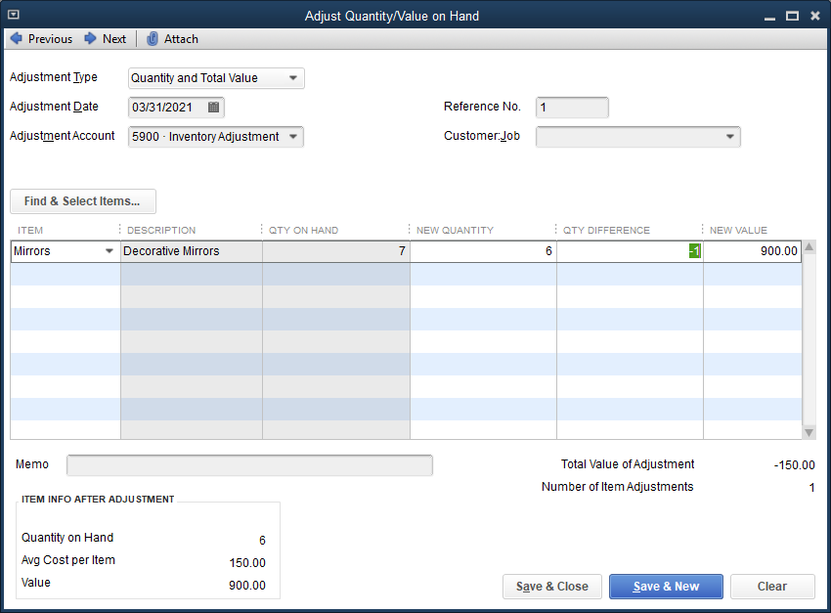
The Adjust Quantity/Value on Hand Window Cont.
If you make an error in this window, click Edit and then Delete Inventory Adjustment and redo the transaction.

Slide 45
The Pay Sales Tax Window
The Pay Sales Tax window is:
used to record the remittance of sales tax charged to customers to the proper tax agency
Designed for Activities identified as payment of sales tax charged to customers
The default accounts include:
Sales Tax Payable
Cash
QuickBooks records the transaction as follows:

Slide 46
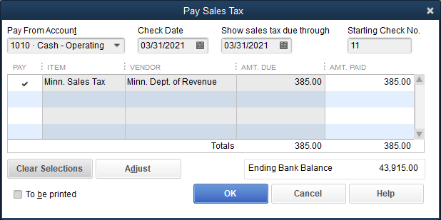
The Pay Sales Tax Window Cont.
To pay the sales tax collected:
Click Vendors and then click Sales Tax.
At the Sales Tax submenu, click Pay Sales Tax.
Choose the dates for the Check Date and Show sales tax due through fields.
Click the Pay All Tax button to select the liability.
Place a check mark at the Pay field, and then click OK.

Slide 47
Inventory Reports, Accounting Reports, and Financial Statements
Reports reflect the activities recorded in the various Lists/Centers and Activities windows.
Inventory activities entered in the various windows flow into reports.
reports should be displayed and printed at end of the month
reports help companies track and manage inventory
Inventory reports include:
Inventory Valuation Detail report
Inventory Status by Item report
Purchases by Detail report
Sales by Detail report

Slide 48
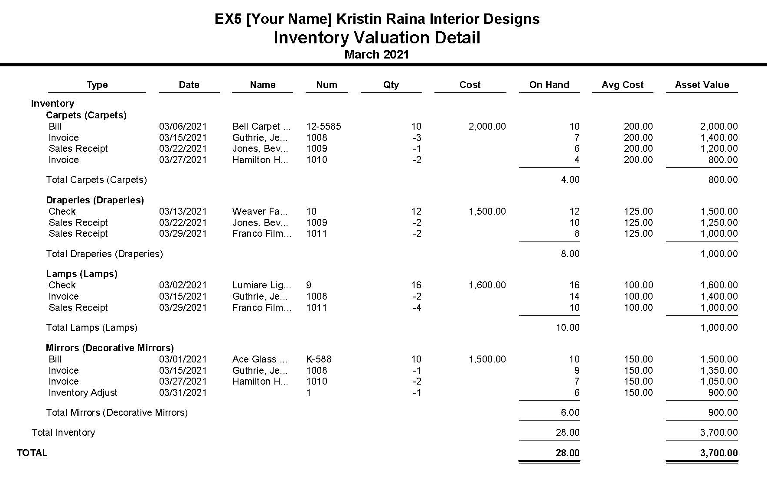
Inventory Reports, Accounting Reports, and Financial Statements Cont.
Inventory Valuation Detail report
displays the transactions affecting each inventory item along with the quantity and value on hand for each

Slide 49
Inventory Reports, Accounting Reports, and Financial Statements Cont.
Inventory Stock Status by Item Report
displays the on-hand status of each inventory item
indicates whether an item should be ordered based upon on-hand quantity and the reorder amount

Slide 50
Inventory Reports, Accounting Reports, and Financial Statements Cont.
Purchases by Item Detail report
displays all purchase information for each inventory item
shows vendor name, cost per unit, quantity purchased, and the total cost

Slide 51
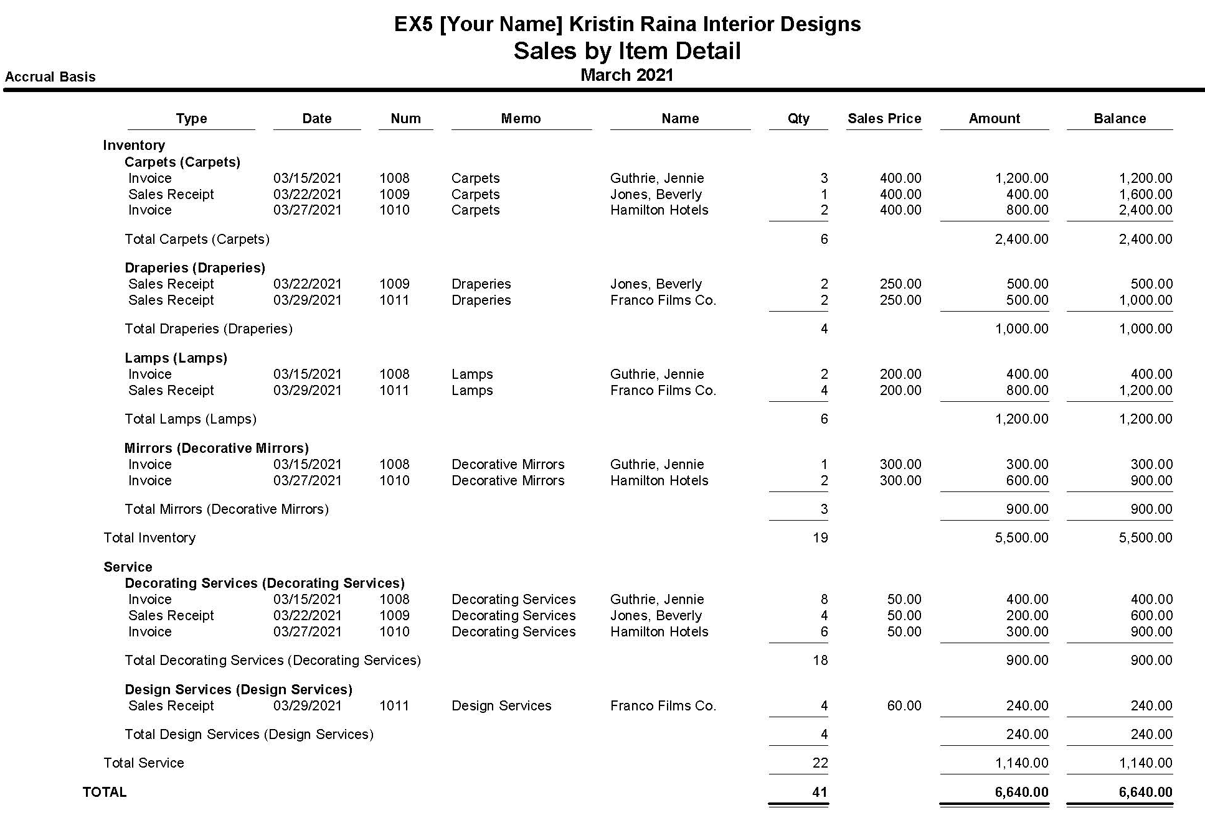
Inventory Reports, Accounting Reports, and Financial Statements Cont.
Sales by Item Detail report
displays sales of all inventory items both on account and for cash

Slide 52
Inventory Reports, Accounting Reports, and Financial Statements Cont.
To view and print a report:
Click Reports and then click Inventory.
Click the report.
Choose the dates, then click the Refresh button.
Click the Print button and then click Report.

Slide 53
Inventory Reports, Accounting Reports, and Financial Statements Cont.
View and print inventory reports from the Lists windows. The following reports can be viewed from the Reports menu of the Item List:
Sales
Purchase
Inventory
Item
Price
Accounting reports and Financial Statements should be viewed and printed at the end of each month:
Journal
Profit & Loss Standard (or Income Statement)
Balance Sheet Standard

Slide 54
Terms
inventory Merchandise that is sold to customers for a profit.
inventory adjustment An amount recorded in an expense or loss account to reflect the reduction of inventory value and/or quantity due to loss, theft, damage, or spoilage.
periodic inventory system Values the inventory periodically based on a physical count of the merchandise; usually done once a year.
perpetual inventory system Values the inventory after every purchase and sale of inventory items.

Slide 55
Terms Cont.
sales discount A reduction in the selling price if the invoice payment is made shortly after the invoice date.
sales tax An amount charged on the sale of merchandise, usually a percentage of the sales price. It is collected by the company as part of the sale and later remitted to the appropriate government agency.

