Slide 1
Computerized Accounting with QuickBooks 2019

Slide 2
New Company Setup—Detailed Start
EasyStep Interview and QuickBooks Setup

Slide 3
Objectives
Create a new company file and establish preferences using the QuickBooks Detailed Start method and EasyStep Interview window
Set up the Customer Center, Vendor Center, and Item List using the QuickBooks Desktop Setup window
Review information recorded in the EasyStep Interview and QuickBooks Desktop Setup windows
Customize the Chart of Accounts List, System Default Accounts, and Terms List
Update the Chart of Accounts and Item Lists
Update the Customer and Vendor Centers
Adjust the new company file to follow the accrual basis of accounting
Display and print accounting reports and financial statements

Slide 4
Introduction
In this chapter, you will learn how to create a new company file in QuickBooks.
Four levels of operation for QuickBooks are
New Company Setup
Lists/Centers
Activities
Reports
In Chapters 2 through 5, the Lists/Centers, Activities, and Reports levels for both a service company and a merchandise company were illustrated
In those chapters, you opened an existing company file, updated the Lists/Centers, recorded Activities in the various windows, and viewed and printed Reports

Slide 5
Introduction Cont.
QuickBooks provides two methods of New Company Setup
Detailed Start – covered in Chapter 6
Express Start – covered in Chapter 7
QuickBooks provides two windows to help with New Company Setup
EasyStep Interview window
QuickBooks Setup window
When you use the Detailed Start method of New Company Setup, you are moved to the EasyStep Interview window.
EasyStep Interview window is designed to assist you in creating and setting up a new company file.
involves entering basic company information and answering questions about your company in the EasyStep Interview window

Slide 6
Introduction Cont.
QuickBooks Desktop Setup window is first used to select the method of New Company Setup.
QuickBooks Desktop Setup window then assists you in setting up your new company file.
allows you to enter information on customers, vendors, service items, and inventory part items
You do not have to use the QuickBooks Setup window after using EasyStep Interview.
Using the EasyStep Interview and QuickBooks Desktop Setup windows is the only part of the process of setting up a new company file.
You then take the information set up in the EasyStep Interview and QuickBooks Setup windows and customize and update it according to your company’s preferences.
Finally, the new company file is prepared for the accrual basis of accounting.

Slide 7
QuickBooks v. Manual Accounting
In a manual accounting system, a company’s records are set up by creating the Chart of Accounts and the general ledger.
The Chart of Accounts is the list of accounts (assets, liabilities, equity, revenues, and expenses) the company intends to use.
The general ledger is the book of all accounts with the beginning balance for each.
If desired, subsidiary ledgers are also created and beginning balances recorded.
Subsidiary ledgers typically include accounts receivable and accounts payable.
If the perpetual inventory system is used, an inventory subsidiary ledger is also created.

Slide 8
QuickBooks v. Manual Accounting Cont.
In QuickBooks, a company’s records are set up by creating a new company file and establishing the Chart of Accounts List.
As the opening balances are entered, QuickBooks simultaneously sets up the general ledger.
Customer Center and Vendor Center are set up
These lists are equivalent to the accounts receivable and accounts payable subsidiary ledgers.
Item List is set up, which is equivalent to an inventory subsidiary ledger.
In QuickBooks, the Item List includes service revenue items and sales tax items in addition to inventory items.

Slide 9
Detailed Start and EasyStep Interview Window
In New Company Setup, the first level of operation in QuickBooks, you will enter the information needed to create and set up a company file for Kristin Raina Interior Designs using the Detailed Start method (and the EasyStep Interview window)
With EasyStep Interview, you proceed through a series of pages by clicking the Next button and entering information.
As you answer questions, QuickBooks establishes preferences about your company
Company preferences enable or disable features available in QuickBooks.
Enabled features allow for choices to be listed on the drop-down menus and on the Home page.
For disabled features, you won’t see that choice on the drop-down menu or Home page.

Slide 10
Detailed Start and EasyStep Interview Window Cont.
Company information can later be edited by clicking Company and then My Company
Preferences can be edited by clicking Edit and then Preferences
At any time you can click the Leave button to leave the EasyStep Interview window
It is advisable not to leave before saving the company file, as all information will be lost.

Slide 11
Detailed Start and EasyStep Interview Window Cont.
To begin New Company Setup and create a new company file using the Detailed Start method and the EasyStep Interview window:
Open QuickBooks.
At the No Company Open window, click Create a new company, or click File and then click New Company.
At the QuickBooks Setup window on the Let’s get your business set up quickly! page, click the Detailed Start button.
At the EasyStep Interview window, read and complete each of the pages. Click Next after each page is completed.
At the Congratulations! window, click Go to Setup. Continue New Company Setup using the QuickBooks Setup window or exit the QuickBooks Setup window and go directly into the new company file.

Slide 12
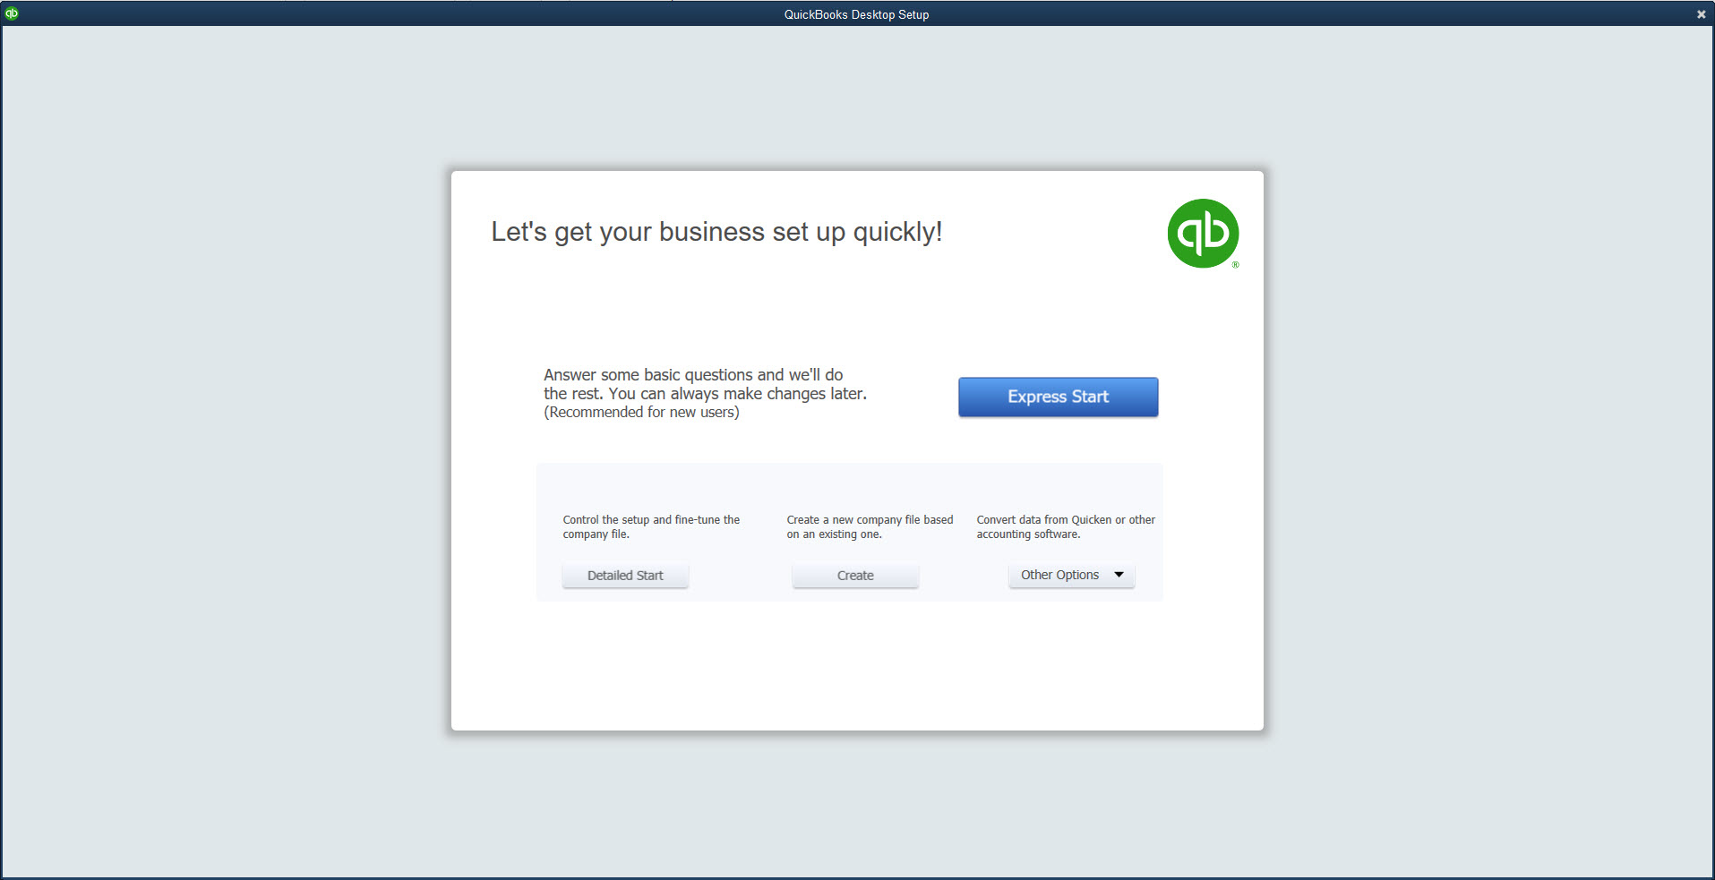
Detailed Start and EasyStep Interview Window Cont.

Slide 13
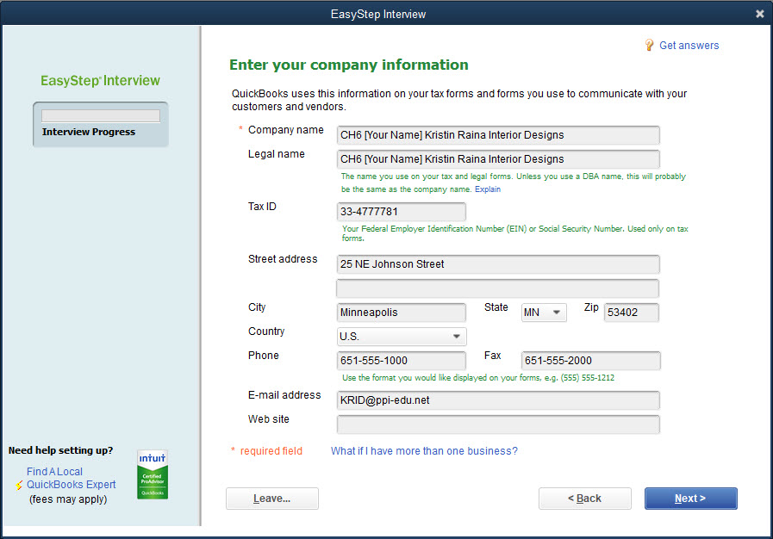
Detailed Start and EasyStep Interview Window Cont.

Slide 14
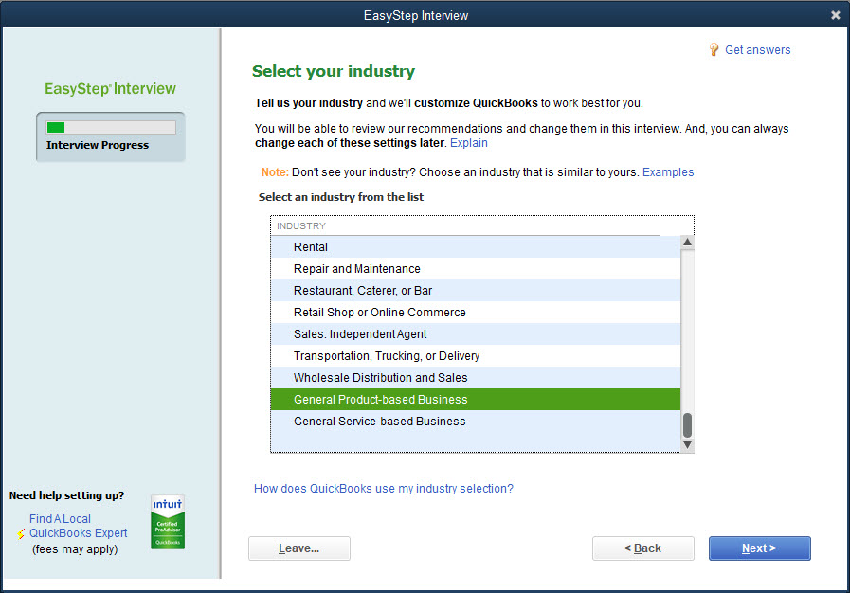
Detailed Start and EasyStep Interview Window Cont.

Slide 15
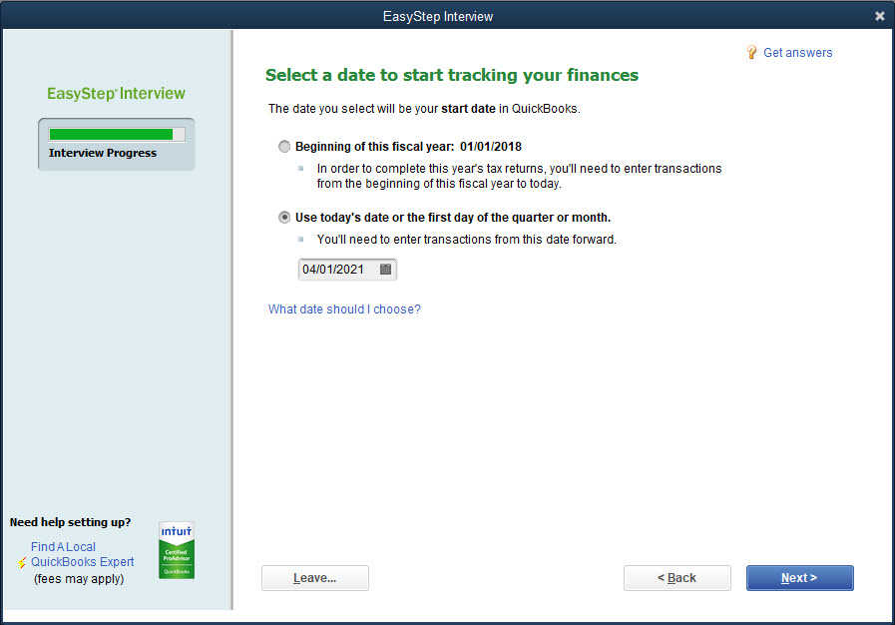
Detailed Start and EasyStep Interview Window Cont.

Slide 16
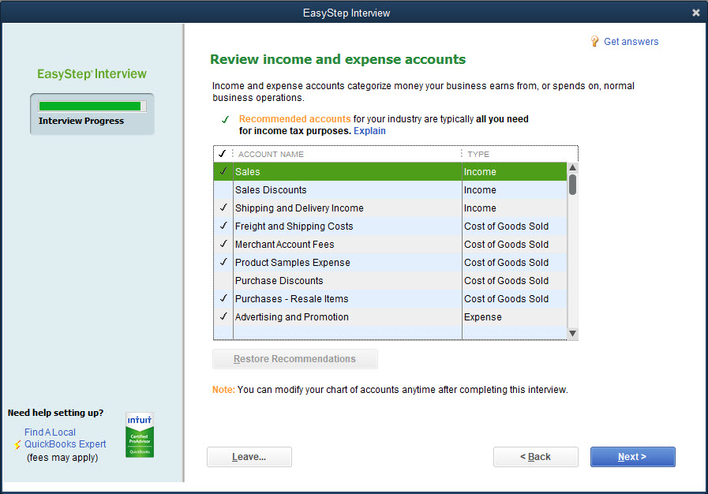
Detailed Start and EasyStep Interview Window Cont.

Slide 17
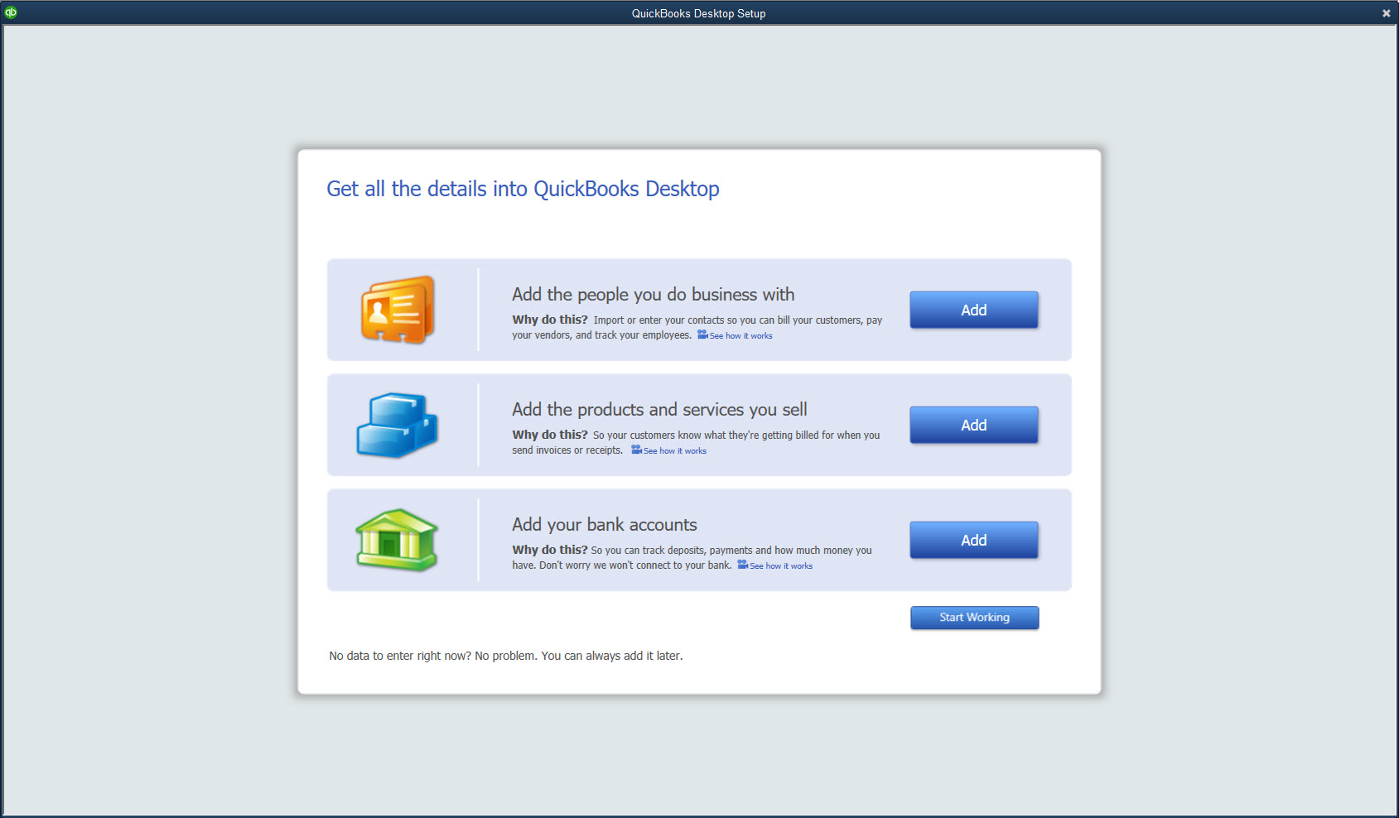
Detailed Start and EasyStep Interview Window Cont.

Slide 18
QuickBooks Desktop Setup Window
You can use the QuickBooks Desktop Setup window—Get all the details into QuickBooks Desktop page to enter your
Customers (Customer Center)
Vendors (Vendor Center)
Service items and inventory items (Item List)
Banking (Cash – Operating) information
Or you can go directly into QuickBooks (Start Working)
For Kristin Raina Interior Designs, the QuickBooks Desktop Setup window will be used to continue setting up the new company file and to create the Customer Center, Vendor Center, and add to the Item List which begins in EasyStep Interview
If you wish to leave the QuickBooks Desktop Setup window, click the X
You will enter QuickBooks in the new company file
To return to the QuickBooks Desktop Setup window, click Company and then click Bulk Enter Business Details.

Slide 19
QuickBooks Setup Window Cont.
To leave the EasyStep Interview window:
Click the Leave button.
Click OK at the EasyStep Interview message.
You should not leave the EasyStep Interview window until the new company file has been saved.
To re-enter the EasyStep Interview window:
At the No Company Open window, click Open or Restore an existing company, or click File and then click Open Company.
Open the new company file.
Click OK at the QuickBooks Information message.
When you open the company file, you are returned to the page you were last using.
To enter the QuickBooks Setup window:
Click Company and then click Bulk Enter Business Details.

Slide 20
QuickBooks Setup Window Cont.
To add customers to the Customer Center using the QuickBooks Desktop Setup window:
In the QuickBooks Desktop Setup window, at the Get all the details into QuickBooks page, in the Add the people you do business with section, click the Add button.
At the next Add the people you do business with page, click the Paste from Excel or enter manually button and then click Continue.
At the next Add the people you do business with page, in the Customer column, click Select all.
Enter the information for the customers in the appropriate columns and then click Continue.
At the next Add the people you do business with page, click Enter opening balances.
Enter the balances for the customers and enter the correct date.
Click Continue. You return to the Add the people you do business with page.
Click Continue. You return to the QuickBooks Desktop Setup window—Get all the details into QuickBooks page.
Click Add More to enter additional customers, vendors, or items, or click the X to exit the QuickBooks Desktop Setup window.

Slide 21
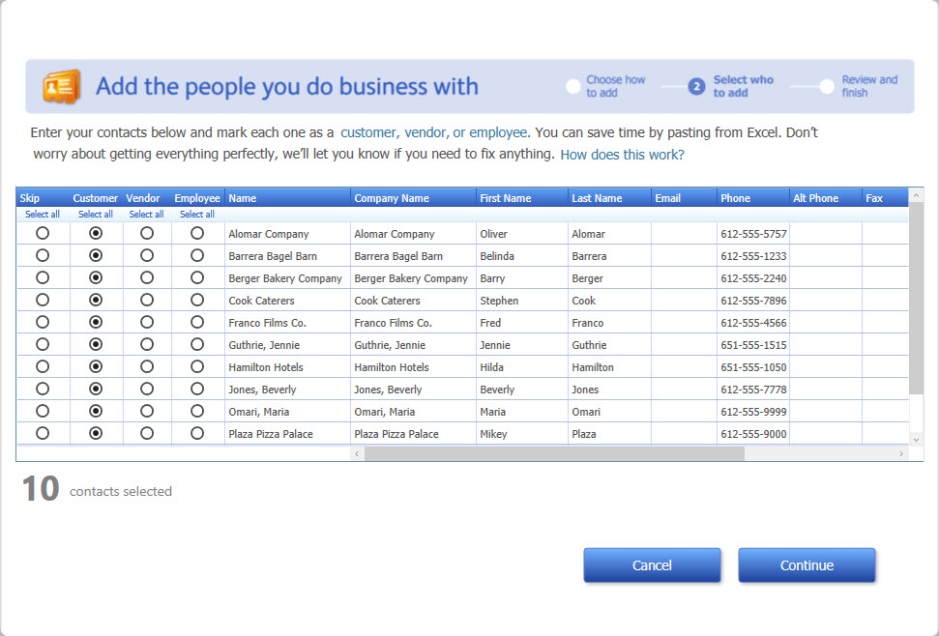
Setting Up the Customer Center

Slide 22
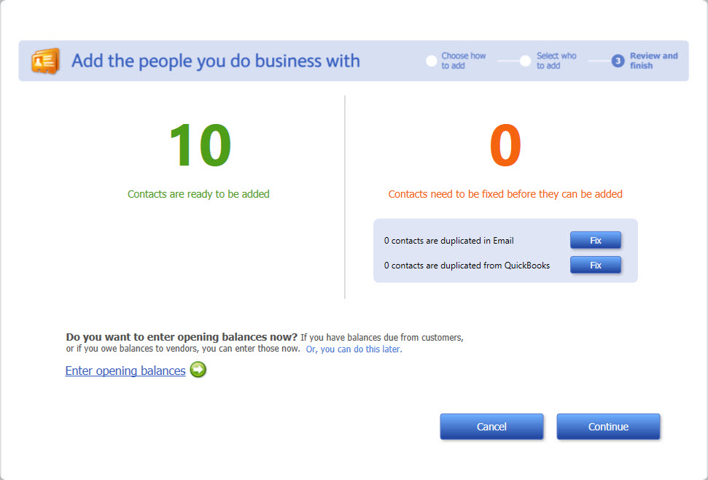
Setting Up the Customer Center Cont.
Don’t forget to enter Opening Balances at this time!

Slide 23
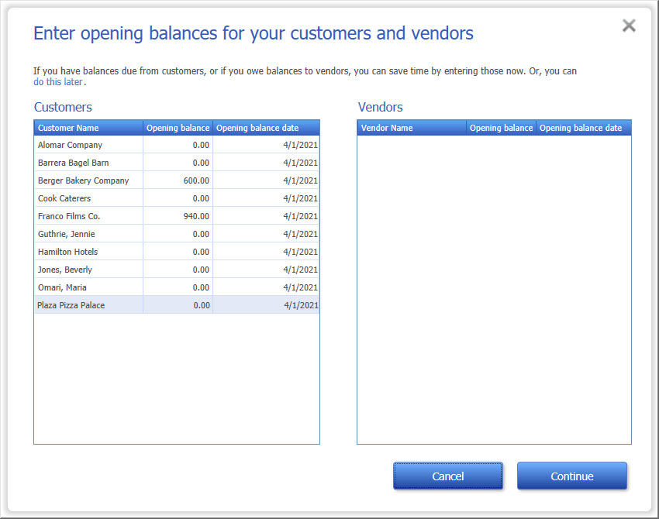
Setting Up the Customer Center Cont.

Slide 24
Setting Up the Vendor Center
To add vendors to the Vendor Center using the QuickBooks Desktop Setup
window:
In the QuickBooks Desktop Setup window, at the Get all the details into QuickBooks page, in the Add the people you do business with section, click the Add More button.
At the Add the people you do business with page, click the Paste from Excel or enter manually button and then click Continue.
At the next Add the people you do business with page, in the Vendor column, click Select all.
Enter the information for the vendors and then click Continue.
At the next Add the people you do business with page, click Enter opening balances.
At the Enter opening balances for customers and vendors page, enter the balances for the vendors and enter the correct date.
Click Continue. You return to the Add the people you do business with page.
Click Continue. You return to the QuickBooks Desktop Setup window—Get all the details into QuickBooks page.
Click Add More to enter additional vendors, customers, or items, or click the X to exit the QuickBooks Desktop Setup window.

Slide 25
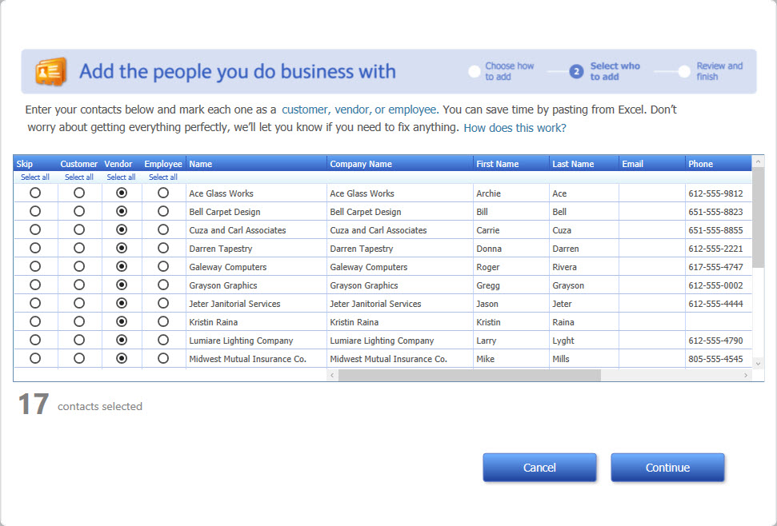
Setting Up the Vendor Center Cont.

Slide 26
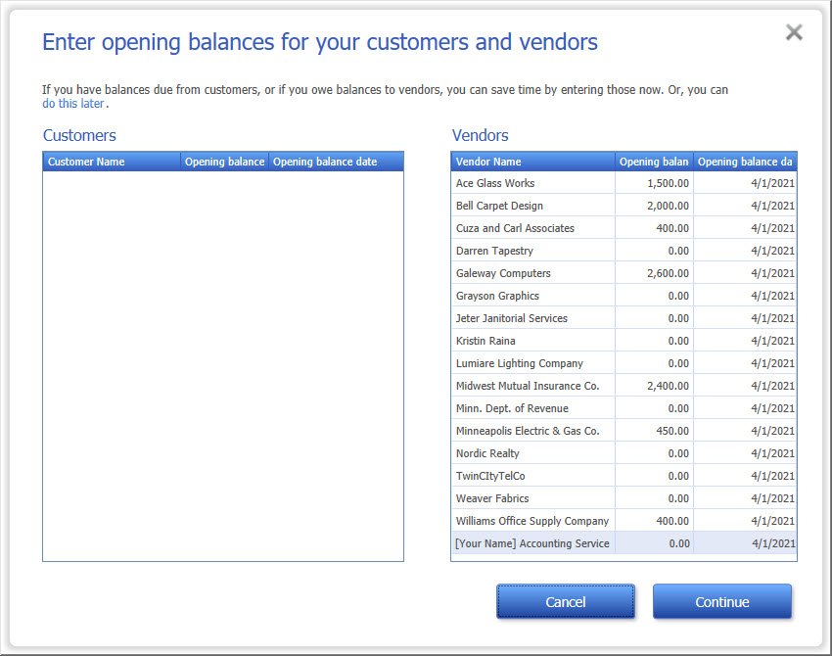
Setting Up the Vendor Center Cont.

Slide 27
Adding to the Item List
Item List stores information about the service items, the inventory part items, and the sales tax.
As transactions are recorded in the Activities windows, QuickBooks uses information in the Item List to record the transaction to the correct accounts.
When you record the quantity on hand for inventory parts, QuickBooks creates the inventory asset for that inventory part.
When entering a quantity on hand for an inventory part item, the total value is computed automatically based on the cost multiplied by the quantity.
It is important to have the correct date because a journal entry will be recorded on that date.

Slide 28
Adding to the Item List Cont.
To add service items to the Item List using the QuickBooks Desktop Setup window:
In the QuickBooks Desktop Setup window, at the Get all the details into QuickBooks page, in the Add the products and services you sell section, click the Add button.
At the Add the products and services you sell page, click the Service option and then click Continue.
Enter the information for the service items in the appropriate columns.
After all the service items information is entered, click Continue. You return to the Add the products and services you sell page.
Click Continue. You return to the QuickBooks Desktop Setup window—Get all the details into QuickBooks Desktop page.
Click Add More to enter additional items, customers, or vendors, or click the X to exit the QuickBooks Setup window.

Slide 29
Adding to the Item List Cont.
To add inventory part items to the Item List using QuickBooks Setup:
In the QuickBooks Desktop Setup window, at the Get all the details into QuickBooks page, in the Add the products and services you sell section, click the Add or Add More button.
At the Add the products and services you sell page, click the Inventory part button and then click Continue.
Enter the information for the inventory part items in the appropriate columns and choose the correct date.
After all the inventory part items information is entered, click Continue. You return to the Add the products and services you sell page.
Click Continue. You return to the QuickBooks Desktop Setup window—Get all the details into QuickBooks page.
Click Add More to enter additional items, customers, or vendors, or click the X to exit the QuickBooks Desktop Setup window.

Slide 30
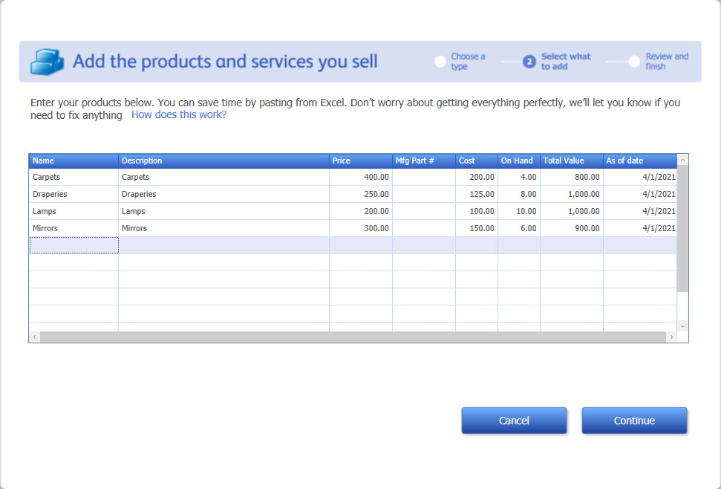
Adding to the Item List Cont.

Slide 31
Customer Center
QuickBooks creates the customers based on the information entered in QuickBooks Desktop Setup—Add the people you do business with pages.
If you entered an opening balance, the balance is displayed in the Current Balance field.
If you did not enter an opening balance, the Current Balance field indicates a zero.
You can correct all information in the Edit Customer window, except the Current Balance.
There are different ways to correct the errors in the Customer Center.
If there is an error in the name, address, phone or fax numbers, or contact, you can correct it in the Edit Customer window.
If there is an error in the current balance, you can correct it when viewing journal entries.
If there is no current balance for a customer with an outstanding balance, delete the customer, and then go back to the QuickBooks Desktop Setup—Add people you do business with pages.

Slide 32
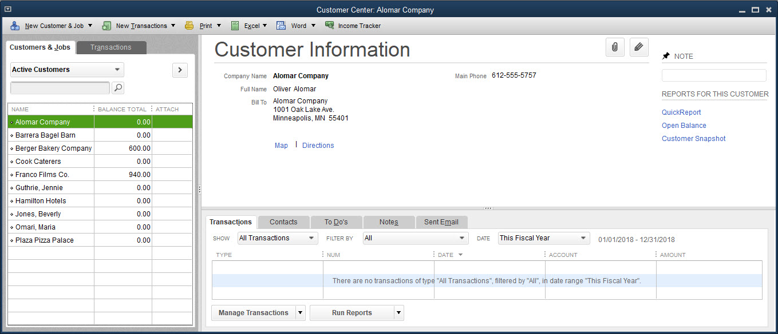
Customer Center Cont.

Slide 33
Quick Check
If you do not click the Enter Opening Balances link on the Add the people you do business with page, then
you will have to re-enter the customers with balances.
QuickBooks will automatically enter them for you.
you will have to start the entire process over.
you cannot enter the balances at all.

Slide 34
Vendor Center
QuickBooks creates the vendors based on the information entered in QuickBooks Desktop Setup—Add the people you do business with pages.
If you entered an opening balance, the balance is displayed in the Current Balance field.
If you did not enter an opening balance, the Current Balance field indicates a zero.
You can correct all information in the Edit Customer window, except the current balance.
There are different ways to correct the errors in the Vendor Center.
If there is an error in the name, address, phone or fax numbers, or contact, you can correct it in the Edit Vendor window.
If there is an error in the current balance, you can correct it when viewing journal entries.
If there is no current balance for a vendor with an outstanding balance, delete the vendor, and then go back to the QuickBooks Desktop Setup—Add people you do business with pages.

Slide 35
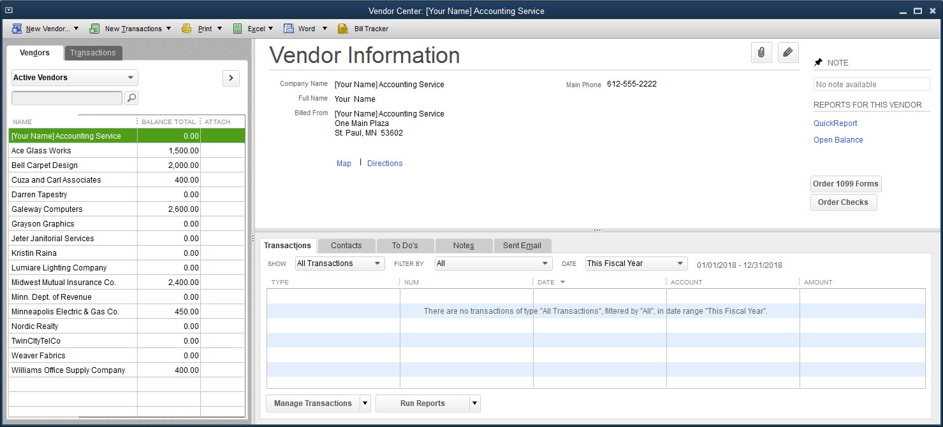
Vendor Center Cont.

Slide 36
Journal Report
Reviewing the Journal report allows you to see the journal entries created as part of the QuickBooks Setup.
As you added customers, vendors, and inventory part items on the appropriate pages in QuickBooks Desktop Setup, behind the scenes QuickBooks recorded the information in general journal format and updated the appropriate balances.
In the Journal report, QuickBooks recorded 13 journal entries based on information recorded in the QuickBooks Desktop Setup. (See next slide.)

Slide 37
Journal Report Cont.
Journal entries can be categorized as follows:
Two journal entries labeled as Invoice were created when two customers with balances were recorded in the Add people you do business with pages. QuickBooks debits the Accounts Receivable with the customers’ outstanding balances and credits an account called Uncategorized Income.
Seven journal entries labeled as Bill were created when seven vendors with outstanding balances were recorded in the Add people you do business with pages. QuickBooks credits the Accounts Payable with the vendors’ outstanding balances and debits an account called Uncategorized Expenses.
Four journal entries labeled as Inventory Adjust were created when the inventory part items with balances were recorded in the Add new products and services page. QuickBooks credits the Opening Balance Equity account and debits the Inventory Asset account with the total value for each inventory part item.

Slide 38
Journal Report Cont.
If you determine an error in the Journal report, you can drill down to the original source, which is based on the transaction type.
The transaction type is the same as seen in prior chapters.
For a transaction type of Invoice
You can make corrections to a customer’s opening balance or date.
For a transaction type of Bill, you are drilled down to the Enter Bills window.
You can make corrections to a vendor’s opening balance or date in this window.
For a transaction type of Inventory Adjust, you are drilled down to the Adjust Quantity/Value on Hand window.
You can make corrections to an inventory part quantity on hand.
Value is computed by QuickBooks as the quantity on hand multiplied by the cost for the inventory part.

Slide 39
Trial Balance
Reviewing the Trial Balance allows you to see the balances in the accounts you created as part of the QuickBooks Setup and indicates the following:
amount in the Accounts Receivable account equals the amount in the Uncategorized Income account
amount in the Inventory Asset account equals the amount in the Opening Balance Equity account
amount in the Accounts Payable account equals the amount in the Uncategorized Expenses account
Compare the trial balance of April 1, 2019, to the trial balance of March 31, 2019.
This is the Trial Balance from EX5 [Your Name] Kristin Raina Interior Designs and represents the balances from Activities previously recorded.
Although EasyStep Interview and QuickBooks Desktop Setup guides you in creating a new company file, it does not completely enter all the information for a company.

Slide 40
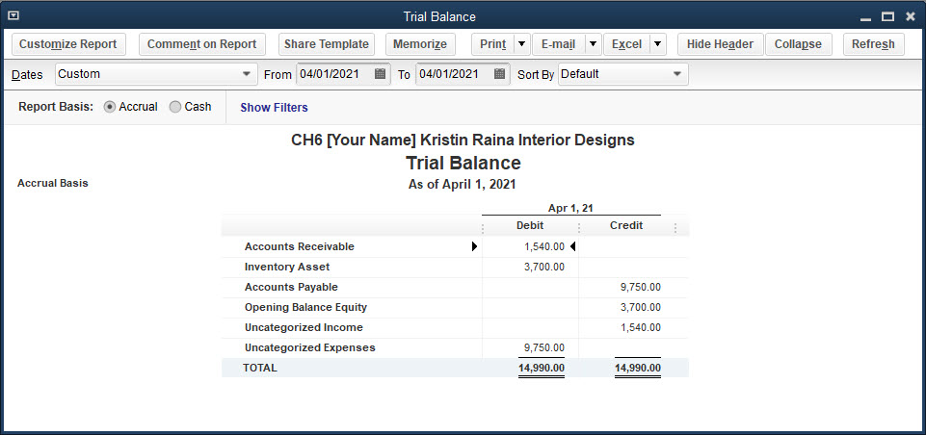
Trial Balance Cont.

Slide 41
Profit & Loss Standard Report
Reviewing the Profit & Loss Standard report allows you to see the balances created as part of the QuickBooks Setup that flow into the Profit & Loss Standard report.
Profit & Loss Standard report indicates only Uncategorized Income and Uncategorized Expenses.
These amounts are off-setting amounts of the Accounts Receivable and Accounts Payable accounts.
To view and print financial statements from the Reports menu:
Click Reports and then click Company & Financial.
At the Company & Financial submenu, choose a financial report.
Indicate the start and end dates for the report.
Click the Print button at the top of the report and then click Report.
At the Print Reports dialog box, review the settings and then click Print.
Close the report.

Slide 42
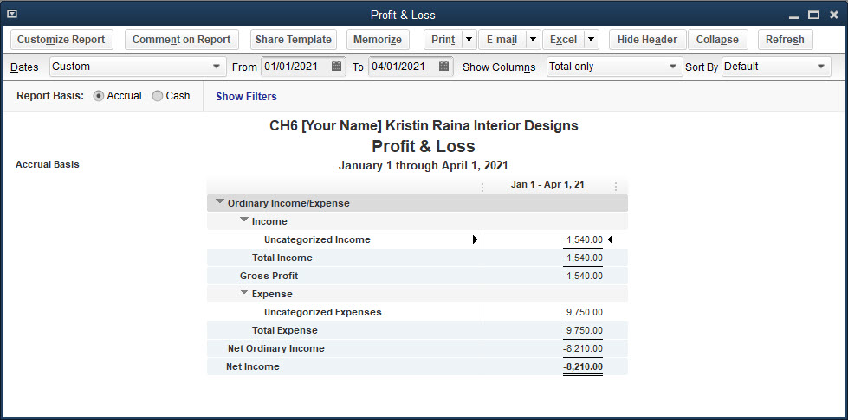
Profit & Loss Standard Report Cont.

Slide 43
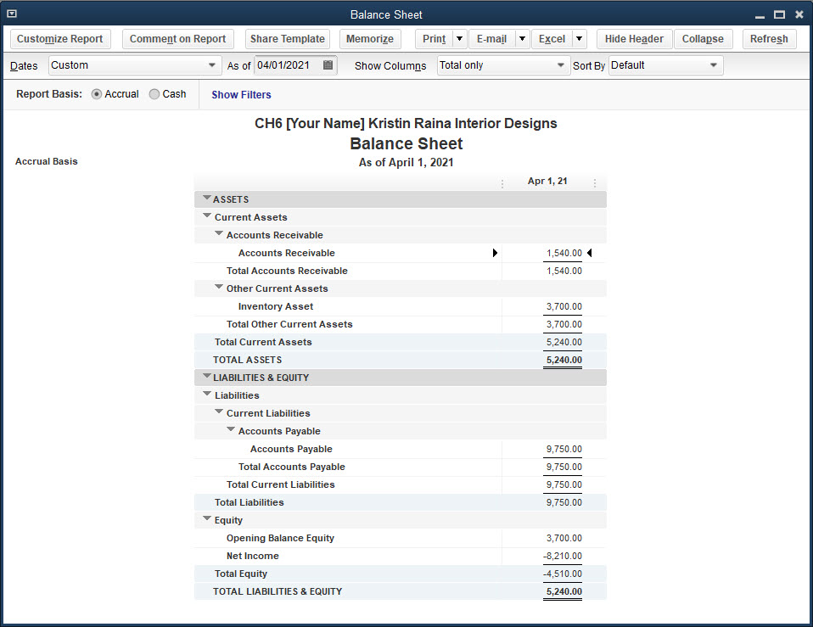
Balance Sheet Standard Report
A review of the balance sheet indicates the following:
The only assets recorded so far are Accounts Receivable and Inventory Asset.
The only liabilities recorded so far are the Accounts Payable.
The balance in the Opening Balance Equity account is the amount in Inventory Asset.
The net income is incorrect as seen in the Income Statement (Profit & Loss report) because of incomplete information.

Slide 44
Customizing the New Company File
When you use the EasyStep Interview and QuickBooks Desktop Setup windows, only part of New Company Setup is completed.
EasyStep Interview window is used to:
create the new company file
enable or disable some preferences
record a sales tax item which begins the Item List
begin the setup of the Chart of Accounts List
QuickBooks Desktop Setup window is used to:
create the Customer Center
create the Vendor Center
update the Item List to include service items and inventory part items
At the same time, the information entered in the QuickBooks Desktop Setup window records opening balances for Accounts Receivable, Accounts Payable, and Inventory Asset.

Slide 45
Customizing the Chart of Accounts List
Customize the Chart of Accounts for Kristin Raina by enabling the account numbers feature and editing account numbers and account names assigned by QuickBooks.
Adding Account Numbers
Open the Chart of Accounts List, select any account, click the Accounts menu button, and then click Edit Account.
By default, QuickBooks does not use account numbers.
To add account numbers to the Chart of Accounts List, you must activate the account numbers feature in the Preferences window.
Along the left side of the Preferences window are 23 icons that represent the different categories of features.
For each category there is a My Preferences tab and a Company Preferences tab.
The Company Preferences tab is used for most customizations when setting up a new company file.

Slide 46
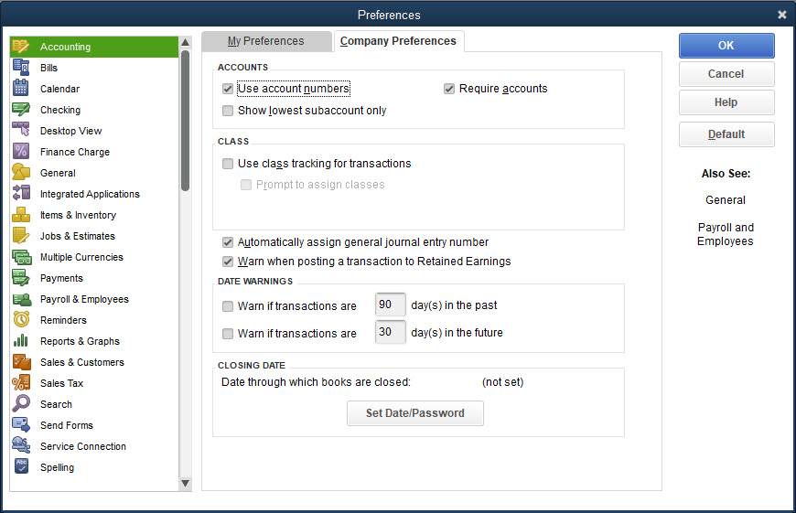
Customizing the Chart of Accounts List Cont.
Adding Account Numbers
My Preferences tab records the preferences for each individual user on his or her own personal computer
When using the EasyStep Interview window, most preferences are established based on the responses to the questions in the EasyStep Interview

Slide 47
Customizing the Chart of Accounts List Cont.
Editing Account Numbers and Names
When you activate the account numbers feature, QuickBooks assigns account numbers to certain accounts.
You can change or delete these numbers.
Deleting an Account
As part of the EasyStep Interview and QuickBooks Setup, QuickBooks created two sales accounts:
Sales Income and 47900 Sales
The Sales Income account was not assigned an account number by QuickBooks but was the revenue account QuickBooks used in the Item List whenever an income account was needed.
This account now has the number 4060 and the name has been changed to Sale of Carpets.
47900 Sales will be deleted, as it’s not needed.

Slide 48
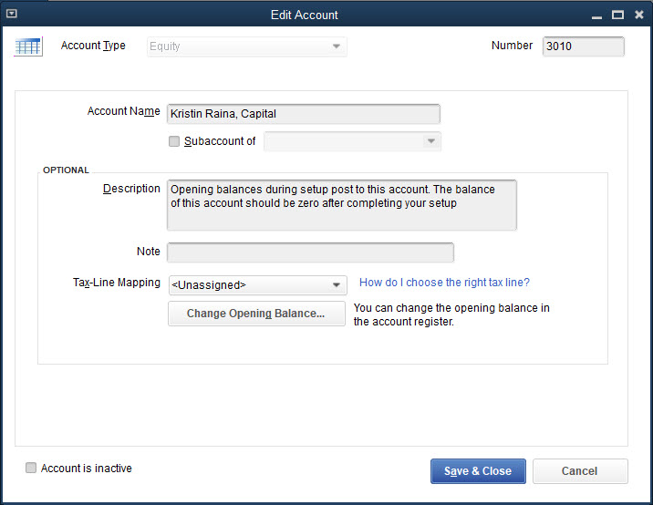
Customizing the Chart of Accounts List Cont.
To customize the accounts on the Chart of Accounts List created in EasyStep Interview and QuickBooks Desktop Setup windows and change account numbers and names:
Click Lists and then click Chart of Accounts.
Select the account to edit.
Click the Account button.
At the Account menu, click Edit Account.
Make any necessary changes to the account and then click Save & Close.

Slide 49
Customizing System Default Accounts
As you saw in prior chapters, QuickBooks sets up default accounts and uses those accounts when recording transactions in the Activities windows.
QuickBooks looks for these accounts in the Chart of Accounts List, and if it cannot find an account it will create one.
Some system default accounts you’ve learned so far are
Accounts Receivable
Undeposited Funds
Accounts Payable
Sales Tax Payable
Inventory Asset
Cost of Goods Sold
Other system default accounts include the equity accounts (capital and accumulated earnings)

Slide 50
Customizing System Default Accounts Cont.
When you created the company file using EasyStep Interview and QuickBooks Setup, QuickBooks created some of the system default accounts as part of the Chart of Accounts.
Accounts Receivable
Accounts Payable
Sales Tax Payable
Opening Balance Equity
Owner’s Equity
You will customize these system default accounts created as part of EasyStep Interview (sales tax payable and the equity accounts) and QuickBooks Setup (accounts receivable and accounts payable).
Edit the account numbers and names to follow the company’s pattern for naming and numbering accounts on the Chart of Accounts List.

Slide 51
Customizing System Default Accounts Cont.
You will then force QuickBooks to create additional system default accounts not created by EasyStep Interview or QuickBooks Setup.
Undeposited funds
Inventory asset
Cost of goods sold
These additional system default accounts will then also be customized by editing the account numbers and names.
To allow QuickBooks to create system default accounts:
Open and close Activities windows, such as the Create Invoices, Enter Sales Receipts, and Enter Bills windows. Also open the Item List and the New Item window, and select Inventory Part.
This process creates the system default accounts: Undeposited Funds, Inventory Asset, and Cost of Goods Sold. After QuickBooks creates these accounts, you can edit the account number and name.

Slide 52
Customizing System Default Accounts Cont.
When you created the company and indicated it was a sole proprietorship QuickBooks automatically created three equity accounts:
Opening Balance Equity
Owners Draw
Owners Equity
When you activated the sales tax feature, QuickBooks created a Sales Tax Payable account.
When you added customers in QuickBooks Setup, QuickBooks created the Accounts Receivable account.
When you added vendors in QuickBooks Setup, QuickBooks created the Accounts Payable account.
When you added inventory parts in QuickBooks Setup, QuickBooks created the Inventory Asset and Cost of Goods Sold accounts.
Numbers and names for each of these accounts can be edited.

Slide 53
Customizing System Default Accounts Cont.
The Opening Balance Equity account will be renamed as Kristin Raina, Capital, and the Owners Draw account was already renamed Kristin Raina, Drawings.
Opening Balance Equity account is used by QuickBooks as an offsetting account when certain opening balances are entered in the accounts.
The Owners Equity account is created to capture net income at the end of the fiscal year.
QuickBooks recognizes the Accounts Receivable, Accounts Payable, Sales Tax Payable, Kristin Raina, Capital, and Accumulated Earnings (Owner’s Equity) accounts as system default accounts.
But, QuickBooks does not recognize the Inventory Asset and Cost of Goods Sold accounts as system default accounts. QuickBooks usually identifies a system default account by graying, or dimming, the account type.

Slide 54
Customizing Payment Terms
In QuickBooks, a list with payment terms is accessed when needed in
Customer files
Vendor files
Activities windows
As seen in prior chapters, payment terms can be identified in both the customer and vendor files if they relate to a particular customer or vendor.
Payment terms include Net 30 Days, 2/10 Net 30 Days, and so on.
When you create a new company file, QuickBooks creates a list of payment terms.
You can add, delete, or edit the Terms List.

Slide 55
Customizing Payment Terms Cont.
To add, delete, and edit the payment terms created in the EasyStep window:
Click Lists and then click Customer & Vendor Profile Lists.
At the Customer & Vendor Profile Lists submenu, click Terms List.
At the Terms List window, click the Terms menu button.
At the Terms menu, click New.
At the New Terms window, enter the appropriate information for any terms QuickBooks did not create that you wish to create.
Click Next or OK.
At the Terms List window, select the term created by QuickBooks that you wish to delete.
Click the Terms menu button and then click Delete Terms. Click OK at the warning.
At the Terms List window, select the term created by QuickBooks that you wish to edit.
Click the Terms menu button and then click Edit Terms.
Change the appropriate information and then click OK.

Slide 56
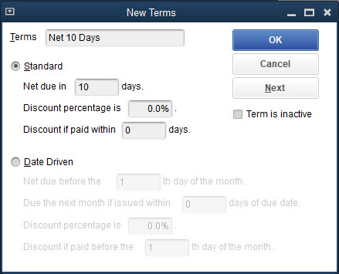
Customizing Payment Terms Cont.

Slide 57
Updating the Chart of Accounts List
QuickBooks created some accounts in the new company file, but many additional accounts must be added to the Chart of Accounts List.
Most of these accounts have opening balances.
Opening balances will later be entered by general journal entry.
To update the Chart of Accounts List:
Click Lists and then click Chart of Accounts.
Click the Account button.
At the Account menu, click New.
At the Add New Account: Choose Account Type window, choose the type and then click Continue.
At the Add New Account window, enter the information and then click Save & New or Save & Close.

Slide 58
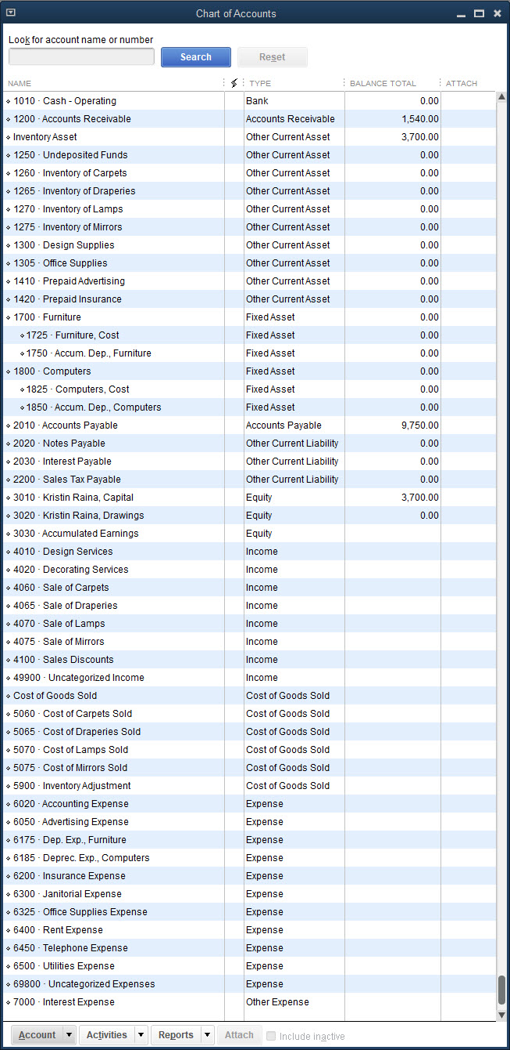
Updating the Chart of Accounts List Cont.

Slide 59
Updating the Item List
In QuickBooks, the Item List stores information about the
Service items
Inventory part items
Sales tax
As transactions are recorded in the Activities windows, QuickBooks uses information in the Item List to record the transaction in the correct accounts.
Open and review the Item List.
In EasyStep Interview, when responding yes to the question if sales tax is used, QuickBooks created a sales tax item.
In QuickBooks Setup, service and inventory part items were added on the Add products and services you sell pages.

Slide 60
Updating the Item List Cont.
As this information was entered in EasyStep Interview and QuickBooks Desktop Setup windows, QuickBooks recorded the information in the Item List.
Earlier in the chapter, you reviewed the Item List and saw that for service items and inventory part items, QuickBooks used the same Sales Income account as the income account for each item.
For each inventory part item, QuickBooks used the same Cost of Goods Sold account and Inventory Asset account.
When customizing the system default accounts, some of the account names and numbers were changed:
Sales Income was changed to 4060 Sale of Carpets.
12100 Inventory Asset was changed to 1260 Inventory of Carpets.
50000 Cost of Goods Sold was changed to 5060 Cost of Carpets Sold.

Slide 61
Updating the Item List Cont.
When updating the Chart of Accounts List, you added additional inventory accounts, income accounts, and cost of goods sold accounts.
When you changed the account names and numbers on the system default accounts, these changes flowed into the Item List.
You will now edit the service items and inventory part items to reflect the accounts used by Kristin Raina Interior Designs.
When you entered the service items and inventory part items in the QuickBooks Desktop Setup window, it did not allow you to indicate if the item was taxable or non-taxable.
When you edit the service and inventory part items for the correct accounts, you will also indicate if the item is taxable or non-taxable.
In addition, the sales tax item does not have the necessary information for Kristin Raina Interior Designs sales tax and must be edited.

Slide 62
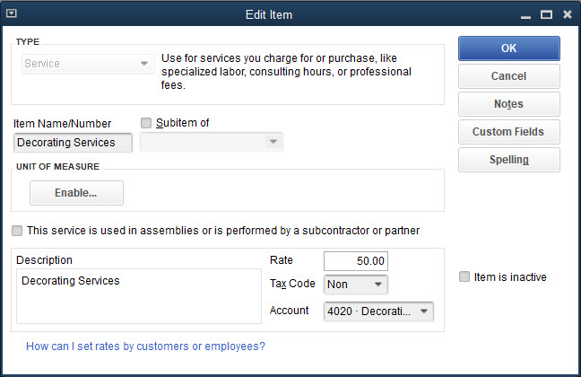
Updating the Item List Cont.
To edit the Item List for service items created in the QuickBooks Desktop Setup window:
Click Lists and then click Item List.
At the Item List window, choose the service item by double-clicking. The Edit Item window appears.
In the Tax Code field, click Non Non-Taxable Sales.
In the Account field, click the correct account.
If the information is correct, click OK.
At the warning, click Yes.

Slide 63
Updating the Item List Cont.
To edit an inventory part item created in the QuickBooks Desktop Setup window:
Click Lists and then click Item List.
At the Item List window, choose the inventory part item. The Edit Item window appears.
In the COGS Account field, click the correct account.
In the Tax Code field, click Tax Taxable Sales.
In the Income Account field, click the correct account.
In the Asset Account field, click the correct account.
Click OK.
At the warning, click Yes.

Slide 64
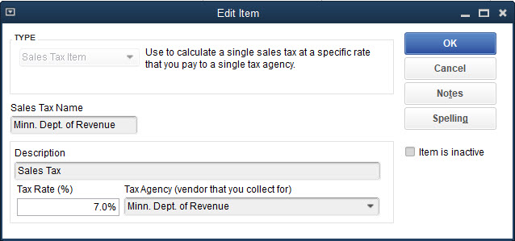
Updating the Item List Cont.
To edit the Item List for sales tax created in EasyStep Interview:
Click Lists and then click Item List.
At the Item List window, double-click the sales tax item to display the Edit window for that item.
Review the sales tax information and make any necessary changes.
Click OK.

Slide 65
Updating the Customer Center and Vendor Center
The Customer Center and Vendor Center were created when information was entered in the QuickBooks Desktop Setup window—Add the people you do business with pages.
You reviewed them when the QuickBooks Setup was complete.
At this time if there was additional information that you would want to include in the Customer Center or Vendor Center that was not included in the QuickBooks Setup, such as terms of payment, email addresses, account numbers, and so on, you could edit each customer and vendor to add the additional information.

Slide 66
Quick Check
When you edit the service and inventory part items for the correct accounts, you also indicate if the item is
taxable or non-taxable.
fundable or refundable.
in or out of stock.
There is nothing further to indicate.

Slide 67
Adjusting for the Accrual Basis of Accounting
You have now
Created the new company file
Customized and updated the Lists/Centers in the new company file
The final step is to enter the remaining opening balances and prepare the company file for the accrual basis of accounting.
In QuickBooks, by default, the accounting reports and financial statements are prepared using the accrual basis of accounting
The accrual basis of accounting requires the recording of revenues when earned and expenses when incurred regardless of cash receipts or cash payments.
Accrual basis of accounting follows GAAP, generally accepted accounting principles.

Slide 68
Completing New Company Setup Using the Accrual Basis of Accounting
Recall that you entered the opening balances for the Accounts Receivable, Accounts Payable and Inventory Asset accounts when you entered the information in the QuickBooks Setup window.
When adding new accounts to the Chart of Accounts List, you could have entered the opening balances for assets (excluding Accounts Receivable), liabilities (excluding Accounts Payable), and equity accounts at that time.
You cannot enter opening balances for some system default accounts, such as Accounts Receivable, Accounts Payable, and Sales Tax Payable, and you cannot enter opening balances for revenue and expense accounts.
All opening balances will be entered in one journal entry.

Slide 69
Completing New Company Setup Using the Accrual Basis of Accounting
As you saw in the Journal report:
Every time an Accounts Receivable account was recorded, a corresponding Uncategorized Income account was recorded.
Every time an Accounts Payable account was recorded, a corresponding Uncategorized Expenses account was recorded.
Uncategorized Income and Uncategorized Expenses accounts are not used in an accrual basis of accounting and therefore must be reversed to eliminate them.
Do this by using reversing entries.
To complete New Company Setup using the accrual basis of accounting, three journal entries will be prepared:
Entering opening balances
Reversing uncategorized income account
Reversing uncategorized expenses account

Slide 70
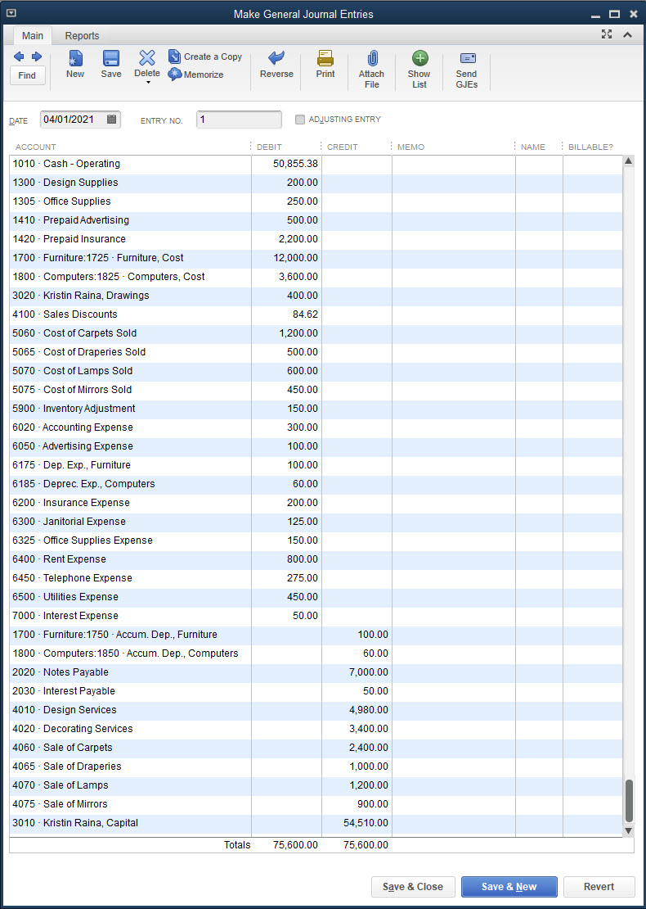
Completing New Company Setup Using the Accrual Basis of Accounting Cont.
To enter opening balances in the Make General Journal Entries window:
Click Company and then click Make General Journal Entries.
Choose the date and make/accept the entry in the ENTRY NO. field.
Remove the check mark from ADJUSTING ENTRY.
Enter the accounts and amounts to be debited.
Enter the accounts and amounts to be credited.
Record the balancing amount as a credit (or debit) to the capital account.
Click Save & Close.

Slide 71
Reversing the Uncategorized Income Account
Recall in the Journal report shown in Figure 6–Y that there were two journal entries recorded that debited Accounts Receivable and credited Uncategorized Income for two customers as follows:
Debit entries to the Accounts Receivable account are correct and should stay in that account.
Credits to the Uncategorized Income account need to be reversed by:
Debiting Uncategorized Income for the total of $1,540
Crediting account 3010 Kristin Raina, Capital (formerly the Opening Balance Equity account) for $1,540
As part of customizing the Chart of Accounts, the account Opening Balance Equity, created by QuickBooks, was changed to 3010 Kristin Raina, Capital
Customer | Uncategorized Income
Berger Bakery Company | $ 600
Franco Films Co. | 940
Total | $1,540

Slide 72
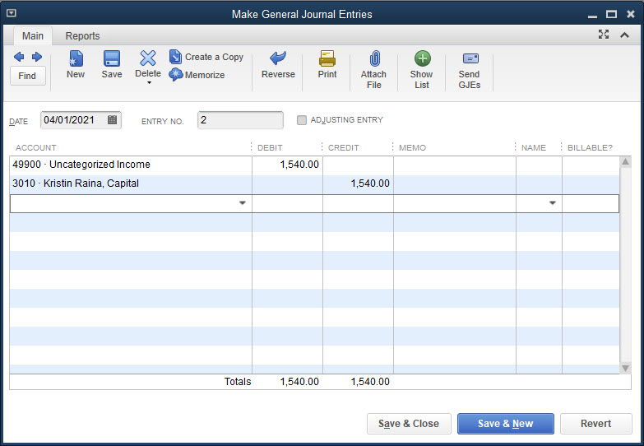
Reversing the Uncategorized Income Account Cont.
To reverse the Uncategorized Income account:
Click Company and then click Make General Journal Entries.
Choose the date and check the entry in the ENTRY NO. field.
Remove the check mark from ADJUSTING ENTRY.
Debit the Uncategorized Income account for the full amount in that account, and credit the Capital account for the same amount.
Click Save & Close.

Slide 73
Reversing the Uncategorized Expenses Account
In the Journal report, there were seven journal entries recorded that credited Accounts Payable and debited Uncategorized Expenses for seven vendor balances as follows:
Customer | Uncategorized Expenses
Ace Glass Works | $1,500
Bell Carpet Design | 2,000
Cuza and Carl Associates | 400
Galeway Computers | 2,600
Midwest Mutual Insurance | 2,400
Minneapolis Electric & Gas | 450
Williams Office Supply Company | 400
Total | $9,750
Credit entries to the Accounts Payable account are correct and should stay in that account.
Debits to the Uncategorized Expenses need to be reversed by
Crediting Uncategorized Expenses for the total of $9,750
Debiting the 3010 Kristin Raina account, Capital for $9,750

Slide 74
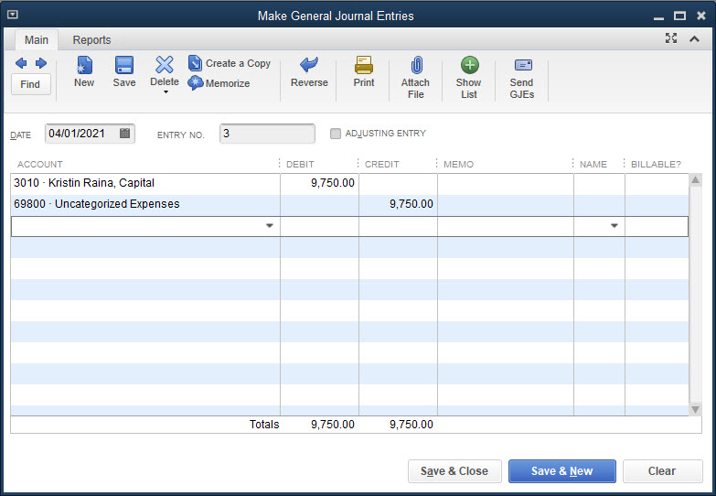
Reversing the Uncategorized Expenses Account Cont.
To reverse the Uncategorized Expenses account:
Click Company and then click Make General Journal Entries.
Choose the date and check the entry in the ENTRY NO. field.
Remove the check mark from ADJUSTING ENTRY.
Debit the Capital account for the full amount in the Uncategorized Expenses account, and credit the Uncategorized Expenses account for the same amount.
Click Save & Close.

Slide 75
Accounting Reports
Journal report
You displayed and printed the Journal report after the EasyStep Interview and QuickBooks Desktop Setup windows were completed.
After recording the opening balances and reversing the Uncategorized Income and Uncategorized Expenses accounts, three more journal entries have been added to the Journal report.
You can view and print all of the journal entries.
Trial Balance report
Compare the trial balance of April 1, to the trial balance of March 31.
Trial balances should be the same.
QuickBooks created the Uncategorized Income and Uncategorized Expenses accounts when you entered outstanding accounts receivable and accounts payable balances in the Customer Center and Vendor Center, respectively, the balances in these uncategorized accounts were subsequently reversed when the company file was prepared for the accrual basis of accounting.
These accounts are no longer needed and can be marked inactive.

Slide 76
Accounting Reports Cont.
To view and print accounting reports from the Reports menu:
Click Reports and then click Accountant & Taxes.
At the Accountant & Taxes submenu, choose a report.
Indicate the start and end dates for the report.
Click the Print button at the top of the report and then click Report.
At the Print Reports dialog box, review the settings and then click Print.
Close the report.

Slide 77
Backing Up the New Company File
You should make a backup copy of the new company file in the event there is damage to the file or the computer, or you are working on a different computer.
Using the procedures learned in previous chapters, make a backup copy of the new company file to your subfolder and/or removable storage device.
Upon completing the New Company Setup level of operation, updating the Lists/Centers, viewing and printing reports, and making a backup copy of the new company file, your accounting records are now ready for recording daily activities.
Activities would be recorded in the new company file using the procedures illustrated in the prior chapters.

Slide 78
Terms
accrual basis of accounting Accounting method that requires the recording of revenue when it is earned and the recording of expenses when they are incurred, regardless of cash receipts or cash payments.
reversing entries Entries recorded in the general journal to offset a balance in an account.

