Slide 2
New Company Setup—Express Start
Setting Up Company Preferences

Slide 3
Objectives
Create a new company file using the QuickBooks Express Start method
Set up a company file password
Establish preferences
Update the Chart of Accounts List
Customize the system default accounts and Terms List
Update the Item List
Update the Customer and Vendor Centers
Adjust the new company file to follow the accrual basis of accounting
Display and print accounting reports and financial statements

Slide 4
Introduction
In this chapter you will learn an alternative method for creating a new company file in QuickBooks.
Four levels of operation for QuickBooks are
New Company Setup
Lists/Centers
Activities
Reports
In Chapters 2 through 5, the Lists/Centers, Activities, and Reports levels for both a service company and a merchandise company were illustrated.
In those chapters, you opened an existing company file, updated the Lists/Centers, recorded Activities in the various windows, and viewed and printed Reports.

Slide 5
Introduction Cont.
QuickBooks provides two methods of New Company Setup
Detailed Start – covered in Chapter 6
Express Start – covered in Chapter 7
In Chapter 6, the New Company Setup level of operations was presented using the Detailed Start method which moves you to the EasyStep Interview window.
In addition, you used the QuickBooks Desktop Setup window to continue with the New Company Setup.
In Chapter 7, you will learn how to conduct New Company Setup using the Express Start method.
Instead of using the EasyStep Interview window, you will directly enable the features you desire.
Instead of using the QuickBooks Desktop Setup window, you will use many of the procedures you learned earlier for updating the Lists/Centers to enter information in the new company file.

Slide 6
QuickBooks v. Manual Accounting
In a manual accounting system, a company’s records are set up by creating the Chart of Accounts and the general ledger.
The Chart of Accounts is the list of accounts (assets, liabilities, equity, revenues, and expenses) the company intends to use.
The general ledger is the book of all accounts with the beginning balance for each.
If desired, subsidiary ledgers are also created and beginning balances recorded.
Subsidiary ledgers typically include accounts receivable and accounts payable.
If the perpetual inventory system is used, an inventory subsidiary ledger is also created.

Slide 7
QuickBooks v. Manual Accounting Cont.
In QuickBooks, a company’s records are set up by creating a new company file and establishing the Chart of Accounts List.
As the opening balances are entered, QuickBooks simultaneously sets up the general ledger.
The Customer Center and Vendor Center are set up.
These lists are equivalent to the accounts receivable and accounts payable subsidiary ledgers.
The Item List is set up, which is equivalent to an inventory subsidiary ledger.
In QuickBooks, the Item List includes service revenue items and sales tax items in addition to inventory items.

Slide 8
QuickBooks v. Manual Accounting Cont.
When you set up a new company file using the Express Start method, you must
identify certain company preferences
customize parts of the company file
If you do not use the QuickBooks Desktop Setup window to enter information, you use the Lists/Centers windows to continue with the setup of the new company file.
Entering information in the Lists/Centers is similar to creating a Chart of Accounts, general ledger, and subsidiary ledgers in a manual accounting system.
Finally, make three journal entries to complete the New Company Setup.
One journal entry records the opening balances in the accounts that were not included when you set up the Lists/Centers.
Two journal entries reverse accounts QuickBooks sets up during New Company Setup that are not used in the accrual basis of accounting.

Slide 9
New Company Setup: Express Start
With the Express Start method of New Company Setup, you will
enter some information about the company
identify the type of industry for your business in the QuickBooks Setup window
save the company file
Follow the steps in the text to create a new company file using the Express Start method.
After creating the new company file using the Express Start method, the QuickBooks Desktop Setup window can be used to enter information for customers, vendors, service items, and inventory part items, as was illustrated in Chapter 6.
In this chapter, however, the QuickBooks Desktop Setup window will not be used. Instead, you will enter information directly into the Lists/Centers.

Slide 10
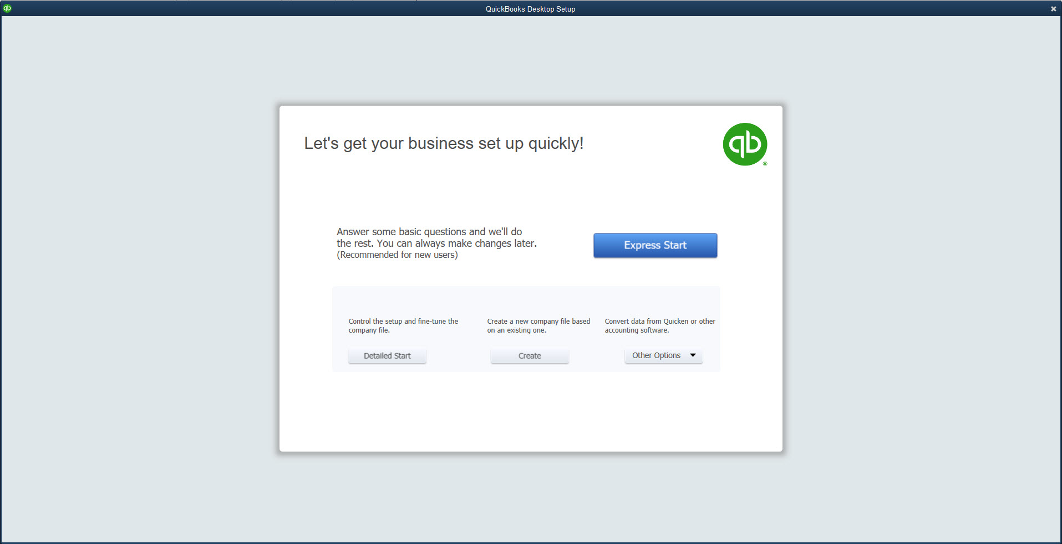
New Company Setup: Express Start Cont.
To begin New Company Setup and create a new company file using Express Start:
Open QuickBooks.
At the No Company Open window, click the Create a new company button or click File and then click New Company.
At the QuickBooks Setup window, on the Let’s get your business set up quickly! page, click the Express Start button.
Continues…

Slide 11
New Company Setup: Express Start Cont.
At the Glad you’re here! page, in the Business Name field, enter the company name.
Move to the Industry field and click Help me choose. The Select Your Industry page appears.
At the Select Your Industry page, in the Industry field, scroll to the bottom and select Other/None.
Click OK. You return to the Glad you’re here! page.
In the Business Type field, click the drop-down arrow and choose Sole Proprietorship.
At the Employer Identification Number (EIN) field, enter the tax identification number.
Enter your business contact information.
Click the Preview Your Settings button.
At the Preview Your Company Settings page, click the Company File Location tab.
Continues…

Slide 12
New Company Setup: Express Start Cont.
Continues…

Slide 13
New Company Setup: Express Start Cont.
On the Company File Location tab, click the Change Location button. You are moved to the Browse For Folder window.
At the Browse For Folder window, scroll through the list and choose the folder where you save your files, and then click OK.
If the path and folder are correct, click OK. You return to the Glad you’re here! page.
Click the Create Company button. The company file is saved in the path and folder you indicated. The QuickBooks Desktop Setup window appears.
Click the X to close the QuickBooks Desktop Setup window. The Home page and Left Icon bar appear. Click the X to close the Home page.

Slide 14
Company File Password
In recent versions of QuickBooks, password protection has become mandatory.
There are a few instances when a password can be optional (such as when a business identification number has not been entered), but in most situations, a password is now required to open a company file.
To create company file password:
Click Company and then click Setup Users and Passwords.
At the Setup Users and Passwords submenu, click Change Your Password. The Change Your Password window appears.
Enter a password in the New Password and Confirm New Password fields.
At the Challenge Question drop-down list, select a question.
In the Answer text box, type the answer to the Challenge Question.
Click OK.

Slide 15
Company File Password Cont.

Slide 16
Establishing Preferences
When you use the Express Start method of New Company Setup, you skip EasyStep Interview, therefore you must establish the preferences for the new company file yourself.
Company preferences enable or disable features available in QuickBooks.
When a feature is enabled it allows for choices to be listed on the drop-down menus and the Home page.
If a feature is disabled, then you will not see some choices on the drop-down menu or Home page.
Use the Preferences window to
Activate the account numbers field in the Chart of Accounts List window
Activate the inventory feature
Activate the sales tax
Disable the payroll feature

Slide 17
Quick Check
When setting up a new company file without the EasyStep Interview or QuickBooks Desktop Setup, which step should come first?
Create an inventory list.
Format reports.
Enter opening account balances.
Establish company preferences.

Slide 18
Account Numbers
Since QuickBooks by default does not use account numbers, you must activate the account numbers feature to add them.
To activate the account numbers feature:
Click Edit and then click Preferences.
Along the left frame of the Preferences window, click the Accounting icon.
Click the Company Preferences tab.
At the Accounts section, place a check mark in the box to the left of Use account numbers to turn on the account numbers feature.
Click OK.

Slide 19
Account Numbers Cont.

Slide 20
Inventory
QuickBooks provides you with the ability to maintain inventory records, but the inventory feature must be activated.
To activate the inventory feature:
Click Edit and then click Preferences.
Click the Items & Inventory icon.
Click the Company Preferences tab.
In the PURCHASE ORDERS AND INVENTORY section, place a check mark in the box to the left of Inventory and purchase orders are active to turn on the inventory feature.
Click OK.

Slide 21
Inventory Cont.

Slide 22
Sales Tax
QuickBooks also provides you with the ability to charge and maintain sales tax information, but the sales tax feature must be activated.
To activate the sales tax feature:
Click Edit and then click Preferences.
Click the Sales Tax icon.
Click the Company Preferences tab.
At the Do You Charge Sales Tax? field, click Yes.
At the Your most common sales tax item drop-down list, click < Add New >.
Enter the sales tax item information.
At the Tax Agency (vendor that you collect for) drop-down list, click < Add New >.
Enter the appropriate vendor information and then click OK.
Click OK at the completed New Item window and then click OK at the Preferences window.
At the Updating Sales Tax dialog box, click OK.

Slide 23
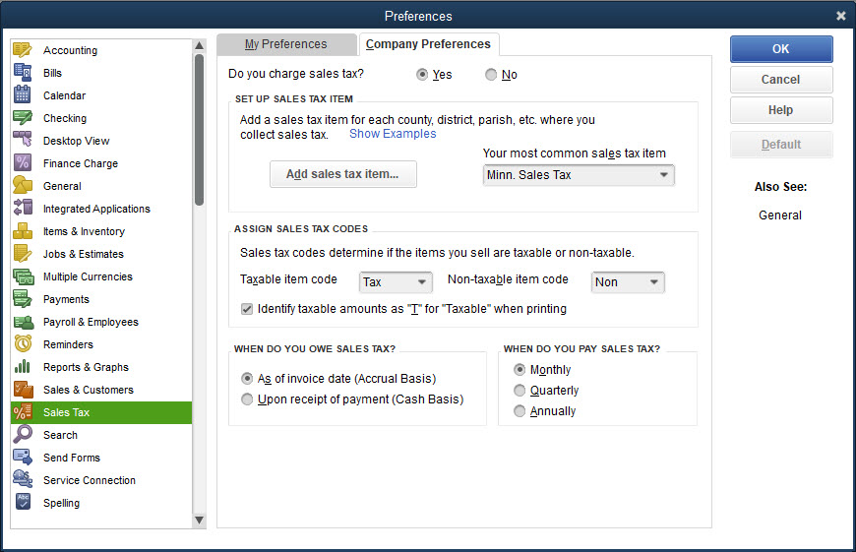
Sales Tax Cont.

Slide 24
Payroll
When you create a new company file using the Express Start method, QuickBooks assumes you will be using the Payroll feature and by default activates it.
When QuickBooks activates the payroll feature, it automatically creates a Payroll Liabilities account and Payroll Expenses account in the Chart of Accounts List.
Even if you disable the payroll feature, the Payroll Liabilities account and the Payroll Expenses account will appear on the Chart of Accounts List.

Slide 25
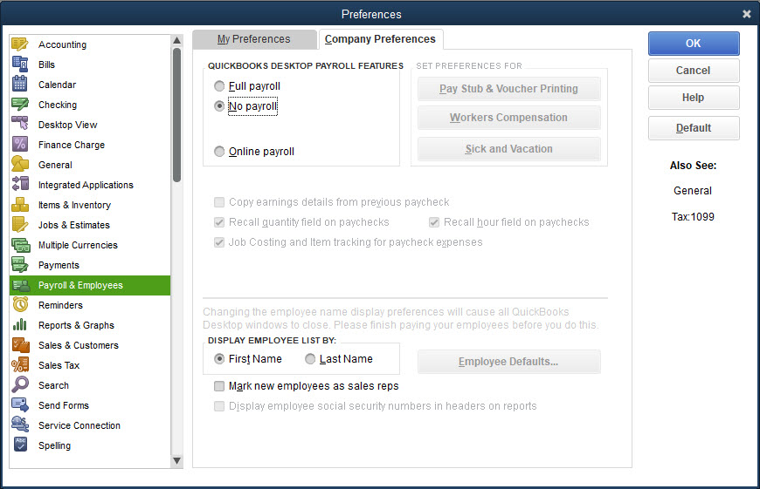
Payroll Cont.
To disable the payroll feature:
Click Edit and then click Preferences.
Click the Payroll & Employees icon.
Click the Company Preferences tab.
In the QUICKBOOKS PAYROLL FEATURES section, click No payroll.
Click OK.

Slide 26
Updating the Chart of Accounts List
When you created the new company file and established some of the preferences for the new company file, QuickBooks began to set up the Chart of Accounts List.
Add accounts to the Chart of Accounts List using the Chart of Accounts window as illustrated in prior chapters.
Opening balances will be entered later by general journal entry.
To update the Chart of Accounts List:
Click Lists and then click Chart of Accounts.
Click the Account menu button.
At the Account menu, click New.
At the Add New Account: Choose Account Type window, choose the type and then click Continue.
At the Add New Account window, enter the information and then click Save & New or Save & Close.

Slide 27
Customizing System Default Accounts
QuickBooks establishes default accounts and uses those accounts when recording transactions in the Activities windows.
QuickBooks looks for these accounts in the Chart of Accounts List, and if it cannot find an account it will create one.
Some system default accounts you learned so far are
Accounts Receivable
Undeposited Funds
Accounts Payable
Sales Tax Payable
Inventory Asset
Cost of Goods Sold
Other system default accounts include
Equity accounts (capital and accumulated earnings)
Payroll accounts (payroll liabilities and payroll expenses)

Slide 28
Customizing System Default Accounts Cont.
When you created the company file using the Express Start method, QuickBooks created some of the system default accounts as part of the Chart of Accounts.
Sales Tax Payable
Opening Balance Equity
Owner’s Equity
You will customize these system default accounts created by QuickBooks.
Edit the account numbers and names to follow the company’s pattern for naming and numbering accounts.
You will then force QuickBooks to create additional system default accounts.
Undeposited funds
Inventory asset
Cost of goods sold

Slide 29
Customizing System Default Accounts Cont.
When you created the company and indicated it was a sole proprietorship, QuickBooks created three equity accounts:
Opening Balance Equity
Owners Draw
Owners Equity
When you activated the sales tax feature, QuickBooks created a Sales Tax Payable account.
Numbers and names for each of these accounts can be edited.
The Opening Balance Equity account is used by QuickBooks as an offsetting account when certain opening balances are entered in the accounts.
The Owners Equity account is created to capture net income at the end of the fiscal year (Accumulated Earnings).

Slide 30
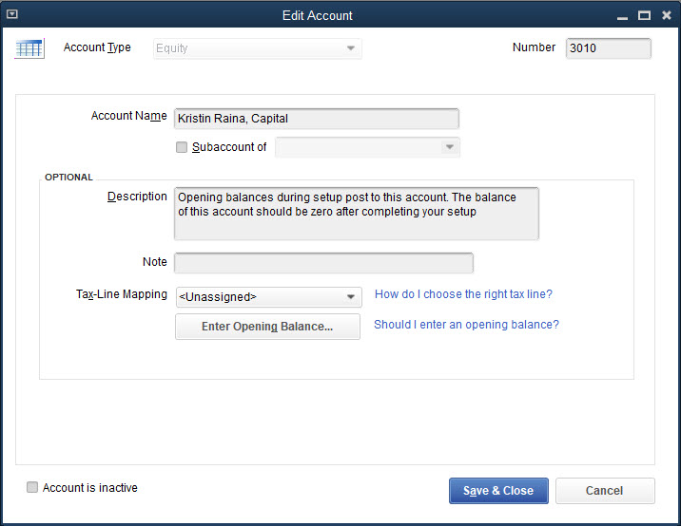
Customizing System Default Accounts Cont.
To customize the system default accounts:
Click Lists and then click Chart of Accounts.
Select the account to edit.
Click the Account button.
At the Account menu, click Edit Account.
Make any necessary changes to the account, then click Save & Close.

Slide 31
Customizing System Default Accounts Cont.
When you create a new company file using the Express Start method, QuickBooks assumes by default that you will be using the payroll feature and automatically creates a Payroll Liabilities account and a Payroll Expenses account.
Even though you turned off the payroll feature in the Preferences window, once payroll accounts are created in QuickBooks, you cannot delete them.
Once you turned on the account numbers feature, QuickBooks assigned the account numbers 24000 to the Payroll Liabilities account and 66000 to the Payroll Expenses account.
Payroll has not yet been covered, so you can make the accounts inactive and they will not be displayed in the reports.

Slide 32
Customizing System Default Accounts Cont.
To mark an account inactive:
Click Lists and then click Chart of Accounts.
Select the account to make inactive.
Click the Account button.
At the Account menu, click Make Account Inactive.
To view inactive accounts, click the Account button, then click Show Inactive Accounts. Inactive accounts are displayed with an X to the left of the account name.
Close the Chart of Accounts List window.

Slide 33
Customizing System Default Accounts Cont.
Recall that in the Create Invoices window, the system default account is a debit to Accounts Receivable, and in the Enter Bills window, the system default is a credit to Accounts Payable.
When you chose an inventory item in any of the Activities windows, QuickBooks knew from the Item List, which inventory asset account, cost of goods sold account, and sale of inventory account was the system default account to use to properly record the transaction.
You can also create accounts in the Chart of Accounts List but sometimes QuickBooks will not find the account you created.
You must let QuickBooks create the account in order for the software to identify it as a system default account.

Slide 34
Customizing System Default Accounts Cont.
To illustrate how QuickBooks creates its own system default accounts, you will open some Activities windows and the Item List and you will then see that QuickBooks cannot locate the accounts you created and creates its own accounts.
As you opened each of these windows, QuickBooks looked for certain accounts and when they could not be identified, QuickBooks created new accounts:
12000—*Undeposited Funds
12100—Inventory Asset
50000—Cost of Goods Sold
In some situations, such as these, you must allow QuickBooks to create their own accounts and then you may edit them to your liking.
In all cases, accounts created by QuickBooks will have dimmed account types and you will not be able to change the account type, but you may change the account numbers and account names.

Slide 35
Quick Check
Which of the follow is not one of QuickBooks' system default accounts?
Accounts Receivable
Sales Tax Payable
Inventory Asset
Accounts Payable

Slide 36
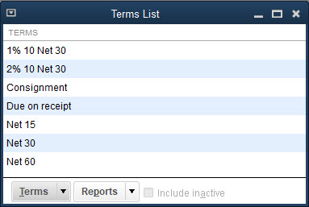
Customizing Payment Terms
In QuickBooks a list with payment terms is accessed when needed in
customer files
vendor files
activities windows
Payment terms include
Net 30 Days
2/10 Net 30 Days
You can add, delete, or edit the payment Terms List.

Slide 37
Customizing Payment Terms Cont.
To customize payment terms:
Click Lists and then click Customer & Vendor Profile Lists.
At the Customer & Vendor Profile Lists submenu, click Terms List.
At the Terms List window, click the Terms menu button.
At the Terms menu, click New.
At the New Terms window, enter the appropriate information for any terms QuickBooks did not create that you wish to create.
Click Next or OK.
At the Terms List window, select the terms created by QuickBooks that you wish to delete.
Continues…

Slide 38
Customizing Payment Terms Cont.
Click the Terms menu button; from the Terms menu, click Delete Terms. Click OK at the warning.
At the Terms List window, select the terms created by QuickBooks that you wish to edit.
Click the Terms menu button; from the Terms menu, click Edit Terms.
Change the appropriate information and then click OK.

Slide 39
Updating Lists and Centers
At this point, the company file has been created, preferences have been established, the Chart of Accounts List has been updated, and the system default accounts and payment terms have been customized.
Since you did not use the QuickBooks Desktop Setup window to create the Customer and Vendor Centers or update the Item List, the next step is to update the Item List and the Customer and Vendor Centers using the procedures learned in prior chapters.
When you update the Item List and Customer and Vendor Centers, you will enter the beginning balances.

Slide 40
Updating the Item List
In QuickBooks, the Item List stores information about the
service items sold
inventory part items sold
sales tax
As transactions are recorded in the Activities windows, QuickBooks uses information in the Item List to record the transaction to the correct accounts.
The Item List needs to be updated to include additional service items and inventory part items.
Then, add the quantity on hand for inventory part items.

Slide 41
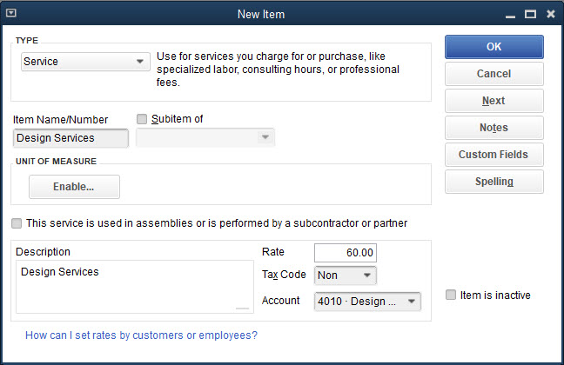
Updating the Item List Cont.
To update the Item List:
Click Lists and then click Item List.
At the Item List window, click the Item menu button.
At the Item menu, click New.
At the New Item window, select the Type and then enter the information.
Click Next or OK.

Slide 42
Updating the Item List Cont.

Slide 43
Updating the Customer Center
The Customer Center records the information for all customers with whom the company does business.
You can update the Customer Center using the procedures learned in Chapter 3 to add a new customer.
The only additional step you need to take is to enter outstanding balances that some of these customers have when you record the new customer file.
If inadvertently you don’t enter the opening balance, delete the customer and re-enter the customer with the balance and the correct date.

Slide 44
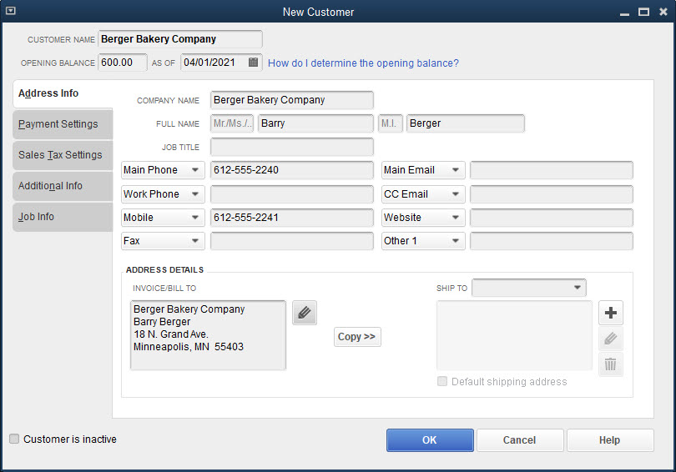
Updating the Customer Center Cont.
To update the Customer Center:
Click Customers and then click Customer Center.
At the Customer Center window, click the New Customer & Job button and then click New Customer.
Enter the background data for the customer including the opening balance, if any, and the correct date on the Address Info and Payment Settings tabs.
Click OK.

Slide 45
Updating the Vendor Center
The Vendor Center records the information for all vendors with whom the company does business.
You added one vendor, Minn. Dept. of Revenue, when you set up the sales tax item.
All other vendors need to be added to the Vendor Center.
The Vendor Center is updated using procedures learned in Chapter 2 to add a new vendor.
The only additional step you need to take is to enter outstanding balances for some of these vendors when recording the new vendor file.
If inadvertently you don’t enter the opening balance, delete the vendor and re-enter the vendor along with the balance and the correct date.

Slide 46
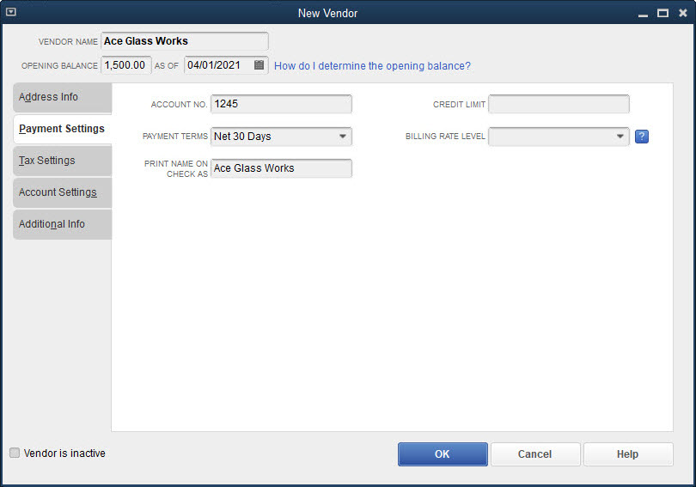
Updating the Vendor Center Cont.
To update the Vendor Center:
Click Vendors and then click Vendor Center.
At the Vendor Center window, click the New Vendor button and then click New Vendor.
Enter the background data for the vendor including the opening balance, if any, and the correct date on the Address Info and Payment Settings tabs.
Click OK.

Slide 47
Interim Review of New Company Setup
So far in setting up the new company file, you have
Created the company file
Established preferences
Updated and customized the Chart of Accounts List
Updated the Item List, and Customer and Vendor Centers
As you added the inventory items, customers, and vendors, with balances to the Lists and Centers, behind the scenes QuickBooks recorded the information in general journal format and updated the appropriate account balances.
Display the Journal, Profit & Loss Standard, and Balance Sheet Standard reports to see the activity taking place behind the scenes up to this point.

Slide 48
Journal Report
Journal entries can be categorized as follows:
For items that are debit entries to the inventory accounts, the credit entry is to the Kristin Raina, Capital (Opening Balance Equity) account.
For entries that are debits to Accounts Receivable, the credit is to Uncategorized Income.
For entries that are credits to Accounts Payable, the corresponding debit is to Uncategorized Expenses.

Slide 49
Journal Report Cont.

Slide 50
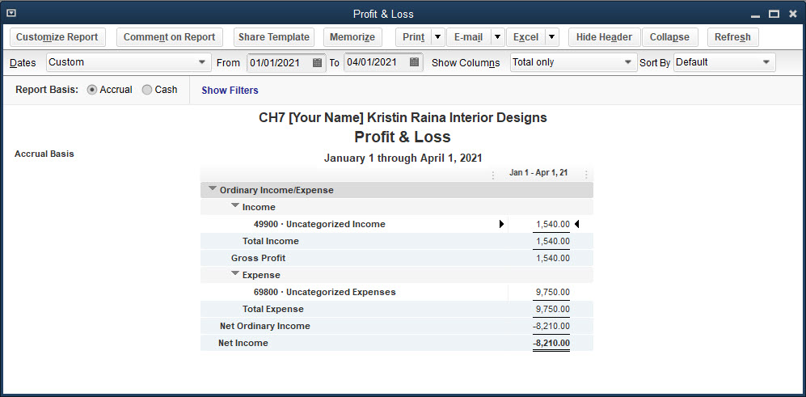
Profit & Loss Standard Report
indicates only Uncategorized Income and Uncategorized Expenses
These amounts are offsetting amounts of the Accounts Receivable and Accounts Payable accounts.

Slide 51
Balance Sheet Standard Report
A review of the balance sheet indicates the following:
The only assets recorded so far are accounts receivable and inventory.
The only liabilities recorded so far are the accounts payable.
The balance in the Kristin Raina, Capital (Opening Balance Equity) account is the same as the total inventory.
The net income is incorrect as seen in the Income Statement.

Slide 52
Balance Sheet Standard Report Cont.

Slide 53
Adjusting for the Accrual Basis of Accounting
The final step is to enter the remaining opening balances and prepare the company file for the accrual basis of accounting.
In QuickBooks, by default, the accounting reports and financial statements are prepared using the accrual basis of accounting.
The accrual basis of accounting requires the recording of revenues when earned and expenses when incurred regardless of cash receipts or cash payments.
Accrual basis of accounting follows GAAP – generally accepted accounting principle.

Slide 54
Completing New Company Setup Using the Accrual Basis of Accounting
Recall that you entered the opening balances for the Inventory accounts, Accounts Receivable, and Accounts Payable accounts when you set up and updated the Lists/Centers.
When you set up the Chart of Accounts List, you could have entered the opening balances for assets (excluding Accounts Receivable and Inventory), liabilities (excluding Accounts Payable), and equity accounts at that time.
You cannot enter opening balances for some system default accounts, such as Accounts Receivable, Accounts Payable, and Sales Tax Payable, and you cannot enter opening balances for revenue and expense accounts.
All opening balances will be entered in one journal entry.

Slide 55
Completing New Company Setup Using the Accrual Basis of Accounting Cont.
As you saw in the Journal report:
Every time an Accounts Receivable account was recorded, a corresponding Uncategorized Income account was recorded.
Every time an Accounts Payable account was recorded, a corresponding Uncategorized Expenses account was recorded.
Uncategorized Income and Uncategorized Expenses accounts are not used in an accrual basis of accounting and therefore must be reversed to eliminate them.
Do this by using reversing entries.
To complete New Company Setup using the accrual basis of accounting, three journal entries will be prepared:
Entering opening balances
Reversing Uncategorized Income account
Reversing Uncategorized Expenses account

Slide 56
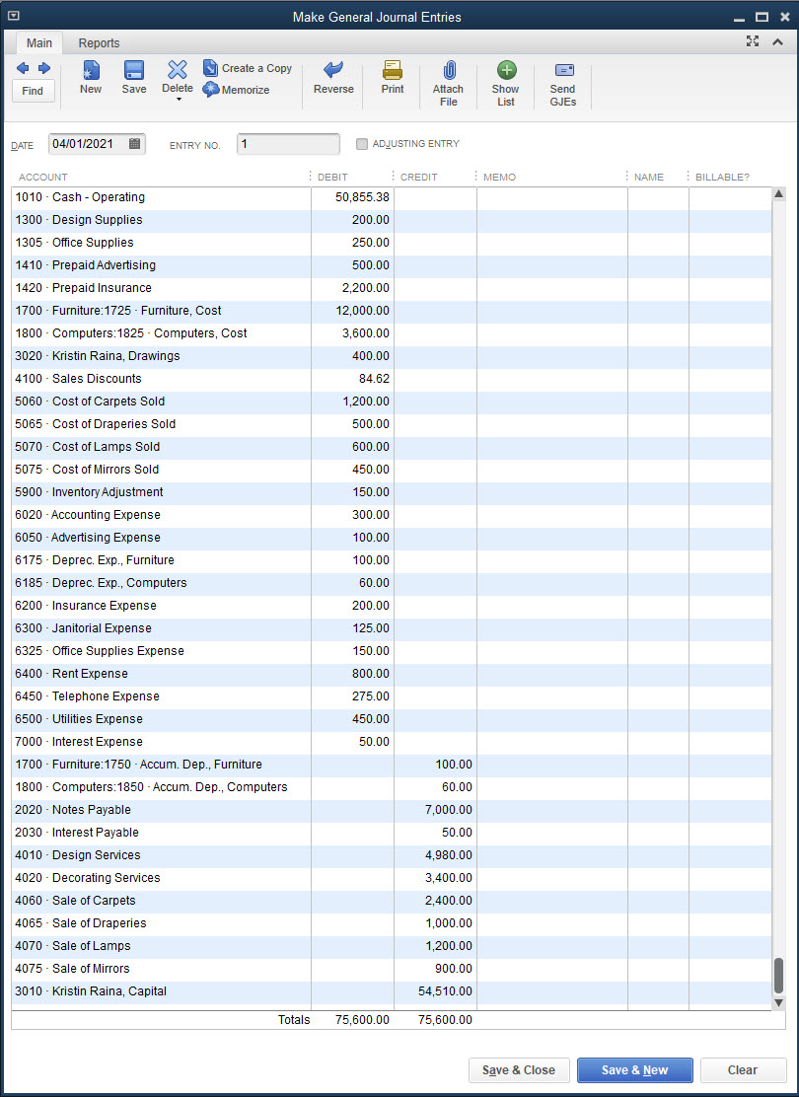
Entering Opening Balances
Enter all opening balances for Kristin Raina Interior Designs, excluding inventory, accounts receivable, and accounts payable, as one large compound journal entry

Slide 57
Reversing the Uncategorized Income Account
In the Journal report, there are two journal entries recorded that debit the Accounts Receivable and credit Uncategorized Income for two customers as follows:
Berger Bakery Company $600
Franco Films Co. $940
Total Uncategorized Income $1,540
Debit entries to the Accounts Receivable account are correct and will stay in that account.
Credits to the Uncategorized Income account will be reversed.
Debit Uncategorized Income for $1,540.
Credit the account 3010 Kristin Raina, Capital (formerly the Opening Balance Equity account) for $1,540.
As part of customizing the Chart of Accounts, the account Opening Balance Equity, created by QuickBooks, was changed to 3010 Kristin Raina, Capital.

Slide 58
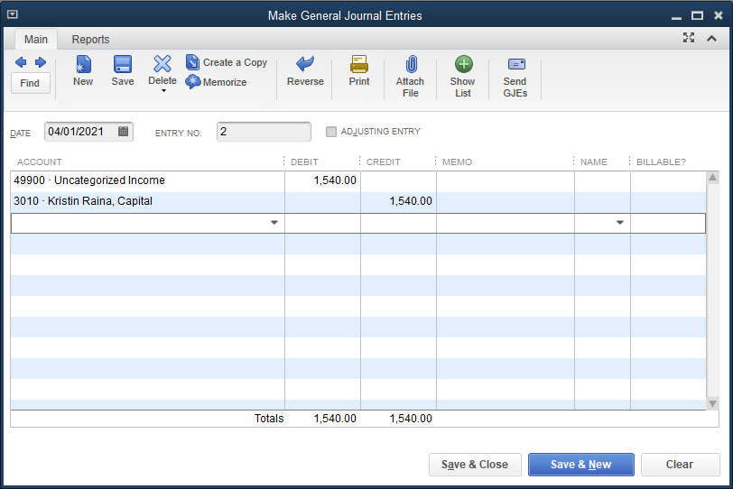
Reversing the Uncategorized Income Account Cont.
To reverse the Uncategorized Income account:
Click Company and then click Make General Journal Entries.
Choose the date and check the entry in the ENTRY NO. field.
Remove the check mark from ADJUSTING ENTRY.
Debit the Uncategorized Income account for the full amount in that account, and credit the Capital account for the same amount.
Click Save & Close.

Slide 59
Reversing the Uncategorized Expenses Account
In the Journal report, there were seven journal entries that credited Accounts Payable and debited Uncategorized. Expenses for seven vendor balances as follows:
Ace Glass Works $1,500
Bell Carpet Design $2,000
Cuza and Carl Associates $2,600
Galeway Computers $400
Midwest Mutual Insurance $2,400
Minneapolis Electric & Gas $450
Williams Office Supply Company $400
Total Uncategorized Expenses $9,750
Credit entries to the Accounts Payable account are correct and should stay in that account.
Debits to the Uncategorized Expenses need to be reversed by
Crediting Uncategorized Expenses for the total of $9,750
Debiting the 3010 Kristin Raina account, Capital for $9,750

Slide 60
Reversing the Uncategorized Expenses Account Cont.
To reverse the Uncategorized Expenses account:
Click Company and then click Make General Journal Entries.
Choose the date and check the entry in the ENTRY NO. field.
Remove the check mark from ADJUSTING ENTRY.
Debit the Capital account for the full amount in the Uncategorized Expenses account, and credit the Uncategorized Expenses account for the same amount.
Click Save & Close.

Slide 61
Accounting Reports
Accounting reports in the new company file consist of the following reports
Journal
Trial Balance
Journal Report
You displayed and printed the Journal report after the initial company setup.
After recording the opening balances and reversing the Uncategorized Income and Uncategorized Expenses accounts, three more journal entries have been added to the Journal report.
You can view and print all of the journal entries.

Slide 62
Accounting Reports Cont.
Trial Balance Report
Compare the trial balance of April 1, to the trial balance of March 31.
Trial balances should be the same.
QuickBooks created the Uncategorized Income and Uncategorized Expenses accounts when you entered outstanding accounts receivable and accounts payable balances in the Customer Center and Vendor Center, respectively, the balances in these uncategorized accounts were subsequently reversed when the company file was prepared for the accrual basis of accounting.
These accounts are no longer needed and can be marked inactive .

Slide 63
Accounting Reports
To view and print accounting reports from the Reports menu:
Click Reports and then click Accountant & Taxes.
At the Accountant & Taxes submenu, choose a report.
Indicate the start and end dates for the report.
Click the Print button at the top of the report and then click Report.
At the Print Reports dialog box, review the settings and then click Print.
Close the report.

Slide 64
Accounting Reports Cont.

Slide 65
Accounting Reports Cont.

Slide 66
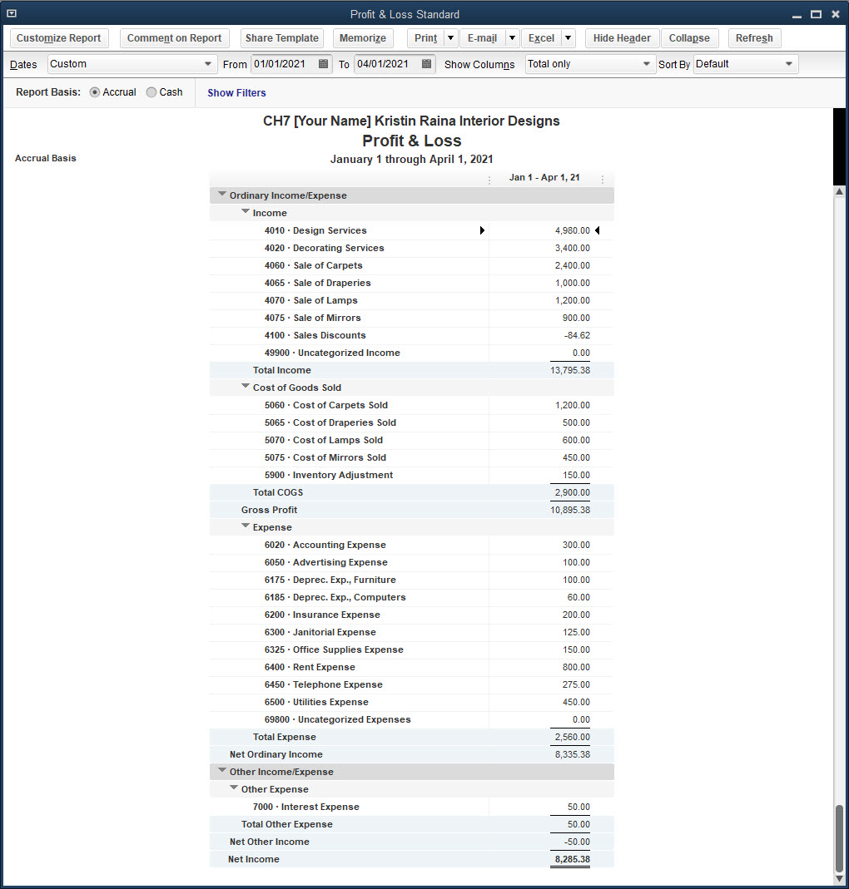
Financial Statements
Financial statements consist of:
Profit & Loss Standard

Slide 67
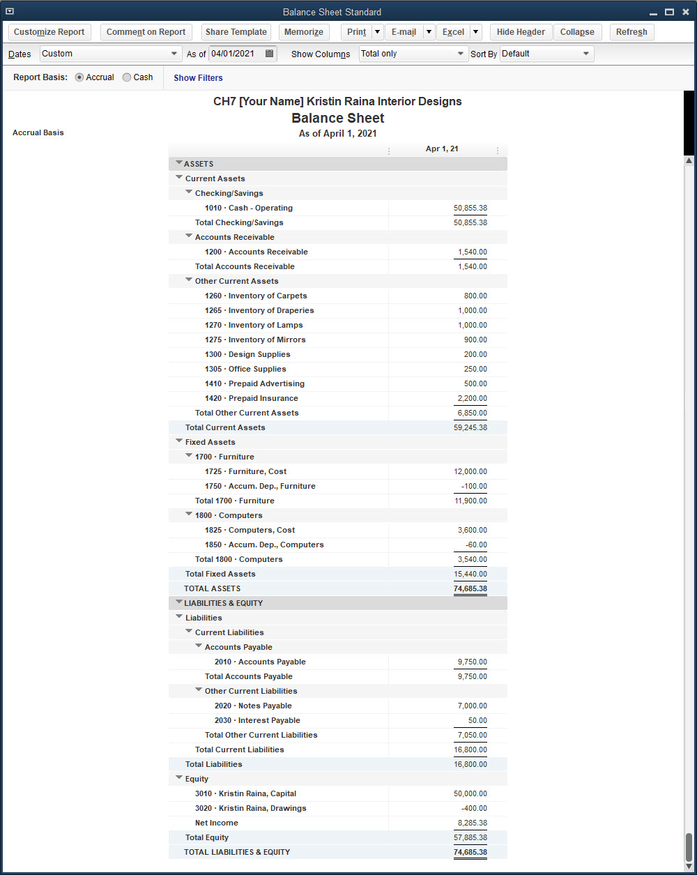
Financial Statements Cont.
Financial statements consist of:
Balance Sheet Standard

Slide 68
Hybrid Method of New Company Setup and QuickBooks Setup Window
You have learned two methods of new company setup: Detailed Start and Express Start.
In addition, in Chapter 6 you learned how to use the QuickBooks Setup window to enter information, but the QuickBooks Setup window could also have been used in Chapter 7.
Instead, in Chapter 7, you learned to enter the service items, inventory part items, customers, and vendors, by going directly to the Item List, Customer Center, and Vendor Center to enter the appropriate information bypassing the QuickBooks Setup window.
Once you create the new company file with either the Detailed Start or Express Start methods, you can use any combination of entering company information for service items, inventory part items, customers, and vendors.
QuickBooks will accept any variation of using the QuickBooks Setup window or Lists/Centers for entering the information for customers, vendors, service items, and inventory part items.

Slide 69
Backing Up the New Company File
You should make a backup copy of the new company file in the event there is damage to the file or the computer, or you are working on a different computer.
Using the procedures learned in previous chapters, make a backup copy of the new company file to your subfolder and/or removable storage device.
Upon completing the New Company Setup level of operation, updating the Lists/Centers, viewing and printing reports, and making a backup copy of the new company file, your accounting records are now ready for recording daily activities.
Activities would be recorded in the new company file using the procedures illustrated in the prior chapters.

Slide 70
Terms
accrual basis of accounting Accounting method that requires the recording of revenue when it is earned and the recording of expenses when they are incurred regardless of cash receipts or cash payments.
cash basis of accounting An accounting method that records revenue only when cash is received for services provided or for a product sold, and records expenses only when payments have been made.
reversing entries Entries recorded in the general journal to offset a balance in an account.

