Slide 2
Payroll Processing
Paying Employees, Paying Payroll Liabilities, and Processing Payroll Forms

Slide 3
Objectives
Review accounting for payroll transactions
Update the Employee Center
Record payroll in the Pay Employees windows
Record payments of payroll taxes in the Pay Liabilities window
Display and print payroll-related reports, accounting reports, and financial statements

Slide 4
Introduction
QuickBooks allows you to process payroll and track payroll information for your company’s employees.
You can establish a file for each employee and then process payroll transactions.
These employee files comprise the Employee Center.
Once you have established an employee file, you can enter transactions for payroll (Activities) in the windows:
Pay Employees
Pay Liabilities
Every time a company processes payroll for employees in the activities windows, QuickBooks simultaneously updates the information in the Employee Center.
QuickBooks changes balance sheet and income statement accounts based upon payroll transactions entered in the payroll activities windows.

Slide 5
QuickBooks v. Manual Accounting
In a manual accounting system, employee pay transactions are usually recorded in a payroll journal or register:
employee’s gross pay
tax withholding
other payroll deductions
The transactions use the applicable tax schedules and the employee’s background information:
pay rate
marital status
state of residency, and so on
Payroll checks and tax remittance checks are usually recorded in the cash payments journal.
In QuickBooks, the Employee Center contains background information for each employee, such as name, address, Social Security number, pay rate, tax deductions.

Slide 6
QuickBooks v. Manual Accounting Cont.
When the company processes payroll, the transactions are recorded in the Pay Employees window.
QuickBooks uses the information entered in the Employee Center along with the items on the Payroll Item List applicable to the employee to determine gross pay, payroll deductions, and net pay in the Pay Employees window.
When payroll tax liabilities are paid, the Pay Liabilities window is used to record the transaction.
These transactions update the Chart of Accounts List (general ledger) while at the same time updating the employee’s file.
In both manual and computerized systems, payroll reports will be generated and forwarded periodically to the appropriate federal and state tax authorities.

Slide 7
QuickBooks v. Manual Accounting Cont.
In QuickBooks, these payroll forms are prepared using the Process Payroll Forms window if you subscribe to a QuickBooks payroll service.
Below is a comparison of manual accounting ledger and journals with QuickBooks functions:
Manual Accounting | QuickBooks
Payroll Journal or Register | Pay Employees Windows

Slide 8
Accounting for Payroll Transactions
When a company generates a paycheck, the transaction affects a number of expense and liability accounts:
The employee’s gross pay is an expense the company records at the payroll date.
Additional expenses for the company include the various taxes imposed on the employer, including, but not limited to the following items, which are recorded in the appropriate expense accounts at the payroll date:
Social Security tax (FICA)
Medicare tax
Federal Unemployment Insurance (FUTA)
State Unemployment Insurance (SUI)

Slide 9
Accounting for Payroll Transactions Cont.
The employee, at a minimum, will have amounts deducted from his or her paycheck by the employer for
FICA, Medicare, Federal income tax, State income tax (if applicable)
These withheld taxes, along with the taxes imposed on the employer, are recorded as liabilities on the books of the company because the company is responsible for remitting these taxes to the appropriate governmental tax-collecting agency at a later date.
Gross pay less the employee deductions results in a net payroll check to the employee.

Slide 10
Quick Check
The employee’s gross pay is a(n) _____ the company records at the payroll date.
expense
deduction
asset
withholding

Slide 11
Accounting for Payroll Transactions Cont.
Many companies use a separate checking account for payroll transactions.
Periodically, funds are transferred into this account from the operating account.
Having a separate checking account helps track payroll transactions.
In addition, the journal entry for the employer’s payroll tax expenses is recorded on the paycheck date.

Slide 12
Accounting for Payroll Transactions Cont.
When the company remits the employer and employee taxes to the federal and local governments, it records several journal entries.
Payment for the employer and employee will be forwarded to the federal government for:
Social Security tax
Medicare tax
Employee federal withholding
FUTA tax

Slide 13
Accounting for Payroll Transactions Cont.
Payment for the state withholding tax and the SUI to the state taxing authority responsible for these taxes.
usually made with one check
In some states, two checks have to be sent because two different tax agencies are responsible.
Payroll accounting is a time-consuming process that can result in costly errors and omissions.
With QuickBooks and other general ledger software packages, small companies can
process payroll
determine gross pay, tax expenses, and tax liabilities
prepare employee paychecks and payroll data in compliance with federal and state payroll regulations

Slide 14
The Employee Center
The Employee Center contains a file for each employee of the company.
Information is indicated for each employee such as
name, address, Social Security number, hire date, pay rate and applicable payroll taxes
QuickBooks uses the information contained in each employee’s file, along with the information in the Payroll Item List, to calculate the employee’s gross pay, deductions, and net paycheck
Like all other Centers in QuickBooks, the Employee Center needs to be updated when
new employees are hired
employees leave the company
information about an employee changes and needs to be revised

Slide 15
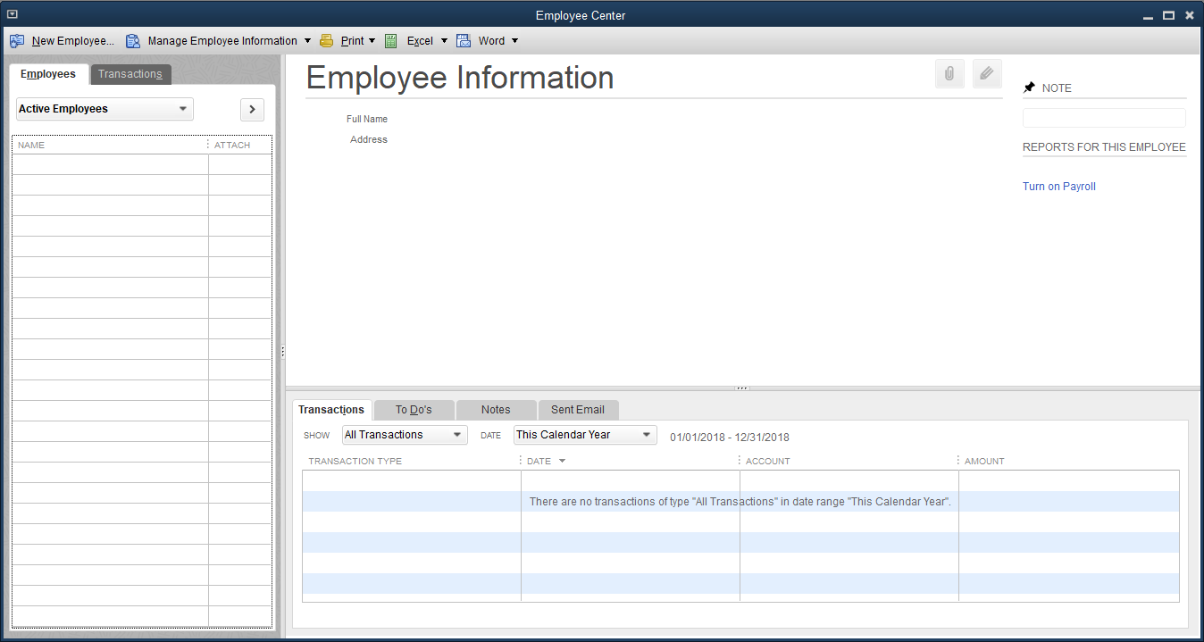
The Employee Center Cont.

Slide 16
The Employee Center Cont.
The Employee Center contains the following parts:
Employee Center feature | Description
Employees tab | Lists all current employees. You can display active employees, all employees, or only released employees.
Transactions tab | Lists all transactions for selected employees.
New Employee button | Used to add a new employee.
Employee Information section | Displays background and transaction information for the employee selected on the Employees tab.
Edit icon | Used to edit background information for the employee selected on the Employees tab.
Notes tab | Used to include narrative information specific to an employee.

Slide 17
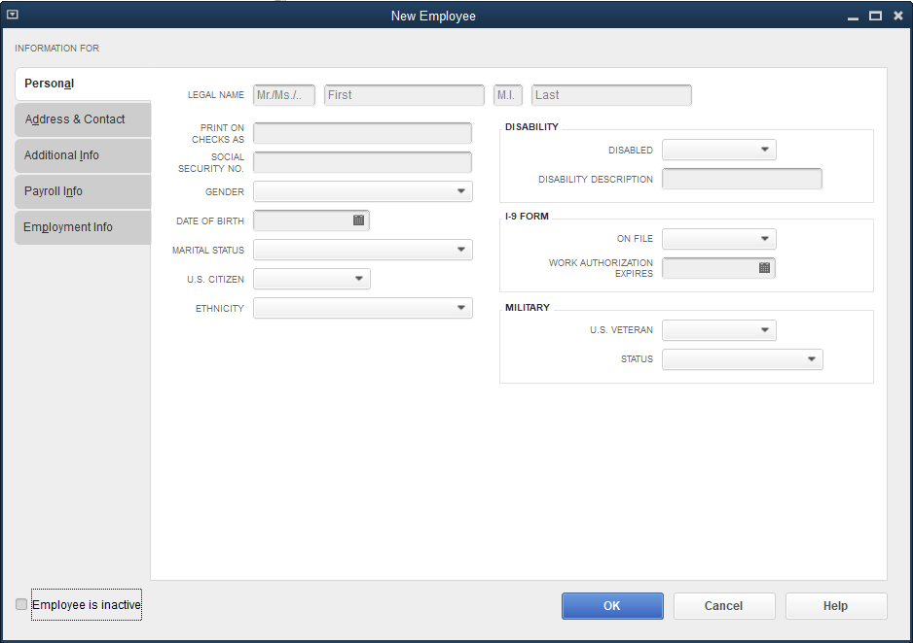
The Employee Center Cont.
To add an employee:
Click Employees and then click Employee Center.
At the Employee Center window, click the New Employee button. The New Employee window appears.
Continues…

Slide 18
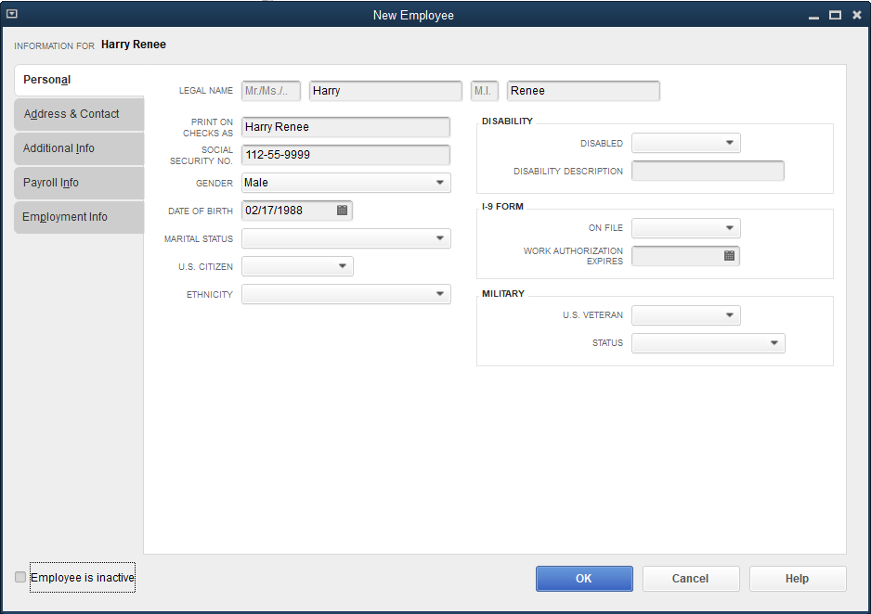
The Employee Center Cont.
The New Employee window has five information tabs: Personal, Address & Contact, Additional Info, Payroll Info, and Employment Info. The Personal tab is the initial display. Enter the information.
Click the Address & Contact tab. Enter the information.

Slide 19
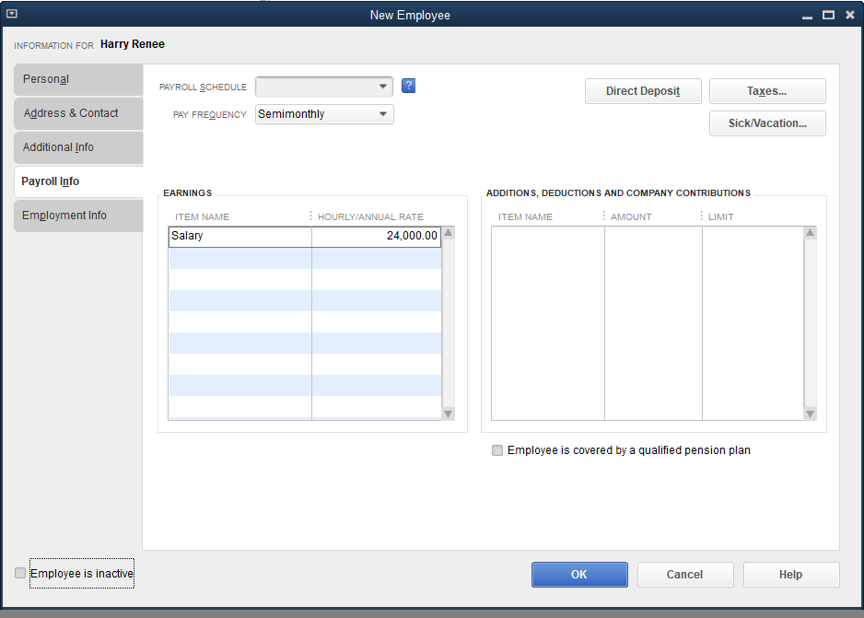
The Employee Center Cont.
Click the Payroll Info tab.
In the PAY FREQUENCY field, click Semimonthly from the drop-down list.
In the EARNINGS—ITEM NAME field, click Salary from the drop-down list.
In the HOURLY/ANNUAL RATE field, fill in the amount.

Slide 20
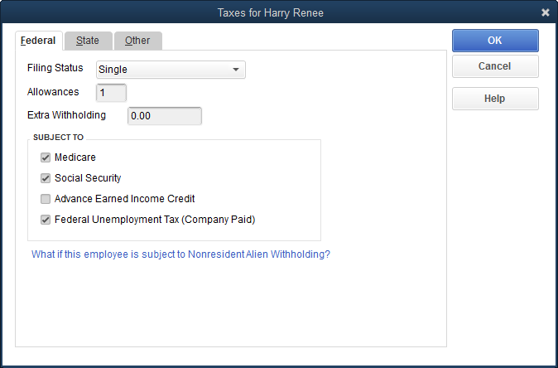
The Employee Center Cont.
Click the Taxes button. The Taxes for the employee window appears.
At the Federal tab, at the Filing Status field, enter details as instructed in text.

Slide 21
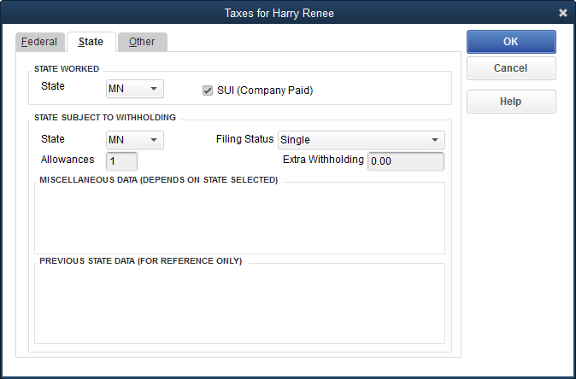
The Employee Center Cont.
Click the State tab. In both the STATE WORKED and STATE SUBJECT TO WITHHOLDING sections, select a state. Accept the check mark ✓ in the SUI box.
Accept Single in the Filing Status field; at the allowances field, key as instructed.

Slide 22
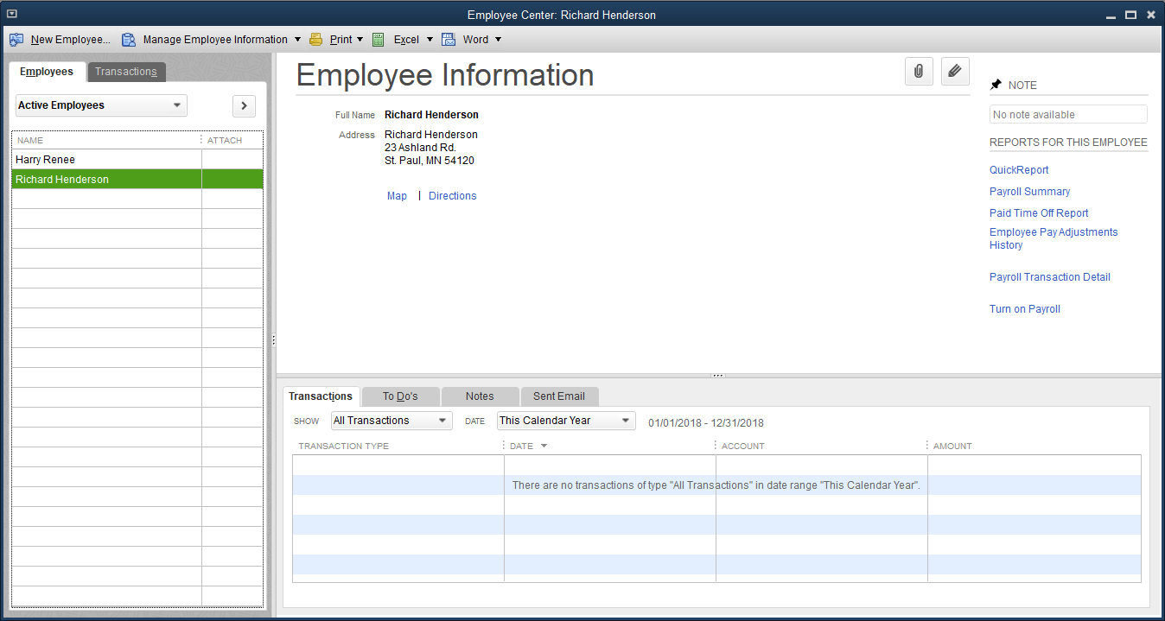
The Employee Center Cont.
Click OK. If the QuickBooks Information window appears, read the information and then click OK. Click the Delete button to remove the tax added by the QuickBooks program.
Click OK to close the window. At the QuickBooks for Windows message, click No. You are returned to the Payroll Info tab.
Click OK. The New Employee: Payroll Info (other) window appears.
Click Leave As Is. You are returned to the Employee Center.

Slide 23
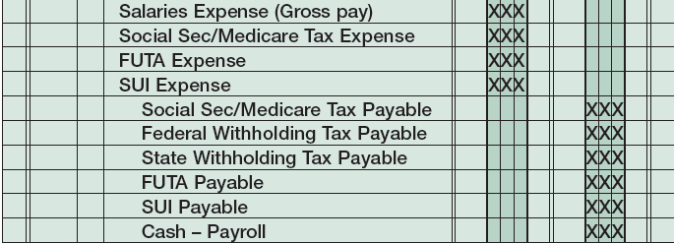
The Pay Employees Windows
Use the Pay Employees windows to calculate gross pay, taxes, and net payroll for employees.
When you process payroll through the Pay Employees windows, a number of general ledger accounts are affected by the transaction.
It is common in a manual accounting system to record payroll using two journal entries:
One entry records the salaries/wages expense, the employees’ withholdings as liabilities, and the net pay.
The second entry usually records the employer’s related tax expense and related liabilities.
In QuickBooks, the transaction is recorded as one compound journal entry:

Slide 24
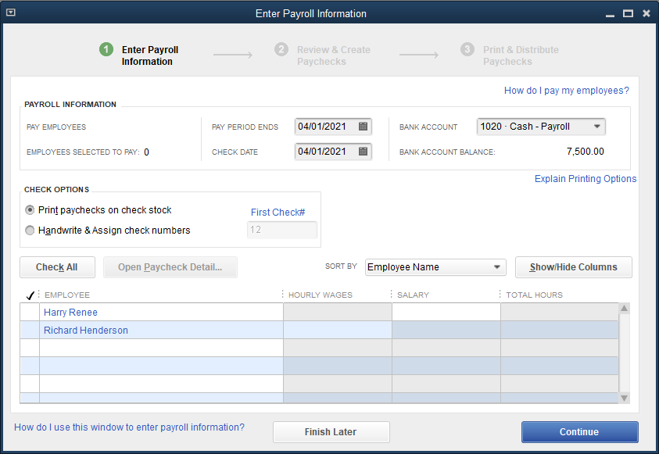
The Pay Employees Windows Cont.
There are three Pay Employees windows:
Enter Payroll Information
used to select the employee(s) to be paid at the current pay date

Slide 25
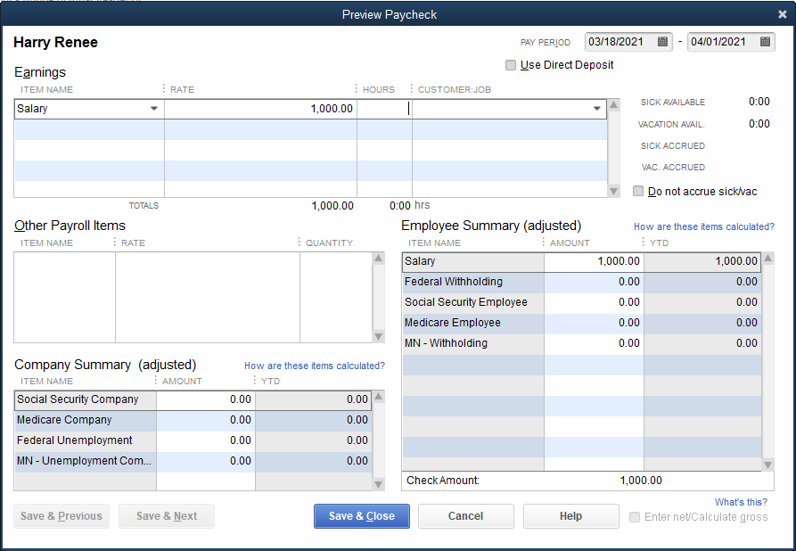
The Pay Employees Windows Cont.
Once an employee(s) is selected, you move to the Preview Paycheck window.
allows you to enter pay and tax information both for company-imposed taxes and employee deductions

Slide 26
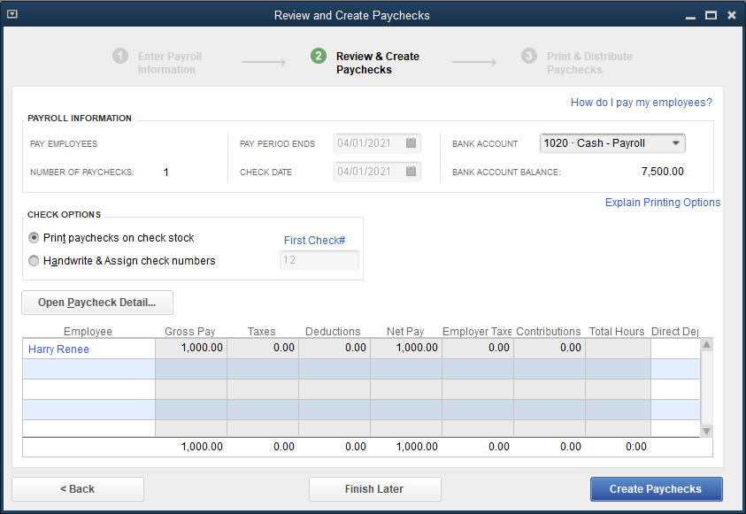
The Pay Employees Windows Cont.
The Review and Create Paychecks window allows you to review gross pay and deductions computations before creating a paycheck

Slide 27
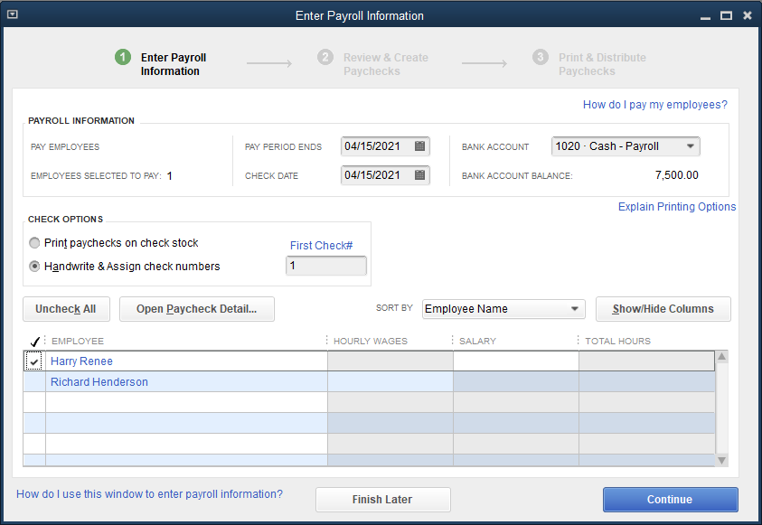
Paying an Employee
To pay an employee:
Click Employees and then click Pay Employees.
At the PAY PERIOD ENDS and CHECK DATE fields, choose the appropriate dates.
At the BANK ACCOUNT field, click 1020 Cash - Payroll.
At the CHECK OPTIONS section, choose the Handwrite & Assign check numbers option and type 1 in the First Check# field.
Select employee by placing a check mark next to the name.
Continues…

Slide 28
Paying an Employee Cont.
Click the Open Paycheck Detail button. The Preview Paycheck window appears.
Make sure the ITEM NAME field lists Salary in the EARNINGS section, the RATE field shows the correct amount, and the PAY PERIOD fields display the correct dates.
Move to the Company Summary (adjusted) section.
Enter the employer’s taxes in the Company Summary (adjusted) section.
Move to the Employee Summary (adjusted) section.
Enter the employee’s taxes in the Employee Summary (adjusted) section.
Click Save & Close. You return to the Enter Payroll Information window.
Click Continue. You move to the Review and Create Paychecks window with the taxes columns completed.
Continues…

Slide 29
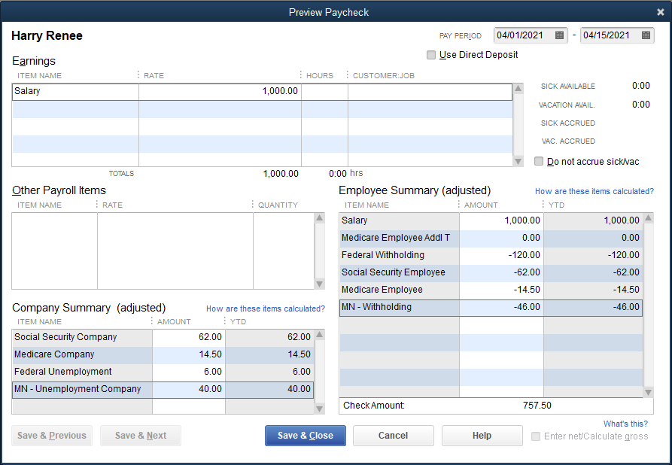
Paying an Employee Cont.
Continues…

Slide 30
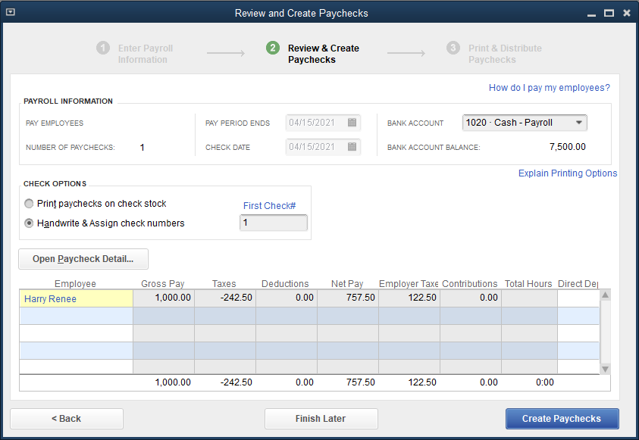
Paying an Employee Cont.
Click the Create Paychecks button.
At the Confirmation and Next Steps window, click Close.

Slide 31
Correcting an Error in a Paycheck
If you discover an error in a paycheck after you have created the check, you cannot correct the error in the Pay Employees window.
You have to use the Paycheck – Cash – Payroll window to edit or, if necessary, delete the paycheck and start over.
As an alternative to correcting any errors, you can delete the entire paycheck.
Click Write Checks from the Banking menu, select the Cash – Payroll account, click Previous until the paycheck is displayed, and then use the Edit menu to delete or void the paycheck.

Slide 32
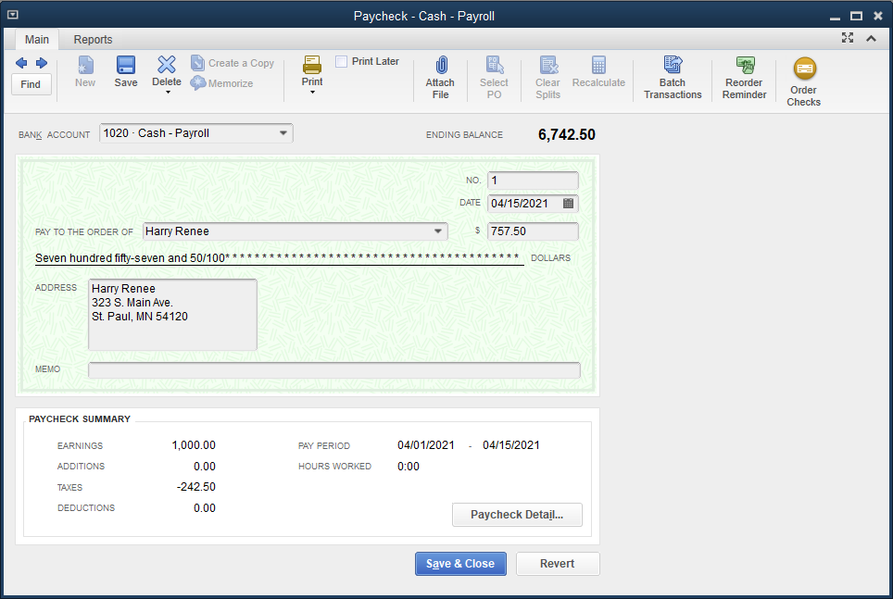
Correcting an Error in a Paycheck Cont.
To correct a paycheck:
Click Banking and then click Write Checks.
At the BANK ACCOUNT drop-down list, click 1020 Cash - Payroll. At the Setting Default Accounts message, place a check mark in the box to the left of Do not display this message in the future, and then click OK.
Click the Previous arrow until you arrive at the check for the employee.
Continues…

Slide 33
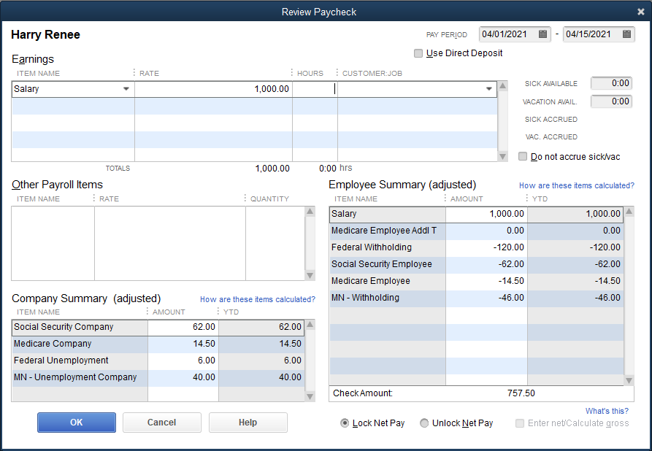
Correcting an Error in a Paycheck Cont.
Click the Paycheck Detail button. The Review Paycheck window appears.
Correct any errors and then click OK. You are returned to the Paycheck - Cash - Payroll window.
Click Save & Close.

Slide 34
The Pay Liabilities Window
Activities identified as paying employees are recorded in the Pay Employees window.
Activities identified as paying payroll liabilities are recorded in the Pay Liabilities window.
As you process paychecks in the Pay Employees windows, QuickBooks tracks all payroll liabilities as they accumulate from each paycheck.
The Pay Liabilities window displays all payroll liabilities existing at a specified date and allows you to pay each to its appropriate tax-collecting agency.
The Pay Liabilities window is designed for the payment of federal and state payroll tax liabilities.
Default accounts are the various payroll tax liability accounts that have been credited during the payroll processing in the Pay Employees window.

Slide 35
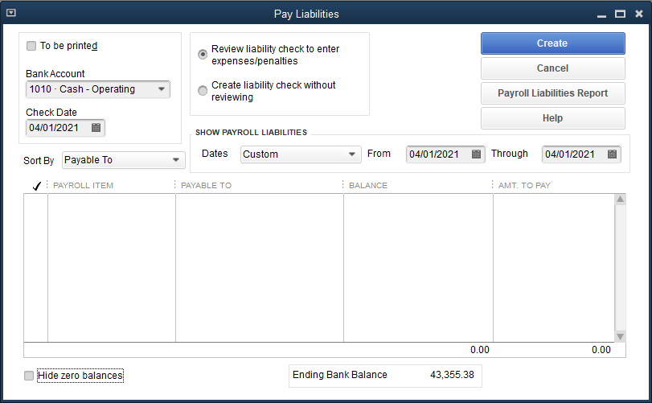
The Pay Liabilities Window Cont.
Once a liability is selected for payment, the transaction is recorded as follows:

Slide 36
The Pay Liabilities Window Cont.
To pay federal payroll tax liabilities:
Click Employees and then click Payroll Taxes and Liabilities.
At the Payroll Taxes and Liabilities submenu, click Pay Payroll Liabilities.
At the Select Date Range For Liabilities dialog box, choose the appropriate date range and then click OK.
Make sure the To be printed box is unchecked, the Review liability check to enter expenses/penalties option is selected, and the correct date range appears.
At the Bank Account drop-down list, click 1020 Cash - Payroll.
At the Check Date field, choose the appropriate date.
Place a check mark next to the liabilities listed below, all of which are payable to the United States Treasury:
Federal Unemployment
Federal Withholding
Medicare Company
Medicare Employee
Social Security Company
Social Security Employee
Continues…

Slide 37
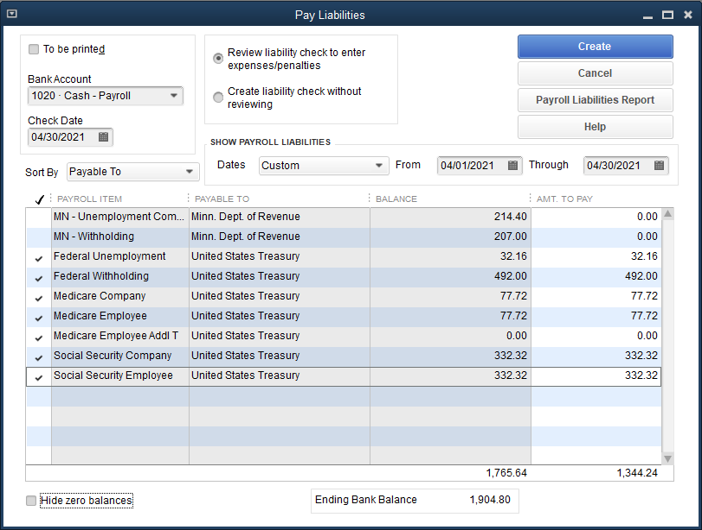
The Pay Liabilities Window Cont.
Click the Create button. The Liability Check - Cash - Payroll window is displayed.
Click Save & Close.
Continues…

Slide 38
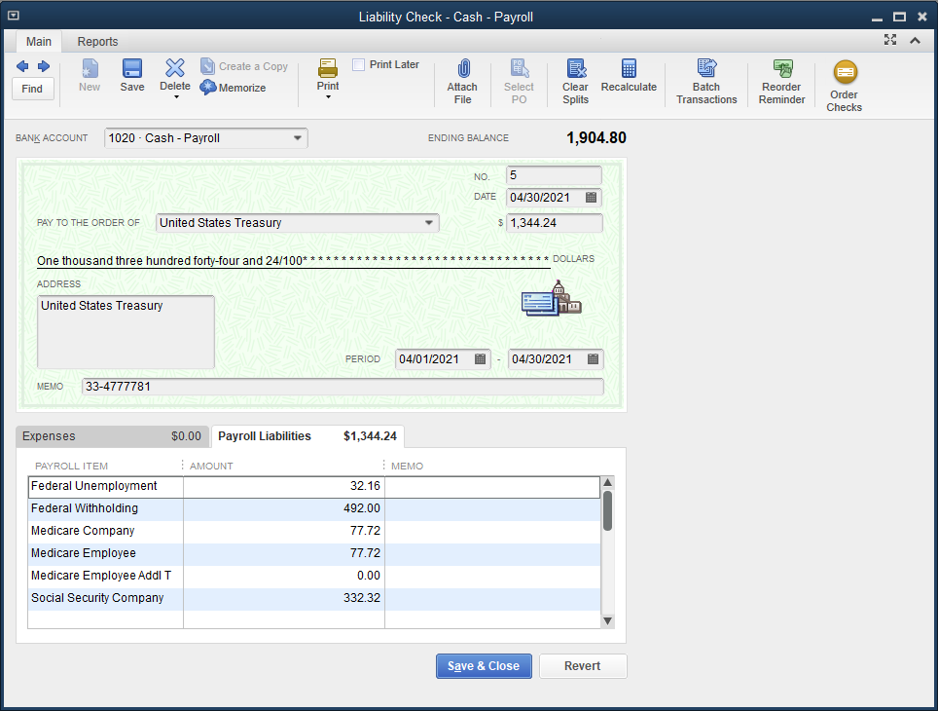
The Pay Liabilities Window Cont.
Like other Write Check windows in QuickBooks, even though a check is not printed, the liability is considered paid and a check is recorded in the system.

Slide 39
Quick Check
When payroll tax liabilities are paid, which QuickBooks window is used to record the transaction?
Pay Liabilities window
General journal
Register for Cash – Payroll
Pay Bills window

Slide 40
Payroll Reports, Accounting Reports, and Financial Statements
Payroll management reports provide the company with valuable information concerning payroll costs, such as
gross pay
payroll liabilities and withholding
employer payroll taxes
Government compliance reports (Forms 941, W-2, and 940) are replications of
federal form 941
filed quarterly
federal forms W-2 and 940
filed annually
only available with a QuickBooks Payroll Service subscription

Slide 41
Payroll Management Reports
The following reports are available in QuickBooks to assist the company in managing and tracking the payroll process:
Payroll Summary, Payroll Liabilities Balances, Payroll Transaction Detail, Employee State Taxes Detail
These reports are accessed from the Employees and Payroll submenu of the Reports menu.
They are not required by law and therefore are not forwarded to a government agency.
Information contained in these reports is sometimes used to complete government-mandated payroll reports, especially at the state or local level.
You can also view payroll management reports from the Reports menu of the Payroll Item List or the Employee Center window.

Slide 42
Payroll Management Reports Cont.
Payroll Summary report
Lists the earnings, deductions, and employer payroll taxes for each employee for a specified period of time.
To view and print the Payroll Summary report:
Click Reports and then click Employees & Payroll.
At the Employees & Payroll submenu, click Payroll Summary.
At the From and To fields, choose a range of dates and then click Refresh. The report is displayed for the period.
To print the report, click the Print button at the top of the report.
Close the report.

Slide 43
Payroll Management Reports Cont.

Slide 44
Payroll Management Reports Cont.
Payroll Liability Balances report
Lists all payroll liabilities owed and unpaid for a specified period of time. If liabilities have been accrued and paid, a zero will appear for that liability.
To view and print the Payroll Liability Balances report:
Click Reports and then click Employees & Payroll.
At the Employees & Payroll submenu, click Payroll Liability Balances.
At the From and To fields, choose a range of dates and then click Refresh.
Click the Print button at the top of the report, check the settings in the Print Reports dialog box, and then click Print.
Close the report.

Slide 45
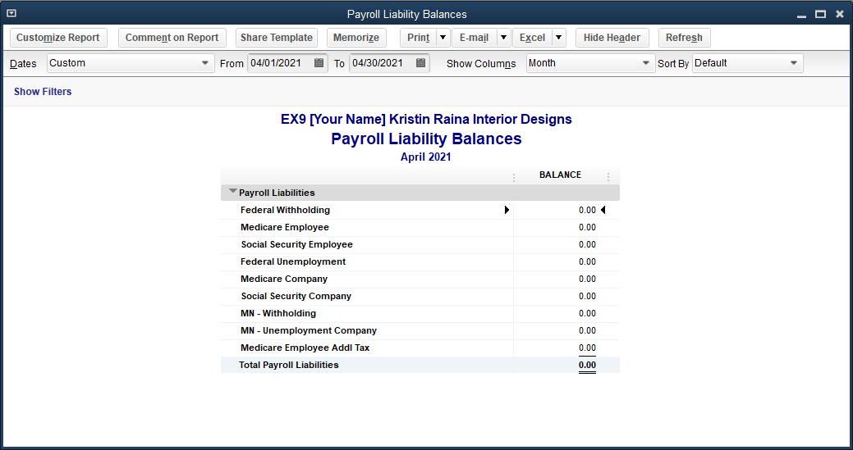
Payroll Management Reports Cont.

Slide 46
Payroll Management Reports Cont.
Payroll Transaction Detail report
Provides detailed information for each payroll transaction (paychecks and payroll liability payments) recorded during the period, such as employee salary per paycheck, tax withholding, net pay, employer-paid taxes, and taxes remitted
To view and print the Payroll Transaction Detail report:
Click Reports and then click Employees & Payroll.
At the Employees & Payroll submenu, click Payroll Transaction Detail.
At the To and From fields, choose a range of dates, then click Refresh. The report displays all payroll transactions recorded during the specified period.
Click the Print button at the top of the report, click Report, check the settings in the Print Reports dialog box, and then click Print.
Close the report.

Slide 47
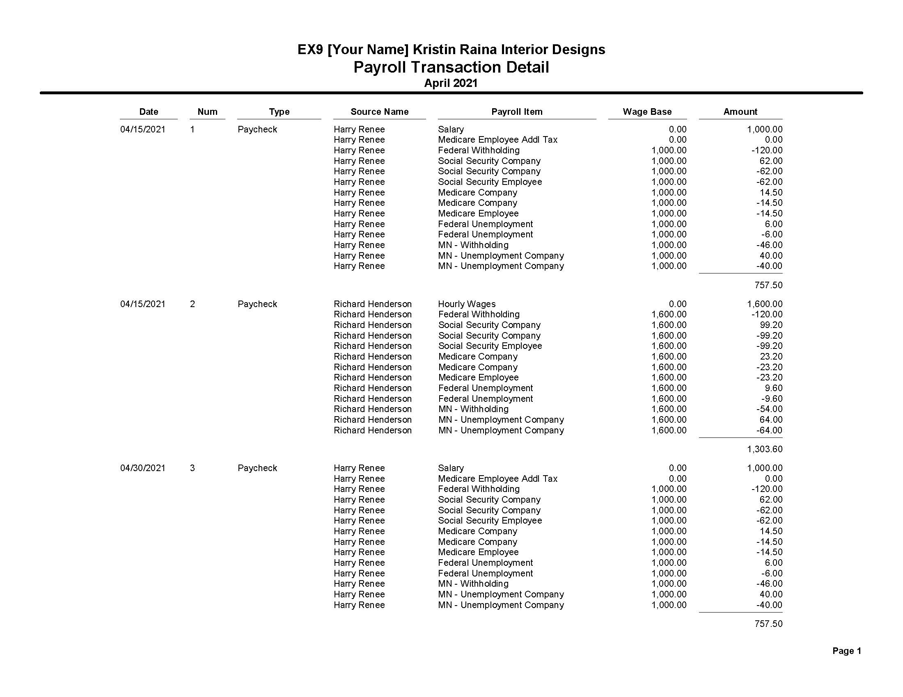
Payroll Management Reports Cont.

Slide 48
Payroll Management Reports Cont.
Employee State Taxes Detail report
Provides most information most states will require a company to submit periodically, such as type of state tax, amount of income subject to tax, and amount of each tax
To view and print the Employee State Taxes Detail report:
Click Reports and then click Employees & Payroll.
At the Employees & Payroll submenu, click Employee State Taxes Detail.
At the To and From fields, choose a range of dates, and then click Refresh.
Click the Print button at the top of the report, click Report, check the settings in the Print Reports dialog box, and then click Print.
Close the report.

Slide 49
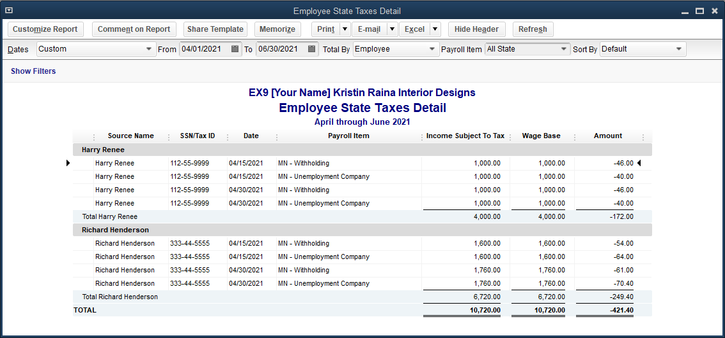
Payroll Management Reports Cont.

Slide 50
Payroll Government Compliance Reports
The Employees menu contains the basic government compliance reports that all companies with payroll are required to file with the federal government (IRS).
You will need to subscribe to a QuickBooks Payroll Service in order to print these reports.
Form 941 – Employer’s Quarterly Federal Tax Return
forwarded to the Internal Revenue Service quarterly
Summarizes the following:
total wages paid to all employees for the quarter
federal tax withheld
employer’s and employees’ Social Security and Medicare tax liabilities

Slide 51
Payroll Government Compliance Reports Cont.
Form 940
filed annually with the IRS
computes the FUTA tax liability for the company for the year and reconciles the amount to the tax payments made by the company toward the tax during the year
Form W-2
prepared annually and furnished to the employee
totals the employee’s earnings and tax withholding for the year
used by employee to complete personal income tax return
A copy of this form is also forwarded to the federal government to be reconciled with the quarterly Form 941 filings and the employee’s tax return.
accessed from the Employees menu using similar steps to those used to access Form 941

Slide 52
Accounting Reports and Financial Statements
At the end of the month, the following reports should be displayed and printed:
Journal report
Profit & Loss standard report
Balance Sheet standard report
The general journal transaction types described below:
TYPE | Activity Window | SYSTEM DEFAULT ACCOUNT
 |  | DEBIT | CREDIT
Paycheck | Pay Employees | Salaries and Wages Expense Payroll Tax Expenses | Payroll Withholdings Liabilities Cash – Payroll
Liability Check | Pay Payroll Liabilities | Payroll Withholdings Liabilities | Cash – Payroll

Slide 53
Terms
employee Someone hired by the company who will receive salary or wages on a regular basis.
payroll journal (register) A journal used to calculate payroll and record payroll entries for each employee.

