Slide 1
Computerized Accounting with QuickBooks 2019

Slide 2
Banking
Transferring Funds, Reconciling Accounts, and Entering Credit Card Charges

Slide 3
Objectives
Transfer funds between accounts using the Transfer Funds between Accounts window
Reconcile cash accounts using the Reconcile window
Enter credit card charges using the Enter Credit Card Charges window
Pay credit card charges using the Write Checks window
Display and print banking-related reports, accounting reports, and financial statements

Slide 4
Introduction
An integral part of operating any business is effectively managing cash. This usually involves:
maintaining cash in one or more bank accounts
transferring funds among the bank accounts
reconciling account balances
utilizing credit cards for business purchases
making credit card payments
QuickBooks allows you to:
transfer funds from one bank account to another
process the month-end bank reconciliation
enter and pay credit card charges

Slide 5
Introduction Cont.
Many companies have more than one checking account.
regular checking account (operating)
used to pay bills and collect and deposit receivables and other funds
payroll checking account
used to pay employees and payroll taxes
special purpose accounts
needed when a business grows in complexity (e.g., interest-bearing money market accounts)

Slide 6
QuickBooks v. Manual Accounting
Banking activities in both manual and computerized accounting systems require a company to:
record transfers of funds among bank accounts
reconcile each bank account balance to the company’s balances
track charges and payments by credit card

Slide 7
QuickBooks v. Manual Accounting Cont.
Transfer Funds
Manual accounting system:
Transfers from the company’s operating account can be recorded in the cash payments journal or general journal.
QuickBooks:
Transfers among bank accounts, if not done by check, are recorded in the Transfer Funds Between Accounts activity window.
This window indicates:
cash accounts involved in the transfer
amount of the transfer

Slide 8
QuickBooks v. Manual Accounting Cont.
Bank Reconciliation
In QuickBooks:
bank reconciliation procedure is carried out using the Reconcile windows
windows display all activity in the account, including debits and credits
information is compared with the bank statement to reconcile the account

Slide 9
QuickBooks v. Manual Accounting Cont.
Bank Reconciliation Cont.
In a manual accounting system:
company receives a statement from the bank detailing the activity in the account for the month
bank statement is compared to company’s accounting records and any differences identified
if no errors, the adjusted bank balances will agree with the adjusted balance for the company’s books
account is then reconciled
if there is an error, a difference will remain until the source of the mistake is found
when mistake is corrected and the difference is zero, the account is then reconciled

Slide 10
QuickBooks v. Manual Accounting Cont.
Credit Card Charges
In QuickBooks:
A credit card charge can be recorded immediately when it is incurred by using the Enter Credit Card Charges window.
QuickBooks tracks the resulting credit card liability, which will be paid at a later date and separate from accounts payable.
In a manual accounting system:
A credit card charge is usually recorded when the bill is paid by the company or tracked as part of accounts payable.

Slide 11
Updating the Chart of Accounts List
Lists/Centers need to be revised periodically when:
new accounts need to be added
accounts not used in the business need to be deleted
modifications need to be made to an account
When you make these revisions to the accounts, you are updating the Chart of Accounts List.
The Chart of Accounts List is the list of accounts a company uses as it conducts its business.

Slide 12
Updating the Chart of Accounts List Cont.
In an accounting system, all of the individual accounts are placed together in a book called the general ledger.
shows all increases and decreases in the account, reflected as debits and credits, and the balance in each account
The Chart of Accounts List displays the balance next to each account name and consists of:
Account number
Name
Type
Balance

Slide 13
The Transfer Funds Window
Write Checks window:
use to transfer funds by writing a check from one cash account to be deposited into another cash account
Transfer Funds Between Accounts window:
use to record the movement of funds among the cash accounts of a business
use to record the transaction when you transfer funds via bank memo, telephone, or online services
The transaction is recorded as follows:

Slide 14
The Transfer Funds Window Cont.
The Transfer Funds Between Accounts window allows you to identify the following:
the source (transferor) cash account
the receiving (transferee) account
the amount to be transferred
This window displays the current balance of the source amount
prevents you from overdrawing it

Slide 15
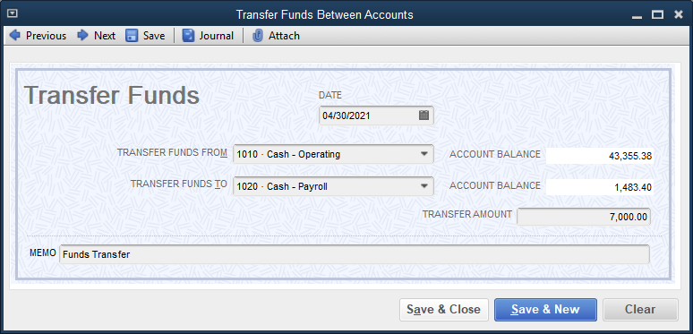
The Transfer Funds Window Cont.
To transfer funds:
Click Banking and then click Transfer Funds.
Choose the date.
Click the account from which you want to transfer funds. The balance in the account is displayed.
Click the account you want to receive the transferred funds.
Type the transfer amount.
Click Save & New.

Slide 16
The Reconcile Windows
The reconciliation procedure in QuickBooks accomplishes two purposes:
It ensures that the company’s cash records are correct and agree with that of the bank.
Transactions missing from the company’s records that are discovered during the reconciling process can be recorded at this time.
The Reconcile windows display:
all additions to a given account, such as deposits and transfers in
all reductions to the account, such as checks written and transfers out

Slide 17
The Reconcile Windows Cont.
Compare the information for each account with the bank statement for that account.
Indicate the transactions that have cleared the bank by placing a check mark next to the transaction
Add transactions recorded on the bank statement that are not yet on the company’s books.
As part of the reconciling process, you may need to make adjustments to the cash account. For example:
service charges
interest income
NSF checks
You have the opportunity to identify and record these transactions and then adjust the company’s accounts.

Slide 18
The Reconcile Windows Cont.
When you add service charges, the default accounts are the Bank Service Charges account and the Cash account. QuickBooks records the transaction as follows:
When you record interest income, the default accounts are the Cash account and the Interest Income account. QuickBooks records the transaction as follows:

Slide 19
The Reconcile Windows Cont.
If the bank records an NSF check from a customer:
QuickBooks does not automatically record the transaction.
You must record the transaction in the Create Invoices window to reestablish the accounts receivable for this customer and deduct the cash that was never actually collected.
system default account is a debit to Accounts Receivable
when you select an item, revenue account is credited
you create an item for NSFs in the Item List and identify default account as Cash
Accounts Receivable is debited for the amount of the NSF still due to the company; the corresponding credit, based on the NSF item, will be to Cash

Slide 20
The Reconcile Windows Cont.
The QuickBooks Reconcile window consists of two parts:
Begin Reconciliation window
Reconcile window
If there are errors in a previous bank reconciliation, QuickBooks allows you to undo that reconciliation and make corrections.

Slide 21
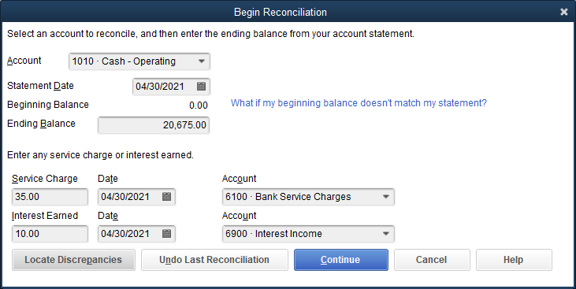
The Reconcile Windows Cont.
The Begin Reconciliation window allows you to:
select a bank account to reconcile
add transactions such as service charges and interest income
enter the bank statement balance

Slide 22
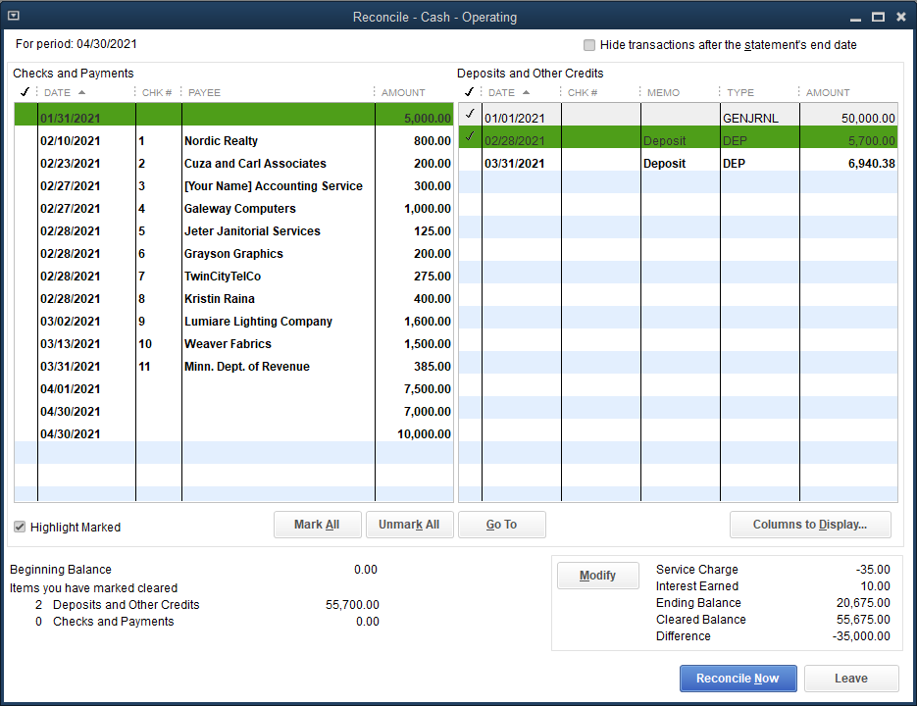
The Reconcile Windows Cont.
The Reconcile window is used to indicate which transactions recorded on the company’s books have cleared the bank.
Once all cleared or missing transactions have been accounted for, the difference amount should be zero.

Slide 23
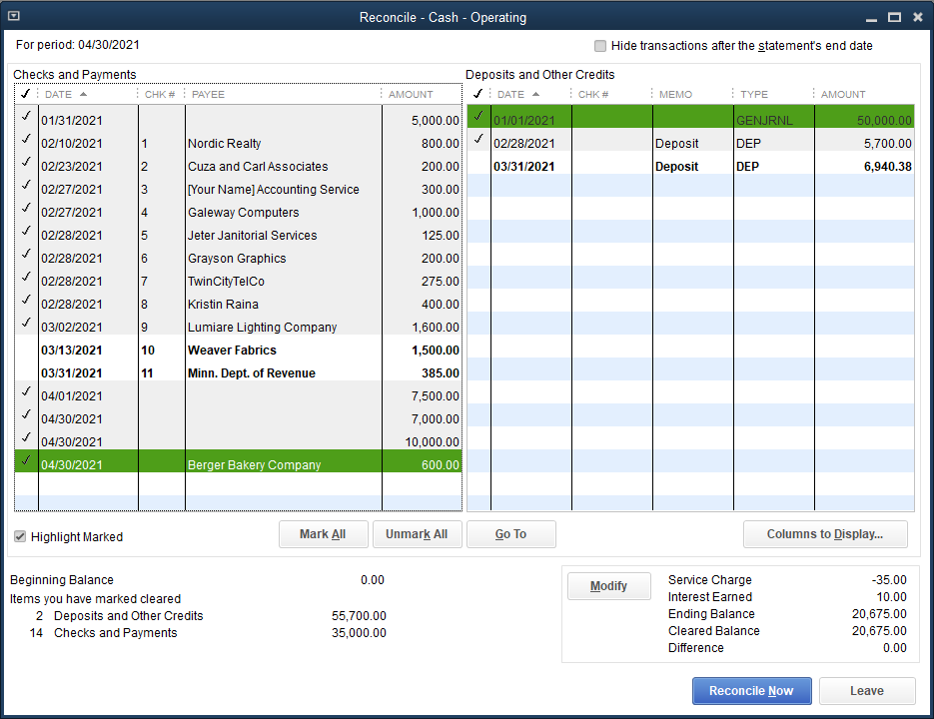
The Reconcile Windows Cont.
When the difference is zero, click the Reconcile Now button. You will have the chance to print a Reconciliation Detail report (next slide).

Slide 24
The Reconcile Windows Cont.

Slide 25
Quick Check
Reconciling items do not include:
timing differences, such as deposits in transit or outstanding checks
omissions, such as the interest recorded by the bank not yet recorded by the company
errors by either party
items that have no differences

Slide 26
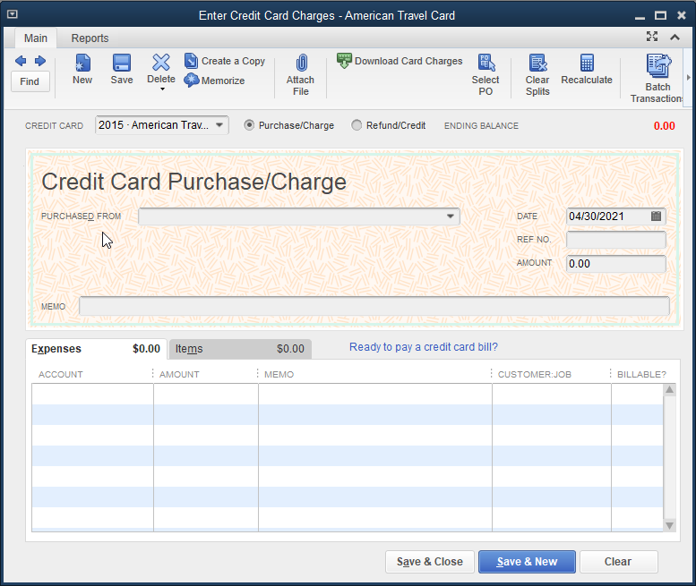
The Enter Credit Card Charges Window

Slide 27
The Enter Credit Card Charges Window Cont.
Activities identified as credit card purchases of goods or services are recorded in the Enter Credit Card Charges window.
The asset purchased or expense incurred is recorded as if the goods were purchased with cash or on account.
purchase creates a liability in the form of a credit card balance to be paid at a later date
default account is Credit Card Liability account
The transaction is recorded as follows:

Slide 28
The Enter Credit Card Charges Window Cont.
When the credit card bill is paid, the credit card liability is reduced by a cash payment.
default accounts are the Credit Card Liability account and the Cash account

Slide 29
The Enter Credit Card Charges Window Cont.
To enter a credit card charge:
Click Banking and then click Enter Credit Card Charges.
Select the credit card.
At the PURCHASED FROM drop-down list, click the vendor.
Choose the date.
Enter the reference number.
Click the Purchase/Charge option if not already selected.
Enter the amount.
On the Expenses tab, select the account.
Click Save & Close.

Slide 30
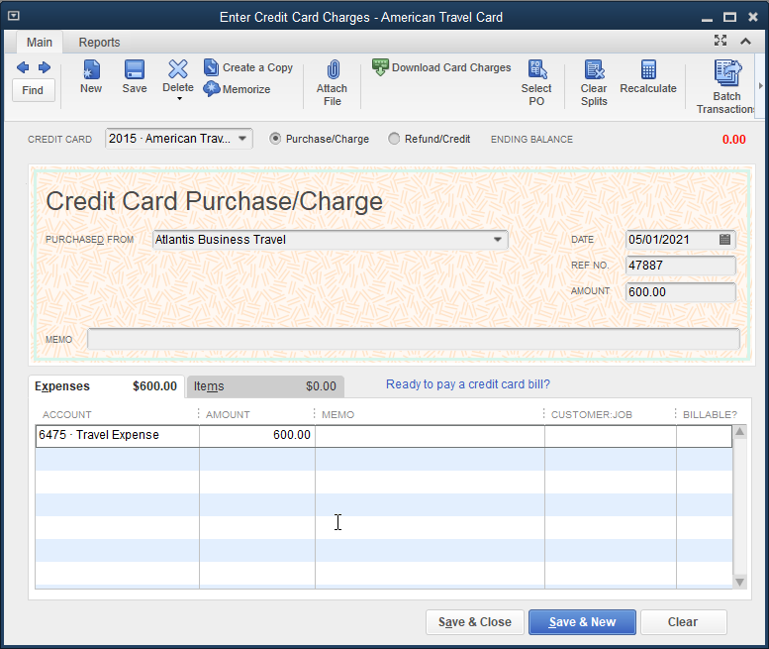
The Enter Credit Card Charges Window Cont.
Example of a completed Enter Credit Card Charges window:

Slide 31
The Enter Credit Card Charges Window Cont.
To pay a credit card charge:
Click Banking and then click Write Checks.
Select the bank account.
Choose the date.
At the PAY TO THE ORDER OF drop-down list, click the appropriate account (e.g., American Travel Card).
Enter the amount.
On the Expenses tab, at the ACCOUNT field, click the credit card liability account.
Click Save & Close.
Remember that since the vendor was paid via a credit card, the liability for the charge is now with the credit card company.

Slide 32
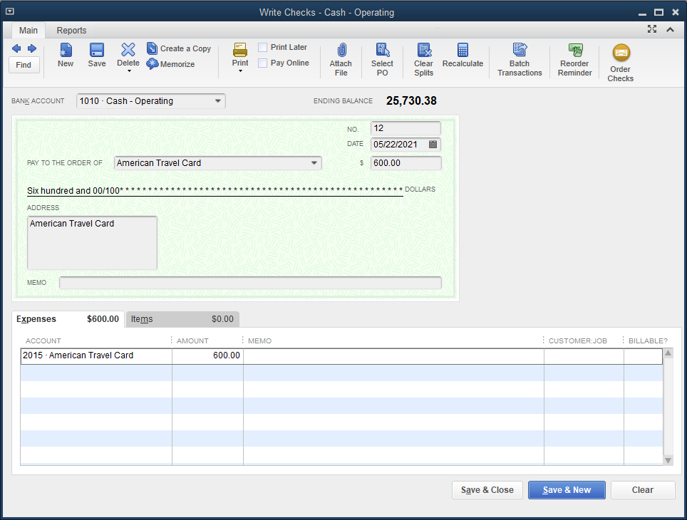
The Enter Credit Card Charges Window Cont.
Example of a completed Write Checks window:

Slide 33
Banking Reports
The Reconciliation Detail report is printed as part of the reconciliation process.
In addition a company may use the following reports:
Deposit Detail report
Missing Checks report

Slide 34
Banking Reports Cont.
Deposit Detail report
displays the components of all deposits to each cash account for a specified period of time
is helpful in tracing a collection from a customer to the actual bank deposit

Slide 35
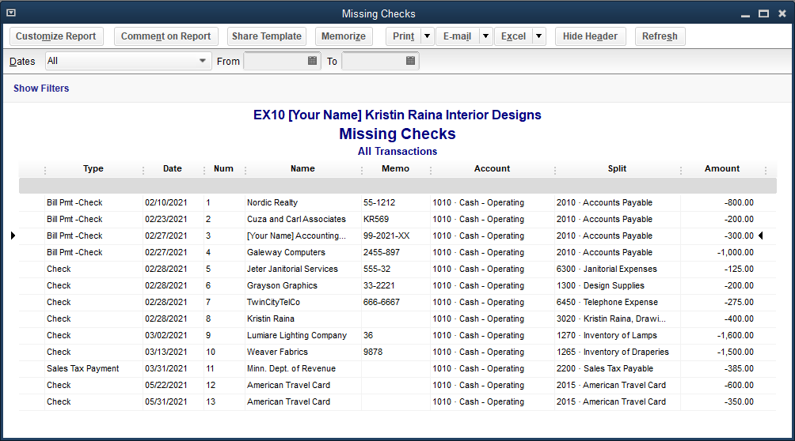
Banking Reports Cont.
Missing Checks report
displays detailed information for all checks written from a specified cash account
is helpful in finding missing or duplicate checks

Slide 36
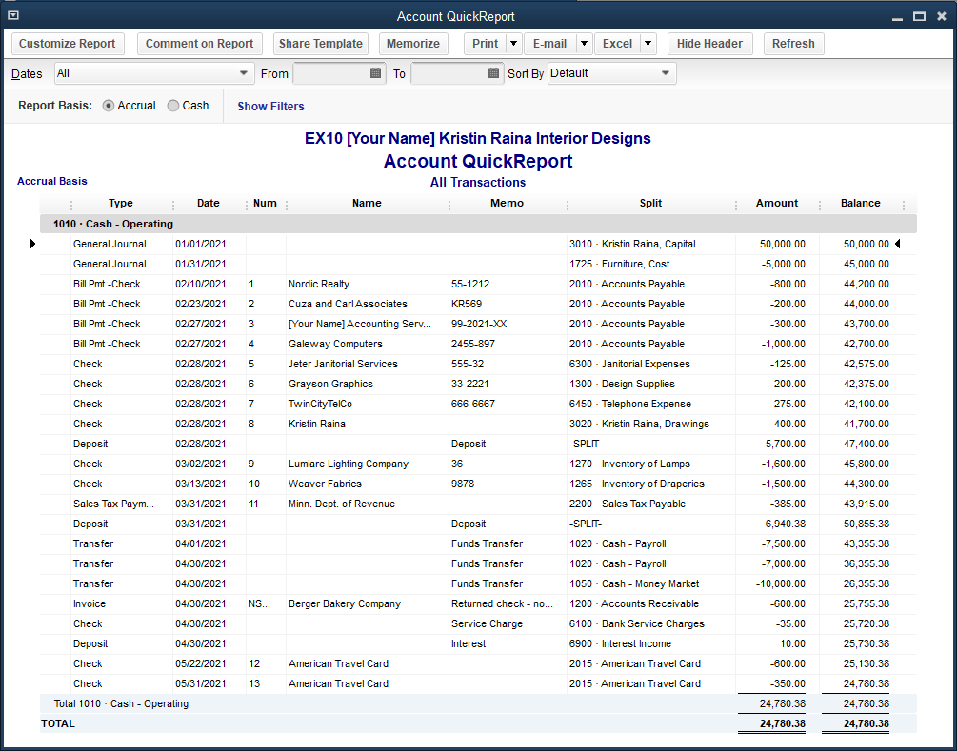
Banking Reports Cont.
QuickReport
Once you access a List, you can view a list of available reports by clicking the Reports button in the List window.
The QuickReport of a cash account displays all the activity affecting the account.

Slide 37
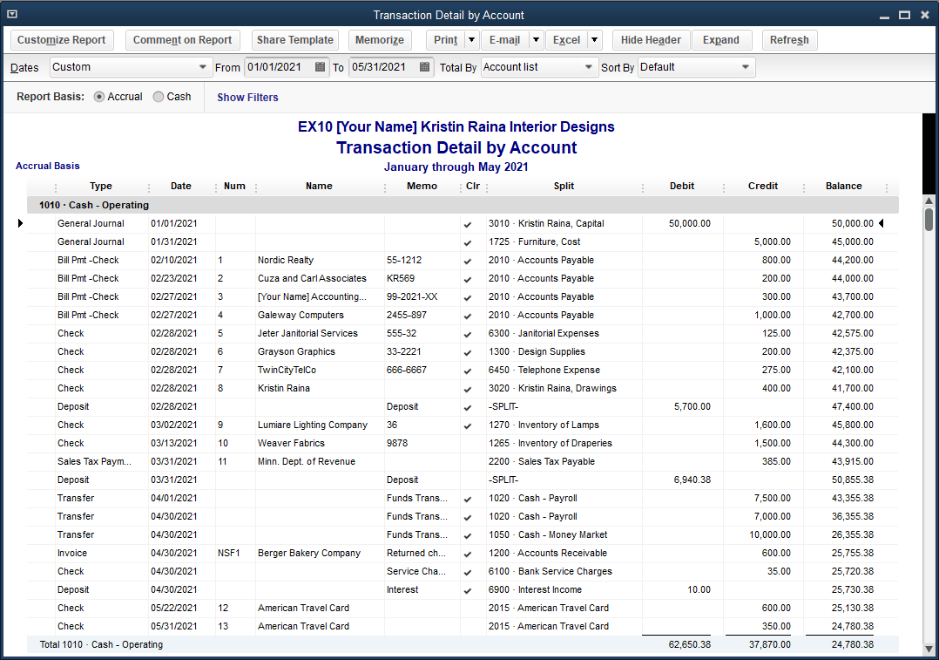
Accounting Reports and Financial Statements
Transaction Detail by Account report
displays, for the cash accounts, all checks written by the company
indicates if checks have cleared the bank
similar to the General Ledger report

Slide 38
Accounting Reports and Financial Statements Cont.
At the end of each month, the following reports should be viewed and printed:
Journal
Profit & Loss Standard
Balance Sheet Standard

Slide 39
Quick Check
When a credit card bill is paid,
the Enter Credit Card Charges window is used.
the default accounts are the vendor’s Accounts Payable account and the Cash account.
the credit card liability is reduced by a cash payment.
the goods purchased are entered as expenses.

Slide 40
Terms
bank reconciliation Procedure used to determine the correct cash balance in an account by comparing the activity recorded in the account to the activity recorded on the bank statement.
credit card charges Expenditures charged to a credit card to be paid at a later date.
deposit in transit A deposit recorded on the company’s books, usually at the end of the month, yet deposited too late to be on the current month’s bank statement.

Slide 41
Terms Cont.
outstanding check A check written and recorded by the company that has not yet been paid by the bank.
reconciling items Differences between the bank statement and the company’s records that have to be reconciled in order to have the cash balance in the company’s accounting records agree with the balance in its bank statement.
transfer funds The movement of money from one account to another account.

