Slide 2
Jobs and Time Tracking
Recording Job Income and Job Payroll Expenses; Tracking Time for Employees and Jobs; and Creating Customer Statements

Slide 3
Objectives
Add a job to the Customer Center
Record and allocate payroll incurred for a specific job in the Pay Employees windows
Record and allocate services rendered for a specific job in the Create Invoices windows
Set up Time Tracking
Track employee time for each job using the Weekly Timesheet window
Pay employees using Time Tracking data
Create invoices using Time Tracking data
Create customer statements
Display and print job and Time-Tracking reports, accounting reports, and financial statements

Slide 4
Introduction
QuickBooks allows you to allocate income and expenses for a specific job for a customer.
A job is a project, assignment, or any identifiable segment of work for a customer.
Identifying jobs allows the company to measure the profitability of individual customer projects or assignments.
When you record revenue in windows such as the Create Invoices or Enter Sales Receipts windows, you can indicate the job for which the revenue was earned.
When you record expenses such as payroll in the Pay Employees window, you can also allocate employee pay and payroll tax expenses to a job.

Slide 5
Introduction Cont.
Most service businesses track employee hours as part of the invoicing process.
Customers are billed, usually at an hourly rate, for services provided by various company personnel.
Time tracking mechanisms can vary from a simple manual system using handwritten timesheets, to stand-alone time-and-billing software.
Billable hours are used to
allocate expenses to a job
determine the invoice to be billed for the job
determine the profit (job revenue less job expenses) for the job

Slide 6
Introduction Cont.
To allocate the revenue and expenses to a specific job, you can
maintain the details manually
utilize QuickBooks’ Time-Tracking feature
When activated, this feature allows you to record time spent by company personnel for customers and specific jobs by entering data in the Weekly Timesheet window.
This data is then used to allocate payroll expenses to those jobs and to bill customers for work done.

Slide 7
QuickBooks v. Manual Accounting
In a manual accounting system, when revenue is recorded in a sales or cash receipts journal, an additional step must be taken to identify the job earning the revenue and to record that revenue in a jobs subsidiary ledger.
Similarly, when job expenses are recorded in the purchases, cash payments, or payroll journals, they also must be posted to the jobs subsidiary ledger.
These steps must be taken in addition to posting to the customer and vendor subsidiary ledgers.
In QuickBooks, the job file of the Customer Center serves as the jobs subsidiary ledger for the company.
When the company earns revenue from the job, the revenue is recorded in much the same manner as previously recorded in the Create Invoices window or the Enter Sales Receipts window.

Slide 8
QuickBooks v. Manual Accounting Cont.
When the revenue is identified with a particular job in each window, it is automatically allocated to the job while the transaction is recorded. These transactions simultaneously update
the general ledger for the revenue earned
the customer file for the account receivable (in the Create Invoices window)
the job file for the job revenue
If employees work on a specific job, the Pay Employees windows allow you to identify the time spent or salary expense related to the job.
Below is a comparison of manual accounting ledger and journals with QuickBooks functions:
Manual Accounting System | QuickBooks
Job Subsidiary Ledger | Customer Center

Slide 9
The Customer Center
The Customer Center contains a file for each customer with which the company does business.
If there are specific jobs for a customer, or multiple jobs for that customer, identify those jobs in the customer file.
A job must always be associated with a customer.
Once a job is added it will have its own file—separate from but part of the customer’s file.
The job file carries over the customer information from the customer’s file (name, address, telephone, and so on).
In addition, the job file will contain important information such as job name, description, start and expected completion dates, and status.

Slide 10
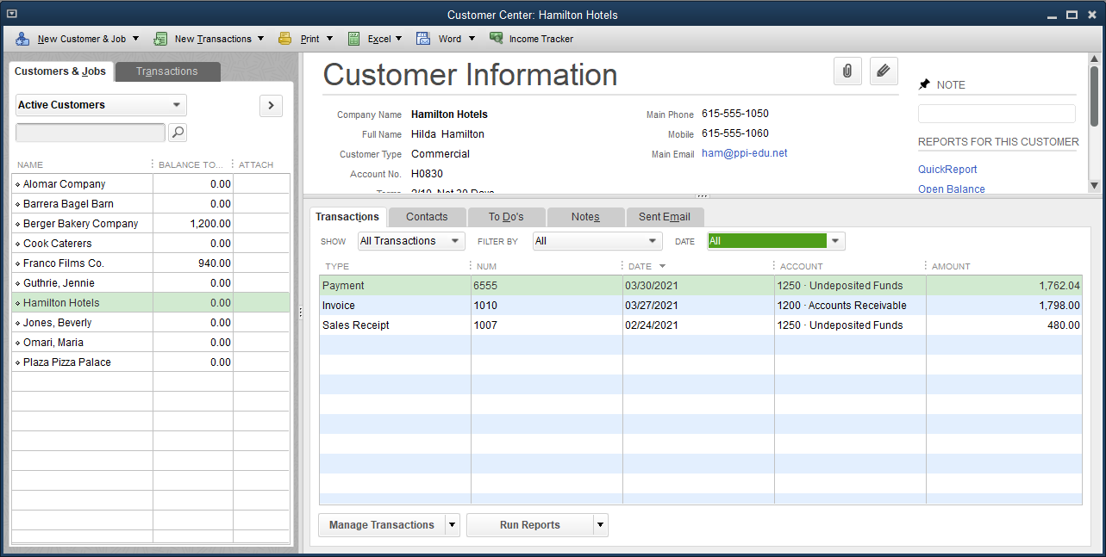
The Customer Center Cont.
To add a job:
Click Customers and then click Customer Center.
At the Customer Center window, select (highlight) the customer, but do not open the file.
Continues…

Slide 11
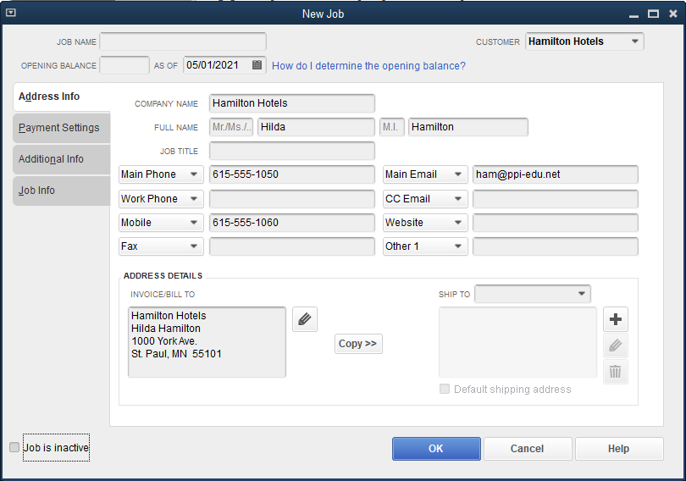
The Customer Center Cont.
Click the New Customer & Job button.
At the New Customer & Job menu, click Add Job. The New Job window opens.
At the JOB NAME field, add a new job name.
On the Job Info tab, complete the following fields: JOB DESCRIPTION, JOB STATUS, START DATE, PROJECTED END DATE.
Click OK.

Slide 12
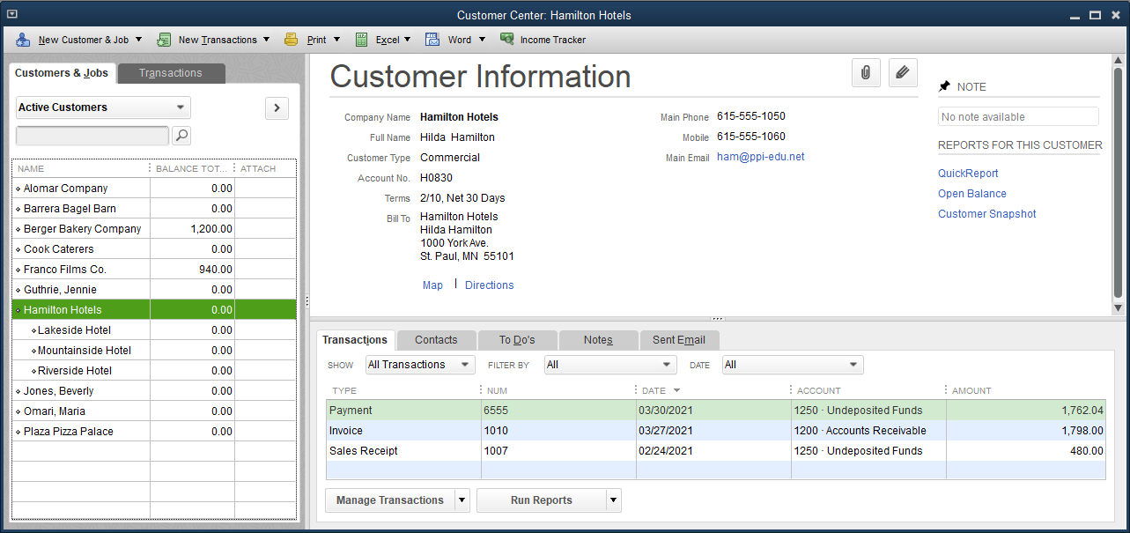
The Customer Center Cont.
Notice the three jobs indented under the customer name, Hamilton Hotels, with which those jobs are associated.

Slide 13
The Item List
To bill customers at different rates depending on who is doing the work, separate items have to be set up for each rate in the Item List.
Note the two different rates for Decorating Services and Design Services below.

Slide 14
Allocating Payroll Expenses to a Job
Kristin Raina has two employees
Harry Renee: an administrative assistant whose time is not billable
Richard Henderson: a design assistant who, along with the owner Kristin Raina, provides design and decorating services to customers
Both Richard Henderson and Kristin Raina will be spending time working on the Hamilton Hotels projects.
Kristin Raina wishes to charge the payroll expense to each project in order to measure the profitability of each project.
For the first payroll in May, Kristin Raina has kept track of the hours spent on each job, by both Richard Henderson and herself, on a manual system.

Slide 15
Allocating Payroll Expenses to a Job Cont.
To pay an employee and allocate to jobs:
Click Employees and then click Pay Employees. The Enter Payroll Information window appears.
At the PAY PERIOD ENDS and CHECK DATE fields, choose the appropriate dates.
At the BANK ACCOUNT field, make a selection (e.g., 1020 Cash – Payroll).
Confirm the number in the First Check# box.
Select an employee by placing a check mark next to the name.
Click the Open Paycheck Detail button. You move to the Preview Paycheck window.
Check the item name, the rate, and the pay period.
At the first line of the HOURS column, select an amount.
At the CUSTOMER:JOB drop-down list, select the job name.
Repeat for any additional jobs and hours completed for the employee.
Enter the company and employee taxes.
Click Save & Close.
Continues…

Slide 16
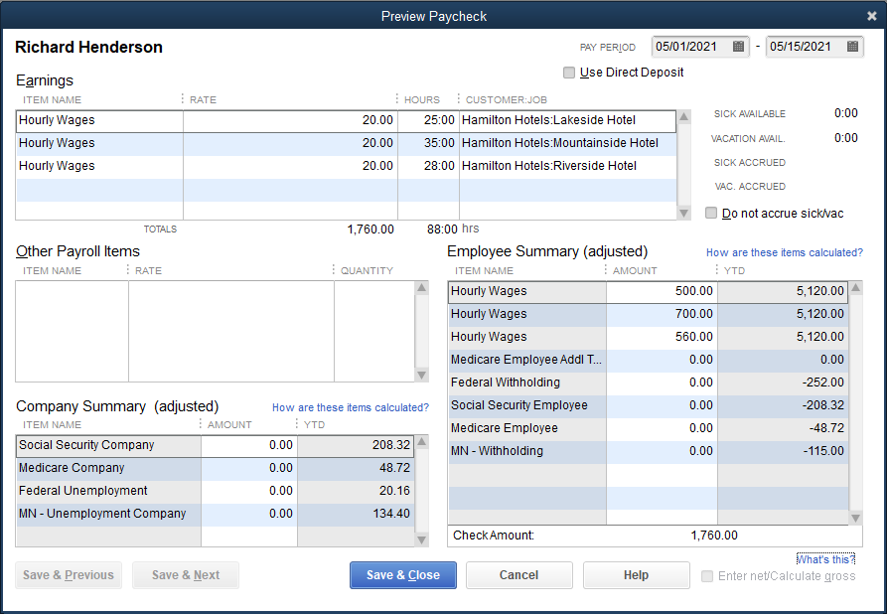
Allocating Payroll Expenses to a Job Cont.

Slide 17
Allocating Payroll Expenses to a Job Cont.
After you click Save & Close, you return to the Enter Payroll Information window.
Click Continue. You move to the Review and Create Paychecks window, and the deductions and net pay columns are now completed.
Click the Create Paychecks button.
At the Confirmation and Next Steps window, click Close.

Slide 18
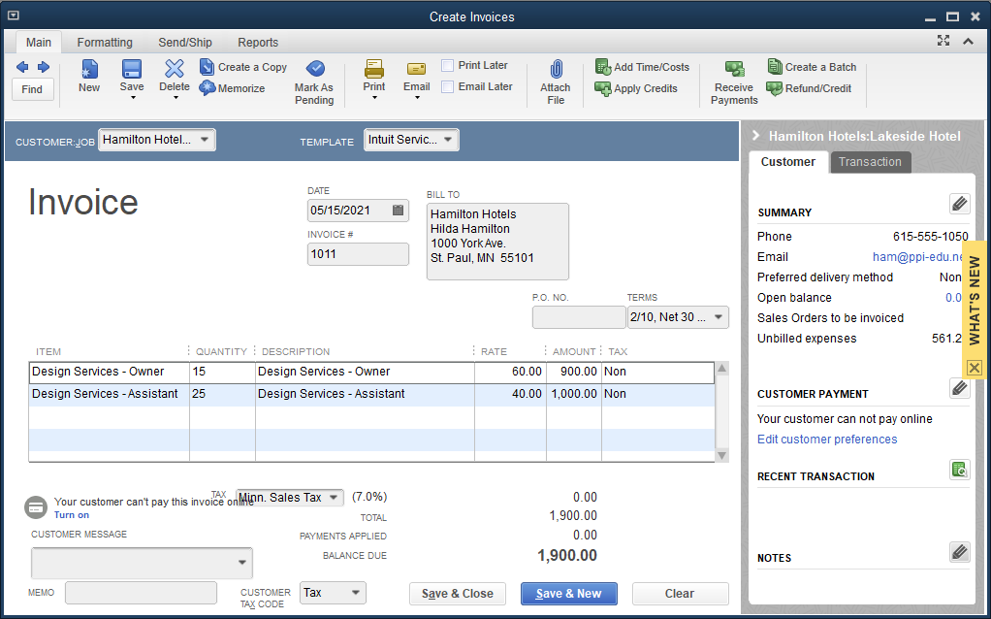
Creating an Invoice for a Job
When invoices are prepared for specific jobs, you select the Job rather than the Customer at the Customer:Job drop-down list.

Slide 19
Quick Check
What is a job?
process by which a company maintains records of time worked by employees for various customers
a category on the Lists menu
a project, assignment, or any identifiable segment of work for a customer
time worked by company personnel that can be billed to customers

Slide 20
Setting up Time Tracking
The Time-Tracking feature allows you to track hours worked by both employees and owners.
Tracking time means recording the hours worked by company personnel while identifying the customer or job for which they spend their working hours.
QuickBooks’ Time-Tracking feature automates that process and enables you to use the resulting data in a number of ways; you can use it to
bill clients by job for work done by the company’s personnel
allocate income and expenses to jobs
process payroll by job
Set up the Time-Tracking feature in the Preferences window.
Once you have done that, the Weekly Timesheet window is available and you can input hourly and daily work activity for customers and/or jobs.

Slide 21
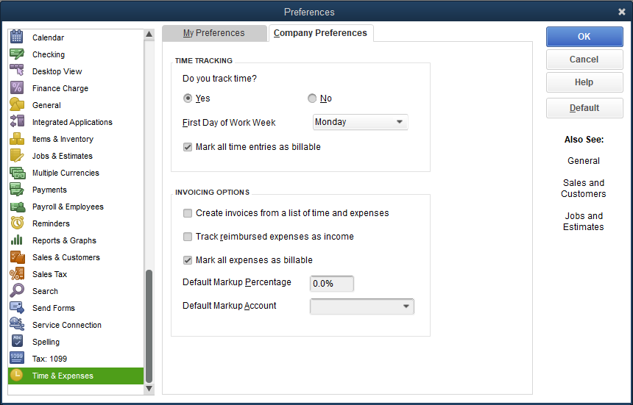
Setting up Time Tracking Cont.
To set up the Time-Tracking feature:
Click Edit and then click Preferences.
Along the left frame of the Preferences window, click the Time & Expenses icon.
Click the Company Preferences tab.
At the Do you track time? field, click Yes. Accept Monday at the First Day of Work Week field.
Place a check mark in the box Mark all time entries as billable.
Click OK.

Slide 22
The Weekly Timesheet Window
You can use the Weekly Timesheet window to enter the daily work activity of employees and owners on a weekly basis.
Each employee or owner indicates the number of hours worked for a customer or job.
You then enter the daily hours along with the customer or job name and the type of service that is performed.
This information does not in itself generate a transaction or journal entry.
Instead, when you wish to invoice a customer for the work and to prepare the payroll for the employees, QuickBooks uses the information in the Weekly Timesheet to automatically complete fields in the these windows:
Create Invoices
Enter Sales Receipts
Pay Employee

Slide 23
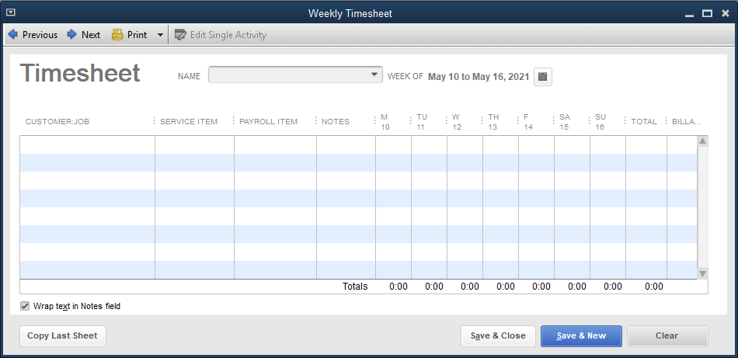
The Weekly Timesheet Window Cont.

Slide 24
The Weekly Timesheet Window Cont.
The Weekly Timesheet window allows you to select the
name of the employee or owner doing the work
type of service to be invoiced
type of payroll item (salary or hourly pay)
daily hours spent for each customer or job
This information is entered daily by the employee or owner.
In this chapter you will enter the data for an entire pay period at one time.
Check the box on the right side of the window to indicate if the hours are billable.

Slide 25
The Weekly Timesheet Window Cont.
Entering Time Tracking data:
Click Employees and then click Enter Time.
At the Enter Time submenu, click Use Weekly Timesheet.
At the NAME drop-down list, click the employee name and then click Yes at the Transfer Activities to Payroll message box.
Click the calendar icon. The Set Date dialog box appears.
Choose the start date.
At the first line of the CUSTOMER:JOB drop-down list, click the job name.
At the SERVICE ITEM drop-down list, click the service item.
At the PAYROLL ITEM drop-down list, click the payroll item for this employee.
In the column for first day of work, enter the hours for that job.
Continues…

Slide 26
The Weekly Timesheet Window Cont.
Continue entering the hours for that job for the period of time displayed.
Move to the second line of the CUSTOMER:JOB field and click the second job from the drop-down list.
Repeat the process for all successive jobs for this time period.
Note the Billable? box is checked.
Click the Next arrow.
Repeat the process for the employee for the next week.
Click Save & Close.
Continues…

Slide 27
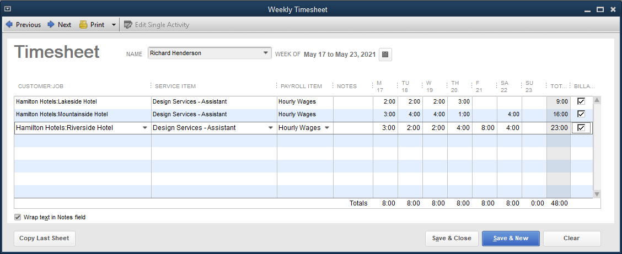
The Weekly Timesheet Window Cont.
When you bill the customer for the work done, QuickBooks will retrieve this information to assist in calculating billable time as part of creating an invoice for the work.
This information will be part of the payroll processing and job allocation procedures. Since the time is billable, this information will be needed to create invoices for this customer.

Slide 28
Paying an Employee and Allocating Payroll Expenses to a Job
Paying an employee and allocating time with Time Tracking:
Click Employees and then click Pay Employees.
Enter the appropriate dates in the PAY PERIOD ENDS and CHECK DATE fields. At the Pay Period Change window, click Yes to update the hours for the new pay period.
At the BANK ACCOUNT field, click the appropriate bank account.
Select the appropriate employee by placing a check mark next to the name.
Click the Open Paycheck Detail button. You move to the Preview Paycheck window. Notice that the data for the hours worked on each job and the pay amount have been filled automatically.
Complete the tax information in the usual manner.
Click Save & Close. You return to the Enter Payroll Information window.
Click Continue. The Review and Create Paychecks window appears with the taxes columns completed.
Click the Create Paychecks button.
At the Confirmation and Next Steps window, click Close.

Slide 29
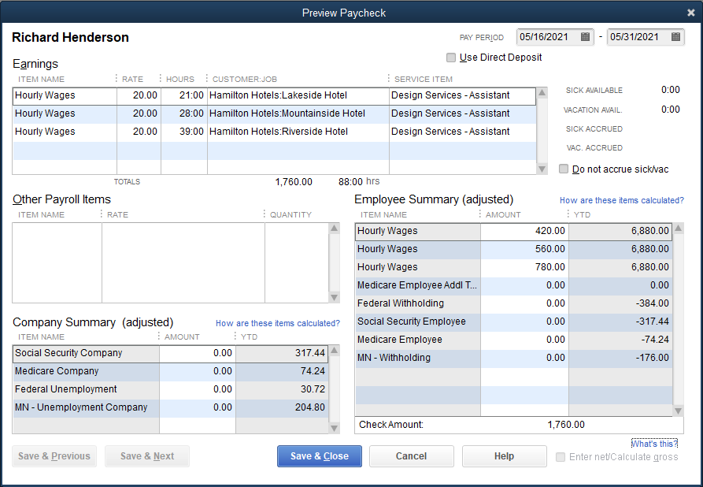
Paying an Employee and Allocating Payroll Expenses to a Job Cont.

Slide 30
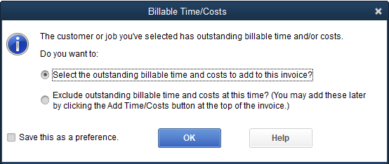
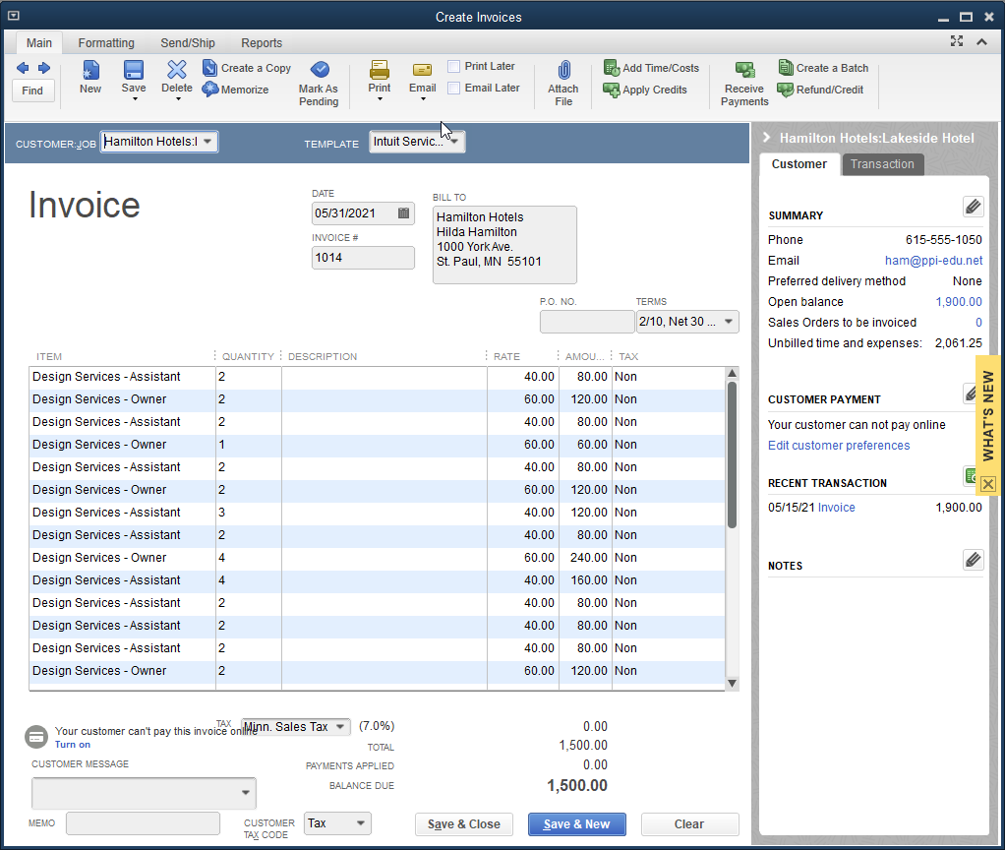
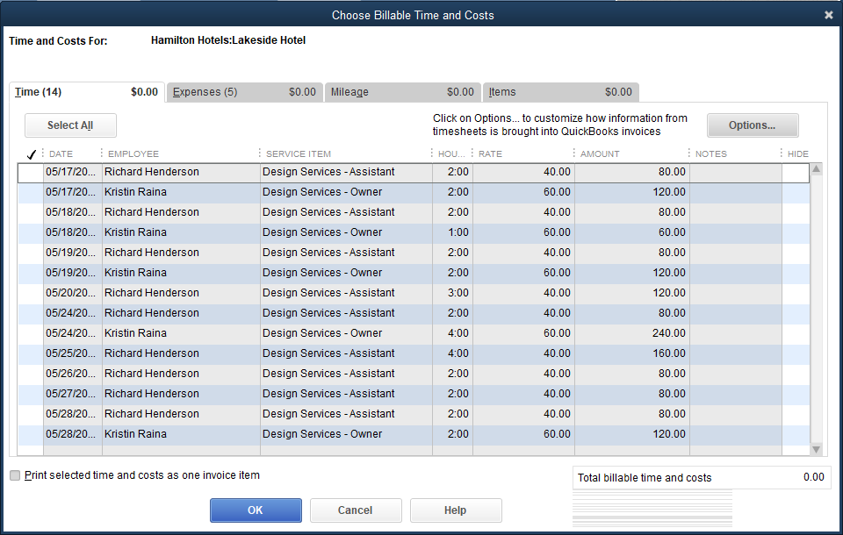
Creating an Invoice with Time Tracking

Slide 31
Creating an Invoice with Time Tracking Cont.
Daily work information is entered in the Weekly Timesheet window.
When the payroll is processed, QuickBooks uses the information from the Weekly Timesheet window to total the hours spent on each job and to allocate the payroll expense accordingly.
QuickBooks also uses the timesheet data to bill customers for services rendered and to allocate revenue earned to each job.

Slide 32
Creating an Invoice with Time Tracking Cont.
To create an invoice with Time Tracking:
Click Customers and then click Create Invoices.
Select the date, invoice number, and template.
At the CUSTOMER:JOB drop-down list, click the job name.
At the Billable Time/Costs window, choose the first option: Select the outstanding billable time and costs to add to this invoice?
Click OK. The Choose Billable Time and Costs window appears, and the hours billed by all company employees for the job are displayed.
Click Select All. A check mark is placed next to all items listed.
Click OK and then click OK at the message. You return to the Create Invoices window with all billable hours entered at the appropriate rate and time.
Click Save & Close.

Slide 33
Quick Check
What is billable time?
job revenue less job expenses
the process by which a company maintains records of time worked by employees for various customers or jobs
a project, assignment, or any identifiable segment of work for a customer
time worked by company personnel that can be billed to customers

Slide 34
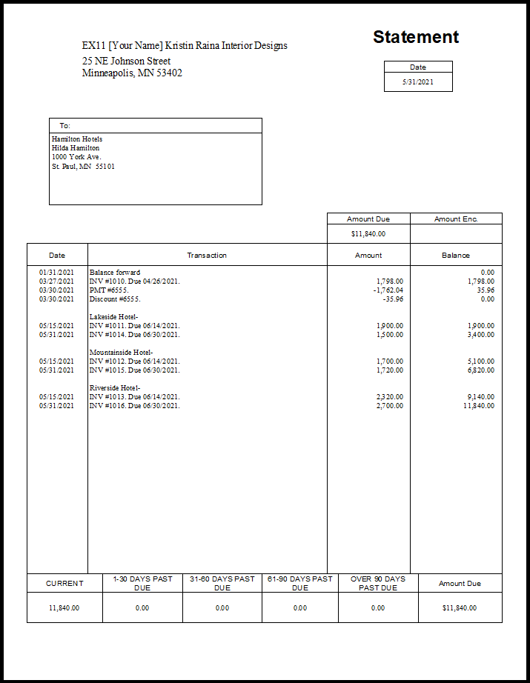
Creating a Customer Statement
Companies generate customer statements as part of the receivable management process.
In QuickBooks, customer statements are prepared using the Create Statements window.

Slide 35
Job and Time Tracking Reports
Profit & Loss by Job report
provides information on the profitability of customer and job activity
shows the type of revenue earned and the expenses incurred for each job for a specified period of time

Slide 36
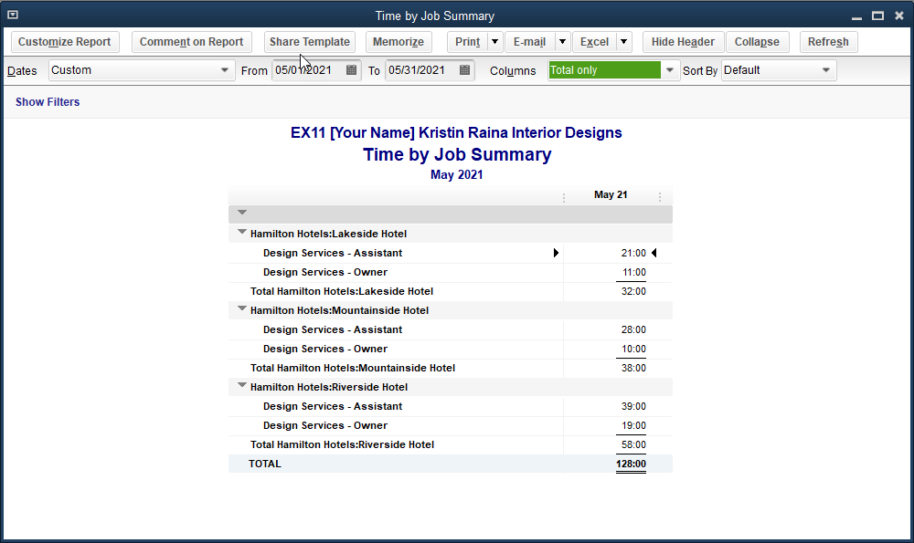
Job and Time Tracking Reports Cont.
Time by Job Summary report
lists hours spent by job for a specified period of time
lists the job and the time each employee devoted to it

Slide 37
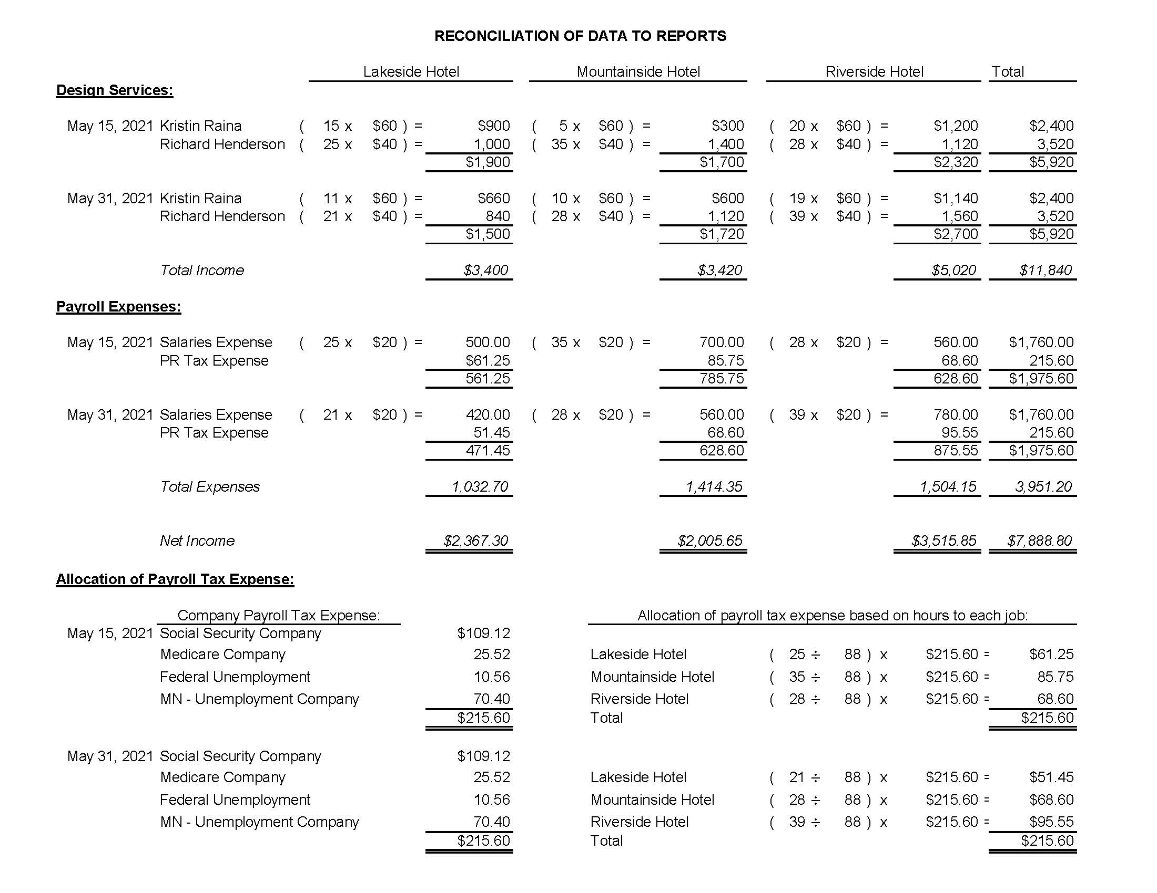
Reconciliation of Data to Reports
Income and expenses can be allocated to jobs either by entering data directly into the Create Invoices window and Payroll window, or by activating the Time-Tracking feature and utilizing the Weekly Timesheet.

Slide 38
Reconciliation of Data to Reports Cont.
When data is entered manually or into the Weekly Timesheet, QuickBooks, behind the scenes, calculates the amounts per job that appear in the Create Invoices window, Payroll windows, Job files, and Job reports.

Slide 39
Terms
job A project, assignment, or any identifiable segment of work for a customer.

