Slide 2
Customization of Your Company File
Customizing the Desktop, Invoices, Letters, Memorized Transactions, Graphs, and Fiscal Year

Slide 3
Objectives
Customize the desktop with the Home page and Icon bars
Customize Lists/Centers (including subaccounts), merge entries, and create custom fields
Customize Activities (including an Activity window display and related invoice), prepare QuickBooks Letter in Microsoft Word, and memorize transactions
Customize Reports (including the appearance of reports) memorize settings, export a report into Microsoft Excel, process multiple reports, change report default settings, view and print a graph
View fiscal year closing, set closing date, prepare for new fiscal year

Slide 4
Introduction
In this final chapter, you will learn how to customize the desktop; customize Lists/Centers by changing subaccount default settings, merging entries, and creating custom fields; and customize Activities by personalizing the Create Invoices window and related printed invoices.
Then you will learn how to prepare a QuickBooks Letter in Microsoft Word and memorize transactions.
Next you will learn how to customize Reports and memorize the settings, export a report to Microsoft Excel, process multiple reports, change report default settings, and view and print graphs.
Finally, you will conclude the accounting cycle in QuickBooks by viewing fiscal year closing, setting the closing date, and preparing for the new fiscal year.

Slide 5
Customize The Desktop
You may have observed that there are many different ways to access Lists/Centers, Activities windows, and Reports in QuickBooks.
Throughout the text only the main menu bar was used to illustrate accessing the Lists/Center, Activities windows, and Reports.
You can customize your desktop to use the Home page and/or the Icon bars as alternative ways to access these items.

Slide 6
Using the Home Page

Slide 7
Using the Home Page Cont.
By default, when you create a new company file, and each time you open a company file, the Home page is displayed.
If the default was changed and the Home page is not automatically displayed, it can be accessed for the current work session or the default can be changed so that the Home page displays each time the company file is opened.
In addition, the Home page can be customized to your choices.

Slide 8
Using the Home Page Cont.
QuickBooks offers two tabs on the Home page
Home page tab
Five sections of the Home page are labeled with tabs:
VENDORS
CUSTOMERS
EMPLOYEES
COMPANY
BANKING
Insights tab
Provides information about the company at a glance.
Profit & Loss
Income
Expenses

Slide 9
Customize the Home Page
Icons are added or removed from the Home page depending on the preferences for the company file.
Recall in the New Company Setup chapters, that when you create a new company file, the QuickBooks preferences, or features, are turned on (enabled) or turned off (disabled).
In Chapter 6, the preferences were enabled or disabled as you answered questions in the EasyStep Interview window.
In Chapter 7, you went directly to the Preferences window to enable or disable preferences.
As a preference is enabled, choices appear on the drop-down menus on the main menu bar and also on the Home page.
If a preference is enabled, you cannot remove the icon from the Home page.

Slide 10
Customize the Home Page Cont.
In Chapter 12, most preferences for our sample company Kristin Raina Interior Designs have been enabled.
If you look at the Home page for a company file in the earlier chapters, you will see fewer icons on the Home page.
For example, look at Figure 1–H in Chapter 1.
Currently, Kristin Raina is not using Estimates.
Look at the Home page and observe in the CUSTOMERS section that there is not an Estimates icon.
Upon enabling the Estimates preference, the icon will appear on the Home page.

Slide 11
Customize the Home Page Cont.

Slide 12
Customize the Home Page Cont.
Along the right side of the Home page are three areas of information titled:
Account Balances
Do More with QuickBooks
Backup Status
While you cannot remove these categories from the Home page, you can minimize the detail below each heading by clicking the up arrow.
When you click this arrow, only the information title is displayed.
To see the information below the title, click the down arrow.
The Preferences window is used to change the default setting for displaying the Home page when opening a new company file.

Slide 13
Changing the Default for the Home Page
To change the default setting for the Home page:
Click Edit and then click Preferences. The Preferences window appears.
Along the left frame of the Preferences window, click the Desktop View icon.
Click the My Preferences tab.
Depending on your preference, place or remove a check mark in the box to the left of Show Home page when opening a company file.
Click OK to save the setting.
Close the Home page.

Slide 14
Icon Bars
In addition to the Home page, the Icon bars can be used to access Lists/Centers, Activities windows, and Reports.
Left Icon Bar
Four sections on the Left Icon bar:
Search, Content, Categories, Do More With QuickBooks
Information in the Content section changes depending on which Category is selected.
By default, the My Shortcuts category is selected.
Next to each icon in the Content section is part of the text name for the icon.
Move the mouse pointer over the icons in the Content section and the entire text name for each icon is displayed.
The Left Icon bar can be customized to add, delete, or edit the icons in the My Shortcuts Content list.

Slide 15
Icon Bars Cont.
To view the Left Icon bar:
Click View on the main menu bar. On the View drop-down menu, when a check mark appears to the left of Left Icon Bar, the Left Icon bar is enabled. If there is no check mark, the Left Icon bar is disabled.
Click Left Icon Bar if there is no check mark.
To add an icon to an Icon bar:
Click View and then click Customize Icon Bar. The Customize Icon Bar window appears.
In the Customize Icon Bar window, click the Add button. The Add Icon Bar Item window appears.
At the Add Icon Bar Item window, scroll through the list on the left until you see the icon you wish to add.
Click the icon you wish to add.
Click OK at the Add Icon Bar Item window, and then click OK at the Customize Icon Bar window to save the changes.

Slide 16
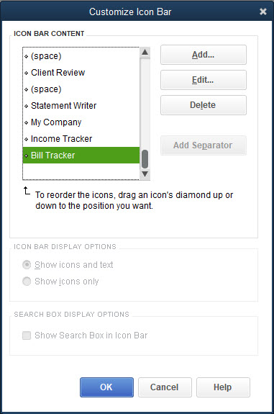
Icon Bars Cont.
To edit an icon on an Icon bar:
Click View and then click Customize Icon Bar. The Customize Icon Bar window appears.
In the Customize Icon Bar window, in the ICON BAR CONTENT section, scroll through the list and click once on the icon you wish to edit to highlight it.
Click the Edit button.
At the Edit Icon Bar Item window, in the Label field, delete the name and then enter the new name.
Click OK in the Edit Icon Bar window and then click OK in the Customize Icon Bar window. In the Content section of the Left Icon bar, the icon text is updated to the new name.

Slide 17
Icon Bars Cont.
The Top Icon bar can be customized to add, edit, and delete icons the same way the Left Icon bar was customized.
Changes made to the icons on the Left Icon bar are carried over to the Top Icon bar.
In addition, the Top Icon bar can be customized to add a space and vertical line between the icons.
This is done using the Add Separator button in the Customize Icon Bar window.
Only one Icon bar can be displayed.
To view the Top Icon bar:
Click View at the main menu bar. On the View drop-down menu, when a check mark appears to the left of Top Icon Bar, the top icon bar is enabled. If there is no check mark, then the Top Icon bar is disabled.
Click Top Icon Bar if there is no check mark.

Slide 18
Customize Subaccounts Presentation
Accounts in the Chart of Accounts List can be denoted as subaccounts.
Accounts are marked as subaccounts for the primary purpose of showing a subtotal or net amount of the parent account on the financial statements.
This was illustrated with fixed assets where the accumulated depreciation account (subaccount) was deducted from the fixed asset cost account (subaccount) to show the net book value of the fixed asset account (parent) on the Balance Sheet.
Sometimes when you are reviewing the Account Listing report, or choosing an account in an Activity window, the default listing of first the parent account followed by the subaccount is cumbersome.
You can change the default settings to simplify the presentation of the parent and subaccounts.

Slide 19
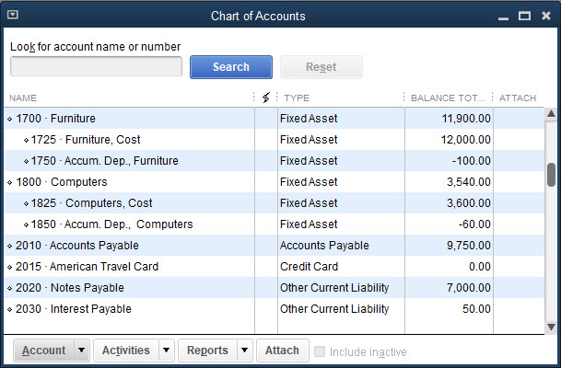
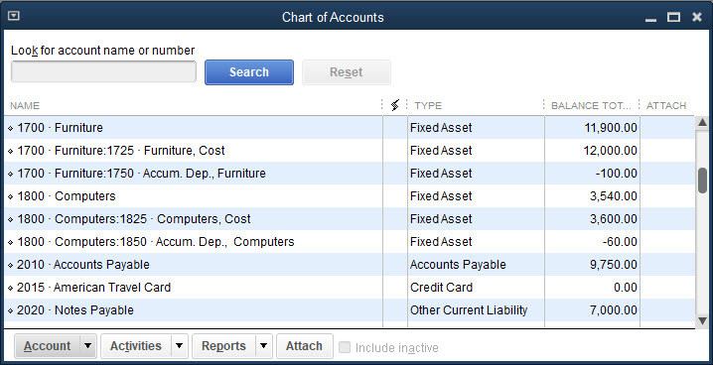
Chart of Accounts List Window Presentation
To change to flat or hierarchical view:
In the Chart of Accounts List window, click the Account menu button. Notice that Hierarchical View is checked.
Click Flat View.
The subaccounts are no longer indented; they are now left-aligned in the window. Notice each line lists both the parent account and subaccount.
Hierarchical View
Flat View

Slide 20
Lists and Activities Windows Presentation

Slide 21
Lists and Activities Windows Presentation Cont.
In the Lists, Activities, and Reports windows, the default setting is to display the subaccounts after the parent account.
The Account field is typically small in an Activity window (e.g., Make General Journal Entries window), and you see the parent account and only part of the subaccount.
The default setting can be changed in the Preferences window.
To change the default setting of subaccounts:
Click Edit and then click Preferences.
Along the left frame of the Preferences window, click the Accounting icon.
Click the Company Preferences tab.
In the ACCOUNTS section, place a check mark in the box to the left of Show lowest subaccount only.

Slide 22
Lists and Activities Windows Presentation Cont.

Slide 23
Merge Entries
You can combine, or merge, vendors, customers, accounts, service items, and inventory part items
Simply use a name or number already in use and QuickBooks will inquire if you wish to merge two items.
To merge two accounts:
Open the Chart of Accounts List.
Select the account you wish to merge but do not open it.
Click the Account button and then click Edit Account. The Edit Account window opens.
In the account number field, change the name or number to the desired account to merge, and then click Save & Close. A Merge message informs you the account is already in use and asks if you wish to merge the accounts.
At the Merge message, click Yes. The two accounts are merged. All information in QuickBooks is updated accordingly.
Close the Chart of Account List.

Slide 24
Create Custom Fields
QuickBooks allows you add your own fields of information to display in reports.
Custom fields can be created for customers, vendors, employees, or items.
For example, you could create a field to sort customers by regions or cities and then filter the Customer Center to list only the customers in a specific region or city.

Slide 25
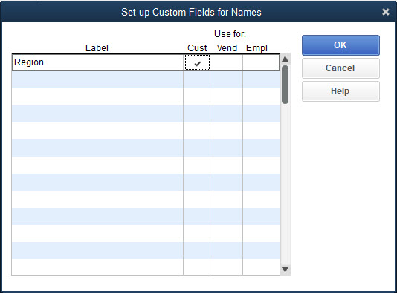
Create Custom Fields Cont.
To create a custom field:
Open a Center and choose a customer or vendor by double-clicking the name. The Edit window appears.
Click the Additional Info tab.
On the Additional Info tab, in the CUSTOM FIELDS section, click the Define Fields button. The Set up Custom Fields for Names window appears.
On the first line in the Label column, enter the name of the new field you wish to create.
In the Use for: field, place a check mark in the appropriate column.
Continues…

Slide 26
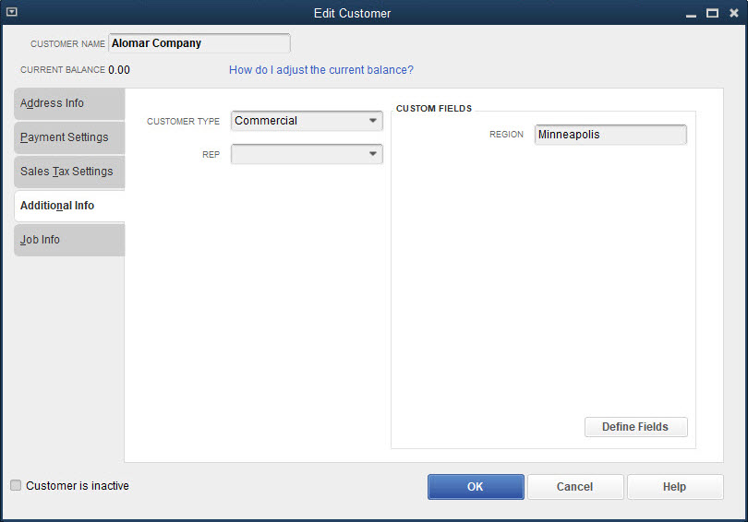
Create Custom Fields Cont.
Click OK.
At the Information message, place a check mark in the box to the left of Do not display this message in the future and then click OK. The new field now displays in the CUSTOM FIELDS section on the Additional Info tab.
You can now enter data in the custom field.
Click OK to save the information.
Edit each file to update the new field on the Additional Info tab.
Close the Center.

Slide 27
Create Custom Fields Cont.
To filter a center by the custom field:
Open the Center.
Click the Search icon. The Custom Filter dialog box appears.
In the dialog box, make selections in the Search, in, and For fields.
Click Go. The Center is updated to display only the files that have been identified for the custom field on the Additional Info tab.
To remove the Custom Filter, click the X that replaced the Search icon.
Close the Center.

Slide 28
Quick Check
What is the process to include a custom field in the Vendor Center?
Open any vendor in the Edit Vendor window, then on the Additional Info tab, click the Define Fields button.
Open the QuickReport for any vendor and click Customize Report.
Open the Vendor Center and click the Define Fields button.
Add the field as an item in the Item List.

Slide 29
Customize Activities Windows and Printed Documents
QuickBooks allows you to change the default settings of a
A window
A document that can be printed as a result of data entered in a window
Recall that in Chapter 11 when you used time tracking, the data you entered in the Weekly Timesheet window was carried forward to the Create Invoices window.
The Create Invoices window displayed by default did not display all relevant information carried over to that window.
By changing the default settings in the Create Invoices window, you can display more of the important information.

Slide 30
Customize Activities Windows and Printed Documents Cont.
Both the Create Invoices window and the invoice itself do not display all the detailed information.
Not an invoice you would want to send to a customer
You can customize both the Activities window and the invoice so that all detailed information is adequately displayed.
Two QuickBooks pre-established invoices include
Intuit Service Invoice
Intuit Product Invoice
Create your own invoice by customizing a template.
To do this you first make a copy of the existing template and then customize the copy.
This is done using the Manage Templates icon on the Formatting tab in the Create Invoices window.

Slide 31
Customize Activities Windows and Printed Documents Cont.
After creating the template, save the invoice.
The Columns tab lists the pre-established settings for the service invoice.
There are four columns with boxes listed next to each of the pre-established settings.
The first column of boxes applies to the Screen, that is, which settings appear in the Create Invoices window.
The second column of boxes applies to the settings which appear on the printed invoice.
The third column applies to the Order of display both on the screen and on the printed copy.
The fourth column is the title for the column.
A check mark indicates the setting will appear on the screen or on the printed invoice.

Slide 32
Customize Activities Windows and Printed Documents Cont.
To customize the Create Invoices window and a printed invoice:
With the Create Invoices window open, on the Formatting tab, click Manage Templates.
In the SELECT TEMPLATE section, select an invoice and then click the Copy button.
In the PREVIEW section, at the Template Name field, enter a new name.
Click OK.
At the Basic Customization dialog box, click Additional Customization.
At the Additional Customization dialog box, click the Columns tab.
Add or remove check marks for the different fields of information.
Change the order of the fields, if desired.
Click OK at the Additional Customization and Basic Customization dialog boxes.
In the Create Invoices window, click Save & Close.

Slide 33
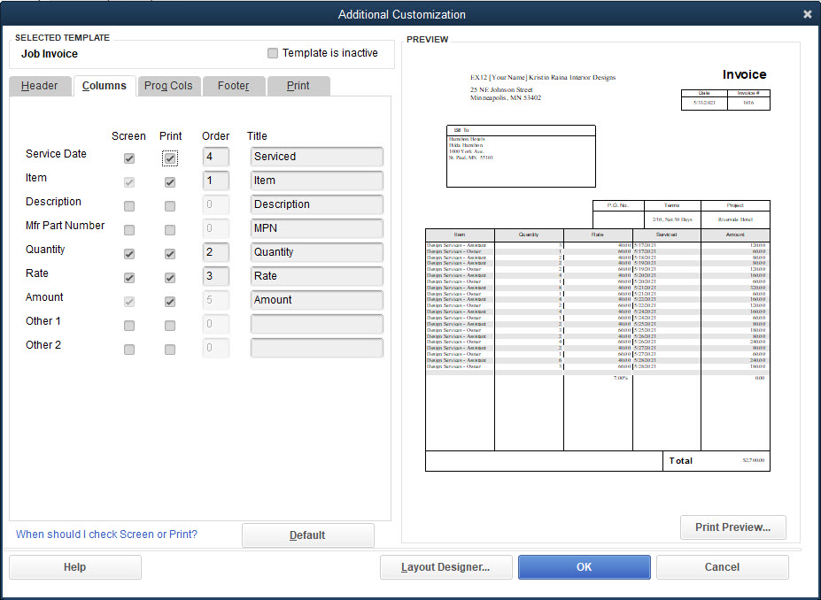
Customize Activities Windows and Printed Documents Cont.

Slide 34
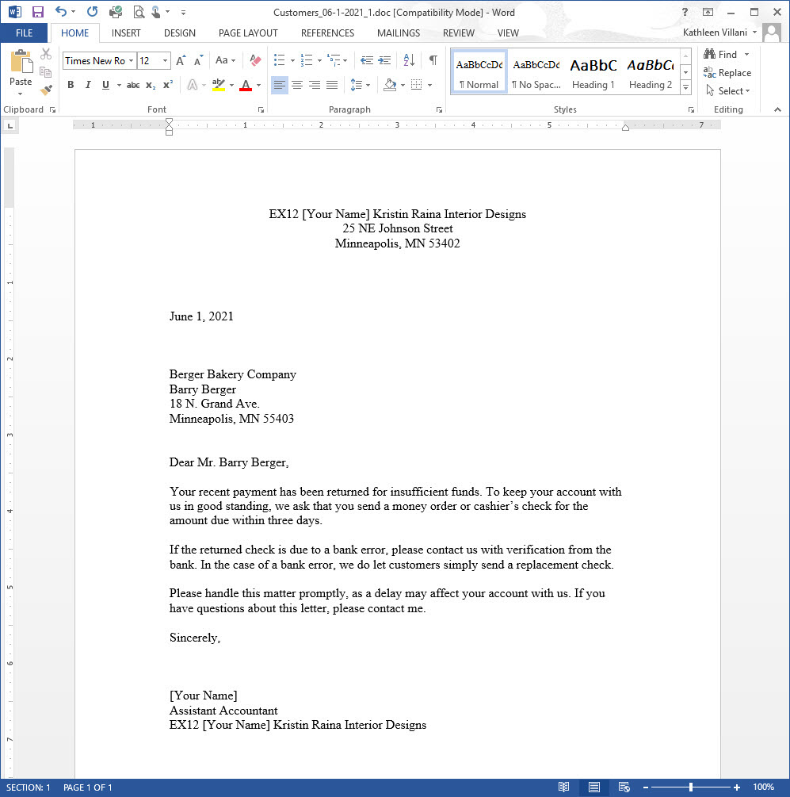
QuickBooks Letters
QuickBooks provides preformatted letters that may be used in certain business circumstances.
You can use these letters as they are or customize them based on your personal preferences.
You must have Microsoft Word on your computer to use this feature.

Slide 35
QuickBooks Letters Cont.
To prepare a business letter using QuickBooks Letters:
Click Company and then click Prepare Letters with Envelopes.
At the Prepare Letters with Envelopes submenu, click Customer Letters. If the Find Letter Templates message appears, click Copy. The Letters and Envelopes window appears.
At the Review and Edit Recipients page, click Unmark All to remove all check marks from the customer names.
Select the desired name and then click Next.
At the Choose a Letter Template page, select a letter and then click Next.
At the Enter a Name and Title page, enter the appropriate data.
Click Next. Microsoft Word opens, and the chosen letter is displayed with your company name, the current date, and customer name included.
Save and print the letter and then close Microsoft Word.

Slide 36
Memorized Transactions
Many routine business activities are repeated often at daily, weekly, and monthly intervals.
QuickBooks allows you to memorize repetitive transactions.
Once a transaction is memorized, you can
Recall the transaction at the appropriate time to record it.
Have QuickBooks automatically record the transaction on certain dates.
To set up and memorize a transaction:
Record a transaction, but do not click Save.
Click Edit on the main menu bar and then click Memorize Check.
In the How Often field, select an interval such as Monthly.
In the Next Date field, choose the date to start the memorized transaction.
Click OK. The transaction is memorized.
At the Activity window, click Save & Close.

Slide 37
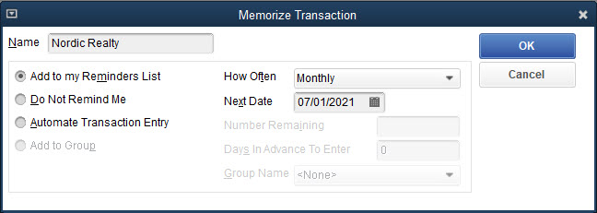
Memorized Transactions Cont.
To recall a memorized transaction:
Click Lists and then click Memorized Transaction List.
At the Memorized Transaction List window, select the transaction you wish to record and then click the Enter Transaction button.
The Activity window appears with the correct date and other information automatically entered. You may make changes if necessary.
Click Save & Close to record the transaction.
Close the Memorized Transaction List window.

Slide 38
Customize the Appearance of Reports
As you have seen, QuickBooks contains a large variety of pre-established management reports, accounting reports, and financial statements, many of which you have displayed and printed.
When you display a report, there is a row of buttons along the top of the report.
These buttons can be used to
Customize the presentation of a report
Make comments (notes) on a report
Share a customized report template
Memorize settings in a report
Email a report
Export a report into an Excel spreadsheet
Hide the header of a report
Collapse or expand the numbers in a report

Slide 39
Customize the Report Button
The Customize Report button at the top of the report is used to adjust the appearance of the report.
The Customize Report button moves you to the Modify Report dialog box which consists of four tabs:
Tab | Description
Display | add or delete fields of information displayed in a report
Filters | filter (select) which categories of information should be included in a report
Header/Footer | indicate which information should be displayed in the headers or footers
Fonts & Numbers | indicate the fonts and formats of the numbers in the reports

Slide 40
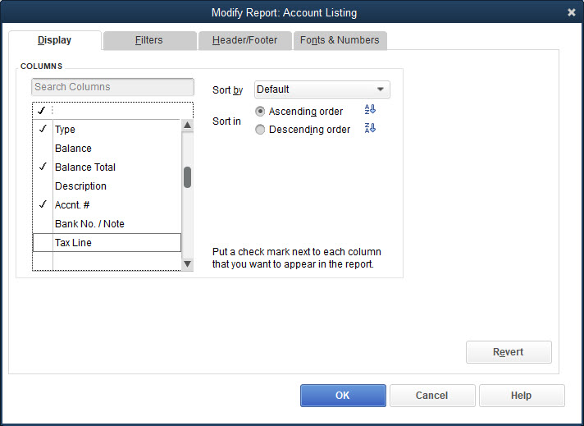
Customize the Report Button Cont.
Modify Report—Display Tab
The Modify Report dialog box–Display tab displays the fields of information that can be displayed in the columns of a report.
Any column title that is checked off is displayed.

Slide 41
Customize the Report Button Cont.
Modify Report—Header/Footer Tab
Header/Footer tab is used to establish the
Headers (including titles)
Footers (including page numbers) to be displayed in a report
Two items in the heading of a report you can format are the Date Prepared and Time Prepared items.
By default, the date and time the report is prepared always displays in the upper left corner.
If you print reports often, it is useful to have the date and time you print a report listed to avoid confusion.
There may be times you don’t want the date or time displayed on the report.
Printouts reproduced in this text did not include a current date or time because the Date Prepared and Time Prepared fields default were disabled.

Slide 42
Customize the Report Button Cont.
To disable or change the format of the Date Prepared and Time Prepared fields and change a subtitle in a report:
Open the report and then click the Customize Report button at the top of the report.
In the Modify Report dialog box, click the Header/Footer tab.
Remove the check mark from the box to the left of the Date Prepared and Time Prepared fields.
In the Subtitle field, delete the date provided and then enter the new subtitle.
Click OK at the Modify Report dialog box.
Memorize the report if desired and then close the report.

Slide 43
Customize the Report Button Cont.

Slide 44
Memorize Button
Changes just made to a report remain in place as long as the report is displayed.
But as soon as you close the report, those changes are lost.
When you reopen the report, the original default settings again display.
Instead of having to change the settings each time you open the report, you can save the changes to a report by using the Memorize button at the top of the report.
To memorize the settings for a report:
Open the report and make the desired changes.
Click the Memorize button at the top of the report.
At the Memorize Report dialog box, enter the new report name.
Click OK.
Close the report.

Slide 45
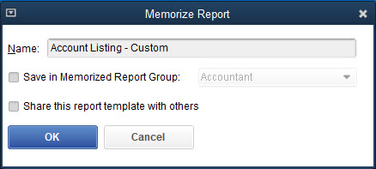
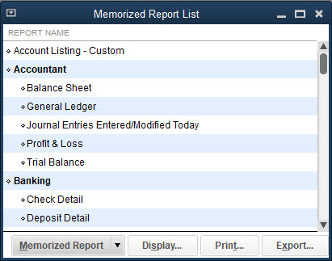
Memorize Button Cont.
To open a memorized report:
Click Reports and then click Memorized Reports.
At the Memorized Reports submenu, click Memorized Report List. The Memorized Reports List appears.
In the Memorized Reports List, double-click the desired report. The memorized report appears.

Slide 46
Quick Check
If you wish to see a customized report again,
open the report from the Reports menu.
export the report to Excel.
first memorize the report and then open the memorized report.
change the settings each time you open the report.

Slide 47
Collapse/Expand Button
There are two formats for a printed report
Expanded format
Collapsed format
To collapse and expand the numbers in a report:
Open the report and then click the Collapse button on the top of the report. Any account that has subaccounts is collapsed into one amount.
To expand the numbers, click the Expand button at the top of the report. The report returns to the original presentation.
Close the report.

Slide 48
Share Template Button
The Report Center provides the same choices of reports that appear on the Reports menu.
The Report Center provides a forum where customized report templates can be shared among QuickBooks users.
Customized report templates are provided by Intuit and QuickBooks users.
An internet connection is required to use the Report Center.
To access the Report Center, click Reports and then click Report Center.
Customized report templates are accessed on the Contributed tab in the Report Center.
By default, the Intuit report templates are displayed.
To access report templates prepared by other QuickBooks users, in the Report Center – on the Contributed tab – in the SORT BY field, choose Community created on the drop-down menu.
When you customize any of your reports, the Share Template button in the report is activated which allows you to share your report with the community.
Only the format of a report is shared, not the financial details.

Slide 49
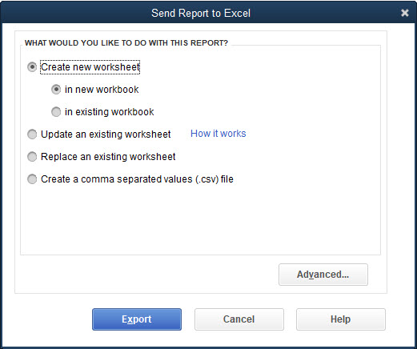
Excel Button
QuickBooks allows you to export reports to a Microsoft Excel worksheet where you can incorporate the report into other Excel files you may have or you can create a new spreadsheet.
You can then utilize Excel to further customize the report.
Excel must be installed on your computer to export the report.

Slide 50
Excel Button Cont.
To export a report to a new Microsoft Excel worksheet:
Open the report and then click the Excel button at the top of the report.
Click Create new worksheet. The Send Report to Excel dialog box appears.
Click the Advanced button if you wish to review any Excel options, and then click OK or Cancel.
At the Send Report to Excel dialog box, with Create a new worksheet and in new workbook selected, click Export. Excel opens and a worksheet is prepared using the report.
Save and close the Excel report.

Slide 51
Excel Button Cont.
To export a report to an existing Microsoft Excel worksheet:
Open the report and enter the correct dates.
Click the Excel button.
Click Update Existing Worksheet. The Send Report to Excel dialog box appears.
At the Send Report to Excel dialog box, with Update Existing Worksheet selected, click the Browse button. You are moved to the Open Microsoft Excel File dialog box.
Select the folder where you save your files, select the file, and then click Open. You return to the Send Report to Excel dialog box with the path filled in the first box in the Select workbook field.
In the second box in the Select workbook field, choose Sheet1 from the drop-down list, and then click Export.
At the Export Alert message, click Yes. Excel opens the existing worksheet updated with the new data. Any previous changes in the formatting of the Excel worksheet would be retained.
Save the report, close Excel, and then close the report.

Slide 52
Excel Button Cont.

Slide 53
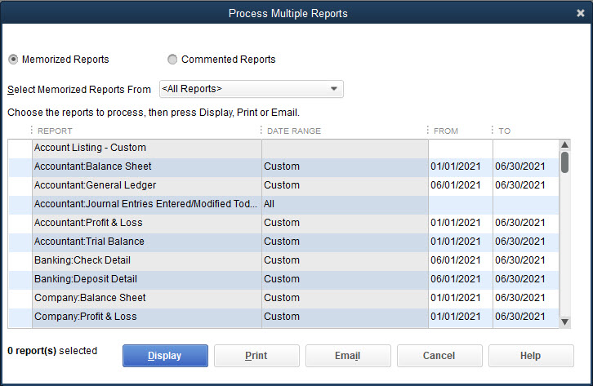
Process Multiple Reports
To display multiple reports:
Click Reports and then click Process Multiple Reports. The Process Multiple Reports window is displayed.
In the Select Memorized Reports From drop-down list, click <All Reports>.
Place a check mark to the left of the reports you wish to view.
In the From and To fields for each of these reports, choose the appropriate dates and then click Display. All reports are displayed for the period of time indicated.
Close all the reports.

Slide 54
Set Default Settings in Reports
Each time you display a report, you can modify the display using the buttons at the top of the report.
Customize Report (Display, Filter, Header/Footer tabs)
Collapse/Expand
These changes are only temporary.
To save the changes, you can memorize the report.
As an alternative, you can change the default settings of all reports using the Preferences window
Steps used to disable the Date Prepared and Time Prepared items using the Preferences window are the same steps taken when you disabled the Date Prepared and Time Prepared items while a report is opened.
This changes the default setting.
Now, each time you open any report, the date or time will no longer display.
If you wish to see the date or time prepared in an individual report, you can activate it for the specific report.

Slide 55
Set Default Settings in Reports Cont.
To disable or change the Date Prepared and Time Prepared items default settings:
Click Edit and then click Preferences.
Click the Reports & Graphs icon.
Click the Company Preferences tab.
Click the Format button.
Click the Header/Footer tab. You can change the default formats or disable any field of information for all reports in this dialog box.
To disable the Date Prepared item, remove the check mark from the box to the left of the Date Prepared field.
To disable the Time Prepared item, remove the check mark from the box to the left of the Time Prepared field.
Click OK at the Report Format Preferences dialog box. You are returned to the Preferences window.
Click OK.

Slide 56
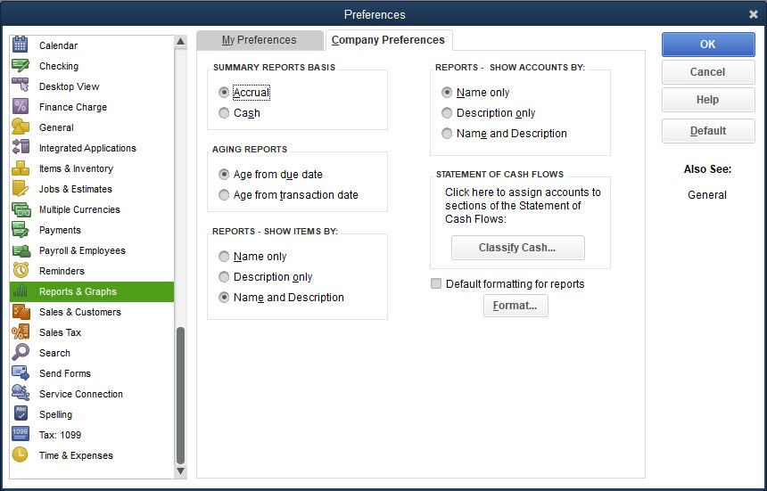
Set Default Settings in Reports Cont.

Slide 57
Graphs
QuickBooks allows you to display financial information in graph format.
Graph presentations are available for the following reports
Income and Expense, Net Worth, Accounts Receivable, Sales , Accounts Payable, Budget vs. Actual
All graphs are displayed in the same manner.
To view a graph:
Use the Reports menu from the main menu bar or the Reports button in a List window to choose a graph.
Click the Dates button.
Choose the dates and then click OK. The graph for that period of time is displayed.
At the Income and Expense graph, to display the income as a pie chart, click the Income button. The pie chart changes to display the income analysis.
Close the graph.

Slide 58
Fiscal Year
Businesses must prepare their financial statements, including the Profit & Loss report and the Balance Sheet report, at least once a year.
The fiscal year can be the calendar year or any other 12-month period.
In QuickBooks, the start of the fiscal year is displayed in the Company Information – Report Information window.
To view the fiscal year:
Click Company and then click My Company.
At the My Company window, click the Edit icon. The Company Information window appears.
At the Company Information window, click Report Information.
Close the Company Information and My Company windows.

Slide 59
Fiscal Year Closing
When the books are closed at fiscal year-end, temporary accounts are brought to a zero balance, usually
Revenues
Expenses
Some equity accounts
Net income for the year is transferred into a capital or retained earnings equity account for the next year.
After the books are closed, preclosing balances in the temporary accounts are no longer accessible.
QuickBooks does not require you to close the books on fiscal year-end.
QuickBooks automatically creates an Owner’s Equity system default account and at the start of a new fiscal year automatically transfers the net income for the previous fiscal year into it.
At the beginning of the new fiscal year, QuickBooks begins all revenue and expense accounts with a zero balance so the net income for the new fiscal year can be accumulated.

Slide 60
Fiscal Year Closing Cont.
When the new company file was created for Kristin Raina Interior Designs, the fiscal year was designated as beginning on January 1.
New Company Setup (Chapters 6 and 7), the Owner’s Equity system default account created by QuickBooks was renamed Accumulated Earnings.
When you move to the new fiscal year, January 1, 2020, QuickBooks transfers the net income for 2019 into the equity account called Accumulated Earnings.
For example, see text for the Profit & Loss Standard report for the period 01/01/2019 to 06/30/2019, there is a net income of $8,357.58.
Net income is carried over to the Balance Sheet standard report.

Slide 61
Fiscal Year Closing Cont.
Assuming no other activity for the year 2019, look at the Balance Sheet Standard and Profit & Loss Standard reports for the first day of the new fiscal year, January 1, 2020.
Notice there is no longer a line for net income, but the $8,357.58 has been transferred into the new Accumulated Earnings account.
In addition, the revenue and expenses all begin with a zero balance for the start of the new fiscal year.
Since there are no revenues or expenses on January 1, 2020, there is no income.
At this point, if you wanted to close the Drawings account, you would have to record an adjusting journal entry in the Make General Journal Entries window.

Slide 62
Set Closing Date
Because QuickBooks does not actually close the books, you still have access to all records for prior years.
You can protect the data for a fiscal year by restricting access to the records so no changes can be made after fiscal year-end.
To set the closing date:
Click Company and then click Set Closing Date. The Preferences window appears on the Accounting page – Company Preferences.
Click the Set Date/Password button. The Set Closing Date and Password dialog box appears.
In the Closing Date field, choose the closing date.
In the Closing Date Password and Confirm Password fields, enter a password of your choosing.
Click OK.
At the Preferences window, click OK.

Slide 63
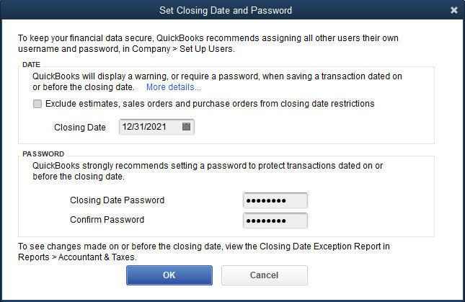
Set Closing Date Cont.

Slide 64
New Fiscal Year
In QuickBooks the accounting records aren’t closed, so all the activities previously recorded will be retained in the company files.
If you wish to continue with the company file in the new fiscal year, but do not want to carry forward the prior fiscal year activities into the new fiscal year, QuickBooks provides a utility called Condense Data.
When you condense the data in a company file, the prior year activities are removed from the company file but all preferences previously established remain intact.
As part of the process, QuickBooks will make a copy of the company file before the company file is condensed.
Note that this process is normally done in the year after the fiscal year-end.

Slide 65
New Fiscal Year Cont.
To condense the company file to prepare for the new fiscal year:
Click File and then click Utilities.
At the Utilities menu, click Condense Data. The Condense your company file window appears with the How do you want to condense your company file? page displayed.
Accept the default Remove the transactions you select from your company file and click Next.
Choose the Transactions before a specific date option, select the date of the new fiscal year, and then click Next.
At the How Should Transactions Be Summarized page, accept the default Create one summary journal entry (recommended) and then click Next.
At the How Should Inventory Be Condensed? page, accept the default Summarize inventory transactions (recommended), and then click Next.
Continues…

Slide 66
New Fiscal Year Cont.
At the Do You Want To Remove The Following Transactions page, accept the defaults and then click Next.
At the Do You Want To Remove Unused List Entries? page, accept the defaults and then click Next.
At the Begin Condense page, click Begin Condense. It will take several minutes and then you will see a QuickBooks Information message. Note that QuickBooks made a copy of the company file.
At the QuickBooks Desktop Information message, click OK.
In the condensed company file, QuickBooks creates an equity account 32000 Retained Earnings. Edit the account in the Chart of Accounts List to match the company’s pattern for numbering accounts.

Slide 67
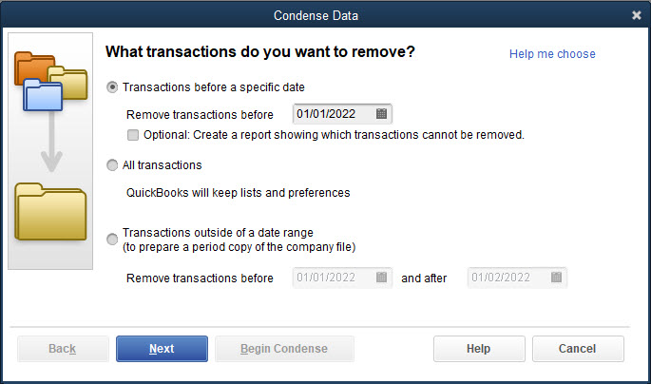
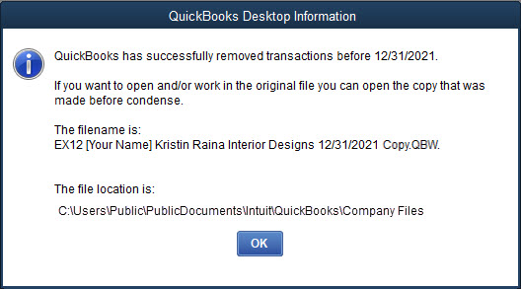
New Fiscal Year Cont.

Slide 68
Terms
Fiscal year The 12-month financial reporting year of the company. It can be the calendar year or any other 12-month period.

