Slide 1
Payroll Accounting 2019
Bernard J. Bieg and Judith A. Toland

Slide 2
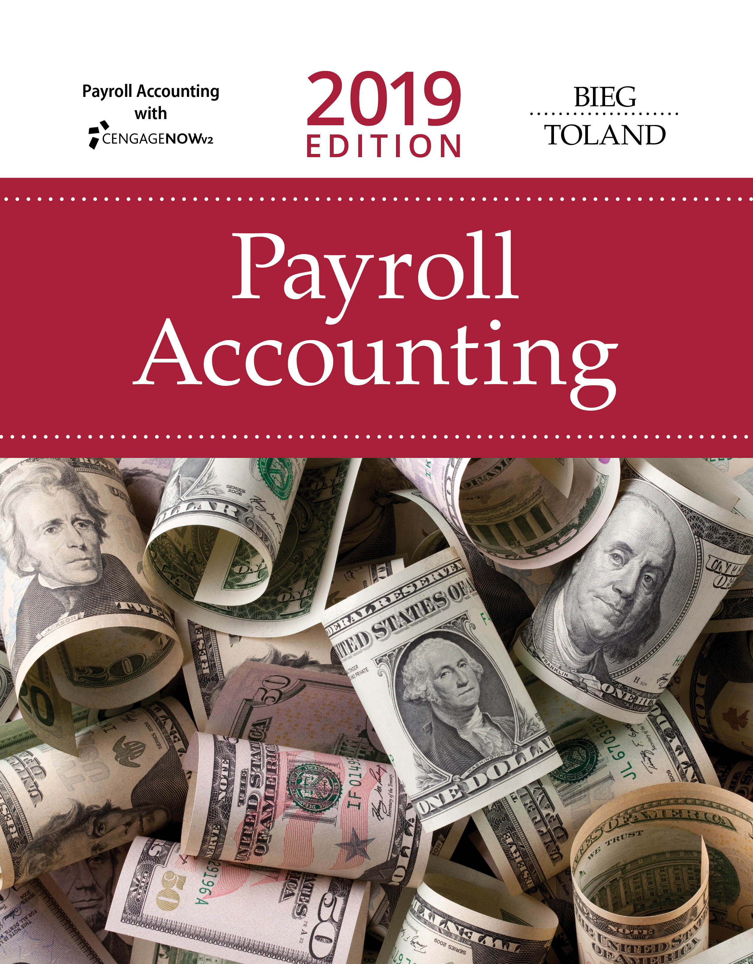
THE NEED FOR PAYROLL & PERSONNEL RECORDS

Slide 3
Learning Objectives
Identify various laws that affect employers in their payroll operations.
Examine the recordkeeping requirements of these laws.
Describe employment procedures generally followed in a Human Resources Department.
Recognize the various personnel records used by businesses and outline the type of information shown on each form.
Identify the payroll register and the employee’s earnings record.

Slide 4
Payroll Profession
Payroll professionals are required to comply with numerous regulations that requires advanced knowledge
Positions within payroll profession range from payroll clerk to senior payroll manager
  Payroll managers’ salaries (per 2018 Robert Half Associates survey) range from $71,000 - $124,350
  Membership in American Payroll Association (APA) helps in keeping current
  “Code of Ethics” sets direction for profession (Figure 1.1)

Slide 5
Figure 1.1 APA Code of Ethics
To be mindful of the personal aspect of the payroll relationship between employer and employee, and to ensure that harmony is maintained through constant concern for the Payroll Professional’s fellow employees.
To strive for perfect compliance, accuracy, and timeliness of all payroll activities.
To keep abreast of the state of the payroll art with regard to developments in payroll technologies.
To be current with legislative developments and actions on the part of regulatory bodies, insofar as they affect payroll.
To maintain the absolute confidentiality of the payroll within the procedures of the employer.
To refrain from using Association activities for one’s personal self-interest or financial gain.
To take as one’s commitment the enhancement of one’s professional abilities through the resources of the American Payroll Association.
To support one’s fellow Payroll Professionals, both within and outside one’s organization.

Slide 6
Many Laws Affect Payroll
Fair Labor Standards Act (FLSA)
Federal Insurance Contribution Act (FICA)
Income tax withholding laws
  Federal, state and local
Unemployment tax acts
Fair employment laws
Other federal laws
State minimum wage and maximum hour laws and other state specific laws

Slide 7
Fair Labor Standards Act (FLSA)
Federal Wage & Hour Law of 1938
Minimum wage is $7.25/hour
Equal pay for equal work provisions
Sets law for companies involved
  In interstate commerce or
  In production of goods/services for interstate commerce
Requires payroll records be maintained
Covered in greater detail in Chapter 2

Slide 8
Federal Insurance Contributions Act (FICA)
Comprised of two taxes
Both taxes paid by employer and employee
  OASDI (Old Age & Survivors’ Trust Fund & Federal Disability Insurance Trust Fund)
  HI (Health Insurance Plan - Medicare)
Imposes tax on net earnings of self-employed individuals
Covered in greater detail in Chapter 3

Slide 9
Income Tax Withholding Laws
Federal income tax
  Levied on earnings of employees
  Income tax is withheld from paychecks
State and local income tax
  Income tax is withheld from paychecks
  Different in each state
  Not all states have state income tax
Covered in greater detail in Chapter 4

Slide 10
Unemployment Tax Acts
FUTA (Federal Unemployment Tax Act)
  Employer tax
  Taxes used to pay state and federal administrative expenses, not used to pay unemployment benefits
SUTA (State Unemployment Tax Act)
  Mandatory unemployment insurance – each state is different
  Social Security Act outlines standards that each state’s unemployment compensation law must follow
  Used to pay unemployment benefits
Covered in greater detail in Chapter 5

Slide 11
Fair Employment Laws
Title VII of the Civil Rights Act of 1964
  EEO (Equal Employment Opportunity)
  Prohibits discrimination in hiring, firing, promoting or compensating based on color, race, religion, national origin or gender
  Unions may not exclude/segregate members on above bases
  Sexual harassment is also prohibited
EEO applies to all employers who engage in an industry “affecting commerce” and employ 15 or more workers in each of 20 or more weeks
Civil Rights Act of 1991 – compensatory and punitive damages in cases where discrimination is intentional
See U.S. Equal Employment Opportunity Commission for more information

Slide 12
Age Discrimination in Employment Act (ADEA)
Age Discrimination in Employment Act of 1967 states employers cannot use age to discriminate in hiring, firing or promoting
  Applies to employers engaged in interstate commerce with 20 or more employees
  Provides protection to workers over 40 years old, with a few key exceptions
Places onus on employer to keep accurate personnel and payroll records

Slide 13
Americans with Disabilities Act (ADA)
Prevents employers with 15 or more employees from discriminating against qualified (defined as person that can perform essential functions of the job with or without reasonable accommodation) persons based upon disability
“Reasonable accommodation” must be provided - this is a very vague term and subject to court interpretation

Slide 14
Federal Personal Responsibility & Work Opportunity Reconciliation Act of 1996
Requires employers to report information on all new hires within 20 days to state agency
  Includes name, address and social security number (submitting copy of W-4 suffices in many states)
  Records are coordinated through federal Office of Child Support Enforcement (OCSE)
  Fines up to $25/hire levied for failure to report
  A few states now require same from independent contractors
Used to help enforce child support obligations

Slide 15
Immigration Reform and Control Act of 1986 (IRCA)
Law that bars hiring and retaining aliens unauthorized to work in U.S.
Accomplished by employee completing Form I-9 (Employment Eligibility Verification) within 3 business days of employment
  Section 1 should be signed no later than first day of employment
  Can photocopy I-9 documents; however, if do so should apply to all new employees
U.S. Citizenship & Immigration Services may audit and levy civil penalties for recordkeeping violations
E-Verify is a government-run system that allows employers to check employment eligibility of new hires by cross matching I-9 information with the Social Security Administration and Department of Homeland Security
  Voluntary program, although federal contracts contain E-Verify clause and 20 states require for some or all employees

Slide 16
Family Medical Leave Act (FMLA) of 1993
Covers companies with 50 or more employees within 75 mile radius
Employee guaranteed 12 weeks unpaid leave for birth, adoption, critical care for child, spouse or parent
  Leave may be used all at once or at separate times – within 12 months of qualifying event
  Employer must continue health-care coverage and guarantee right to return to same job or comparable position
Federal tax credits now available for employers that provide paid family/medical leave to their employees (up to 12 weeks)
FMLA expanded to include up to 12 weeks when family member is on active duty or up to 26 weeks for line of duty injury/illness
Employers can exempt employees in specific situations
Some states have paid family leave plans

Slide 17
Uniformed Services Employment & Reemployment Rights Act of 1994
Military personnel given right to take leaves of absences from civilian jobs
  Right to return to prior jobs with seniority intact – must be granted within 2 weeks of the job request
  Health benefits must be started without a waiting period
  Doesn’t apply if dishonorably discharged

Slide 18
Employee Retirement Income Security Act (ERISA)of 1974
Legislation that safeguards pension funds and ensures workers covered by private pension plans receive benefits in accordance with their credited years of service
  Trustees must monitor pension plans
  Vested 100% in 3 or 6 years (graduated)
    See sample in table
Stringent recordkeeping required
Employee is eligible after reaching age 21 or completing one year of service, whichever is later
Employer must file Form 5500 annually
Provides for Pension Benefit Guaranty Corporation
  A federal agency which guarantees benefits to employee if plan can’t pay benefits
Years of Service | % Vested in Plan
2 | 20%
3 | 40%
4 | 60% etc

Slide 19
Affordable Care Act (ACA) of 2010
ACA consists of two pieces of legislations (Note: In 2017 legislation requiring coverage for individuals and dependents was repealed. As we go to press, the ACA faces an uncertain future.)
  Health Care and Education Reconciliation Act (HCERA)
  Patient Protection & Affordable Care Act
    Designed to expand health care coverage while increasing benefits and lowering costs
    State-based health insurance exchanges established for those who don’t have employer-provided coverage or are ineligible for Medicaid
Applicable large employers (ALEs) with 50+ full-time employees are required to report (on 1095-C) to both employee and IRS
Small employers (less than 50 employees) can purchase affordable insurance through Small Business Health Options Program and may also receive a tax credit (if pay at least 50% of cost for premiums for single)

Slide 20
State Laws
Workers’ Compensation Laws
  Most states require employers to pay employees’ premiums
    Can self insure if state approved
    Different premiums based upon job class
State Disability Benefit Laws
  Five states plus Puerto Rico have established laws requiring employers to provide disability benefits
  This applies even if the disability, illness or disease did not arise due to employment

Slide 21
Human Resource & Payroll Accounting Systems
Critical that a business keep human resources and payroll records that meet federal and state requirements
The Payroll Department performs accounting functions and can be under direct control of chief financial officer, although trend is to place it under direction of Human Resources Department

Slide 22
Human Resources System (1 of 3)
In many mid- and large-sized companies, the Human Resources (HR) system sets procedures for recruiting, selecting, orienting, training and terminating personnel
FLSA requires stringent personnel recordkeeping – embodied in the HR System
  Job descriptions must be clear and accurate
  Requisition for Personnel notifies HR of need for new employee(s)
  Application for Employment (similar to Figure 1.5, on pp 1-17 and 1-18) should be completed by person seeking employment
Pre-hire inquires can include questions on gender, national origin, criminal background, etc. only if there is a bona fide occupational reason
Background checks must be in compliance with Fair Credit Reporting Act
Aptitude/psychological testing only lawful if related to job performance
Employers should consult state law regarding drug testing

Slide 23
Human Resources System (2 of 3)
Safeguards to prevent lawsuits include:
  Accepting applications only online
  Have person not involved in interviews review applications
  Use applicant screening software
Some states now require a formal job offer to be extended before probing salary/benefits history of applicants (in an effort to ensure pay equality)
Applications must be kept for one year
Reference Inquiry conducted before employment
  Due to amount of litigation in this area, respondents should only verify facts and not offer subjective information
  Really diminishes credibility of reference inquiries
    Prospective employer may require applicant to sign Employment Reference Release
    Some states have passed laws providing protection from liability to employers who want to provide references

Slide 24
Human Resources System (3 of 3)
Hiring Notice alerts payroll department to new employee
Employee History Record contains performance evaluations, compensation adjustments, disciplinary issues, performance appraisals, etc.
  Employee must have access to his/her HR file
Termination of employee may be ‘at-will’ or ‘for good cause only’ depending on situation
Various other forms also exist to document internal transaction

Slide 25
Payroll Accounting System – Part 1
This system encompasses procedures and methods related to disbursement of pay to employees
  Two basic records are inherent in this system (see following two slides)

Slide 26
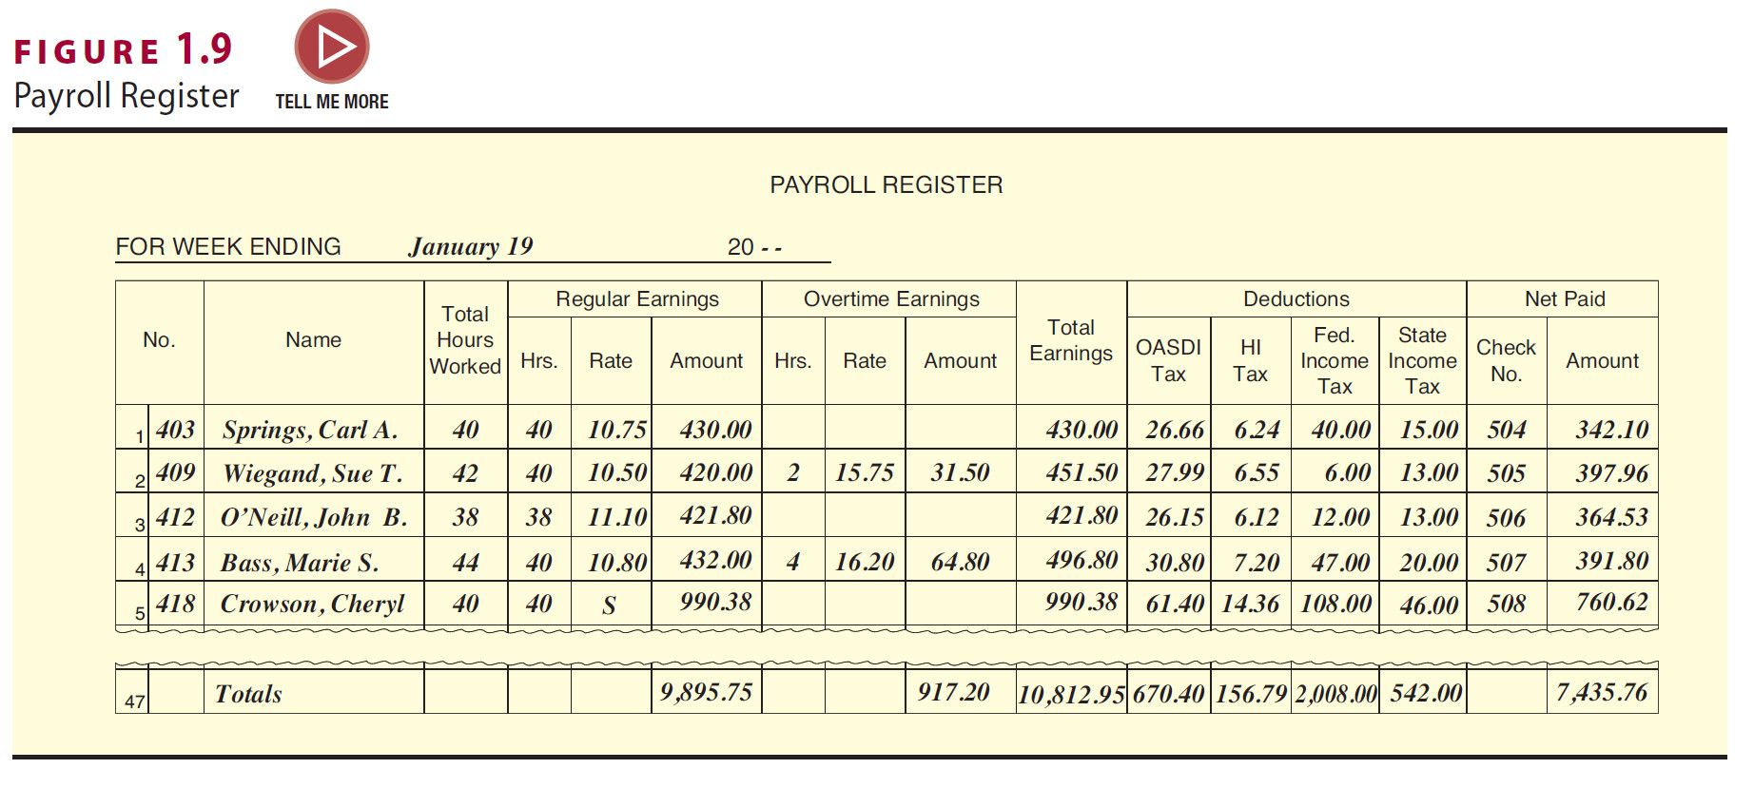
Payroll Register
Compiles data per payroll period
Occurs after hours recorded
Used to compute gross pay, deductions and net pay

Slide 27
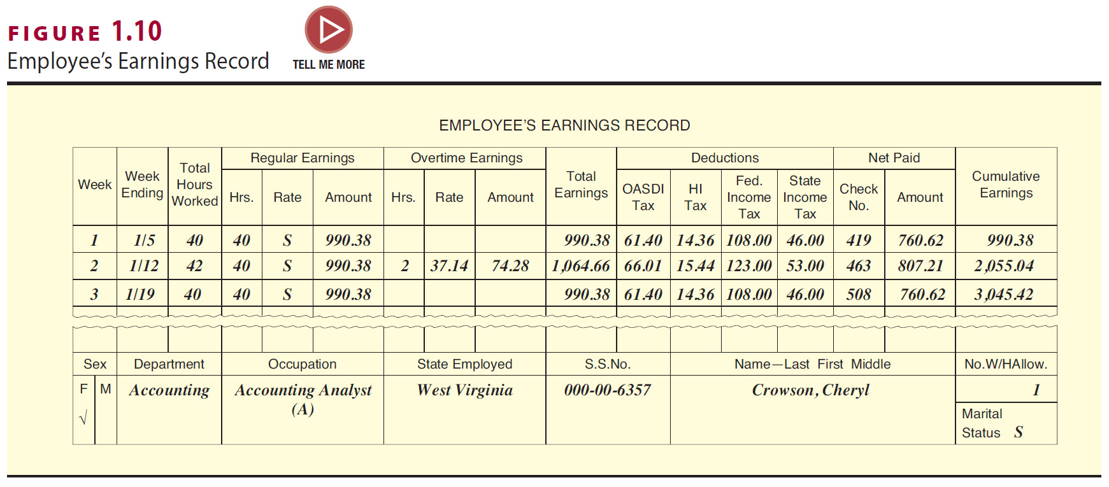
Employee’s Earnings Record
It is updated after completion of payroll register
Outlines earnings per period, as well as cumulative earnings for each employee
Used to compile data for a multitude of reports

Slide 28
Payroll Accounting System – Part 2
Outsourcing Payroll
  Many small- to mid-sized businesses hire a payroll company to do their processing
  This is an independent company responsible for compliance
  Reduce risk of unpaid payroll taxes by
    Hiring only bonded providers
    Disallowing provider the ability to sign tax returns
    Disallowing tax correspondence to be sent to provider
    Requesting regular IRS transcripts of company accounts

