Slide 1
Payroll Accounting 2020
Bernard J. Bieg and Judith A. Toland

Slide 2
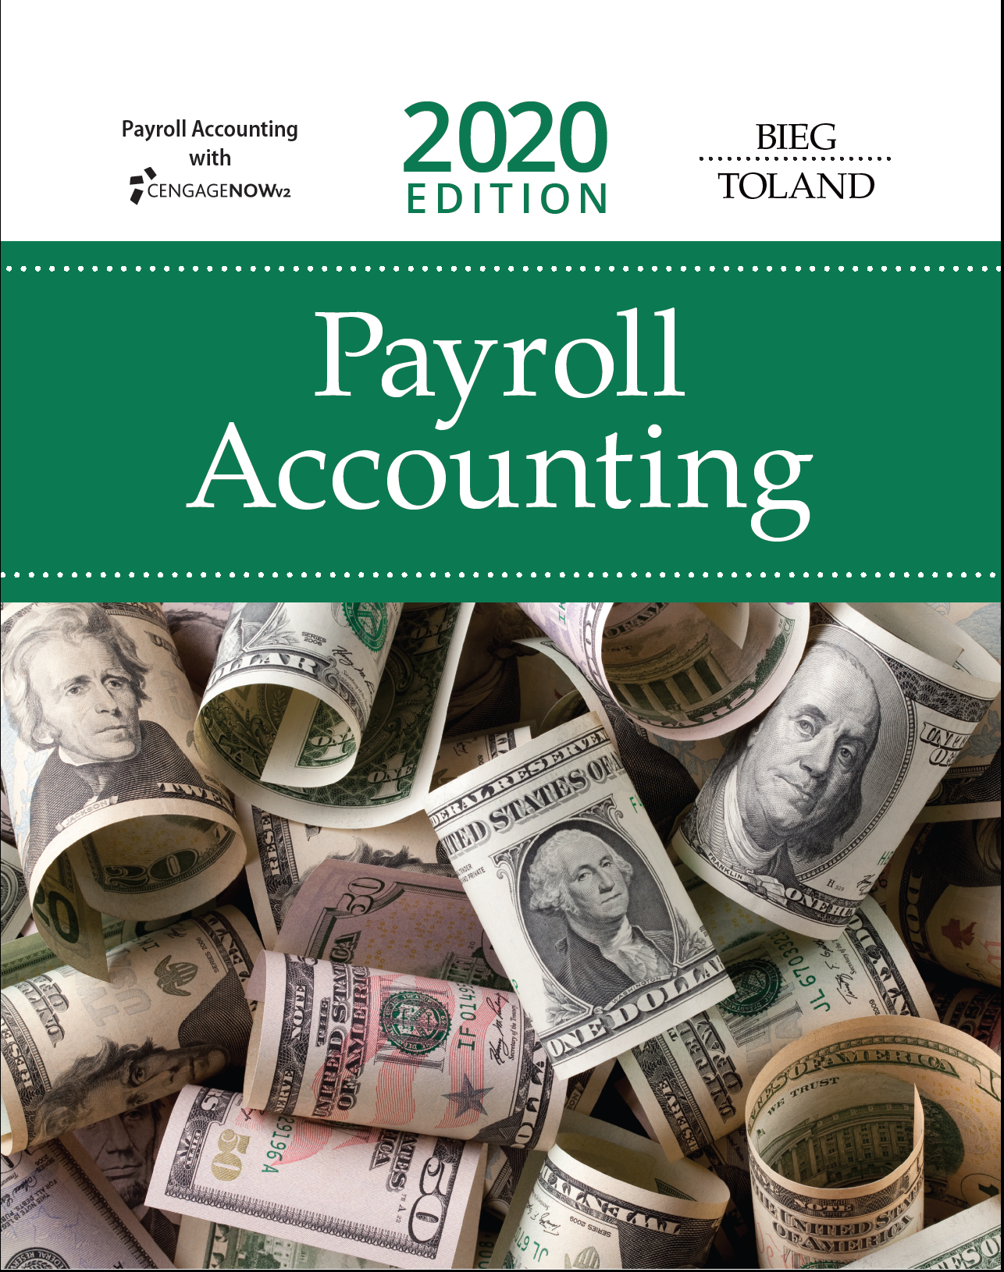
THE NEED FOR PAYROLL & PERSONNEL RECORDS
Chapter 3

Slide 3
Learning Objectives
Identify, for social security purposes, those persons covered under the law and those services that make up employment.
Identify the types of compensation that are defined as wages.
Apply the current tax rates and wage base for FICA and SECA purposes.
Describe the different requirements and procedures for depositing FICA taxes and income taxes withheld from employees’ wages.
Complete Form 941, Employer’s Quarterly Federal Tax Return.

Slide 4
Coverage under FICA (1 of 2)
FICA (1935)
  Federal Insurance Contributions Act
  Taxes paid both by employees and employers
  6.2% employer OASDI plus 1.45% HI
  6.2% employee OASDI plus 1.45% HI
    Additional Medicare tax of 0.9% applies if wages exceed $200,000 (employer does not “match”) ~ current administration may rescind this (see “As We Go To Press”)
SECA (1951)
  Self-Employment Contributions Act
  Tax upon net earnings of self-employed
  (6.2% + 6.2%) = 12.4% OASDI plus (1.45% + 1.45%) = 2.9% HI*
    *Employee HI - Additional Medicare tax of 0.9% on earned income in excess of $200,000

Slide 5
Coverage under FICA (2 of 2)
3 issues
  Are you an employee or an independent contractor?
  Is service rendered considered employment?
  Is compensation considered taxable wages?
Visit Social Security Administration's Employer W-2 Filing Instructions & Information page

Slide 6
Independent Contractor (SECA) vs. Employee (FICA)
Every person is an employer if “person employs one or more individuals for performance of services in U.S.”
  “Person includes an individual, a trust or estate, a partnership or a corporation”
  “Employment applies to any service performed by employees for their employers, regardless of the citizenship or residence of either.”
Certain occupations specifically covered by FICA
  Full-time life insurance salespersons
  Agent- and commission-drivers of food/beverages or dry cleaning
  Full-time traveling salespersons
  Individual working at home on products that employer supplies and are returned to furnished specifications

Slide 7
More Specific Situations
Government employees - certain exemptions from OASDI/HI depending upon date of hire
Inpatriates - may be exempt from FICA (over 20 countries)
Expatriates - subject to foreign social security taxes
Family employees - in certain situations, children under the age of 18 may be exempt from FICA
Household employees
  If they make cash wages of $2,100 or more per year
  Must pay if domestic employee, like a nanny or cook, is under your control
Additional exemptions - inmates, medical interns, student nurses and workers serving temporarily in case of emergency

Slide 8
Independent Contractor
Persons may be classified as independent contractors if they conduct an independent trade or business
  See Figure 3.2 on page 3-5 for characteristics of independent contractors
Hiring agent does not pay/withhold FICA on worker classified as independent contractor
Independent contractor liable for his/her own social security taxes on net earnings
If employer misclassifies employees, there is a penalty
  Generally equal to employer’s share of FICA taxes plus income/FICA taxes that were not withheld from employees’ earnings
  However, if employee reported earnings on Form1040 (federal income tax return), penalty is voided
  Penalty may be reduced if employer filed a Form1099-MISC (covered in Chapter 4)

Slide 9
What are Taxable Wages? (1 of 2)
Cash
  Wages and salaries
  Bonuses and commissions
  Cash value of meals/lodging provided (but only if for employee’s convenience)
Fair market value of noncash compensation, examples include:
  Gifts (over certain amounts)
  Stock payments
  Fringe benefits (i.e., personal use of corporate car or flights on employer-owned plane)
  Bonuses
  Premiums on group term life insurance > $50,000
  Vacation pay
Other types of taxable wages found in Figure 3.3 on page 3-6

Slide 10
What are Taxable Wages? (2 of 2)
Tips greater than $20 or more in a calendar month
  Employees can report tips to employer using Form 4070 or
  Attributed Tip Income Program (ATIP) – a formula based on employer’s credit card sales
  Employer calculates FICA on tips and withholds from regular paycheck on these reported tips
    Must withhold on first paycheck after tips are reported; employer pays FICA on reported tips

Slide 11
Specifically Exempt Wages
Meals/lodging for employer’s convenience
Sick pay
  Only after 6 consecutive months off (personal injury)
  FICA defines sick pay as ‘any payment made to individuals due to personal injury or sickness that does not constitute wages.’
Pay for difference between employees’ salary and military pay for soldiers/reservists activated for more than 30 days
Employer contribution to retirement plan
Employer-provided nondiscriminatory education assistance
  Job-related educational expenses not subject to FICA
  Payments for non-job-related expenses up to $5,250

Slide 12
FICA Taxable Wage Base
For 2020 OASDI estimated taxable wage base see “As We Go To Press”
OASDI for 2019
  Tax rate is 6.2%
  Wage base is $132,900
  Maximum tax is $8,239.80
HI
  Tax rate is 1.45%
  No wage base/maximum tax
  Additional 0.9% Medicare tax on wages in excess of $200,000 (employer does not “match”)
    Although may be rescinded (see “As We Go To Press”)
Interesting note: In 1950 there were 16 workers paying into Social Security for every one person collecting benefits. By 2042, that ratio is projected to be 2 to 1.

Slide 13
Calculating FICA - Example 1
Facts: Tamara earns $141,800/year and is paid semimonthly on the15th and 30th; determine FICA for December 15 payroll
First find prior payroll year-to-date gross $141,800/24 =$ 5,910.00 semimonthly pay
Hint: how many payrolls were run before the 12/15 payroll? Multiply that by the gross per payroll:
  $5,910.00 x 22 payrolls (before today)= $130,020.00
How much will be taxed for OASDI?
  $132,900.00 – $130,020.00 = $2,880.00
  Tamara’s OASDI tax is $2,880 x 6.2% = $178.56
  Employer’s OASDI tax is $2,880 x 6.2% = $178.56
  Both Tamara’s and the employer’s HI tax is $5,910.00 x 1.45% = $ 85.70
How much is total FICA?
  Total FICA for Tamara is $178.56 + $85.70 = $264.26
  Total FICA for employer is $178.56 + $85.70 = $264.26

Slide 14
Calculating FICA - Example 2
Facts: Sambit earns $225,000/year and is paid monthly: determine FICA for November 30 payroll.
First find prior payroll year-to-date gross $225,000/12 = $18,750 monthly pay
Hint: how many payrolls were run before the 11/30 payroll? Multiply that by the gross pay per payroll.
  $18,750 x 10 (before today) = $187,500
How much will be taxed for OASDI?
  $132,900 - $187,500 = $0 taxable wages, Employee and Employer OASDI = $0
How much will be taxed for HI?
  Sambit’s HI tax will be $328.13
  $18,750 x 1.45% = $271.88
  Plus 0.9% additional HI for wages > $200,000
  [$206,250 (prior wages + this month’s pay) - $200,000] x 0.9% additional HI = $56.25
Employer’s HI will be $271.88
  Employer does not “match” 0.9%

Slide 15
SECA and Independent Contractors
The self-employed tax is paid if net earnings exceed $400
  Net Earnings = Net income + distributive share of partnership income
If own more than one business - offset losses and income and calculate self-employed tax based on combined net income
SECA tax = 15.3% (12.4% OASDI + 2.9% HI)
  Plus 0.9% additional HI if self-employment (SE) income or SE alone exceeds $200,000
Can have W-2 and self employment income
  Count both towards calculating cap of $132,900 for OASDI
Report on Schedule C (Form 1040) “Profit or Loss from Business”
Also file Schedule SE (Form 1040) “Self-Employment Tax”
  Must include SECA taxes in quarterly estimated payments

Slide 16
Calculating FICA with W-2 and
Self-Employed Earnings - Example 1
Facts: Celia’s W-2 = $138,768 and her self-employment income = $14,500; how much is her FICA on $14,500?
No OASDI is due because Celia capped on W-2
HI = $14,500 x 2.9% = $420.50
Total FICA is therefore = $420.50

Slide 17
Calculating FICA with W-2 and
Self-Employed Earnings - Example 2
Facts: Preben’s W-2 = $68,250 and his self-employment income = $94,500; how much is his FICA on $94,500?
OASDI is due on the amount between his W-2 wages and the taxable wage base
  $132,900.00 – $68,250.00 = $64,650.00
  $64,650 x 12.4% = $8,016.60 OASDI
    Preben pays both employee’s and employer’s share
  HI = $94,500 x 2.9% = $2,740.50 HI
Total FICA is therefore = $10,757.10

Slide 18
SS-4 and SS-5
File SS-4 with IRS to get Employer Identification Number (EIN)
  EIN used on all returns, forms and correspondence with IRS
File SS-5 (Application for a Social Security Card) to receive a social security number
Employers can verify up to 10 names/SSNs per screen or upload files of up to 250,000 names/SSNs with verification results the next day
The Social Security Number Verification Service

Slide 19
Returns Required for Social Security Purposes
File Form 941, Employer’s Quarterly Federal Tax Return
  Download at the IRS Forms, Instructions & Publications page
  Due on last day of month following close of quarter
    January 31, April 30, July 31, October 31
    If that falls on weekend or legal holiday, file next business day

Slide 20
Major Forms for Preparing FICA Tax Returns/Deposits
Employers who owe $2,500 or less per year may file Form 944
Form 945, Annual Return of Withheld Federal Income Tax, should be filed for nonpayroll items (pensions, IRAs, etc.)
See Figure 3.6 on page 3-17 for complete list

Slide 21
Depositing FIT & FICA
FICA & FIT always deposited together
Each November, IRS notifies employer whether they will be a monthly or semiweekly depositor for next calendar year (“lookback period”)
  Monthly - pay FICA and FIT by 15th of following month
  Semiweekly – if payday is Wed., Thur., or Fri., then due following Wed. and if payday is Sat., Sun., Mon., or Tue., then due following Fri.
However, one-day rule states that if $100,000 or more of federal payroll tax liability is due, taxpayer has until close of next banking day
No deposit is required if accumulated employment taxes is less than $2,500 for whole quarter
New employers are monthly depositors unless $100,000+ of liability triggers one-day rule and converts them to semiweekly
Different requirements for agricultural and household employees

Slide 22
How to Deposit FIT and FICA Electronically
The original paper-based system has been replaced by an electronic depositing system
Most employers are now on EFTPS (Electronic Federal Tax Payment System)
  Only exception is for businesses owing $2,500 or less in quarterly tax liabilities
  Enroll in EFTPS by completing Form 9779, EFTPS Business Enrollment Form
Employers who want to use online option must enroll at EFTPS Online
Two electronic methods of deposit:
  EFTPS (direct) – withdraw funds from employer’s bank account and route to Treasury’s account
  EFTPS (through financial institution) – employer instructs bank to send payment directly to Treasury’s account at Federal Reserve Bank

Slide 23
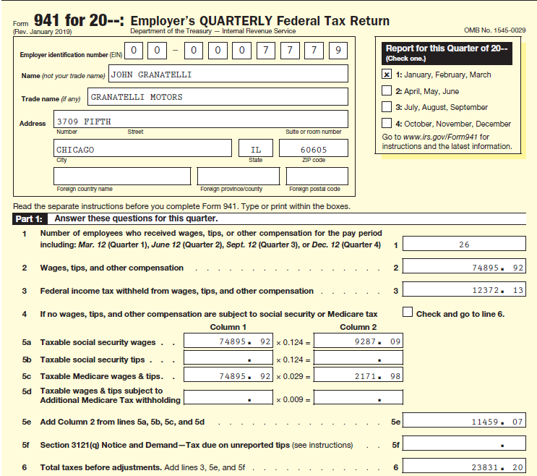
Preparing Form 941 (1 of 10)

Slide 24
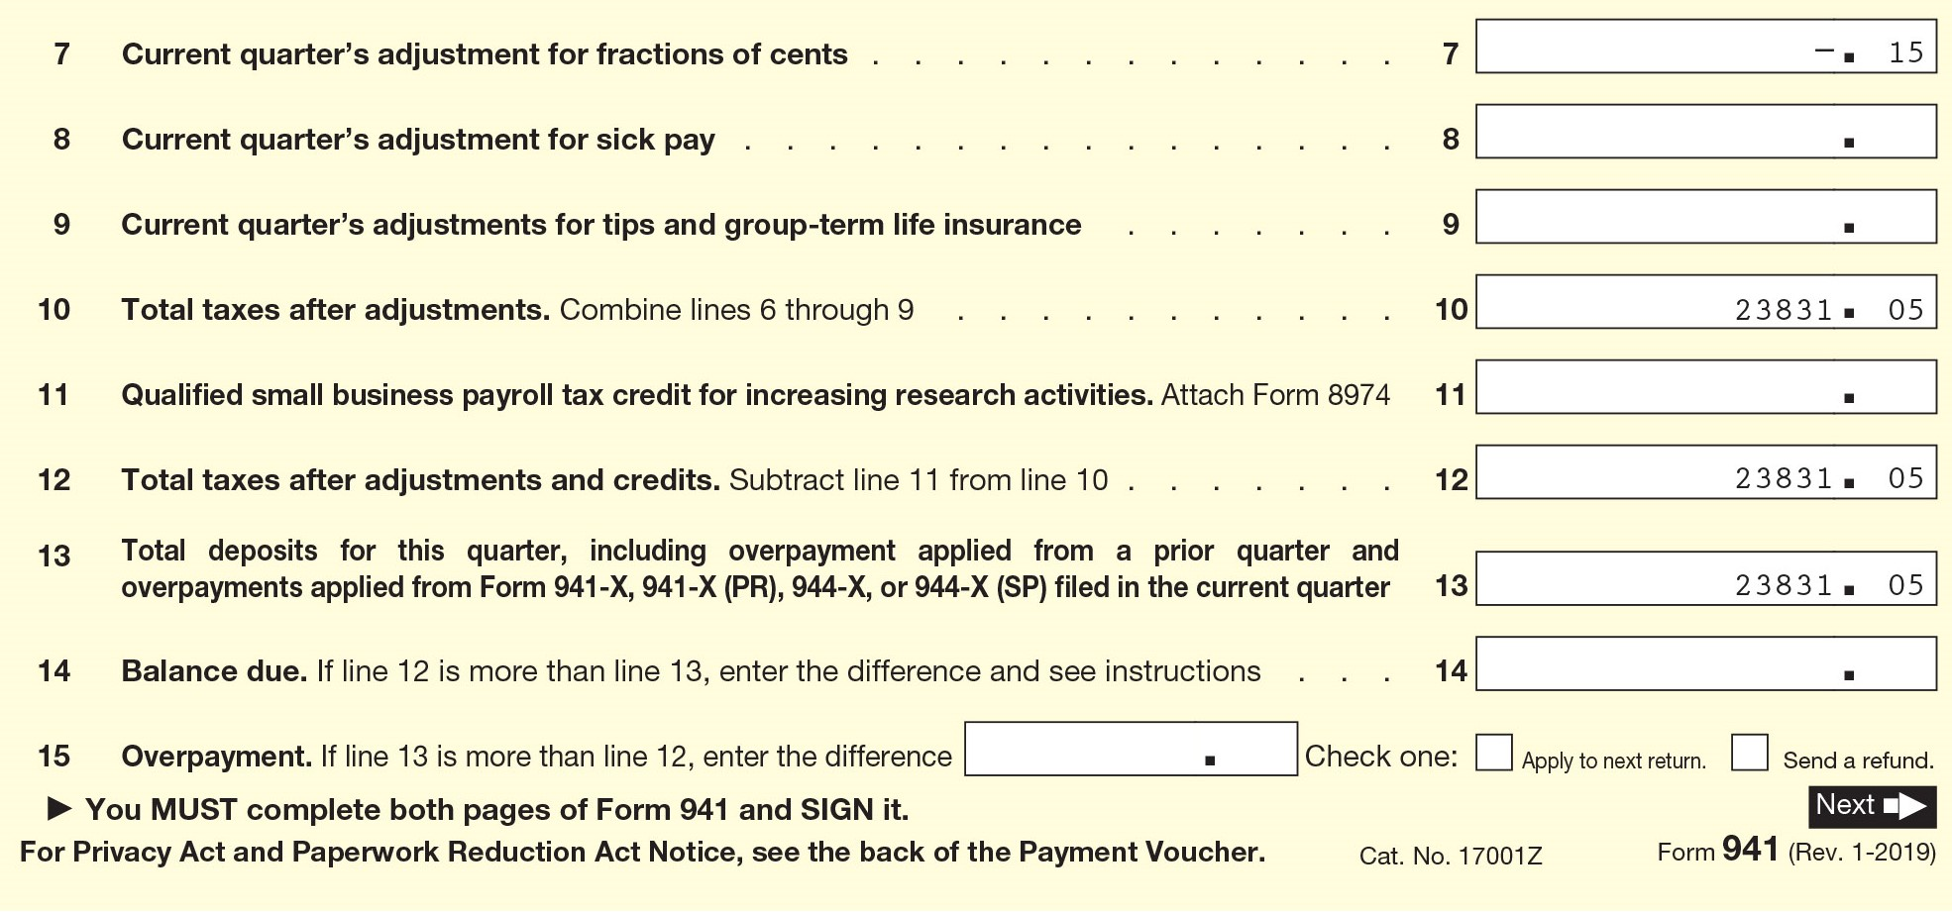
Preparing Form 941 (2 of 10)

Slide 25
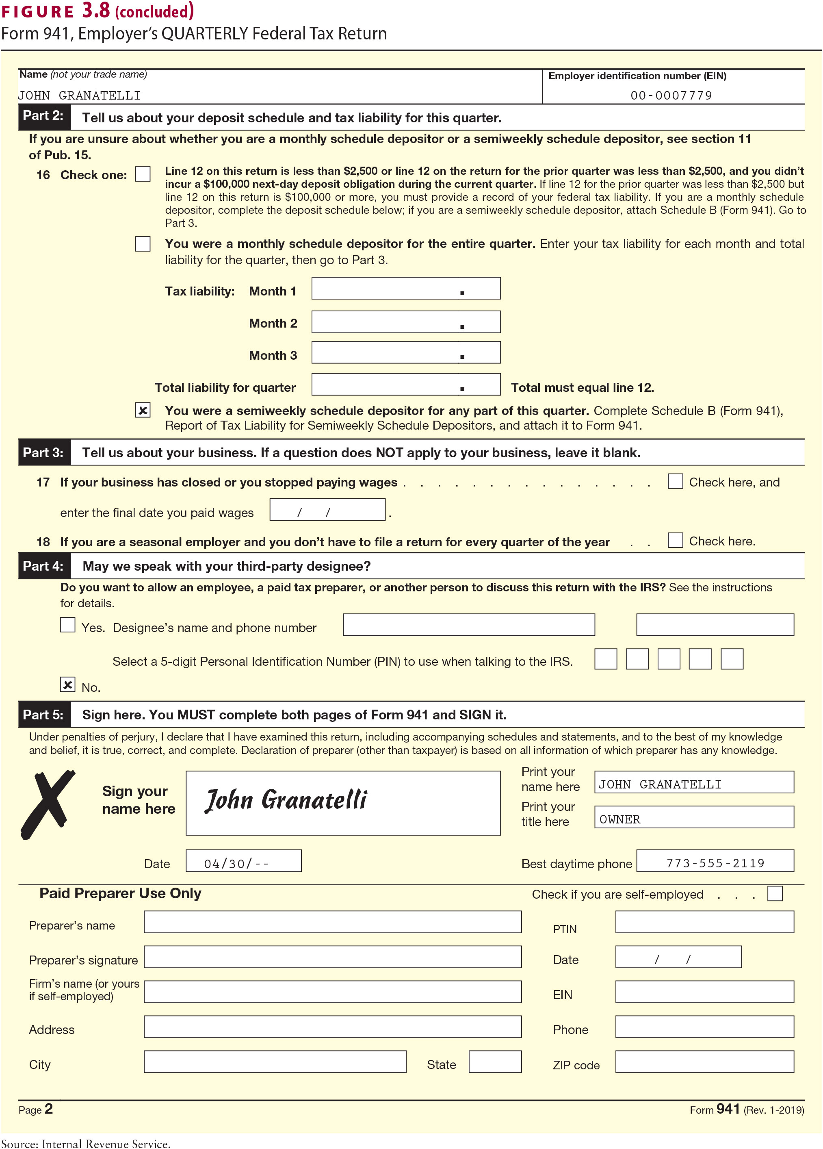
Preparing Form 941 (3 of 10)

Slide 26
Preparing Form 941 (4 of 10)
Part 1
  Most of the entries required on this part are self-explanatory. Other sources of information are shown in Figure 3.9 on page 3-25 and slides Preparing Form 941 (7 through 10 of 10). The tax adjustments and credits relate to:
    5f. Employer’s share of FICA taxes on tips reported on Form 4137, Social Security and Medicare Tax on Unreported Tip Income
    7. Fractions of cents—employees’ share (one-half) of amounts on lines 5(a)–5(d) may differ slightly from amounts actually withheld (due to rounding)
    8. Sick pay—adjustment for employees’ share of FICA taxes that were withheld by third-party sick pay payer
    9. Tips and group-term life insurance—uncollected FICA taxes on tips and group-term life insurance premiums
    11. Qualified small business payroll tax credit for increasing research activities

Slide 27
Preparing Form 941 (5 of 10)
Part 2
  16. Check the appropriate box. If the monthly schedule applies, enter a summary of your tax liability by month.
  In addition, semiweekly and next-day depositors must complete Schedule B of Form 941, Report of Tax Liability for Semiweekly Schedule Depositors, instead of Form 941, line 16 (if the tax liability for the quarter was $2,500 or more). The employer’s tax liability is listed by each payday (see Figure 3.10 on page 3-26).
Part 3
  17. and 18. Complete if either situation applies.
Part 4
  Complete if the employer wants to allow an employee, a paid tax preparer, or another person to discuss Form 941 with the IRS.

Slide 28
Preparing Form 941 (6 of 10)
Part 5
  The form must be signed by the employer or other person who is required to withhold and pay the tax. If the employer is:
    1. An individual, the return should be signed by that person.
    2. A corporation, the return should be signed by its president, vice president, or other principal officer authorized to sign the return. Corporate officers or duly authorized agents may use facsimile signatures under certain conditions.
    3. A partnership or other unincorporated organization, a responsible and duly authorized partner or officer having knowledge of the firm’s affairs should sign the return.
    4. A trust or estate, the return should be signed by the fiduciary of the trust or estate.
    5. A political body, such as a state or territory, the return should be signed by the officer or employee having control of the wage payments or officer properly designated for that purpose.
    6. An agent, who pays the wages for the employer, may be authorized by the employer to sign the appropriate tax returns.

Slide 29
Preparing Form 941 (7 of 10)
Line Number | Source of Information
1 | Payroll register
2 | General ledger accounts for wages and salaries; Forms 4070, or employees’ written statements reporting cash tips.
3 | General ledger accounts
4 | General ledger balances
5a | Payroll register; include any social security taxes (OASDI) paid for employees, sick pay, and taxable fringe benefits subject to OASDI. Do not include any tips. Do not report any employees’ wages that exceed $132,900, the taxable wage base for 2019.
5b | Forms 4070, or employees’ written statements to report cash tips. Enter all tips reported until tips and wages for each employee reach $132,900. Report this information even if you are unable to withhold the employee OASDI tax. Do not include allocated tips, which should be reported on Form 8027.
5c | Payroll register; Forms 4070, or employees’ written statements to report cash tips. Report amounts paid to certain federal, state, and local government employees who are subject only to the HI portion of the FICA tax.

Slide 30
Preparing Form 941 (8 of 10)
Line Number | Source of Information
5d | Payroll register; enter all wages, tips, sick pay, and taxable fringe benefits that are subject to additional Medicare tax withholding. You are required to begin withholding additional Medicare tax in the pay period in which you pay wages in excess of $200,000 to an employee and continue to withhold it each pay period until the end of the calendar year. Additional Medicare tax is only imposed on the employee. There is no employer share of additional Medicare tax. All wages that are subject to Medicare tax are subject to additional Medicare tax withholding if paid in excess of the $200,000 withholding threshold.
5e | Add lines 5a, 5b, 5c, and 5d.
5f | Enter the tax due from Notice and Demand on line 5f. The IRS issues a Notice and Demand to advise an employer of the amount of tips received by employees who failed to report or underreported tips to the employer.
6 | Add lines 3, 5e, and 5f.

Slide 31
Preparing Form 941 (9 of 10)
Line Number | Source of Information
7 | To adjust for fractions of cents: If there is a difference between the total tax on line 6 and the total deducted from your employees’ wages or tips plus the employer’s tax on those wages or tips (general ledger accounts) because of fractions of cents added or dropped in collecting the tax, report the difference. Enter this difference in the space for “Fractions of Cents.” If a negative number is to be used, use a minus sign —.
8 | To adjust for the tax on third-party sick pay: Deduct the social security tax on third-party sick pay for which you are not responsible. Enter the amount of the adjustment in the space for “Sick Pay.”
9 | To adjust for the tax on tips and group-term life insurance: Include the total uncollected employee social security tax for lines 5b and 5d.
10 | Total of lines 6 through 9.
11 | Enter qualified small business payroll tax credit for increasing research activities. Attach Form 8974.
12 | Subtract line 11 from line 10.

Slide 32
Preparing Form 941 (10 of 10)
Line Number | Source of Information
13 | General ledger accounts, previous Form 941; record the total deposits for the quarter, including any overpayment applied from previous quarter.
14 | Compute balance due by subtracting line 13 from line 12. Pay the balance due IRS.
15 | Compute overpayment by subtracting line 13 from line 12 and indicate if amount is to be applied to the next return or refunded.

Slide 33
How to Report and Reconcile FIT/FICA
Make deposit with Form 941 if taxes for quarter are less than $2,500
  Use 941-V when making payment or can pay by credit card
Electronic filing options available for employers who meet requirements
  Complete an e-file application; then electronically submit 941 or
  Apply for a PIN on IRS website and file electronically through third-party transmitter or
  Can use reporting agent (file clients’ Forms 941 electronically)
Can correct errors on previously filed Form 941s by filing Form 941-X

Slide 34
Types of Penalties
Failure-to-comply penalties will be added to tax and interest charges; negligence can also result in fines/imprisonment
  Interest rate is set quarterly, based on short-term Treasury bill rate
Penalties imposed for:
  Not filing employment tax returns on time
  Not paying full taxes when due
  Not making timely deposits
  Not furnishing payee statements to employees/contractors on timely basis
  Not filing information returns with IRS on time
  Not supplying identification numbers

