Slide 1
Payroll Accounting 2020
Bernard J. Bieg and Judith A. Toland

Slide 2
Income Tax Withholding
Chapter 4

Slide 3
Learning Objectives
Explain coverage under the Federal Income Tax (FIT) Withholding Law by determining: (a) the employer-employee relationship, (b) the kinds of payments defined as wages, and (c) the kinds of pretax salary reductions.
Explain: (a) the types of withholding allowances that may be claimed by employees for income tax withholding and (b) the purpose and use of Form W-4.
Compute the amount of federal income tax to be withheld using: (a) the percentage method; (b) the wage-bracket method; (c) alternative methods such as quarterly averaging, annualizing of wages, and part-year employment; and (d) withholding of federal income taxes on supplementary wage payments.
Explain: (a) Form W-2, (b) the completion of Form 941, Employer’s Quarterly Federal Tax Return, (c) major types of information returns, and (d) the impact of state and local income taxes on the payroll accounting process.

Slide 4
Coverage Under FIT Withholding Laws
Employee-employer relationship must exist for FIT withholding laws to apply
  See Chapter 3 for guidance on determining status
Statutory nonemployees have no federal taxes withheld
  Direct sellers and qualified real estate agents
Taxable wages for FIT withholding purposes – gross amount of following items are taxable
  Wages and Salaries
  Vacation allowances
  Supplemental payments
  Bonuses and Commissions
  Tips
  Cash awards
  Taxable fringe benefits (discussed in greater detail on slides 7-8)
  See Figure 4.1 on next two slides for special types of taxable payments subject to federal income tax withholding

Slide 5
Figure 4.1 Taxable Payments to Employees (1 of 2)
Disabled Worker’s Wages – Withhold for wages paid after the year in which the worker became entitled to disability insurance under the Social Security Act.
Drawing Account Advances – Advance payments to salespersons against their commissions or unearned salaries for which they are to perform services, but for which they are not legally obligated to repay.
Gift Certificates (cards) – Considered cash equivalent, and therefore taxable.
Meals and Lodging – Unless furnished for the employer’s convenience and on the employer’s premises, as a condition of employment. Cash allowances for meals and lodging are taxable. If more than half of the meals provided to employees on the employer’s premises are for the convenience of the employer, then these meals are treated as for the employer’s convenience.
Moving Expenses – Nonqualified reimbursed and employer-paid expenses are subject to withholding. Nonqualified expenses include cost of sale of old residence, purchase of new residence, house hunting, temporary living expenses, and meals. See Figure 4.2 (slides 12-15) for exempt reimbursements to members of U.S. Armed Forces.

Slide 6
Figure 4.1 Taxable Payments to Employees (2 of 2)
Partially Exempt Employment – If the employee spends half or more time in a pay period performing services subject to employment taxes, all pay in that pay period is taxable.
Payments to Nonresident Aliens – Subject to withholding (unless excepted by regulations).
Scholarship – Cash or reduced tuition is taxable if paid for teaching, research, or other services as a condition of receiving the scholarship.
Sick Pay – Subject to withholding whether paid by the employer or third party (to the extent of the employer’s contribution into the plan).
Supplemental Unemployment Compensation – To the extent it is includible in an employee’s gross income. It does not include separation due to disciplinary problems or age.
Travel and Business Expenses (nonaccountable plans) – If (1) the employee is not required to or does not substantiate expenses with receipts or (2) the employee receives travel advances and does not or is not required to return any unused amount of the advance.

Slide 7
Fringe Benefits (1 of 2)
Subject to income tax withholding unless specifically excluded
  Equals fair market value of benefits minus payment by employer
  Examples of noncash fringe include
  Tickets to athletic events
  Athletic club membership
  Personal use of corporate car
  Frequent flier miles
  Vacations
Specifically excluded fringe benefits include
  Qualified employee discounts
  Use of on-premises athletic facilities
  Reduced tuition, meals & lodging for employer benefit
  De minimis fringe benefits (like personal use of corporate cell phone)
  Complete list on page 4-4 or consult Publication 15 (Circular E), Employer’s Tax Guide

Slide 8
Fringe Benefits (2 of 2)
How to withhold FIT on fringe benefits
  Value fringe benefits and withhold tax at supplemental wage rate (flat 22%)
  OR
  Value fringe benefits and add to regular wages - treat as one paycheck and withhold on total
Flexible reporting of fringe benefits – option of treating benefits as being paid on one or more dates in the same calendar year
  Example - Can add entire $2,000 value of country club membership or add $500 to 4 paychecks – then calculate withholding accordingly

Slide 9
FIT Withholding on Tips
Employee must report cash tips to employer by 10th of the month following the month of receipt (if more than $20 in a month)
Employer collects income tax and social security taxes on these “reported tips”
In food/beverage establishments with more than 10 employees, employer must allocate tips
  If total tips reported by employees are less than 8% of that establishment’s gross receipts
  Allocated tips = Reported tips minus 8% of gross receipts
      Gross receipts should exclude carryout sales and those that already have 10%+ service charge added
Employer is not required to withhold taxes on allocated tips - only reported tips
Tip allocation can be done using one of three methods – hours worked, gross receipts, good faith agreement

Slide 10
Traveling Expenses
Reimbursement of travel expense to an employee, paid under an “accountable plan,” are not subject to FIT withholding
  An accountable plan is an approved plan that must meet three IRS-sanctioned rules
  If there is no plan in place, travel reimbursements are made under a nonaccountable plan and considered wages
  Therefore employer must withhold FIT

Slide 11
Payments Exempt from Withholding
Law excludes certain payments such as
  Payment received by church ministers for their services
  Advances for travel and other business expenses
  Educational assistance if it maintains/improves job status
    $5,250 per year of employer provided assistance for undergraduate and graduate is tax-free (also applies to down-sized employees)
  Moving expense reimbursements for active military
  Transportation in a commuter highway vehicle/transit pass up to $265/month
    See Figure 4.2 on the next slides for comprehensive list of exempt payments

Slide 12
Figure 4.2 Exempt Payments (1 of 4)
Type of Payment or Individual | Conditions
Advances | For travel and other business expenses reasonably expected to be incurred.
Accident and Health Insurance Payments | Exempt except 2% shareholder-employees of S corporations.
Deceased Person’s Wages | Paid to the person’s beneficiary or estate.
Dependent Care Assistance | To the extent it is reasonable to believe the amounts will be excludable from gross income. Up to $5,000 can be excluded from an employee’s gross income without being subject to social security, Medicare, or income tax withholding.
Domestic Service | Private home, local college club, or local chapter of college fraternity or sorority.
Educational Assistance | If education maintains or improves employee’s skills required by the job. For the non–job-related educational assistance, up to $5,250 per year of employer-provided assistance for undergraduate and graduate education is tax-free. Also applies to “downsized” employees and can be used after voluntary or involuntary termination.

Slide 13
Figure 4.2 Exempt Payments (2 of 4)
Type of Payment or Individual | Conditions
Employee Business Expense Reimbursements | Accountable plans for amounts not exceeding specified government rates for mileage, lodging, meals, and incidental expenses.
Employee-Safety and Length-of-Service Awards | If merchandise costs $400 or less. Rises to $1,600 for a written nondiscriminatory plan.
Employer-Provided Parking | Up to $265 per month.
Foreign Service by U.S. Citizens | As employees for affiliates of American employers if entitled to exclusion under section 911 or required by law of foreign country to withhold income tax on such payment.
Group-Term Life Insurance Costs | The employer’s cost of group-term life insurance less than $50,000.
Health Reimbursement Arrangements (HRA) | As long as no person has the right to receive cash or any other taxable or nontaxable benefit other than medical care reimbursement.

Slide 14
Figure 4.2 Exempt Payments (3 of 4)
Type of Payment or Individual | Conditions
Individuals Under 18 | For delivery or distribution of newspapers, shopping news, and vendors of newspapers and magazines where payment is the difference between the purchase and sales price.
Long-Term Care Insurance Premiums | Employer-paid premiums for long-term care insurance up to a limit. For example, for an employee age 40 or under, the first $420 of premiums are nontaxable.
Ministers of Churches, Members of Religious Orders | Performing services for the order agency of the supervising church or associated institution.
Moving Expense Reimbursements | No longer exempt, except for active military.
Public Officials | For fees only, not salaries.

Slide 15
Figure 4.2 Exempt Payments (4 of 4)
Type of Payment or Individual | Conditions
Retirement and Pension Plans | Employer contributions to a qualified plan. Employer contributions to IRA accounts under an SEP [see section 402(g) for salary reduction limitation]. Employer contributions to section 403(b) annuity contract [see section 402(g) for limitation]. Elective contributions and deferrals to plans containing a qualified cash or deferred compensation arrangement, such as 401(k).
Sickness or Injury Payments | Payments made under workers’ compensation law or contract of insurance.
Transportation in a Commuter Highway Vehicle and Transit Pass | Up to $265 per month.

Slide 16
Pretax Salary Reductions are Exempt from FIT
Contribution to cafeteria plans
  Employee can choose between cash (pay) or qualified (nontaxable) benefits (for list of potential benefits see next slide)
Contribution to Flexible-Spending Accounts
  In 2019, employee can put up to $2,700 pretax dollars per year into a trust account for out of pocket health care costs
  These dollars do not have FIT or FICA withheld
  They are forfeited by participants if not used
Health Savings Accounts (HSA)
  If employee has high-deductible health insurance (for 2020 – $1,400 for self-only coverage and $2,800 for family coverage), can contribute annually to an HSA to meet out-of-pocket medical bills
Archer Medical Savings Accounts
  For employees of small business that have high-deductible insurance plans

Slide 17
Cafeteria Plans
The following benefits may be included in the plan:
  Accident and health insurance
  Self-insured medical reimbursement plan
  Group-term life insurance (first $50,000 of coverage)
  Dependent care assistance (first $5,000)
  Health savings accounts
These benefits cannot be included in a cafeteria plan:
  Transportation fringe benefits
  Educational assistance
  Scholarships and fellowship grants
  Meals and lodging for the convenience of employer
  Dependent group-term life insurance
  Deferred compensation except for 401(k) contributions

Slide 18
Tax-Deferred Retirement Contributions Exempt from FIT
Contributions to tax-deferred retirement accounts are monies set aside from current paychecks that will be paid out to employee upon retirement (and at that point subject to FIT).
  Types of retirement plans - contributions are made from pretax
    401(k), Sec. 403(b), Sec. 457(b) or SIMPLE plans
      However, employer must still withhold and match FICA
Individual Retirement Accounts (IRA)
  In 2019, depending upon certain conditions, an employee can contribute lesser of $6,000 or 100% of pretax income to a retirement account, subject to phaseouts
    Different limits if self or spouse are active participants in qualified retirement plan at work
    Additional “make up amounts” allowed to be contributed if age 50 or older (see page 4-9 for 2019 annual contribution amounts)
  Roth IRAs are used for nondeductible contributions

Slide 19
Withhold Allowances
Best for employee if FIT withholding = tax liability (the goal is no refund and no tax due)
  Employee completes W-4
    See W-4 (Employee’s Withholding Allowance Certificate) in Figure 4.4 (see next few slides)
    See www.irs.gov/W4 for updates to Form W-4
    The W-4 identifies number of withholding allowances an employee can take:
      One allowance for self and each qualified dependent (if not claimed by other person with certain stipulations – see slide 29)
      One allowance for each dependent (other than a spouse)
      Special withholding allowances
All these allowances are calculated on worksheet on back of W-4 and include items such as itemized deductions, other compensation, tax credits, etc.
Employer must retain W-4 as long as it’s in effect, and for four years thereafter

Slide 20
Completing Form W-4 (1 of 4)
Choose “Single” or “Married” or “Married, but withhold at higher Single rate” box
  Q: Why would an EE choose the last option listed above? (line 3 of Form W-4)
  A: Two wage-earner married couple or a married employee with more than one employer may elect to have her/his federal withholding computed at the single rate to increase the amount of income tax withheld.
    Note: IRS doesn’t pay interest on over-withheld taxes. If using as a means to save, it is better to calculate the difference between married or married but withhold at higher single rate, and invest it yourself.

Slide 21
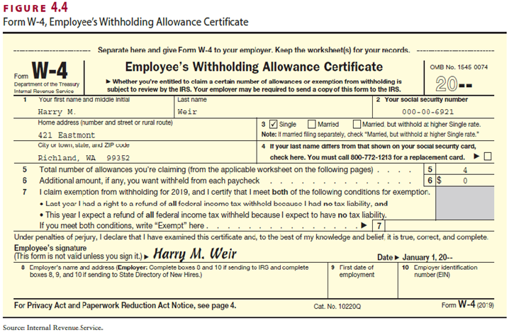
Completing Form W-4 (2 of 4)

Slide 22
Completing Form W-4 (3 of 4)
Exempt status
  Can claim if taxpayer had no income tax liability last year and none expected this year (line 7 of Form W-4)
  Exemption is valid for one year
Person can’t claim exempt if:
  Dependent on someone else’s tax return and
    Income exceeds $1,100 (including more than $350 unearned income)
    OR
    Unearned income < $350, but total income > $12,200
Some individuals are automatically exempt
Note: Never advise employee as to how many allowances to claim

Slide 23
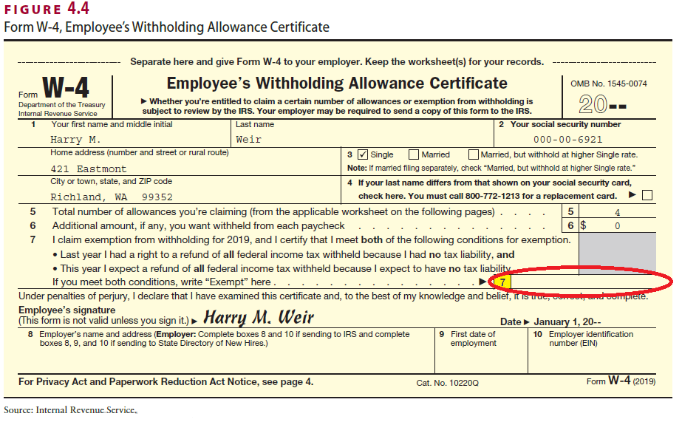
Completing Form W-4 (4 of 4) [Line 7]

Slide 24
Other Situations on W-4
If employee doesn’t provide a completed W-4, employer must withhold as if the employee is single and has zero allowances (highest rate)
Employee can change W-4
  When employer receives amended W-4, has 30 days to replace the form
  Employee must change within 10 days for decrease in number of allowances
  If there’s an increase in number of allowances, can change or leave in effect
Additional/voluntary withholding agreements
  Create additional FIT withholding by either reducing number of allowances or request specific additional amount be withheld on line 6 of W-4
Employer can establish electronic W-4 system, but must provide paper option if employee requests
Unauthorized changes/additions invalidate W-4
Employers should submit W-4s to IRS only when requested
Penalties imposed for willfully and falsely filing Form W-4s
  In addition to any other penalty, subject to fines of up to $1,000 or imprisonment for up to one year or both
  Employees subject to $500 civil penalty for claiming excess deductions

Slide 25
FIT Withholding on Other Income Sources
Pensions in excess of $24,396 per year (W-4P)
  Withhold as if the recipient is married and claiming 3 allowances, unless the employee chooses to have no withholdings or a different amount to be withholded.
Payment of sick pay by third party (W-4S)
Government payments, such as social security benefits (W-4V)
  This request is voluntary

Slide 26
Employer Calculation of FIT Withholding
Wage-bracket method (easiest) or
Percentage method
  Applicable to highly compensated individual
There are other methods, rarely used, for withholding
All these methods require data related to
  Single/married, how often paid, gross pay and number of allowances

Slide 27
Example #1 Calculating FIT Withholding
FACTS: Noni’s annual salary is $40,144 – she is paid biweekly and her W-4 shows “Married with 4 allowances.” What is her FIT withholding?
  Biweekly gross $40,144/26 = $1,544.00
  Can use wage bracket tables to look up married, biweekly and 4 allowances
  FIT withholding = $45

Slide 28
Example #2 Calculating FIT Withholding
FACTS: John earns an annual salary of $84,400 and is paid biweekly. His W-4 shows “Married with 2 allowances.” What is his FIT withholding?
  Biweekly gross is $84,400/26 = $3,246.15
  Must use percentage method; steps are as follows:
  Subtract allowance amount [From Table of Allowances on page T-2 ($161.50 * 2 = $323.00)] from gross
    $3,246.15 – $323.00 = $2,923.15
  FIT equals $74.60 + (.12)($2,923.15 – 1,200.00) = $281.38

Slide 29
Example #3 Calculating FIT Withholding
FACTS: Maggie earns an annual salary of $336,000 and is paid monthly. Her W-4 shows “Married with 2 allowances .” What is FIT withholding?
  Monthly gross is $336,000/12 = $28,000.00
  Must use percentage method, steps are as follows: Subtract allowance amount (monthly allowance for 2) from gross
    $28,000.00 – (2 x $350.00) = $27,300.00
  FIT equals $2,397.14 + (.24)($27,300.00 – $15,017.00) = $5,345.06

Slide 30
Example #4 Calculating FIT Withholding
FACTS: Belinda earns a monthly salary of $3,000 and is paid biweekly. Her W-4 says “Single with 2 allowances.” What is her FIT withholding?
  Annualize salary $3,000 x 12 = $36,000
  Biweekly gross $36,000/26 = $1,384.62
  Can use wage bracket tables to look up single, biweekly and 2 allowances
  FIT withholding = $102

Slide 31
Example #5 Calculating FIT Withholding
FACTS: Ferhart’s annual salary is $485,000 – he is paid semimonthly. His W-4 says “Married with 4 allowances.” What is his FIT withholding?
  Semimonthly gross is $485,000/24 = $20,208.33
  Must use percentage method, steps are as follows:
    Subtract allowance amounts (semimonthly allowance for 4) from gross
      $20,208.33 – (4 x $175.00) = $19,508.33
    FIT equals $3,885.74 + (.35)($19,508.33 – $17,500.00) = $4,588.66

Slide 32
Supplemental Wages Withholding
Vacation pay (treated differently than other supplemental wages)
  Withhold as though it were regular payroll
  If vacation pay is in lieu of taking vacation time, treat as regular supplemental wage payment and calculate tax on total as single payment
Supplemental wages paid with regular wages
  Each type of wage not indicated specifically by employer
    Withholding by employer as it were a single regular payment for payroll period
  Each type of wage is indicated specifically by employer
    Use flat rates (see below) for supplemental wages and regular withholding rate for regular earnings
      22% flat supplemental withholding
      37% for amounts in excess of $1,000,000
If amount of supplemental wages is paid separately from regular wages, Method A or Method B can be used (p. 4-21)

Slide 33
Gross-Up Supplemental Wages
If want to give an employee the intended amount of supplemental check, must “gross up” the supplemental amount
For example, an employer wants Dov, an employee, to receive a $700 net bonus check
To do: Must divide desired net check by (1.00 – Applicable tax rates)
  Supplemental W/H rate = 0.22
  OASDI tax rate = 0.062
  HI tax rate = 0.0145
  $700/[1.00 – (0.22 + 0.062 + 0.0145)] = $995.02 grossed up bonus
  Then subtract taxes to get $700 desired net bonus
Note: In many states there is a required withholding rate for state income tax

Slide 34
Wage and Tax Statement (Form W-2) (1 of 2)
Employers required to furnish Form W-2 to employees and send copies to federal and state/local governments
  Reports wages paid and amount of tax withheld
  Form W-2 is illustrated on the next slide (Figure 4.8)
  Send hard copy to employee on or before 1/31 or can post on secure web site so employee can access individual W-2
  If issuing 250+ W-2s, must file electronically, using Form 4419
Instructions for completing Form W-2 are found in Figure 4.9 (pages 4-24 and 4-25).
Various penalties for filing incorrect or late W-2s are discussed on page 4-26
When the W-2s are completed, a W-3 is prepared
  This is transmittal form; the total of employer’s Forms 941 must tie to W-3
File W-2c and W-3c if correcting errors in previously filed W-2 and W-3, respectively

Slide 35
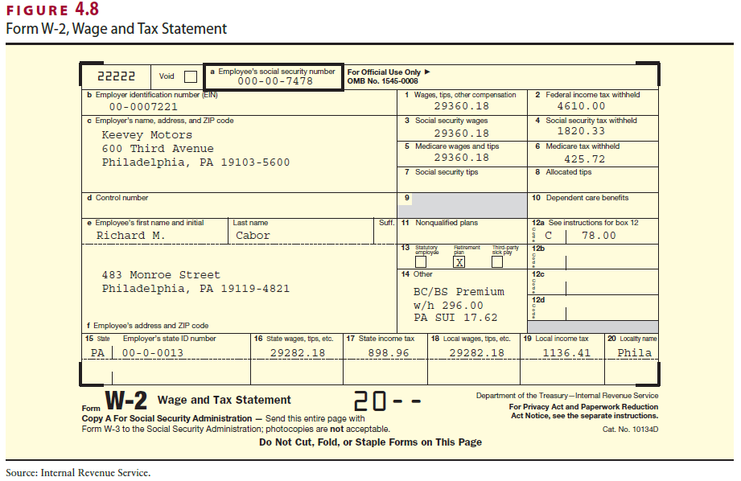
Wage and Tax Statement (Form W-2) (2 of 2)

Slide 36
Returns – Quarterly & Informational
Employers must file returns that report amount of quarterly wages and amount of taxes withheld (see the data from Figure 4.12 on following slides)
Employers must file information returns to report compensation paid to non employees (see the data from Figure 4.13 on following slides) to report tax liability for non-payroll items such as
  Backup withholding
    Occurs when individual receives interest, dividends and certain other payments and fails to provide correct taxpayer identification number
  Withholding on gambling winnings, pensions, and annuities

Slide 37
Figure 4.12 Major Returns Filed by
Employers (1 of 2)
Form 941, Employer’s Quarterly Federal Tax Return
  For reporting federal income taxes withheld during the calendar quarter and the employer and employee portions of the FICA taxes. Form 941 is illustrated in Chapter 3.
Form 943, Employer’s Annual Tax Return for Agricultural Employees
  For reporting the withholding of federal income taxes and FICA taxes on wages paid to agricultural workers. Form 943 is used for agricultural employees even though the employer may employ nonagricultural workers.

Slide 38
Figure 4.12 Major Returns Filed by
Employers (2 of 2)
Form 944, Employer’s Annual Federal Tax Return
  Replaces Form 941 for employers who owe $2,500 or less in employment taxes for the year.
Form 945, Annual Return of Withheld Federal Income Tax
  Used to report tax liability for nonpayroll items such as backup withholding and withholding on gambling winnings, pensions, and annuities, and deposits made for the year. Backup withholding occurs when an individual receives taxable interest, dividends, and certain other payments and fails to furnish the payer with the correct taxpayer identification numbers. Payers are then required to withhold 24% of those payments. Backup withholding does not apply to wages, pensions, annuities, or IRAs.

Slide 39
Figure 4.13 Major Information Returns (1 of 3)
Form 1099-DIV, Dividends and Distributions
  For reporting dividends totaling $10 or more to any person; foreign tax withheld and paid on dividends and other distributions on stock for a person; distributions made by corporations and regulated investment companies (including money market funds) as part of liquidation.
Form 1099-G, Certain Government Payments
  For reporting unemployment compensation payments, state and local income tax refunds of $10 or more, taxable grants, income tax refunds, and agricultural subsidy payments.
Form 1099-INT, Interest Income
  For reporting payments of (a) interest of $10 or more paid or credited on earnings from savings and loans, credit unions, bank deposits, corporate bonds, etc.; (b) interest of $600 or more from other sources; (c) forfeited interest due on premature withdrawals of time deposits; (d) foreign tax eligible for the recipient’s foreign tax credit withheld and paid on interest; (e) payments of any interest on bearer certificates of deposit.

Slide 40
Figure 4.13 Major Information Returns (2 of 3)
Form 1099-MISC, Miscellaneous Income (See Figure 4.13)
  For reporting miscellaneous income, such as rents, royalties, commissions, fees, prizes, and awards of at least $600 paid to nonemployees, and any backup withholding. Gross royalty payments of $10 or more must also be reported on this form. Life insurance companies may use either 1099-MISC or Form W-2 to report payments to full-time life insurance sales agents.
Form 1099-PATR, Taxable Distributions Received from Cooperatives
  For cooperatives to report patronage dividends paid and other distributions made that total $10 or more during the year.
Form 1099-R, Distributions from Pensions, Annuities, Retirement or Profit-Sharing Plans, IRAs, Insurance Contracts, etc.
  For reporting all distributions that total $10 or more from pensions, annuities, profit-sharing and retirement plans, and individual retirement arrangements made by employees’ trusts or funds; federal, state, or local government retirement system; life insurance companies.

Slide 41
Figure 4.13 Major Information Returns (3 of 3)
Form 5498, IRA Contribution Information
  For reporting contributions received from each person to an IRA or simplified employee pension plan (SEP) and qualified deductible voluntary employee contributions to a plan maintained by the employer.
Form 8027, Employer’s Annual Information Return of Tip Income and Allocated Tips
  For large food or beverage establishments to report to the IRS the receipts from food and beverage operations and tips reported by employees.

Slide 42
Form 1099-MISC
Form 1099-MISC with 1096 as transmittal - See Figure 4.14 on next slide
  Must issue to independent contractor (IC) if paying contractor at least $600 and the contractor isn’t incorporated
  IC must submit taxpayer identification number (TIN) on W-9 to hiring agent
    If this is not done, then hiring agent must withhold federal income tax = 24% of payments made
    Nonpayroll items (like withholding on military pay, pensions, IRAs, etc. ) reported on Form 945

Slide 43
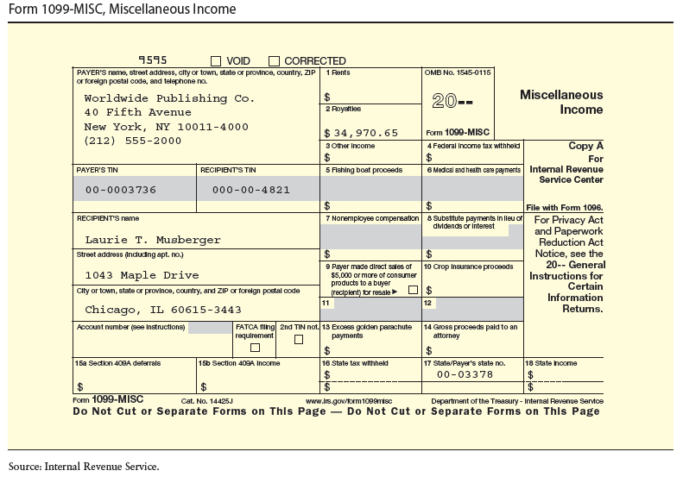
Figure 4.14 Form 1099-MISC

Slide 44
Withholding State & Local Income Taxes
Three different methods of withholding SIT – full taxation, leftover taxation and reciprocity
  Most states require employers to withhold tax from both nonresidents and residents, unless a reciprocal agreement is in place
In states with state income tax (SIT), and localities with local income tax, generally the payroll department is required to:
  File periodic withholding returns to report wages and withholding
  Prepare reconciliation returns to compare deposits to withholdings
  Send annual statements to employees to report annual wages paid and applicable taxes withheld
  Issue information returns to report payments to individuals not subject to withholding

