Slide 1
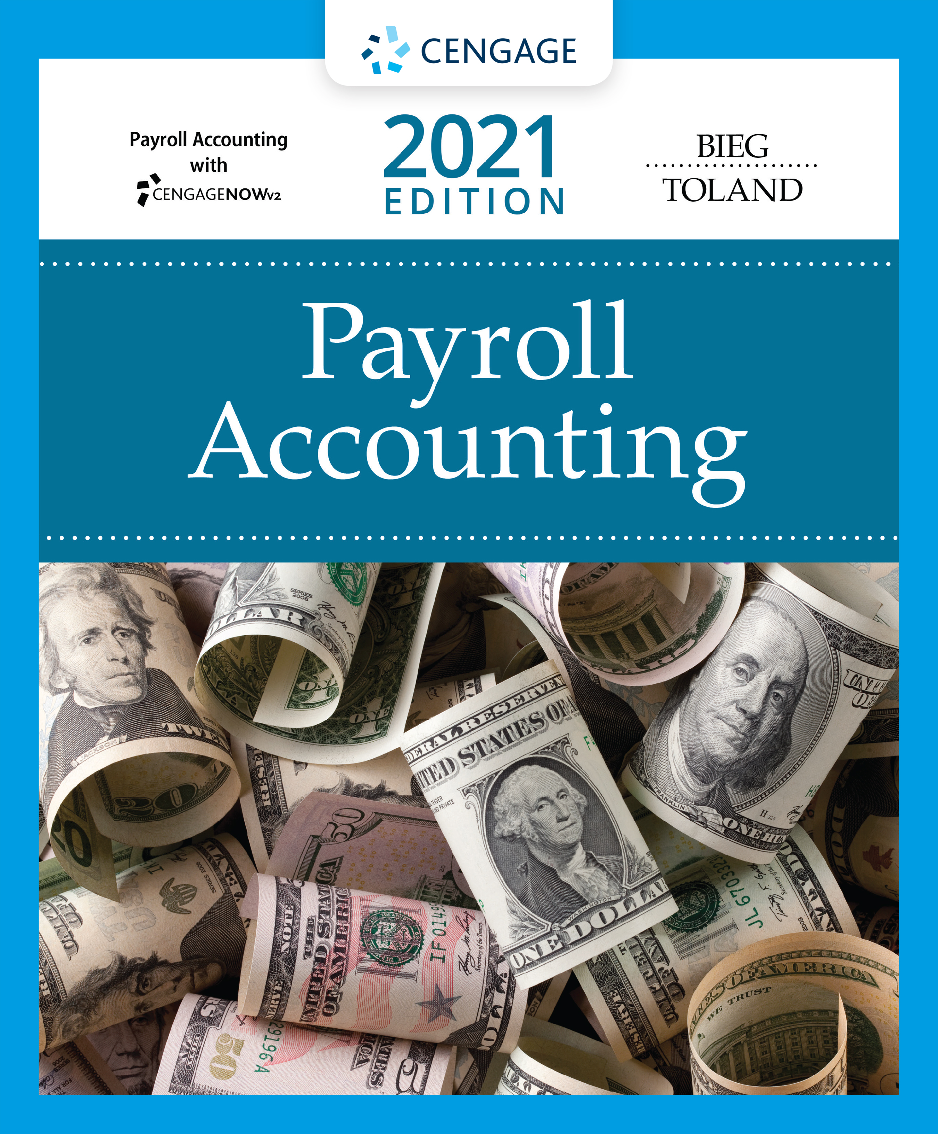
Payroll Accounting,
31e
Chapter 1: The Need for
Payroll and Personnel Records

Slide 2
Icebreaker
The class will be broken up into groups
Each group will have four students
Each group will present their idea on payroll professionals and need for maintaining the payroll records
Notes:
Task: This is an introductory exercise at the beginning of the chapter.
Objectives: To provide an informal way for participants to learn about each other and begin working together. This exercise also gives students practice in speaking in front of a group. It also helps students to brainstorm ideas about tax withholding.
Instructions: Break the class into groups. Each group will have four students.
Average Time: 30 min
Note: To adapt this activity for an online learning environment, conduct the interviews using a web conferencing tool (e.g., Zoom or Microsoft Teams). When you break the class into pairs, send the pairs into breakout rooms for 10 minutes to interview each other. When the class comes back together, give each pair 2–4 minutes to introduce each other to the rest of the class.

Slide 3
Chapter Objectives
By the end of this chapter, you should be able to:
01.01 Identify the various laws that affect employers in their payroll operations.
01.02 Examine the recordkeeping requirements of these laws.
01.03 Describe the employment procedures generally followed in a Human Resources Department.
01.04 Identify the various personnel records used by businesses and the type of information shown on each form.
01.05 Identify the payroll register and the employee’s earnings record.

Slide 4
The Payroll Profession
Payroll professionals are required to comply with numerous regulations that requires advanced knowledge
Positions within payroll profession range from payroll clerk to senior payroll manager
  Payroll managers’ salaries (per 2020 Robert Half Associates survey) range from $61,000 – $130,000
  Membership in American Payroll Association (APA) helps in keeping the professionals updated with the current changes
  “Code of Ethics” sets direction for profession (Figure 1.1)

Slide 5
Figure 1.1 APA Code of Ethics
To be mindful of the personal aspect of the payroll relationship between employer and employee, and to ensure that harmony is maintained through constant concern for the Payroll Professional’s fellow employees
To strive for perfect compliance, accuracy, and timeliness of all payroll activities
To keep abreast of the state of the payroll art with regard to developments in payroll technologies
To be current with legislative developments and actions on the part of regulatory bodies, insofar as they affect payroll
To maintain the absolute confidentiality of the payroll within the procedures of the employer
To refrain from using Association activities for one’s personal self-interest or financial gain
To take as one’s commitment the enhancement of one’s professional abilities through the resources of the American Payroll Association
To support one’s fellow Payroll Professionals, both within and outside one’s organization

Slide 6
Many Laws Affect Payroll
Fair Labor Standards Act (FLSA)
  States’ Minimum Wage and Maximum Hour Laws
Federal Insurance Contributions Act (FICA)
Income tax Withholding Laws
  Federal, State and Local
Unemployment Tax Acts
Fair Employment Laws
  Civil Rights Act of 1964
  Age Discrimination in Employment Act
  Americans with Disabilities Act
Other Federal Laws
Other State Laws

Slide 7
Fair Labor Standards Act (FLSA)
Federal Wage & Hour Law of 1938
Minimum wage is $7.25/hour
Equal pay for equal work provisions
Sets law for employers involved
  In interstate commerce or
  In production of goods/services for interstate commerce
Requires payroll records be maintained
Covered in greater detail in Chapter 2

Slide 8
Federal Insurance Contributions Act (FICA)
Comprised of two taxes
  OASDI (Old Age & Survivors’ Trust Fund & the Federal Disability Insurance Trust Fund)
  HI (Health Insurance Plan - Medicare)
Both taxes paid by employer and employee
Imposes tax on net earnings of the self-employed individuals
Covered in greater detail in Chapter 3

Slide 9
Income Tax Withholding Laws
Federal income tax
  Levied on earnings of employees
  Is withheld from paychecks
  Percentage formula or Wage bracket chart used to withhold tax
State and local income tax
  Is withheld from paychecks
  Different in each state
  Not all states have state income tax
Covered in greater detail in Chapter 4

Slide 10
Unemployment Tax Acts
FUTA (Federal Unemployment Tax Act)
  Employer tax
  Taxes used to pay state and federal administrative expenses, not used to pay unemployment benefits
SUTA (State Unemployment Tax Act)
  Mandatory unemployment insurance – for each state it is different
  Social Security Act outlines standards that each state’s unemployment compensation law must follow
  Used to pay unemployment benefits
Covered in greater detail in Chapter 5

Slide 11
Knowledge Check Activity 1
According to the Fair Labor Standards Act (FLSA), what is the minimum wage rate per hour?
$6.75
$7.25
$8.00
$8.25
Notes:
Present slide information with possible answers and have students select an answer.

Slide 12
Knowledge Check Activity 1: Answer
According to the Fair Labor Standards Act (FLSA), what is the minimum wage rate per hour?
Answer: b. $7.25
According to the Fair Labor Standards Act (FLSA), referred to as the Federal Wage and Hour Law, the minimum wage is $7.25 per hour.
The act also deals with overtime pay requirements, equal pay for equal work, employment of child labor, public service contracts, and wage garnishment.

Slide 13
Fair Employment Laws
Title VII of the Civil Rights Act of 1964, entitled EEO (Equal Employment Opportunity)
  Prohibits discrimination in hiring, firing, promoting or compensating based on color, race, religion, national origin or gender
    Unions may not exclude/segregate members on above bases
  Sexual harassment is also prohibited
  Applies to all employers who engage in an industry “affecting commerce” and employ 15 or more workers in each of 20 or more weeks in the current or preceding calendar year
Civil Rights Act of 1991 – compensatory and punitive damages in cases where discrimination is intentional
See U.S. Equal Employment Opportunity Commission for more information

Slide 14
Age Discrimination in Employment Act (ADEA)
Age Discrimination in Employment Act of 1967 states that employers, employment agencies, and labor unions cannot use age to discriminate in hiring, firing or promoting
  Applies to employers engaged in interstate commerce with 20 or more workers
  Provides protection to workers over 40 years old, with a few key exceptions
  Exception is executives 65 years or older who have held high policy making positions during two-year period prior to retirement and are entitled to an annual retirement benefit of at least $44,000
    Such employees can be forcibly retired.
Places onus on employer to keep accurate personnel and payroll records

Slide 15
Americans with Disabilities Act (ADA)
ADA of 1990 prohibits employers with 15 or more employees, employment agencies, labor organization, or joint labor management committees from discriminating against qualified (defined as persons who can perform essential functions of the job with or without reasonable accommodation) persons based upon disability
The prohibition of disability-based discrimination applies to job application procedure, hiring, advancement, termination, compensation, job training, and other conditions of employment
Reasonable accommodations, such as wheelchair-accessible restrooms and ramps for qualified disabled job applicants and workers, must be provided

Slide 16
Federal Personal Responsibility & Work Opportunity Reconciliation Act of 1996
Requires employers to report information on all new hires within 20 days of hire to state agency
  Includes name, address and social security number (submitting copy of W-4 suffices in many states)
  Records are coordinated through federal Office of Child Support Enforcement (OCSE)
  Fines up to $25/new hire levied for failure to report
  A few states now require same information for independent contractors
Used to help enforce child support obligations

Slide 17
Immigration Reform and Control Act of 1986 (IRCA)
Law that bars hiring and retaining aliens unauthorized to work in U.S.
Employees have to complete Form I-9 (Employment Eligibility Verification)
  Employers can photocopy I-9 documents; however, if done, photocopying should apply to all new employees
  Section 1 of the form should be signed by the employee no later than first day of employment
  Section 2 must be signed by the employer within three business days of the employee’s first day of employment.
U.S. Citizenship & Immigration Services may audit and levy civil penalties for recordkeeping violations
E-Verify is a government-run system that allows employers to check employment eligibility of new hires by cross matching Form I-9 information with the Social Security Administration and Department of Homeland Security
  Voluntary program, although federal contracts contain E-Verify clause and 20 states require for some or all employees

Slide 18
Family and Medical Leave Act (FMLA) of 1993
Covers employers with 50 or more employees within 75-mile radius for at least 20 weeks in the current or preceding calendar year
Employee guaranteed 12 weeks unpaid leave for birth, adoption, critical care for child, spouse or parent
  Leave may be used all at once or at separate times – within 12 months of qualifying event
  Employer must continue health-care coverage and guarantee right to return to same job or comparable position
Federal tax credits now available for employers that provide paid family/medical leave to their employees (up to 12 weeks)
FMLA expanded to include up to 12 weeks when family member is on active duty or up to 26 weeks for line of duty injury/illness
Employers can exempt employees in specific situations
Some states have paid family leave plans

Slide 19
Employee Retirement Income Security Act (ERISA)of 1974
Legislation that safeguards pension funds and ensures workers covered by private pension plans receive benefits in accordance with their credited years of service
  Trustees must monitor pension plans
  Vested 100% in 3 or 6 years (graduated)
    See sample in table
Stringent recordkeeping required
Employee is eligible after reaching age 21 or completing one year of service, whichever is later
Employer must file Form 5500 annually
Provides for Pension Benefit Guaranty Corporation
  A federal agency which guarantees benefits to employee if plan can’t pay benefits
Years of Service | % Vested in Plan
2 | 20%
3 | 40%
4 | 60% etc.

Slide 20
Affordable Care Act (ACA) of 2010
ACA consists of two pieces of legislations (Note: In 2017 legislation requiring coverage for individuals and dependents was repealed. As we go to press, the ACA faces an uncertain future.)
  Health Care and Education Reconciliation Act (HCERA)
  Patient Protection & Affordable Care Act
Designed to expand health insurance coverage while increasing benefits and lowering costs
State-based health insurance exchanges established for those who don’t have employer-provided coverage or are ineligible for public programs like Medicaid
Applicable large employers (ALEs) with 50+ full-time employees are required to report (on Form 1095-C) to both full-time employee and IRS
Small employers (less than 50 employees) can purchase affordable insurance through Small Business Health Options Program and may also receive a tax credit (if pay at least 50% of cost for premiums for single coverage)

Slide 21
Other State Laws
Workers’ Compensation Laws
  The Law protects employees and their dependents against losses due to work-related injury, illness, or death
  Most states require employers to pay employees’ premiums
    Can self insure if state approved
      The company bears all risk itself
    Different premiums based upon job class
State Disability Benefit Laws
  Five states plus Puerto Rico have established laws requiring employers to provide disability benefits
  This applies even if the disability, illness or disease did not arise due to employment

Slide 22
Human Resource & Payroll Accounting Systems
Critical that a business keeps human resources and payroll records that meet federal and state law requirements
The Payroll Department performs accounting functions and can be under direct control of chief financial officer, although trend is to place it under direction of Human Resources Department

Slide 23
Discussion Activity 1
Cascade International, a chemical manufacturing company, has recently started its business in San Francisco. The company has plans of expanding its business to other cities in California. As per the company’s business plan, it will be recruiting 50 employees in the current quarter. The payroll clerk of the company has advised that all the employees joining the company should complete Form I-9 before accepting the job offer. You are a payroll manager at Cascade International and the company’s executives are seeking your advice on the procedure involved in the filing of Form I-9.
Discuss if the payroll clerk’s advice is valid and discuss in detail the procedure involved in completing Form I-9.
Notes:
Instructions:
Gather into small groups of three to five.
Read through the slide information.
Collectively decide on your small group’s answer to the questions.
Share your findings with the larger group.

Slide 24
Discussion Activity Debrief 1
Discuss if the payroll clerk’s advice is valid and discuss in detail the procedure involved in completing Form I-9.
Answer:
The Immigration Reform and Control Act of 1986 (IRCA) bars employers from hiring and retaining persons unauthorized to work in the United States
It requires all employers to verify employment eligibility for all individuals by examining the employee’s verification documents and having the employee complete Form I-9, Employment Eligibility Verification
The employer cannot ask an applicant about his or her immigration status before a conditional job offer
Section 1 of the form must be signed by the employee no later than the first day of employment, but not before accepting a job offer
Section 2 must be signed by the employer or authorized representative within three business days of the employee’s first day of employment
The process of collecting, filing, and retaining I-9 forms and supporting documentation should be a centralized function so that inconsistencies are eliminated
Notes:
Conduct a debriefing session with the class.

Slide 25
Human Resources System
In many mid- and large-sized companies, the human resources (HR) system sets procedures for recruiting, selecting, orienting, training, and terminating personnel
Before the Payroll Department can pay newly hired employees, the Human Resources Department must process those employees (Figure 1.4, on page 1-16, charts the procedure that the Human Resources Department follows in this hiring process)
Job descriptions must be accurate and must have been prepared before the job was advertised or the interviewing began
Requisition for personnel form notifies the Human Resources Department of the need for additional or replacement employees
  The process can also be completed electronically, through the use of a company’s e-mail system

Slide 26
Discussion Activity 2
Your friend owns a startup and he is of the opinion that the Payroll Department can handle all the steps involved in the hiring of employees and there is no need for a separate Human Resources Department.
Explain to your friend the need for a separate Human Resource Department. Discuss the role that the Human Resources Department plays in the hiring process.
Notes:
Instructions:
Gather into small groups of three to five.
Read through the slide information.
Collectively decide on your small group’s answer to the questions.
Share your findings with the larger group.

Slide 27
Discussion Activity Debrief 2
Explain to your friend the need for a separate Human Resource Department. Discuss the role that the Human Resources Department plays in the hiring process.
Answer:
The human resources system embodies all the procedures and methods related to recruiting, selecting, orienting, training, and terminating personnel
Before the Payroll Department can pay newly hired employees, the Human Resources Department must process those employees
Receive request for new employee
Examine applications
Interview applicants
Administer tests
Check references
Select and notify successful applicant
Send information to Payroll Department and prepare personnel file
Notes:
Conduct a debriefing session with the class.

Slide 28
Application for Employment (1 of 3)
Application for Employment (similar to Figure 1.5, on pages 1-18 and 1-19) should be completed by person seeking employment
Pre-hire inquiries can include questions on gender, national origin, criminal background, etc. only if there is a bona fide occupational reason
Background checks must be in compliance with Fair Credit Reporting Act
Aptitude/psychological testing only lawful if related to job performance
Employers should consult state law regarding drug testing

Slide 29
Application for Employment (2 of 3)
Safeguards to prevent lawsuits include:
  Accepting applications only online
  Have person not involved in interviews process review applications
  Use applicant screening software
Some states now require a formal job offer to be extended before probing salary/benefits histories of applicants (in an effort to ensure pay equality)
Applications must be kept for one year
Reference inquiry conducted before employment
  Due to amount of litigation in this area, respondents should only verify facts and not offer subjective information
  Diminishes credibility of reference inquiries
    Prospective employer may require applicant to sign Employment Reference Release
    Some states have passed laws providing protection from liability to employers who want to provide references

Slide 30
Application for Employment (3 of 3)
Hiring notice alerts payroll department to add new employee
Employee history record contains performance evaluations, compensation adjustments, disciplinary issues, performance appraisals, etc.
  Employee must have access to his/her HR file
Termination of employee may be ‘at-will’ or ‘for good cause only’ depending on situation
Change in payroll rate form notifies the proper department of a change in the employee’s rate of remuneration
Various other forms also exist to document internal transaction

Slide 31
Knowledge Check Activity 2
Every business, regardless of size, should have an application form to be filled out by a person seeking employment. Which of the following steps is legal in the process of collecting information on employment application forms?
Lie detector tests should be conducted to verify the criminal background of the applicant.
Give the applicant a notice and a copy of the investigative consumer report within two days of making an adverse employment decision.
Notify the applicant in writing that the information obtained will be used in the employment decision.
Persons involved in the reviewing of application forms should be involved in the interview process as well.
Notes:
Present slide information with possible answers and have students select an answer.

Slide 32
Knowledge Check Activity 2: Answer
Every business, regardless of size, should have an application form to be filled out by a person seeking employment. Which of the following steps is legal in the process of collecting information on employment application forms?
Answer: c. Notify the applicant in writing that the information obtained will be used in the employment decision.
Lie detector tests are strictly illegal.
The EEOC has stated that criminal background checks can only be used if there is a solid business reason for them. Asking for arrest records is illegal.
Give the applicant a notice and a copy of the report at least five days before making an adverse employment decision.
Some of the safeguards to prevent lawsuits would be to have someone not involved in the interview process review applications.

Slide 33
Payroll Accounting System (1 of 2)
This system encompasses procedures and methods related to disbursement of pay to employees
  Two basic records are inherent in this system (see following two slides)

Slide 34
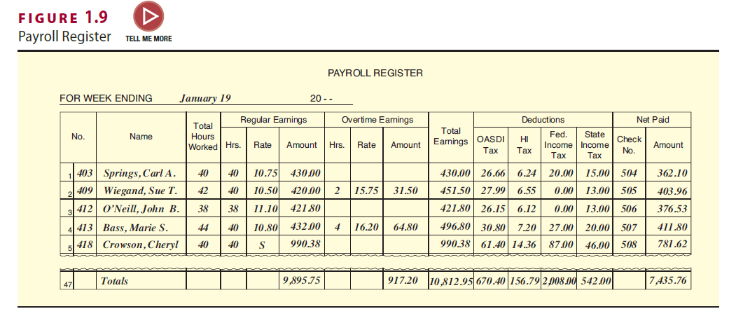
Payroll Register
Compiles data per payroll period
It provides information for recording payroll entries and for preparing reports required by other federal, state, and local laws.
Used to compute gross pay, deductions and net pay

Slide 35
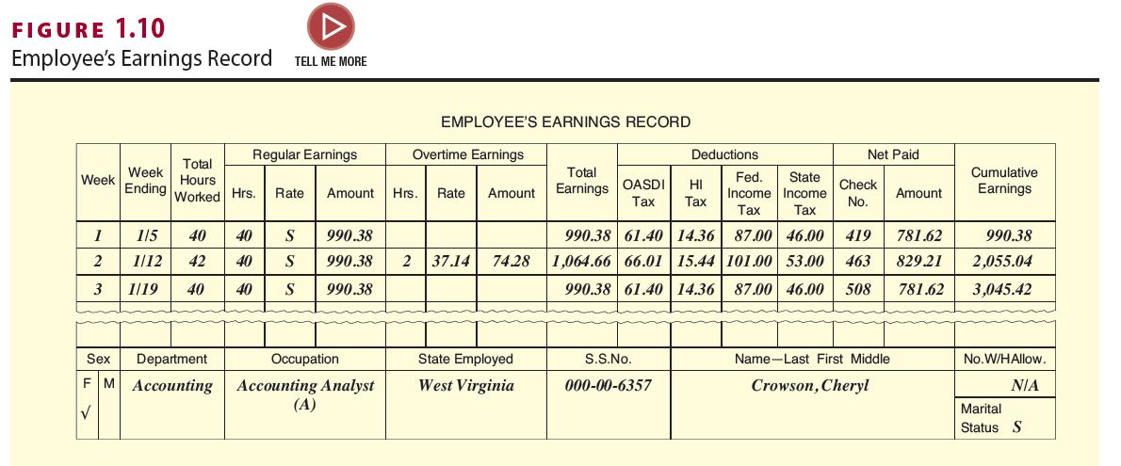
Employee’s Earnings Record
Updated after completion of payroll register
Outlines earnings per period, as well as cumulative earnings for each employee
Used to compile data for a multitude of reports

Slide 36
Payroll Accounting System (2 of 2)
Outsourcing Payroll
  Many small- to mid-sized businesses hire a payroll company to do their processing
    This is an independent company responsible for compliance
  Reduces risk of unpaid payroll taxes by
    Hiring only bonded providers
    Disallowing provider the ability to sign tax returns
    Disallowing tax correspondence to be sent to provider
    Requesting regular IRS transcripts of company accounts

Slide 37
Discussion Activity 3
Your friend, an executive at a small-sized company, is planning to outsource the payroll operations of her company. However, she is skeptical about the quality and cost involved in the outsourcing of the payroll services. You work at an outsourcing company, and she is seeking your advice on her plan before making any decision on payroll outsourcing. Explain to your friend the process and benefits of outsourcing the payroll operations.
Notes:
Instructions:
Gather into small groups of three to five.
Read through the slide information.
Collectively decide on your small group’s answer to the questions.
Share your findings with the larger group.

Slide 38
Discussion Activity Debrief 3
Explain to your friend the process and benefits of outsourcing the payroll operations.
Answer:
Processing payroll by using an outside payroll company is more cost effective than doing the processing in-house.
Other benefits realized from outsourcing is increased quality, improved efficiency, and a quicker release time, all of which enable the company to concentrate on its other operations.
The payroll operations at the company’s site need to deal only with the entry of new employee information and number of hours worked by each employee. This information is sent to the payroll processing company electronically. The input is then processed by the outside firm. Once the processing is completed, the output package is returned to the company.
These third-party payroll arrangements can range from just the cutting of paychecks and filing of tax returns to handling all aspects of employment from the hiring through the firing process.
The payroll operations can be customized to meet the needs of each individual business at a cost that many businesses find affordable.
Notes:
Conduct a debriefing session with the class.

Slide 39
Self-Assessment
What is the relationship between the Human Resources Department and the Payroll Department? How are the roles and responsibilities of the two departments different?
What are the federal laws affecting the need for payroll and personnel records? What are the major provisions of these laws?
What are the steps involved in a payroll accounting system?

Slide 40
Summary
Now that the lesson has ended, you should have learned how to:
Identify the various laws that affect employers in their payroll operations.
Examine the recordkeeping requirements of these laws.
Describe the employment procedures generally followed in a Human Resources Department.
Identify the various personnel records used by businesses and the type of information shown on each form.
Identify the payroll register and the employee’s earnings record.

