Slide 1
Nutrition & Diet Therapy
Final Review

Slide 2
Medical Terms
Hypertension-is the medical term for high blood pressure also known as the “silent killer”
Hypotension- is the medical term for low blood pressure
Hyperglycemia-high levels of glucose in the bloodstream Common term: high blood sugar
Hypoglycemia-low level of glucose in the bloodstream
Common term: low blood sugar “hangry”

Slide 3
Medical Terms
Hypervitaminosis- the excessive consumption of vitamins such as power shakes, protein bars and taking two or more megavitamins everyday.
Anemia-a deficiency of iron and folate in the blood
Dysphagia-difficulty swallowing
Total Parenteral Nutrition- the process of providing all nutrients intravenously.

Slide 4
Medical Terms
Oncology- The study of Cancer
Nasogastric Tube- instrument used to feed through the nose into the stomach.
Peristalsis-rhythmic like contractions which move food along the digestive tract.
Villi-fingerlike projections along the wall of the intestine through which nutrients are absorbed

Slide 5
Common Abbreviations (acronyms)
NPO-nothing by mouth
HTN-high blood pressure
BMI-body mass index
RDA-recommended daily allowance
NG-nasogastric tube
TPN-total parental nutrition
BMR-Basal Metabolic Rate

Slide 6
Medical Terminology
Gerontology is the study of the process of the aging.
Geriatrics is the branch of medicine involved with healthcare of the elderly.

Slide 7
Aging Adults
Body’s functions slow with age
Ability to replace worn cells reduced
Bone density and metabolism decreases
Hearing, taste, and smell less acute
Heart and kidneys less efficient
Lean muscle mass reduced
Eyes lose focus on nearby objects

Slide 8
Bones
Two minerals that are major components of your bones and teeth are calcium and phosphorus.
Calcium is the most prevalent mineral in the body.
Bone loss usually begins between the ages of 35-40 bone density decreases as the body ages.

Slide 9
Osteoporosis
A condition in which bones become brittle due to insufficient mineral deposits especially calcium. Vitamin D can reduce the chance of developing osteoporosis.
Decrease in height
Calcium and Vitamin D deficiency
Estrogen replacement therapy is used to prevent osteoporosis.

Slide 10
Arthritis
Excess weight worsens symptoms
Aspirin or anti-inflammatory drugs may help
No Cure
Arthritis causes structural changes in the cartilage making joints stiff and painful.

Slide 11
Goiter & Iodine Goiter is a deficiency disease related to a lack of the nutrient iodine.

Slide 12
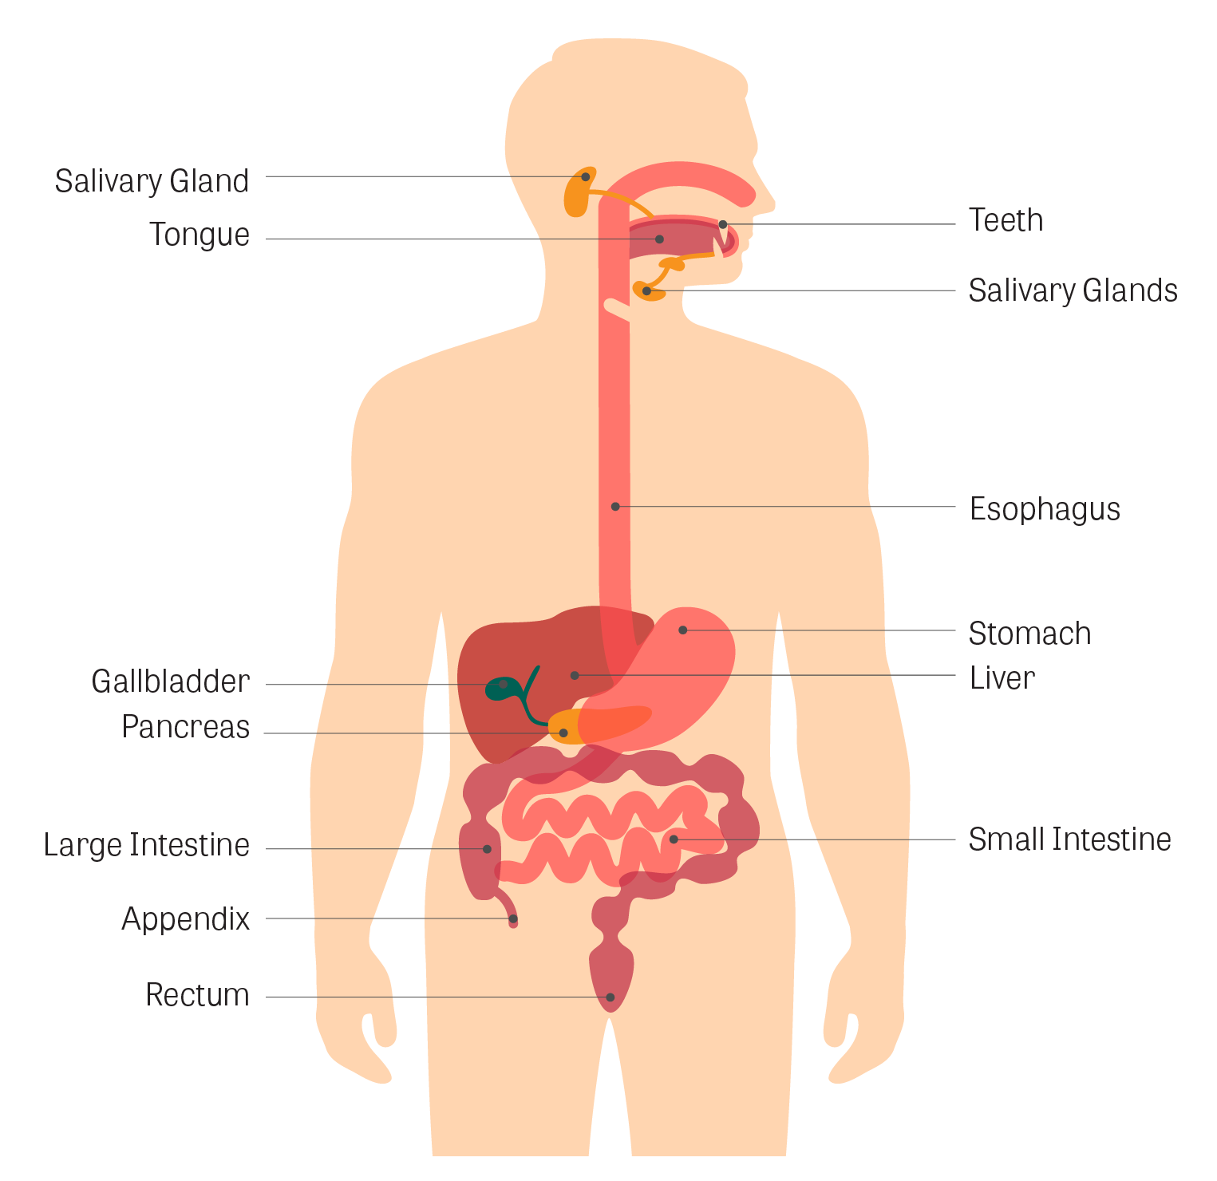
Gastrointestinal Tract
Peristalsis-rhythmic contractions of the muscular wall of the gastrointestinal tract

Slide 13
Nasogastric Tube instrument used to feed through the nose into the stomach

Slide 14
Anemia Can be caused by a deficiency of iron and folate, namely iron.

Slide 15
Hypertension

Slide 16
Hypotension Low Blood Pressure

Slide 17
Dysphagia Medical term for difficulty swallowing When feeding a client that has difficulty swallowing the feeder should place the food toward the back of the mouth.

Slide 18
Feeding the Client Who Requires Assistance
Help the client sit up straight
Place food toward the back of the mouth
Client diagnosed with dysphagia requires specialized diet
Should not use straw
May be offered thickened liquids.
May be prescribed a soft food diet
It is helpful for families to adapt the meals to fit all family members.

Slide 19
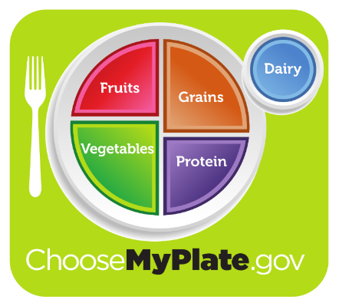
My Plate
Your healthy eating plan should follow the My Plate recommendations listed below.
Choose variety. The best meals have a balance of items from different food groups.
Make ½ half your plate vegetables and fruit.
½ your grain serving should be whole grains
1% milk

Slide 20
Protein Essential for building and repairing body tissue

Slide 21
Lacto-Vegetarian
A lacto-vegetarian diet is a diet that includes vegetables and dairy products such as milk, cheese, yogurt, and butter.
NO MEAT
NO EGGS

Slide 22
Vitamin C Vitamin C aids in Iron absorption

Slide 23
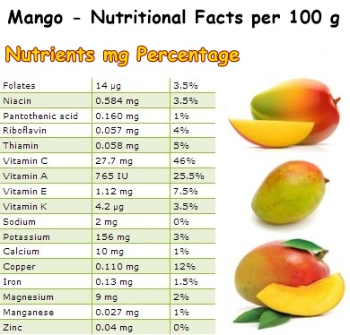
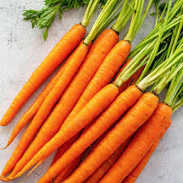
How much Vitamin A?
Top sources: Carrots and Mango

Slide 24
Vitamin C
Aids in the absorption of Iron
Sources:
Citrus fruits, melons, strawberries, tomatoes, potatoes, red and green peppers, cabbage, and broccoli
Deficiency can cause Scurvy (decaying teeth &bleeding gums)
Tip: Stress and cigarette smoking increase need for extra Vitamin C consumption.

Slide 25
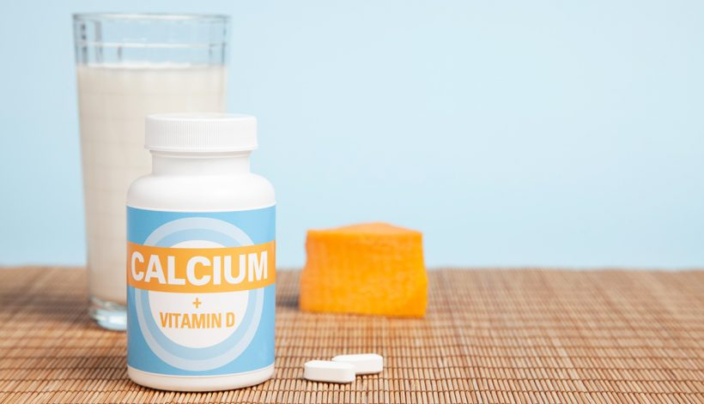
Vitamin D and Calcium
Vitamin D enhances the absorption of calcium in the human body.

Slide 26
Vitamin D
Foods that contain Vitamin D:
Eggs
Liver
Fortified milk
Fortified margarine
Oily fish
Mushrooms
The best source of Vitamin D for our bodies is Sunlight.

Slide 27
Infant Recommendations
Recommendations for nursing mothers include avoiding caffeine because caffeine can cause irritability in infants.
Feed on Demand is suggested as the best method of meeting the nutritional needs of infants.
Infants under the age of 1 should not be given regular cow milk because it is harder to digest, can cause gastro-intestinal blood loss, and is harder the kidneys to filter.

Slide 28
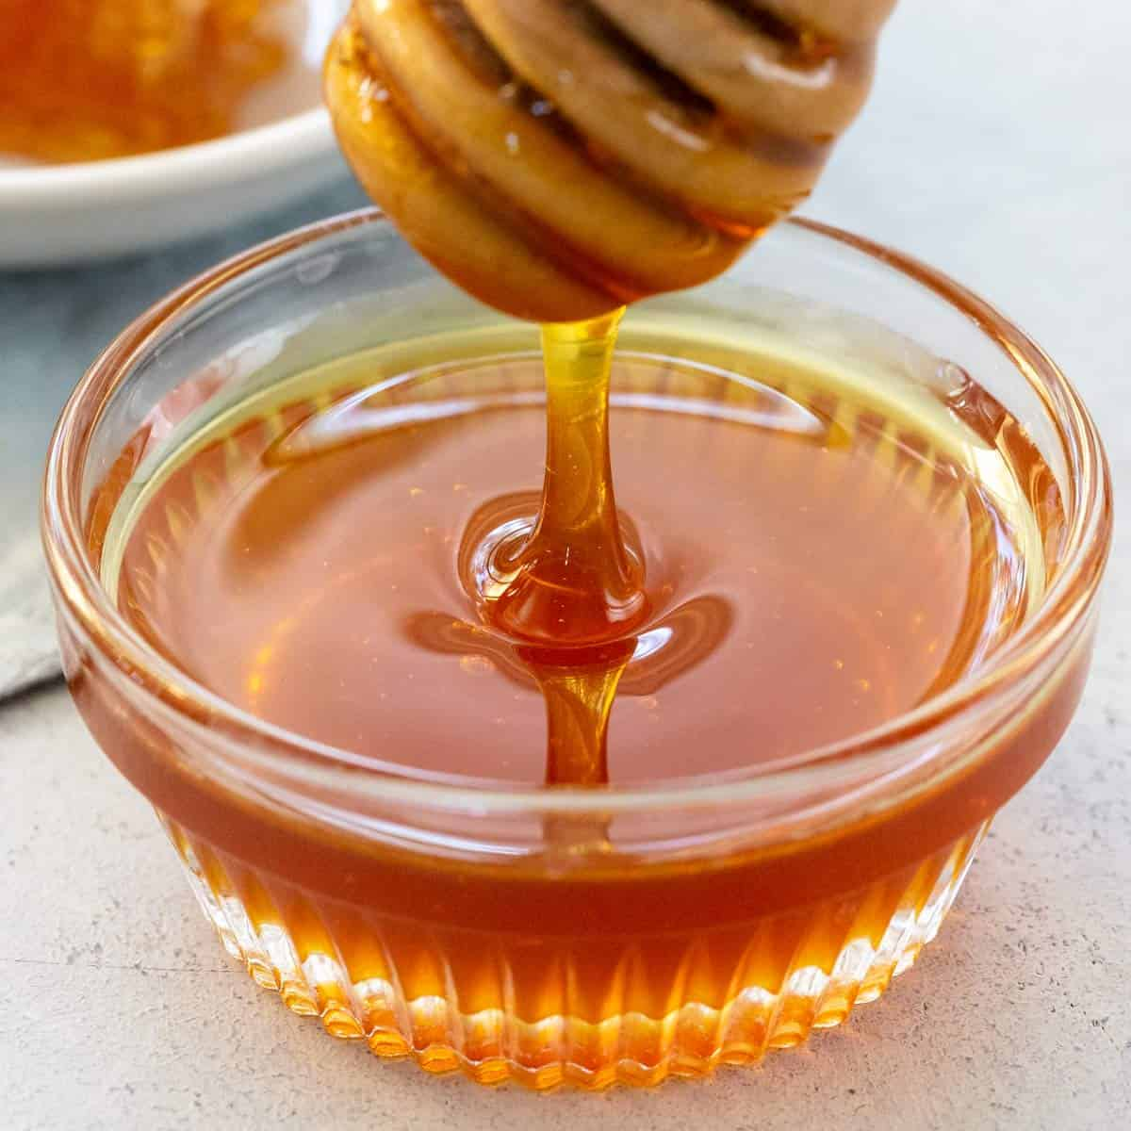
Infant Recommendations
Honey can be contaminated with the microorganism
C. botulinum and should NOT be given to infants.

Slide 29
Contaminated Foods
Food poisoning happens when a person consumes contaminated food. Contaminated food occurs when someone does not properly prepare and store foods.
Foods could easily be contaminated with bacteria, cleaning agents or insecticides if foods are not stored properly or the worker does not wash their hands.

Slide 30
Cross Contamination of Foods
Cross-contamination occurs when non-infected food is prepared with equipment that has been used to prepare infected foods.
Example: Cutting fresh vegetables on a cutting board that has been used to cut up raw poultry.

Slide 31
Low Nutrient Dense Foods
Low nutrient dense foods are food that are high in calories with little nutritional value.
Can you name a few low nutrient dense foods?
Honey Buns
Brownies
Potato Chips

Slide 32
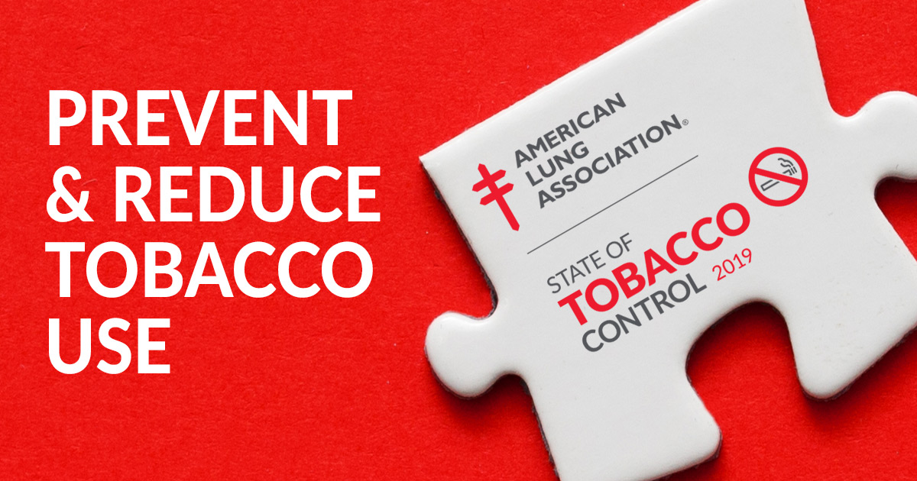
Tobacco
Addictive
Can influence appetite, nutritional status, and weight
Smoking increases the risk of heart disease.
Smokers need more vitamin C

Slide 33
Metabolism & Weight Reduction
Metabolism is the body’s use of food to create energy.
Most common cause of being overweight:
Energy imbalance
Best solution for weight control: Balanced diet with controlled calories.
3500 calories equals approximately 1 pound
Overweight people are prone to social and emotional problems.

Slide 34
Weight Loss Recommendations

Slide 35
Fats
Animal (Saturated) LDL
Fatty meats and fish
Dairy products
Egg yolk
Plant fats (Monounsaturated) HDL
Avocados
Olive Oil
Canola Oil

Slide 36
HDL vs. LDL
Low Density Lipoproteins are often termed “bad cholesterol” or LDL (like the devil such as visible fats on meat, whole milk, buttermilk, egg with yoke, and butter.
High Density Lipoproteins are often termed good cholesterol or HDL (hit the devil with good cholesterol such as avocados, olive oil, canola oil)
An example of a low-cholesterol food is egg whites, baked fish, whole wheat toast and jelly.
An example of high-cholesterol foods eggs, shrimp, whole milk, buttermilk.

Slide 37
Kidneys are the filtering system in the human body and play the main role in electrolyte balance.
Kidneys
Large amounts of fluids are needed for a client with kidney stones. Studies suggest at least half of the fluid consumed should be water.

Slide 38
Water
Water is essential for all body processes.
The human body can not survive more than10 to 14 days without water.
Large amounts of fluid namely water is helpful in preventing kidney stones. (renal calculi)

Slide 39
Chinese Foods Chinese food is prepared with soy sauce. Soy sauce contains high amounts of sodium therefore people with high blood pressure may need to avoid these foods. Chinese foods are not recommended for “no added salt” or “low sodium” diets.

Slide 40
Sodium
Keeping blood pressure in the normal range reduces one’s risk of coronary artery disease, stroke, congestive heart failure and kidney disease. Foods that are low in sodium are lower in salt. The human body only needs approximately one teaspoon of salt each day. (2,300mg of sodium)
The essential mineral iodine is found in iodized table salt.
Most Americans consume 2 to 6 times more salt than necessary each day.
Soy sauce is high in sodium/salt.

Slide 41
Learning Point
Lacto-Vegetarians use dairy products such as cheese and milk but no meat or eggs.
Metabolism is the body’s use of food to create energy.
Peristalsis is described as rhythmic contractions of the muscular wall of the gastrointestinal tract.

Slide 42
Learning Points
Fever, pregnancy and lactation can increase Basal Metabolic Rate. (BMR) Ketoacidosis occurs when too little carbohydrates are consumed to provide the energy needed by the body. Vitamin A loss in foods can be avoided during the cooking process by steaming vegetables.
Most Americans consume 2 to 6 times more sodium than needed each day.

Slide 43
Learning Points
Kidneys are the filtering system in the human body and play the main role in electrolyte balance.
Food Poisoning happens in the event food borne illnesses are consumed or a person can develop food poisoning by ingesting cleaning agents and insecticides

Slide 44
Learning Points
Whole milk should be avoided on a low cholesterol diet.
Hiatal hernia symptoms can be eliminated by eating small frequent meals.
Anemia can be caused by a lack of iron and folate in the diet, namely iron.
Teenagers tend to consume too much saturated fats and tend to imitate their peers.

