Slide 1
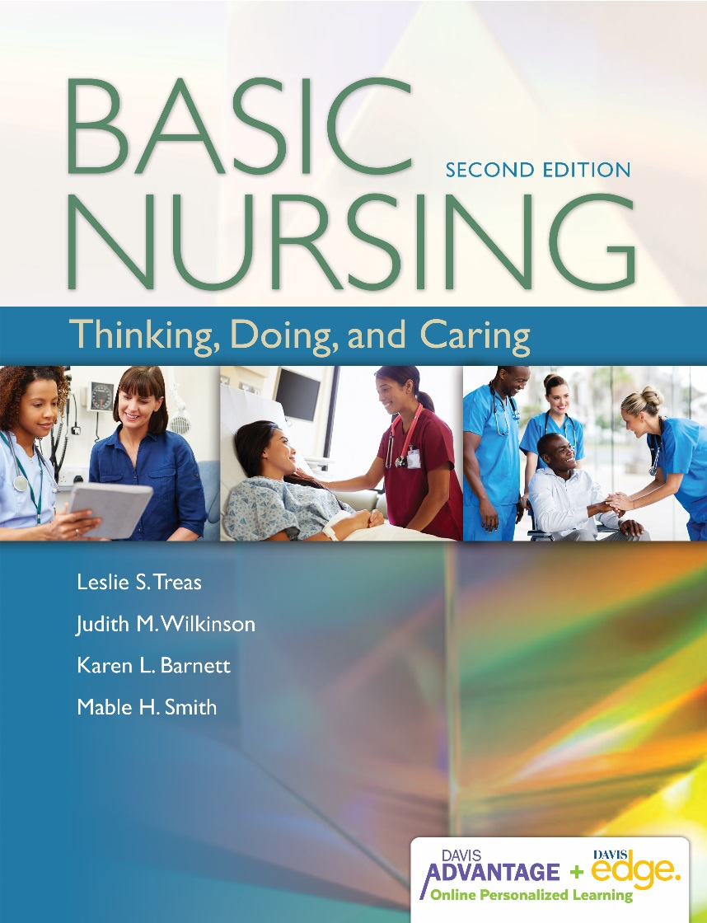

Slide 2
Critical Thinking & the Nursing Process
Chapter 2

Slide 3
What Is Critical Thinking?
A combination of
  Reasoned thinking
  Openness to alternatives
  Ability to reflect
  A desire to seek truth
Notes:
An important aspect of critical thinking is the process of identifying and checking your assumptions—and this is also an important part of the research process.
Critical thinkers are flexible, nonjudgmental, inquisitive, honest, and interested in seeking the truth. They possess intellectual skills that allow them to use their curiosity to their advantage, and they have critical attitudes that motivate them to use those skills responsibly.

Slide 4
ClickerCheck
The most correct definition of critical thinking is
A problem-solving process that enables one to show others they are wrong
An examination of one’s own beliefs in order to defend them intelligently
Purposeful, analytical thinking that results in a
reasoned decision
Rational thinking that results in obtaining the one
correct answer
Notes:
<< Instruct students to select the most appropriate answer to this question by using their clickers. >>

Slide 5
Correct Answer: C
Most definitions of critical thinking include the concept of it being purposeful and deliberate. It is more than just problem-solving and is not used exclusively to defend one’s beliefs. Critical thinking enables a person to see that there may be more than one correct answer.
Notes:
The correct answer is C. The key words in the stem are purposeful and deliberate. Critical thinking is not used exclusively to defend one’s beliefs, and it should enable a person to see that there may be more than one correct answer.

Slide 6
What Are Critical-Thinking Skills?
Objectively gathering information on a problem or issue
Recognizing the need for more information
Evaluating the credibility and usefulness of sources of information
Recognizing gaps in one’s own knowledge
Listening carefully; reading thoughtfully
Separating relevant from irrelevant data and important from unimportant data
Notes:
Skills in critical thinking refer to the cognitive (intellectual) processes used in complex thinking operations such as problem-solving and decision making.
When planning nursing care, nurses gather information about the client and then draw tentative conclusions about the meaning of the information to identify the client’s problems. Then they think of several different actions they might take to help solve or relieve the problem.
If problem-solving is hyphenated, why wouldn’t decision making be as well? Now, am I using critical thinking?
Examples of critical thinking skills are identified on this and the next slide.

Slide 7
What Are Critical-Thinking Skills? (cont’d)
Organizing or grouping information in meaningful ways
Making inferences (tentative conclusions) about the meaning of the information
Visualizing potential solutions to a problem
Exploring the advantages, disadvantages, and consequences of each potential action
Evaluating the credibility and usefulness of sources of information
Recognizing differences and similarities among things or situations
Prioritizing or ranking data as needed

Slide 8
What Are Critical-Thinking Attitudes?
Independent thinking
Intellectual curiosity
Intellectual humility
Intellectual empathy
Intellectual courage
Intellectual perseverance
Fair-mindedness
Notes:
Attitudes are not the same as intellectual skills. They are more like feelings and states of mind. Your attitudes and character determine whether you will use your thinking skills fairly and with an open mind. Without a critical attitude, people tend to use thinking skills to justify narrow-mindedness and prejudice and to benefit themselves rather than others.

Slide 9
What Are Complex Thinking Processes?
Use a combination of critical-thinking skills and attitudes
  Problem-solving
  Decision making
  Clinical reasoning
Notes:
Complex thinking (reasoning) processes use a combination of critical-thinking skills and attitudes. This is a list of the processes most commonly used in nursing.

Slide 10
Why Is Critical Thinking Important for Nurses?
Nurses are faced with complex situations.
Each client is unique.
Nurses apply knowledge to provide holistic care.
Nursing is an applied discipline.
Nursing uses knowledge from other fields.
Nursing is fast paced.
The scientific basis for patient care changes constantly.
Critical thinking is linked to evidence- based practice.
Notes:
Holistic care recognizes that each client is unique in terms of type of illness, culture, and age. Critical thinking enables the nurse to assess the client’s and family’s cultural beliefs and adapt care so that it is culturally sensitive and responsive to their needs.
Nursing is an applied discipline. Nurses must apply their knowledge, not just memorize and regurgitate facts.
Nursing uses knowledge from other fields. Nurses use information from chemistry, physiology, psychology, social sciences, and other disciplines to identify and plan interventions for patient problems.
Nursing is fast paced. A patient’s condition may change hour to hour or even minute to minute; thus, nurses need critical thinking in order to respond appropriately under stress.

Slide 11
ClickerCheck
A nurse who is newly employed at a hospital questions a standard of patient care that does not seem to follow evidence-based practice. Which critical thinking attitude is the nurse demonstrating?
Independent thinking
Intellectual humility
Intellectual courage
Fair-mindedness
Notes:
<< Instruct students to select the most appropriate answer to this question by using their clickers. >>

Slide 12
Correct Answer: A
Critical thinkers are not afraid to question things. They do not proceed with a questionable action simply because “that’s the way it’s always been done.”
Notes:
The correct answer is A. The key point in the slide is that critical thinkers are not afraid to question things.

Slide 13
Critical-Thinking Model
Five step/category process
  Contextual awareness
  Inquiry
  Considering alternatives
  Analyzing assumptions
  Reflecting skeptically and deciding what to do
Notes:
The critical-thinking model used throughout this book provides one way of making sense of critical thinking. This model organizes critical thinking into five major categories. This model is not meant to be all inclusive. Use it as a guide when faced with clinical decisions or unfamiliar situations. It should help you to achieve good outcomes for your patients.

Slide 14
Different Kinds of Nursing Knowledge
Theoretical
Practical
Self
Ethical
Notes:
Theoretical knowledge: Consists of information, facts, principles, and evidence-based theories in nursing and related disciplines (e.g., physiology and psychology). It includes research findings and rationally constructed explanations of phenomena. “This is the type of knowledge you will use to describe your patients, understand their health status, rationalize which interventions you choose, and it allows you to predict patient responses to interventions and treatments.”
Practical knowledge: Knowing what to do and how to do it. Consists of processes (e.g., the decision process and the nursing process) and procedures (e.g., how to give an injection) and is an aspect of nursing expertise.
Self-knowledge: To think critically, you must be aware of your beliefs, values, and cultural and religious biases. You can gain self-knowledge by developing personal awareness, by reflecting (asking yourself), “Why did I do that?” or “How did I come to think that?”
Ethical knowledge: Ethical knowledge consists of information about moral principles and processes for making moral decisions. Ethical knowledge helps you to fulfill your ethical obligations to patients and colleagues.

Slide 15
What Is the Nursing Process?
Definition
  A systematic problem-solving process that guides all nursing actions
Purpose
  To help the nurse provide goal-directed,
  client-centered care
Notes:
The nursing process, like nursing itself, involves both thinking and doing. Nurses must have good psychomotor and interpersonal skills, and they must use a sound knowledge base and good judgment to use the nursing process effectively.

Slide 16
Characteristics of the Nursing Process
Useful in many settings
Goal directed and client centered
Involves both thinking and doing
Not linear but rather a cyclical process
Steps may be concurrent
Notes:
Characteristics of the nursing process are listed on this slide.

Slide 17
What Are the Phases of the Nursing Process?
<Insert Fig. 2-2>
Notes:
The figure on this slide identifies the phases of the nursing process.

Slide 18
What Are the Phases of the Nursing Process? (cont’d)
Assessment
  First phase: Gather data.
Diagnosis
  Second phase: Identify client’s health needs.
Notes:
Assessment: Your purpose is to gather data that you will use to draw conclusions about the client’s health status.
Diagnosis: You will identify the client’s health needs (usually stated in the form of a problem) based on careful review of your assessment data. You need to analyze all your data, synthesize and cluster information, and hypothesize about your client’s health status.

Slide 19
What Are the Phases of the Nursing Process? (cont’d)
Planning outcomes
  Decide goals you want to achieve with your
  nursing activities.
Planning interventions
  Choose interventions to help the client achieve
  stated goals.
Notes:
Planning outcomes: Making decisions about goals for your care; that is, the client outcomes you want to achieve through your nursing activities. These outcomes will drive your choice of interventions.
Planning interventions: Developing a list of possible interventions based on your nursing knowledge and then choosing those most likely to help the client achieve the stated goals. The best interventions are evidence based; that is, they are supported by sound research.

Slide 20
What Are the Phases of the Nursing Process? (cont’d)
Implementation
  Action phase when you carry out or delegate actions you previously planned.
Evaluation
  Final phase: Judge whether your actions have successfully treated or prevented the client’s health problems.
Notes:
Implementation: You carry out the actions that you previously planned, and you document your actions and the client’s responses to them.
Evaluation: You determine whether the desired outcomes have been achieved and assess whether your actions have successfully treated or prevented the client’s health problems. This phase also includes modification of the care plan based on what has been achieved and what yet needs to be achieved.

Slide 21
How Is the Nursing Process Related to Critical Thinking?
Critical thinking and nursing process are interrelated but not identical.
Nursing decisions that require critical thinking may not be related to the nursing process.
Some nursing activities do not require reflective critical thinking, although they must be done skillfully.
Nursing process is a problem-solving process.
<Insert Fig. 2-1>
Notes:
This slide identifies the relationship between the nursing process and critical thinking.

Slide 22
What Is Caring?
Caring is always specific and relational for each nurse–person encounter.
Caring is not an abstraction.
Caring involves thinking and acting in ways that preserve human dignity and humanity.
Notes:
Caring involves personal concern for people, events, projects, and things. It allows you to connect with others and to give help as well as receive it. One aspect of self-knowledge is to be aware of what and whom you care about. Knowing what the patient cares about reveals what is stressful for the patient, because only things that matter can create stress. Caring also enables the nurse to notice which interventions are effective.

Slide 23
Components of Caring
Knowing
Being with
Doing for
Enabling
Maintaining belief
Notes:
The components of caring are listed on this slide.

Slide 24
What Is Full-Spectrum Nursing?
Definition
  A unique blend of thinking, doing, and caring for
  the purpose of affecting good outcomes from a
  patient situation
What are the model concepts?
  Thinking
  Doing
  Caring
  Patient situation
Notes:
Nurses use critical thinking in all steps of the nursing process. They also apply critical thinking to the four kinds of nursing knowledge and what they are doing for the patient. Caring motivates and facilitates the thinking and doing. The goal of all this is to have a positive effect on a patient’s health outcomes.

Slide 25
Full-Spectrum Nursing Model
<Insert Fig. 2-3>

Slide 26
How Does the Model Work?
Thinking
  Critical thinking
  Theoretical knowledge
Doing
  Practical knowledge
  Nursing process
Notes:
Refer to Table 2-3.
Critical thinking: Enables you to fully use your knowledge and skills.
Theoretical knowledge: Principles, facts, theories, what you have to think with.
Practical knowledge: Skills, procedures, and processes (including the nursing process).
Nursing process: Assessment and evaluation: everything you know about the patient, including context. Planning and implementation: what you do for the patient.

Slide 27
How Does the Model Work? (cont’d)
Caring
  Self-knowledge
  Ethical knowledge
Patient situation
  Patient data
  Patient preferences
  Context
Notes:
Self-knowledge: Awareness of your values, beliefs, and biases.
Ethical knowledge: Understanding your obligations; sense of right and wrong.
Patient data: Physical, psychosocial, spiritual.
Patient preferences/context: Context for care, environment, relationships, culture, resources, supports.

Slide 28
ClickerCheck
College courses, such as microbiology and human growth and development, present content that is considered part of theoretical nursing knowledge.
True
False
Notes:
<< Instruct students to select the most appropriate answer to this question by using their clickers. >>

Slide 29
Correct Answer: A
Knowledge gained in these courses helps the nurse develop a more holistic and complete plan of patient care.
Notes:
The correct answer is A.

Slide 30
Critical Thinking
It is a pleasant Saturday afternoon and you are meeting with an old friend whom you have not seen in 2 years. She says, “I hear you’ve decided to be a nurse. What made you choose that?” How would you reply to her question?
Notes:
Consider the personal experiences that you have had that have fostered your desire to be a nurse. Also consider the people in your life who are nurses and identify how they have influenced your decision to become a nurse.

Slide 31
Safe, Effective Care: Thinking, Doing, Caring
The term “critical thinking” seems to suggest that good thinking is an intellectual activity rather than involving feeling and emotion. How do you think a nurse can use critical thinking to practice in a caring manner?
Notes:
<<Instructor: Ideally this is a discussion question, but you could use it as a writing exercise. It will take more time for a student to do this alone than in a group situation. Some answers you may hear from the group include the following.>>
Critical thinking helps the nurse to assess cultural beliefs and adapt care so that it is culturally sensitive. This demonstrates caring and holistic care.
A caring nurse is active in preventing and relieving pain. The ability to apply knowledge of pain causes and pain interventions as well as to assess pain levels allows the nurse to be effective in providing pain relief measures. Applying theoretical knowledge to a specific patient situation is a critical-thinking skill.

Slide 32
Socratic Reasoning
As a patient, which safe, effective care competence would you choose for your nurse to have if the nurse could be expert in only one of the skills?
  Thinking (knowledge, problem-solving)
  Doing (skills)
  Caring (self-knowledge, ethical knowledge, affective and interpersonal skills)
Notes:
<<Ask the students to explain which skill category would be the most important to them. All categories are important; however, the student is asked to choose. >>
<INSTRUCTOR: Read or say in your words the following to students:>>
“Most of us are more talented on one area than another. Not every nurse is equally competent in thinking, skills, and caring. Suppose you are a patient, and you can choose a nurse who is expert in only one of those competencies, but not quite average in the other two.
Would you choose a nurse who is expert thinking – that is who has a good fund of theoretical knowledge, and is a good critical-thinker and problem-solver? Or one who is expert in performing procedures? Or one who is the most emotionally supportive and caring person on the staff?”
<<<<INSTRUCTOR: Socratic Questions: After a student responds (and do make them choose one nurse; it’s forced choice), ask questions such as the following. The student’s answer may elicit questions or responses from other students. Use whatever other of the following you choose.>>>
Could you explain your reason for choosing that nurse?
By what reasoning did you come to that conclusion?
What might the nurses deficits in the other 2 skills <name them> mean for you?
Would anyone else choose differently for their nurse? What causes you to think this is a better choice?

