Slide 1
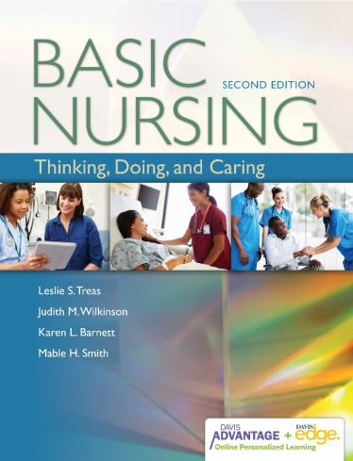

Slide 2
Theory, Research, & Evidence-Based Practice
Chapter 8

Slide 3
Importance of Nursing Theory and Research
Framingham studies
Watson’s Science of Human Caring
Benner’s Novice to Expert
Notes:
The Framingham studies are a longitudinal, multidisciplinary research project consisting of several studies carried out over 50 years (from 1948 to 1998) to identify the health and healthcare practices of one community: Framingham, Massachusetts. The results of the various Framingham studies have influenced healthcare practices for diabetes mellitus, breast cancer, heart disease, osteoarthritis in older adults, and other disease entities.
Watson’s Science of Human Caring is a nursing theory developed by Dr. Jean Watson. This theory describes what caring means from a nursing perspective. It may not seem that nurses need to be taught how to care, but Dr. Watson and other nursing theorists found that they did. Before the so-called caring theorists, nurses were more mechanistic in the work they did. A mechanistic nurse has a list of things to do, completes the list, and does nothing more. The “something more” often consists of caring behaviors, such as singing to a frightened child or taking the time to teach a new mother for the second time how to bathe her baby. This is not to say that nurses didn’t care about their patients before Watson. The point is that a theory can change the focus of nursing.
Dr. Patricia Benner, in her book, Novice to Expert, proposed a theory that describes the progression of a beginning nurse to increasing levels of expertise. Benner’s theory provides the information necessary to understand how you learn and perform your nursing responsibilities.

Slide 4
Nursing Theory
An organized set of related ideas and concepts that
Assist us in finding meaning in our experiences.
Organize our thinking around an idea.
Develop new ideas and insights into the work we do.
Notes:
<<Instructor: Review each bulleted item while referring to the following notes.>>
A theory answers the following questions: What is this? How does it work? Although a theory is based on observations of facts, the theory itself is not a fact. A theory is merely a way of viewing phenomena (reality); it defines and illustrates concepts and explains how they are related or linked. Theories can be, and are, changed.

Slide 5
Components of a Theory
Assumptions
Phenomena
Concepts
Definitions
Statements/propositions
Notes:
<<Instructor: Review each bulleted item while referring to the following notes.>>
Assumptions are ideas that we take for granted. In a theory, they are the ideas that the theorist or researcher presumes, or takes for granted, to be true and does not intend to test with research. They are statements about concepts or relationships between concepts.
Phenomena are the subject matter of a discipline (when used in this sense, they are often called phenomena of concern). Think of phenomena as marking the boundaries (domain) of a discipline—making one discipline unique from another.
Concepts: A concept is a mental image of a phenomenon. It is formed by generalizing an abstract idea from your experiences and observations of events, objects, and properties, and it exists as a symbol (e.g., a word or picture) in your mind.
Definitions: A definition is a statement of the meaning of a term or concept that sets forth the concept’s characteristics or indicators; that is, the things that allow you to identify the concept. A definition may be general or specific. A theoretical definition refers to the conceptual meaning of a term, whereas an operational definition specifies how you would observe or measure the concept (e.g., when doing research).
Statements/propositions systematically describe the linkages and interactions among the concepts of a theory. The statements, taken as a whole, make up the theory.

Slide 6
Theory, Framework, Model, or Paradigm?
Paradigm: Worldview or ideology
Conceptual framework: A set of concepts related to form a whole
Model: A symbolic representation of a framework or concepts
Notes:
<<Instructor: Review each bulleted point while referring to the following notes.>>
Paradigm: A way of thinking that is shared by a community of scholars who are studying and working on the same phenomena.
Conceptual framework: A set of concepts that are related to form a whole or pattern. Frameworks (and models) tend to be broader and more philosophical than theories.
Model: A symbolic representation of a framework or concepts—a diagram, graph, picture, drawing, or physical model. A conceptual model (sometimes referred to as a conceptual framework) is a model that is expressed in language—the symbols are words.

Slide 7
How Are Theories Developed?
A nurse has an idea to explore through research.
Logical reasoning
Inductive reasoning
Deductive reasoning
Notes:
<<Instructor: Review each bulleted item while referring to the following notes.>>
Logical reasoning: The purpose is to develop an argument or statement based on evidence that will result in a logical conclusion.
Inductive reasoning: You gathered separate pieces of information, recognized a pattern, and formed a generalization. Remember induction by thinking: “IN-duction: I have specific data ‘out there,’ and I bring it ‘IN’ to make the generalization.”
Deductive reasoning: Deduction starts with a general premise and moves to a specific deduction.
Inductions and deductions are not “facts” or “truth,” but rather they point you in the direction to go in seeking truth (reality). They also allow you to make connections between ideas when you are developing a theory. The more information you have to support your conclusions, the more confident you can be that they are correct.

Slide 8
ClickerCheck
A patient has pitting pedal edema, crackles, and an elevated blood pressure. The nurse concludes that the patient has fluid volume excess. Which type of reasoning did the nurse use?
Theoretical
Inductive
Deductive
Conceptual
Notes:
<<Instruct students to select the most appropriate answer to the question using their clickers.>>

Slide 9
Correct Answer: B
Inductive reasoning involves drawing a general conclusion from a pattern found in individual pieces of information.
Notes:
The correct answer is B.

Slide 10
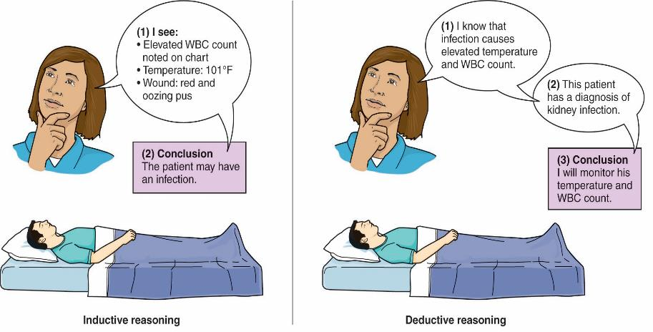
Logical Reasoning
Notes:
<< Instructor: This slide shows the comparison of inductive and deductive reasoning. Theorists and nurses in practice use both types of reasoning.>>

Slide 11
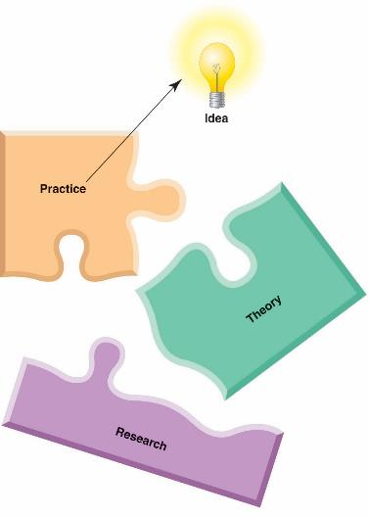
Essential Concepts of a Nursing Theory
Person
Environment
Health
Nursing
Notes:
<< Instructor: Review each bulleted item while referring to the following notes.>>
Person: Who was the person(s) involved? (Person refers to the patient or resident or the family and support persons.)
Environment: What was the environment? A community center? A bathing room in a nursing home? The person’s bedside in a hospital?
Health: What was the health condition of the person? For example, was the person seeking information for self-care? Critical? In pain? Ready for discharge?
Nursing: How was nursing involved? For example, was the nurse compassionate? Angry? Efficient? A novice or an expert?

Slide 12
Nursing Theories
Describe, explain, and predict human behavior
Used in practice, education, and research
Notes:
<<Instructor: Review each bulleted item while referring to the following notes.>>
Nursing theories try to describe, explain, and predict human behavior. The theory you use influences what you look for, what you notice, what you perceive as a problem, what outcomes you hope to achieve, and what interventions you will choose.
Practice: Clinical practice theories specifically guide what you do each day. They are limited in scope; that is, they do not attempt to explain all of nursing. A theory on human interaction directs nurse–client communication; another theory provides a guide for teaching people how to be self-reliant.
Education: Some schools of nursing use theories to guide curriculum planning, programs, and projects. These are frequently grand theories, such as Watson’s Theory of Caring or Rogers’ Science of Unitary Human Beings. A grand theory covers broad areas of concern within a discipline. A grand theory is usually abstract and does not outline specific nursing interventions. Instead, it tends to deal with the relationships among nurse, person, health, and environment.
Research: Theories help generate new knowledge by suggesting questions for researchers to study. Researchers also use theories and models as a framework for structuring a study. Theories provide a systematic way to define the questions for study, identify the variables to measure, and interpret the findings.

Slide 13
Important Nurse Theorists
Florence Nightingale
Virginia Henderson
Hildegard Peplau
Patricia Benner
Madeleine Leininger
Jean Watson
Notes:
<<Instructor: Review each bulleted item while referring to the following notes.>>
Florence Nightingale used her research to develop her theory that a clean environment would improve the health of patients. Because of her theory and research, Nightingale dramatically reduced the death rate of the soldiers and changed the way the entire British Army hospital system was managed (Dossey, 1999).
Virginia Henderson: Her “idea” was that nurses deserve to know what it means to be a nurse. She identified 14 basic needs that are addressed by nursing care. Henderson’s (1966, p. 3) definition of nursing states: “The ultimate function of the nurse is to assist the individual, sick or well, in the performance of those activities contributing to health or its recovery (or to a peaceful death) that he would perform unaided if he had the necessary strength, will or knowledge.”
Hildegard Peplau: Her “idea” was that health could be improved for psychiatric patients if there were a more effective way to communicate with them. Peplau’s research showed that developing a relationship with psychiatric patients does make their treatment more effective. She developed the theory of interpersonal relations, which focuses on the relationship a nurse has with the patient.
Patricia Benner: Caring is the central concept in Benner and Wrubel’s Primacy of Caring Model. This theory stresses that each person is unique, so that caring is always specific and relational for each nurse–person encounter. Benner also developed the novice to expert; she identified five stages of knowledge development and acquisition of nursing skills.
Madeleine Leininger: Her theory focuses on caring as cultural competence (using knowledge of cultures and of nursing to provide culturally congruent and responsible care). Her “idea” came from working with children from diverse cultures who were under her care in a psychiatric hospital.
Jean Watson developed a nursing theory called the Science of Human Caring (Watson, 1988). This theory describes what caring means from a nursing perspective.

Slide 14
ClickerCheck
The nurse incorporates Hispanic beliefs about “hot and cold” into her plan of care for her client. On which theorist is the nurse basing care?
Florence Nightingale
Patricia Benner
Jean Watson
Madeleine Leininger
Notes:
<<Instruct students to select the most appropriate answer to the question using their clickers.>>

Slide 15
Correct Answer: D
Madeleine Leininger’s work focused on transcultural nursing and developing cultural competence.
Notes:
The correct answer is D.

Slide 16
Theories From Other Disciplines
Maslow’s Hierarchy of Basic Human Needs
Validation theory
Stress and adaptation theory
Developmental theories
Systems theory
Notes:
<<Instructor: Review each bulleted item while referring to the following notes.>>
Maslow’s Hierarchy of Basic Human Needs: This theory identifies eight different levels of needs and identifies that lower-level needs must be met to some degree before the higher-level needs can be achieved.
Validation theory: Arises from social work and provides for a way to communicate with older people with dementia. The theory asks the caregiver to go where the demented person is in his or her own mind.
Stress and adaptation theory: Hans Selye (1993) developed the stress and adaptation theory. His theory states that a certain amount of stress is good for people; it keeps them motivated and alert. However, too much stress, called distress, results in physiological symptoms and eventual illness.
Developmental theories look at stages that individuals, groups, families, and communities progress through over time. These theories are useful in nursing practice because they identify norms and expectations at various stages of development and help you identify activities and interventions that are appropriate for your client.
Systems theory: One of the premises of systems theory is that all complex phenomena, regardless of their type, have some principles, laws, and organization in common. A system is made up of separate components (or subsystems) that constantly interact with each other and with other systems.

Slide 17
Nursing Research
A systematic, objective process of analyzing phenomena of importance in nursing
Encompasses all clinical practice arenas, nursing education, and nursing administration
Notes:
<< Instructor: Review each bulleted point while referring to the following notes.>>
The purpose of nursing research is to develop knowledge about issues that are important in nursing.

Slide 18
Safe, Effective Nursing Care
Why is it vital for nurses to base nursing care on sound, scientific evidence rather than strictly anecdotal or historical practice?
Notes:
<< Instructor: Lead discussion about the various reasons why nurses must base nursing care on evidence-based practice (EBP) rather than implementing interventions just because “We have always done it this way” or “That’s the easiest way to do the procedure.”>>
Verify clinical practice decisions and interventions.
Improve clinical care practices, interventions, and patient outcomes.
Dispel myths in clinical practice.
Avoid errors and unintended consequences and complications.
Evidence-based practice contributes to the science of nursing.
Leads to repeatability of intended patient outcomes.
Standardize effective care.

Slide 19
Learning About Research
Enhances quality patient care
Expectation of
American Nurses Association (ANA) standards
Quality and Safety Education for Nurses (QSEN)
Institute of Medicine (IOM)
Notes:
The best reason for learning about research is that the ability to read and use nursing research enhances your ability to give quality patient care. A practical reason is that educational and practice standards require that you acquire a degree of research competence. Like theory, research affects you every day you are a nurse. Full-spectrum nurses participate in research by doing the following:
Identifying ideas that should be examined through the research process.
Assisting in, designing, and/or performing research.
Using research as a basis for their practice.
ANA standards: The position of the ANA is that all nurses share a commitment to the advancement and ethical conduct of nursing science.
QSEN: Recall that the QSEN project has identified quality and safety competencies for nurses. One important competency is evidence-based practice: the ability to “integrate the best available current evidence with clinical expertise and patient/family preferences and values for delivery of optimal healthcare.”
IOM: The IOM core competencies for health providers are the basis for the safe, effective nursing care (SENC) competencies used in this text.

Slide 20
Educational Preparation for Nursing Research
Associate degree and diploma in nursing
Baccalaureate degree in nursing
Master’s degree in nursing
Doctoral degree in nursing or related field
Notes:
<< Instructor: Review each bulleted item while referring to the following notes.>>
Associate degree and diploma in nursing: At this educational level, there are four research roles you can fulfill. You can 1) be aware of the importance of research to evidence-based practice, 2) help identify problem areas in nursing, 3) help collect data with a more experienced nurse researcher, and 4) use evidence-based practice in planning nursing interventions.
Baccalaureate degree in nursing: If you are a baccalaureate-prepared nurse, you should be able to 1) critique research for application to clinical practice, 2) identify nursing research problems and help implement research studies, and 3) apply research findings to establish sound, evidence-based clinical practice.
Master’s degree in nursing: Nurses with graduate degrees should be able to 1) analyze problems so that appropriately designed research can be used to solve the problem; 2) through clinical expertise, apply evidence-based practice to nursing care situations; 3) provide support to ongoing research projects; and 4) conduct research for the purpose of assuring quality nursing care.
Doctoral degree in nursing or related field: Doctorally prepared nurses are specifically educated to be nurse researchers. They are qualified to 1) conduct nursing research, 2) serve as leaders in applying research results to the clinical arena, and 3) develop ways to monitor the quality of nursing care being administered by nurses (adapted from ANA, 1981). In addition, they should disseminate their research findings via publications and conferences.

Slide 21
Ways to Gain Nursing Knowledge
Trial and error plus common sense
Authority and tradition
Intuition and inspiration
Logical reasoning
Notes:
<< Instructor: Review each bulleted item while referring to the following notes.>>
Trial and error plus common sense: Try what makes sense to do, and if that does not work try something else. If you find something that works partially, then use it.
Authority and tradition: This means to rely on an expert or to do “what has always been done.”
Intuition and inspiration: Intuition is a “feeling” about something—an inner sense.
Logical reasoning: Using your knowledge and the facts available, you form conclusions.

Slide 22
What Is Scientific Method?
A process
The researcher uses senses.
Systematic data collection
Data are observable, verifiable.
Purpose: To describe, explain, or predict events
Notes:
<< Instructor: Review each bulleted item while referring to the following notes.>>
Scientific inquiry is the process in which the researcher, through use of the senses, systematically collects observable, verifiable data to describe, explain, or predict events. The goals of scientific inquiry are to find solutions to problems and to develop explanations of the world (theories).

Slide 23
Scientific Method Research Design
Quantitative research: Generalized to populations
Qualitative research: Focuses on lived experiences of people
Notes:
<< Instructor: Review each bulleted item while referring to the following notes.>>
Quantitative research: The main purpose of this research is to gather data from enough subjects (people being studied) to be able to generalize the results to a similar population. Generalizing results means that you think, “What I found to be so for this group of people will probably be the same for all people who are similar” (e.g., “My findings for this group of women over age 40 in the United States will probably be useful for all women over age 40 in the United States”). In quantitative research, researchers carefully control data collection and are careful to maintain the objectivity of the process. Quantitative data are reported as numbers.
Qualitative research: This type of research focuses on the lived experience of people. The purpose is not to generalize the data but to share the experience of the person or persons in the study. There is no need for large numbers. A case study of one person can examine the lived experience, for example, of a 19-year-old single mother of triplets or a middle-aged woman with HIV. Qualitative research uses words, quotations from persons interviewed, observations, and other nonnumeric sources of data.

Slide 24
Socratic Reasoning
The nurse wants to know which best taping method is most secure in prolonging peripheral IVs in newborns. She plans and implements a quantitative study measuring longevity of the patent IV in hours. What questions might she ask when planning her study design?
Notes:
<<Instructor: Present this scenario to students, then ask some of the following questions and follow each up with discussion solicited from other students. Some example questions might include:>>
What might you imply about the need for the study?
How does the taping method in your study affect catheter duration? Where did you get your information?
What generalizations can you make based on your study findings?
What are the consequences of IV lines that remain patent for longer duration?
How do taping methods differ among nurses caring for sick newborns? How could you find this information?

Slide 25
ClickerCheck
A nurse researcher who intends to interview clients about the factors that influence their compliance with insulin therapy and summarize the data as themes is doing quantitative research.
True
False
Notes:
<<Instruct students to select the most appropriate answer to the question using their clickers.>>

Slide 26
Correct Answer: B
The data in this study would come from the experiences of clients living with diabetes as they relate that information to the nurse researcher.
Notes:
The correct answer is B.

Slide 27
Steps of the Research Process
Select and define the problem you wish to study.
Select a research design.
Collect data.
Analyze data.
Use the research findings.
Notes:
<<Instructor: Refer to each bulleted item after giving the following introduction.>>
At the novice level, you will be using but not performing research. But in order to evaluate the research you read, you should have a general idea of the steps for conducting valid, reliable research. The research process is a problem-solving process, similar to but not the same as the nursing process. Different study designs require different steps, and you will find some variation in how different authors present the research process steps. However, in general, the steps include the five phases on this slide (Fain, 2009).

Slide 28
Rights of Research Participants
Informed consent
Right to not be harmed
Right to full disclosure
Right to self-determination
Rights to privacy and confidentiality
Institutional review boards
Notes:
<<Instructor: Review each bulleted item while referring to the following notes.>>
Informed consent
Right to not be harmed: The information given to the participant outlines the safety protocols of the study. If at any time preliminary data indicate potential harm to the participant, the study must be stopped immediately.
Right to full disclosure: Participants have a right to answers to such questions as: What is the purpose of this research? What risks are there? Are there any benefits? Will I be paid? What happens if I get sick or feel worse? Whom do I contact with questions and concerns?
Right to self-determination: This refers to the right to say no. At any time in a study, the participant has the right to stop participating, for any reason. As the nurse, you are responsible to support a participant during the process of withdrawing from a study. Do not allow anyone to coerce the participant into remaining in the study.
Rights to privacy and confidentiality: All research participants have the right to have their identity protected. Generally, they are given a code number rather than being identified by name. Once the study is completed and the data are analyzed, the researcher is responsible for protecting the raw data (such as questionnaires and taped interviews).
Institutional review boards (IRBs): Every hospital, university, and other healthcare facility where federal funds are involved has an IRB. It consists of healthcare professionals and people from the community who are willing to review and critique research proposals. The two main responsibilities of the IRB are to 1) protect the research participants from harm and 2) ensure that the research is of value.

Slide 29
Identifying Clinical Nursing Problems
Experience
Social issues
Theories
Ideas from others
Nursing literature
Notes:
<<Instructor: Review each bulleted item while referring to the following notes.>>
Experience: If you are curious about why things are done and about what might happen if changes were made, you will find plenty of problems; for example, problems with staffing, equipment, nursing interventions, or coordination among health professionals.
Social issues: You may be concerned about broader social issues that affect or require nursing care, such as issues of gender equity, sexual harassment, and domestic violence. You may be concerned about patients who do not have access to healthcare or about the health problems of a particular group or subculture.
Theories: Recall that theories must be tested in order to be useful in nursing practice. You might want to suggest research to test a theory in which you are interested. If the theory is accurate, what behaviors would you expect to find, or what evidence would you need to support the theory?
Ideas from others: Your instructor may suggest a topic to research, or perhaps you might brainstorm with nurses or other students. Agencies and organizations that fund research often ask for proposals on certain topics (e.g., the ANA and the National Institute of Nursing Research).
Nursing literature: Read widely in your field of interest. You may identify clinical problems by reading articles and research reports in nursing journals.

Slide 30
PICO Questions
P: Patient/population
I: Intervention
C: Comparison intervention
O: Outcome
Notes:
<<Instructor: Review this acronym with the students.>>
The acronym stands for Patient or population, Intervention, Comparison intervention, and Outcome. You may not always need a comparison intervention (C).

Slide 31
Analyzing Research
What is the book, journal, or article about as a whole?
What is being said in detail, and how?
Is the book, journal, or article “true” in whole or part?
What of it?
Notes:
<<Instructor: Review each bulleted item while referring to the following notes.>>
What is the book, journal, or article about as a whole? That is, what is the theme of the article, and how is it developed?
What is being said in detail, and how? What are the author’s main ideas, claims, and arguments? In a research article, you will find this mainly in the abstract and the conclusions.
Is the book, journal, or article “true” in whole or part? You must decide this for yourself. The strategies in “How Do I Appraise the Research I Read” may help you to determine the truth of a research report.
What of it? Is it of any significance? Is there any way to use the information to improve patient care, education, or other areas of nursing?

Slide 32
Research Utilization
The reason for conducting research is to establish evidence-based practice.
Notes:
<<Instructor: Emphasize this point with the students.>>
True evidence-based practice requires that after discovering and critiquing the best available evidence, nursing expertise must be applied to see how the recommended interventions fit into the practice setting and whether they are compatible with patient preferences. Research is more than just an exercise that nurses engage in to earn master’s and doctoral degrees. The ultimate reason for conducting research is to establish an evidence-based practice or to gain greater understanding of a phenomenon. This means that nurses in practice have a responsibility for finding and using the credible, scientific research that others do. You must have reasons for what you do. Research can provide those reasons.

Slide 33
Barriers to Using Research
Lack of knowledge of nursing research
Negative attitudes toward research
Inadequate forums for disseminating research
Lack of support from the employing institution
Study findings that are not ready for the clinical environment
Notes:
Common reasons nurses do not use research as the basis for their practice include:
1. Lack of knowledge of nursing research
2. Negative attitudes toward research
3. Inadequate forums for disseminating research
4. Lack of support from the employing institution
5. Study findings that are not ready for the clinical environment

Slide 34
Think Like a Nurse
Think of an experience you have had in clinical. Perhaps it was taking vital signs or bathing a confused patient. Describe how each of the four components of a nursing theory occurred in your clinical situation. Share your thinking with the class.
Who were the persons involved?
What was the environment?
What was the health condition of the person?
How was nursing involved?
Notes:
<<Instructor: Facilitate discussion of these clinical experiences as the students present.>>

