Slide 2
Communicating & Therapeutic Relationships
Chapter 20

Slide 3
What Is Communication?
Basic human function
Sending messages back and forth between two or more people
Consists of verbal and nonverbal messages
Helps build working relationships
Helps meet physical, psychosocial, emotional, and spiritual needs
Notes:
<< Instructor: Review each bulleted item while encouraging students to give examples of these different types of communication. >>

Slide 4
Levels of Communication
Intrapersonal: Self-talk; can be positive or negative
Interpersonal: Between two or more people
Group: With many people at the same time
Public speaking: Unique form of group communication
Notes:
<< Instructor: Review each bulleted item while referring to the following notes. >>
Intrapersonal: Conscious internal dialogue, sometimes known as self-talk, it can be positive or negative
Interpersonal: Face-to-face conversation between two people is the most frequent form of interpersonal communication. Nurses use interpersonal communication to gather information during assessment, teach about health issues, explain care, and provide comfort and support.
Group: Interaction that occurs among several people. Small-group communication occurs when you engage in an exchange of ideas with two or more individuals at the same time. Examples of small-group communication include staff meetings, committee meetings, educational groups, self-help groups, and family teaching sessions.
Public speaking is a unique form of group communication. Generally, the speaker addresses a group with varying degrees of interaction. Nurses engage in public speaking to educate various sized groups of people about health issues, lobby for health legislation, and address colleagues at professional conferences.

Slide 5
Components of Communication: Content
Subject matter
Words
Gestures
Substance of the message
Open to interpretation
Notes:
<< Instructor: Review each bulleted item while referring to the following notes. >>
The content of communication describes the actual subject matter, words, gestures, and substance of the message. It is the message that everyone may hear or see.

Slide 6
Components of Communication: Process
The active part of communication
Involves six elements
Sender: Initiates content delivery
Encoding: Process of selecting the words, gestures, tone of voice, signs, and symbols used to transmit the message
Message: Words; gesture; letter
Channel: Face-to-face; written; audiovisual; telephone; e-mail
Receiver: Interprets the message
Feedback: Verbal, nonverbal, or both
Notes:
<< Instructor: Review each bulleted item while referring to the following notes. >>
Sender: The sender begins the conversation to deliver a message (content) to another person. The sender, sometimes called the source or the encoder, uses verbal and nonverbal methods to transmit the message.
Encoding refers to the process of selecting the words, gestures, tone of voice, signs, and symbols used to transmit the message.
Message: The message is the verbal and/or nonverbal information the sender communicates. It might be a conversation, a speech, a gesture, a letter, and so forth. Effective messages are complete, clear, concise, organized, timely, and expressed in a manner that the receiver can understand. The message must be appropriate for the situation and for the developmental level of the person receiving the message.
Channel: The channel is the medium used to send the message. Face-to-face communication is a commonly used channel. Nurses frequently use touch as a nonverbal way to communicate caring and concern. Other channels include written pamphlets, audiovisual aids, recordings, telephone and text messages, and the Internet.
Receiver: The receiver is the observer, listener, and interpreter of the message. Interpretation, also called decoding, refers to relating the message to your past experiences to determine the sender’s meaning. The receiver uses visual, auditory, and tactile senses to decode the message.
Feedback validates that the receiver received the message and understood it as the sender intended. Feedback may be verbal, nonverbal, or both. Verifying the message avoids confusion.

Slide 7
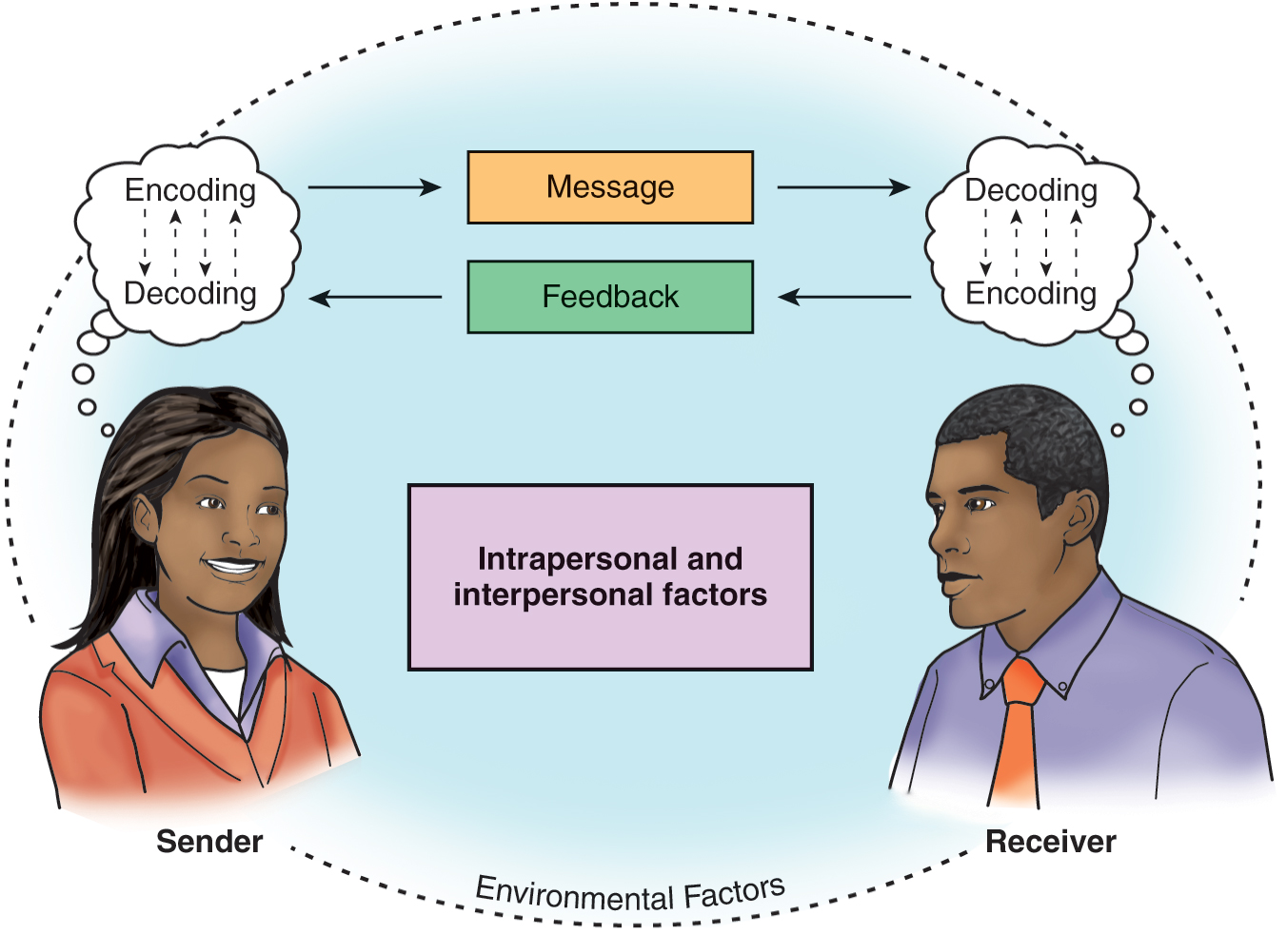
Communication Components
Notes:
<< Instructor: Review this visual with the students and allow them time to ask questions. >>

Slide 8
ClickerCheck
During the communication process, “decoding” is
The selection of words by the sender
The interpretation of the message by the receiver
The method by which the message is given
The way in which feedback is interpreted
Notes:
<< Instruct the students to select the most appropriate answer to this question using their clickers. >>

Slide 9
Correct Answer: B
Decoding is the interpretation of the message by the receiver.
Notes:
The correct answer is B.

Slide 10
Verbal Communication
Involves speaking or writing words to send a message
Notes:
<< Instructor: Review this definition with the students. >>
Verbal communication is the use of spoken and written words to send a message. It is influenced by such factors as educational background, culture, language, age, and past experiences. Verbal communication is generally a conscious act in which the sender is able to select the most effective words to communicate a message. When delivering a verbal message, the goal is that the receiver will understand both your words and your meaning.

Slide 11
Factors Affecting Verbal Communication
Vocabulary
Denotative vs. connotative meaning
Pacing of conversation
Intonation: Tone, pitch, cadence, volume
Clarity and brevity
Timing
Relevance of information
Credibility of the sender
Humor
Notes:
<< Instructor: Review each bulleted item while referring to the following notes. >>
Vocabulary: It is your responsibility to deliver messages that the client can understand; therefore, use medical terms only when you are certain the listener understands them. When encoding a message, consider the receiver’s age, knowledge, education, and any cultural differences, including primary language spoken. (These factors are discussed shortly.) Encourage feedback to be sure that the receiver understood the message as you intended.
Denotative vs. connotative meaning: Denotation is the literal (dictionary) meaning of a word. In contrast, connotation is the implied or emotional meaning of the word.
Pacing of conversation: The pace and rhythm of the delivery can alter the receiver’s interpretation of the message.
Intonation: “Tone of voice” reflects the feeling behind the words. We get a sense of a person’s intonation by listening to the pitch (high or low), cadence (rising and falling of the pitch), and volume (soft or loud).
Clarity and brevity: You can achieve brevity by using the fewest words possible. A conversation that is clear and brief holds the interest of all parties and effectively conveys the intended messages.
Timing: Timing also means that the interaction must allow time for response. A rapid flow of questions or one-sided conversations inhibit interaction.
Relevance of information: Communication is effective when both parties value the interaction and find the discussion relevant.
Credibility of the sender: Credibility depends on a pattern of honest and timely response to patient concerns, as well as congruence between your verbal and nonverbal communication.
Humor: Humor and laughing can have a positive influence on attitude and healing. Laughter can create physiological changes that contribute to well-being and provide an emotional release in a tense situation.

Slide 12
ClickerCheck
The nurse is teaching the client about his upcoming procedure and the client is very stressed. What is most important for the nurse to do?
Use humor first to decrease the client’s stress level.
Determine if the teaching should take place at a different time.
Introduce himself as the RN to give credibility to his message.
Speak to the client when family members are there so they can teach the client.
Notes:
<< Instruct the students to select the most appropriate answer to this question using their clickers. >>

Slide 13
Correct Answer: B
Clients who are stressed may be unable to listen fully and will not receive/understand the intended message.
Notes:
The correct answer is B.

Slide 14
Nonverbal Communication
The unconscious use of body language when sending a message
Notes:
<< Instructor: Review this definition with the students. >>

Slide 15
Factors Affecting Nonverbal Communication
Facial expression: Communicates feelings behind a message
Posture and gait: Clue to attitude, self-concept
Personal appearance: Clue to socioeconomic status, culture, feelings
Gestures: Emphasize and clarify spoken word; can have different meanings
Touch: Can be misinterpreted
Notes:
<< Instructor: Review each bulleted item while referring to the following notes. >>
Facial expressions communicate joy, anger, sadness, concern, or fear. Raised eyebrows, staring, squinting, or darting eyes all convey meaning.
Posture and gait: Body position, gait, and posture offer clues to a person’s attitudes, emotions, physical well-being, and self-concept.
Personal appearance: Clothing and personal appearance provide clues to a person’s feelings, socioeconomic status, culture, and religion. Dress and accessories are powerful cultural clues.
Gestures: Hand and body gestures emphasize and clarify the spoken word. They are good indicators of the feeling tone behind the conversation.
Touch: Touch can convey affection, caring, concern, and encouragement. Avoid using touch when dealing with someone who is angry or mentally disturbed because the touch may be misinterpreted (e.g., as a sign of aggression or sexual attraction). Although touch can be highly effective, use it with conscious awareness of the situation, environment, culture, and receptivity of the patient.

Slide 16
Nonverbal Communication
Notes:
What nonverbal cues does this nurse use to convey caring?

Slide 17
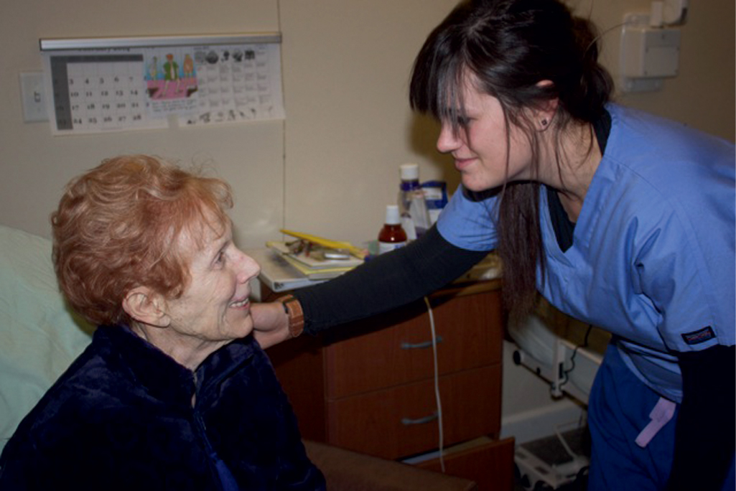
Nonverbal Communication (cont’d)
Notes:
How does this nurse convey caring to the patient?

Slide 18
Factors That Affect Communication in General
Environment
Developmental variations
Gender
Personal space
Territoriality
Sociocultural factors
Roles and relationships
Notes:
<< Instructor: Review each bulleted item while referring to the following notes. >>
Environment: Communication is most successful in an environment that is quiet, private, free of unpleasant smells, and at a comfortable temperature. Think creatively to secure the most comfortable environment possible for communicating with patients and families. Hospital chapels, foyers, and activity rooms may be ideal locations for conversation.
Developmental variations: Physical and cognitive development, language skills, level of education, and maturity influence the communication process. Thus, you will need to modify your communication strategies to fit your client’s developmental level.
Gender: Gender differences in communication are important to nurses because male and female patients may communicate their needs very differently. Similarly, the gender of the nurse may affect the response to the patient’s requests. For example, a female patient might state, “I feel so lousy today.” A female nurse may interpret this as a desire to talk. In contrast, a male nurse may discuss pain control.
Personal space: People vary in the amount of physical space they are comfortable with when communicating. The distance they maintain between one another is influenced by the relationship of the individuals, the nature of the conversation, the setting, and cultural influences.
Territoriality refers to the space and things that an individual identifies as belonging to him. Territories may be bounded and visible to others or may be defined by the individual in a way not noticeable to others.
Sociocultural factors: Culture and socioeconomic status strongly influence communication. Facial expressions, nonverbal communication, and even the selection of whom to interact with are affected. For example, in some cultures it would be unacceptable for a male nurse to address and provide care to a female patient.
Roles and relationships of the sender and receiver affect communication. They affect the choice of vocabulary, tone of voice, use of gestures, and distance associated with the communication.

Slide 19
Collaborative Professional Communication
Assertive style
Uses standard communication tools
Notes:
You might recognize collaborative professional communication by the following characteristics:
Uses an assertive style
Makes use of standard communication tools

Slide 20
Communication Styles
Passive
Aggressive
Notes:
A passive approach avoids conflict and allows others to take the lead. It tends to be submissive, helpless, indecisive, apologetic, or whining.
An aggressive approach, in contrast, forces others to lose. The goal is to win and be in. Aggressive communication can be bossy, arrogant, opinionated, sarcastic, manipulative, intolerant, or overbearing.

Slide 21
Assertive Communication
Speak clearly and positively.
Maintain professional composure.
Use “I” statements.
Focus on the issue.
Use effective nonverbal communication.
Don’t invite negative responses.
Accept criticism.
Use negative inquiry.
Strive for a compromise.
Notes:
Assertive communication is the expression of a wide range of positive and negative thoughts and feelings in a style that is direct, open, honest, spontaneous, responsible, and nonjudgmental. Assertiveness recognizes your rights while still respecting the rights of others. It allows you to take responsibility for your own thoughts and actions without blaming others, encourages feedback, and enables you to find mutually satisfying solutions to conflict by confronting people constructively. Assertive communication has the following characteristics:
Speak clearly and firmly in a positive manner; convey a “can do” attitude.
Maintain professional composure.
Question care decisions openly and honestly.
Use “I” statements.
Focus on the issue, not the participants.
Use effective nonverbal language.
Don’t invite negative responses.
Learn to accept criticism without becoming anxious or defensive.
Use negative inquiry.
Strive for a workable compromise,.

Slide 22
Communicating Within the Healthcare Team
SBAR: Situation, Background, Assessment, Recommendation, Questions
Patient rounds
Notes:
<< Instructor: Review each bulleted item while referring to the following notes. >>
Professionals often have different communication styles. Nurses are taught to be more descriptive of clinical situations and patient responses, whereas physicians learn to be concise and precise. Standardized communication tools are quite effective in overcoming differences in nurse–physician communication styles, and conveying key information clearly and concisely. Structured communication tools not only ensure accuracy but also create an environment for individuals to express concerns, thus improving interdisciplinary communication and patient outcomes.
Patient rounding is a collaborative approach in which physicians and nurses gather at the patient’s bedside to discuss goals for care and/or changes in the plan of care and to answer the questions of the patient, family, and healthcare staff. Meeting for rounds allows the nurse to provide input, which results in improved nurse and physician working relationships and professional satisfaction.

Slide 23
Therapeutic Relationships in Healthcare
Focus on improving the health of the client.
Provide necessary information about health, treatments, and care.
Involve use of therapeutic communication.
Notes:
<< Instructor: Review each bulleted item on this slide. >>

Slide 24
Therapeutic Communication
Client-centered
Goal-directed
Strengthens therapeutic relationship
Notes:
<< Instructor: Review each bulleted item while referring to the following notes. >>
Therapeutic communication is client-centered communication directed at achieving client goals. It is used to establish the therapeutic relationship, provide and obtain healthcare information, and express interest and concern for the client and family.

Slide 25
Phases of the Therapeutic Relationship
Stage 1: Preinteraction phase
Gathering information prior to meeting client
Notes:
<< Instructor: Review this definition of Stage 1 with the students. >>
Stage 1: Preinteraction phase: This phase involves gathering information about the client, but the nurse and client do not have direct communication.

Slide 26
Phases of the Therapeutic Relationship (cont’d)
Stage 2: Orientation phase
Meeting the client; introductions; establishing rapport and trust
Notes:
<< Instructor: Review this definition of Stage 2 with the students. >>
Stage 2: Orientation phase: The goal of this phase is to establish rapport and trust through the use of verbal and nonverbal communication. Orientation begins with introductions, followed by an initial exchange of information, such as the client’s reason for the visit or chief concerns. Orientation ends when the relationship has been defined.

Slide 27
Phases of the Therapeutic Relationship (cont’d)
Stage 3: Working phase
Use of techniques germane to therapeutic communication
Active part of the relationship
Client clarifies feelings and concerns through verbal and nonverbal communication
Notes:
<< Instructor: Review these definitions of Stage 3 with the students. >>
Stage 3: Working phase: During this phase, the nurse communicates caring, the patient expresses thoughts and feelings, mutual respect is maintained, and honest verbal and nonverbal expression occurs. Key communication goals are to assist the client to clarify feelings and concerns.

Slide 28
Phases of the Therapeutic Relationship (cont’d)
Stage 4: Termination phase
Conclusion of the relationship
Notes:
<< Instructor: Review this definition of Stage 4 with the students. >>
Stage 4: Termination phase: The conclusion of the relationship, whether at the end of the nurse’s shift or on the client’s discharge from the unit, facility, or service. Reviewing and summarizing help to bring the relationship to a comfortable conclusion.

Slide 29
ClickerCheck
Use of the statements “Tell me more about …” or “I see” encourages clients to continue talking and expressing themselves. This is called
Summarizing
Open-ended questions
Focusing
Encouraging elaboration
Notes:
<< Instruct the students to select the most appropriate answer to this question using their clickers. >>

Slide 30
Correct Answer: D
Use of the statements “Tell me more about …” or “I see” encourages clients to continue talking and expressing themselves. This is called encouraging elaboration.
Notes:
The correct answer is D.

Slide 31
Key Characteristics of Therapeutic Communication
Empathy
Respect
Genuineness
Concreteness
Confrontation
Notes:
<< Instructor: Review each bulleted item while referring to the following notes. >>
Empathy is the desire to understand and be sensitive to the feelings, beliefs, and situation of another person. Empathy is more than sharing of information. Empathy requires you to be willing to adapt your style, tone, vocabulary, and behavior to create the best approach for each client situation.
Respect: In the therapeutic relationship, you communicate respect by valuing the client and being flexible to meet the client’s needs. As a nurse, you must be willing to adjust to your client rather than expecting the client to adjust to you, the healthcare environment, or hospital routines.
Genuineness is the ability to respond honestly. If you are unable to answer a client’s question, do not offer guesses. Be honest. Tell the client you need assistance before you can answer the question. Genuineness also involves willingness to self-evaluate. How well did I communicate? Did I handle that situation appropriately? How could I improve my communication?
Concreteness: In a therapeutic relationship, you must offer understandable responses to a client’s questions and concerns. To do so requires you to express in concrete, specific terms what you mean.
Confrontation: Communication is a reciprocal process. If your client is unable to express his thoughts clearly, you must be willing to confront him to request clarification. Similarly, you must be willing to be confronted if you are unclear.

Slide 32
Group Communication
Types of groups
Task
Ongoing
Self-help
Therapy
Work-related social
Notes:
Groups can enhance problem-solving and creativity, generate understanding and support, enhance morale, and provide affiliation. However, groupthink, a pattern of communication in which consensus overrides creativity in problem-solving, can emerge, particularly in cohesive groups or those with unbalanced power structure.
Task groups are formed to address a task or fulfill a need. Typically, members are chosen based on ability to complete the task. Other times members are selected for reasons of convenience, such as availability, interest, or agenda, rather than for the skills needed to accomplish the goal of the group.
Ongoing groups address recurrent issues. Committees are a form of an ongoing task group. Ongoing committees in healthcare organizations include quality improvement, infection control, and discharge planning. Members have designated roles within the group. A leader or chairperson is usually appointed or elected. In small groups, members have an opportunity to communicate their opinions. In larger groups, patterns of communication form; some members voice their opinion regularly, whereas others are often silent. When not all members speak, it is essential to examine nonverbal behavior to determine whether the nonspeaking members are in agreement.
Self-help groups are voluntary organizations composed of individuals with a common need. Members are encouraged to share experiences and seek support from other members of the group.
Therapy groups are organized to help individual members cope with challenging personal issues or stressful life events, such as divorce, death of a spouse, or new motherhood. Therapy groups may also address ways to improve relationships and communication. Also called self-awareness or growth groups, they may be ongoing or have a designated length of operation.
Work-related social support groups help members of a profession cope with the stress associated with their work.

Slide 33
Assessment
Medications
Language, vocabulary, literacy
Cognitive function
Hearing
Vision
Aphasia
Physiological barriers
Communication style
Notes:
A focused assessment should identify factors that alter a patient’s ability to receive, understand, and transmit verbal and nonverbal messages and include:
Medications
Language, vocabulary, literacy
Cognitive function
Hearing
Vision
Aphasia
Physiological barriers
Communication style

Slide 34
Analysis/Nursing Diagnosis
Readiness for Enhanced Communication
Impaired Verbal Communication
Impaired Communication
Notes:
Communication can be the problem or the etiology of a nursing diagnosis. The following NANDA-I diagnosis labels describe communication problems. Note that communication problems may involve the inability to receive, interpret, or express spoken, written, and nonverbal messages.
Readiness for Enhanced Communication is appropriate when the client expresses willingness to improve communication that is already effective.
Impaired Verbal Communication is useful if the client has 1) expressive aphasia or a physiological problem such as dyspnea, stuttering, or laryngeal cancer that impairs the ability to speak; or 2) receptive aphasia or sensory deficits that impair the ability to receive messages.
Impaired Communication is the preferred diagnosis if the client is unfamiliar with the dominant language or has some other difficulty receiving and sending messages. Note: This is not a NANDA-I label.

Slide 35
Planning Outcomes/Evaluation
Depend on the nursing diagnoses
Notes:
Individualized client outcomes and goals depend on the nursing diagnosis you identify.

Slide 36
Planning Interventions/Implementation
Enhance therapeutic communication
Barriers to therapeutic communication
Notes:
The following are actions to improve your communication with patients and others.

Slide 37
Enhance Therapeutic Communication
Address the patient.
Listen actively.
Establish trust.
Be assertive.
Restate, clarify, and validate message.
Interpret body language and share observations.
Notes:
<<Instructor: Review each bulleted item on this slide.>>

Slide 38
Enhance Therapeutic Communication (cont’d)
Explore issues.
Use silence.
Summarize the conversation.
Use process recordings.
Notes:
<<Instructor: Review each bulleted item on this slide.>>

Slide 39
Barriers to Therapeutic Communication
Asking too many questions
Fire-hosing information
Asking why
Changing the subject inappropriately
Failing to probe
Expressing approval or disapproval
Offering advice
Notes:
<<Instructor: Review each bulleted item on this slide.>>

Slide 40
Barriers to Therapeutic Communication (cont’d)
Providing false reassurance
Stereotyping
Using patronizing language
Notes:
<<Instructor: Review each bulleted item on this slide.>>

Slide 41
Communication: Another Culture
General guidelines
Language barrier issues
Notes:
Clinical Insight 20-3 ➤ Communicating With Clients From Another Culture
General guidelines:
Most important: Be aware of your own cultural beliefs and attitudes.
Learn about other cultures, especially those in your area.
Convey empathy and show respect.
Be certain the communication strategies you usually use are culturally appropriate for the individual.
Use touch cautiously. In some cultures, it is inappropriate to touch certain parts of the body.
Proceed slowly. Rushing may cause the patient to be more anxious and is offensive to some.
Smile and be polite, but not overfriendly or casual. Use the patient’s title and last name when introducing yourself.
Use short words and sentences. Don’t give too much information in one sentence.
Present one idea at a time.
Provide written teaching materials.
If there is a language barrier:
Written information provided must be appropriate to the population served and the language of the patient.
Use a trained medical interpreter, if possible.

Slide 42
Communication: Impaired Speech
Hand gestures
Family assistance
Be positive and patient
Notes:
Clinical Insight 20-4 ➤ Communicating With Clients Who Have Impaired Speech
Nonverbal communication is the key to communication with clients with impaired speech.
Ask the client to use hand gestures and a picture board, as appropriate.
Solicit family assistance in understanding the client’s speech.
Provide a comfortable environment for the client to practice speaking.
Be positive and patient.
Although the client may have difficulty speaking, you should continue to speak and explain all procedures.
A referral to a speech pathologist may be necessary.

Slide 43
Communication: Impaired Cognition
Always communicate.
Address the patient.
Don’t rush.
Eliminate distractions.
Use short sentences.
Ask yes/no questions.
Notes:
Clinical Insight 20-5 ➤ Communicating With Patients Who Have Impaired Cognition or Consciousness
Always try to communicate.
Address the patient slowly and from the front.
Don’t rush the patient.
Use multiple communication modalities.
Provide reminders.
Orient the client.
Eliminate distractions.
Stimulate memory.
Use short sentences.
Ask yes/no questions.
Ask one question at a time.
Limit choices.
Be concrete and specific.
Avoid slang and jargon.
Use gestures.
Don’t assume.

Slide 44
Safe, Effective Nursing Care
The basis for safe, effective care is Thinking, Doing, and Caring. The nurse is caring for a patient with dementia, who is agitated and having trouble reasoning. How might the nurse show caring when providing a morning bed bath? Give some examples.
Notes:
<<Instructor: Allow some good class discussion about how the nurse would show caring for the patient who is combative and difficult to work with. Students will offer different ideas for showing compassion and care for the patient. They might suggest:
Approaching her slowly and from the front as to not frighten her or cause her to feel threatened.
Using a gentle, calm voice; speaking slowly and clearly without rushing.
Rescheduling a better time to do the morning care if the patient is combative or aggressive. Timing is very important.
Asking questions that require simple or yes/no answers, rather than broad, open-ended, or vague questions. Short sentences are best and one simple topic at a time. Comments should be concrete and specific.
Allowing time for the patient to respond to simple directions one at a time.
Orienting her to person, place, time, and situation in the course of conversation while giving the bed bath. This not only helps to orient her but also is a good distraction technique.
Turning the TV on while bathing the patient or performing other care that requires cooperation.
Aiding her memory by repeating her last expressed thought, if she loses her train of thought.
Avoiding slang and jargon. A person with dementia and confusion does not interpret figurative language well.
Using gestures to aid in understanding.
Providing for basic physical needs (e.g., toileting, meals, pain control) before attempting to provide care that requires cooperation.
There are many other ideas that students will come up with. These are just a few examples.>>

Slide 45
Socratic Reasoning
Your patient with addiction to prescription pain reliever is aggressively insisting that he needs a higher dose than prescribed.
Establishing a therapeutic relationship with this patient could be challenging. What do you think could cause this to happen? Patient factors? Nurse factors? Family factors?
What challenges might the nurse experience in establishing patient boundaries within a therapeutic relationship?
Give an example of how the patient might be experiencing this situation.
Describe your own experience in establishing a therapeutic relationship that worked or didn’t work.
Notes:
<<Instructor: These Socratic-style questions trigger discussion about implications and consequences involving therapeutic relationships. Use this scenario to probe assumptions, seek alternate viewpoints, analyze possible contributory factors to a complex situation, and examine implications using personal examples. >>

