Slide 1

Chapter 7
Oxygen Therapy Management

Slide 2
Overview
Anatomy
  Tracheostomy
  Surfactant
  Compliance
Physiology
  Ventilation
  Perfusion
  Oxygenation
Pathophysiology
  Hypoxia
  Hypoxemia
  Dyspnea
Notes:
Anatomy
Tracheostomy – In patients unable to maintain a normal airway, an opening/stoma directly into the trachea by a surgical opening
Surfactant – A phospholipid and protein substance that covers the alveoli to prevent the alveoli from collapsing by reducing surface tension in the alveoli, allowing for gas exchange to take place
Compliance – Ease of expansion of the lungs
Physiology
Ventilation – Movement of air in and out of the lungs
Perfusion – Gas exchange of oxygen and CO2 at alveoli-capillary membrane
Oxygenation – Process of oxygen passively diffusing from alveoli to the blood
Pathophysiology
Hypoxia – Insufficient oxygen to meet the metabolic demands of the cells, tissues, and organs
Hypoxemia – PaO2 level in blood <60 or SaO2 <90
Dyspnea – Subjective feeling of difficulty breathing

Slide 3
Indications for Supplemental Oxygen
PaO2 < 60 mmHg
SaO2 <90%
Increased need for oxygen
  Fever
  Infection
  Anxiety
  Anemia
Notes:
Oxygen therapy is initiated with the intent of treating and preventing the clinical manifestations of hypoxia. Indications for oxygen therapy include PaO2 less than 60 mm Hg or SaO2 less than 90% in a patient breathing room air or a PaO2 and/or SaO2 below the indicated or prescribed range for the patient’s clinical situation. Conditions that result in low PaO2 or SaO2 levels include respiratory, cardiac, and/or central nervous system disorders. Oxygen therapy may be indicated when there is an increased need for oxygen, such as a patient with a fever, infection, anxiety, and/or anemia, to meet the metabolic demands of these conditions

Slide 4
Contraindications to Oxygen Administration
Hypercapnia
Hypercarbia
Notes:
Use extreme caution with patients who are hypoxic and have chronic hypercapnia or hypercarbia (increased PaCO2 levels in the blood), which is often observed in patients with COPD. In a patient with COPD, a low PaO2 level (hypoxia) is the patient’s primary drive for breathing. Oxygen therapy should be started with caution in patients with COPD because delivering too much oxygen may interfere with the hypoxic drive for breathing, leading to decreased respiratory effort and ultimately rate.

Slide 5
Oxygen Monitoring and Measurement
Pulse oximetry
Arterial blood gas (A B G)
  pH
  PaO2
  PaCO2
  HCO3
  SaO2
Notes:
Pulse oximetry – Noninvasive method that can be used in any setting to obtain the oxygen saturation of hemoglobin (SpO2) in the blood. The pulse oximeter is the device used to perform the measurement. It uses a light sensor that has two sources of light (red and infrared) that pass through the skin to measure the amount of hemoglobin saturated with oxygen.
Arterial blood gas analysis is used to measure the pH, PaO2, PaCO2, HCO3 ̄ (bicarbonate), and SaO2 levels of the blood. The ABG sample is obtained through an arterial puncture, usually via the radial or femoral artery, or through an indwelling arterial line or pulmonary artery catheter.

Slide 6
Table 7-1 Normal Arterial Blood Gas Values
Arterial Blood Gas
pH
PaO2
PaCO2
HCO3¯
SaO2
Normal Range
7.35–7.45
80–95 mm Hg
35–45 mm Hg
22–26 mEq/L
95%–100%
Notes:
Table 7-1 Normal Arterial Blood Gas Values

Slide 7
Noninvasive Oxygen Delivery Methods
Low-flow delivery devices
  Nasal cannula
  Face masks
    Simple face mask
    Partial rebreather mask
    Nonrebreather mask
Notes:
Overview

Slide 8
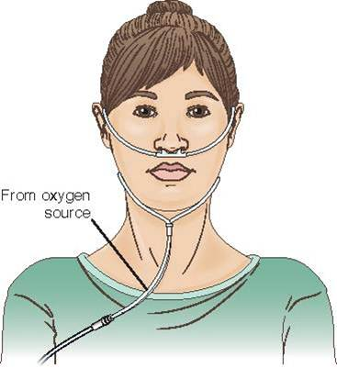
Noninvasive Oxygen Delivery Methods – Low Flow
Nasal cannula
  Delivers 24% (1L/min)-44% (6L/min)
  Used in all care settings and the home
  Most common
  Most comfortable
  Mobile
  Less expensive
Notes:
Figure 7.1 – Nasal cannula.
The nasal cannula device delivers oxygen through tubing that has two soft prongs on one end that are placed into the patient’s nares (Fig. 7.1); the other end of the tubing is connected to an oxygen source. This is the most commonly used delivery system because it is more comfortable, mobile, easy to use, and less expensive than other delivery systems.
The oxygen concentrations of 24% (1 L/min) to 44% (6 L/min) are administered via the nasal cannula.

Slide 9
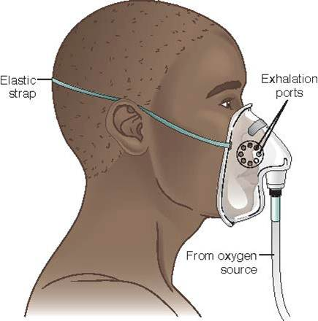
Noninvasive Oxygen Delivery Methods – Low Flow (continued_1)
Simple face mask
  Flow rates 5-10 L/min or 40%-60%
  Used short term
  Helpful for transport
Notes:
Figure 7.2 Simple face mask.
The simple face mask is used when the patient needs a moderate amount of oxygen to maintain an adequate PaO2 level.

Slide 10
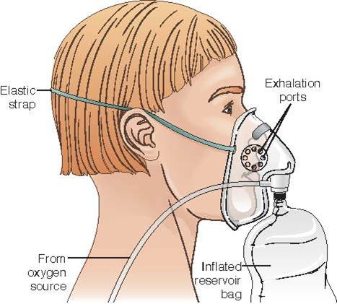
Noninvasive Oxygen Delivery Methods – Low Flow (continued_2)
Partial rebreather mask
  Simple mask with reservoir bag attached
  Reservoir bag filled with oxygen
  Flow rate of 8-10L/min
  50%-75% oxygen to patient
Notes:
Figure 7.3 Partial rebreather mask
A partial rebreather is a simple mask with a reservoir bag attached (Fig. 7.3). The patient breathes in the oxygen from the reservoir bag; on exhalation, the bag refills with oxygen, and the exhaled gases exit through small holes on both sides of the mask. This allows for a greater concentration of oxygen to be delivered to the patient than with the simple face mask. Oxygen flow must be maintained to keep the reservoir bag one-third to one-half full on inspiration. Maintaining a flow rate of 8 to 10 L/min to this device can provide 50% to 75% oxygen to the patient.

Slide 11
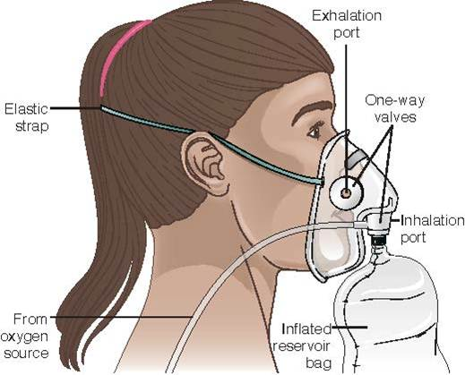
Noninvasive Oxygen Delivery Methods – Low Flow (continued_3)
Nonrebreather mask
  One-way valves between mask and bag
  One-way valves on side of mask
  Prevents rebreathing of CO2
  Flow rate 10mL/min
  90% oxygen to patient
Notes:
Figure 7.4 Nonrebreather mask
A nonrebreather mask is similar to the partial rebreather mask except this mask has one-way valves (Fig. 7.4). There is a one-way valve between the bag and the mask that prevents the exhaled air from entering the bag, thus ensuring a higher/more accurate oxygen concentration in the reservoir. This device also has one-way valves on both sides of the mask to prevent room air from entering the mask on inhalation. The reservoir bag must be kept inflated at one-third to one-half full on inspiration so that the patient receives the optimal amount of oxygen, and there should be a minimal flow rate of 10 L/min to maintain bag inflation. The nonrebreather mask can provide up to 90% oxygen to the patient.

Slide 12
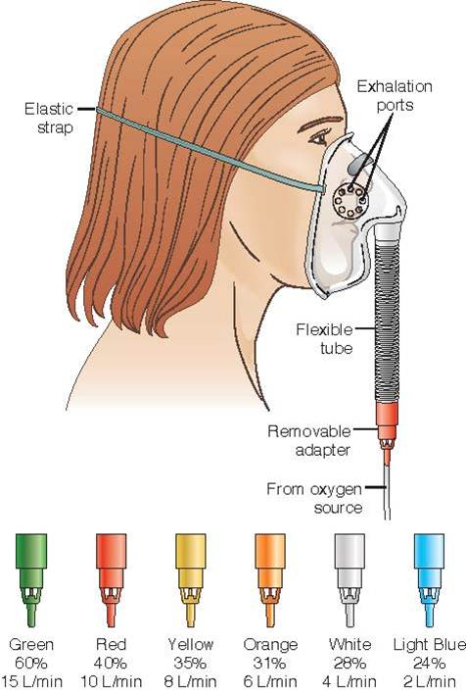
Noninvasive Oxygen Delivery Methods – High Flow
Venturi mask
  Most accurate oxygen concentration
  Flow rate 2-15 L/min
  Oxygen concentration 24%-60%
Notes:
Figure 7.5 Venturi mask
The Venturi mask is the most commonly used high-flow delivery device because this device delivers the most accurate oxygen concentration (Fig. 7.5). This device can deliver oxygen concentrations of 24% to 60% by using different adapters and by adjusting the oxygen flow from 2 to 15 L/min. The adapter indicates the flow rate of oxygen that should be maintained to provide the prescribed percentage of oxygen to the patient.

Slide 13
Noninvasive Oxygen Delivery Methods – High Flow (continued_1)
Aerosol mask
  Indicated for high-humidity oxygen concentration
    Post extubation
    Post upper airway surgery
    Thick secretions
Notes:
This device delivers aerosol therapy that includes humidification and/or medications in order to liquefy secretions for easier removal. It is also used to humidify the respiratory tract, relieve bronchospasm (contraction of the smooth muscles of the bronchioles), and reduce edema of the respiratory tract.

Slide 14
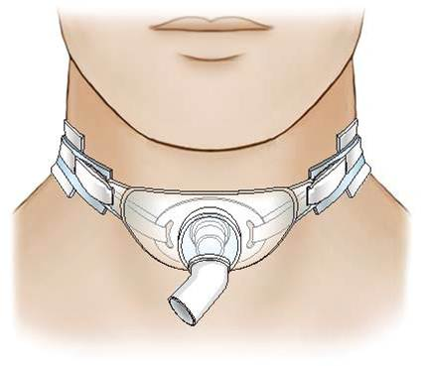
Noninvasive Oxygen Delivery Methods – High Flow (continued_2)
Tracheostomy collar
  Used for patients with tracheostomy
  Needs humidified oxygen
  Can deliver supplemental oxygen
Notes:
Figure 7.6 Tracheostomy collar
This device allows humidified oxygen to be delivered to the patient via the tracheostomy collar because the air is inhaled directly through the tracheostomy and bypasses the usual humidification and filtration processes provided by the nose and mouth.

Slide 15
Noninvasive Oxygen Delivery Methods – High Flow (continued_3)
T-Piece adapter
  Used to wean patient off a ventilator
  Can be used with endotracheal, nasotracheal, or tracheostomy tube
  Used for spontaneous breathing trial
Notes:
This device connects an oxygen source with humidification to the ETT or tracheostomy tube. The T-piece adapter provides high humidity with the desired oxygen concentration and allows a spontaneous breathing trial (SBT) to be performed prior to extubating the patient.

Slide 16
Noninvasive Oxygen Delivery Methods – High Flow (continued_4)
Face tent
  Facial trauma
  Burns
  Upper airway surgery
Notes:
The face tent is a device used for patients who have facial trauma, have burns, or have had upper airway surgery. The device fits under the chin and extends just above the ears. This device allows the delivery of oxygen mixed with a mist.

Slide 17
Noninvasive Oxygen Delivery Methods – High Flow (continued_5)
High flow nasal cannula
  Delivers heated and humidified medical gas
  Up to 60 L/min
Notes:
High-flow nasal cannula uses an air-oxygen blender (blends O2 with compressed air), active humidifier, single heated tube, and nasal cannula to deliver heated and humidified medical gas up to 60 L/min. The advantages include reduced anatomical dead space, positive end-expiratory pressure (PEEP), constant FIO2, and humidification. Soft and flexible nasal prongs are used for the comfort of the patient.

Slide 18
Noninvasive Positive-Pressure Ventilation
Continuous positive airway pressure (C P A P)
Bi-level positive airway pressure (B I P A P)
Notes:
Continuous positive airway pressure provides the patient with a preset, continuous positive pressure throughout the respiratory cycle. The positive pressure is delivered continuously with each breath and is used to keep the alveoli open and to increase the amount of oxygen delivered. The constant pressure keeps the alveoli open during inspiration and exhalation.
Bi-level positive airway pressure provides the patient with two preset pressures; one preset pressure is delivered during inspiration, and the other preset pressure is delivered during exhalation. This modality provides positive pressure at the end of exhalation along with a higher positive airway pressure during inhalation, which allows for better oxygenation and ventilation.

Slide 19
Long-Term Oxygen Therapy
Indicated for chronic hypoxemia associated with chronic disease
May be indicated for specific activities (i.e., during sleep)
Available in different forms
  Liquid oxygen
  Compressed oxygen
  Oxygen concentrator
Notes:
Long-term oxygen therapy may be indicated for the treatment of hypoxemia in patients with a diagnosis of COPD or with specific clinical conditions associated with hypoxemia, such as heart failure, cystic fibrosis, or sleep apnea.
Some of these patients may not meet the criteria for continuous home oxygen therapy but may develop hypoxemia during exercise, ambulation, or during sleep. The indication for oxygen therapy during specific activities, but not continuously, includes an SaO2 level falling to levels less than or equal to 90%. The nasal cannula can be used for continuous or intermittent oxygen therapy in the home
Liquid oxygen is often used for people who are more active because large amounts of oxygen can be stored in smaller portable units. These smaller units can be refilled from a large reservoir canister. The disadvantage is that there is an evaporation loss when the canisters are not used.
An oxygen concentrator is an electrical device that produces oxygen by removing nitrogen, water vapor, and hydrocarbons that are in the air and extracts the oxygen. The advantage of this system is that it does not need to be resupplied and is less expensive than liquid oxygen.
Compressed oxygen is stored under pressure and can be supplied in large cylinders to be used as stationary units in the home. The large tanks are heavy and can be used only in a stationary manner.

Slide 20
Complications of Oxygen Therapy
Oxygen toxicity
Absorption atelectasis
Mucous membrane dryness
Infection
Notes:
Oxygen toxicity – Can develop as a result of the administration of an oxygen concentration equal to or greater than 50% over 24 to 48 hours. The high levels of oxygen can cause damage to the alveolar-capillary membrane and inactivate surfactant production in the lungs.
Absorption atelectasis – High levels of oxygen are administered and cause the alveoli to collapse.
Mucous membrane dryness – Oxygen has a drying effect on the mucous membranes because the humidification of the inspired air is lessened for the patient who is receiving oxygen therapy. When oxygen therapy is prescribed at levels greater than 4 L/min via nasal cannula, humidification should be added.
Infection – The equipment used to deliver oxygen, such as the humidifier, nebulizer, nasal cannula, oxygen tubing, and/or masks, can be a source of bacteria causing infection due to moisture that may accumulate.

Slide 21
Invasive Oxygen Delivery
Artificial airways – Endotracheal tube
  Passed through the nose or mouth into the trachea
  Placement is called intubation
    Performed by a credentialed provider
  Managed by nurse and respiratory therapist
  Complications: Unplanned extubation, aspiration, infection
Notes:
Figure 7.8 Endotracheal tube (ETT)
An endotracheal tube (ETT) is an artificial airway used to maintain a patent airway when a patient is having respiratory distress. An ETT is a long tube made of polyvinyl chloride that is passed either nasally or orally through the vocal cords into the trachea and is placed just above the carina (the point where the trachea divides into the left and right mainstem bronchi).
Endotracheal tubes are indicated when there is upper airway obstruction, apnea, high risk for aspiration, ineffective airway clearance, and/or respiratory distress.
The role of the nurse is to ensure proper ETT management by maintaining a patent airway, monitoring the patient for complications, maintaining proper cuff inflation, providing oral care and suctioning as needed, maintaining correct tube placement, monitoring oxygenation and vital signs, and educating the patient and family members. This role is shared with the respiratory therapist, who works closely with the nurses in managing the patient who has an ETT and is also being mechanically ventilated.
Complications of endotracheal intubation include unplanned extubation, aspiration, and infection.

Slide 22
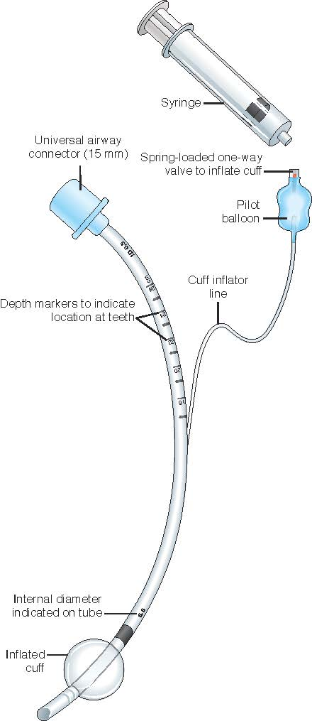
Invasive Oxygen Delivery (continued_1)
Notes:
Figure 7.8 Endotracheal tube (ETT)
An endotracheal tube (ETT) is an artificial airway used to maintain a patent airway when a patient is having respiratory distress. An ETT is a long tube made of polyvinyl chloride that is passed either nasally or orally through the vocal cords into the trachea and is placed just above the carina (the point where the trachea divides into the left and right mainstem bronchi).
Endotracheal tubes are indicated when there is upper airway obstruction, apnea, high risk for aspiration, ineffective airway clearance, and/or respiratory distress.
The role of the nurse is to ensure proper ETT management by maintaining a patent airway, monitoring the patient for complications, maintaining proper cuff inflation, providing oral care and suctioning as needed, maintaining correct tube placement, monitoring oxygenation and vital signs, and educating the patient and family members. This role is shared with the respiratory therapist, who works closely with the nurses in managing the patient who has an ETT and is also being mechanically ventilated.
Complications of endotracheal intubation include unplanned extubation, aspiration, and infection.

Slide 23
Invasive Oxygen Delivery (continued_2)
Artificial airways – Tracheostomy
  Indicated if mechanical ventilation is required >7-14 days
  Advantages
    Decreased airway resistance
    Decreased work of breathing
    Improved oral care
    Improved suctioning
    Improved patient comfort
Notes:
If a patient requires mechanical ventilation for longer than 7 to 14 days, a tracheotomy is usually performed to prevent the laryngeal and upper airway damage that is associated with the prolonged use of an ETT. A tracheostomy is indicated to provide a stable airway in patients who require long-term ventilator support, to allow access to the lower airway for suctioning, and to relieve upper airway obstructions.

Slide 24
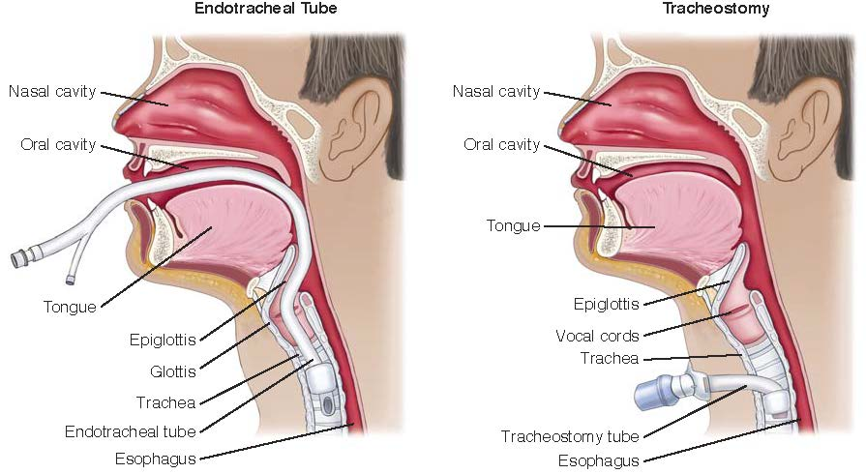
Invasive Oxygen Delivery (continued_3)
Notes:
Figure 7.9 Endotracheal tube (ETT) versus tracheostomy
Other advantages include improved airway security due to the fact that an ETT is not as secure as a tracheostomy tube, improved access for the removal of pulmonary secretions, and improved patient comfort. The tracheostomy tube allows the oral cavity to be free of tubes, making it easier for reading lips, and in time, patients may be able to eat with a tracheostomy in place.

Slide 25
Invasive Oxygen Delivery (continued_4)
Tracheostomy care
  Suctioning
  Replace inner cannula
  Clean stoma site
  Maintain sterile tracheostomy dressing
  Replace Velcro tracheostomy holder if soiled
Notes:
Suctioning – Some patients require suctioning every 1 to 2 hours, and other patients may require less suctioning. Assess breath sounds for wheezes, crackles, and/or rhonchi; these sounds may indicate a need for suctioning. Other indications may include coughing, audible secretions, an increase in pulse or respirations, or restlessness.
Replace inner cannula – Secures a clean inner cannula and reestablishes airway
Clean stoma site – Remove secretions from stoma site and clean area to prevent microorganism growth and excoriation.
Maintain sterile tracheostomy dressing – Dry surfaces provide decreased growth of microorganisms and skin excoriation.
Replace Velcro tracheostomy holder if soiled – Use of two caregivers prevents dislodgement of tracheostomy tube.

Slide 26
Invasive Oxygen Delivery (continued_5)
Post-tracheostomy complications
  Accidental decannulation
  Pneumothorax
  Subcutaneous emphysema
  Infection
  Tracheal stenosis
  Tracheoesophogeal fistula
Notes:
Accidental decannulation – Accidental tracheostomy tube decannulation within the first 72 hours of the surgical procedure is considered a medical emergency because the tracheostomy is not mature, and during reinsertion, there is a greater risk for tissue damage and unsuccessful ventilation.
Pneumothorax – A collection of air in the pleural cavity. This complication may occur during the tracheotomy procedure if the lung is pierced during the procedure, allowing air to enter the chest cavity.
Subcutaneous emphysema – Puncture or tear in the trachea and air moves into the surrounding tissue. The air can move into the neck area, chest, or even the face.
Infection – While the patient is in the hospital, it is imperative to use aseptic techniques when providing tracheostomy care and when suctioning the patient.
Tracheal stenosis – Narrowing of the trachea due to scar tissue that forms from irritation of the mucosal lining of the trachea from the cuff
Tracheoesophogeal fistula – Can develop as a result of over inflation of the tracheostomy cuff. The excessive pressure from the cuff causes a fistula (hole) to occur between the trachea and the esophagus.

Slide 27
Therapeutic Modalities
Incentive spirometry
Chest physiotherapy
Nebulizer treatments
Intermittent positive-pressure breathing
Notes:
Incentive spirometry – A handheld respiratory device designed to assist the patient in deep-breathing exercises and encourage the patient to breathe slowly and deeply to allow lung expansion and to prevent or reverse atelectasis.
Chest physiotherapy – Consists of percussion, vibration, and postural drainage. After CPT, the patient is encouraged to breathe deeply and cough to clear the airway.
Nebulizer treatments – Prescribed by a healthcare provider and are usually administered by a respiratory therapist or another trained healthcare provider. Nebulizer treatments use bronchodilators, corticosteroids, and/or mucolytic agents to assist in thinning secretions, to reduce bronchospasm, and to reduce edema or inflammation of the bronchioles.
Intermittent positive-pressure breathing – Prescribed by the healthcare provider to improve lung expansion, to deliver aerosol medications, or to assist the patient in ventilation

Slide 28
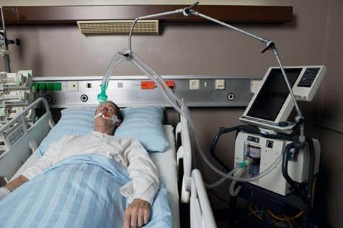
Mechanical Ventilation
Mechanical ventilation
Negative-pressure ventilation
Positive-pressure ventilation
Notes:
Figure 7.15 Mechanical ventilation
Mechanical ventilation – Required when a patient can not maintain adequate ventilation and/or perfusion. Indications include acute respiratory failure; heart failure; exacerbation of COPD; protection of the airway due to cardiac arrest, drug overdose, or respiratory depression; and spinal cord or neurological trauma. The goal of mechanical ventilation is to support the patient until the underlying pathophysiological process is corrected.
Negative pressure ventilation – Noninvasive mechanical ventilation modality used for patients with respiratory disorders usually associated with neuromuscular disorders that impede the normal respiratory muscle function, such as muscular dystrophy. During spontaneous breathing, negative pressure is created when the thoracic cavity expands, causing intrapulmonary pressure to drop and air to flow into the lungs. This type of ventilation is similar to natural respiration.
Positive pressure ventilation – Usually requires placement of either an endotracheal tube (ETT) or a tracheostomy tube. This type of ventilator provides positive-pressure ventilation to support the patient who has impaired ventilation, and it is provided by exerting positive pressure on the airways, pushing air into the lungs, causing the alveoli to participate in gas exchange. Exhalation occurs passively.

Slide 29
Mechanical Ventilation (continued_1)
Mechanical ventilator settings
  Fraction of inspired oxygen
  Rate
  Tidal volume
  Flow
  Positive end-expiratory pressure
Notes:
Fraction of inspired oxygen – Amount of oxygen the patient receives
Rate – Number of respirations the patient receives per minute from the ventilator
Tidal volume – Amount of preset air that is delivered with each breath, measured in mL
Flow – Velocity of gas flow or volume of gas per minute
Positive end-expiratory pressure – Positive pressure applied at the end of expiration to prevent alveolar collapse

Slide 30
Mechanical Ventilation (continued_2)
Modes of ventilation
  Assist-control
  Intermittent mandatory ventilation
  Synchronized intermittent mandatory ventilation
  Airway pressure-release ventilation
  Pressure-support ventilation
Notes:
Assist-control – Used for patients who have weak respiratory muscles and are unable to maintain adequate ventilation. Rate and volume of breaths are preset.
Intermittent mandatory ventilation – Provides a combination of ventilator-assisted breaths and spontaneous breaths
Synchronized intermittent mandatory ventilation – Used for patients being weaned from the ventilator. If the patient does not initiate a breath, the ventilator delivers a preset volume and rate per minute.
Airway pressure-release ventilation – Designed for spontaneously breathing patients who need high pressure to recruit alveoli
Pressure-support ventilation – Gives a set positive pressure during spontaneous respirations

Slide 31
Mechanical Ventilation (continued_3)
Complications
  Hypotension
  Aspiration
  Ventilator-associated pneumonia
  Infection
  Barotrauma
Notes:
Hypotension – Increased intrathoracic pressure decreases venous return to the right side of the heart and ultimately decreases cardiac output
Aspiration – Aspiration of gastric secretions and pulmonary secretions is a potential complication because the natural defense of the epiglottis is bypassed when an artificial airway is in place.
Ventilator-associated pneumonia – A serious healthcare-associated infection resulting in high morbidity, high mortality, and high costs of treatment. Aspiration of oropharyngeal and/or gastric fluids is presumed to be an essential step in the development of VAP, and it typically develops 48 hours or more after endotracheal intubation.
Infection – The normal defenses of the upper and lower respiratory systems are bypassed. The ETT or the tracheostomy tube can become a direct source to the lungs because both increase the risk of introduction of infectious substances.
Barotrauma – A complication of the mechanical ventilator due to the increased positive pressure applied to the lungs, which can cause alveolar rupture. Overdistention of the alveoli can lead to an excessive amount of air entering into the pleural space, causing a tension pneumothorax.

Slide 32
Mechanical Ventilation (continued_4)
Nursing management – Nursing diagnoses
  Ineffective airway clearance
  Ineffective breathing pattern
  Impaired gas exchange
  Risk for trauma and infection
  Decreased cardiac output
  Impaired verbal communication
Notes:
Nursing diagnoses include:
Ineffective airway clearance
Ineffective breathing pattern
Impaired gas exchange
Risk for trauma and infection
Decreased cardiac output
Impaired verbal communication

Slide 33
Mechanical Ventilation (continued_5)
Nursing management – Nursing interventions
  Maintain HOB 30-45 degrees
  Clear airway secretions
  Daily readiness to wean assessment
  Peptic ulcer disease prophylaxis
  Deep vein thrombosis prophylaxis
  Daily oral care with chlorhexidine
Notes:
Nursing interventions
Maintain HOB 30-45 degrees – Reduce risk for aspiration.
Clear airway secretions – Reduce the risk of aspiration and clear airway of secretions.
Daily readiness to wean assessment – Excessive sedation may reduce respiratory rate and effort.
Peptic ulcer disease prophylaxis – Reduce the risk of peptic ulcer disease and GI bleed.
Deep vein thrombosis prophylaxis – Anticoagulants and sequential compression devices
Daily oral care with chlorhexidine – To prevent pneumonia and infection

Slide 34
Mechanical Ventilation (continued_6)
Weaning criteria
  Ability to breathe spontaneously
  Ability to support adequate oxygenation
  Ability to maintain hemodynamic stability
Notes:
The patient is assessed daily to determine readiness for the weaning process and discontinuation of the ventilator. The patient should demonstrate evidence that the underlying cause of respiratory failure has been reversed before the patient can be weaned from the ventilator.

Slide 35
Mechanical Ventilation (continued_7)
Weaning methods
  Pressure support
  C P A P
  T-piece
Notes:
Weaning methods
Pressure support – Used to assist the patient in overcoming the resistance of the ETT and assists the alveoli with perfusion support
CPAP – Used to assist the patient in overcoming ETT resistance through constant pressure maintained throughout respiratory cycle
T-piece – Ventilator is disconnected and patient breathes through ETT.

Slide 36
Mechanical Ventilation (continued_8)
Weaning complications
  Reintubation
  Aspiration
  Stridor
Notes:
Reintubation is the major concern with patients after extuabation.
Aspiration – As the tube is removed, patient can aspirate secretions.
Monitor the patient for any signs of airway obstruction, such as dyspnea, cyanosis, coughing, and stridor. Stridor is an abnormal, high-pitched, crowing sound heard on inspiration that is caused by edema of the glottis or laryngospasm.

Slide 37
Case Study: Episode 1
Sarah Graham, a 70-year-old Caucasian female, presents to the emergency department with complaints of shortness of breath, chills, weakness, and having a productive cough with yellow/green secretions. At night, she sleeps with two pillows behind her back to make it easier to breathe. Mrs. Graham is having difficulty trying to finish a sentence without stopping to rest to catch her breath.

Slide 38
Case Study: Episode 1 (continued_1)
It hurts when she tries to take a deep breath, and the cough gets worse. History includes chronic obstructive pulmonary disease (C O P D), hypertension (H T N), osteoarthritis, and hypothyroidism.

Slide 39
Case Study: Episode 1 (continued_2)
Temperature (T) 101°F (38°C)
Pulse 102 beats per minute
Respiratory rate (R R) 32 breaths per minute
Blood pressure (B P) 142/84 mm Hg
Pulse oximetry (P O) 88% on room air

Slide 40
Case Study: Episode 1 (continued_3)
History: She has a history of C O P D, H T N, osteoarthritis, and hypothyroidism. Social History: Mrs. Graham states that she smokes one pack of cigarettes per day but has decreased the number of cigarettes because of her difficulty in breathing. She has smoked since she was 16 years old. She has not had much of an appetite the last several days and complains of being tired and weak all the time.

Slide 41
Case Study: Episode 1 (continued_4)
Home Medications:
Boniva IV every 3 months
Lisinopril 40 mg every day
Potassium 20 mEq every day
Vitamin D 1,000 units every day
Synthroid 0.1 mg every day
Fish oil every day
Colace 100 mg as needed
Spiriva 1 capsule inhalation daily

Slide 42
Case Study: Episode 2
A physical examination reveals a frail woman who complains of shortness of breath, chills, and weakness, and she has a productive cough of yellow/green sputum. She states that at night she has to use two pillows to make her breathing easier. Now she has problems trying to finish a sentence without stopping to take a breath. It hurts when she tries to take a deep breath, and she notices the coughing gets worse.

Slide 43
Case Study: Episode 2 (continued_1)
Mrs. Graham is alert and oriented times 3, crackles are noted in the lower bases of the lungs with an occasional expiratory wheeze, and her peripheral pulses are palpable but weak. Her abdomen is flat with bowel sounds present.

Slide 44
Case Study: Episode 2 (continued_2)
An indwelling urinary (Foley) catheter is placed, with 80 mL of amber-colored urine noted in the urinary drainage bag. Her skin is warm to the touch and pink in color. She is placed on the cardiac monitor, which reveals a heart rate of 102 bpm with occasional (premature ventricular contractions (P V C’s). A peripheral IV line is started with 0.9% normal saline at 80 mL an hour.

Slide 45
Case Study: Episode 2 (continued_3)
The following diagnostic results are received: Chest x-ray indicates consolidation in the lower lobes of the lungs.
A B G’s:
pH
PaO2
PaCO2
HCO3
SaO2
7.32
56 mm Hg
52 mm Hg
30 mEq/L
88%

Slide 46
Case Study: Episode 2 (continued_4)
Hematology results:
White blood cells (W B C’s)
Red blood cells (R B C’s)
Hemoglobin (Hgb)
Hematocrit (Hct)
Platelets (Plt).
14,000 mm3
6.2 g/dL
18 g/dL
54%
380,000 mm3
A sputum culture is sent to the laboratory. Blood cultures ×2 are sent to the laboratory. Because of these findings, Mrs. Graham is started on a Venturi mask at 28% oxygen.

Slide 47
Case Study: Episode 3
Mrs. Graham becomes confused and combative, her SaO2 drops to 82%, and she pulls off her Venturi mask. Her BP drops to 88/46, and her A B G’s are as follows:
A B G’s:
pH
PaO2
PaCO2
HCO3
SaO2
7.24
58 mm Hg
62 mm Hg
34 mEq/L
82%

Slide 48
Case Study: Episode 3 (continued_1)
Mrs. Graham is intubated and given a 1,000-mL bolus of 0.9% normal saline (N S) and is transferred to the medical intensive care unit. Upon arrival, she is given another 1,000-mL bolus of N S, vancomycin 1 g I V ordered S T A T, and an order to continue the vancomycin 1 g IV every 12 hours. Ventilator settings are as follows:
S I M V:
Vt
FiO2
S I M V
P E E P
550
100%
12
5 cm H2O

Slide 49
Case Study: Episode 3 (continued_2)
Admission orders:
Vital signs (V S) every hour
Continuous electrocardiogram (E C G) and P O monitoring
A B G’s 2 hours after intubation
Daily labs: ABGs, complete blood count (C B C), chemical profile
Portable chest x-ray (C X R) and ECG daily
I V D51/2 N S with 20 mEq of potassium chloride (K C l) at 84 mL/hr Enoxaparin (Lovenox) 40 mg subcutaneous daily
Famotidine (Pepcid) 20 mg intravenous push (I V P) daily

Slide 50
Case Study: Episode 3 (continued_3)
Admission orders:
Methylprednisolone (Solu-Medrol) 125 mg I V piggyback (I V P B) every 8 hours
Nebulizer treatments with albuterol (Ventolin) 2.5 mg every 4 hours and prn
Bedrest
Maintenance of ventilator settings
Strict intake/output (I/O) every hour
Head of bed (H O B) elevated at 30 degrees
Mouth care every 4 hours and prn
Daily sedation vacation
Smoking cessation

Slide 51
Case Study: Episode 3 (continued_4)
Place orogastric tube and begin Pulmocare (enteral nutrition formula) @ 20 mL/hr; increase by 10 mL/hr until a goal of 40 mL/hr is established. Hold tube feedings for residual greater than 100 mL.

Slide 52
Case Study: Episode 3 (continued_5)
The following A B G results are obtained after 2 hours on the previously mentioned settings on the ventilator.
A B G’s:
pH
PaO2
PaCO2
HCO3 ¯
SaO2
7.36
90 mm Hg
46 mm Hg
30 mEq/L
98%

Slide 53
Case Study: Wrap-up
Daily A B G’s and chest x-rays are obtained. Mrs. Graham goes through daily sedation vacations, and on the third day, she successfully passes the weaning trial and is extubated and placed on 2 L of oxygen via nasal cannula and maintains a P O of 94%.

Slide 54
Case Study: Wrap-up (continued_1)
Mrs. Graham and her family are provided with teaching on the following to prevent further exacerbations:
Medication therapy, including reason, action, time, and adverse effects
Importance of making follow-up appointments
Smoking cessation
Breathing exercises
Signs of respiratory infection
Avoiding exposure to people with infections
Need to balance rest and exercise

Slide 55
Case Study: Wrap-up (continued_2)
Discharge planning is begun to transfer Mrs. Graham to a short-term rehabilitation facility to focus on reconditioning and maximizing independence.

Slide 56
Case Study
1. The nurse correlates which clinical manifestations observed in Mrs. Graham to hypoxia?
A. Shortness of breath
B. Chills
C. Productive cough
D. Fever
Notes:
Answer: A
Rationale: Early signs of hypoxia including a
change in mental status, anxiety, restlessness, and/or
confusion because the cells in the brain are not
receiving an adequate supply of oxygen. An increase
in respiratory rate and shortness of breath are also
associated with hypoxia as the body attempts
to increase oxygen delivery. Fever, chills, and
productive correlate to possible pneumonia, and
hypoxia does not always manifest with pneumonia.

Slide 57
Case Study (continued_1)
2. The nurse identifies which benefits of placing Mrs. Graham on a Venturi mask? (Select all that apply.)
A. It delivers low levels of oxygen.
B. It minimizes rebreathing of exhaled CO2.
C. It does not require high flow rates of oxygen.
D. It provides a more precise concentration of oxygen.
E. It provides higher concentrations of oxygen.
Notes:
Answer: B, D, and E
Rationale: The Venturi mask is the most commonly
used high flow delivery device because this device
delivers the most accurate oxygen concentration.
This device can deliver oxygen concentrations of
24% to 50% by using different adaptors and by
adjusting the oxygen concentration from 4-10L/min.
The adapter indicates what the flow rate of oxygen
should be maintained to provide the prescribed
percentage of oxygen to the patient.

Slide 58
Case Study (continued_2)
3. In observing Mrs. Graham for changes in respiratory status, which findings correlate with worsening hypoxia?
A. Decreased PaCO2
B. Decreased respiratory rate
C. Decreased heart rate
D. Decreased PaO2
Notes:
Answer: D
Rationale: The decreased PaO2 are most closely correlated
to hypoxia. Decreased PaCO2 is associated
with hyperventilation. Clinical manifestations of
hypoxia also include increased respiratory rate and
heart rate and dyspnea.

Slide 59
Case Study (continued_3)
4. What is the rationale for Mrs. Graham being ordered Pepcid (famotidine) 20 mg I V push daily when intubated and placed on the mechanical ventilator?
A. To decrease inflammation in the airways
B. To reduce gastric acidity
C. To minimize constipation
D. To enhance gastric emptying
Notes:
Answer: B
Rationale: Medications that reduce gastric acidity
have been shown to protect patients from developing
peptic ulcer disease and gastrointestinal bleeding
due to the stress of intubation. Steroids are
indicated to decrease inflammation and stool
softeners to minimize constipation. Medications to
enhance gastric emptying are not typically indicated
in ventilated patients.

Slide 60
Case Study (continued_4)
5. The nurse identifies which ventilator setting as most important in preventing alveolar collapse in Mrs. Graham while intubated?
A. FiO2 of 100%
B. Vt of 550 mL
C. P E E P of 5 cm H2O
D. S I M V with rate of 12
Notes:
Answer: C
Rationale: Positive end expiratory pressure (PEEP)
is positive pressure applied at the end of expiration
to help prevent alveolar collapse. PEEP improves
oxygenation, allowing the FIO2 level to be lowered.
FIO2 correlates to the concentration of oxygen being
delivered. Tidal volume is the volume of air delivered
with each mechanical breath, and SIMV is a
ventilator mode that synchronizes intermittent
mandatory ventilator breaths with the patient’s
spontaneous breaths.

