Slide 1

Chapter 25
Coordinating Care for Patients With Upper Airway Disorders

Slide 2
Rhinitis
Epidemiology
  Most common nose/sinus problem
  20% of population
Notes:
Rhinitis is the most common problem with the nose and sinuses, affecting 20% of the population. Although not life threatening, rhinitis can impact quality of life by causing headaches, fatigue, sleep disturbances, and cognitive impairment. Rhinitis can result in widespread morbidity with significant financial impact from medical treatment costs, lost workdays with resulting reduced work productivity, and lost school days. Thirty to 60 million American adults and children experience allergic rhinitis.

Slide 3
Rhinitis (continued_1)
Pathophysiology
  Inflammation of mucous membranes of the nose in response to irritant
  Allergic or nonallergic
  Perennial or seasonal
Notes:
Rhinitis is classified as allergic or nonallergic and acute or chronic. It is inflammation and irritation of mucous membranes lining the nose. It can also affect the eyes, throat, and ears. Allergic rhinitis is categorized as perennial (occurring throughout the year) or seasonal. It occurs in response to exposure to allergens found in the environment, medications, foods, or occupational irritants. Common environmental allergens include mold, dust mites, cockroach droppings, weeds, trees, and animal dander. Foods that may induce allergic rhinitis include peanuts, cow’s milk, nuts, eggs, and wheat. Medications such as angiotensin-converting enzyme (ACE) inhibitors, phosphodiesterase-5–selective inhibitors such as Viagra, penicillin-based medications, and aspirin and other NSAIDs may also induce symptoms. In response to the offending allergens, the lining of the nasal mucosa becomes inflamed, congested, and edematous. Mechanical obstructions within the nose or sinuses, such as polyps, nasal septal deviation, and hypertrophy of the nasal turbinate or sinus tumors, may also result in the development of rhinitis.
Nonallergic rhinitis presents similarly to allergic rhinitis but does not involve the immune system. The most common example of nonallergic rhinitis is the common cold, which is caused by a variety of viruses and is usually self-limiting unless a bacterial infection occurs simultaneously. Acute rhinitis can last 1 to 3 weeks; chronic rhinitis may last up to 12 weeks.

Slide 4
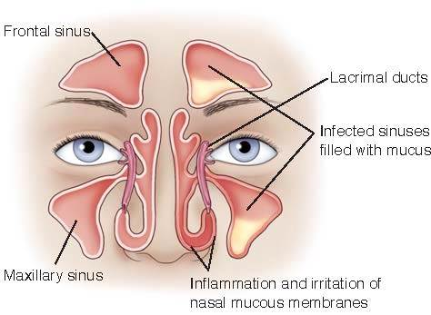
Rhinitis (continued_2)
Notes:
FIGURE 25.1 Rhinitis: inflammation of the mucous membranes and sinuses filled with mucus.

Slide 5
Rhinitis (continued_3)
Clinical Manifestations
  Nasal itching
  Sneezing
  Nasal congestion
  Rhinorrhea
Notes:
Symptoms of rhinitis include nasal itching, sneezing, nasal congestion, and rhinorrhea (runny nose, which is excessive nasal drainage). In chronic rhinitis, symptoms last 12 weeks or longer, with discolored nasal discharge and radiographical evidence of fluid levels within the sinuses.

Slide 6
Rhinitis (continued_4)
Medical Management – Diagnosis
  History and symptoms
  Pulmonary function tests
Notes:
Treatment and management of rhinitis are dependent on the cause. Diagnosis is based on history and symptoms. Obtaining a history of the onset of symptoms that focuses on the pattern, seasonal aspects, environmental exposures to allergens in the home or work, and precipitating factors serves as the basis of determining treatment. If rhinitis is the result of a viral cause, medication to relieve symptoms may be prescribed. In patients with allergic rhinitis, allergy testing may be indicated, followed by a desensitizing regimen.
Additional diagnostic testing may include pulmonary function testing to evaluate for the presence of asthma or OSA. Monitoring of the peak flow rate, a measurement of how fast a person can breathe out (exhale) air, and spirometry, measurement of the amount (volume) and/or speed (flow) of air that can be inhaled and exhaled, are done for evaluating effective treatment of asthma.

Slide 7
Rhinitis (continued_5)
Medical Management – Treatment
  Symptom relief
Notes:
Pharmacological management in allergic and nonallergic rhinitis is aimed at symptom relief.

Slide 8
Rhinitis (continued_6)
Medical Management – Medications
  Oral antihistamines
  Nasal spray
  Decongestants
Notes:
Pharmacological management in allergic and nonallergic rhinitis is aimed at symptom relief. The use of oral antihistamines, nasal spray antihistamines and corticosteroids, and decongestant medications can assist in the relief of symptoms. Prescription and over-the-counter (OTC) antihistamines are the most common treatment of rhinitis symptoms of sneezing, rhinorrhea, and pruritus. Sedation, performance impairment, and anticholinergic effects such as dry mouth and eyes, constipation, and increased heart rate are common side effects of first-generation antihistamines. Second-generation OTC antihistamines such as loratadine (Alavert, Claritin) have less or no tendency to cause sedation. Long-term use of nonsedating antihistamines in rare cases results in mild acute liver injury.

Slide 9
Rhinitis (continued_7)
Nursing Management – Assessment and analysis
  Irritation and inflammation
    Sneezing
    Nasal congestion
    Nasal drainage
Notes:
Symptoms of rhinitis are due to irritation and inflammation of the mucous membranes of the nose, resulting in sneezing, excessive nasal congestion, and nasal drainage.

Slide 10
Rhinitis (continued_8)
Nursing Management – Nursing diagnoses
  Alteration in comfort
  Knowledge deficit
  Risk for infection
Notes:
Alteration in comfort related to sinus inflammation
Knowledge deficit related to medication regimen
Risk for infection related to inadequate primary defenses

Slide 11
Rhinitis (continued_9)
Nursing Interventions – Assessments
  Vital signs
  Peak flow rate
  Nasal drainage
Notes:
Vital signs — Temperature elevation may indicate the presence of infection. Elevations in heart rate and blood pressure may be related to the medication used to treat symptoms.
Peak flow rate and spirometry (if acute asthma exacerbation also present) — Assessment of peak flow rate and spirometry may indicate the severity of exacerbation and response to therapy.
Nasal drainage — Nasal drainage should be thin and clear. Yellow or green indicates infection.

Slide 12
Rhinitis (continued_10)
Nursing Interventions – Actions
  Administer medication as prescribed
Notes:
Administer medications as prescribed: oral or nasal antihistamines, oral or nasal corticosteroids, decongestants, antibiotics — Antihistamines, corticosteroids, and decongestants are used to control the symptoms of excessive drainage, inflammation, and nasal congestion. Antibiotics are used to treat infection.

Slide 13
Rhinitis (continued_11)
Nursing Interventions – Teaching
  Appropriate use of medications
  Avoidance of known allergens or triggers
  Preventing spread of infection
Notes:
Appropriate use of medications — Instruct patients to utilize medications as prescribed for best results. Avoid nasal decongestant use for greater than 2 to 3 days at a time due to the risk of rebound congestion. Instruct the patient to complete antibiotic therapy as prescribed to avoid superinfection or the creation of antibiotic medication resistance.
Avoidance of known allergens or triggers — Reduced exposure to triggers is the first-line treatment to avoid symptoms.
Preventing the spread of infection — Instruct patients about the importance of hand hygiene and covering the mouth when coughing or sneezing. Dispose of facial tissues containing nasal drainage.

Slide 14
Rhinitis (continued_12)
Nursing Management – Evaluating care outcomes
  Decrease in nasal drainage and congestion
  Relief of headache
Notes:
Relief of symptoms is the expected outcome for the patient with rhinitis. A decrease in nasal drainage and congestion and the relief of headache can be achieved with the avoidance of allergens and the use of appropriate medications.

Slide 15
Rhinosinusitis
Epidemiology
  Symptomatic inflammation of nasal and paranasal cavity
  One in eight Americans
Notes:
Rhinosinusitis is the preferred term when referring to sinusitis because it is a more comprehensive term. Rhinosinusitis is the symptomatic inflammation of the nasal cavity and the paranasal cavity. According to the American Academy of Otolaryngology–Head and Neck Surgery Foundation, one in eight Americans is affected by rhinosinusitis, resulting in 30 million people diagnosed each year. Healthcare related costs are estimated at $11 billion annually. These costs are related to acute care and emergency department visits and surgical procedures on the paranasal sinuses.

Slide 16
Rhinosinusitis (continued_1)
Pathophysiology
  Infection and inflammation of paranasal sinuses
  Vasodilation, increased blood flow, vascular permeability
  Reduced size of nasal sinus
  Nasal congestion, obstruction of airflow
Notes:
Rhinosinusitis is infection and inflammation of the paranasal sinuses, the four paired air-filled spaces that surround the nasal cavity. They include the maxillary, frontal, sphenoid, and ethmoid sinuses. Inflammation of the nasal passages causes vasodilation, increased blood flow, and vascular permeability, reducing the size of the nasal passages. Nasal congestion occurs as a result of swelling of the nasal turbinates, bony structures along the nasal passages that aid in maintaining moisture and trapping airborne particles. This results in obstruction of nasal airflow.

Slide 17
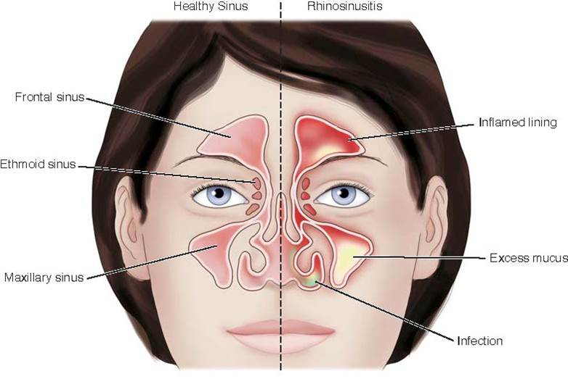
Rhinosinusitis (continued_2)
Notes:
Figure 25.2 Rhinosinusitis: Inflamed sinuses filled with excess mucus.

Slide 18
Rhinosinusitis (continued_3)
Clinical Manifestations
  Purulent nasal drainage, nasal obstruction, facial pain
  Fatigue, fever, maxillary dental pain, cough, ear fullness
Notes:
Acute rhinosinusitis is diagnosed by the presence of three symptoms: purulent nasal discharge; nasal obstruction; and facial pain, pressure, and fullness. Normal nasal secretions are clear. In acute rhinosinusitis, nasal secretions are colored or cloudy in nature. Nasal obstruction may be reported as congestion, stuffiness, or blockage of the nasal passages. Facial pain, pressure, and fullness may be located in the anterior face, in the periorbital areas, or as a diffuse or localized headache. The onset of these symptoms in relation to the development of upper respiratory symptoms indicates ABRS.
Additional symptoms may include fatigue, fever, maxillary dental pain, cough, and ear fullness or pressure. Nasal or purulent drainage may also be noted in the posterior pharynx. Indications of extra sinus involvement include signs of neck stiffness (due to the development of meningitis), orbital protrusion, cellulitis of the face or orbit, and abnormal eye movement.

Slide 19
Rhinosinusitis (continued_4)
Medical Management – Diagnosis
  Physical exam and history
  Radiographical imaging
Notes:
Diagnosis is primarily based on a physical examination and starts with the completion of a history and physical examination focusing on the ears, nose, throat, teeth, sinuses, and chest. During the physical examination, the provider is looking for signs of inflammation, tenderness, firmness, or redness. Light palpation or percussion of the sinuses using the index finger is done to evaluate the presence of pain. A vital sign assessment also needs to be completed to identify temperature elevation. Diagnostic testing may include radiographical imaging of the sinuses, computed tomography (CT), and magnetic resonance imaging (MRI) if patients do not meet clinical diagnosis criteria. On radiographical studies, fluid; thickening of the mucous lining of the sinuses; and the presence of polyps, opacities, or foreign objects may be found, indicating rhinosinusitis.

Slide 20
Rhinosinusitis (continued_5)
Medical Management – Treatment
  Pain relief
  Reduction of nasal mucosal inflammation
  Treating infection
Notes:
The focus of treatment in acute rhinosinusitis is based on the etiology. Treatment goals include pain relief, reduction of nasal mucosal inflammation, and treating infection if present. Normal saline irrigation has local effects that reduce symptoms in acute rhinosinusitis. In this procedure, the patient pours or sprays normal saline into one nostril; it flows through the nasal cavity and pours out the other nostril. Irrigation is beneficial in the removal of infectious debris, bacteria, allergens, and inflammatory mediators. It also decreases edema of the nasal mucosa and the viscosity of nasal secretions.
Caution must be taken to prevent antibiotic use in nonbacterial illnesses such as viral rhinosinusitis to prevent the development of antibiotic resistance, but in bacterial infections, antibiotic therapy is required.

Slide 21
Rhinosinusitis (continued_6)
Complications
  Orbital cellulitis
  Orbital abscess
  Osteomyelitis
  Meningitis
  Sepsis
  Subdural abscess
Notes:
Acute rhinosinusitis, if left untreated or inadequately treated, can lead to several potentially serious although rare complications that include orbital cellulitis, orbital abscess, osteomyelitis, meningitis, sepsis, and subdural abscess. Orbital cellulitis and orbital abscess occur from the transfer of a sinus infection to the area surrounding the eye. In the setting of chronic sinus infection, bacteria can infect the facial bones, resulting in osteomyelitis. Meningitis and subdural abscess occur when bacteria pass through the meninges. Mucoceles, collections of fluid, can develop within the sinuses, primarily the frontal or ethmoid sinuses, because of obstruction and can result in bony erosion.

Slide 22
Rhinosinusitis (continued_7)
Nursing Management – Assessment and analysis
  Facial pressure
  Sense of fullness or pain > nasal obstruction
  Presence of purulent nasal discharge
Notes:
Symptoms of rhinosinusitis are due to obstruction in the flow of nasal drainage from inflammation of the sinus lining. Symptoms include a combination of facial pressure, sense of fullness or pain or nasal obstruction, and the presence of purulent (yellow-green) nasal discharge.

Slide 23
Rhinosinusitis (continued_8)
Nursing Management – Nursing diagnoses
  Risk for infection
  Acute pain
Notes:
Risk for infection related to obstruction and inflammation of the sinus lining
Acute pain related to nasal congestion

Slide 24
Rhinosinusitis (continued_9)
Nursing Interventions – Assessments
  Vital signs
  Physical examination
  Percussion of sinuses
Notes:
Vital signs — Temperature elevation may indicate the presence of infection. Increased blood pressure may be a side effect of the decongestants.
Physical examination of the mouth, nose, and face — Facial pressure, a sense of fullness or pain or nasal obstruction, and the presence of purulent (yellow-green) nasal discharge indicate impaired nasal drainage. Swelling, redness, and pain around the eyes may indicate an abscess or cellulitis.
Percussion of sinuses — Identifies presence of fluid within the sinus cavity, which results in pain.

Slide 25
Rhinosinusitis (continued_10)
Nursing Interventions – Actions
  Administer medication as prescribed
Notes:
Administer medications as prescribed: Normal saline irrigation, decongestants, and antibiotics — Irrigation, decongestants, and antibiotics are used to control the symptoms of nasal congestion, excessive drainage, and inflammation. Antibiotics are used to treat bacterial infection.

Slide 26
Rhinosinusitis (continued_11)
Nursing Interventions – Teaching
  Symptoms to report
  Correct medication usage
  Proper use of normal saline nasal rinse
Notes:
Symptoms to report to provider — Temperature, increase in pain, change in level of consciousness, redness, or edema around the face and eyes can indicate complications of rhinosinusitis.
Instruct patients on correct medication usage — Instruct patients to read the content of the active ingredients and utilize medications as prescribed to prevent overdosing. Start taking decongestants at the onset of symptoms. Complete all antibiotics as prescribed. Limit use of decongestant nasal sprays to less than 4 days to avoid rebound congestion.
Teach proper use of normal saline nasal rinse.
• Lean over the sink with head tilted to one side.
• Insert the spout of the neti pot or other irrigating device into the upper nostril.
• Slowly pour the normal saline into the upper nostril while continuing to breathe through the mouth.
• Allow fluid to drain out the lower nostril.
— Facilitates removal of debris and excess mucous

Slide 27
Rhinosinusitis (continued_12)
Nursing Management – Evaluating care outcomes
  Relief of nasal congestion
  Free of pain and pressure
  Free from infection
  Free from complications
Notes:
With treatment, patients experience a decrease in and resolution of symptoms, such as relief of nasal congestion and drainage, headache, and facial pressure or sense of fullness. The resolution of a bacterial infection is managed through antibiotics. It is important that the patient completes antibiotic therapy as prescribed and reports unresolved symptoms to avoid the serious complications of orbital cellulitis, osteomyelitis, or chronic sinus infection.

Slide 28
Obstructive Sleep Apnea
Epidemiology
  10%-15% females
  20%-30% males
Notes:
Obstructive sleep apnea (OSA) is a condition where the upper airway is obstructed during sleep, causing a narrowing of one or more sites of the upper airway, resulting in intermittent breathing patterns. It is estimated that 10% to 15% of females and 20% to 30% of males have OSA. Increased awareness and recognition, and thus testing, have resulted in an increased prevalence.

Slide 29
Obstructive Sleep Apnea (continued_1)
Risk Factors
  Atrial fibrillation
  Nocturnal dysrhythmias
  Type 2 diabetes mellitus
  Heart failure
  Pulmonary hypertension
  Male gender
  Obesity
  Cigarette smoking
  Alcohol use
  Age 40-65
  Craniofacial or upper airway soft tissue abnormalities
  Menopause
Notes:
A history of atrial fibrillation, nocturnal dysrhythmias, type 2 diabetes mellitus, heart failure, and pulmonary hypertension places patients at higher risk of OSA. Other risk factors for developing OSA include male gender, obesity, cigarette smoking, alcohol use, age between 40 and 65, craniofacial or upper airway soft tissue abnormalities, and menopause. Insulin resistance is seen in patients with OSA and is associated with increased severity. Increases in the prevalence of the risk factors have resulted in an increase in OSA.

Slide 30
Obstructive Sleep Apnea (continued_2)
Pathophysiology
  Upper airways narrow or collapse > increased resistance to airflow
  Sleep > muscle tone relaxes > normal work of breathing unable to overcome increased resistance > airway collapse
  Periods of apnea > no tidal volume or air movement
  Hypoxemia and hypercapnia
Notes:
Obstructive sleep apnea occurs during sleep as the upper airways narrow or collapse, increasing resistance to airflow. Narrowing can occur in the retropalatal region, retroglossal region, or nose. With the onset of sleep, the body muscle tone relaxes, which includes the muscles of the upper airway. With OSA, the normal work of breathing is unable to overcome the increased resistance in the upper airway, causing airway collapse. Narrowing of the upper airways increases inspiratory pressure and intrathoracic pressure, resulting in decreased minute ventilation and gas exchange. Ultimately, there are periods of apnea. During apnea, there is no tidal volume, or movement of air in or out; thus, no gas exchange occurs in the alveoli. Hypoxemia (decreased concentration of oxygen in the blood), hypercapnia (increased concentration of carbon dioxide in the blood), acidosis, and increased sympathetic vasoconstrictive activity occur as a result of the decreased tidal volume and apnea.

Slide 31
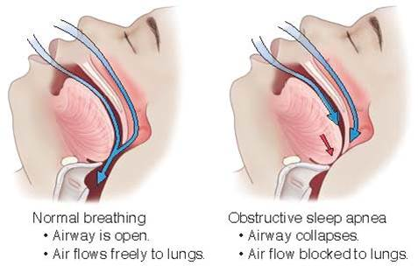
Obstructive Sleep Apnea (continued_3)
Notes:
FIGURE 25.3 Obstructive sleep apnea due to the collapse of the upper airways.

Slide 32
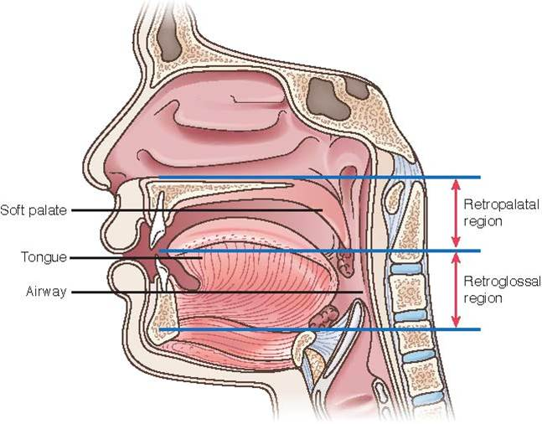
Obstructive Sleep Apnea (continued_4)
Notes:
FIGURE 25.4 Retropalatal region, retroglossal region of the upper airway.

Slide 33
Obstructive Sleep Apnea (continued_5)
Clinical Manifestations
  Loud snoring
  Snorting
  Witnessed apnea
  Gasping during sleep
  Recurrent waking during sleep
  Choking
Notes:
Obstructive sleep apnea is characterized by the following symptoms: loud snoring, snorting, witnessed apnea, gasping during sleep, recurrent waking during sleep, or choking. Spouses often report that patients have disruptive snoring and have witnessed periods of apnea. Fifteen or more obstructive sleep events per hour are sufficient to diagnose the presence of OSA. Because of these frequent sleep disruptions, patients complain of excessive daytime sleepiness, falling asleep during quiet times, short and repetitive attention lapses, and taking intentional naps. Daytime sleepiness has been linked to workplace and motor vehicle accidents and cognitive complaints of poor motor performance, executive performance, and visuospatial learning; storage and recall of visual information about the spatial relationship of objects, and constructional ability.

Slide 34
Obstructive Sleep Apnea (continued_6)
Medical Management – Diagnosis
  Sleep history
  Polysomnography (sleep study)
Notes:
Diagnostic testing begins with a sleep history, which includes gathering information on sleep patterns, a history of snoring, and daytime sleepiness. Polysomnography (a sleep study) is performed to diagnose OSA and can be conducted in an overnight sleep laboratory or using home portable monitoring. Numerous biophysiological measurements are obtained during sleep, including an electrocardiogram, pulse oximetry, respiratory airflow, eye and skeletal muscle movement, and an electroencephalogram. A key value obtained during the sleep study is the apnea-hypopnea index value, the number of apneic events each hour. It can be used to characterize the severity of OSA.

Slide 35
Obstructive Sleep Apnea (continued_7)
Medical Management – Treatment
  Continuous positive airway pressure
  Weight management
Notes:
Treatment of OSA requires multiple interventions and the active participation of the patient. The use of continuous positive airway pressure (CPAP) is the treatment of choice. Continuous positive airway pressure prevents collapse of the upper airway through the use of pressure delivered through the use of a nasal, oral, or oronasal mask during sleep. A CPAP machine delivers a continuous stream of positive pressure, keeping the airway open and providing an unobstructed airway. Patients are taught about the operation, care, and maintenance of the CPAP machine. Follow-up care is conducted for problem solving and to evaluate the effectiveness of therapy.
Weight management and loss are encouraged as a first-line intervention in conjunction with the use of CPAP. Positioning during sleep in a nonsupine position by using pillows is an effective secondary intervention. The avoidance of alcohol and sedatives before bedtime is an additional intervention. Oral appliances that are custom-made for the patient may be used to maintain airway patency. Oral appliances assist with mandibular repositioning to hold the mandible in a forward position to keep the airway open. Forward positioning of the tongue is accomplished with tongue retaining devices.

Slide 36
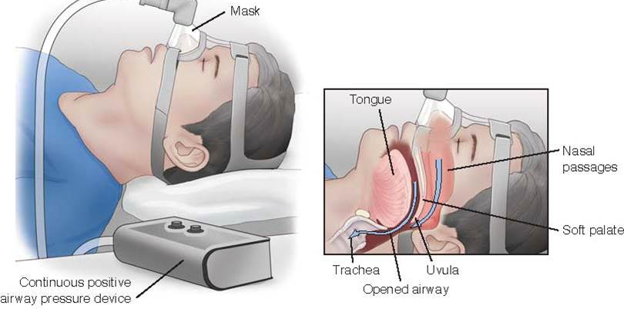
CPAP Machine
Notes:
FIGURE 25.5 Continuous positive airway pressure (CPAP) machine with compressor and mask. The CPAP machine provides continuous positive airway pressure, keeping the upper airways patent.

Slide 37
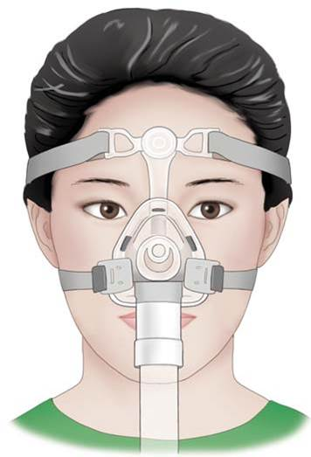
CPAP Mask
Notes:
FIGURE 25.6 Continuous positive airway pressure mask.

Slide 38
Obstructive Sleep Apnea (continued_8)
Surgical Management
  Tonsillectomy
  Adenoidectomy
  Uvulopalatopharyngoplasty
  Septoplasty
  Nasal polypectomy
  Tongue reduction
  Epiglottoplasty
  Bariatric surgery
Notes:
Surgical procedures for OSA are classified as primary or secondary interventions. Surgical procedures are considered primary interventions for patients with severe obstructing anatomy that surgery can correct. Surgery is considered a secondary intervention in patients who are intolerant of CPAP or oral appliances. Surgical procedures that involve the airway include tonsillectomy and/or adenoidectomy, uvulopalatopharyngoplasty, septoplasty, nasal polypectomy, tongue reduction, and epiglottoplasty. These procedures remove excess tissue in the airway that interferes with maintaining adequate airflow. Bariatric surgery to facilitate weight reduction is also a consideration.

Slide 39
Obstructive Sleep Apnea (continued_9)
Complications
  Cardiovascular disease
  Cardiac ischemia
  Myocardial infarction
  Erectile dysfunction
  Stroke
  Atrial fibrillation
  Heart failure
  Sudden cardiac death
Notes:
Obstructive sleep apnea is recognized as a mediator of cardiovascular disease because of recurrent hypoxemia, the release of inflammatory mediators such as endothelins (proteins that constrict blood vessels), and insulin resistance. In response to hypoxia, inflammatory mediators are released, which leads to the adherence of white blood cells to the endothelium, causing endothelial damage and atherosclerosis. The release of endothelin, a potent vasoconstrictor, results in endothelial dysfunction and damage. Severe nocturnal hypoxemia can result in cardiac ischemia, myocardial infarction, erectile dysfunction, stroke, atrial fibrillation, heart failure, and sudden cardiac death.

Slide 40
Obstructive Sleep Apnea (continued_10)
Nursing Management – Assessment and analysis
  No oxygen exchange
  Hypoxia
  Hypercapnia
Notes:
The symptoms of OSA are due to the relaxation of soft tissue in the upper airway that results in occlusion of the airway. Because of the occlusion of the airway, the patient snores, and periods of apnea occur. During apnea, there is no oxygen exchange, resulting in hypoxia and hypercapnia. As hypoxia and hypercapnia progress, the patient wakes and resumes breathing.

Slide 41
Obstructive Sleep Apnea (continued_11)
Nursing Management – Nursing diagnoses
  Sleep deprivation
  Risk for decreased cardiac tissue perfusion
  Ineffective sleeping pattern
Notes:
Sleep deprivation related to inability to breathe during sleep
Risk for decreased cardiac tissue perfusion related to hypoxia during sleep
Ineffective sleeping pattern related to cessation of breathing during sleep

Slide 42
Obstructive Sleep Apnea (continued_12)
Nursing Interventions – Assessments
  Vital signs
  Height and weight
  Sleep, rest, activity
  Assess for edema, bleeding, respiratory distress
Notes:
Vital signs — Hypertension and dysrhythmias are common findings in OSA due to the hypoxia and release of inflammatory mediators as a result of the apneic episodes.
Height and weight — Obesity is a risk factor for OSA.
Sleep, rest, and activity history — Disruptive sleep patterns, daytime fatigue, increased sleepiness, and the presence of snoring indicate OSA.
Assess for edema, bleeding, and respiratory distress postoperatively if a surgical option is pursued. Surgical procedures put the patient at risk for bleeding. Additionally, procedures in that area may cause respiratory distress if swelling occurs.

Slide 43
Obstructive Sleep Apnea (continued_13)
Nursing Interventions – Actions
  Administer medications as ordered
  Diagnostic testing
Notes:
Administer medications as ordered — Patients with OSA may have uncontrolled hypertension or cardiac dysrhythmias.
Diagnostic testing — Patient may undergo a sleep study, electrocardiogram, and echocardiogram.

Slide 44
Obstructive Sleep Apnea (continued_14)
Nursing Interventions – Teaching
  Disease process
  Instruct patient on medication use
  Instruction on C P A P
  Instruct patient on weight reduction
Notes:
Disease process — Instruct the patient and family members about OSA, risk factors, and management.
Instruct patient on medication use — The patient may be started on antihypertensive medications to control blood pressure.
Instruction on CPAP — Depending on the results of the sleep study, the patient may be started on CPAP therapy. Provide instruction on the use and maintenance of equipment and the application of the mask.
Instruct patient on weight reduction and management — Obesity is a risk factor for OSA.

Slide 45
Obstructive Sleep Apnea (continued_15)
Nursing Management – Evaluating care outcomes
  Improved sleep patterns
  Fewer night-time awakenings
  Less daytime sleepiness and fatigue
  Improved mental alertness
  Less irritability
Notes:
Weight loss and the use of CPAP at night may help with the control of OSA. Patients with well-managed OSA will verbalize improved sleep patterns, fewer night-time awakenings, less daytime sleepiness and fatigue, improved mental alertness, and less irritability. In OSA patients with hypertension, control of blood pressure values will be achieved.

Slide 46
Laryngeal Cancer
Epidemiology
  13,150 new diagnoses in 2018
  More men than women
Notes:
In 2018, the American Cancer Society reported an expected 13,150 new diagnoses of laryngeal cancer, with the diagnosis split into 10,490 cases in men and 2,660 cases in women. The number of deaths was estimated at 3,710. This reflects a decrease in the number of people diagnosed with laryngeal cancer because of the decrease in smoking.

Slide 47
Laryngeal Cancer (continued_1)
Risk Factors
  Tobacco and alcohol use
  Poor diet
  Compromised immune system
  Genetic syndromes
  Occupational hazards
  Age
  Race
  G E R D
Notes:
Risk factors for the development of laryngeal cancer include tobacco and alcohol use, poor dietary habits, a compromised immune system, genetic syndromes, occupational hazards, gender, age, race, and GERD. In addition to being at higher risk for laryngeal cancer, patients with GERD are also at higher risk for cancer of the esophagus.
The use of tobacco in any form is the most important risk factor for the development of cancers of the head and neck, including the larynx. Cigarettes, pipes, cigars, and all forms of chewing tobacco raise the risk of laryngeal cancers because of the chemicals contained in tobacco products. Alcohol ingestion combined with tobacco use increases the risk of developing laryngeal cancer up to 100 times as compared with people do not use either product.

Slide 48
Laryngeal Cancer (continued_2)
Pathophysiology
  Originates from squamous cells that line larynx, hypopharynx, and entrance to esophagus
  Irritants (smoking and alcohol) cause cells to become precancerous
Notes:
The larynx is divided into three main parts. The supraglottis is the uppermost part of the larynx above the vocal cords and includes the epiglottis. The middle part is the glottis and is where the vocal cords are located. The lower part of the larynx is the subglottis and is the area located between the vocal cords and the trachea. Laryngeal cancer usually originates from the squamous cells that line the larynx and hypopharynx, the part of the pharynx behind the larynx, the entrance to the esophagus. Changes in the squamous cells from irritation, usually from heavy alcohol drinking and smoking, result in the squamous cells becoming precancerous. According to the American Cancer Society, most precancerous cells do not become cancers, especially if the irritant is removed, but some advance into cancer cells.

Slide 49
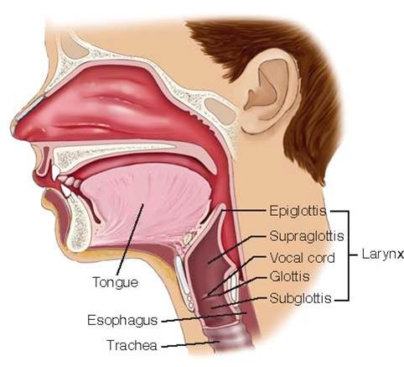
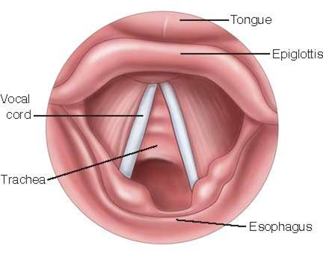
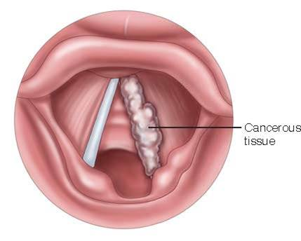
Laryngeal Cancer (continued_3)
Notes:
FIGURE 25.7 A and B, Normal structures of the larynx. C, Laryngeal cancer of the vocal cord.

Slide 50
Laryngeal Cancer (continued_4)
Clinical Manifestations
  Hoarseness
  Change in voice
  Persistent sore throat
  Constant cough
  Pain with swallowing
  Ear pain
  Difficulty swallowing
  Trouble breathing
  Lump or mass in neck
  Weight loss
Notes:
Clinical manifestations include hoarseness or a change in the voice that does not resolve in 2 weeks. Voice changes include lower-than-usual pitch and raspy and hoarse sounds. Additional symptoms include a persistent sore throat, constant cough, pain with swallowing, ear pain that does not go away, difficulty swallowing, trouble breathing, a lump or mass in the neck, and weight loss due to difficulty eating.

Slide 51
Laryngeal Cancer (continued_5)
Medical Management – Diagnosis
  Thorough health history
  Physical assessment
  Endoscopy
  Barium swallow, chest X-ray, M R I, P E T scan
  Laboratory testing
Notes:
Diagnosis starts with the completion of a thorough health history, including general health information, other medical conditions, onset of symptoms, risk factors, and family history. Physical assessment of the neck, thyroid, lymph nodes, and muscle movement of the neck can indicate if tumor growth has invaded these structures. If these initial findings are suspicious for laryngeal cancer, a referral to an otolaryngologist (ear, nose, and throat specialist) or a head and neck surgeon is made.
Further diagnostic procedures include endoscopy and imaging. Visualization and examination of the pharynx and larynx are performed by an otolaryngologist with the use of a direct laryngoscopy with a flexible endoscope. Laryngoscopy allows for assessment of the vocal folds and glottis for the presence of ulcerations, nodules, polyps, strictures, bleeding, or tumors. Laryngoscopy may also be performed under general anesthesia, at which time samples or biopsies of suspicious tissue are obtained for evaluation.
Diagnostic imaging includes a barium swallow, chest x-ray, CT, MRI, and positron emission tomography (PET). A barium swallow evaluates the throat and the ability to swallow. Chest x-rays are obtained to evaluate the lungs for the presence of lung cancer. The CT, MRI, and PET scans are completed to determine the presence of metastasis into the surrounding and distant soft tissues and for regional adenopathy, or lymph node involvement. The information obtained through biopsy and diagnostic imaging is used to determine the stage of the tumor and disease progression. Stages of laryngeal cancer are based on the size of the tumor, the involvement of the lymph nodes, and whether the cancer has spread to other sites within the body.
Diagnostic laboratory testing is also done to provide information about the overall health status of the patient. A complete blood count, blood chemistry profile, coagulation studies, and urinalysis provide vital information about the potential spread of laryngeal cancer, nutritional status, and organ function, such as the kidneys and liver. At present, there is no specific blood test or marker to assist in diagnosing laryngeal cancer. Once cancer is diagnosed, the prognosis is dependent on the stage of the disease; the size, location, and grade of the tumor; and the general health status, age, and gender of the patient.

Slide 52
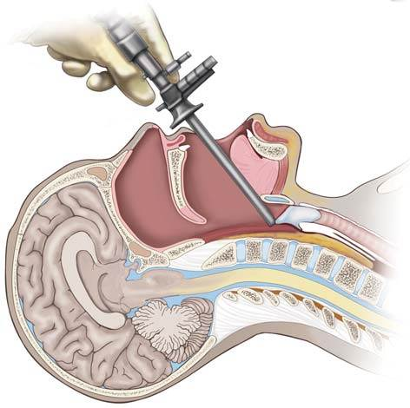
Laryngoscopy
Notes:
FIGURE 25.8 Laryngoscopy: direct visualization of the larynx.

Slide 53
Laryngeal Cancer (continued_6)
Medical Management – Treatment
  Radiation therapy
  Chemotherapy
Notes:
Treatment of laryngeal cancer is based on factors such as the stage of the disease, the location and size of the tumor, and whether the current tumor is a recurrence. Treatment includes radiation therapy, surgery, and chemotherapy.
Radiation therapy is used to eliminate cancer cells and maintain the structure and function of the larynx. It is used to treat small tumors, to reduce tumor size prior to surgery, or in patients who are unable to undergo surgery. Radiation therapy is usually given 5 days a week for 6 to 8 weeks. Side effects of radiation include increased hoarseness; prolonged tissue healing; sore throat; difficulty swallowing; and if the salivary glands are involved, dry mouth (xerostomia).
Chemotherapy can be used in several different ways. It can be given at the same time as radiation therapy (chemoradiation) to improve the effectiveness of the radiation therapy. It can be given before radiation therapy to shrink larger tumors and make radiation therapy more effective. It can also be given prior to surgery to shrink larger tumors that are not easily excised. Finally, it can be used palliatively to help to control the cancer and relieve symptoms (palliative chemotherapy).

Slide 54
Laryngeal Cancer (continued_7)
Surgical Management
  Laser surgery
  Cordectomy
  Partial laryngectomy
  Total laryngectomy
Notes:
Surgical procedures used to treat laryngeal cancer include laser surgery, cordectomy, partial laryngectomy, and total laryngectomy. The goal of surgical treatment is to remove the tumor and maintain the function of the larynx, speech, swallowing ability, and breathing.
Laser microsurgery is used to treat early forms of glottic cancers and is now considered the standard approach at many institutions. It utilizes a beam of light to remove the tumor. A cost-effective alternative to an open surgical procedure, laser microsurgery results in good functional outcomes and causes minimal morbidity. Cordectomy is the removal of part or all of a vocal cord through the use of a transoral laser. If laryngeal cancer is present unilaterally on the vocal cords and is in the early stages, this option may be considered.
Partial laryngectomy is performed to remove part of the larynx in the early stages of laryngeal cancer. This includes removal of part of the larynx, only one vocal cord, and the tumor. Preservation of the voice, which may be slightly altered or hoarse, is achieved because of the presence of the remaining structures. Patients will retain normal breathing and swallowing ability. A temporary tracheostomy may be required after partial laryngectomy to protect the airway.
Total laryngectomy is the complete removal of the larynx. In advanced stages of laryngeal cancer where the cancer has spread beyond the vocal cords, a total laryngectomy is a curative procedure. In this procedure, the larynx and several rings of the trachea are removed. Swallowing ability will remain normal after total laryngectomy, but the surgery results in the inability to speak. The creation of a tracheostomy is required for breathing and because of the risk of aspiration of fluids and food after the removal of the epiglottis.

Slide 55
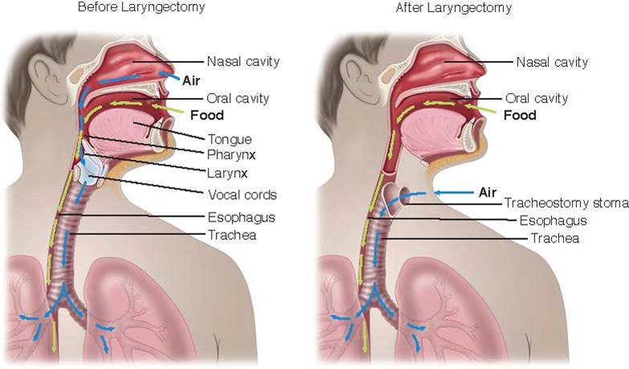
Laryngectomy
Notes:
FIGURE 25.9 Surgical removal of the larynx and the creation of a tracheostomy to protect the airway.

Slide 56
Laryngeal Cancer (continued_8)
Nursing Management – Assessment and analysis
  Symptoms depend on location of cancer
Notes:
The symptoms of laryngeal cancer are dependent on the location of the cancer. Laryngeal cancer affecting the vocal cords results in changes in voice quality and character or hoarseness. A lump in the neck, earache, or sore throat can be seen in tumors above the vocal cords.

Slide 57
Laryngeal Cancer (continued_9)
Nursing Management – Nursing diagnoses
  Ineffective airway clearance
  Impaired swallowing
  Impaired verbal communication
  Impaired body image
  Risk for infection
  Grieving
  Risk for nutritional imbalance
Notes:
Ineffective airway clearance related to surgical removal of the glottis
Impaired swallowing related to laryngectomy/ tracheostomy tube
Impaired verbal communication related to removal of the larynx
Impaired body image related to the surgical procedure
Risk for infection related to the surgical procedure
Grieving related to the change in body image, role performance, and potential death
Risk for nutritional imbalance, less than body requirement, related to impaired swallowing, poor appetite

Slide 58
Laryngeal Cancer (continued_10)
Nursing Interventions – Assessments
  Complete review of risk factors
  Review of symptoms
  Skin/vocal/swallowing assessment
  Laboratory assessments
Notes:
Complete a review of risk factors — Focus on risk factors for laryngeal cancer, such as smoking, alcohol use, and occupational exposure to chemicals.
Review of symptoms/complaints — Hoarseness, earache, and sore throat lasting several weeks need further evaluation.
Skin/vocal/swallowing assessment — Red, tender, peeling skin may result from radiation therapy. Radiation therapy may also cause worsening hoarseness and difficulty swallowing.
Laboratory assessments: electrolytes, white blood cell (WBC) and platelet count — Patients on chemotherapy may have alterations in their electrolyte balance. Also, they can become immunosuppressed, resulting in neutropenia, making them more susceptible to infection. Platelet counts may decrease, resulting in bleeding risk.

Slide 59
Laryngeal Cancer (continued_11)
Nursing Interventions – Postoperative Assessments
  Vital signs
  Oxygenation status
  Patency of tracheostomy
  Weight, nutritional intake, calorie count
Notes:
Vital signs — Decreased blood pressure may occur with blood loss; increased heart rate may be due to hypovolemia or pain.
Oxygenation status — Edema and increased secretions postoperatively may cause shortness of breath and decreased oxygenation.
Patency of tracheostomy — Bleeding or edema may occur postoperatively, impairing the patency of the tracheostomy.
Weight, nutritional intake, calorie count — Swallowing impairments postoperatively may impact adequate nutritional intake.

Slide 60
Laryngeal Cancer (continued_12)
Nursing Interventions – Actions
  Administer chemotherapy as ordered
  Institute bleeding precautions
Notes:
Administer chemotherapy as ordered — Chemotherapy is used in combination with radiation and/or surgery in an effort to destroy cancer cells and reduce tumor size.
Institute bleeding precautions as necessary — Chemotherapy may increase bleeding risk due to decreased platelet count.

Slide 61
Laryngeal Cancer (continued_13)
Nursing Interventions – Postoperative Actions
  Tracheostomy care
  Institute aspiration precautions
  Provide means for communication
  Nutritional consultation
Notes:
Tracheostomy care: use of humidified oxygen via a trach collar; pulmonary hygiene such as turning, coughing, deep breathing, and mobility; suctioning equipment, replacement tracheostomy tube (same size and one smaller), and obturator at bedside;
tracheostomy care twice daily and as needed; management of oral secretions with a Yankauer suction tip – Post-laryngectomy patients will have a permanent tracheostomy tube placed (Figs. 25.11 and 25.12). Good care is essential to maintain patency and decrease infection. Humidity, which will assist in moistening respiratory secretions, and pulmonary hygiene will facilitate secretion removal. Replacement equipment is necessary in case of unintended dislodgement of the tracheostomy. See Chapter 7 for more detailed information on tracheostomies.
Institute aspiration precautions – Postoperatively, the patient is at risk for aspiration because of the removal of upper airway structures/epiglottis.
Provide means for communication – Post-laryngectomy, the patient will not be able to speak due to the removal of the larynx. Provide pen and paper and a picture board.
Nutritional consultation – Swallowing impairments may result in inadequate nutritional intake. Placement of a gastric or percutaneous esophageal gastrostomy tube may be required if the patient cannot maintain adequate nutritional intake.

Slide 62
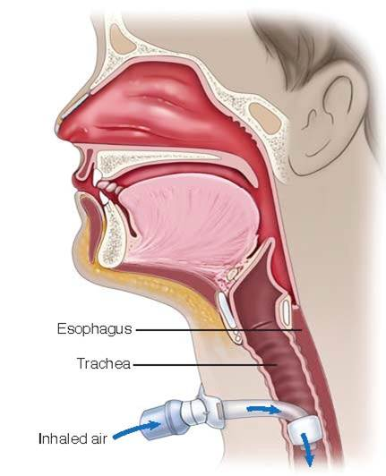
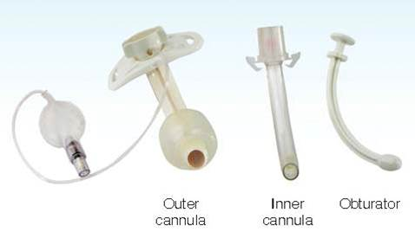
Tracheostomy
Notes:
FIGURE 25.11 Tracheostomy: artificial airway created in the neck to allow for ventilation.
FIGURE 25.12 Essential components of the tracheostomy tube.

Slide 63
Laryngeal Cancer (continued_14)
Nursing Interventions – Teaching
  Diagnostic testing and interventions
  Disease management
  Tracheostomy management
  Nutrition management
  Chemotherapy management
  Communication management
Notes:
Diagnostic testing and interventions such as direct laryngoscopy — Understanding the testing and interventions may ease anxiety and increase adherence.
Disease management — Depending on the location of the laryngeal cancer, the patient may undergo various interventions (laser surgery, laryngectomy, tracheotomy). Understanding the outcomes, such as loss of speech and creation of a tracheostomy, is essential.
Tracheostomy management: suctioning and tracheostomy care with return demonstration — Skillful performance of suctioning and trach and stoma care is essential to keep the airway free from secretions and avoid infection.
Radiation therapy care:
• Skin care: Avoid heating pad, ice pack, lotions or powders, sun exposure, extremes of temperature, and abrasive activities such as shaving at the radiation site; do not rub, scratch, or scrub the radiation treatment site; wear loose-fitting, soft clothing on site; use a mild soap to clean the area — During radiation therapy, the skin can become red and tender and may peel. Radiation delays healing, so care must be taken to limit the additional potential for skin breakdown.
• Oral care: Use a soft-bristle toothbrush and brush and floss after each meal and at bedtime; suck on hard candy or chewing gum; examine the oral cavity for signs of infection, ulcerations, or bleeding — A decrease in the production of saliva, which may be permanent, can occur with radiation therapy, resulting in dry mouth or xerostomia. Changes in taste sensation, halitosis, increased risk of dental cavities, and oral infections can occur as a result of decreased saliva production.
• Throat care: Limit voice use; eat soft foods, drink plenty of fluids; sucking on ice chips or use of saline gargling may decrease the discomfort. The use of throat sprays or mouthwashes that contain a local topical anesthetic prescribed by the provider may assist in relieving the sore throat — With radiation therapy, vocal hoarseness may worsen, and difficulty in swallowing or a sore throat may develop.
Nutrition management: Easy-to-eat, soft, nonspicy, non–acid-containing foods; small, frequent feedings; liquid nutritional supplements may be added — Swallowing impairments may result in inadequate nutritional intake.
Chemotherapy management: Take antiemetics prior to receiving chemotherapy and as needed; avoid crowds and persons with infections, and report any signs of infection immediately; report increases in bruising, presence of blood in the urine or stool, or increased fatigue — Chemotherapy may cause nausea and vomiting, immunosuppression, and decreased platelets.
Communication management: Writing or picture boards, esophageal speech, electrolarynges — Because of the loss of vocal cords with a laryngectomy, the ability to speak will be gone. Alternative forms of communication will be necessary. Esophageal speech occurs through the use of swallowed air to create words in the mouth. Electrolarynges are mechanical devices that are placed against the neck and use vibrated air to create words.

Slide 64
Laryngeal Cancer (continued_15)
Nursing Management – Evaluating care outcomes
  Return to normal activities
  Alternative means for communication
  Avoidance of smoking and alcohol
Notes:
The location, the treatment required (chemotherapy, radiation, surgery), and the presence of metastasis will determine the outcome of the patient with laryngeal cancer. In patients where early detection of laryngeal cancer has occurred, a complete recovery can be expected. If metastasis has occurred, the outcome is dependent on the metastasis site and the patient response to treatment. After laryngectomy, patients can return to normal activities using alternative means for communication. Patients are at risk for recurrence of laryngeal cancer if they continue to smoke and use alcohol.

Slide 65
Laryngeal Trauma
Epidemiology
  Rare
  <1% of blunt traumas
  More males than females
Notes:
Laryngeal trauma is rare. One form of trauma, the laryngeal fracture, occurs in approximately 1 patient per 14,000 to 42,000 emergency department visits and accounts for less than 1% of all blunt traumas. This is partially due to the protected location of the larynx, with the hard, bony structure of the cervical spine posterior and the mandible in a superior and anterior position. Laryngeal trauma is sometimes seen in females because of their slimmer, longer necks, but overall, males present with the highest percentage of laryngeal trauma because of a greater participation in body-contact sports such as fighting.

Slide 66
Laryngeal Trauma (continued_1)
Pathophysiology
  Blunt or penetrating injuries
  Ingestion or inhalation of caustic agents
  Pressure from prolonged intubation
Notes:
Laryngeal trauma occurs as a result of blunt or penetrating injuries, ingestion or inhalation of caustic agents to the neck, or pressure from prolonged endotracheal intubation. Blunt trauma can occur as a result of assaults, crush injuries, falls, motor vehicle crashes, sports, or strangulation. Penetrating injuries can occur from gunshots or stabbings. Laryngeal trauma may be seen in the presence of cardiovascular, neurological, respiratory, or intestinal injuries. Patient outcomes are dependent on early recognition and maintenance of an adequate airway.

Slide 67
Laryngeal Trauma (continued_2)
Clinical Manifestations
  Hoarseness
  Pain
  Stridor
  Dyspnea
  Dysphagia
  Hemoptysis
Notes:
Clinical manifestations of laryngeal trauma are dependent on the extent of the injury. They include hoarseness, pain, stridor, dyspnea (difficulty breathing), dysphagia (difficulty swallowing), and hemoptysis (bloody sputum). The airway can become obstructed from edema or fracture of the laryngeal structures or hematoma development.

Slide 68
Laryngeal Trauma (continued_3)
Medical Management – Diagnosis
  Physical inspection of neck
  Cervical C T, fiberoptic laryngoscopy, flexible bronchoscopy
Notes:
Diagnosis is completed by conducting a physical inspection of the neck for signs of swelling, discoloration, subcutaneous emphysema, tracheal deviation, and open wounds. Diagnostic studies include cervical CT, fiberoptic laryngoscopy, or flexible bronchoscopy. During a laryngoscopy or flexible bronchoscopy, the provider uses a flexible tube with a fiberoptic system to view structures in the upper and lower airways.

Slide 69
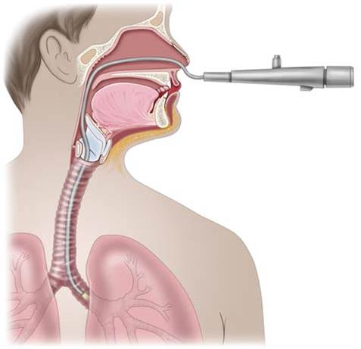
Flexible Bronchoscopy
Notes:
FIGURE 25.13 Flexible bronchoscopy allows for direct visualization of the upper and lower airways.

Slide 70
Laryngeal Trauma (continued_4)
Medical Management – Treatment
  Ensure and maintain patent airway
Notes:
The priority of care in patients with laryngeal trauma is to ensure and maintain a patent airway. Maintenance of the airway may include endotracheal intubation or tracheostomy. Because of the potential of cervical spine injury in addition to laryngeal trauma, stabilization of the cervical spine is vital. Diagnostics wait until the airway is protected and the cervical spine is stabilized.

Slide 71
Laryngeal Trauma (continued_5)
Surgical Management
  Evacuation of hematoma
  Repair of lacerations
  Stabilization/repair of fractures
Notes:
Surgical interventions, if necessary, include evacuation of hematoma, repair of lacerations, and stabilization/repair of fractures.

Slide 72
Laryngeal Trauma (continued_6)
Nursing Management – Assessment and analysis
  Related to injury and edema
Notes:
Symptoms of laryngeal trauma are due to injury to the vocal cords and edema of the soft tissue of the neck. The patient may have a change in the quality and character of the voice or hoarseness, difficulty swallowing, or difficulty breathing. Discoloration and edema of the neck increase the suspicion of laryngeal trauma.

Slide 73
Laryngeal Trauma (continued_7)
Nursing Management – Nursing diagnoses
  Ineffective airway clearance
  Impaired gas exchange
  Impaired swallowing
Notes:
Ineffective airway clearance related to edema
Impaired gas exchange related to laryngeal trauma
Impaired swallowing related to edema

Slide 74
Laryngeal Trauma (continued_8)
Nursing Interventions – Assessments
  Vital signs
  Physical assessment
Notes:
Vital signs — Increases in respiratory and heart rates, decreased oxygen saturation, and tachypnea indicate respiratory distress.
Physical assessment of the neck and upper airway — Identify risk for laryngeal trauma if discoloration, change in voice, stridor, use of accessory muscles for breathing, or restlessness indicating hypoxia are present.

Slide 75
Laryngeal Trauma (continued_9)
Nursing Interventions – Actions
  Keep tracheostomy tray and emergency equipment at bedside
  Provide humified air
  Keep head of bed 45 degrees or greater
  Aspiration precautions
Notes:
Have tracheostomy insertion tray and emergency equipment at the bedside — The patient may have a sudden loss of the airway requiring emergency tracheostomy.
Provide humidified air via a face mask or face tent — Cool humidified air will help decrease airway edema.
Keep the head of the bed elevated at 45 degrees or greater — Elevation of the head of the bed will assist in decreasing edema and maintaining a patent airway.
Aspiration precautions — Maintain nothing-per-os (NPO) status to protect the airway in the presence of edema and/or bleeding. Also, maintain NPO status until the need for surgery has been evaluated.

Slide 76
Laryngeal Trauma (continued_10)
Nursing Interventions – Teaching
  Symptoms to report to the healthcare provider
  Maintenance of voice rest
Notes:
Symptoms to report to the healthcare provider and when to seek emergency medical care — A compromise in airway patency can quickly progress to airway occlusion and death.
Maintenance of voice rest — Limit talking to prevent an increase in trauma to the larynx and to prevent edema.

Slide 77
Laryngeal Trauma (continued_11)
Nursing Management – Evaluating care outcomes
  Prevention of airway compromise
Notes:
In patients with laryngeal trauma, early recognition of airway compromise is key. The nurse provides close monitoring of respiratory rate, effort, breath sounds, and oxygen saturation. Keeping the head of the bed elevated and providing adequate humidification will assist in decreasing edema to the area. Encouraging the patient to observe voice rest helps minimize additional irritation and avoid airway compromise.

Slide 78
Case Study: Episode 1
Henry Comstock is a 56-year-old male who reports a history of snoring and frequently waking during the night. He works as a business manager. He weighs 260 pounds and is 5 ft 10 in. tall. His wife insisted that he see his primary care provider (P C P) because he frequently falls asleep when he sits for short periods of time. He is constantly irritable as a result of his lack of sleep.

Slide 79
Case Study: Episode 2
Henry returns to his P C P 6 weeks after his initial visit regarding his sleep patterns. He has increased his activity by walking 2 miles at the local school track every other day and has modified his diet by reducing his carbohydrate intake. At this visit, he has lost 8 pounds. His wife states he still drifts off to sleep quickly when sitting and abruptly wakes up at night. His P C P recommends a sleep study to be done at the local sleep center.

Slide 80
Case Study: Wrap-up
Henry is found to have hypertension, with his blood pressure ranging from 150 to 170/90 to 100 mm Hg. His electrocardiogram shows sinus rhythm with frequent multifocal premature ventricular contractions. He is scheduled for a polysomnography (sleep study).

Slide 81
Case Study: Wrap-up (continued)
Henry’s polysomnography study shows he has O S A. He is provided with a C P A P device with a nasal mask. He is started on hydrochlorothiazide 25 mg daily for his hypertension. Several months after diagnosis, he has lost 25 pounds. He reports that he is not as sleepy during the day and is more rested upon waking in the morning. His blood pressure currently is 130/82 mm Hg. His wife reports that he is less irritable and more energetic.

Slide 82
Case Study
1. Henry is started on an antihypertensive after his diagnosis of hypertension. Which statement indicates Harry understands his education regarding the new medication?
A. “I can stop taking this medication when I start sleeping better.”
B. “Sleeping through the night is the most important thing to consider.”
C. “I’m glad we found out I had high blood pressure so that I can treat it!”
D. “This medication will help me sleep better.”
Notes:
Answer: C
Rationale: HTN is a great risk factor for heart
disease and stroke and should be treated! The
meds need to be taken continuously as prescribed. Sleeping is
important, but the high risk for stroke and heart
disease caused by HTN is very important. The HTN medication
is not a sleeping aid.

Slide 83
Case Study (continued_1)
2. The nurse provided patient education regarding the sleep study. Which statement made by the patient indicates he understands the procedure?
A. “The study will occur in the cardiology department and will last 2 hours.”
B. “The sleep study will help determine the amount of sleep I need each night.”
C. “I will receive some sedation for the procedure and will need to have a ride home.”
D. “The test determines how deeply and what type of sleep I have.”
Notes:
Answer: D
Rationale: The patient will be monitored for the
stages of sleep. A sleep study determines if and how
long the patient is in REM sleep. They do not determine how much sleep is
needed and they are conducted overnight.

Slide 84
Case Study (continued_2)
3. After a sleep study confirms that Henry has O S A, the nurse is preparing to provide patient education regarding home management. The nurse includes which of the following instructions for Henry?
A. The use of albuterol nebulization treatments to promote bronchodilation
B. The use of oxygen delivery via nasal cannula during sleep
C. The use of a C P A P machine during sleep
D. Keeping the head of the bed flat during sleep
Notes:
Answer: C
Rationale: The patient does not need oxygen or
albuterol. The use of continuous positive airway
pressure keeps the airway open, preventing
obstruction and apnea. The head of bed can be flat if comfortable
for the patient but should ideally be slightly elevated.

Slide 85
Case Study (continued_3)
4. The nurse is providing patient education regarding the use of the C P A P machine to Henry and his wife. Which of the following statements regarding C P A P are correct? (Select all that apply.)
A. The machine utilizes a small compressor.
B. C P A P provides extra oxygen at night.
C. The face mask should snugly fit over the nose and mouth.
D. There is an adjustment period for using the C P A P machine.
E. You should use it only on those nights when you need to get up early the next day.
Notes:
Answer: A, C, and D
Rationale: CPAP for home use provides only
pressure support to maintain a patient airway
only, not oxygen. It should be used every night.
There may be a slight adjustment
getting used to the mask.

Slide 86
Case Study (continued_4)
5. After 4 months of using the C P A P machine, Henry determines that he would like to try to sleep without it. He feels slightly claustrophobic and thinks the weight loss may have improved his O S A. What does the nurse ask Henry and his wife to monitor if he stops using the C P A P machine? (Select all that apply.)
A. Increased belching
B. Irritability
C. Snoring
D. Voice quality
E. Blood pressure
Notes:
Answer: B, C, and E
Rationale: Increased snoring and irritability from
lack of sleep are signs Henry may still need his
CPAP machine. Hypertension is associated with
OSA. Belching and voice quality are not associated with OSA.

