Slide 1

Chapter 29
Coordinating Care for Patients With Cardiac Dysrhythmia

Slide 2
Introduction
Conduction system
  Begins with S A node (sinus rhythm)
  Waveforms
    P wave
    Q R S complex
    T wave
Notes:
An electrical conduction system with specialized muscle cells is necessary for the cardiac action potential that generates a heartbeat and thus cardiac output (CO). There is a designated pathway that the heart’s normal electrical conduction travels. This pathway begins with the sinoatrial (S A) node, the heart’s primary pacemaker, which can generate impulses at a rate of 60 to 100 beats per minute (bpm). The S A node is located in the upper wall of the right atrium near the superior vena cava. Once the S A node fires, the impulse travels through the atrial pathways and heads toward the atrioventricular (A V) node. This node can also be considered the gatekeeper of the heart’s electrical conduction system. The A V node is responsible for allowing impulses to travel between the atria and the ventricles. Also, if for some reason the S A node fails to fire, the A V node can generate impulses at a rate of 40 to 60 bpm. Once the impulse has passed through the A V node into the ventricles, the impulse travels quickly through the ventricular pathways, the bundle branches and Purkinje fibers.
The electrical conduction system is one of two components of the generation of heartbeat and cardiac output. The other component is the actual muscular contraction (squeeze). The electrical conduction system will stimulate the heart’s muscle so that the chambers can contract/squeeze to force blood in and out of the heart. A fully functioning heart requires electrical conduction and mechanical contraction to produce CO.
When the impulse travels along the normal conduction pathway generated by the S A, it is called normal sinus rhythm (N S R). It generates waveforms that indicate the firing of the S A node, the P wave, followed by a Q R S complex indicating ventricular depolarization, and a T wave, indicating ventricular repolarization, all within the correct timing intervals.

Slide 3
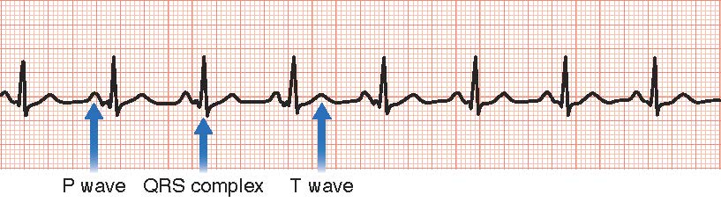
Normal Sinus Rhythm (NSR)
Notes:
FIGURE 29.1 Normal sinus rhythm (N S R) with a P wave, Q R S complex, and T wave.

Slide 4
Dysrhythmias
Risk Factors
  Age
  Myocardial infarction (M I)
  Hypertension (H T N)
  Heart valve disease
  Heart failure (H F)
  Cardiomyopathy (C M)
  Infections
  Diabetes mellitus
  Sleep apnea
  Heart surgery (and procedures)
  Electrolyte disturbances
  Recreational drug use such as cocaine, alcohol, or tobacco
  Medication toxicities such as digoxin toxicity
Notes:
When there is a disruption in the electrical conduction system, an irregular rhythm or dysrhythmias can occur. Age is a primary risk factor for dysrhythmias. Older adults have fewer pacemaker cells in the S A node, and there may be fat deposits around S A node, causing a delay in the propagation of the action potential. Also, slowed impulse transmission may be related to calcification around the A V node and valves.

Slide 5
Dysrhythmias (continued_1)
Pathophysiology
  Disruption in cardiac conduction pathway
  Deviations in normal rate or rhythm
Notes:
Dysrhythmias are disruptions in the cardiac conduction pathway or disorders of the electrical impulse conduction within the heart. They can result in deviations from a normal HR and/or rhythm, causing decreases in cardiac output (CO). Some dysrhythmias are lethal, causing a complete loss of CO, which results in cardiopulmonary arrest. Other dysrhythmias are apparent on E C Gs but are symptomless. In between are symptomatic dysrhythmias that may require treatment.

Slide 6
Dysrhythmias (continued_2)
Clinical Manifestations
  Palpitation
  Hypotension
  Diaphoresis
  Shortness of breath
  Syncope
Notes:
Symptoms of cardiac instability may include:
Palpitation (fast fluttering or beating in the chest or skipping beats)
Hypotension
Diaphoresis (sweating)
Shortness of breath
Syncope (fainting)

Slide 7
Electrocardiogram
Graphical representation of heart activity
E C G paper
Notes:
An E C G provides a graphic representation of the heart’s electrical activity. When electrodes are placed on the patient’s skin, they can monitor the flow of the electrical charges and transmit the corresponding waveforms to an E C G machine or cardiac monitor. The standard E C G has 12 leads or views of the electrical activity in the heart.
E C G paper – When a patient receives an E C G or is placed on a cardiac monitor, the heart’s electrical activity will be printed on specialized graph paper for interpretation. The E C G graph paper can measure both amplitude and time.

Slide 8
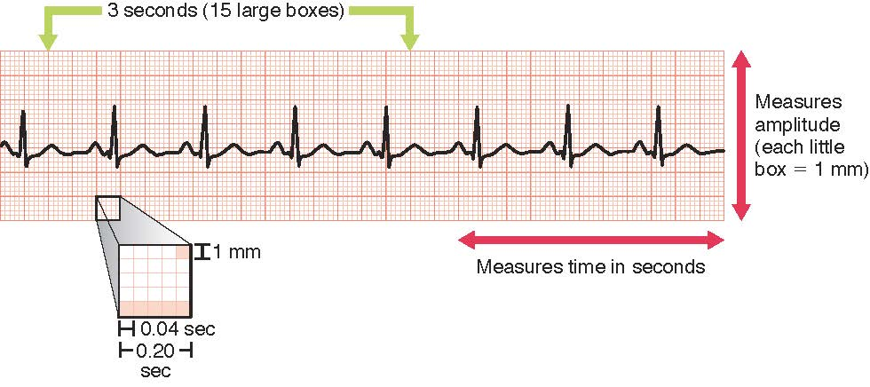
Electrocardiogram Graph Paper
Notes:
FIGURE 29.2 Electrocardiogram graph paper measures both amplitude and time.

Slide 9
Electrocardiogram (continued_1)
Waveforms
  P wave
  Q R S complex
  T wave
  U wave
Notes:
The P wave is the first waveform that is normally seen. The P wave represents the S A node sending out an electrical impulse and represents atrial depolarization. This wave should be upright (positive deflection) with a rounded top in lead II. The P wave itself should not be longer than 0.10 sec in length and no higher than 2.5 mm.
The Q R S wave (or Q R S complex) is the next waveform that is normally seen. This complex represents ventricular depolarization. The ventricles depolarize from the endocardial layer (inside of the heart) to the epicardial layer (outermost layer of the heart).
The T wave occurs after the Q R S and represents ventricular repolarization.
The U wave represents Purkinje fiber repolarization and is rarely seen.

Slide 10
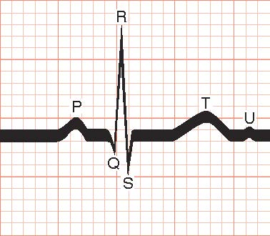
Waveforms Seen on an Electrocardiogram
Notes:
FIGURE 29.3 Waveforms seen on an electrocardiogram (E C G) that show the heart’s electrical current as it travels.

Slide 11
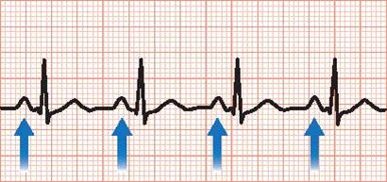
P Wave
Notes:
FIGURE 29.4 The P wave: atrial depolarization.

Slide 12
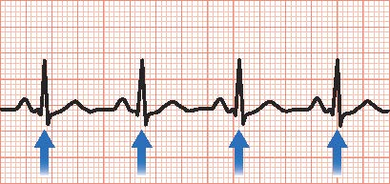
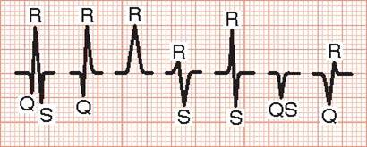
QRS Wave (or QRS Complex)
Notes:
FIGURE 29.5 A, The Q R S wave (or Q R S complex): ventricular depolarization. B, The Q R S complex can take many different forms.

Slide 13
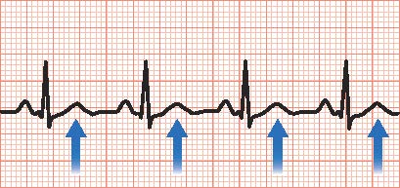
T Wave
Notes:
FIGURE 29.6 The T wave: ventricular repolarization.

Slide 14
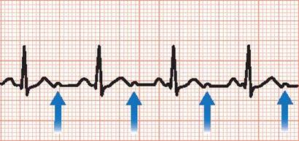
U Wave
Notes:
FIGURE 29.7 The U wave: Purkinje fiber repolarization.

Slide 15
Electrocardiogram (continued_2)
Intervals
  P R interval
  Q R S interval
  Q T interval
Notes:
The P R interval is the measure of time that it takes an electrical impulse to depolarize the atria and travel to the ventricles. To measure this interval, start from the beginning of the P wave (where it starts to leave the baseline) and count the number of small boxes to the beginning of the Q R S complex. The normal P R interval is from 0.12 sec (three small boxes) to 0.20 sec (five small boxes) in length.
The Q R S interval is the measure of time to depolarize the ventricles. It is measured from where the Q R S waveform leaves the baseline to where the Q R S returns to the baseline. The normal interval is 0.06 to 0.10 sec in length. As discussed previously, if the Q R S is prolonged (more than 0.10 sec; equal to or more than three small boxes), it may be a sign of a disturbance within the ventricle itself (i.e., that the impulse originated in the ventricles or that there is a block in the ventricles delaying impulse travel time through the ventricles).
The Q T interval is the measure of time that it takes the ventricle to depolarize and then repolarize. To measure a Q T interval, start where the Q R S leaves baseline and measure to where the T wave returns to baseline (Fig. 29.10). This interval is heart-rate dependent and should never be more than half the distance from one Q R S to the next. A normal Q T is usually less than or equal to 0.52 sec in length.

Slide 16
Electrocardiogram (continued_3)
Steps in E C G Interpretation
  Is the rate fast, slow, or normal?
  Is the rhythm regular?
  Are there P waves present?
  Are there Q R S complexes present?
  Are there T waves present?
  Are the intervals within normal limits?
  Is there a P wave before every Q R S?
  Is there a Q R S after every P wave?
Notes:
Is the rate fast, slow, or normal?
Is the rhythm regular; are complexes an equal distance from one to the next?
• Are the distances from P wave to P wave equal throughout the strip? This is referred to as the P–P interval.
• Are the distances from Q R S wave to Q R S wave equal throughout the strip? This is referred to as the R–R interval.
Are there P waves present?
Are there Q R S complexes present?
Are there T waves present?
Are the intervals within normal limits (e.g., P R interval, Q R S interval)?
Is there a P wave before every Q R S?
Is there a Q R S after every P wave?

Slide 17
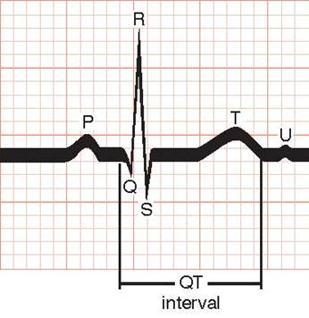
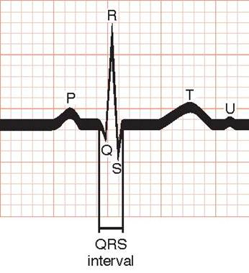
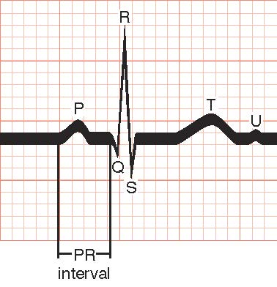
Intervals
Notes:
FIGURE 29.8 The P R interval: measure of time to depolarize the atria and travel to the ventricles.
FIGURE 29.9 The Q R S interval: the measure of time to depolarize the ventricles.
FIGURE 29.10 The Q T interval: the measure of time that it takes the ventricle to depolarize and then repolarize.

Slide 18
Electrocardiogram (continued_4)
Calculating heart rate
Calculating regularity
Notes:
Establishing the heart rate (HR) is the first step in E C G evaluation. A 6-second strip is a quick way to calculate an average HR, but it is not completely reliable if the rhythm is irregular. Electrocardiograph or monitor paper will print time markers, which may be vertical lines or arrows on the top or bottom of the strip. Most E C G/monitor paper time markers represent 3 seconds, which is 15 large boxes long; six seconds equals 30 large boxes. In order to use this method, count the number of Q R S complexes that fall within a 6-second period of time or 30 large boxes and multiply by 10. For example, if you see six Q R S complexes, multiply six by 10, which equals 60 bpm.
An important step in evaluating an E C G is determining regularity. Regularity can be determined by counting the boxes between the waveforms being measured, such as P wave to P wave (P to P) or Q R S complex to Q R S complex (R to R). A regular rhythm will have the same number of boxes or equal space between waveforms or complexes.

Slide 19
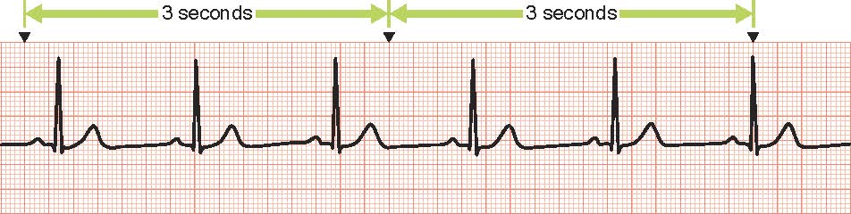
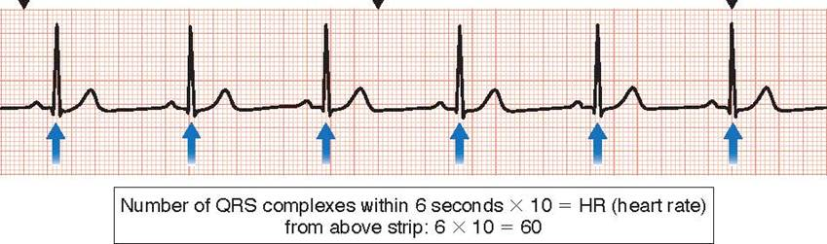
6-Second Strip
Notes:
FIGURE 29.11 A, A 6-second strip. B, Calculating a heart rate using a 6-second strip.

Slide 20
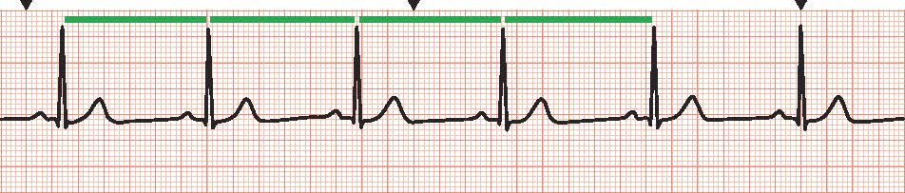
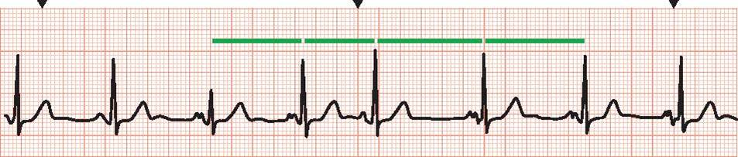
Marching Out the Waveforms
Notes:
FIGURE 29.12 Marching out the waveforms. A, Example of a regular rhythm; equal distance R to R. B, Example of an irregular rhythm. Notice the difference in distance between R waves.

Slide 21
Cardiac Dysrhythmias
Sinus Bradycardia
  Sinus rhythm with rate < 60
  Causes
    Hypoxia
    Hypothermia
  Treatment
    Atropine
Notes:
Sinus bradycardia (SB) is a regular rhythm that has the same characteristics as an N S R except the HR is less than 60 bpm.
Causes of SB include but are not limited to hypoxia and/or hypothermia. It can occur during sleep, or it may be the normal rate in well-trained athletes. It is important to determine if the patient is symptomatic or experiencing symptoms such as syncope, chest pain, hypotension, shortness of breath (SOB), or diaphoresis while bradycardic. A symptomatic patient will require treatment. It may be normal in a nonsymptomatic patient, or that patient may just require observation.
Treatment of symptomatic SB is atropine 0.5 mg IV push (IVP).

Slide 22
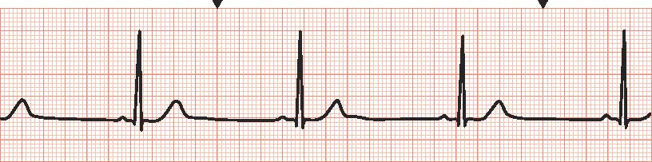
Sinus Bradycardia (SB)
Notes:
FIGURE 29.13 Sinus bradycardia (SB): sinus rhythm with a rate less than 60; in this strip, the rate is 40.

Slide 23
Cardiac Dysrhythmias (continued_1)
Sinus Tachycardia
  Sinus rhythm with rate > 100
  Causes
    Fever
    Anemia
    Hypovolemia
    Hypotension
    Pulmonary embolism
    Myocardial infarction
Notes:
Sinus tachycardia (ST) is a regular rhythm that has the same characteristics as an N S R except the HR is greater than 100 bpm.
Causes of ST include but are not limited to fever, anemia, hypovolemia, hypotension, pulmonary embolism (P E), and myocardial infarction (M I).
The treatment for ST is based on patient symptoms and possible causes. For example, if the patient is anemic and volume depleted, the treatment may be as simple as administering red blood cells and IV fluids. Medications such as beta blockers or calcium channel blockers may be used to control or reduce the HR.

Slide 24
Cardiac Dysrhythmias (continued_2)
Sinus Tachycardia
  Treatment
    Treat cause
    Beta blockers
    Calcium channel blockers
Notes:
Sinus tachycardia (ST) is a regular rhythm that has the same characteristics as an N S R except the HR is greater than 100 bpm.
Causes of ST include but are not limited to fever, anemia, hypovolemia, hypotension, pulmonary embolism (P E), and myocardial infarction (M I).
The treatment for ST is based on patient symptoms and possible causes. For example, if the patient is anemic and volume depleted, the treatment may be as simple as administering red blood cells and IV fluids. Medications such as beta blockers or calcium channel blockers may be used to control or reduce the HR.

Slide 25
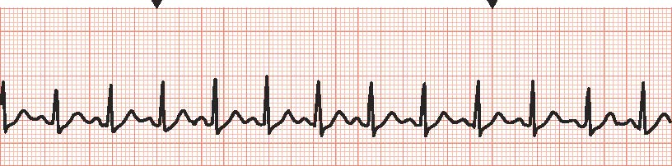
Sinus Tachycardia (ST)
Notes:
FIGURE 29.14 Sinus tachycardia (ST): sinus rhythm with a rate greater than 100; in this strip, the rate is 130.

Slide 26
Cardiac Dysrhythmias (continued_3)
Premature Atrial Contractions
  Pacemaker close to S A node fires earlier than expected
  Causes
    Hypoxia
    Excessive stimulant ingestion
    Infection
    Digoxin toxicity
    Coronary artery disease
Notes:
Premature atrial contractions (PACs) are non–life-threatening dysrhythmias that can be seen in N S R. In this dysrhythmia, a pacemaker cell close to the S A node fires earlier than expected (Fig. 29.15). This is an irregular rhythm due to the early impulse or beat. The PAC has a pause at the end of the complex called a compensatory pause allowing the conduction system to reset and resume the regular rhythm.
Causes of PAC include hypoxia, excessive stimulant ingestion (e.g., caffeine), infections, digoxin toxicity, and coronary artery disease.
The treatment for PACs is to monitor the frequency and eliminate the cause. This is especially important if the patient is symptomatic. If the patient gets PACs after drinking a pot of coffee in the morning, the “treatment” will be to eliminate or limit the coffee intake. This will help decrease the stimulus to the S A node and hopefully resolve the PACs.

Slide 27
Cardiac Dysrhythmias (continued_4)
Premature Atrial Contractions
  Treatment
    Monitor frequency
    Eliminate cause
Notes:
Premature atrial contractions (PACs) are non–life-threatening dysrhythmias that can be seen in N S R. In this dysrhythmia, a pacemaker cell close to the S A node fires earlier than expected (Fig. 29.15). This is an irregular rhythm due to the early impulse or beat. The PAC has a pause at the end of the complex called a compensatory pause allowing the conduction system to reset and resume the regular rhythm.
Causes of PAC include hypoxia, excessive stimulant ingestion (e.g., caffeine), infections, digoxin toxicity, and coronary artery disease.
The treatment for PACs is to monitor the frequency and eliminate the cause. This is especially important if the patient is symptomatic. If the patient gets PACs after drinking a pot of coffee in the morning, the “treatment” will be to eliminate or limit the coffee intake. This will help decrease the stimulus to the S A node and hopefully resolve the PACs.

Slide 28
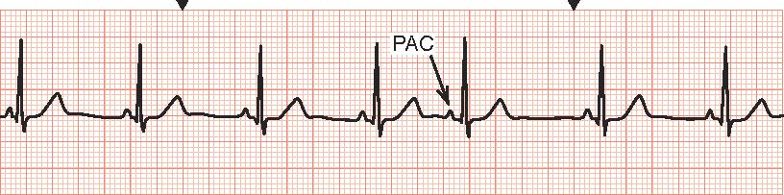
Premature Atrial Contractions (PACs)
Notes:
FIGURE 29.15 Premature atrial contractions (PACs); notice how the PAC occurs early or prematurely compared with the four previous complexes.

Slide 29
Cardiac Dysrhythmias (continued_5)
Atrial Fibrillation
  Multiple impulses within the atria
  Causes
    Age
    Cardiomyopathy
    Pericarditis
    Hyperthyroidism
    Hypertension
    Valvular disease
    Obesity
    Diabetes
    Chronic kidney disease
    Cardiac procedures or surgery
    Coronary artery disease
Notes:
Atrial fibrillation has no P waves. It is best described as multiple pacemaker cells generating independent electrical impulses and causing chaos within the atria. It is characterized as irregularly irregular. The Q R S complexes are usually narrow with irregular R–R intervals.
The risk for A F increases with age. Causes include but are not limited to cardiomyopathy, pericarditis, hyperthyroidism, H T N, valvular disease, obesity, diabetes, chronic kidney disease, patients undergoing cardiac procedures or surgery, and coronary artery disease.
Initial rate control is typically necessary in new-onset A F. Medications to control the HR, such as digoxin, beta blockers, and calcium channel blockers, are considered. Once the heart rate is managed, rhythm control is considered either through antiarrhythmic medications, cardiac ablation (scarring/destroying the tissue in the heart responsible for the irregular rhythm), or cardioversion. Typically, cardioversion is considered for A F after adequate anti-coagulation is attained.

Slide 30
Cardiac Dysrhythmias (continued_6)
Atrial Fibrillation
  Treatment
    Rate control – Digoxin, beta blockers, calcium channel blockers
    Antiarrhythmic medications
    Cardiac ablation
    Cardioversion
Notes:
Atrial fibrillation has no P waves. It is best described as multiple pacemaker cells generating independent electrical impulses and causing chaos within the atria. It is characterized as irregularly irregular. The Q R S complexes are usually narrow with irregular R–R intervals.
The risk for A F increases with age. Causes include but are not limited to cardiomyopathy, pericarditis, hyperthyroidism, H T N, valvular disease, obesity, diabetes, chronic kidney disease, patients undergoing cardiac procedures or surgery, and coronary artery disease.
Initial rate control is typically necessary in new-onset A F. Medications to control the HR, such as digoxin, beta blockers, and calcium channel blockers, are considered. Once the heart rate is managed, rhythm control is considered either through antiarrhythmic medications, cardiac ablation (scarring/destroying the tissue in the heart responsible for the irregular rhythm), or cardioversion. Typically, cardioversion is considered for A F after adequate anti - coagulation is attained.

Slide 31
Cardiac Dysrhythmias (continued_7)
Atrial Fibrillation Complications
  Loss of cardiac output
  Clots
Notes:
Because the atrial pacemaker cells are firing and competing against one another at such a rapid rate, the atria can only quiver instead of beating or contracting/squeezing normally. Without a normal atrial contraction, the heart can lose approximately 30% of its CO. This is referred to as loss of atrial kick, the filling force contributed by atrial contraction immediately before ventricular systole to maximize ventricular preload. This decrease in CO can cause significant symptoms for some patients, such as syncope, palpitations, and SOB.
Because the atria are not squeezing or contracting efficiently, blood pools in the atria, which can predispose the patient to clot formation. Blood clots moving through the circulation put the patient at risk for embolic events such as strokes. Care should be taken when administering any treatments that could convert A F to N S R because of the increased risk of an embolus (blood clot) being forced out into the circulatory system.

Slide 32
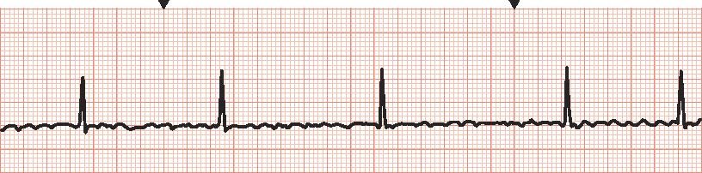
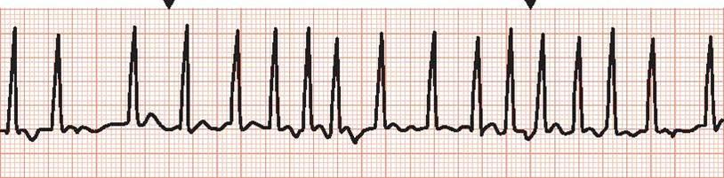
Atrial Fibrillation (A F)
Notes:
FIGURE 29.16 Atrial fibrillation (A F). A, Controlled A F with a ventricular rate of 50. B, Uncontrolled A F with rapid ventricular response (RVR).

Slide 33
Cardiac Dysrhythmias (continued_8)
Atrial Flutter
  Atrial rhythm produced outside of S A node
  Causes
    Acute M I
    Mitral valve disease
    Thyrotoxicosis
    C O P D
Notes:
Atrial flutter (A FL) is a dysrhythmia produced by a pacemaker cell other than the S A node. Because the S A node is not the primary pacemaker in this rhythm, there are no P waves. Flutter waves (F waves), however, are present. F waves resemble a sawtooth pattern between narrow Q R S complexes.
Causes of A FL in adult patients include acute M I, severe mitral valve disease, thyrotoxicosis (high thyroid hormone levels), and chronic obstructive pulmonary disease. Patients who have had surgical procedures within the chest, such as coronary artery bypass graft or pneumonectomy (removal of a portion of the lung), are prone to A FL. Atrial flutter can also be seen with digoxin toxicity.
Treatment options for A FL are similar to those for A F. The goal of treatment is to control the ventricular rate until the S A node takes over again, producing a normal rhythm. Beta blockers, calcium channel blockers, and digoxin can be used to control the ventricular rate. Some of these agents should be used cautiously because they can exacerbate H F symptoms and cause bradycardia. If a patient is still in A FL after the rate is controlled or is less than 100 bpm, then an antiarrhythmic may be ordered to chemically convert the rhythm back to an N S R. Cardioversion can be used to terminate the A FL but is not the first-line treatment unless the patient is severely symptomatic, and it may not be successful. Some of the symptoms that could warrant cardioversion include but are not limited to chest pain, hypotension, and SOB.

Slide 34
Cardiac Dysrhythmias (continued_9)
Atrial Flutter
  Treatment
    Rate control – Beta blocker, calcium channel blocker, digoxin
    Antiarrhythmic
    Cardioversion
Notes:
Atrial flutter (A FL) is a dysrhythmia produced by a pacemaker cell other than the S A node. Because the S A node is not the primary pacemaker in this rhythm, there are no P waves. Flutter waves (F waves), however, are present. F waves resemble a sawtooth pattern between narrow Q R S complexes.
Causes of A FL in adult patients include acute M I, severe mitral valve disease, thyrotoxicosis (high thyroid hormone levels), and chronic obstructive pulmonary disease. Patients who have had surgical procedures within the chest, such as coronary artery bypass graft or pneumonectomy (removal of a portion of the lung), are prone to A FL. Atrial flutter can also be seen with digoxin toxicity.
Treatment options for A FL are similar to those for A F. The goal of treatment is to control the ventricular rate until the S A node takes over again, producing a normal rhythm. Beta blockers, calcium channel blockers, and digoxin can be used to control the ventricular rate. Some of these agents should be used cautiously because they can exacerbate H F symptoms and cause bradycardia. If a patient is still in A FL after the rate is controlled or is less than 100 bpm, then an antiarrhythmic may be ordered to chemically convert the rhythm back to an N S R. Cardioversion can be used to terminate the A FL but is not the first-line treatment unless the patient is severely symptomatic, and it may not be successful. Some of the symptoms that could warrant cardioversion include but are not limited to chest pain, hypotension, and SOB.

Slide 35
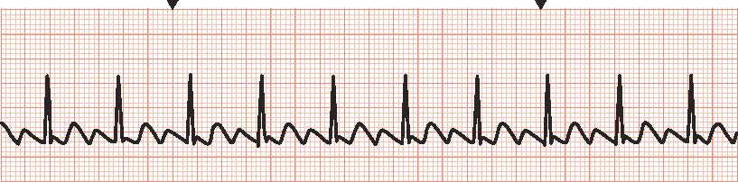
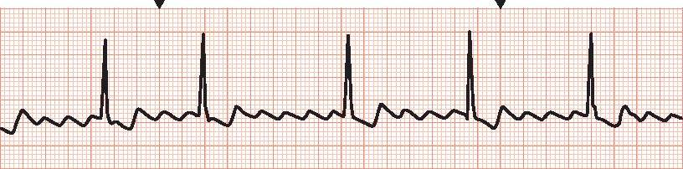
F Waves
Notes:
FIGURE 29.17 F waves. A, Atrial flutter (A FL; 2-to-1 conduction rate). B, A FL with a variable conduction rate.

Slide 36
Cardiac Dysrhythmias (continued_10)
Supraventricular Tachycardia
  Regular, narrow Q R S complex tachycardia
  Treatment
    Treat the cause
    Cardioversion
Notes:
Supraventricular tachycardia (SV T) is a rapid heart rhythm that originates above the ventricles. It most commonly appears as a regular, narrow Q R S complex tachycardia.
The treatment for SV T is based on the symptoms and underlying rhythm. The key for treating SV T is to figure out the underlying rhythm while slowing down the HR. If the patient is symptomatic, medications can be used, and electrical cardioversion can be considered; however, careful consideration should be taken if the underlying rhythm is not known.

Slide 37
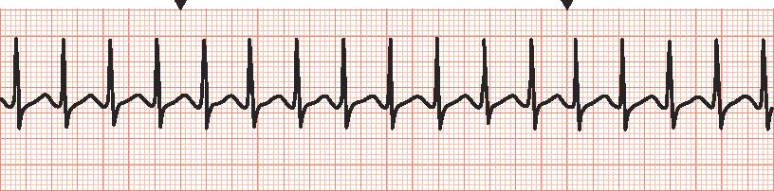
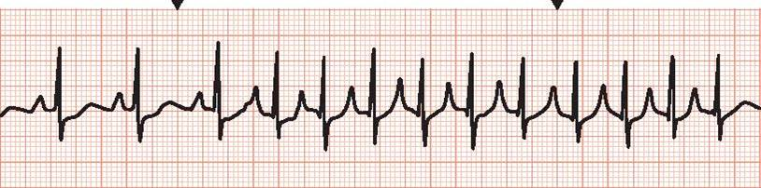
Supraventricular Tachycardia (SV T)
Notes:
FIGURE 29.18 Supraventricular tachycardia (SV T). A, Continuous SV T with a heart rate of 170. B, Paroxysmal supraventricular tachycardia (PSV T).

Slide 38
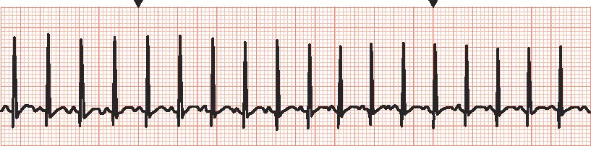
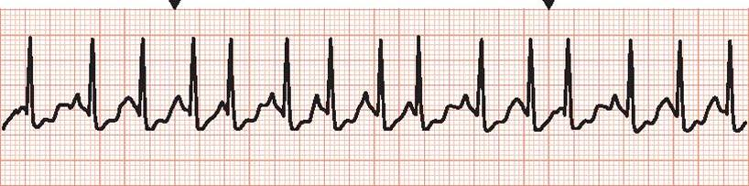
Atrial Tachycardia (AT)
Notes:
FIGURE 29.19 Atrial tachycardia (AT). A, Unifocal AT originating from the one pacemaker in the atria. B, Multifocal AT originating from many pacemakers in the atria.

Slide 39
Cardiac Dysrhythmias (continued_11)
Junctional Rhythms
  Rhythm originates in A V node
  Rate 40–60 bpm
Notes:
Junctional rhythms begin within the A V node. The A V node is a cluster of pacemaker cells positioned between the atria and the ventricles. The A V node generates impulses at a rate between 40 and 60 bpm. If the rate increases to 61 to 100 bpm, it is identified as an accelerated junctional rhythm. If the HR is greater than 100 bpm, it is identified as a junctional tachycardia. In order for the atria and the ventricles to depolarize, the electrical impulse from the A V node must split and travel in different directions. The ventricular conduction pathway will accept the electrical impulse as usual. However, in order for the atria to depolarize, the electrical impulse must travel backward (the opposite direction of the normal conduction), producing a retrograde P wave. This will display as an inverted or upside-down P wave or an absent P wave that is buried in the Q R S complex.

Slide 40
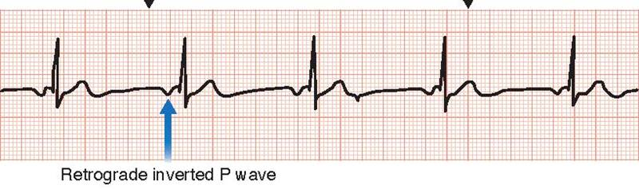
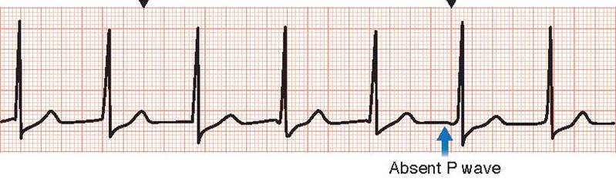
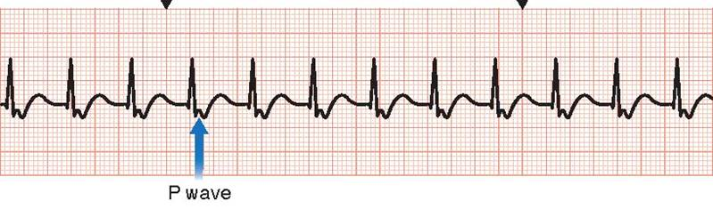
Junctional Rhythms
Notes:
FIGURE 29.20 Junctional rhythms. A, Junctional rhythm with a ventricular rate of 50. B, Accelerated junctional rhythm with a ventricular rate of 70. C, Junctional tachycardia with a ventricular rate of 120.

Slide 41
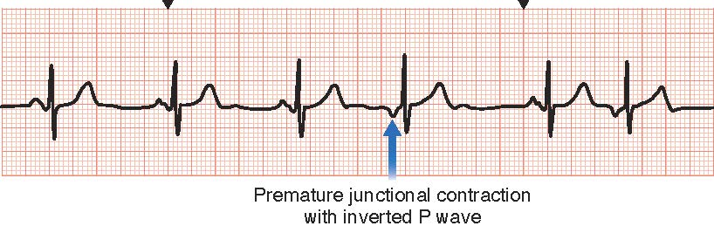
Premature Junctional Contractions (PJCs)
Notes:
FIGURE 29.21 Premature junctional contractions (PJCs); notice the inverted P wave.

Slide 42
Cardiac Dysrhythmias (continued_12)
Premature Ventricular Contractions
  Impulses originate in ventricle
  Causes
    Hypoxia
    M I
    Cardiomyopathy
    Electrolyte imbalance
Notes:
Ventricular rhythms are those rhythms that originate somewhere within the ventricles. When an impulse starts in the ventricle, there is no P wave, and the Q R S is usually wide (greater than or equal to 0.12 sec or three small boxes).
Causes of PVCs include hypoxia, M I, C M, electrolyte imbalance, excessive stimulant ingestion (such as caffeine), hypertension, and recreational drug use.
Treatment of PVCs is based on the patient’s symptoms. If the patient is symptomatic, treatment includes correcting the cause and, rarely, antiarrhythmic therapy.

Slide 43
Cardiac Dysrhythmias (continued_13)
Premature Ventricular Contractions
  Treatment
    Correct cause
    Antiarrhythmic therapy
Notes:
Ventricular rhythms are those rhythms that originate somewhere within the ventricles. When an impulse starts in the ventricle, there is no P wave, and the Q R S is usually wide (greater than or equal to 0.12 sec or three small boxes).
Causes of PVCs include hypoxia, M I, C M, electrolyte imbalance, excessive stimulant ingestion (such as caffeine), hypertension, and recreational drug use.
Treatment of PVCs is based on the patient’s symptoms. If the patient is symptomatic, treatment includes correcting the cause and, rarely, antiarrhythmic therapy.

Slide 44
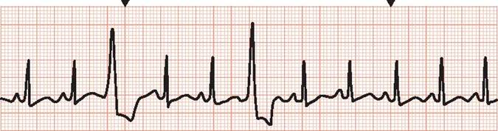
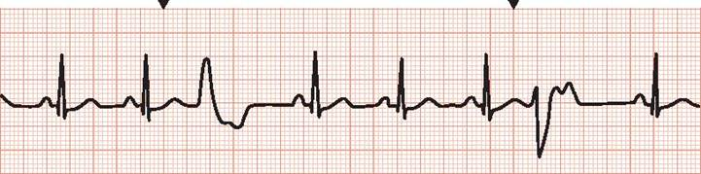
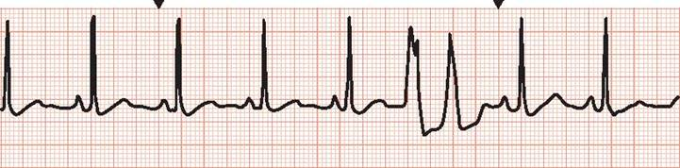
Premature Ventricular Contractions
Notes:
FIGURE 29.22 Premature ventricular contractions. A, Unifocal PVCs: notice how the PVCs present the same. B, Multifocal PVCs: notice how the PVCs present differently. C, Couplet.

Slide 45
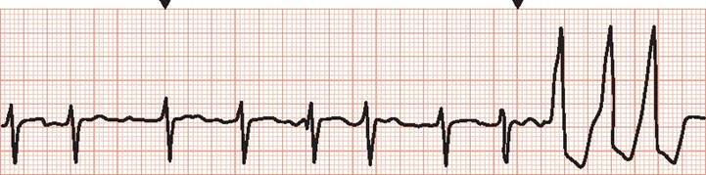
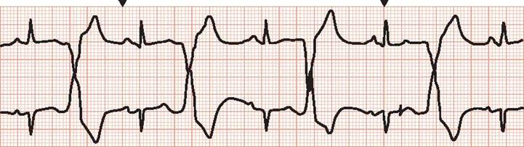
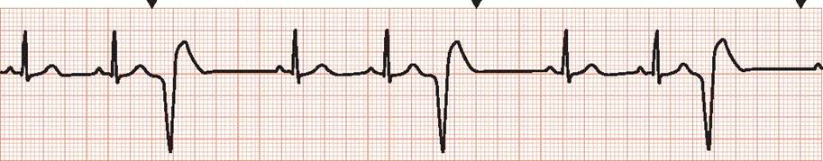
Premature Ventricular Contractions (continued)
Notes:
FIGURE 29.22 Premature ventricular contractions (continued). D, Triplet or a three-beat run of ventricular tachycardia (V T). E, Bigeminy. F, Trigeminy.

Slide 46
Cardiac Dysrhythmias (continued_14)
Ventricular Tachycardia
  Three or more P V C’s in a row
  Causes
    Hypovolemia
    Hypoxia
    Acidosis
    Hypokalemia
    Hyperkalemia
    Hypoglycemia
    Hypothermia
    Toxins
    Cardiac tamponade
    M I
    P E
Notes:
Ventricular tachycardia (V T) is defined as three or more PVCs (wide and fast impulses originating from the ventricles) in a row. V T can be a life-threatening dysrhythmia as a result of the significant reduction in CO that can occur.
V T with a pulse describes a patient in V T who is maintaining a blood pressure and pulse with or without symptoms. The treatment options are antiarrhythmic medications such as amiodarone, electrolyte replacements such as potassium or magnesium, and/or cardioversion. Cardioversion is an electrical shock given to the patient at the time of ventricular depolarization.
Pulseless V T describes a patient who is in cardiac arrest. The first-line treatment is cardiopulmonary resuscitation (C P R) and defibrillation.

Slide 47
Cardiac Dysrhythmias (continued_15)
Ventricular Tachycardia
  Treatment
    V T with a pulse – Antiarrhythmic medication, electrolyte replacement, cardioversion
    Pulseless V T – Cardiopulmonary resuscitation and defibrillation
Notes:
Ventricular tachycardia (V T) is defined as three or more PVCs (wide and fast impulses originating from the ventricles) in a row. V T can be a life-threatening dysrhythmia as a result of the significant reduction in CO that can occur.
V T with a pulse describes a patient in V T who is maintaining a blood pressure and pulse with or without symptoms. The treatment options are antiarrhythmic medications such as amiodarone, electrolyte replacements such as potassium or magnesium, and/or cardioversion. Cardioversion is an electrical shock given to the patient at the time of ventricular depolarization.
Pulseless V T describes a patient who is in cardiac arrest. The first-line treatment is cardiopulmonary resuscitation (C P R) and defibrillation.

Slide 48
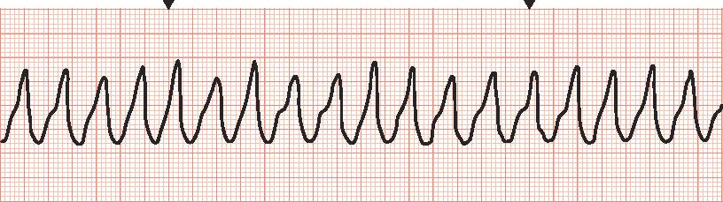
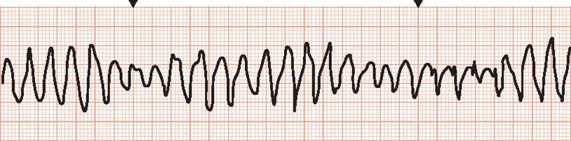
Ventricular Tachycardia (V T)
Notes:
FIGURE 29.23 Ventricular tachycardia (V T). A, Monomorphic: originating from one pacemaker cell. B, Polymorphic: originating from multiple pacemaker cells.

Slide 49
Cardiac Dysrhythmias (continued_16)
Ventricular Fibrillation
  Lethal dysrhythmia
  Causes
    Hypovolemia
    Hypoxia
    Acidosis
    Hypokalemia
    Hyperkalemia
    Hypoglycemia
    Hypothermia
    Toxins
    Cardiac tamponade
    M I
    P E
Notes:
Ventricular fibrillation (VF) is a lethal dysrhythmia requiring immediate treatment. It is the most frequently seen rhythm in cardiac arrests occurring outside of the hospital. Ventricular fibrillation occurs when the ventricle has multiple chaotic impulses rapidly firing. This chaotic firing prevents the ventricles from pushing blood out of the heart, stopping CO, and causing death.
Treatment requirements for VF start with chest compressions and include defibrillation and medication. Chest compressions and defibrillation are the most important interventions that can be done for a patient in VF.

Slide 50
Cardiac Dysrhythmias (continued_17)
Ventricular Fibrillation
  Treatment
    Chest compressions, defibrillation
Notes:
Ventricular fibrillation (VF) is a lethal dysrhythmia requiring immediate treatment. It is the most frequently seen rhythm in cardiac arrests occurring outside of the hospital. Ventricular fibrillation occurs when the ventricle has multiple chaotic impulses rapidly firing. This chaotic firing prevents the ventricles from pushing blood out of the heart, stopping CO, and causing death.
Treatment requirements for VF start with chest compressions and include defibrillation and medication. Chest compressions and defibrillation are the most important interventions that can be done for a patient in VF.

Slide 51
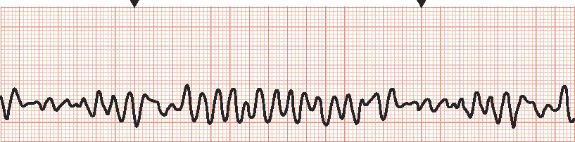
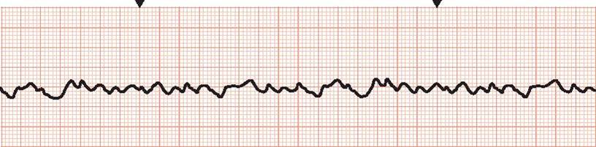
Ventricular Fibrillation (VF)
Notes:
FIGURE 29.24 Ventricular fibrillation (VF). A, Coarse VF. B, Fine VF.

Slide 52
Cardiac Dysrhythmias (continued_18)
Idioventricular Rhythm
  S A and A V nodes fail
  Causes
    M I
    Postcardiac arrest
    Medication and drug toxicities
    Electrolyte imbalances
    Myocarditis
    Cardiomyopathy
    Congenital heart disease
Notes:
Idioventricular rhythm (IVR) occurs when the S A and A V nodes fail to function and the rhythm is generated from the ventricle. The rate is usually less than 40 bpm.
Causes of IVR include M I, postcardiac arrest, medication and drug toxicities (e.g., cocaine, digoxin, anesthetics), electrolyte imbalances, myocarditis, C M, and congenital heart disease.
Treatment of IVR is based on the patient’s symptoms. If the patient is symptomatic, the treatment includes correcting the cause, pacing, and atropine.

Slide 53
Cardiac Dysrhythmias (continued_19)
Idioventricular Rhythm
  Treatment
    Treat the cause, pacing, atropine
Notes:
Idioventricular rhythm (IVR) occurs when the S A and A V nodes fail to function and the rhythm is generated from the ventricle. The rate is usually less than 40 bpm.
Causes of IVR include M I, postcardiac arrest, medication and drug toxicities (e.g., cocaine, digoxin, anesthetics), electrolyte imbalances, myocarditis, C M, and congenital heart disease.
Treatment of IVR is based on the patient’s symptoms. If the patient is symptomatic, the treatment includes correcting the cause, pacing, and atropine.

Slide 54
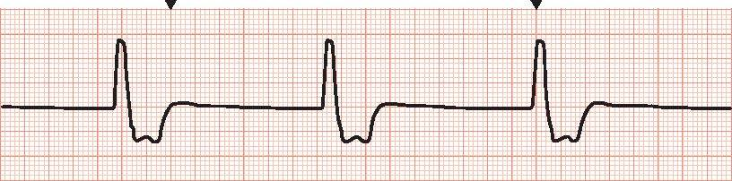
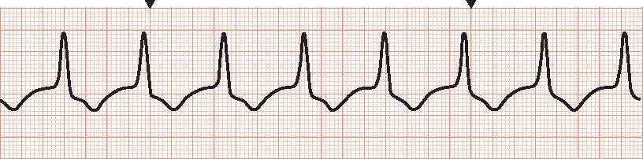
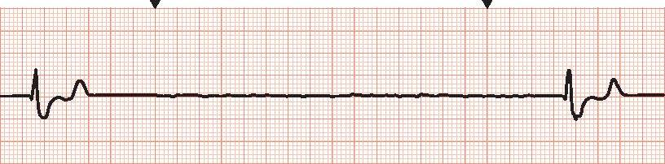
Idioventricular Rhythm (IVR)
Notes:
FIGURE 29.25 Idioventricular rhythm (IVR). A, IVR with a rate of 30. B, Accelerated idioventricular rhythm (AIVR) with a rate of 80. C, Agonal rhythm or dying heart.

Slide 55
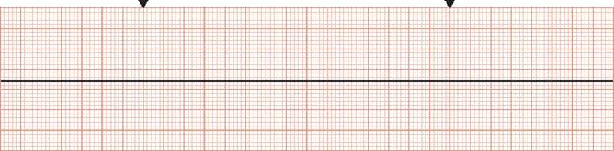
Cardiac Dysrhythmias (continued_20)
Asystole
  No measurable electrical activity from the heart
  Start C P R
Notes:
Asystole is a condition in which there is no measurable electrical activity originating from the heart. A straight or flat line is produced on the cardiac monitor (Fig. 29.26). Without an electrical stimulus, the cardiac muscles cannot squeeze or contract to force blood in or out of the heart’s chambers. It is important to assess the patient to be sure that it is a true asystolic event. Occasionally, a loose E C G patch or wire from the monitor will cause a false reading. However, if it is a true asystolic event, the patient will be pulseless. Compressions should be started immediately. The patient should be assessed with a second monitor lead, pausing compressions only briefly (less than 10 seconds) to rule out a fine VF. If VF is confirmed, the patient should be defibrillated. If the second lead continues to show a flat line, asystole is confirmed, and defibrillation is not indicated. The treatment for asystole is C P R, epinephrine, and treating the cause, which is the same as that for VF addressed previously.

Slide 56
Cardiac Dysrhythmias (continued_21)
Heart Blocks
  Delay or block in conduction
  Causes
    Acute coronary syndrome, electrolyte imbalance, medication toxicities
Notes:
Heart blocks are caused by the delay or blockage of electrical conduction at the A V node. There are four types of heart blocks: first degree, second-degree type I, second-degree type II, and third degree. The A V node’s blood supply comes from the right coronary artery (RCA). If the RCA becomes partially or completely blocked, the A V node is deprived of oxygen, which causes ischemia. If the A V node tissue becomes ischemic or dies, the electrical impulses originating in the atria will have difficulty traveling through the A V node to the ventricles along the usual pathway. The electrical impulses will need to find an alternative pathway, which could cause conduction delays or even an electrical disassociation of the atria and the ventricles.
The primary cause of most A V heart blocks is acute coronary syndrome. Acute coronary syndrome (ACS) is an umbrella term used to describe unstable angina, acute non–ST elevation M I (NSTEM I), and acute ST elevation M I (STEM I). Other causes of heart blocks include, but are not limited to, electrolyte imbalances and medication toxicities.

Slide 57
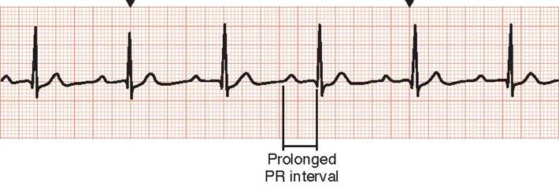
Cardiac Dysrhythmias (continued_22)
First-Degree A V Block
  P R interval prolonged > 0.20 sec
  Treatment
    Monitor
Notes:
FIGURE 29.27 First-degree atrioventricular block: the P R interval is prolonged (greater than 0.20 sec); in this strip, the P R interval is 24.

Slide 58
Cardiac Dysrhythmias (continued_23)
Second-Degree A V Block
  Type I
    P R gets progressively longer until Q R S is dropped
  Type II
    Dropped Q R S without prolonged P R interval
  Treatment
    Temporary pacing
Notes:
FIGURE 29.28 Second-degree atrioventricular block type I (Mobitz I or Wenckebach).
FIGURE 29.29 Second-degree atrioventricular block type II (Mobitz II).
Second-degree A V block type I (also known as Wenckebach or Mobitz I) occurs when not all atrial impulses get through the A V node to the ventricles. There are more P waves than Q R S complexes, and the P R interval gets progressively longer until a Q R S is dropped.
Second-degree A V block type II (also known as Mobitz II) also drops Q R S complexes, but unlike second-degree type I, the P R intervals are exactly the same length with each complex. This dysrhythmia is more alarming and is considered a potentially life-threatening dysrhythmia because it can quickly progress to a third-degree A V block.
Treatment of second-degree A V block type II is dependent on the patient’s symptoms. If the patient is symptomatic, then temporary pacing is the treatment of choice.

Slide 59
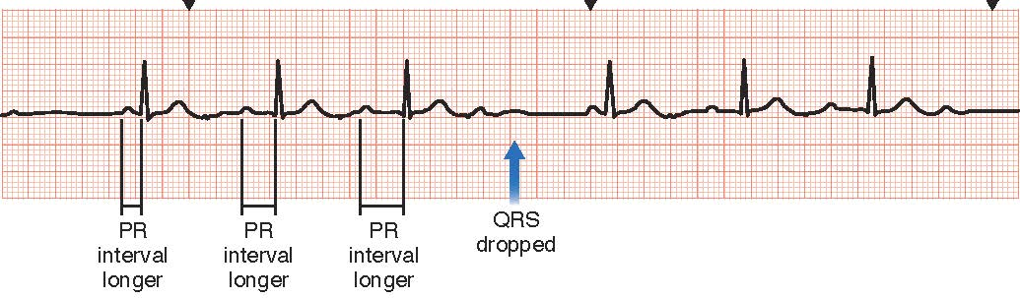
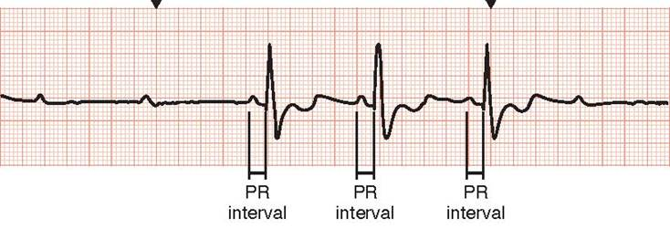
Second-Degree AV Block Type I and Type II
Notes:
FIGURE 29.28 Second-degree atrioventricular block type I (Mobitz I or Wenckebach).
FIGURE 29.29 Second-degree atrioventricular block type II (Mobitz II).
Second-degree A V block type I (also known as Wenckebach or Mobitz I) occurs when not all atrial impulses get through the A V node to the ventricles. There are more P waves than Q R S complexes, and the P R interval gets progressively longer until a Q R S is dropped.
Second-degree A V block type II (also known as Mobitz II) also drops Q R S complexes, but unlike second-degree type I, the P R intervals are exactly the same length with each complex. This dysrhythmia is more alarming and is considered a potentially life-threatening dysrhythmia because it can quickly progress to a third-degree A V block.
Treatment of second-degree A V block type II is dependent on the patient’s symptoms. If the patient is symptomatic, then temporary pacing is the treatment of choice.

Slide 60
Cardiac Dysrhythmias (continued_24)
Third-Degree A V Block (Complete heart block)
  A V node completely blocked
  P waves and Q R S complexes independent of each other
  Treatment
    Supportive care
    Treat cause
    Pacing
Notes:
FIGURE 29.31 Third-degree heart block or complete heart block (CHB). R to R is regular, and P to P is regular, but there is no communication between the atria and the ventricles.
Third-degree A V block or complete heart block (CHB) occurs when the A V node is completely blocked and prevents any impulses from entering or exiting. There is no communication between the atria and the ventricles. In CHB, Q R S complexes march out regularly and are independent of the P waves. Similarly, the P waves march throughout the rhythm strip at a regular rate.
Treatment of CHB is initially based on treating the patient’s symptoms, such as hypotension or SOB. Attempts are made to reverse the cause(s) if possible. Transcutaneous pacing is indicated in symptomatic CHB. Long-term treatment is typically the insertion of a permanent pacemaker.

Slide 61
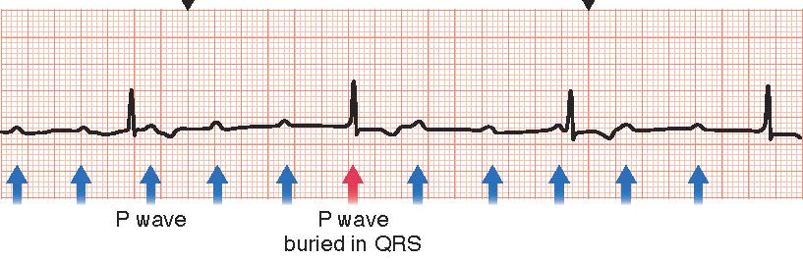
Third-Degree AV Block or Complete Heart Block (CHB)
Notes:
FIGURE 29.31 Third-degree heart block or complete heart block (CHB). R to R is regular, and P to P is regular, but there is no communication between the atria and the ventricles.
Third-degree A V block or complete heart block (CHB) occurs when the A V node is completely blocked and prevents any impulses from entering or exiting. There is no communication between the atria and the ventricles. In CHB, Q R S complexes march out regularly and are independent of the P waves. Similarly, the P waves march throughout the rhythm strip at a regular rate.
Treatment of CHB is initially based on treating the patient’s symptoms, such as hypotension or SOB. Attempts are made to reverse the cause(s) if possible. Transcutaneous pacing is indicated in symptomatic CHB. Long-term treatment is typically the insertion of a permanent pacemaker.

Slide 62
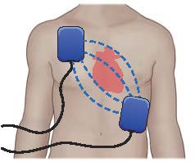
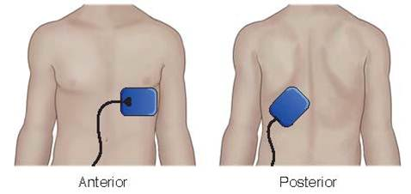
Transcutaneous Pacing (TCP)
Notes:
FIGURE 29.30 A, Apex/sternum pad placement. B, Anterior/posterior pad placement.

Slide 63


Pacemaker
Notes:
FIGURE 29.32 A, Example of ventricular paced rhythm with pacer spikes. B, Pacemaker implantation; there may be a lead in the atrium, ventricle, or both.

Slide 64
Cardiac Dysrhythmias (continued_25)
Nursing Management – Assessment and analysis
  Impact on cardiac output
    Shortness of breath
    Pain
    Hypotension
    Fatigue
    Death
Notes:
Clinical manifestations for dysrhythmias are dependent on their impact on the patient’s cardiac output. Some dysrhythmias have little impact on cardiac output and so have few manifestations. The more dangerous dysrhythmias, such as atrial fibrillation and ventricular rhythms or blocks, can greatly reduce cardiac output, causing SOB, pain, hypotension, fatigue, and if severe enough, death.

Slide 65
Cardiac Dysrhythmias (continued_26)
Nursing Interventions – Assessments
  Vital signs
  Change in level of consciousness
  Diaphoresis
  Chest pain
  Peripheral circulation
  Nausea and vomiting
Notes:
Evaluate E C G and identify the rhythm – Recognizing the rhythm helps the nurse anticipate and respond appropriately.
Determine if the patient is symptomatic versus asymptomatic – Symptomatic patients require immediate response and evaluation of causes; asymptomatic patients require observation and evaluation of causes.
To assess if symptomatic, evaluate:
• Vital signs – The lack of efficient contractile function of a heart experiencing dysrhythmias results in a decrease in CO and hypotension. In an attempt to increase oxygenation in the face of decreased CO, SOB and tachypnea may occur. The HR may be faster, slower, regular rhythm, or irregular rhythm depending on the type of dysrhythmia.
• Change in level of consciousness – Decreased blood pressure and thus CO may cause a decrease in blood flow to the brain, resulting in dizziness or syncope.
• Diaphoresis – Diaphoresis is the result of the stimulation of the sympathetic nervous system in response to low CO.
• Chest pain – Dysrhythmias may cause an imbalance in myocardial oxygen demand and supply, potentially resulting in chest pain.
• Poor peripheral circulation – Decreased CO may cause weak peripheral pulses, cool extremities, and sluggish capillary refill. Poor contractile function may cause peripheral edema.
• Nausea and vomiting – Shunting of blood away from nonessential organ systems during low-flow states may cause nausea and vomiting.
Electrolyte levels and cardiac enzymes – Dysrhythmias may indicate acute cardiac injury, which may be demonstrated by elevated cardiac enzymes. Elevated potassium levels can cause changes in the shape of the T wave.

Slide 66
Cardiac Dysrhythmias (continued_27)
Nursing Interventions – Actions
  Administer antiarrhythmic therapy as ordered
  Perform E C G
  Be prepared to administer advanced cardiac life support
  Document occurrence of dysrhythmia
Notes:
Administer antiarrhythmic therapy as ordered – Antiarrhythmic medications limit the occurrence of dysrhythmias, helping to maintain an adequate CO and decrease the risk of life-threatening events associated with lethal dysrhythmias.
Perform an E C G/maintain continuous E C G monitoring as ordered – Monitoring facilitates immediate recognition of dysrhythmias, which allows for prompt treatment as necessary.
Be prepared to administer advanced cardiac life support in the event of a lethal dysrhythmia – Cardiopulmonary resuscitation, defibrillation if indicated, and administration of emergency medications may restore adequate CO in a patient experiencing lethal dysrhythmias.
Document the occurrence of dysrhythmias – Documentation helps evaluate the need for and/or the effectiveness of therapy.

Slide 67
Cardiac Dysrhythmias (continued_28)
Nursing Interventions – Teaching
  Immediately report chest pain/discomfort
  Take antiarrhythmic medications as prescribed
  Recognize signs of complications
Notes:
Immediately report chest pain or chest discomfort – Prompt treatment is one way to help maximize positive outcomes when a patient is experiencing dangerous or lethal dysrhythmias.
Take antiarrhythmic medications as prescribed – Maintaining adequate medication levels helps decrease the occurrence of adverse effects of dysrhythmias.
Recognize signs of possible complications of dysrhythmias, such as strokes due to clot formation in A F – It is important that the patient (and family) is able to detect early signs of complications to ensure prompt treatment and reduce adverse effects.

Slide 68
Case Study: Episode 1
Ms. Danielle Fletcher is a 68-year-old female who presents to the emergency department (E D) with complaints of acute light-headedness and palpitations. She reports that she is becoming progressively more dyspneic (short of breath). Her medical history includes hypertension (H T N) and type 2 diabetes that is diet controlled. Ms. Fletcher is currently taking hydro - chlorothiazide 12.5 mg daily and lisinopril 20 mg daily.

Slide 69
Case Study: Episode 1 (continued)
On admission to the E D, Ms. Fletcher is triaged quickly to obtain baseline vital signs, such as blood pressure, heart rate (HR), respirations, and temperature, and a 12-lead electrocardiogram (E C G). A thorough history is obtained to determine onset and triggers of symptoms for this event. Ms. Fletcher’s E C G reveals atrial fibrillation (A F).

Slide 70
Case Study: Episode 2
The patient history reveals that Ms. Fletcher has not been feeling well for several days. Her symptoms are related to a decrease in C O resulting from A F. She is seeking treatment in the E D because she became more short of breath and dizzy this morning. Anticoagulation therapy is indicated initially to prevent thrombus formation. She is placed on a heparin drip.

Slide 71
Case Study: Episode 2 (continued)
Laboratory clotting studies are performed to evaluate the effectiveness of the heparin drip. She is placed on bleeding and fall precautions. Ms. Fletcher is given patient education on the risk of increased bleeding caused by the anticoagulation medication.

Slide 72
Case Study: Wrap-up
After being started on heparin, Ms. Fletcher is prepared for a T E E to determine if clots are present in her atria. If there are no clots, she may be a candidate for cardioversion. If clots are visualized, anticoagulation therapy will be continued. Ms. Fletcher’s T E E reveals no clots. She is electively cardioverted because of her increasing instability. Her rhythm returns to N S R. She is admitted to a cardiac telemetry bed for observation overnight.

Slide 73
Case Study : Wrap-up (continued)
She will need further education on the signs and symptoms of A F and her new medications. She is referred for follow-up to an appropriate dysrhythmia specialist.

Slide 74
Case Study
1. What is the priority nursing action for Ms. Fletcher upon admission to the unit?
A. Orientation to the room
B. Initiating E C G monitoring
C. Calculating intake and output
D. Assessing pain level
Notes:
Answer: B
Rationale: Continuous E C G monitoring is the
priority to monitor for the return of A F.

Slide 75
Case Study (continued_1)
2. The nurse monitors for which clinical manifestations in Ms. Fletcher? (Select all that apply.)
A. Complaints of palpitations
B. Complaints of shortness of breath
C. Diaphoresis
D. Fever
E. Hyperglycemia
Notes:
Answer: A, B, and C
Rationale: Diaphoresis and SOB occur due to the decrease in cardiac output that occurs with A F. Palpitations may be present due to the irregular rhythm. Fever and hyperglycemia are not associated with A F.

Slide 76
Case Study (continued_2)
3. The charge nurse is reviewing new admission orders for Ms. Fletcher. It is a priority for the charge nurse to follow up with the provider about which order?
A. Regular diet
B. Discontinuing monitor
C. Vital signs every 4 hours
D. Saline lock
Notes:
Answer: B
Rationale: Continuous monitoring is necessary to
monitor for the return of A F or other dysrhythmias.
VS Q4h, regular diet, and a saline lock are all
indicated for her care.

Slide 77
Case Study (continued_3)
4. The nurse caring for Ms. Fletcher incorporates which nursing diagnoses into the plan of care? (Select all that apply.)
A. Risk for decreased cardiac output
B. Risk for embolic event
C. Knowledge deficit
D. Risk for poor nutrition
E. Risk for bleeding
Notes:
Answer: A, B, C, and E
Rationale: All except D are priority diagnoses.
A F puts the patient at risk for clots, thus an embolic
event, decreased cardiac output due to the loss of
atrial kick, knowledge of the diagnosis of
A F and necessary self-care is essential for health
maintenance.

Slide 78
Case Study (continued_4)
5. Which statement by Ms. Fletcher indicates that teaching has been effective?
A. “I’m just glad the problem was fixed, and I don’t need to go back to the doctor.”
B. “I’m glad I don’t have to worry about having a stroke anymore.”
C. “I guess I need to follow up with a heart doctor.”
D. “I guess things will go back to normal now.”
Notes:
Answer: C
Rationale: A F may return so follow-up is an
essential component of care.

