Slide 1
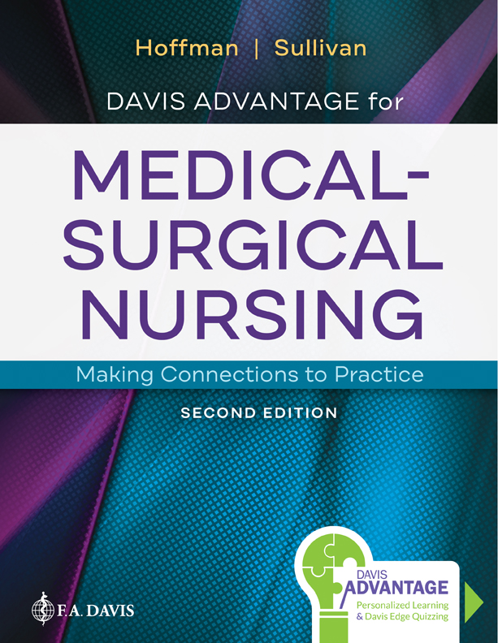
Chapter 47
Assessment of Auditory Function

Slide 2
Introduction
Ear works with brain to interpret sound
Notes:
The ear is an extraordinary sensory organ that works in conjunction with the brain to interpret sounds. These sounds allow assessment of surroundings, warning of potential dangers, interactions with other people, and appreciation of sounds such as music, work, and play. Many aspects of daily life are affected by the ability to hear. Assessment of the anatomy and physiology of the ear provides essential data about hearing and balance. The interpretation of screening assessments and diagnostic results is also pertinent to providing comprehensive care to patients with hearing disorders.

Slide 3
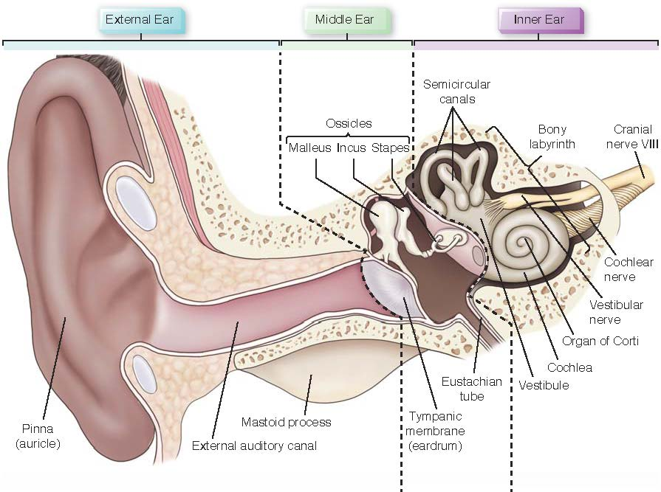
Overview of Anatomy and Physiology
Notes:
Figure 47.1 Anatomy of the ear.

Slide 4
Auditory Function
Sound transmitted by air and bone conduction
Notes:
Sound is transmitted by air and bone conduction, and air conduction of sound is the most common pathway of hearing. Transmission by air follows the subsequent sequence for sound to be successfully interpreted. Sound is gathered by the pinna, and the waves enter the ear traveling through the auditory canal until they reach the tympanic membrane (eardrum). The sound waves set up vibrations in the eardrum. These vibrations of the eardrum cause the auditory ossicles (the malleus, incus, and stapes) in the middle ear to move back and forth. The cochlea receives the sound vibrations next. Finally, the sound stimulus travels to the vestibulocochlear nerve (acoustic or auditory nerve), cranial nerve VIII, and terminates in the cerebral cortex.

Slide 5
Assessment – History
Patient history
Current medications
Observe for hearing difficulties
Notes:
A detailed patient history is completed before the physical examination. During assessment of the auditory system, it is important that the provider carefully listen, ask questions regarding the patient’s medical history and family history, and note any current medications the patient is taking. Observation of the patient’s posture and facial expressions can also yield clues about hearing difficulties. For example, does the patient frequently lean toward the provider when questions are being asked? Other careful considerations include whether the patient is able to accurately answer the questions and if there are frequent requests to repeat questions.

Slide 6
Personal Hygiene
Assess hygiene of ears
Instruct patients not to insert foreign objects into ear canal
Notes:
The physical examination is an ideal time to assess how the patient cares for and cleans the ears. This is also an opportunity for the nurse to instruct the patient regarding the dangers of using cotton swabs or other foreign objects in the ear canal because inserting foreign objects can cause tissue injury to the sides of the canal, as well as causing cerumen to be moved. Movement of the cerumen by a foreign object places the patient at risk for cerumen impaction, causing changes in hearing, as well as rupture of the eardrum.

Slide 7
Physical Inspection
Palpate external ear
Size and shape
Symmetry
Absence of swelling or thickening
Notes:
Inspection begins with palpation of the external ear. The provider notes the size and shape of the ears because they should be equal in size bilaterally without swelling or thickening. The color of the ears should be consistent with the facial skin tone of the patient. Inspection for lumps or lesions is also performed. The pinna should feel firm and should be freely moveable without causing any discomfort. Palpation of the mastoid process is also completed at this time, and there should be no swelling or complaint of pain present during the examination.

Slide 8
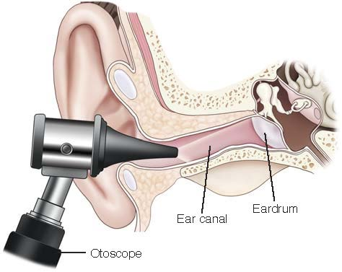
Otoscopic Examination
Notes:
FIGURE 47.2 Otoscopic examination. The otoscope is used to examine the internal structures of the ear.

Slide 9
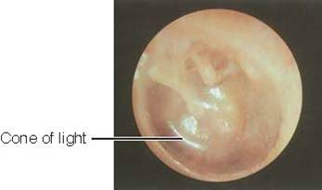
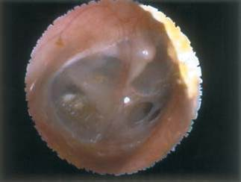
Otoscopic Examination (continued)
Notes:
FIGURE 47.3 Normal eardrum on otoscopic examination (left ear). The normal eardrum is shiny, translucent, and pearl gray in color. The cone-shaped light reflex, which is the reflection of the otoscope light that is elicited is noted in the anteroinferior quadrant (7:00 in the left eardrum).
FIGURE 47.4 Perforated eardrum.

Slide 10
Auditory Assessment
Hearing loss categorized in 3 ways
Conductive hearing loss
Sensorineural hearing loss
Mixed-conductive-sensorineural hearing loss
Notes:
Auditory, or hearing, assessment is completed after the external and otoscopic examination of both ears has been completed. These simple but meaningful tests help identify deficiencies present; however, they cannot determine the extent of the deficiency. Hearing loss is categorized in three ways:
Conductive hearing loss describes a physical obstruction of sound wave transmission.
Sensorineural hearing loss describes a deficit present in the cochlea, cranial nerve VIII, or the brain.
Mixed conductive-sensorineural hearing loss describes profound hearing loss that encompasses both conductive and sensorineural injuries.

Slide 11
Diagnostic Studies
Audiometry
Tympanometry
Electronystagmography
Computed tomography
Magnetic resonance imaging
Notes:
Audiometry — Hearing acuity is measured through audiometry, and this test is most often performed by skilled technicians and nurses with specialized training. This test measures frequency (the highness or lowness of tones expressed in hertz; hertz is the international unit of frequency defined as the number of cycles per second of a sound).
Tympanometry is completed in healthcare providers’ offices and clinics and is performed by technicians, nurses, or other specially trained personnel. Patient preparation centers on educating the patient as to how and why the test will be completed. The equipment used is sensitive and requires delicate handling and usually has single-use earpieces that require disposal and replacement. Tympanometry is performed to assess the mobility of the eardrum and structures of the middle ear because these changes are consistent with presence of fluid in the middle ear.
The electronystagmography (ENG) test is done to detect both central and peripheral diseases of the vestibular system (the system in the inner ear that is responsible for maintaining balance and orientation in space) in the ear. The ENG detects and records nystagmus (involuntary eye movements), because the eyes and ears depend on each other for balance.
Computed tomography and magnetic resonance imaging — Detailed visualization of the internal structures of the ear is achieved by either computed tomography (CT) or with magnetic resonance imagining (MRI).

Slide 12
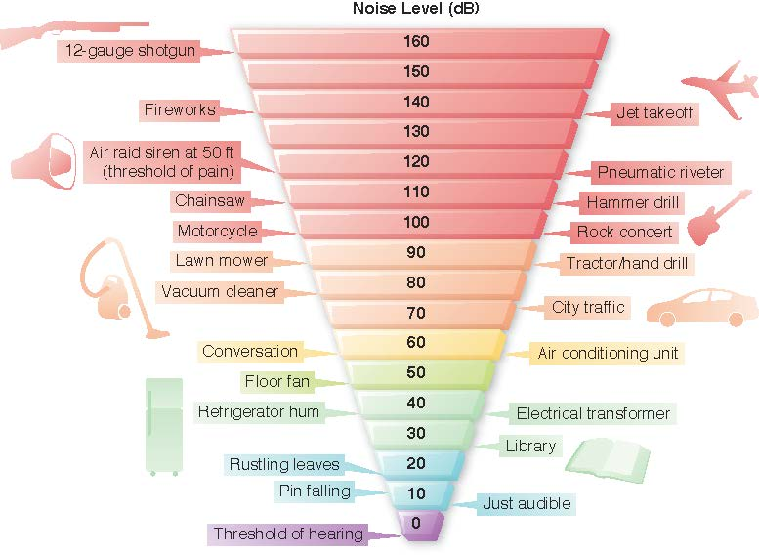
Noise Levels
Notes:
FIGURE 47.5 Noise levels of common sounds. Volume levels ranging from 0 to 160 dB.

Slide 13
Ototoxic Medications
Most common:
Antibiotics
Diuretics
N S A I D’s
Chemotherapeutic agents
Notes:
The ear is a sensitive organ with many fragile parts. Several categories of medications can prove dangerous to the proper functioning of the ear (ototoxic), and often patients are not aware of this side and adverse effects. The most common categories of medications that pose ototoxic risks are in the following categories:
Antibiotics
Diuretics
NSAIDs
Chemotherapeutic agents
Miscellaneous

Slide 14
Hearing Protection
Protection from excessive noise
Earplugs
Earmuffs
Notes:
Protecting the numerous sensory organs of the ear is imperative for the long-lasting health and function of the ear. Evaluation of hearing function is an essential part of the patient’s yearly examination. This examination includes the basic screening tools discussed previously as well as more in-depth testing based on the presence of any ear abnormalities. Protection of the ears from excessive noise is facilitated by using earplugs, earmuffs, or other protective equipment.

Slide 15
Case Study: Episode 1
Erin Hodge is a 22-year-old waitress who plans to see her provider this week for a physical examination. Erin has always enjoyed excellent health, though she did experience numerous ear infections as a child requiring surgical insertion of pressure-equalizing tubes (tiny tubes surgically inserted in the tympanic membrane to equalize pressure and prevent infectious buildup). Currently, Erin has no known chronic diseases and takes no medication on a daily basis.

Slide 16
Case Study: Episode 1 (continued)
She has been noticing waxy buildup in her ear canal lately, which she has treated herself using a cotton swab to remove the wax. Erin has not noticed any hearing changes and plans to discuss the recent waxy build up in her ears with her provider.

Slide 17
Case Study: Episode 2
Erin Hodge provides a detailed health, family, and medication history to the nurse provider. Erin’s physical examination and simple hearing assessments are all noted as “normal” by the advanced practice nurse and yield no concerns. To complete the examination, the nurse practitioner removes the earwax to increase visualization. Erin notices an immediate improvement in her hearing ability after the wax is removed.

Slide 18
Case Study: Wrap-Up
The provider notes the opportunity for teaching regarding Erin’s use of cotton swabs to clean the earwax from her ears. Concern is raised regarding the possibility of inducing trauma to the eardrum or other internal ear structures by use of this foreign object. Erin states that this is the way “everyone” in her family cleans his or her ears, and so she has performed this action for as long as she can recall.

Slide 19
Case Study: Wrap-Up (continued)
The provider concludes Erin’s examination with teaching of ear hygiene without the use of introducing objects into the ear canal, thereby possibly preventing trauma or hearing loss to her.

Slide 20
Case Study
1. The nurse recognizes that ear infections are more common in children for which reason?
A. The immaturity of the hair cells within the ear canal
B. The increase in wax production in children younger than 5 years
C. The flat position of the eustachian tube
D. The immaturity of the immune system
Notes:
Answer: C
Rationale: In children, this tube is more flat in
appearance, thereby allowing fluids to collect and
stagnate increasing the chance of infection.

Slide 21
Case Study (continued_1)
2. What teaching is most important for the provider to provide to Erin during this visit?
A. Not using cotton swabs or other similar instruments in the ear canal
B. Ways to remove the waxy buildup from the ear canal
C. What to do if the patient starts to notice hearing loss
D. Use of earbuds for listening to music
Notes:
Answer: A
Rationale: Use of cotton swabs or other similar
instruments can create a rupture or impact cerumen
in the ear canal.

Slide 22
Case Study (continued_2)
3. The healthcare provider instructs the patient on which ear protective measures? (Select all that apply.)
A. Earbuds to reduce noise in areas with high-decibel noise levels
B. Earbuds to help prevent water from entering the ear canal
C. Headphones to listen to music at medium to high decibel ranges
D. Earplugs to help decrease water from entering the canal while swimming
E. Wearing earmuffs in the winter
Notes:
Answer: D
Rationale: Earplugs can help prevent water from
entering the ear canal and potentially cause infection
for those at increased risk for ear infections.

Slide 23
Case Study (continued_3)
4. Erin does not notice any hearing changes; the provider verifies Erin’s ability to hear by using which test?
A. An M R I for the most definitive testing
B. Audioscopy
C. A C T scan of the head
D. Electronystagmography (E N G)
Notes:
Answer: B
Rationale: This hand-held portable test allows the
provider to assess the patient’s ability to hear
general tones.

Slide 24
Case Study (continued_4)
5. Erin’s ability to hear better after her physical examination is directly related to which action?
A. The removal of the embedded wax from the ear canal
B. The examination with an otoscope
C. It is not clear why Erin is hearing more clearly.
D. The stretching of the ear canal while an otoscopic examination is completed
Notes:
Answer: A
Rationale: Removal of ear wax can improve hearing
as impacted wax can form an obstruction, thereby
decreasing the ability of sound waves to transmit.

