Slide 1
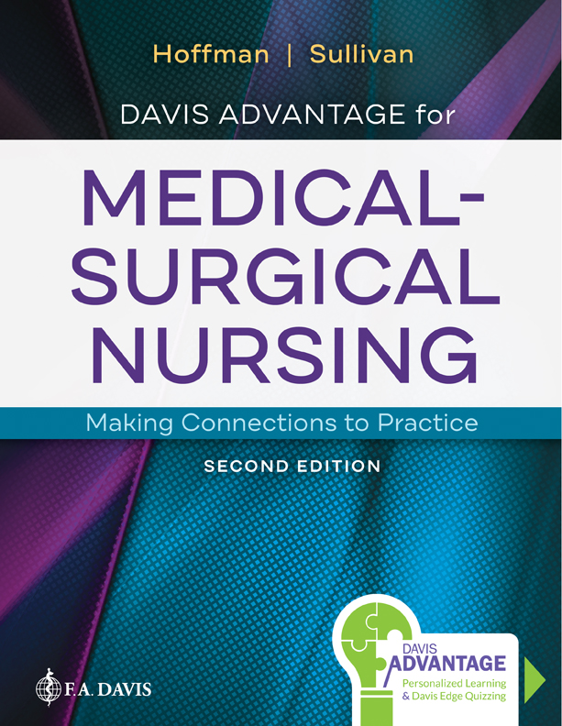
Chapter 49
Assessment of Integumentary Function

Slide 2
Introduction
Skin
Hair
Nails
Notes:
The integumentary system, including the skin, hair, and nails, comprises the protective coating that guards the body from injury. Because the skin is the largest and most visible organ, alterations in integumentary appearance and function may signal underlying pathologies of other body systems. Careful assessment and interpretation of skin, hair, and nail abnormalities as well as expedient implementation of nursing interventions sustain the body’s protective shield.

Slide 3
Overview of Anatomy, Physiology, and Function
Skin
  Protection, temperature regulation, vitamin D metabolism, sensation, excretion
Notes:
The skin layers include the epidermis and dermis. The five major functions of the skin are protection, temperature regulation, vitamin D metabolism, sensation, and excretion. Providing protection from the external environment, as well as to underlying structures and organs, the skin is essential to homeostasis. Supporting temperature regulation, the skin also plays a role through facilitating heat loss or heat conservation through the skin. Vitamin D metabolism is another major function of the skin, because the epidermis is the major source of vitamin D for the body. Activated in the epidermis by ultraviolet (UV) light, vitamin D enters the circulation and works in the gastrointestinal system to facilitate calcium absorption. Sensation is controlled in the dermis, the location of many nerve receptors that communicate with the central nervous system. The role of the skin in excretion is linked to losses of fluid through the sweat glands; the evaporation of water through the skin also aids in cooling the body. Eccrine sweat glands cover most of the body’s surface and apocrine sweat glands are present in hair follicles of the armpits and genitalia.

Slide 4
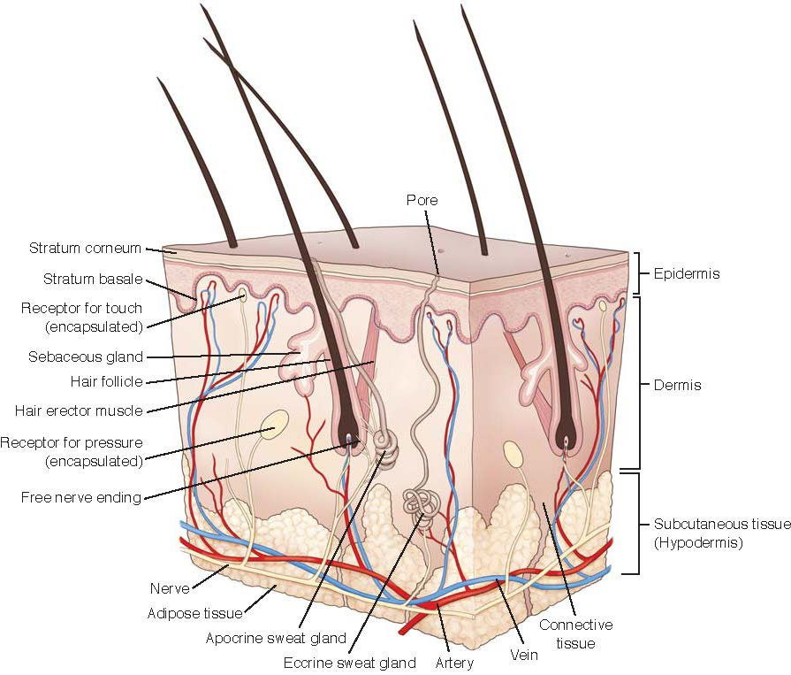
Anatomy of the Skin
Notes:
Figure 49.1 Anatomy of the skin.

Slide 5
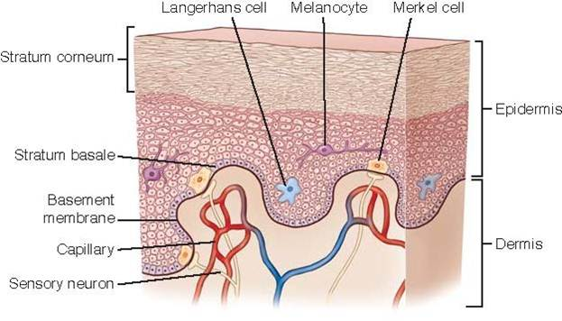
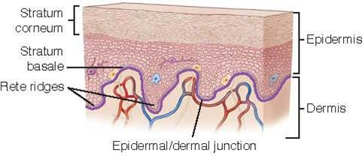
Anatomy of the Skin (continued)
Notes:
Figure 49.2 Epidermis.
FIGURE 49.3 Rete ridges. The epidermis is anchored to the dermis by rete ridges that point downward into the dermis that creates a secure bond between the two skin layers.

Slide 6
Skin
Epidermis
Dermis
Subcutaneous tissue
Notes:
Epidermis — The outermost skin layer is called the epidermis (Fig. 49.2) and protects the body by forming a barrier that resists pathogen invasion.
Dermis — The dermis is approximately 2 to 4 mm thick and encases blood vessels, nerves, immune system cells including macrophages and mast cells, dermal proteins including collagen and elastin, hair follicles, and sweat and sebaceous glands (glands that secrete sebum, which lubricates the hair follicles to the skin and hair). Each of these structures supports the five functions of the skin.
Subcutaneous tissue — Below the two skin layers lies the subcutaneous tissue or hypodermis, which contains adipose tissue, connective tissue, nerves, and blood supply. The adipose tissue located in this layer surrounds and insulates the deeper structures including organs, muscle, and bone. Distribution of adipose tissue varies depending on gender, genetic predisposition, and lifestyle habits.

Slide 7
Hair
Reduces heat loss
Shields skin from sun
Notes:
In addition to having significant cosmetic importance, hair reduces heat loss and shields the skin from sun exposure. Although distribution varies, hair is present on most of the body. Both hair and hair follicles are composed of keratinocytes. Hair follicles are anchored in the dermis and then protrude into the epidermis. The hair itself is referred to as a root when contained within the follicle, and the portion that emerges from the follicle is referred to as the shaft.

Slide 8
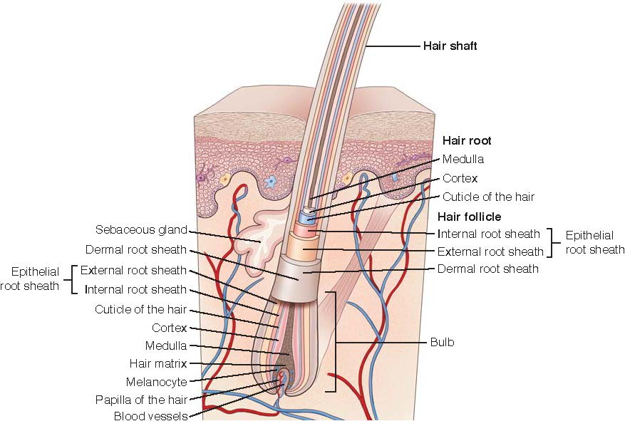
Structure of the Hair Follicle
Notes:
FIGURE 49.4 Structure of the hair follicle.

Slide 9
Nails
Protect fingers and toes
Notes:
Nails — Nails protect the tips of the fingers and toes. They are composed of a hard keratin and have a slow but continuous growth process. Beneath the skin, the nail matrix houses constantly dividing basale keratinocytes that form the nail root (Fig. 49.5). The nail body refers to the visible portion that adheres to the nail bed. The condition of the nails reflects general health, state of nutrition, occupation, and habits of self-care. Coloration of the nail bed provides information about the perfusion status of the body’s most distal locations.

Slide 10
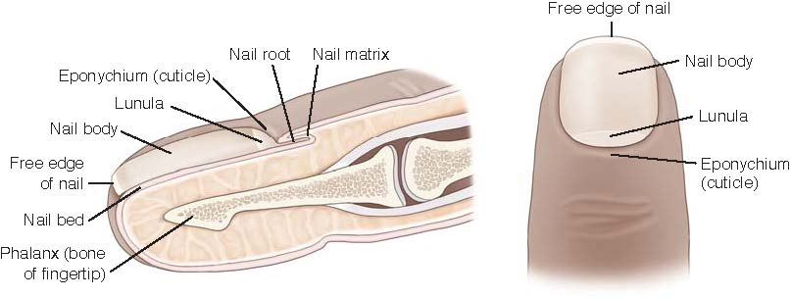
Structure of the Nail
Notes:
FIGURE 49.5 Structure of the nail.

Slide 11
Assessment – History
Demographics
Personal history
Medications
Family history
Diet
Environmental factors
Notes:
Demographics — When obtaining a history, the nurse gathers demographic data, including age and race, because the skin’s primary functions are affected by age.
Personal history: comorbid conditions — The nurse collects a personal history that includes comorbid conditions. Advancing comorbid conditions that affect other body systems can frequently lead to the emergence of wounds, skin and nail bed discoloration, textural changes, and hair distribution changes. When these deviations from normal are detected, the common underlying pathology is inadequate oxygen and nutrient delivery to the integumentary system. However, common conditions including diabetes mellitus, cardiovascular disease, respiratory disease, liver and kidney disease, and obesity each have a specific pathophysiology that results in an alteration in skin tissue perfusion.
Medications — Commonly used medications frequently have side effects that affect skin appearance and function. For example, corticosteroid therapy leads to thin, fragile skin that tears easily because the medication interferes with the formation of the epidermis and collagen production.
Family history — After discussing the patient’s current skin conditions and personal history, the nurse inquires about family history. It is important to collect data about skin, hair, and nail conditions affecting family members because many conditions are genetically linked.
Diet — Consumption of adequate amounts of protein, carbohydrates, fats, vitamins, and minerals is required to maintain a healthy integumentary system. If a patient lacks sufficient intake of nutrients, it is often visible in the appearance of the skin, hair, and nails
Environmental factors — Occupational exposures, lifestyle habits, and sun exposure impact skin integrity. Chemical exposures in the workplace or at home can lead to skin inflammation or chemical burns. Allergic contact dermatitis is a T cell–mediated hypersensitivity reaction to a substance after repeated exposures.

Slide 12
Physical Assessment
Color and temperature
Moisture
Integrity
Cleanliness
Tissue changes
Notes:
After inspection and palpation, the nurse documents observations regarding the following characteristics:
Color and temperature
Moisture
Integrity
Cleanliness
Tissue changes

Slide 13
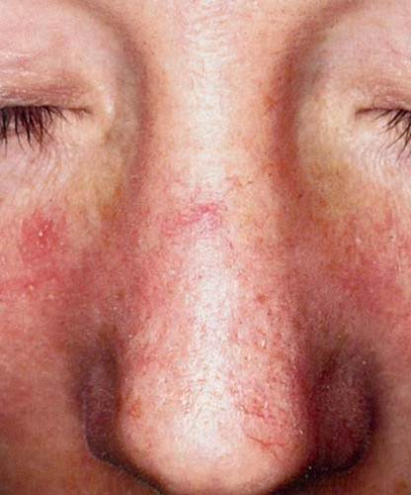
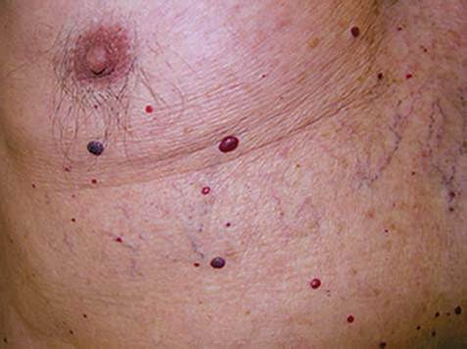
Physical Assessment (continued_1)
Notes:
FIGURE 49.6 Spider angioma.
FIGURE 49.7 Cherry angioma.

Slide 14
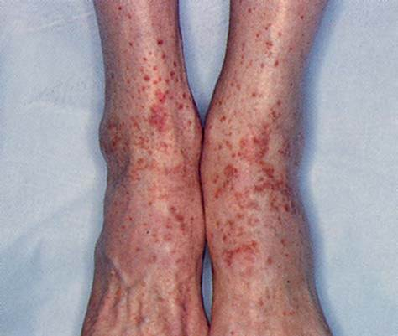
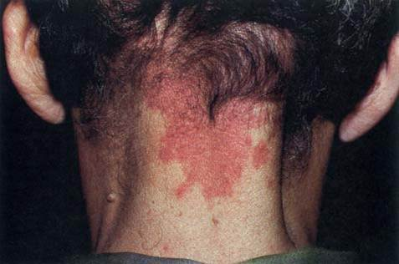
Physical Assessment (continued_2)
Notes:
FIGURE 49.8 Port-wine stain.
FIGURE 49.9 Petechial rash.

Slide 15
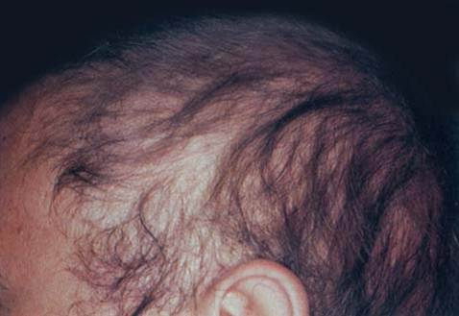
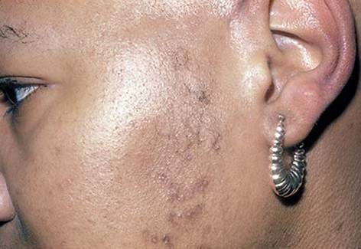
Physical Assessment (continued_3)
Notes:
FIGURE 49.10 Alopecia secondary to chemotherapy.
FIGURE 49.11 Hirsutism of face.

Slide 16
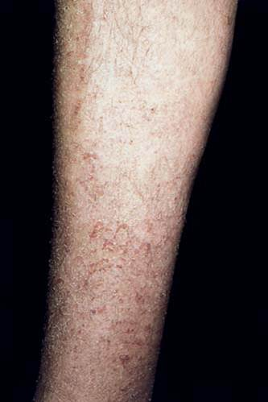
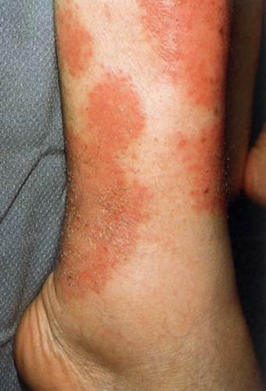
Physical Assessment (continued_4)
Notes:
FIGURE 49.12 Xerosis (dermatitis).
FIGURE 49.13 Eczema.

Slide 17
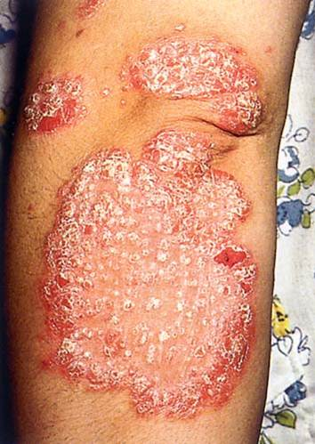
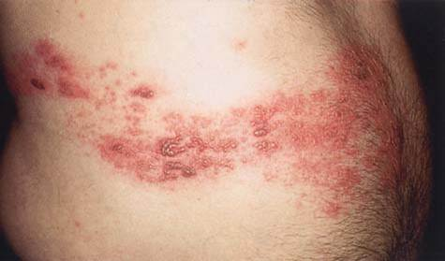
Physical Assessment (continued_5)
Notes:
FIGURE 49.14 Psoriasis vulgaris: elbow.
FIGURE 49.15 Varicella-zoster virus infection.

Slide 18
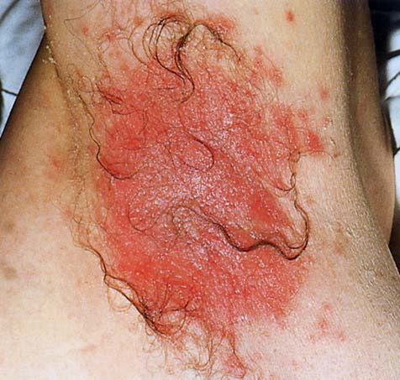
Physical Assessment (continued_6)
Notes:
FIGURE 49.16 Cutaneous candidiasis.

Slide 19
Braden Scale
Assists in identifying patients at risk for pressure injury
  Sensory perception
  Moisture
  Activity/mobility
  Nutrition
  Friction and shear
Notes:
In all healthcare settings, nurses must be knowledgeable about the risk of pressure injury as well as prevention strategies. The Braden scale is a commonly used tool that assists the nurse with identifying patients who are at risk for pressure-related skin damage. This tool requires the nurse to evaluate specific parameters for each patient: sensory perception, moisture, activity, mobility, nutrition, friction, and shear. Scores can range from 6 to 23, with a score of 1 or 2 in the mobility category as the most sensitive indicator for risk of pressure injury. Lower total scores indicate higher overall risk for developing alterations in skin integrity.

Slide 20
Hair Assessment
Color
Cleanliness
Quantity
Thickness
Texture
Distribution and lubrication
Notes:
Color, cleanliness, quantity, thickness, texture, and distribution and lubrication of the patient’s hair are evaluated during the skin assessment. Before physical assessment and palpation, the nurse questions the patient about recent or gradual changes in the texture or pattern of hair on all body surfaces. Underlying illness, nutritional deficits, medications, stress, and unhealthy dieting may cause hair loss or textural changes.

Slide 21
Nail Assessment
Color
Shape
Consistency
Lesions
Notes:
Color — The color of the nail beds provides information about perfusion status as well as chronic illness. Normal capillary refill time (CRT) is less than 2 seconds.
Shape — A normal nail adheres to the nail bed, is surrounded on three sides by the nail folds, and is slightly convex in shape. Alterations in nail shape often indicate chronic disease states.
Consistency — The consistency of the nail should be firm, and the underlying nail bed color should be visible. Overly thick nails are often a result of advanced age, infection, or heredity as well as onycholysis, which refers to the nail plate detaching from the nail bed.
Lesions — Nail bed and nail fold lesions may be associated with a wide variety of skin conditions.

Slide 22
Case Study: Episode 1
Lacy Bloom is a 72-year-old white female patient who presents to her healthcare provider because of recent skin changes on her anterior chest. She reports itching, burning, redness, and blistering at the site as well as a low-grade fever. The patient reports that she spends a lot of time outdoors working in her garden. Also, she has an allergy to latex but has not had any recent exposures.

Slide 23
Case Study: Episode 2
Because of Ms. Bloom’s advanced age, her skin is at increased risk for dryness caused by the physiological changes associated with aging. The patient reports a latex allergy that causes redness but denies any serious skin reactions in the past. She has struggled with being overweight since her late-30s, and her current BMI is 28 kg/m2. Ms. Bloom denies any recent dietary changes or any travel outside the country.

Slide 24
Case Study: Episode 2 (continued)
She lives with her husband, and they are retired. Ms. Bloom reports spending a lot of time working outdoors in her garden, and she regularly wears sunscreen. Her daily skin care regimen includes bathing and moisturizing her skin once a day, and she reports using a new fragrance spray for approximately 2 weeks.

Slide 25
Case Study: Episode 3
Overall, Ms. Bloom’s skin has a healthy appearance. All of her nail beds are pale pink and display C R T of less than 2 seconds. She appears to have adequate moisture balance as evidenced by the absence of cracks, excessive dryness, or scabs. Skin, hair, and nails are clean and well-groomed. Hair distribution is appropriate on the basis of age and gender.

Slide 26
Case Study: Episode 3 (continued_1)
The rash is located below the neck on her anterior chest wall and measures 6 cm × 8 cm × 0 cm, which correlates to the length times width times depth. The site has erythema with a well-defined border and increased warmth in comparison with surrounding skin.

Slide 27
Case Study: Episode 3 (continued_2)
Within the 6 cm × 8 cm × 0 cm erythematous area, there are scattered, serous-filled, intact vesicles that are localized to the chest. The affected area appears to have increased moisture, but there are no localized signs of infection. Ms. Bloom reports a low-grade fever, pruritus, and burning. The provider orders the collection of a sterile swab culture of a vesicle base to rule out an infectious source.

Slide 28
Case Study: Wrap-Up
On the basis of information gathered in the history and physical assessment, this rash is characteristic of an allergic contact dermatitis brought on by the recent change in the patient’s fragrance. The nurse teaches Ms. Bloom to discontinue the new fragrance and explains how the rash may progress. Explaining that the contact with the new spray led to an acute allergic contact dermatitis, the nurse describes that the rash will most likely develop into vesicles opening into erosions that will then crust and eventually flake off.

Slide 29
Case Study
1. Which skin layers have been affected by Ms. Bloom’s allergic contact dermatitis?
A. Dermis only
B. Epidermis only
C. Both epidermis and dermis
D. Subcutaneous tissue
Notes:
Answer: B
Rationale: By definition, vesicles and erosions are
limited to the epidermis.

Slide 30
Case Study (continued_1)
2. When a sterile swab specimen is collected, which statement best describes the correct technique?
A. Rotate swab with gentle pressure within a 1- to 2-cm2 area of nonviable wound tissue
B. Saturate swab with drainage found in the base of the wound
C. Rotate swab with gentle pressure within a 1- to 2-cm2 area of clean wound tissue
D. Clean the wound with an antiseptic solution before obtaining the specimen
Notes:
Answer: C
Rationale: To ensure that the sterile swab specimen is
representative of the infective agent that has invaded
surrounding tissues, fluid should be expressed from a
clean portion of the wound bed.

Slide 31
Case Study (continued_2)
3. What information is important to include regarding site care instructions for the healing rash?
A. Clean skin with an abrasive surface to remove dried substances
B. Moisturize the drying rash with emollients to soften and gently remove crusts
C. Manually drain the vesicles
D. Avoid showering while rash persists
Notes:
Answer: B
Rationale: Site care for damaged skin involves
gentle cleansing and moisturizing to support the
growth of new epithelial tissue.

Slide 32
Case Study (continued_3)
4. The nurse recognizes which description as indicative of a vesicle?
A. Less than 1 cm in diameter, circumscribed, elevated, serous-filled
B. Size varies, circumscribed, elevated, pus-filled
C. Less than 1 cm in diameter, circumscribed, elevated, palpable, firm
D. Greater than 1 cm in diameter, flat, elevated, firm, rough
Notes:
Answer: A
Rationale: A vesicle is < 1cm in size, circumscribed,
elevated, serous-filled, and located in the epidermis.

Slide 33
Case Study (continued_4)
5. The nurse correlates which surveillance cell, present in the epidermal layers, as introducing the allergen to the T cells?
A. Macrophage
B. Merkel cells
C. Mast cells
D. Langerhans cells
Notes:
Answer: D
Rationale: Langerhans cells are the outermost
cells of the immune system and are located in
the epidermis. The cells take up the antigen, travel
to the lymph nodes, and present the antigen to the
T-cells of the immune system. The T-cells play a
key role in cytokine release, which leads to the
inflammatory response that occurs in allergic
contact dermatitis.

