Slide 1
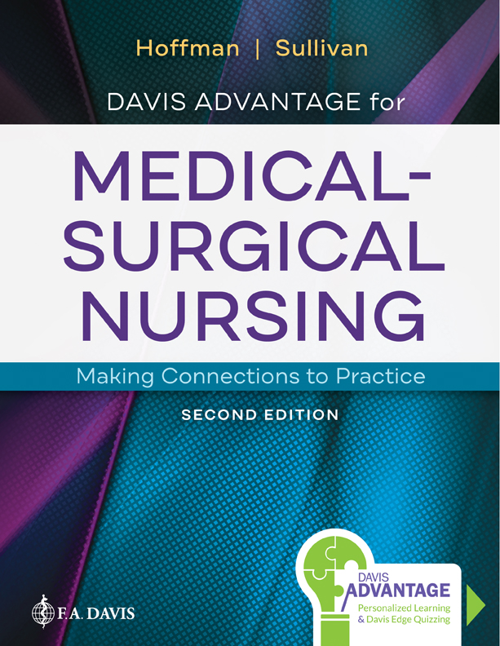
Chapter 52
Assessment of Musculoskeletal Function

Slide 2
Overview of Anatomy and Physiology
Bones
  Structure
  Shape
Notes:
Bones are generally classified in two ways, by structure (composition) or by shape. Classification by bone shape includes long bones, short bones, flat bones, irregular bones, and sesamoid bones.
Bones of different shapes contain different portions of osseous tissue known as compact and spongy bone. Compact bone is dense and looks smooth. Microscopically, compact bone contains the canals and passageways that serve as conduits for nerves, blood vessels, and lymphatic vessels. Spongy bone, on the other hand, is composed of small latticelike pieces and therefore has more open space.

Slide 3
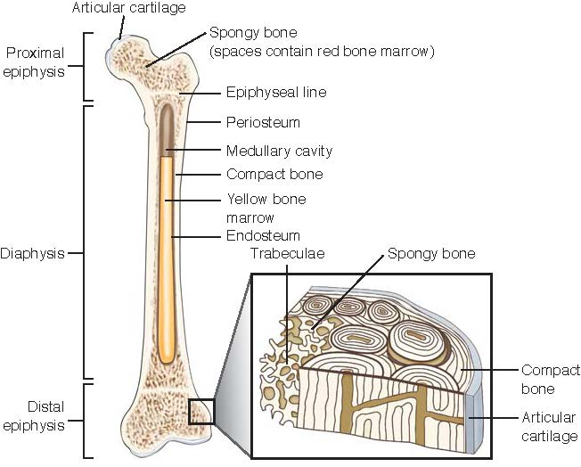
Bones
Notes:
Figure 52.1 Long bone.

Slide 4
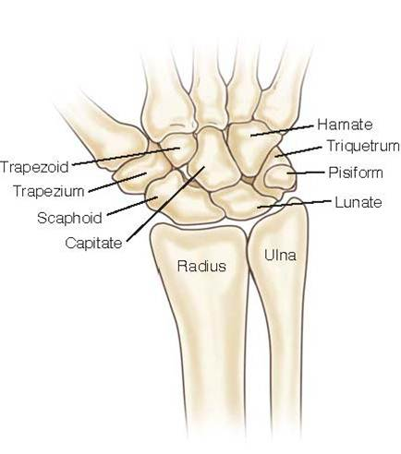
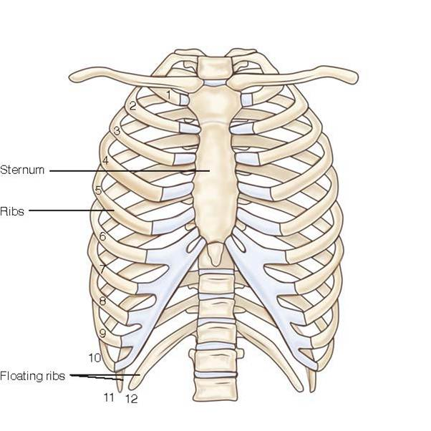
Bones (continued_1)
Notes:
Figure 52.2 Short bones. Examples are carpal bones in the wrist.
FIGURE 52.3 Flat bones. Examples are the protective bones of the chest and sternum.

Slide 5
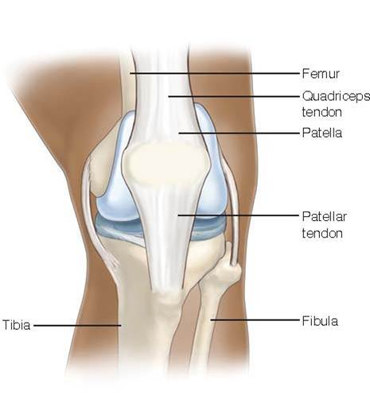
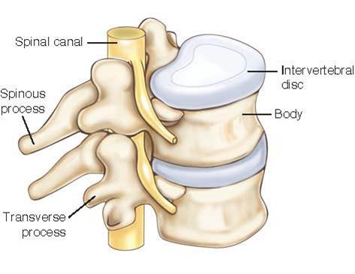
Bones (continued_2)
Notes:
FIGURE 52.4 Irregular bones. Example is the vertebral body.
FIGURE 52.5 Sesamoid bone. Example is the patella or “knee cap.”

Slide 6
Overview of Anatomy and Physiology (continued_1)
Bones
  Hormonal influences
    Estrogen
    Calcitonin
    Parathyroid hormone
    Growth hormone
Notes:
Several hormones have been identified as factors that influence bone growth and loss. The specific hormones and their roles in creating this influence include:
Estrogen: Induces a chemical in osteoclasts that causes them to self-destruct and slow the rate of bone destruction. Menopause with the associated loss of estrogen makes women more prone to bone loss. Asian and Caucasian women are especially vulnerable to this process.
Calcitonin and thyroid-stimulating hormone (TSH): These two hormones inhibit the activity of osteoclasts. Recent research has found that TSH, a hormone produced in the anterior pituitary gland, can promote bone growth independent of its usual thyroid functions. This suggests that TSH or other medications that mimic its effect on bone may be a key factor for possible treatments of osteoporosis or other bone loss conditions.
Parathyroid hormone: Promotes the activity and number of osteoblasts
Growth hormone: Initiates the growth of bone until adult size is achieved

Slide 7
Overview of Anatomy and Physiology (continued_2)
Muscles
  Skeletal muscle
  Smooth muscle
  Cardiac muscle
Notes:
Muscles are structures that contract and help produce movement.
The main function of skeletal muscles is conscious or voluntary control of movement of the body or its parts.
Smooth muscle, or nonstriated muscle, is involuntary. Smooth muscles are under control of the autonomic nervous system, which controls contractions of organs and blood vessels automatically. This specific muscle tissue is found in the walls of hollow organs such as the stomach, esophagus, blood vessels, and bronchi.
Cardiac muscle is a highly specialized striated muscle that can contract without neural stimulation because of the property of automaticity. Automaticity allows cardiac tissue to set a contraction rhythm through the presence of pacemaker cells.

Slide 8
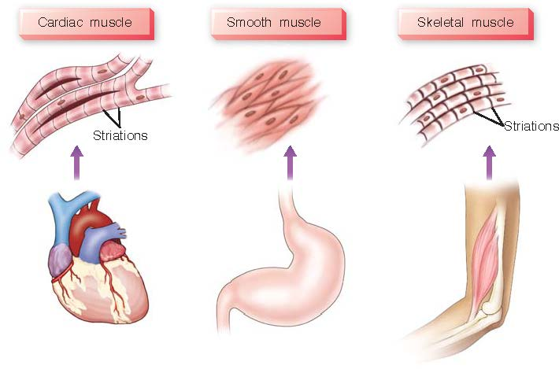
Muscle Tissues
Notes:
FIGURE 52.6 Muscle tissues; cardiac striated muscle, striated skeletal muscle, and smooth muscle.

Slide 9
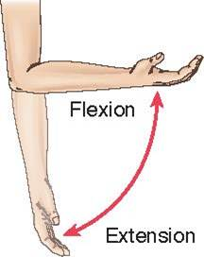
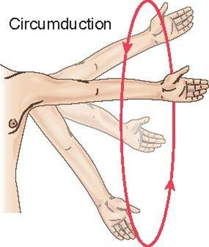
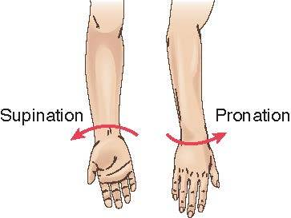
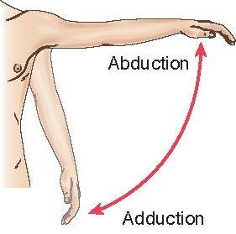
Skeletal Muscle Movements
Notes:
FIGURE 52.7 Skeletal muscle movements. A, Supination and pronation; B, Flexion and extension; C, Abduction and adduction; D, Circumduction; E, Inversion and eversion; F, Head rotation; G, Protraction, retraction, elevation, and depression.

Slide 10
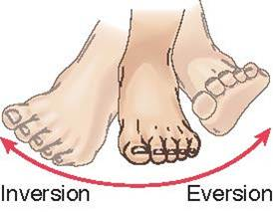
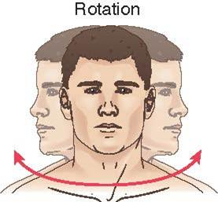
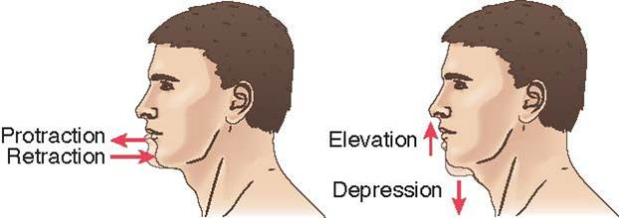
Skeletal Muscle Movements (continued)
Notes:
FIGURE 52.7 Skeletal muscle movements. A, Supination and pronation; B, Flexion and extension; C, Abduction and adduction; D, Circumduction; E, Inversion and eversion; F, Head rotation; G, Protraction, retraction, elevation, and depression.

Slide 11
Overview of Anatomy and Physiology (continued_3)
Joints
  Nonsynovial
  Synovial
Cartilage
Notes:
Joints are defined as a place of union between two or more bones. They permit mobility, provide mechanical support, and are an essential part of the musculoskeletal system. Joints are often referred to as either nonsynovial or synovial.
Nonsynovial joints are joined by fibrous tissue or cartilage and are immovable.
Synovial joints are freely moveable because of the lubricating liquid called synovial fluid that fills the joint space.
Cartilage is an avascular structure that receives its necessary nutrients from the synovial fluid while it is circulated during joint movement. The cartilage also provides additional cushion to the joint to allow for unencumbered and comfortable movement.

Slide 12
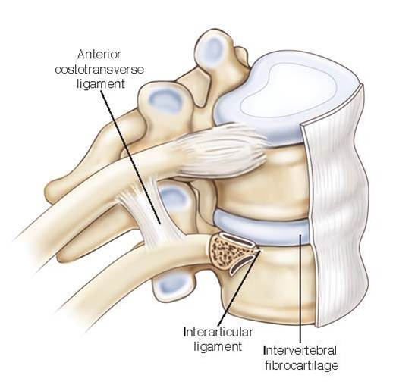
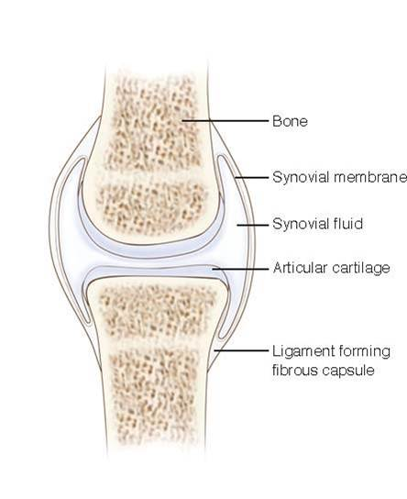
Joints
Notes:
FIGURE 52.8 Nonsynovial joint. Example is vertebral body.
FIGURE 52.9 Synovial joint. Examples include elbow, wrist, and knee.

Slide 13
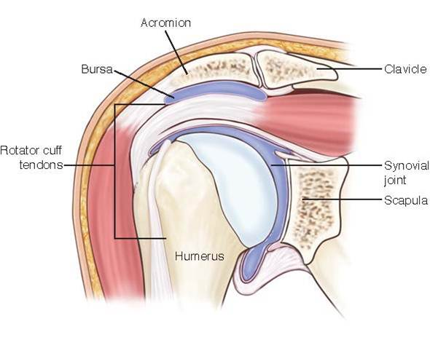
Bursa
Notes:
FIGURE 52.10 Bursa provides a cushion between tendons, skin, or ligaments and bones.

Slide 14
Overview of Anatomy and Physiology (continued_4)
Ligaments, tendons, and fascia
  Ligaments
  Tendons
  Fascia
Notes:
Ligaments are fibrous connective tissues present at joints to help provide stability to the joint. These fibrous bands, composed of tough collagen fibers, run directly from one bone to another to reinforce the joint and help prevent undesired directional movements.
Tendons are fibrous connective tissues that connect muscle to bone or structures such as the eye. Where ligaments provide stability, tendons facilitate movement.
Fascia is a layer of interconnected fibers of connective tissue with elastic properties that encloses, stabilizes, and separates muscles and internal organs.

Slide 15
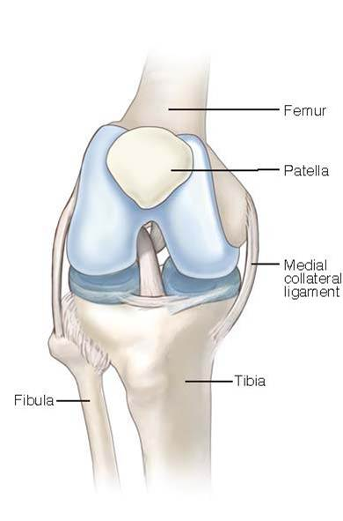
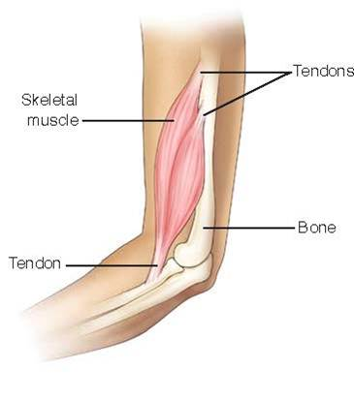
Ligaments, Tendons, and Fascia
Notes:
FIGURE 52.11 Medial collateral ligament of the knee provides joint stability and protection against undesired directional movement.
FIGURE 52.12 Tendons connect muscle to bone and facilitate movement.

Slide 16
Assessment
Past Medical History and History of Present Illness
  Pain
  Swelling
  Stiffness
  Deformity
  Weakness
  Instability
  Loss of function
  Temperature changes
  Altered sensation
  Associated symptoms
  Responses to treatment
Notes:
The aim of gathering the history of the present illness or chief complaint is to gain a clear description of the current problem so that proper treatment may be initiated. Interview questions include:
Location of pain including quality of pain (sharp, stabbing, dull, throbbing, continuous); time frame associated with pain (when did the pain start); factors that make the pain better/worse
Presence of swelling? Note time swelling was first noticed and any increase/decrease of swelling.
Stiffness? Note location, duration, and degree of stiffness present.
Deformity? Note any change from the uninjured state of the affected area.
Weakness? Note the presence of weakness and measure the degree of weakness present. Has the weakness increased or resolved since the injury?
Instability of the affected area? Is there instability present? If so, note the degree of instability present by recording the specific current level of functioning of the injured area.
Loss of function? Is there an inability of the affected area to function in a manner that it previously did?
Are there color or temperature changes present with the affected area?
Is there any altered sensation present such as numbness or tingling?
Are there any other associated symptoms or past medical history that could impact the injury? Is there any significant family past medical history related to this type of injury?
How have the symptoms responded (if at all) to any treatment that has been administered?

Slide 17
Assessment (continued_1)
Physical Assessment
  Posture
  Gait
  Joint mobility
Notes:
Posture — To assess the posture of a patient, the patient should stand comfortably erect as appropriate for age. A plumb line (imaginary or actual) should be drawn through the anterior ear, shoulder, hip, patella, and ankle. Curvature of the spine as well as the length, symmetry, and movement of the extremities should be noted.
Gait — Gait is described as the patient’s ability to demonstrate an erect stance and swing phase with walking. The stance phase, 60% of the cycle, is when the foot is on the ground. The swing phase is defined as the time when the foot is not on the ground. Assessment of gait must be done by directly observing the patient walking. Normal gait is assessed first by noting the base of the walking movement. The base is said to be as wide as the shoulder width of the patient. Foot placement is accurate, and the walk is smooth, even, and well balanced in a patient with a normal gait. A symmetrical arm swing should also be noted during assessment and observation of a patient’s gait status.
Joint mobility — Assessment of ROM or joint mobility should be completed while stabilizing the body part proximal to the joint being assessed. Familiarity with each type of joint in the body is essential so that abnormalities may be readily identified. Joint motion is not expected to cause pain or discomfort upon movement. A goniometer is an instrument that is used to measure the angles that a patient is able to achieve with the movement of each specific joint.

Slide 18
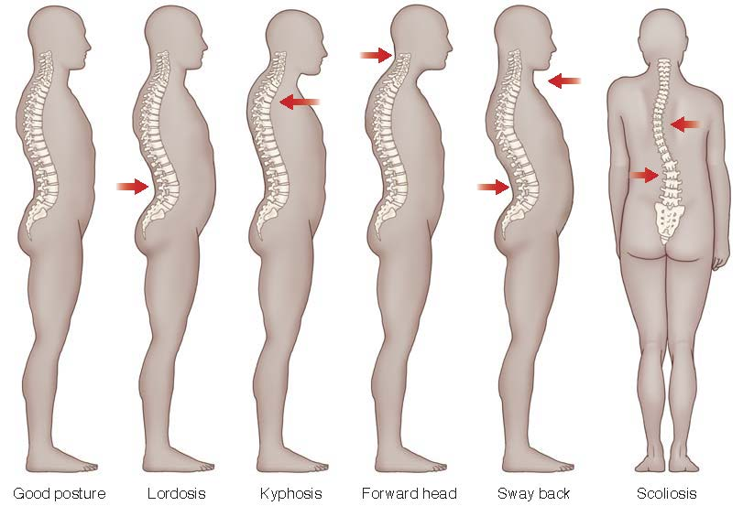
Assessing Postures
Notes:
Figure 52.13 Assessing postures.

Slide 19
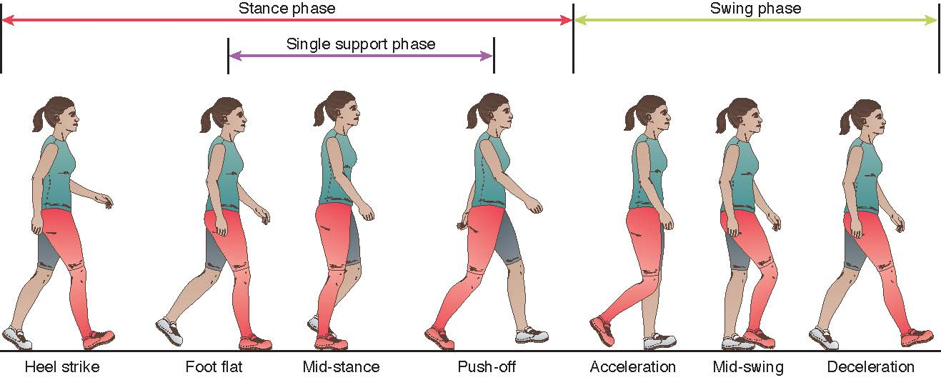
Normal Walking Gait
Notes:
Figure 52.14 Assessing for normal walking gait.

Slide 20
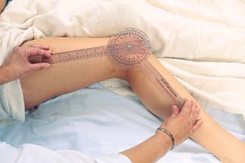
Goniometer
Notes:
FIGURE 52.15 Goniometer to assess joint mobility.

Slide 21
Assessment (continued_2)
Physical Assessment
  Sensation
  Pulses
  Muscle tone and strength
Notes:
Sensation — Evaluation of sensation is another key indicator regarding skeletal bone function. Numbness or tingling (paresthesia) is an abnormal assessment finding when evaluating the musculoskeletal system. Paresthesia often indicates damage to a sensory nerve by pressure or fracture and often resolves after treatment of the injury has been initiated. Assessing the patient’s ability to determine the presence of a stimulus is also important. The pinprick test may be used. With the use of a paper clip or other specific instrument designed specifically for this purpose, a stimulus is applied to assess whether the patient is able to feel the stimulus equally and symmetrically near the suspected area of injury. The inability to feel sensation is an indicator that sensory nerve damage may be present.
Pulses — An assessment of pulses in the patient’s extremities is a standard part of the physical examination. It is particularly important to assess the pulses when injury or suspected injury is present. Pulses indicate whether blood flow is adequate to an extremity. Pulse assessment is done using two fingers and avoiding the use of the thumb because it has its own pulse, which may be misleading. It is important to assess the pulse rate, rhythm, depth, and symmetry.
Muscle tone and strength
Tone is the normal degree of tension (contraction) in voluntary relaxed muscles. Muscle tone may be found to be increased or decreased. Assessing for increased tone is usually a bit easier to detect. Ask the patient to completely relax all muscles, or “go limp.” The practitioner then takes the extremity and moves it through a full ROM. It is expected in a normal examination that the practitioner will note a mild, even resistance to movement. Notations should be made for any extra or involuntary movements of the muscles if they are present.
Muscle strength is tested by having the patient resist force as the practitioner attempts to move the patient’s body part against the direction of pull. Muscle strength should be equal bilaterally. Muscle strength is graded on a 0 to 5 scale, with 0 representing no contraction of muscle and 5 representing full ROM against resistance. A grade of “5” is considered to represent normal muscle strength. Oftentimes, it is easier to determine the presence of muscle weakness when there is a normal side present from which to compare.

Slide 22
Diagnostic Studies
Laboratory studies
  Calcium
  Vitamin D
  Hormones
Notes:
Bones are the major source of calcium in the body. Adequate calcium levels are essential for bone health. Assessing calcium levels through blood tests is an important indicator of bone integrity or density. Low calcium levels are an indicator of increased fracture risk. In addition to calcium, phosphorus and vitamin D levels are all common laboratory values used to assess bone health. Vitamin D works in the body to promote the gastrointestinal absorption of calcium and phosphorus. In a healthy individual, calcium and phosphorus have an inverse relationship, meaning that while calcium levels rise, phosphorus levels decrease. The hormones calcitonin and parathyroid hormone work together to keep the equilibrium of calcium and phosphorus. Estrogens also play an important role in stimulating osteoblast activity. The decrease of estrogens with menopause increases fracture risk. Assessing estrogen levels is primarily done through an analysis of urine.

Slide 23
Imaging Studies
X-ray
Computed tomography
Magnetic resonance imaging
Arthrogram
Notes:
X-ray — Obtaining images of a part of the musculoskeletal system is often needed to find a specific injury or confirm the presence of an abnormality. These images assist the practitioner in assessing the full extent of the injury/abnormality that is present so that effective treatment may be initiated.
Computed tomography — A computed tomography (CT) scan combines a series of x-ray views from different angles to produce cross sectional images of bones and soft tissues within the body. The addition of contrast material can be used to identify blockages or other blood vessel abnormalities.
Magnetic resonance imaging — Magnetic resonance imaging is a radiological imaging test that uses a magnetic field and radio wave energy to create pictures of internal structures of the body. The pictures from an MRI often provide more detail than those from other imaging methods.
Arthrogram — An arthrogram is a series of images taken of a joint after contrast medium has been injected. After administration of local anesthetic, a radiologist or orthopedic provider uses fluoroscopy or ultrasound to accurately inject the appropriate quantity of contrast into the joint. This procedure allows for visualization of soft tissue structures of a joint: the tendons, ligaments, muscles, cartilage, and joint capsule.

Slide 24
Imaging Studies (continued_1)
Bone mineral density studies
Bone scan
Electromyography
Arthroscopic examination arthroscopy
Notes:
Bone mineral density studies — Radiological examinations using CT scans, dual-energy x-ray absorptiometry (DEXA) scans, and ultrasound can assess bone density or the amount of calcium and other minerals in the bone.
Bone scan — A bone scan is a diagnostic scan to find damage to bones, disease (such as cancer), infection, or trauma. A radioactive material, a tracer, is injected IV. The tracer travels through the body and after approximately 3 hours is absorbed into the bones. The bone images are then completed. Areas that show little or no amount of tracer appear as dark or “cold” spots. These areas of “cold” spots define areas with a lack of blood supply to the bone and may indicate the presence of cancer. “Hot spots” are areas where the tracer accumulates in the bone. These spots are often attributed to fractures that are healing, bone infection, or diseases of bone metabolism. Hot spots, as cold spots, may also indicate bone cancer and need further evaluation.
Electromyography — Electromyography (EMG) is a diagnostic test that assesses the health of motor neurons and muscle. Motor neurons transmit electrical signals to the muscles that make them contract. Using tiny needle electrodes that are strategically placed on the muscles, the EMG machine translates these signals into graphs or numbers that the practitioner interprets. This test takes approximately 30 to 60 minutes and is done to distinguish nerve dysfunction, muscle dysfunction, or problems with nerve-to-muscle signal transmission.
Arthroscopic examination — Arthroscopy is a surgical procedure that allows a practitioner to view the inside of a joint through an instrument called an arthroscope. This procedure is used to diagnose, repair, and remove loose or foreign materials in the joint.

Slide 25
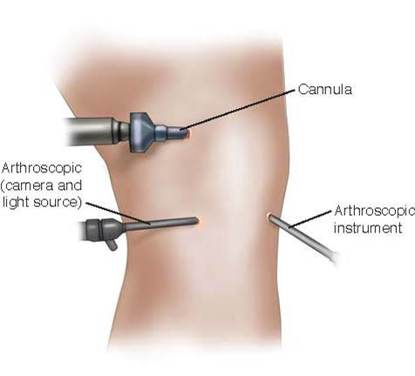
Imaging Studies (continued_2)
Notes:
FIGURE 52.16 Arthroscopic surgery allows visualization inside of the joint to diagnose, repair, and/or remove loose or foreign materials.

Slide 26
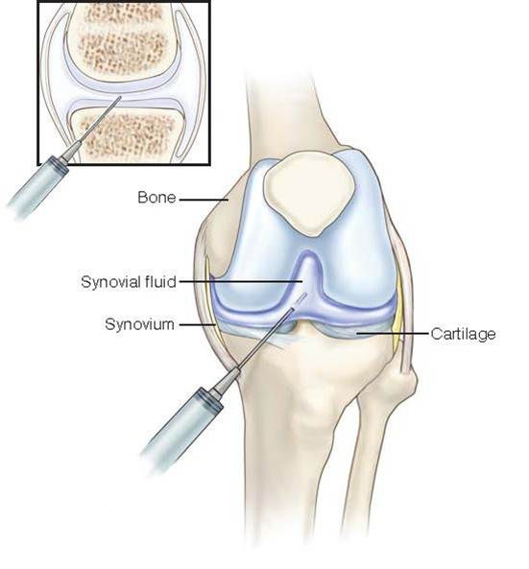
Arthrocentesis
Notes:
FIGURE 52.17 Arthrocentesis; a procedure to aspirate fluid from a joint for diagnostic reasons as well as for pain relief.

Slide 27
Case Study: Episode 1
Twenty-four-year-old Abby Ridgeway recently graduated from a prestigious Midwestern college where she was a 4-year scholar athlete on the school’s championship women’s soccer team. Since graduation, Abby has been playing on a weekly intermural coeducational soccer team with a talented and competitive group of young adults. Last Tuesday evening during one of the games, Abby, in uncontested pursuit of the ball, extended her left leg to keep the ball in play.

Slide 28
Case Study: Episode 1 (continued)
Almost as soon as she extended her leg, she felt a “pop” followed by instant unyielding pain, the kind that every soccer player dreads. After being assisted to a standing position, Abby was unable to bear any weight on the injured left leg. Assisted by teammates, Abby was taken to the closest emergency department (E D) for medical evaluation.

Slide 29
Case Study: Episode 2
Shortly after arriving at the local E D, Abby is seen by the department’s nurse practitioner. The nurse practitioner completes a thorough history and a modified physical examination of Abby’s left leg. Pain prevents Abby from completing a full range of motion (R O M) evaluation. After an initial x-ray, the practitioner decides to send Abby to the radiology department for magnetic resonance imaging (M R I) of her left knee.

Slide 30
Case Study: Wrap-Up
Abby returns to the E D after her MRI. Results are returned shortly and confirm that Abby has a medial meniscus tear of her left knee. She is promptly fitted for crutches and is given detailed instructions for care at home that include ice, elevation, and immobilization as well as strict follow-up instructions to see an orthopedic surgeon in the next 48 hours.

Slide 31
Case Study
1. Signs and symptoms of an acute knee injury include which of the following?
A. Pain that is transient
B. Inability to bear weight
C. Loss of popliteal pulse
D. An unsteady gait
Notes:
Answer: B
Rationale: Inability to bear weight, not an unsteady
gait, is a symptom of acute knee injury. Pain may
or may not be transient; pulses should be present.

Slide 32
Case Study (continued_1)
2. The ED nurse anticipates the orthopedic surgeon will perform which diagnostic procedure for further analysis of Abby’s injury?
A. Bone scan
B. X-ray
C. Arthroscopy
D. Arthrocentesis
Notes:
Answer: B
Rationale: Obtaining x-ray images of a part of
the musculoskeletal system is often needed to find
a specific injury or confirm the presence of an
abnormality. A bone scan is a diagnostic scan to
find damage to bones, disease (such as cancer),
infection, or trauma. Arthrocentesis is a clinical
procedure where fluid is aspirated from a joint. This
procedure is done for diagnostic reasons as well as
for pain relief. Arthroscopy is a surgical procedure
that allows a practitioner to view the inside of a
joint through an instrument called an arthroscope.
This procedure is used to diagnose, repair, and
remove loose or foreign materials in the joint.

Slide 33
Case Study (continued_2)
3. Abby’s nurse in the ED provides discharge instructions that include which of the following?
A. Exercise the joint as tolerated
B. Follow-up with her primary care doctor after swelling has decreased
C. Ice, elevation, and follow-up with an orthopedic surgeon within 48 hours
D. Application of warm packs and keeping the leg in a dependent position as often as possible
Notes:
Answer: C
Rationale: The patient should use ice, elevation,
and follow-up with an orthopedic surgeon, not the
primary care physician, within 48 hours. Immobilization,
not exercise, is recommended. Warm packs
and a dependent position would increase swelling.

Slide 34
Case Study (continued_3)
4. The nurse should intervene if she notices that Abby has which of the following?
A. Increased pain after immobilization and ice application
B. Worry about her soccer career
C. Her leg elevated above the level of her heart
D. Developed some nausea
Notes:
Answer: A
Rationale: Increased pain may indicate an unstable
injury. Nausea may be due to anxiety or medication.
Elevating her leg helps decrease swelling. Worry
about soccer is not a priority art this time.

Slide 35
Case Study (continued_4)
5. Which statement by Abby indicates that the discharge teaching has been ineffective?
A. “Elevation and application of ice to the knee will help decrease swelling.”
B. “Crutches are optional and should be used only if needed.”
C. “Follow-up with an orthopedic surgeon within 48 hours is essential.”
D. “Take pain medication and immobilize the leg.”
Notes:
Answer: B
Rationale: Immobility is required to avoid further
injury.

