Slide 1
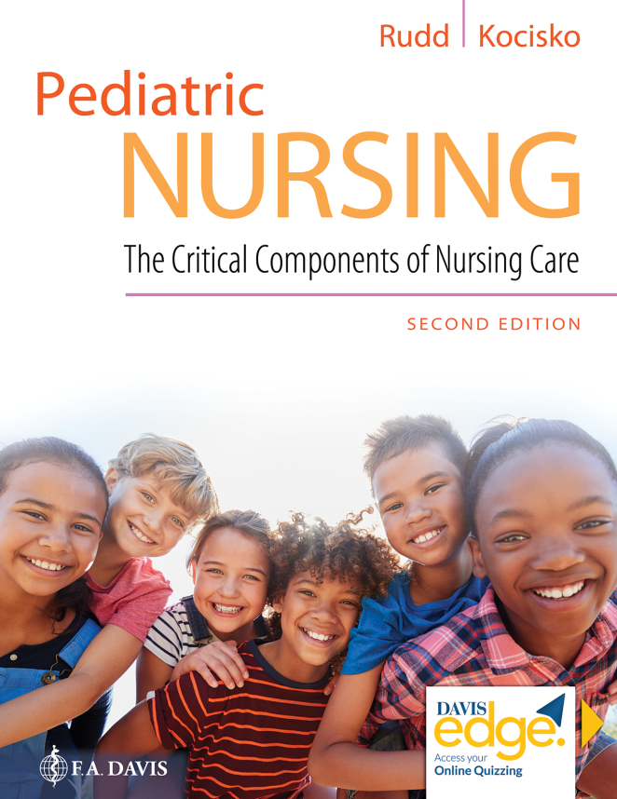
Chapter 1
Issues and Trends in Pediatric Nursing

Slide 2
Learning Objectives
Define pediatric nursing.
Describe the differences between nursing care of infants, children, and adolescents and care of the adult population.
Describe the history of pediatric nursing.
Describe the projected racial changes in America.
Identify models of care applied to pediatric nursing.

Slide 3
Learning Objectives (continued)
Describe the roles of the pediatric nurse.
Identify the different fields of pediatric nursing and the education required for each.
Identify current issues and trends in pediatric nursing practice, education, and research.
Identify evidence-based resources available for pediatric nurses.

Slide 4
Introduction to Pediatric Nursing
Nursing care of children from birth through adolescence
Nursing care for children versus care for adults
Role of development

Slide 5
History of Pediatric Nursing
Children’s Hospital of Pennsylvania
Common practices in infant and child care in early hospitals
Field of pediatric nursing
Advanced practice roles

Slide 6
Racial Makeup of American Children
Demographics of pediatric population
Illnesses/chronic diseases based on ethnic and cultural background
Projected 2020 demographics for U S pediatric population

Slide 7
Models of Care in Pediatric Nursing
Family-centered care
Relationship-based care
Pediatric medical home
Importance of the family

Slide 8
Question
Which of the following is not a core concept of the family-centered care model?
A. Dignity and respect for the child and family
B. Referral from primary care to community services for additional non-medical needs
C. Information sharing with the family
D. Family participation in care, including collaboration in care planning and provision

Slide 9
Answer
Correct Answer: B
“Referral from primary care to community services for additional non-medical needs” is a core concept of the pediatric medical home care model.

Slide 10
Role of the Pediatric Nurse
Critical roles of the pediatric nurse
Where pediatric nurses work
Additional training and certification

Slide 11
Issues in Pediatric Nursing
Expected nursing shortage
Research projects
Continuity of care
Communication
Special issues
Health education
Healthcare costs

Slide 12
Trends in Pediatric Nursing Practice
Various trends
Obesity
Lesbian, gay, bisexual, and transgender (L G B T) youth

Slide 13
Question
Which of the following is not a trend in pediatric nursing practice?
A. Increased usage of blood conservation techniques for hospitalized children
B. Increased admissions based on lack of primary care access
C. Increased incorporation of families in the overall care of children
D. Decreased incidence of adolescent obesity as a result of school intervention programs

Slide 14
Answer
Correct Answer: D
The prevalence of obesity among adolescents has doubled since the 1990's, increasing from approximately 10 percent (in 1990) to 20 percent in 2014 (Federal Interagency Forum on Child and Family Statistics, 2016).

Slide 15
Trends in Pediatric Nursing Education
Keeping pace with new initiatives
Multicultural care topics and family theory
Growth and development concepts
Experience in a range of settings
Focus on health promotion and disease prevention
Focus on community-based nursing education
Education supplemented with simulation

Slide 16
Trends in Pediatric Nursing Research
Best Pharmaceuticals for Children Act
Pediatric Research Equity Act
Pediatric Medical Device Safety and Improvement Act

Slide 17
Resources
Resources for pediatric health data
Resources for evidence-based pediatric nursing practice

Slide 18
Summary
In this chapter, we covered:
An overview and brief history of pediatric nursing
The racial makeup of American children
Models of care and the role of the pediatric nurse
Issues and trends in pediatric nursing
Important resources

