Slide 1
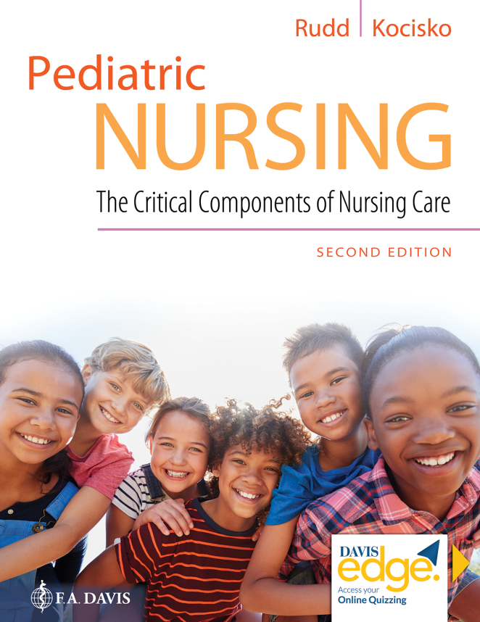
Chapter 2
Standards of Practice and Ethical Considerations

Slide 2
Learning Objectives
Identify and describe sources of standards of practice relevant to the day-to-day practice of pediatric nurses.
Identify and elaborate on the key themes related to pediatric nursing standards of practice.

Slide 3
Learning Objectives (continued_1)
List the six standards of practice and 11 standards of professional performance highlighted in the Pediatric Nursing Scope and Standards of Practice (American Nurses Association, 2015a) and discuss associated measurement criteria.
Describe the value and functions of the Code of Ethics for Nurses (American Nurses Association, 2015b).

Slide 4
Learning Objectives (continued_2)
Identify the nine provisions of the Code of Ethics for Nurses and relate them to practical situations encountered in the day-to-day practice of pediatric nursing.
Identify ethics controversies commonly encountered in the practice of pediatric nursing and discuss relevant principles, duties, rights, and virtues.

Slide 5
Learning Objectives (continued_3)
Differentiate “consent,” “permission,” and “assent,” and discuss how promoting the best interest of children in the issue of consent differs from obtaining informed consent from a competent adult.

Slide 6
Introduction
Care of children and their families requires the application of the nursing process in accordance with accepted standards of practice, professional performance, and ethics.

Slide 7
Ethics in Nursing Practice
Public perception of nursing
A N A Code of Ethics for Nurses

Slide 8
Pediatric Nursing Scope and Standards of Practice
Primary source of standards
Therapeutic relationships
Professional boundaries and personal authenticity
Challenging patient and family behaviors

Slide 9
Family-Centered Care
Overview
Rewards
Child life specialists

Slide 10
Question
The A N A Code of Ethics for Nurses can be characterized as which of the following?
A. A source of guidance and empowerment
B. A covenant between the profession and the patients who nurses serve
C. A reflection of key ethics philosophies, principles, rights, duties, and virtues
D. All of the above

Slide 11
Answer
Correct Answer: D
The A N A Code of Ethics for Nurses can be characterized as:
A source of guidance and empowerment
A covenant between the profession and the patients who nurses serve
A reflection of key ethics philosophies, principles, rights, duties, and virtues

Slide 12
Developmentally Appropriate Care
Development and pain management
Patient and family education
Privacy and confidentiality

Slide 13
Developmentally Appropriate Care (continued)
Conflicting duties
Chaperones
H I P A A

Slide 14
Pediatric Decision Making
Best interests
Role of parental religion
Partnering with children in decision making
P S D A and advance directives

Slide 15
Safety in the Pediatric Setting
National patient safety goals (N P S G S)
Two patient identifiers
Patient falls reduction standards
Medication safety standards
Medication safety precautions

Slide 16
Question
Children in the U S do not have the right to confidentiality until they reach age 18.
A. True
B. False

Slide 17
Answer
Correct Answer: B
Children do have a right to confidentiality, although there are certainly practical considerations that may preclude it.

Slide 18
Standards of Culturally Sensitive Care and Truth Telling
Cultural sensitivity
Veracity
Medical errors

Slide 19
Advocacy
Child maltreatment
Ethical issues
Strategies and skills

Slide 20
Summary
In this chapter, we covered:
Ethics in nursing practice
Pediatric nursing scope and standards of practice
Family-centered care
Developmentally appropriate care
Pediatric decision making
Safety in the pediatric setting
Standards of practice and culturally sensitive care
Truth-telling standards and pediatric nursing
Advocacy

