Slide 1
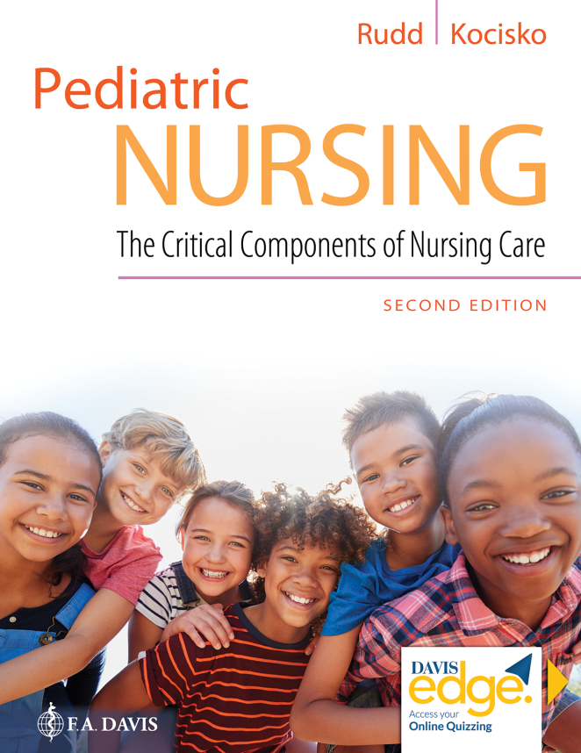
Chapter 4
Cultural, Spiritual, and Environmental Influences on the Child

Slide 2
Learning Objectives
Identify individual cultural bias.
Discuss Leininger’s theory and how it can be used to plan patient care.
Identify effective cross-cultural communication, body language, nurse-patient relationships, and multidisciplinary relationships between the caregiver, family, and the pediatric patient.
Identify strategies for overcoming language barriers and describe the importance of doing so.

Slide 3
Learning Objectives (continued)
Identify and describe the characteristics that are determined by culture.
Describe the components involved in a cultural assessment.
Discuss how spiritual beliefs influence the care of a child and family.
Identify environmental and societal considerations when caring for the pediatric patient and family.

Slide 4
Culturally Competent Care
Cultural competence
Template for evaluating psychosocial needs
Cultural bias

Slide 5
Culturally Competent Care (continued_1)
Environmental considerations
Health disparities

Slide 6
Culturally Competent Care (continued_2)
2020 projected ethnicity breakdown
White, non-Hispanic: <50%
Hispanic: 26%
Black, non-Hispanic: 14%
Asian, non-Hispanic: 5%
Non-Hispanic children who represent two or more races: 5%
American Indian and Alaska Native, non-Hispanic: 0.8%
Native Hawaiian and Other Pacific Islander, non-Hispanic: 0.2%
Source: Projection for America’s children in 2020. Data are from America’s Children in Brief: Key National Indicators of Well-Being, 2016 (Federal Interagency Forum on Child and Family Statistics, 2016).

Slide 7
Cross-Cultural Communication
Best practices
Body language and touch awareness

Slide 8
Cross-Cultural Communication (continued_1)
Nurse-patient relationship
Language barriers

Slide 9
Cross-Cultural Communication (continued_2)
Characteristics and behaviors determined by culture
Personal space
Eye contact
Diet
Time
Touch
Family use of alternative medicine

Slide 10
Question
Which of the following best practices is related to effective communication?
A. Know who is responsible for making health decisions for the patient.
B. Respect differences of opinion.
C. Recognize appropriate boundaries and maintain those boundaries.
D. All of the above.

Slide 11
Answer
Correct Answer: A
While all of the options are best practices a nurse should employ, knowing who is responsible for making health decisions for the patient relates specifically to effective communication. How might communication be hindered if the nurse doesn’t know who is responsible for making health decisions for the patient?

Slide 12
Cultural Assessments
Mechanism through which the nurse gathers subjective data to identify beliefs and values associated with the patient’s culture

Slide 13
Cultural Assessments (continued_1)
Giger and Davidhizar’s transcultural assessment model
Communication
Space
Biological variation
Time
Control
Social organizations

Slide 14
Cultural Assessments (continued_2)
Spirituality
Respecting religion

Slide 15
Cultural Assessments (continued_3)
F I C A assessment tool
Faith and belief
Importance
Community
Address in care

Slide 16
Question
A cultural assessment should evaluate which of the following areas?
A. Religious beliefs
B. Food preferences
C. Typical daily schedule
D. All of the above

Slide 17
Answer
Correct Answer: D
All of these impact health care and may differ by culture.

Slide 18
Summary
In this chapter, we covered:
Culturally competent care
Cross-cultural communication
Cultural assessments

