Slide 1
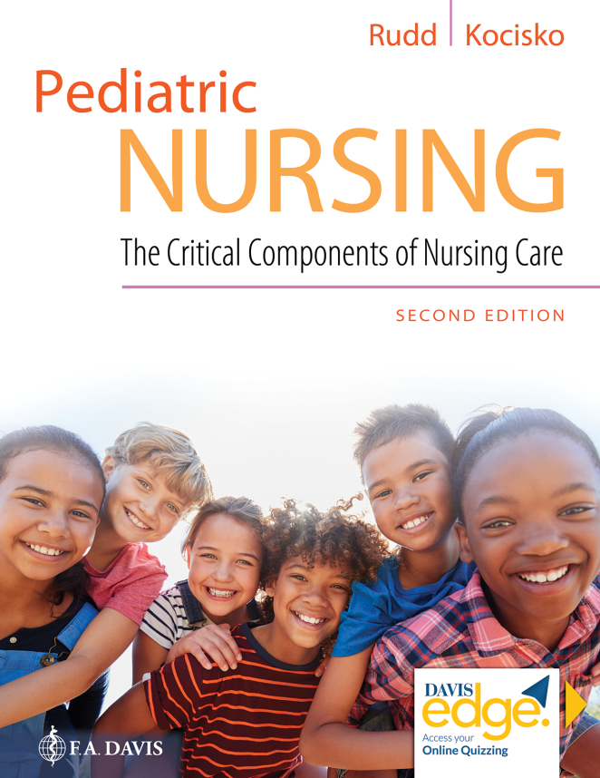
Chapter 11
Respiratory Disorders

Slide 2
Learning Objectives
Identify normal assessment of anatomy and physiology of the pediatric respiratory system.
Identify differences in the anatomy and physiology of the pediatric and adult patient.
Identify the clinical presentation and nursing care of the pediatric patient with respiratory disorders.

Slide 3
Learning Objectives (continued)
Describe common tests used in the diagnosing and treating pediatric respiratory disorders.
Identify areas of education for caregiver of a child with a respiratory disorder.

Slide 4
Introduction
Anatomy and physiology
Developmental differences in respiratory system

Slide 5
Respiratory Disorders
General history
Physical assessment
Barrel chest, skin color
Auscultation

Slide 6
Respiratory Disorders (continued)
Percussion
Palpation
Diagnostic tests

Slide 7
Upper Airway Infectious Disorders
Otitis
Otitis media (O M), otitis media with effusion (O M E), otitis externa (O E)
Sinusitis
Pharyngitis

Slide 8
Upper Airway Infectious Disorders (continued)
Nasopharyngitis
Influenza
Tonsillitis
Tracheitis

Slide 9
Question
What are rales?
A. Fine cracking noises heard on inspiration
B. Low-pitched sounds heard throughout respiration
C. High-pitched sounds heard on inspiration in the upper airway
D. High-pitched musical sounds heard throughout respiration

Slide 10
Answer
Correct Answer: A
Rales are fine cracking noises heard on inspiration. The other options refer to rhonchi, stridor, and wheezes.

Slide 11
Upper Airway Noninfectious Disorders
Esophageal atresia (E A) and tracheoesophogeal fistula (T E F)
Laryngomalacia
Subglottic stenosis
Croup syndromes

Slide 12
Infections of Lower Airways
Bronchitis
Bronchiolitis
Pneumonia

Slide 13
Infections of Lower Airways (continued)
Pertussis (whooping cough)
Tuberculosis
Latent, active

Slide 14
Noninfectious Disorders of Lower Airway
Respiratory distress syndrome
Congenital diaphragmatic hernia
Cystic fibrosis (C F)
Asthma

Slide 15
Noninfectious Disorders
Foreign body aspiration
Bronchopulmonary dysplasia (B P D)
Apnea

Slide 16
Noninfectious Disorders (continued)
Apparent life-threatening event (A L T E)
Pneumothorax
Sudden infant death syndrome (S I D S)

Slide 17
Question
What is subglottic stenosis?
A. A congenital laryngeal cartilage abnormality in which the tissue is soft and floppy, collapsing in on itself
B. Viral inflammation of the glottis and subglottic region
C. The narrowing of the airway within the rigid cricoid cartilage
D. The rapidly progressing inflammation of the larynx and epiglottis

Slide 18
Answer
Correct Answer: C
Subglottic stenosis is the narrowing of the airway within the rigid cricoid cartilage. The other options refer to laryngomalacia, laryngotracheitis, and epiglottitis.

Slide 19
Summary
Anatomy and physiology of the respiratory system
Developmental differences
Respiratory disorders
Upper airway, lower airway
Infectious, non-infectious

