Slide 1
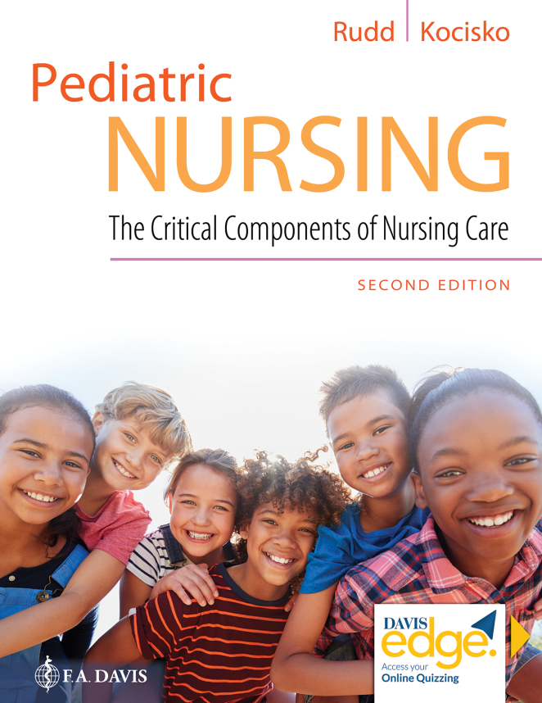
Chapter 14
Mental Health Disorders

Slide 2
Learning Objectives
Discuss three current trends in pediatric psychiatry.
Describe components of mental health assessment in children and adolescents.
Describe learning disabilities and recommended treatments.
Discuss reactive attachment disorder and its treatments.

Slide 3
Learning Objectives (continued_1)
Explain two mood disorders diagnosed in children and their recommended treatments.
Explain five anxiety disorders diagnosed in children and their recommended treatments.
Identify three disruptive disorders diagnosed in children and their recommended treatments.

Slide 4
Learning Objectives (continued_2)
Discuss impulse-control disorder and its recommended treatments.
Discuss schizophrenia in children.
Describe autism spectrum disorders.
Identify three eating disorders diagnosed in children and their recommended treatments.

Slide 5
Learning Objectives (continued_3)
Describe three current treatment modalities in pediatric substance abuse treatment.
Describe dual diagnosis in children.
Discuss child abuse assessment, diagnosis, and recommended treatments.

Slide 6
Introduction
What is mental illness?
Etiology of mental illness in children
Trends in pediatric mental health
Assessment

Slide 7
Settings of Care, Therapeutic Approaches, and Schools
Variety of settings of care
Inpatient psychiatric therapy
Therapeutic approaches
School for children with mental illness

Slide 8
Learning Disabilities, Behavioral Challenges, and Stress
Factors involved in learning disabilities
Behavior problems
Stress and children

Slide 9
Personality Disorders
Theories of personality disorders
MacDonald triad
Borderline personality disorder

Slide 10
Impaired Executive Functioning
Symptoms of impaired executive functioning
Nursing interventions

Slide 11
Attachment Disorders
Primal wound theory of attachment disorders
Treatment

Slide 12
Mood Disorders
Depression
Bipolar disorder

Slide 13
Anxiety Disorders
Chronic anxiety
Obsessive-compulsive disorder (O C D)
Phobia
Panic disorder
Post-traumatic stress disorder (P T S D)

Slide 14
Question
What theory of personality disorders describes the patient as stuck at a developmental age of about 7 years old?
A. Biological/neurochemical
B. Determined/intentional
C. Cognitive/behavioral
D. Psychodynamic/developmental

Slide 15
Answer
Correct Answer: D
Psychodynamic/developmental theory describes someone with a personality disorder as stuck in a developmental age of about 7 years old.

Slide 16
Dissociative Disorders
Dissociative amnesia
Dissociative fugue
Depersonalization disorder
Dissociative identity disorder
Dissociative disorder not otherwise specified

Slide 17
Disruptive Disorders in Children
Attention-deficit hyperactivity disorder (A D H D)
Oppositional defiant disorder (O D D)
Conduct disorder (C D)

Slide 18
Impulse-Control Disorders
Kleptomania
Pyromania
Intermittent explosive disorder

Slide 19
Schizophrenia
Causes
Related disorders
Risk factors for other disorders
Symptoms of schizophrenia in children
Effects on thought processes and content
Sensory and perceptual disturbances
Treatments and side effects

Slide 20
Autism Spectrum Disorder
Characteristics
Incidence
Screening
Nursing interventions
Sensory processing disorder

Slide 21
Eating Disorders
Anorexia nervosa
Bulimia nervosa
Compulsive overeating

Slide 22
Substance-Related Disorders
Alcoholism
Marijuana (cannabis)
Hallucinogens (L S D, P C P)
Cocaine/crack cocaine
Prescription drug abuse
Tobacco/nicotine
Caffeine
Inhalants

Slide 23
Childhood Abuse
Risk factors
Sexual abuse
Evaluation
Assessment

Slide 24
Question
Which of the following is an appropriate nursing intervention for a patient with O C D?
A. Interrupt the child’s ritual to slow increasing anxiety
B. Instruct the child on how to complete thought stopping
C. Refer for cognitive-behavioral or exposure therapy
D. Reassure the child that you will not leave

Slide 25
Answer
Correct Answer: B
Appropriate nursing interventions for a child with obsessive-compulsive disorder include:
Do not interrupt the ritual, as this will make the child more anxious.
Instruct the child on how to complete thought stopping—child becomes aware of the thoughts and tries to stop them
Relaxation techniques
Cue cards

Slide 26
Summary
In this chapter, we covered:
What Mental Illness Is
Etiology of Mental Illness in Children
Trends in Pediatric Mental Health
Assessment
Settings of Care, Therapeutic Approaches, and Schools
Learning Disabilities, Behavioral Challenges, and Stress
Personality Disorders
Impaired Executive Functioning
Attachment Disorders

Slide 27
Summary (continued)
Mood Disorders
Anxiety Disorders
Dissociative Disorders
Disruptive Disorders in Children
Impulse-Control Disorders
Autism Spectrum Disorder
Eating Disorders
Substance-Related Disorders
Childhood Abuse

