Slide 1
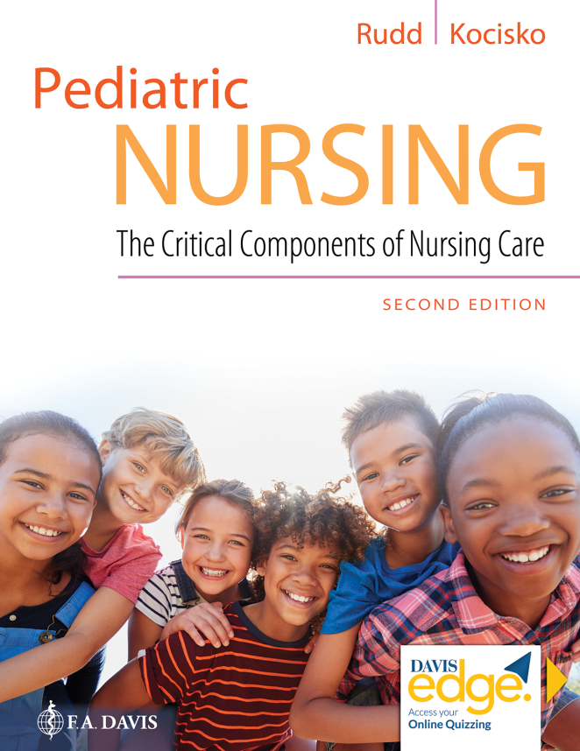
Chapter 18
Reproductive and Genetic Disorders

Slide 2
Learning Objectives
Identify the anatomy of the male and female reproductive systems.
Discuss common pediatric reproductive health concerns.
Describe the signs and symptoms and interventions for common sexually transmitted infections.
Explain the human genome and its function.

Slide 3
Learning Objectives (continued)
Describe errors in reproduction, including mitosis, meiosis, and their contribution to genetic disorders.
Explain differences and similarities among autosomal dominant, recessive, and X-linked disorders.
Describe a variety of common genetic syndromes.
Explain the recommended age-appropriate care and pediatric surveillance for common genetic syndromes.

Slide 4
Introduction
Female anatomy and physiology
Pubertal changes in girls
Common pediatric problems of the female genital tract
Adolescent vaginal complaints

Slide 5
Introduction (continued)
Male anatomy and physiology
Puberty in boys
Common pediatric and adolescent problems of the male genital tract
Development of the testis

Slide 6
Sexually Transmitted Infections
Risk factors for S T I's
Screening for S T I's

Slide 7
Sexually Transmitted Infections (continued_1)
Pelvic inflammatory disease (P I D)
Trichomoniasis
Gonorrhea

Slide 8
Sexually Transmitted Infections (continued_2)
Chlamydia
Syphilis

Slide 9
Question
What is menorrhagia?
A. Secondary non-retractability of the foreskin after retractability at an earlier age
B. Failure of the testis to descend into the scrotum
C. Menstrual flow of excessive duration and/or heavy volume
D. The absence of monthly menses

Slide 10
Answer
Correct Answer: C
Menorrhagia is characterized by menstrual flow of excessive duration, greater than 7 days, and/or heavy volume, greater than 80 milliliters/cycle.

Slide 11
Genetics and Genetic Disorders
Genetic inheritance
Genetic errors
Meiosis
Oocyte
Spermatocyte
Reproduction
Alterations in chromosomes and development

Slide 12
Genetics and Genetic Disorders (continued_1)
Trisomy 21 (Down Syndrome)
Trisomy 18 (Edward’s Syndrome)
Trisomy 13 (Patau Syndrome)

Slide 13
Genetics and Genetic Disorders (continued_2)
Turner syndrome
Cri-Du-Chat syndrome
Williams syndrome
Velocardial facial syndrome

Slide 14
Genetics and Genetic Disorders (continued_3)
Phenylketonuria (P K U)
Neurofibromatosis, Type 1 (Von Recklinghausen’s Disease)
Neurofibromatosis, Type 2 (N F-2)
Tuberous Sclerosis

Slide 15
Genetics and Genetic Disorders (continued_4)
Sturge-Weber syndrome
Charcot-Marie-Tooth disease
Achondroplasia
X-Linked hydrocephalus

Slide 16
Genetics and Genetic Disorders (continued_5)
Fragile X syndrome
Prader-Willi syndrome
Angelman syndrome
Fetal alcohol spectrum disorder

Slide 17
Question
In Edward’s syndrome, each chromosome has ____ copies of chromosome ____.
A. three, 18
B. two, 18
C. three, 13
D. two, 13

Slide 18
Answer
Correct Answer: A
In trisomy 18 (Edward’s syndrome), each chromosome has three copies of chromosome 18. It is characterized by prenatal growth deficiency, craniofacial features, characteristic hand gestures with overriding fingers, nail hypoplasia, and short sternum.

Slide 19
Summary
In this chapter, we covered:
Female Anatomy and Physiology
Male Anatomy and Physiology
Sexually Transmitted Infections
Genetics and Genetic Disorders

