Slide 1
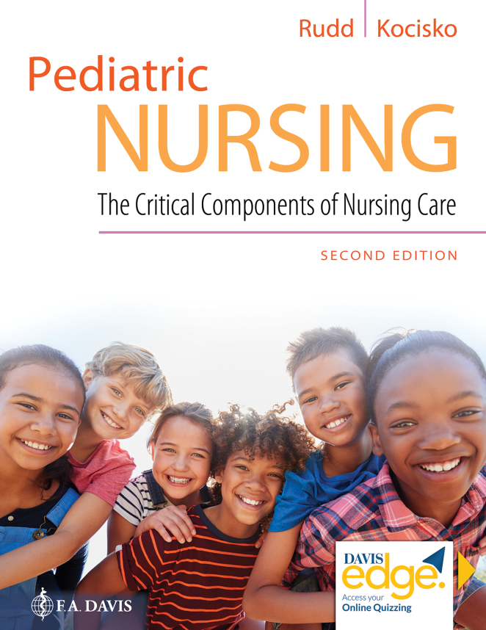
Chapter 19
Hematologic, Immunologic, and Neoplastic Disorders

Slide 2
Learning Objectives
Identify the classifications of anemia.
Compare iron deficiency and sickle cell anemia.
Identify the major pathophysiology associated with the care of the child with cancer.
Identify nursing assessments and interventions that promote health during the care of children with cancer and their families.

Slide 3
Learning Objectives (continued)
Develop a nursing care plan for the child with cancer experiencing pain.
Develop a caregiver education plan for high-risk oncology clients.
Demonstrate an understanding of the pathophysiology of and nursing interventions for the child with immunodeficiency disorders.
Identify the categories of hematopoietic stem cell transplant.

Slide 4
Introduction
Hematologic disorders
Immunologic disorders
Neoplastic disorders

Slide 5
Hematologic Disorders
Iron-deficiency anemia
Most common type of anemia
Not enough healthy R B C's

Slide 6
Hematologic Disorders (continued_1)
Acquired thrombocytopenia (A T P)
Platelet counts decrease
Infection

Slide 7
Hematologic Disorders (continued_2)
Sickle cell disease
Most common genetic condition
Deformed cell changes from round to sickle

Slide 8
Hematologic Disorders (continued_3)
Aplastic anemia
Deficiency of the formation of blood elements

Slide 9
Hematologic Disorders (continued_4)
Hemophilia
Commonly a deficiency of factor EIGHT
Types A and B
Lead poisoning
Chronic ingestion or inhalation of materials containing lead

Slide 10
Question
Iron deficiency anemia is characterized by what?
A. Small, pale R B C's and decrease in bone marrow erythropoiesis
B. Large, pale R B C's and dangerous increase in bone marrow erythropoiesis
C. Platelet count decrease and spontaneous bleeding
D. Platelet count increase and blood in mucous membranes

Slide 11
Answer
Correct Answer: A
Iron deficiency anemia is characterized by small, pale R B C's and depleted iron stores, with subsequent decrease in bone marrow erythropoiesis.

Slide 12
Immunological Disorders
Acquired immunodeficiency syndrome
Develops from H I V infection
Most common when transmitted in utero from mother with H I V

Slide 13
Oncologic Disorders
Neoplasm
Uncontrolled abnormal cell growth
Oncology emergencies
Side effects of radiation therapy

Slide 14
Oncologic Disorders (continued_1)
Leukemia
Group of malignant diseases of the bone marrow and lymphatic system
Lymphomas
Hodgkin’s lymphoma
Non-Hodgkin’s lymphoma

Slide 15
Oncologic Disorders (continued_2)
Brain Tumors
Can arise from any cell in cranium
Classified by location of origin
Wilms Tumor
Originates in fetal development
Tumor typically found on kidneys

Slide 16
Hematopoietic Stem Cell Transplantation
Lethal dose of chemotherapy
Body resupplied with stem cells
Disease-free marrow replaces cancerous marrow
P S C T

Slide 17
Question
Which type of lymphoma occurs in the peripheral lymph nodes and spreads to tissues throughout the body?
A. Hodgkin’s lymphoma
B. Non-Hodgkin’s lymphoma

Slide 18
Answer
Correct Answer: B
Non-Hodgkin’s lymphoma occurs in the peripheral lymph nodes and spreads to tissues throughout the body.

Slide 19
Summary
In this chapter, we covered:
Hematologic Disorders
Immunologic Disorders
Neoplastic Disorders
Hematopoietic Stem Cell Transplantation

