Slide 1
RNSG 1030: Pediatrics
Chapters 13 and 14

Slide 2
Neurological System
Chapter 13: pages 250 - 291

Slide 3
Neuro Overview
PNS
CNS
Somatic and Autonomic
Brain and Spinal Cord
Afferent Nerve Fibers
Efferent Nerve Fibers
12 Cranial Nerve Pairs
3 Meninges
2 Hemispheres
4 Lobes
4 Ventricles
31 Spinal Nerve Pairs
ANS
Parasympathetic and Sympathetic
Fight-or-Flight
Rest and Recuperation

Slide 4
Assessing the Pediatric Client: Neuro
Head Circumference
Muscle Tone
Skin Lesions
Behavioral Concerns
Dysmorphic Features
Cranial Nerve Abnormalities
Birth History
Socioeconomic Issues
Social History
Genetic Disorders
Prenatal Teratogen Exposure
https://neurologicexam.med.utah.edu/pediatric/html/introduction.html
Notes:
Website for pediatric developmental milestones, neuro assessment, quiz, etc

Slide 5
Clinical Scenario:
A mother reports that her 10 month old boy is right handed because he reaches for most objects with that hand. The nurse knows that this is:
A. Normal.
B. It's a little early but probably normal and nothing to worry about.
C. It's a little early but probably normal. It's something that needs to be watched over time.
D. It's abnormal for a baby to have a hand preference at this age.

Slide 6
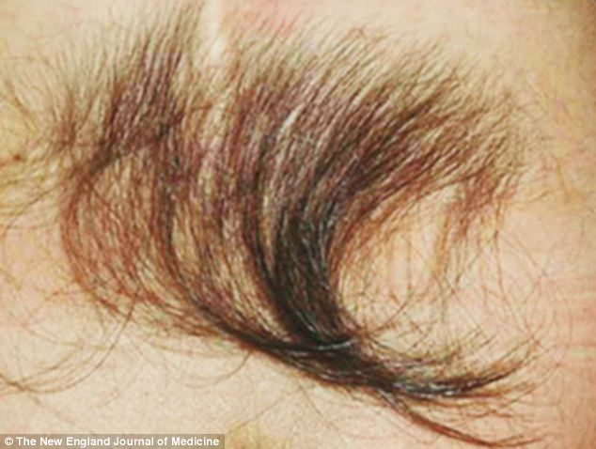
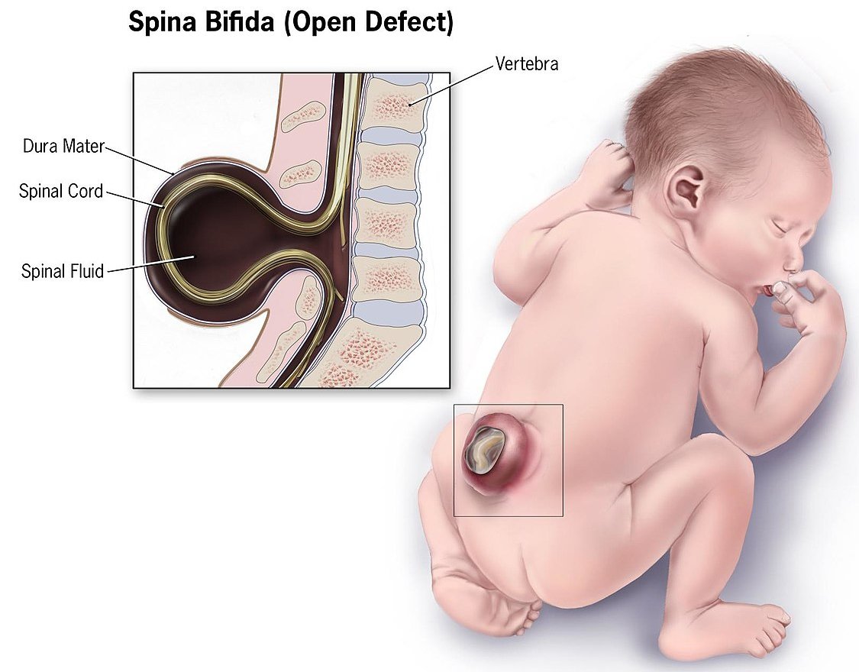
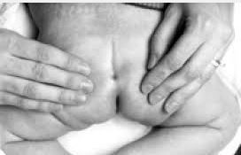
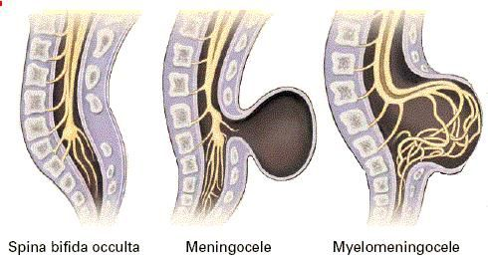
Spina Bifida – pg. 261

Slide 7
Fetoscopic Spina Bifida Repair
Notes:
https://www.youtube.com/watch?v=NjQBq0GH8BM

Slide 8
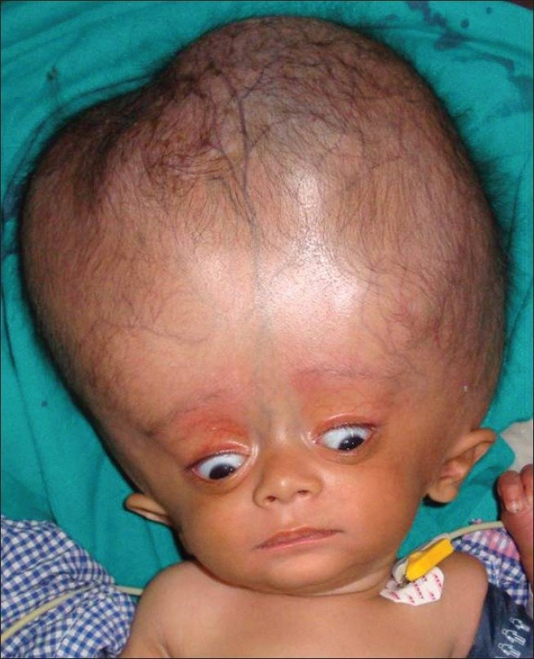
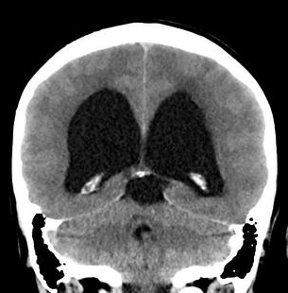
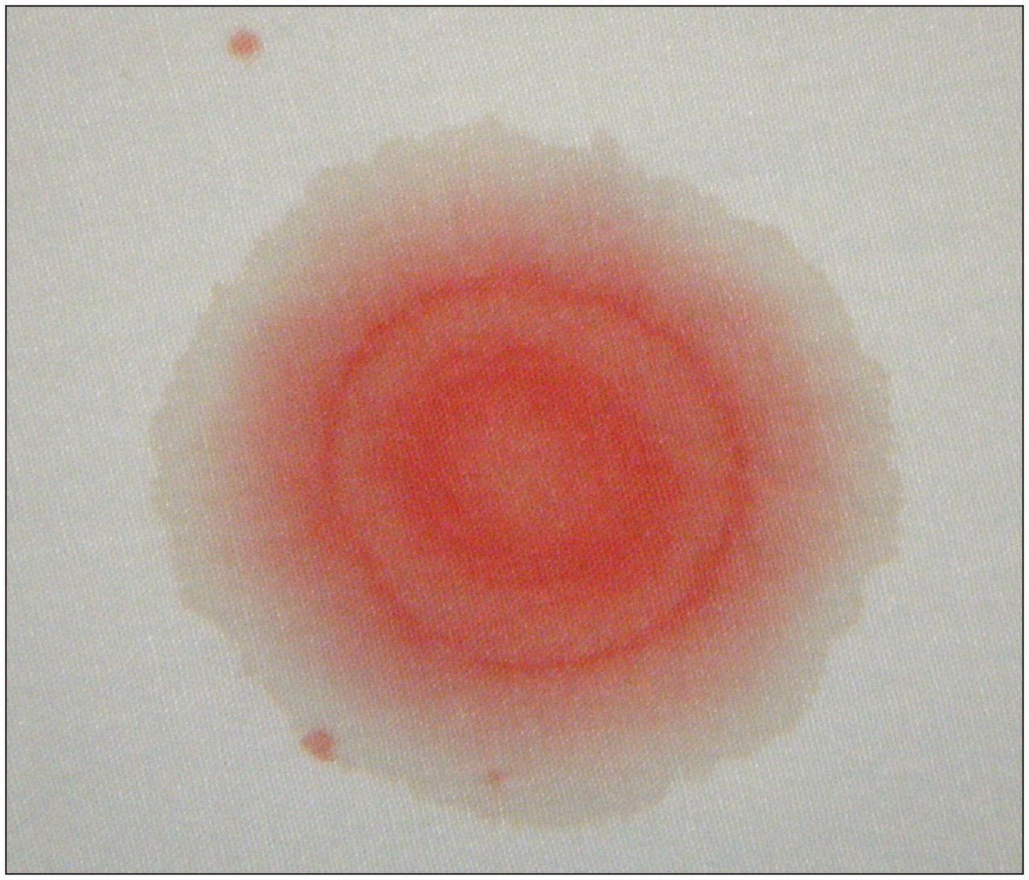
Hydrocephalus – pg. 264
Halo Sign

Slide 9
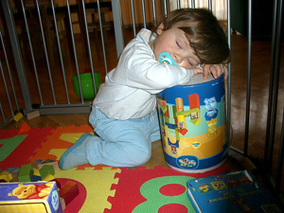
Sleepwalking – pg. 267
4 to 8

Slide 10
Seizure Disorders – pg. 268
Notes:
https://www.youtube.com/watch?v=8kYJughJXbs

Slide 11
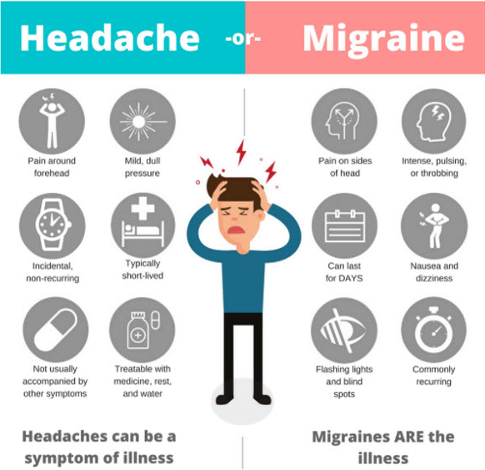
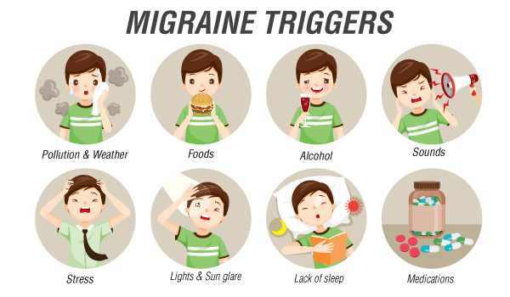
Migraines – pg. 278

Slide 12
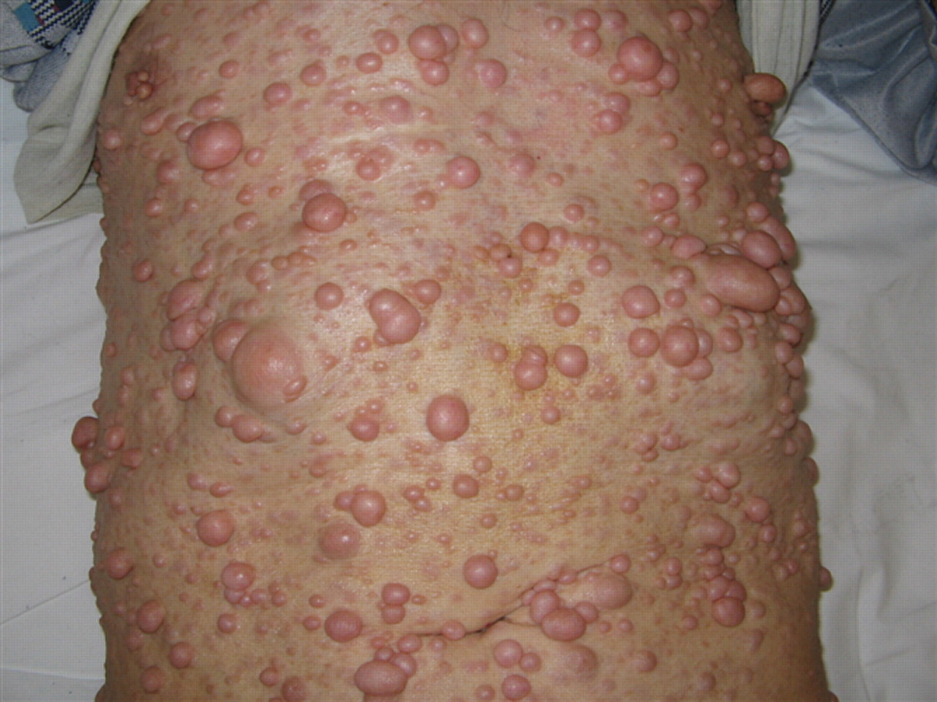
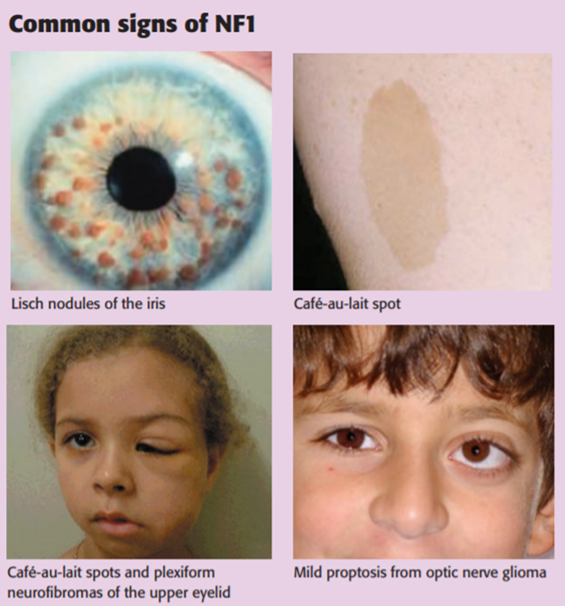
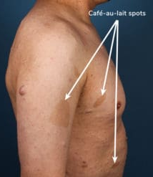
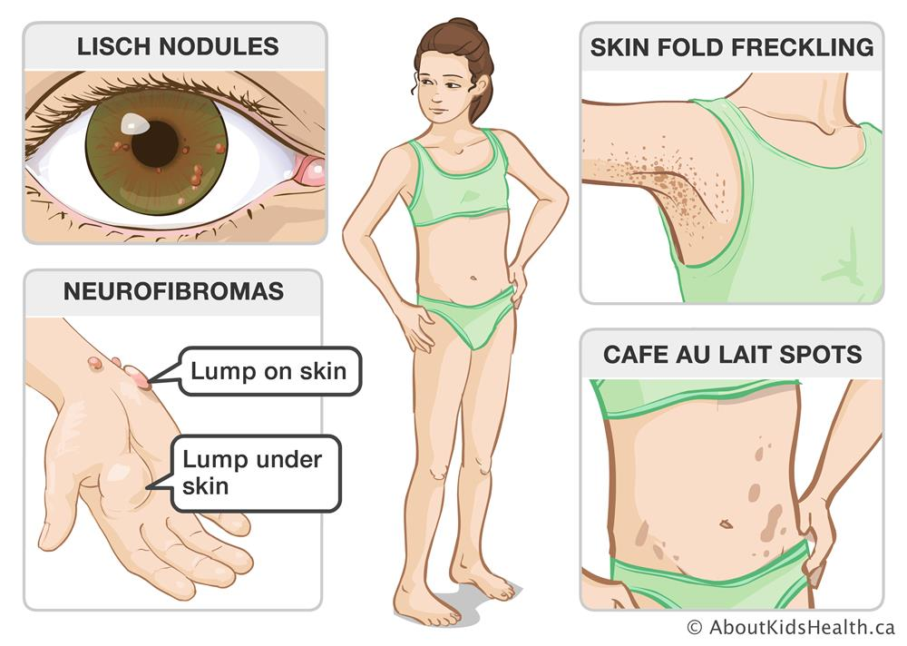
Neurofibromatosis – pg. 280

Slide 13
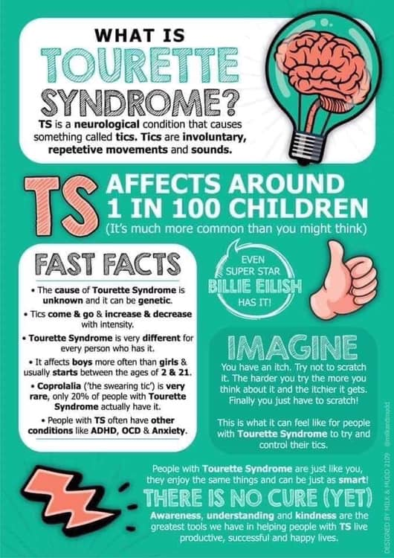
Tourette Syndrome – pg. 281

Slide 14
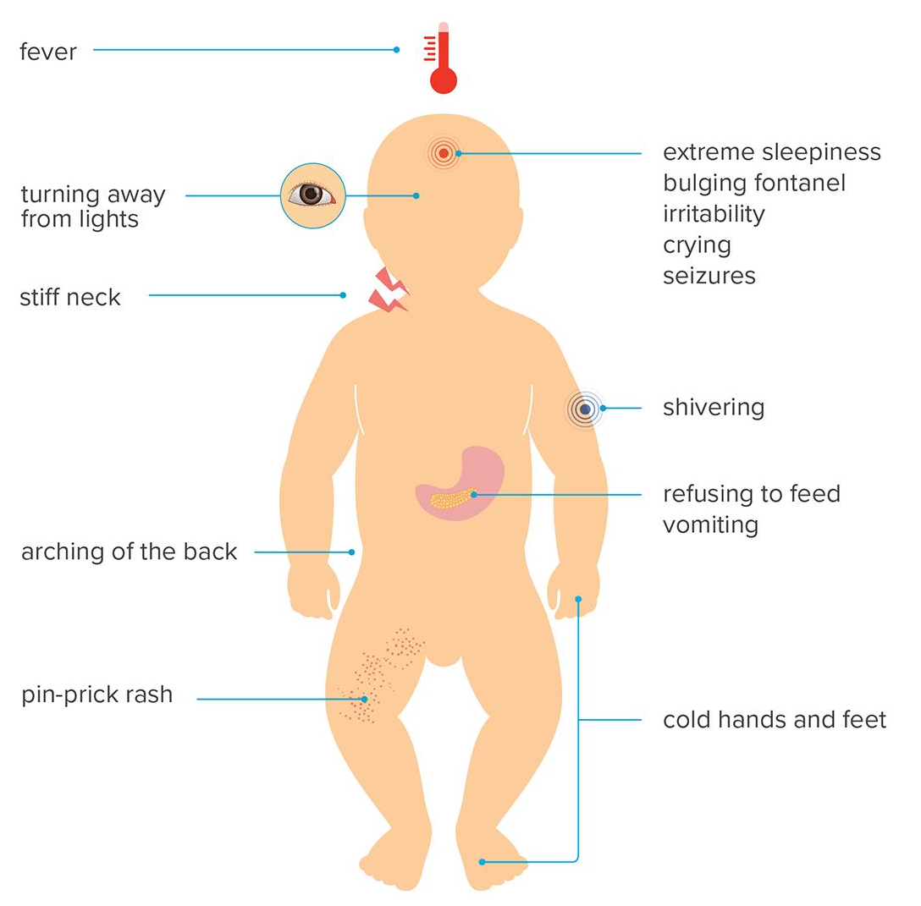
Meningitis – pg. 283

Slide 15
Clinical Scenario:
A 9 month old child comes to your pediatric hospital as a direct admit from the pediatrician’s office, with symptoms of lethargy, high fever, runny nose, and poor oral intake x 2 days. Child has past medical history of frequent ear and sinus infections, is up to date on age appropriate vaccinations, and has hit all developmental milestones on time. Admitting provider lists admission reason as “rule out meningitis”. In which sequence should the nurse implement the following provider ordered interventions?
Prepare child for lumbar puncture (LP)
Administer antibiotics
Implement isolation precautions
Collect blood cultures
Collect full set of vital signs and perform a neuro check

Slide 16
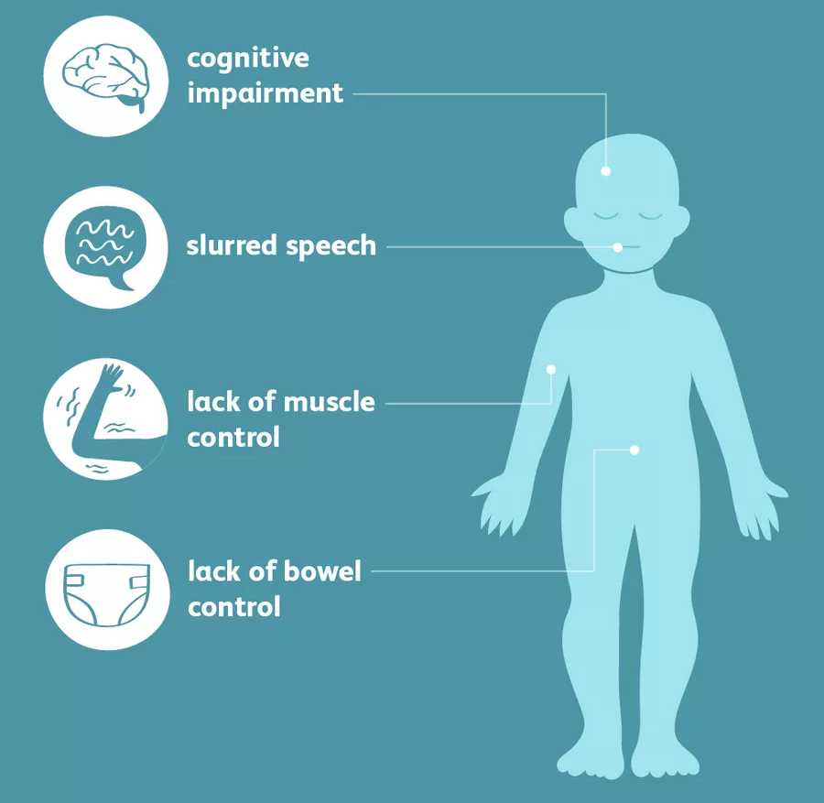
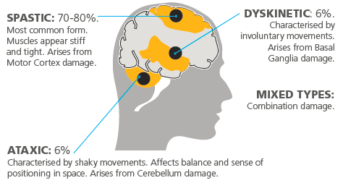
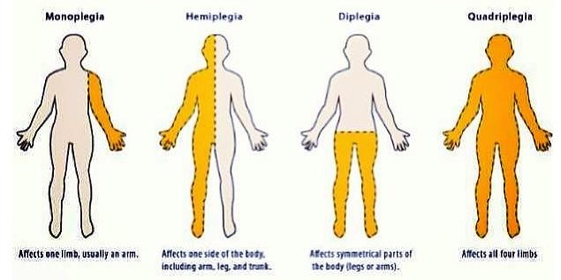
Cerebral Palsy – pg. 285

Slide 17
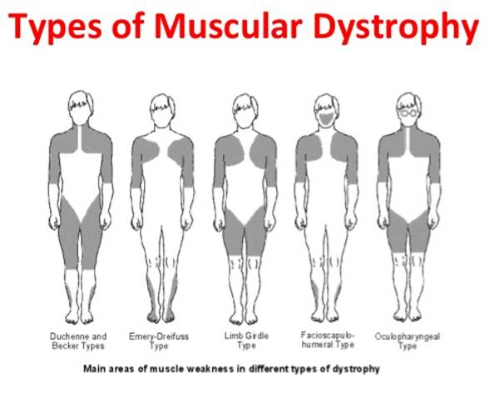
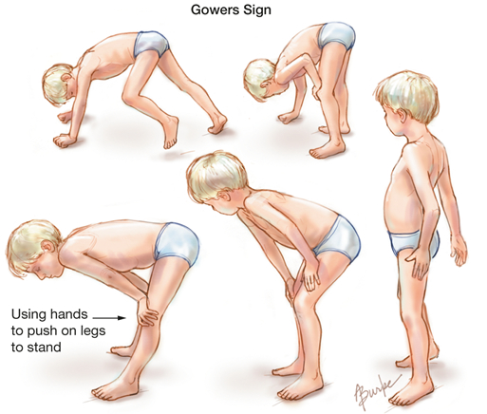
Muscular Dystrophy – pg. 286

Slide 18
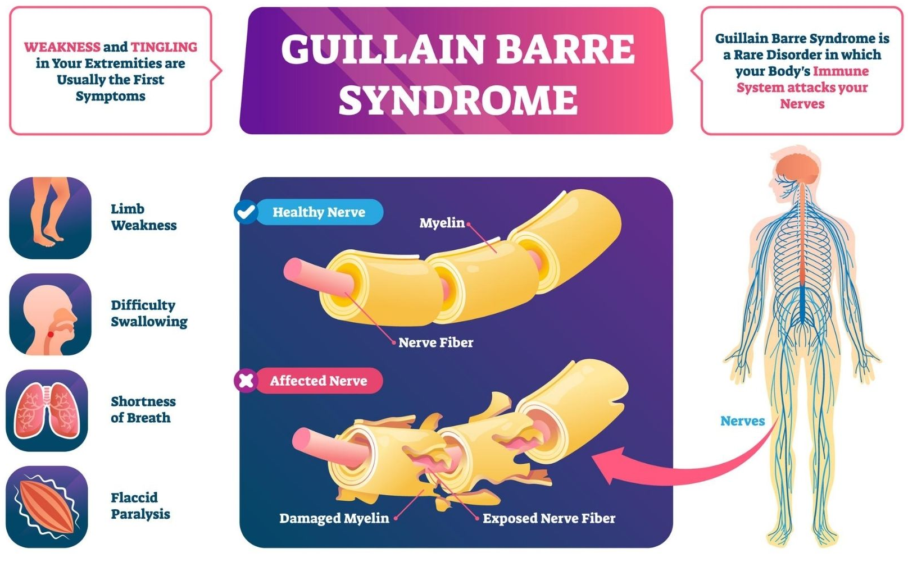
Guillain-Barré – pg. 288

Slide 19
Mental Health
Chapter 14: pages 292 - 319

Slide 20
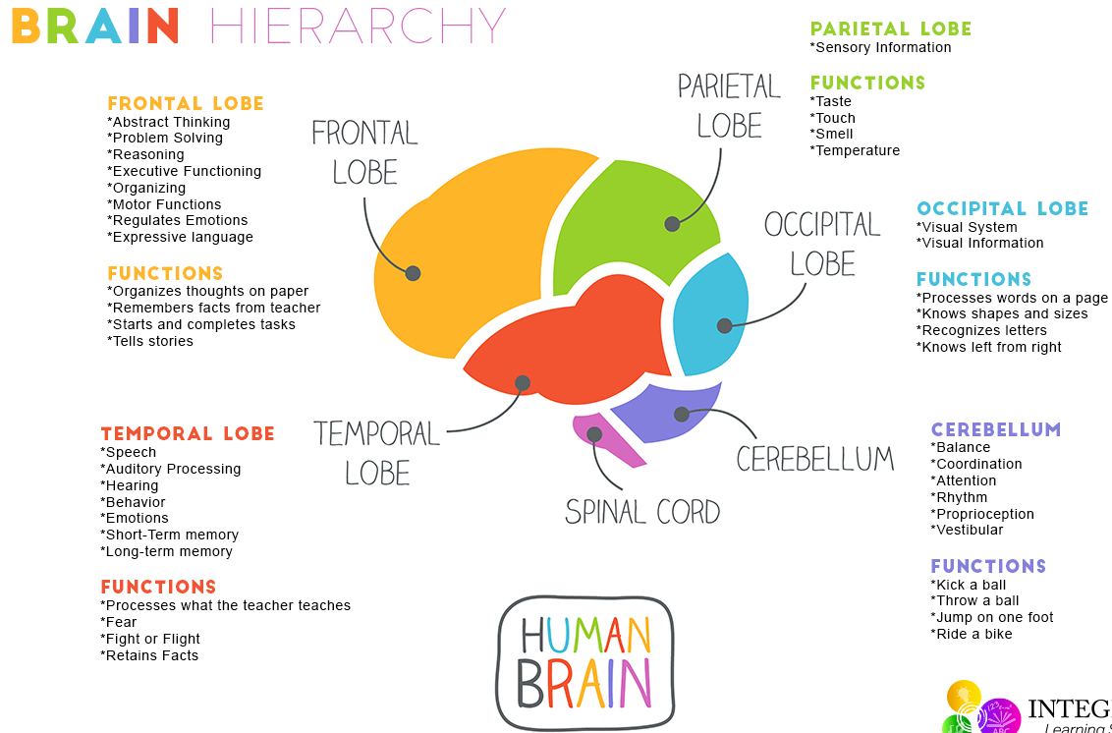
Mental Health – pg. 294

Slide 21
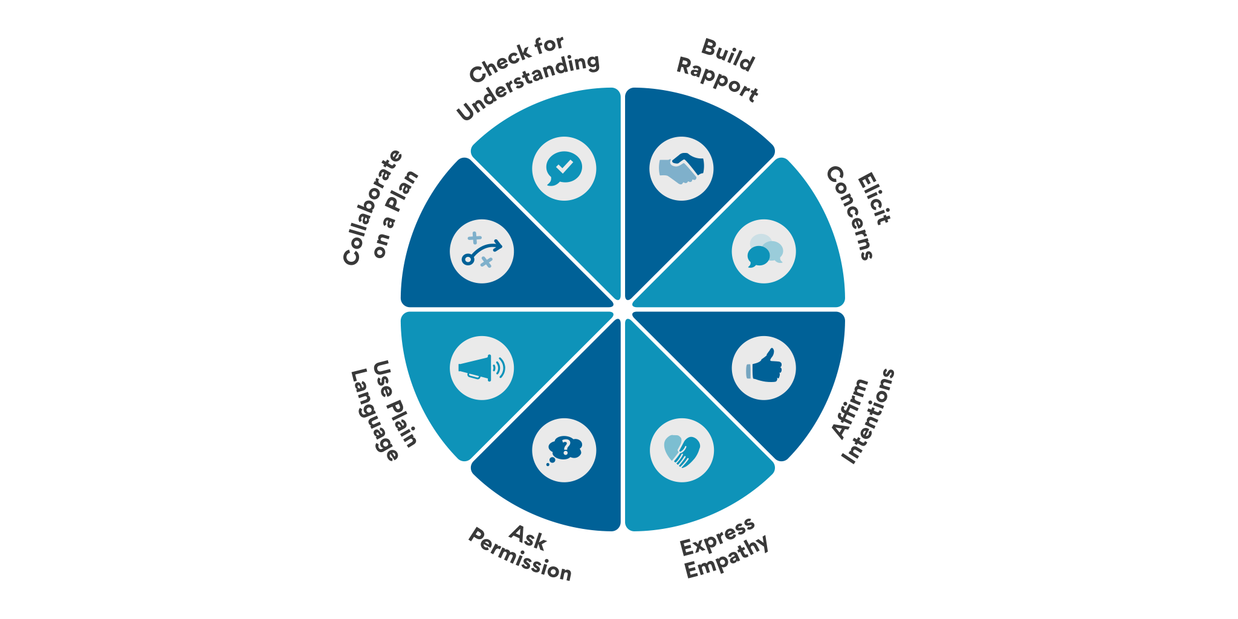
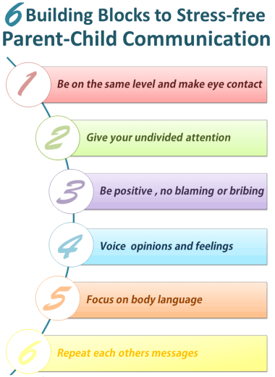
Therapeutic Approaches – pg. 299

Slide 22
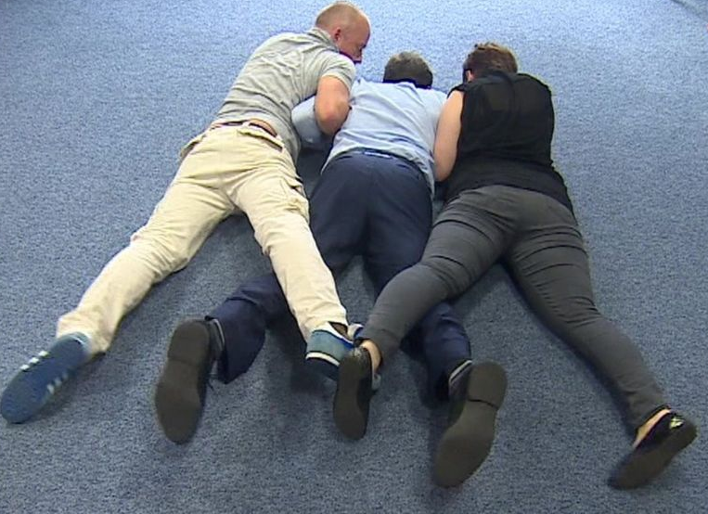
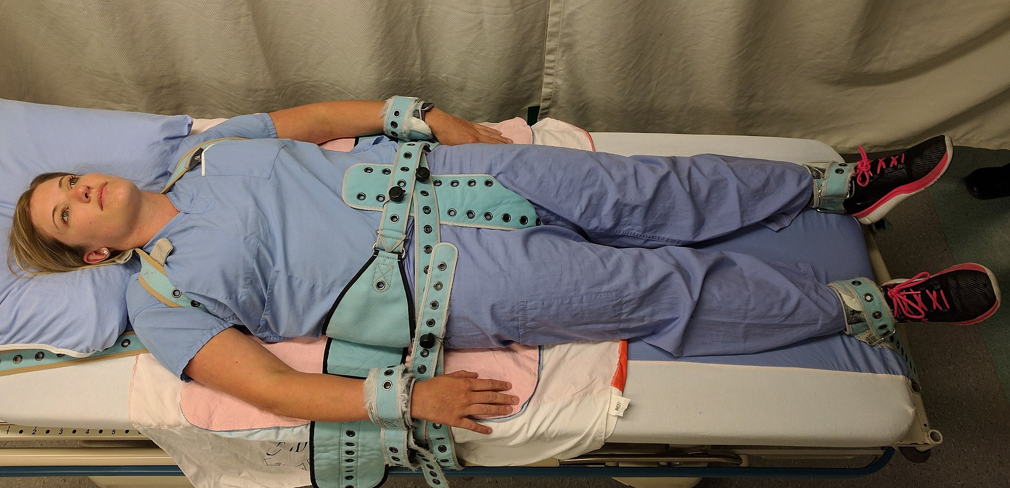
Restraint and Seclusion – pg. 298

Slide 23
Bullying – pg. 162

Slide 24
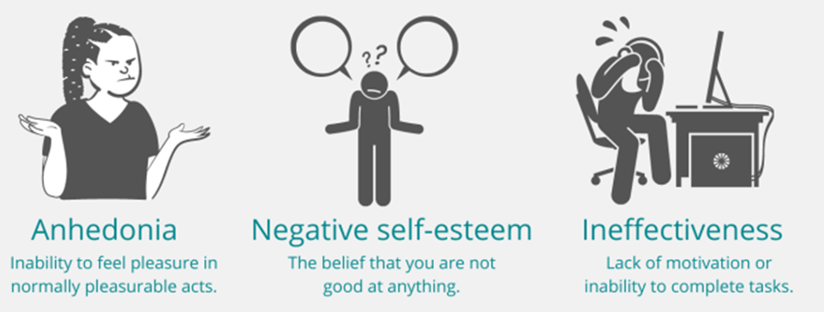
Depression – pg. 303

Slide 25
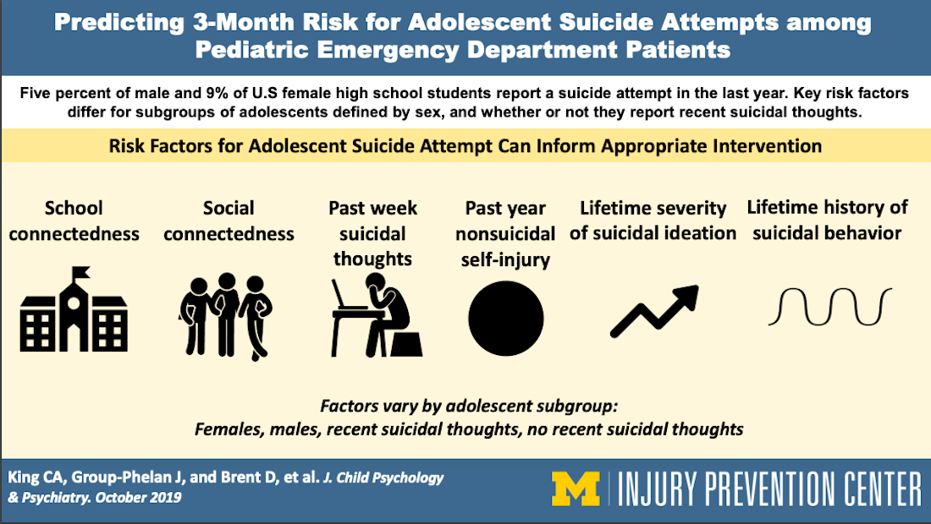
Suicide – pg. 304
10-14

Slide 26
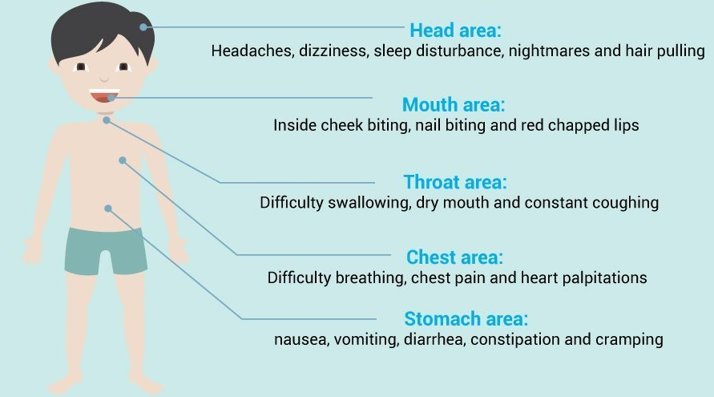
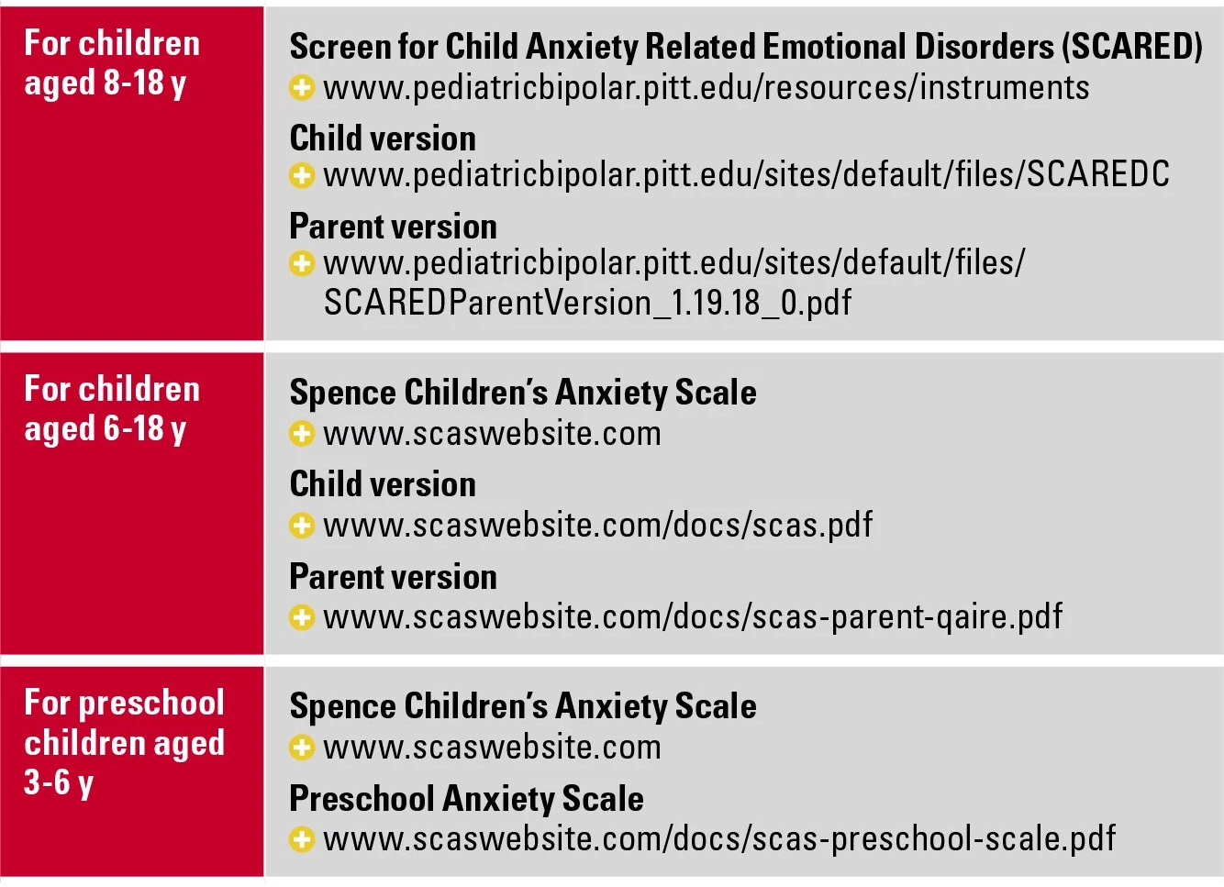
Anxiety – pg. 307

Slide 27
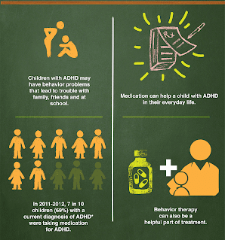
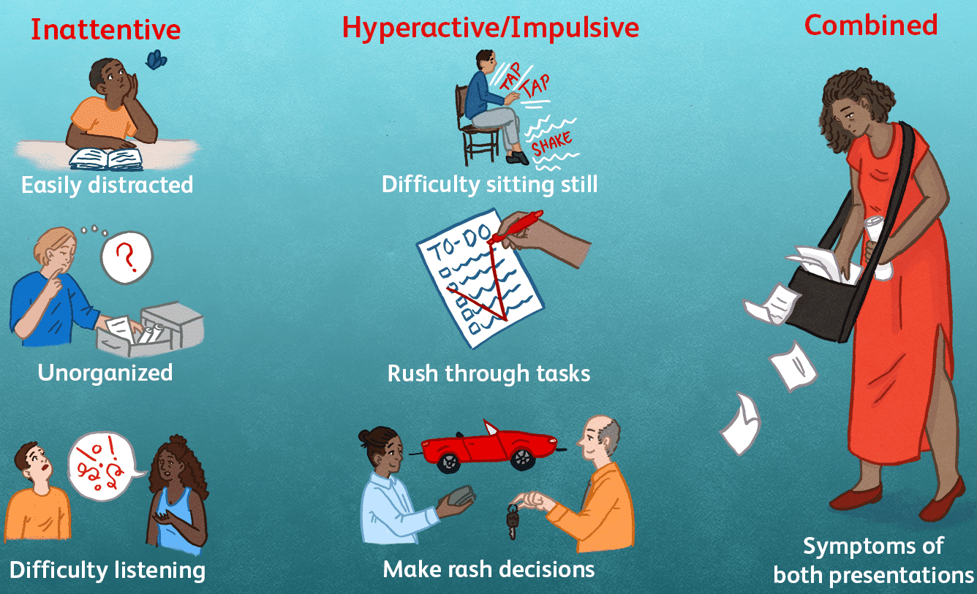
ADD/ADHD – pg. 308

Slide 28
Oppositional Defiant Disorder – pg. 309

Slide 29
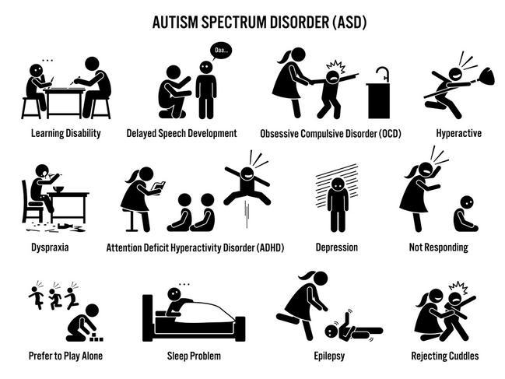
Autism Spectrum Disorder – pg. 312

Slide 30
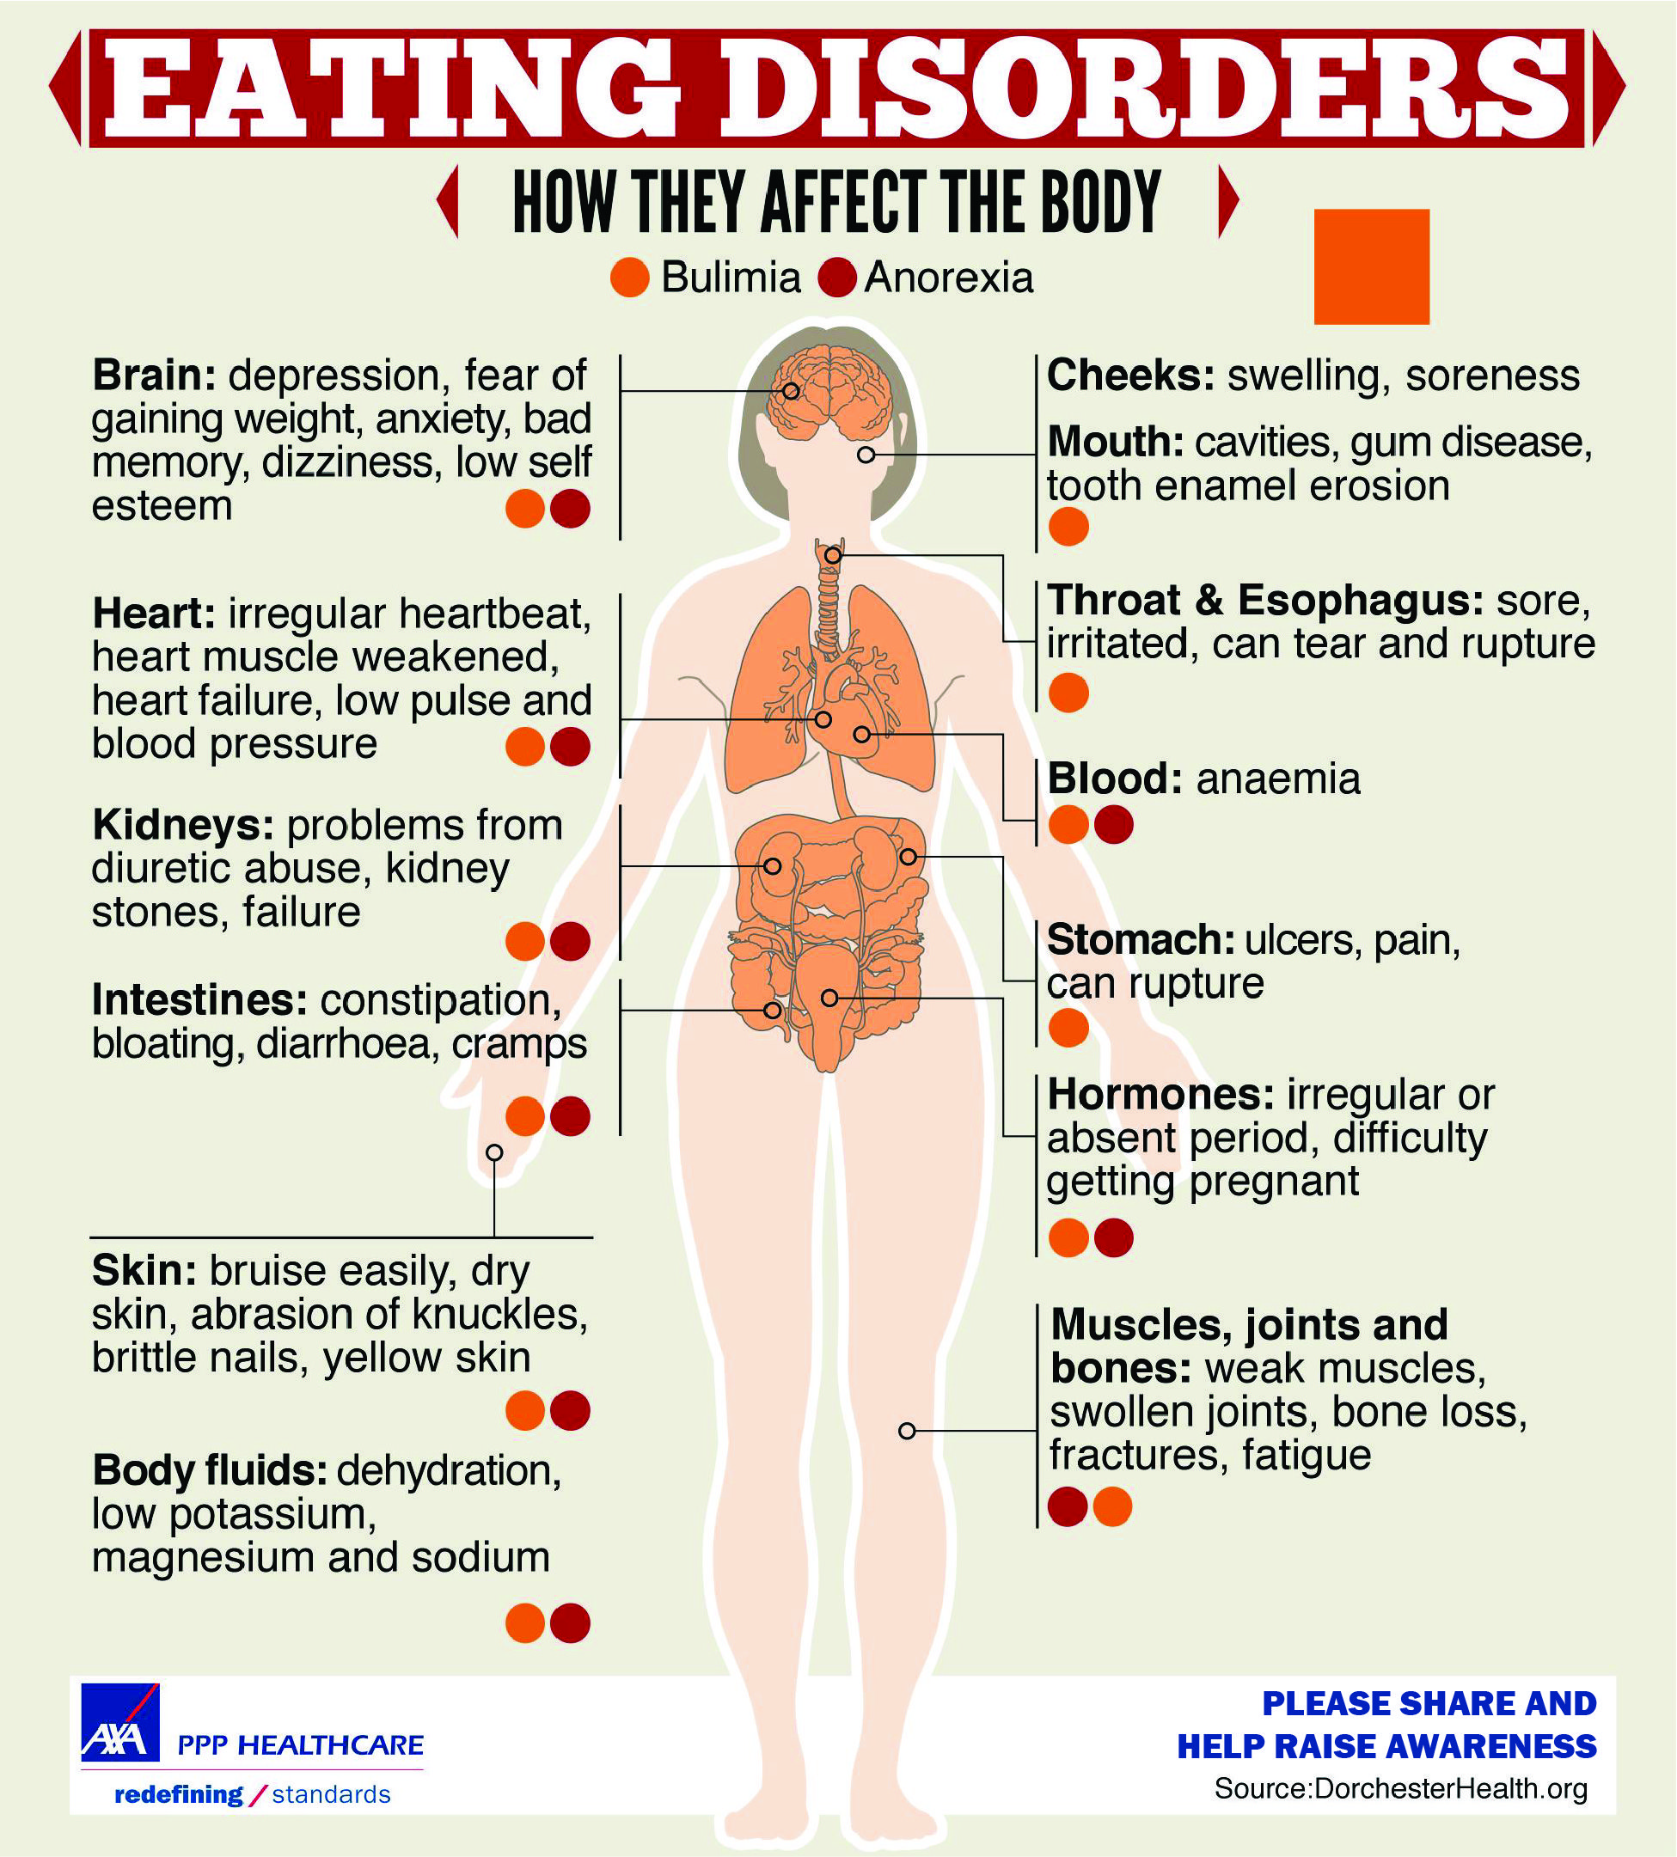
Anorexia & Bulimia – pg. 313
Notes:
Pg. 313

Slide 31
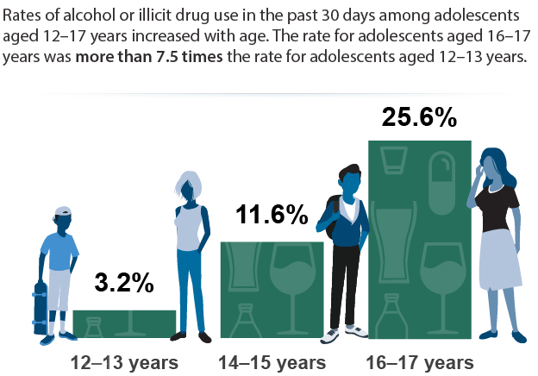
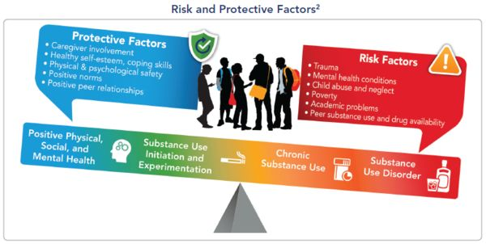
Substance Related Disorders – pg. 314

Slide 32
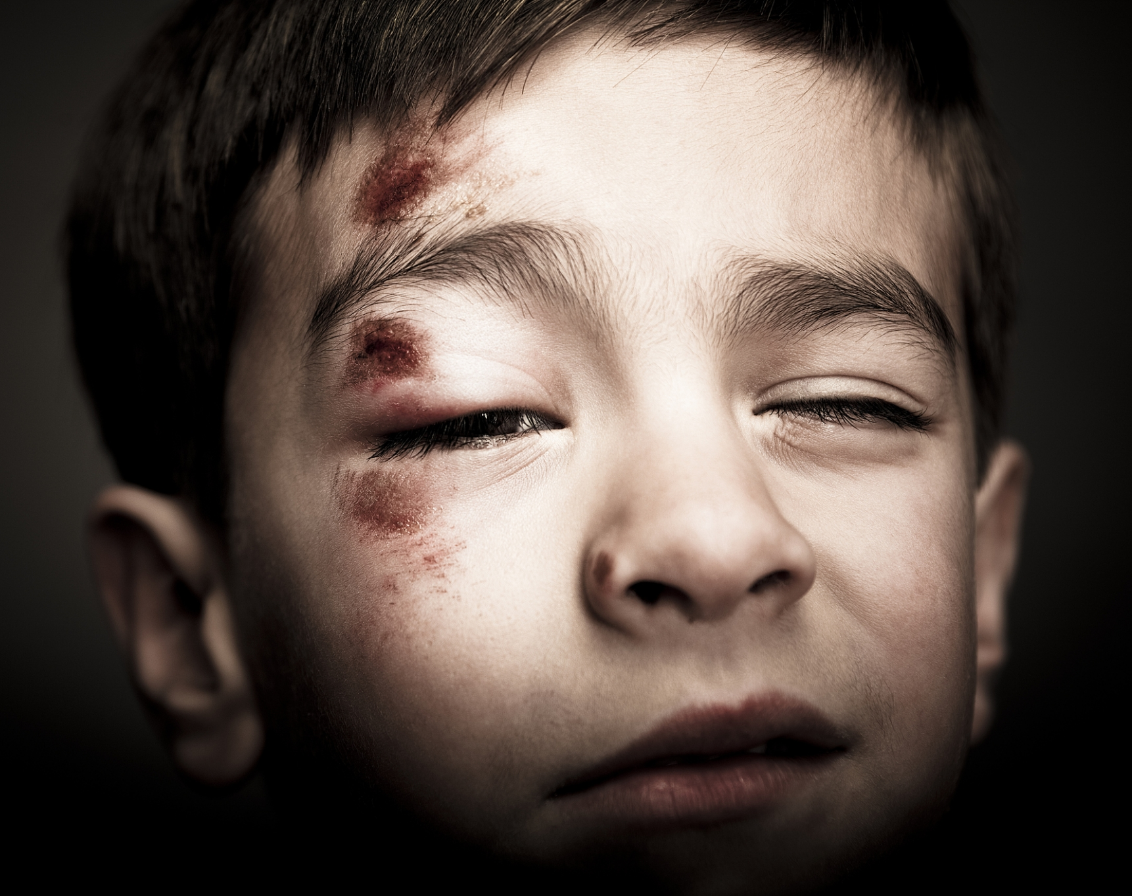
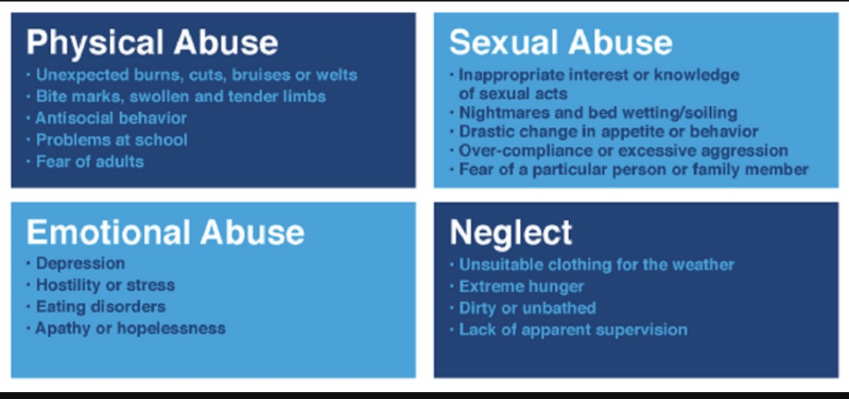
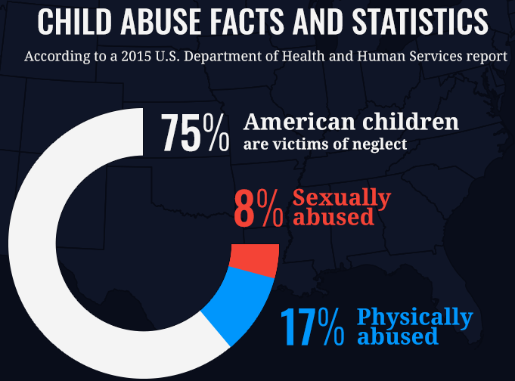
Child Abuse – pg. 318

