Slide 1
7: The Cellular Basis of Inheritance

Slide 2
7.1 Sexual Reproduction
Sexual reproduction is the production by parents of haploid cells and the fusion of a haploid cell from each parent to form a single, unique diploid cell.
In multicellular organisms, the new diploid cell undergoes mitotic cell divisions to develop into an adult organism.
Meiosis and fertilization introduce variations into offspring.
Meiosis is the division of the contents of the nucleus that divides the chromosomes among gametes. Variation is introduced during meiosis.

Slide 3
Life Cycles
Fertilization and meiosis alternate in sexual life cycles.
Meiosis reduces the resulting gamete’s chromosome number by half. Fertilization restores the diploid condition.
3 main categories of life cycles:
Diploid-dominant
Multicellular diploid stage is most obvious stage
Most animals, including humans
Haploid–dominant
Multicellular haploid stage is most obvious
Specialized haploid cells from two individuals join to form a diploid zygote that undergoes meiosis to form four haploid cells called spores.
Fungi and some algae
Alternation of Generations
Haploid and diploid are apparent to some degree
Gametophytes – fertilization between the gametes forms a diploid zygote which undergoes many rounds of mitosis to form a sporophyte. Cells of sporophyte undergoes meiosis to produce haploid spores which form gametophytes.
Plants and some algae
Nearly all animals employ a diploid-dominant life cycle. The gametes are produced from diploid germ cells, a special cell that only produces gametes. Fertilization occurs with the fusion of two gametes.

Slide 4
Life cycles of sexually reproducing organisms
In animals, sexually reproducing adults form haploid gametes from diploid germ cells.
Fungi, such as black bread mold (Rhizopus nigricans), have haploid-dominant life cycles.
Plants have a life cycle that alternates between a multicellular haploid organism and a multicellular diploid organism.

Slide 5
7.2 Meiosis
Meiosis-type of nuclear division that reduces the chromosome number from diploid (2n) to haploid (n)
These terms refer to total chromosome number
Gametes-reproductive cells (sperm and egg)
Haploid
In sexual reproduction, gametes are produced during meiosis
zygote

Slide 6
Homologous pairs of chromosomes
Also called, homologues
Similar banding patterns, length, centromere location, etc.
Have genes for the same traits, but alternate forms of that trait
Hence the genes are referred to as alleles
Highly similar, but different enough to produce alternative physical traits

Slide 7
Overview of Meiosis
Meiosis involves two nuclear divisions and produces four haploid daughter cells.
Each daughter cell has half the number of chromosomes found in the diploid parent nucleus.

Slide 8
Meiosis I
Meiosis I is the first nuclear division.
Prior to meiosis I, DNA replication occurs, each chromosome thus has two sister chromatids.
During meiosis I, homologous chromosomes pair forming a synaptonemal complex; this process is called synapsis.
During synapsis, the two sets of paired chromosomes lay alongside each other as a tetrad (sometimes called a bivalent).

Slide 9
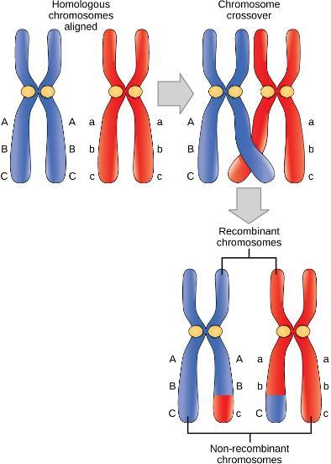
Meiosis I
In synapsis, the genes on the chromatids of the homologous chromosomes align precisely with each other.
Crossing over occurs – exchange of chromosome segments between non-sister homologous chromatids. Revealed as chiasmata.
At the end of prophase I, the pairs are held together only at chiasmata and are called tetrads because the four sister chromatids of each pair of homologous chromosomes are visible.
A single crossover event between homologous non-sister chromatids leads to a reciprocal exchange of equivalent DNA between a maternal chromosome and a paternal chromosome. The recombinant sister chromatid has a combination of maternal and paternal genes.

Slide 10
Independent assortment
During independent assortment, the homologous chromosomes separate independently or in a random manner.

Slide 11
Significance of genetic variation
In humans who have 23 pairs of chromosomes, the combinations possible from independent assortment alone are 2²³ or 8,388,608.
When gametes fuse at fertilization, chromosomes donated by parents combine.
The chromosomally different zygotes from same parents have (2²³)² or 70,368,744,000,000 combinations possible without crossing-over.
If crossing-over occurs once, then (4²³)² or 4,951,760,200,000,000,000,000,000,000 genetically different zygotes are possible for one couple.
A successful parent in a particular environment can reproduce asexually and produce offspring adapted to that environment.
If the environment changes, differences among offspring provide the offspring of sexually reproducing parents with much improved chances of survival.

Slide 12
Meiosis I
Two unique and consecutive cell divisions
DNA is replicated in the S phase of Meiosis I but not in Meiosis II-both contain a prophase, metaphase, anaphase and telophase
Prophase I
Pairing of homologous chromosomes
Metaphase I
Bivalents (tetrads) at metaphase plate

Slide 13
Anaphase I
Homologues of each bivalent separate and duplicated chromosomes move toward the poles
Telophase I
Two haploid daughter cells, NOT identical to the parent cell
Interkinesis between meiosis I and II is similar to the interphase between mitotic divisions; however:
Usually much shorter
No DNA replication occurs (the chromosomes are already duplicated)

Slide 14
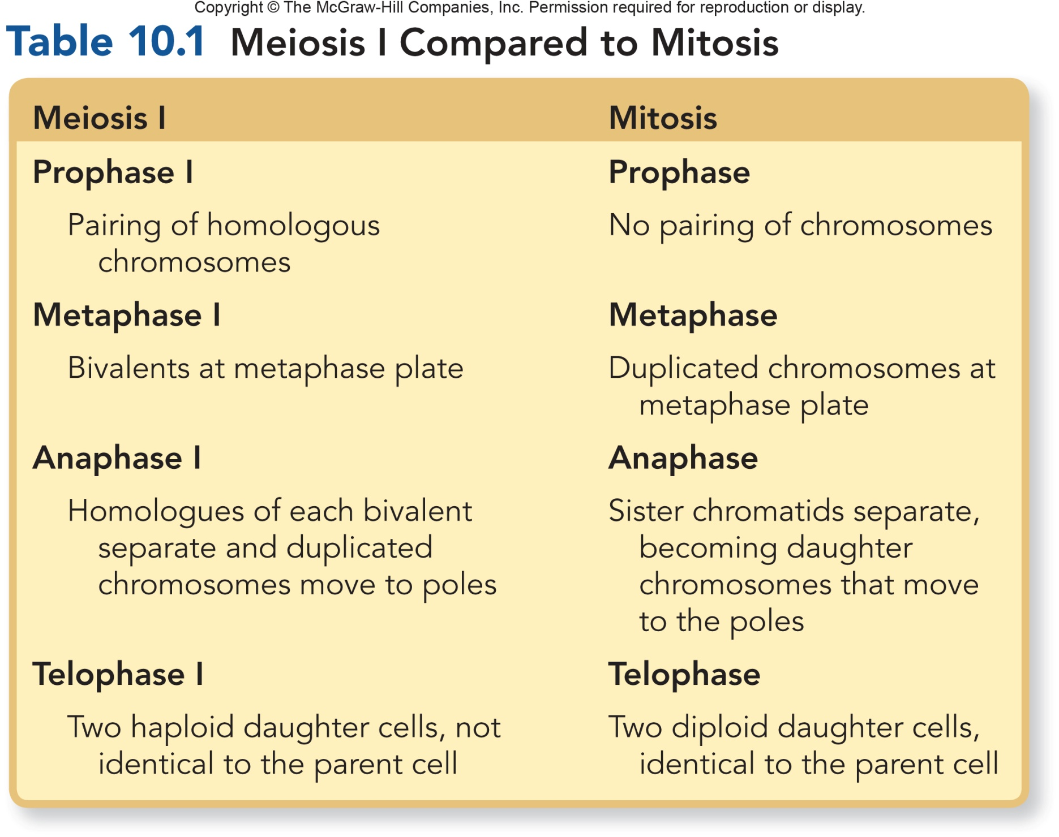

Slide 15
Meiosis II
In meiosis II, the centromeres divide and daughter chromosomes (derived as sister chromatids) separate.
No replication of DNA is needed between meiosis I and II because chromosomes are already doubled (DNA replication occurred prior to meiosis I).
Chromosomes in the four daughter cells have only one chromatid.
Fertilization restores the diploid number in cells.

Slide 16
Meiosis II and Gamete Formation
During metaphase II, the haploid number of chromosomes align at the metaphase plate.
During anaphase II, the sister chromatids separate at the centromeres; the two daughter chromosomes move toward the poles.
Due to crossing-over, each gamete can contain chromosomes with different types of genes.
At the end of telophase II and cytokinesis, there are four haploid cells.
In animals, the haploid cells mature and develop into gametes.

Slide 17
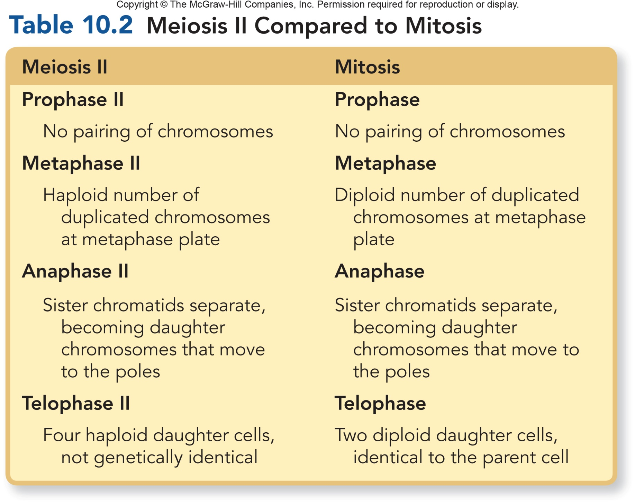

Slide 18
7.3 Errors in Meiosis
Disorders in Chromosome Number
Although meiosis almost always proceeds normally, failure of chromosomes to separate, or nondisjunction, may occur, resulting in gain or loss of chromosomes.
Also referred to as aneuploidy

Slide 19
Nondisjunctions, Duplications, and Deletions
Chromosomal mutations are changes in chromosome number or structure.
Mutations, along with crossing-over, recombination of chromosomes during meiosis, and gamete fusion during fertilization, increase the amount of variation among offspring.
The correct number of chromosomes in a species is called euploidy; changes in chromosome number resulting from nondisjunction during meiosis is called aneuploidy.
Monosomy (2n – 1) occurs when an individual has only one of a particular type of chromosome.
Trisomy (2n + 1) occurs when an individual has three of a particular type of chromosome.
In nondisjunction both members of the homologous pair go into the same gamete.
Primary nondisjunction occurs during meiosis I when both members of a homologous pair go into the same daughter cell
Secondary nondisjunction occurs during meiosis II when the sister chromatids fail to separate and both daughter chromosomes go into the same gamete.
Monosomy and trisomy occur in plants and animals; in autosomes of animals, it is generally lethal.
Trisomy 21 is the most common autosomal trisomy in humans.

Slide 20
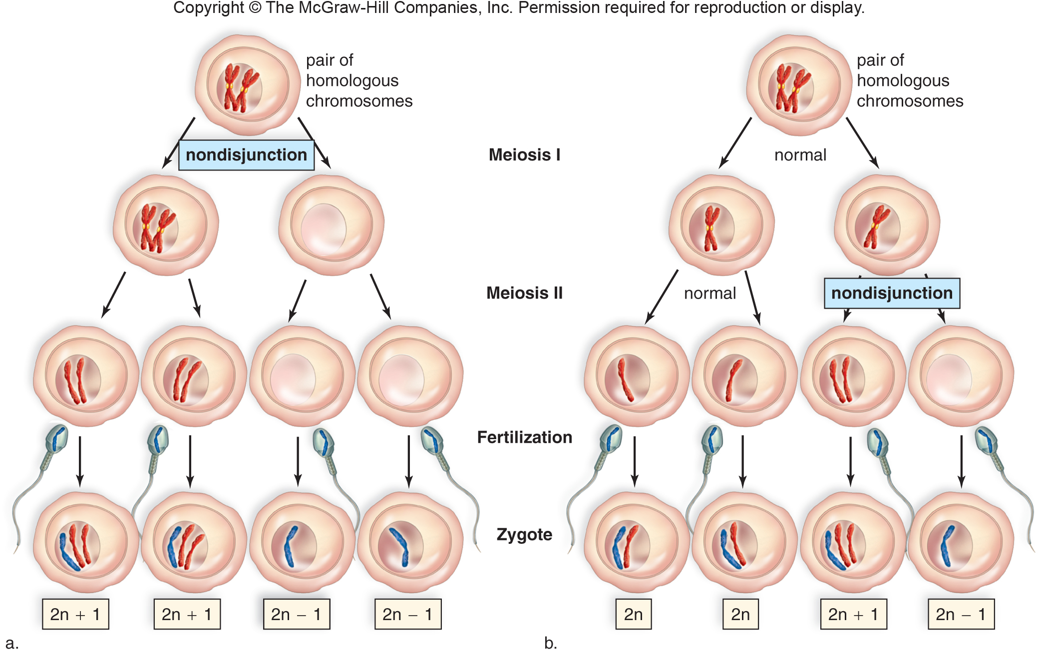

Slide 21
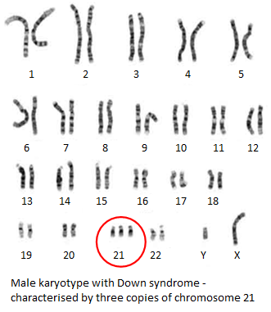
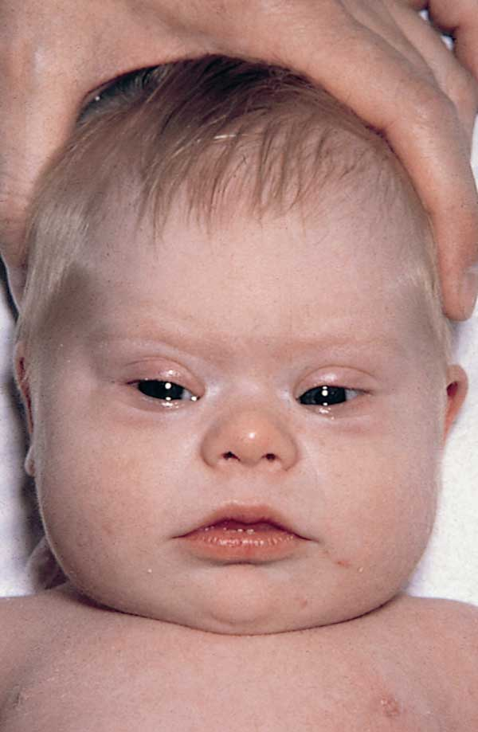
Trisomy 21-Down’s Syndrome
Trisomy 21 (also called Down syndrome) occurs when three copies of chromosome 21 are present.
Usually two copies of chromosome 21 are contributed by the egg; in 23% of the cases, the sperm had the extra chromosome 21.
Chances of a woman having a Down syndrome child increase with age (AMA).
A karyotype, a visual display of the chromosomes arranged by shape, size, and banding pattern, may be performed to identify babies with Down syndrome and other aneuploid conditions.

Slide 22
More nondisjunction
Nondisjunction during oogenesis can result in too few or too many X chromosomes; nondisjunction during spermatogenesis can result in missing or too many Y chromosomes.
Any additional X chromosomes become an inactive mass called a Barr body.

Slide 23
Chromosome Structural Rearrangements
Environmental factors including radiation, chemicals, and viruses, can cause chromosomes to break; if the broken ends do not rejoin in the same pattern, this causes a change in chromosomal structure.
A deletion occurs when an end of a chromosome breaks off or when two simultaneous breaks lead to the loss of an internal segment.
A duplication is the presence of a chromosomal segment more than once in the same chromosome.

Slide 24
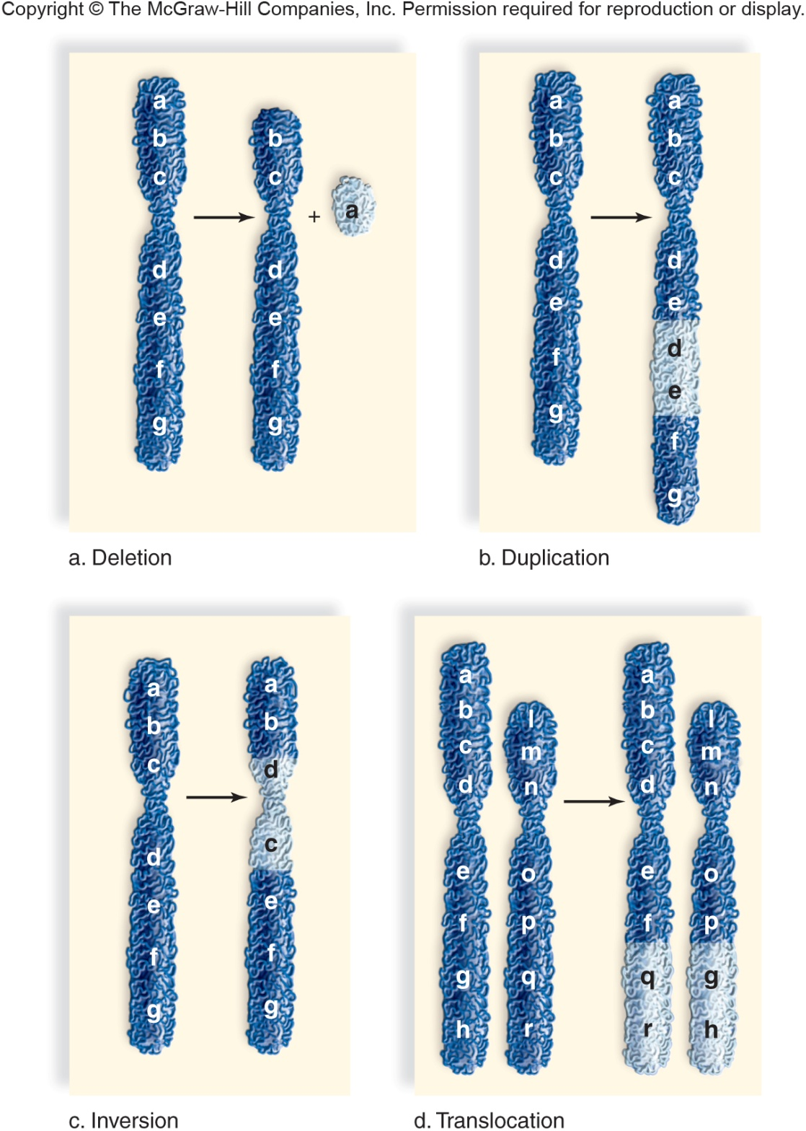

Slide 25
A duplication may also involve an inversion where a segment that has become separated from the chromosome is reinserted at the same place but in reverse; the position and sequence of genes are altered.
A translocation is the movement of a chromosomal segment from one chromosome and inserted into another nonhomologous chromosome; in Down syndrome, 5% of cases are due to a translocation between chromosome 21 and 14, a situation that runs in the family of the father or mother.

Slide 27
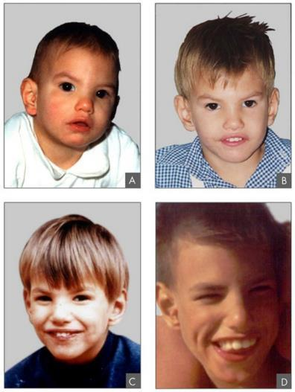
Structural rearrangements in humans:
Cri du chat syndrome (“cry of the cat”) is a deletion in which an individual has a small head, is mentally retarded, has facial abnormalities, and an abnormal glottis and larynx resulting in a cry resembling that of a cat.

