Slide 1
Chapter 11-Mendelian Patterns of Inheritance

Slide 2
Gregor Mendel
Austrian monk.
Formulated two fundamental laws of heredity in the early 1860s.
University of Vienna.
At the time of his research, he was a substitute science teacher at a local technical high school.
Because Mendel had a mathematical background, he used a statistical basis for his breeding experiments.
Mendel’s particulate theory is based on the existence of minute particles—now called genes.

Slide 3
True Breeding
Mendel prepared his experiments carefully and conducted preliminary studies.
He chose the garden pea, Pisum sativum, because peas were easy to cultivate, had a short generation time, and could be cross-pollinated by hand.
From many varieties, Mendel chose 22 true-breeding varieties for his experiments.
True-breeding varieties had all offspring like the parents and like each other.
Mendel studied simple traits (e.g., seed shape and color, flower color, etc.).
He used his understanding of mathematical principles of probability to interpret his results.

Slide 4
Law of Segregation
A monohybrid cross is between two parent organisms true-breeding for two distinct forms of one trait.
Mendel tracked each trait through two generations.
P generation is the parental generation in a breeding experiment.
F₁ generation is the first-generation offspring in a breeding experiment.
F₂ generation is the second-generation offspring in a breeding experiment.

Slide 5
He performed reciprocal crosses, i.e., pollen of tall plant to stigma of short plant and vice versa.
His results were contrary to those predicted by a blending theory of inheritance.
He found that the F₁ plants resembled only one of the parents.
Characteristics of other parents reappeared in about 1/4 of F₂ plants; 3/4 of offspring resembled the F₁ plants.

Slide 6
Mendel saw that these 3:1 results were possible if:
F₁ hybrids contained two factors for each trait, one being dominant and the other recessive;
factors separated when gametes were formed; a gamete carried one copy of each factor;
and random fusion of all possible gametes occurred upon fertilization.

Slide 7
Results of his experiments led Mendel to develop his first law of inheritance—the law of segregation:
Each organism contains two factors for each trait.
Factors segregate during the formation of gametes.
Each gamete contains one factor for each trait.
Fertilization gives each new individual two factors for each trait.

Slide 8
Some vocabulary…
locus is the specific location of alleles on homologous chromosomes.
Alternative versions of a gene are called alleles.
dominant allele masks or hides expression of a recessive allele; it is represented by an uppercase letter.
recessive allele is an allele that exerts its effect only in the homozygous state; its expression is masked by a dominant allele; it is represented by a lowercase letter.
The process of meiosis explains Mendel’s law of segregation.

Slide 9
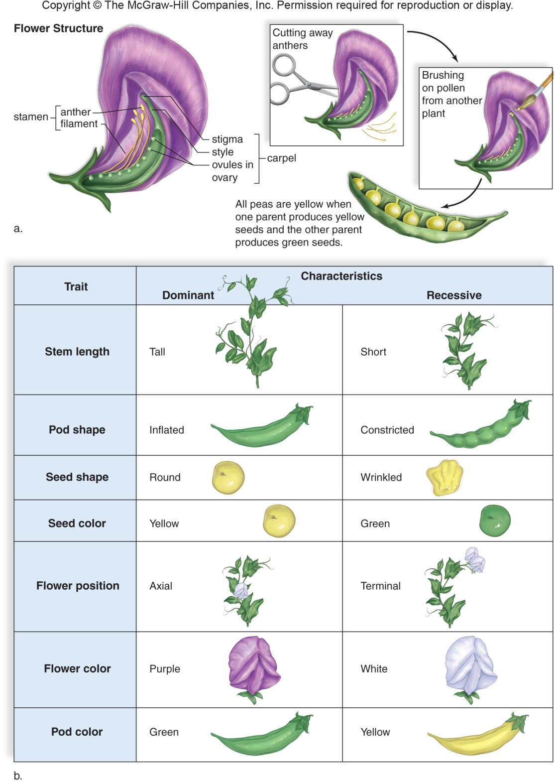

Slide 10
In Mendel’s cross, the parents were true-breeding; each parent had two identical alleles for a trait–they were homozygous, indicating they possess two identical alleles for a trait.
Homozygous dominant genotypes possess two dominant alleles for a trait.
Homozygous recessive genotypes possess two recessive alleles for a trait.
After cross-pollination, all individuals of the F₁ generation had one of each type of allele.
Heterozygous genotypes possess one of each allele for a particular trait.
The allele not expressed in a heterozygote is a recessive allele.

Slide 11
Genotype Versus Phenotype
Two organisms with different allele combinations can have the same outward appearance (e.g., TT and Tt pea plants are both tall; therefore, it is necessary to distinguish between alleles present and the appearance of the organism).
Genotype refers to the alleles an individual receives at fertilization (dominant, recessive).
Phenotype refers to the physical appearance of the individual (tall, short, etc.).

Slide 12
The Law of Independent Assortment
A dihybrid cross is between two parent organisms that are true-breeding for different forms of two traits; it produces offspring heterozygous for both traits.
Mendel observed that the F₁ individuals were dominant in both traits.
He further noted four phenotypes among F₂ offspring; he deduced his second law of heredity-the law of independent assortment:

Slide 13
The law of independent assortment:
Members of one pair of factors assort independently of members of another pair.
All possible combinations of factors occur in gametes.

Slide 14
Mendel’s Law of Probability
A Punnett square is used to determine the probability of genotypes and phenotypes among offspring.
Probability is the likely outcome a given event will occur from random chance.
For example, with every coin flip there is a 50% chance of heads and 50% chance of tails.

Slide 15
The product rule of probability states that the chance of two or more independent events occurring together is the product of the probability of the events occurring separately.
The chance of inheriting a specific allele from one parent and a specific allele from another is ½ x ½ or ¼.
Possible combinations for the alleles Ee of heterozygous parents are the following:
EE = ½ x ½ = ¼ eE = ½ x ½ = ¼ Ee = ½ x ½ = ¼ ee = ½ x ½ = ¼

Slide 16
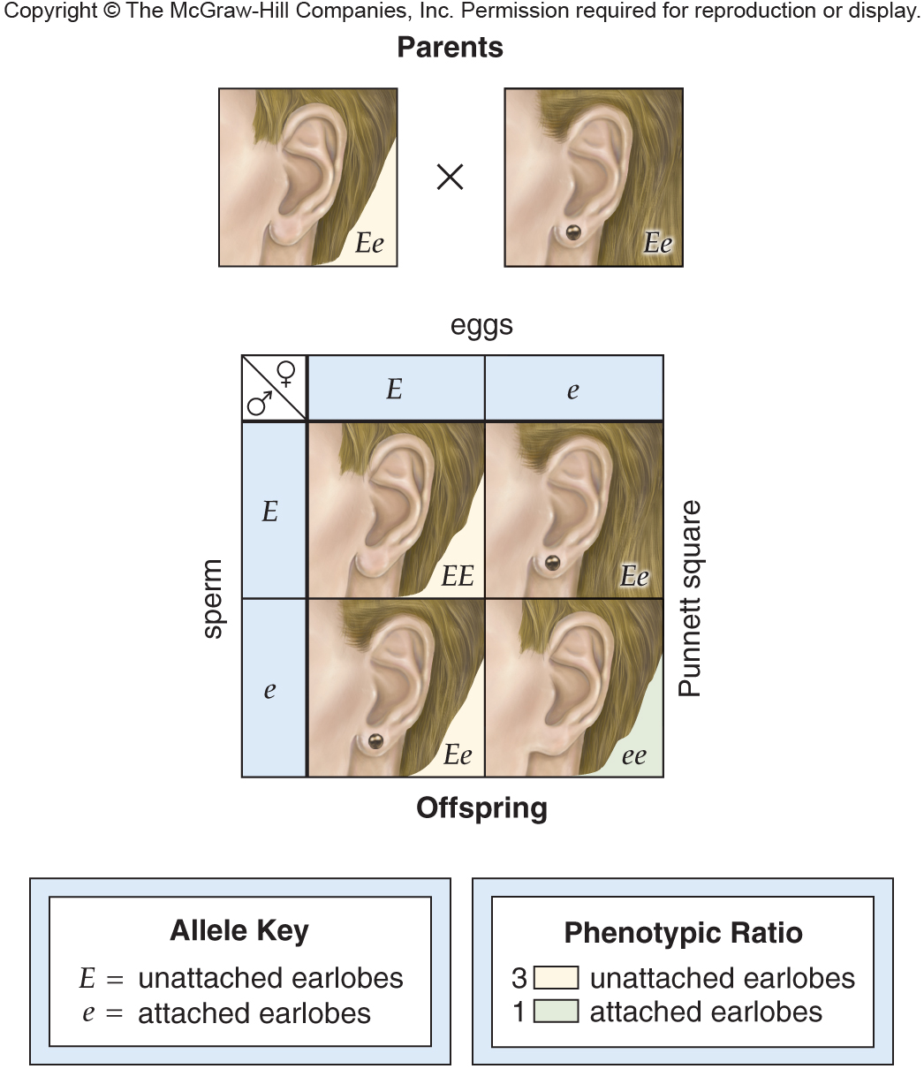

Slide 17
The sum rule of probability calculates the probability of an event that occurs in two or more independent ways; it is the sum of individual probabilities of each way an event can occur; in the above example where the phenotype unattached earlobes is dominant (EE, Ee, and eE), the chance for unattached earlobes is ¼ + ¼ + ¼ = ¾.

Slide 18
Testcrosses
A testcross is used to determine if an individual with the dominant phenotype is homozygous dominant or heterozygous for a particular trait.

Slide 19
Homework!
Read Chapter 11 in the text book to prepare for the remainder of lecture and lab this week!
You must be prepared for lab. Read through Lab Unit 11 – starts on p 119

