Slide 1
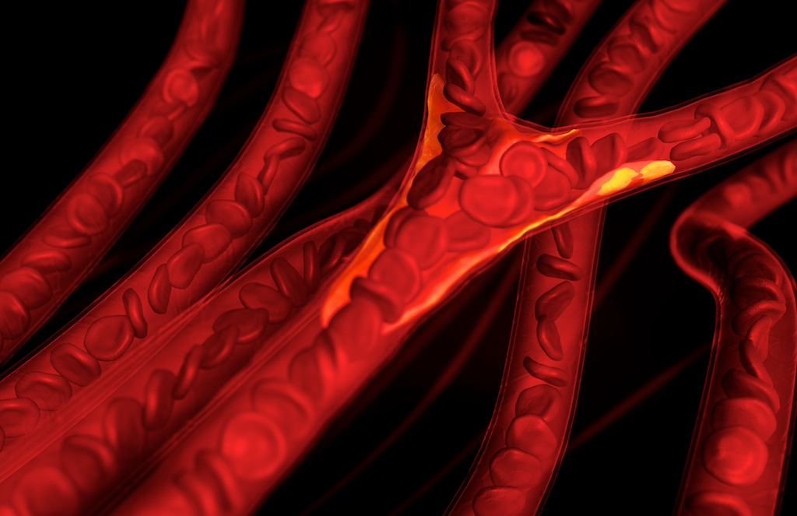
Chapter 21: The Cardiovascular System: Blood Flow & Hemodynamics

Slide 2
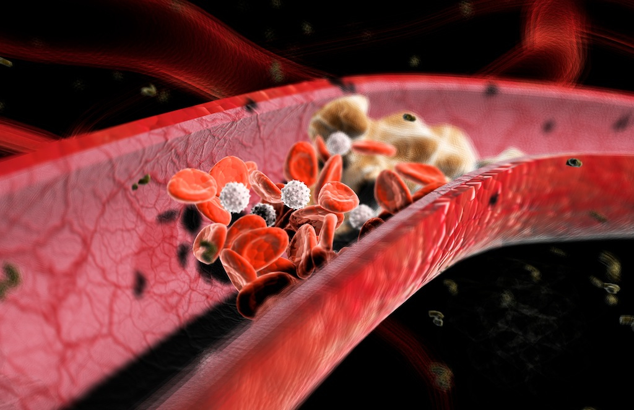
Blood Vessels & Blood Flow

Slide 3
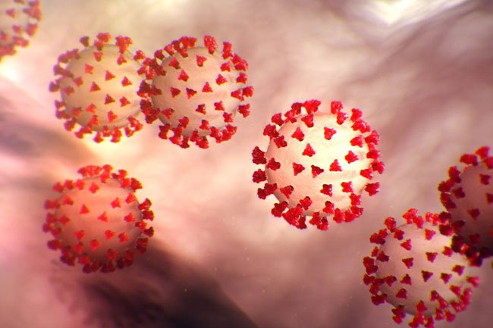

Slide 4
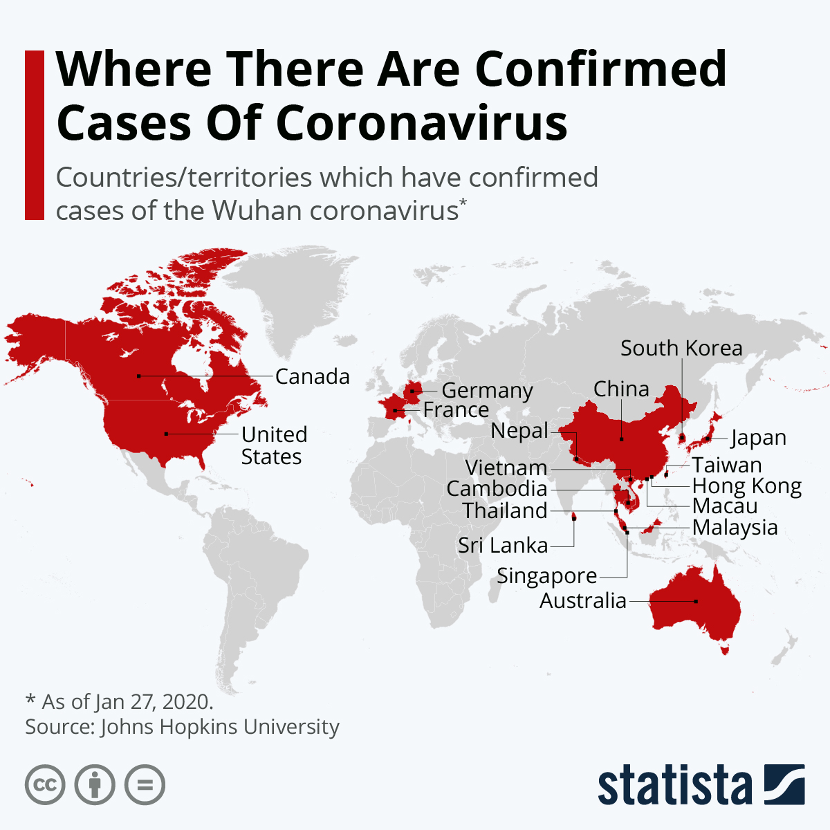

Slide 5
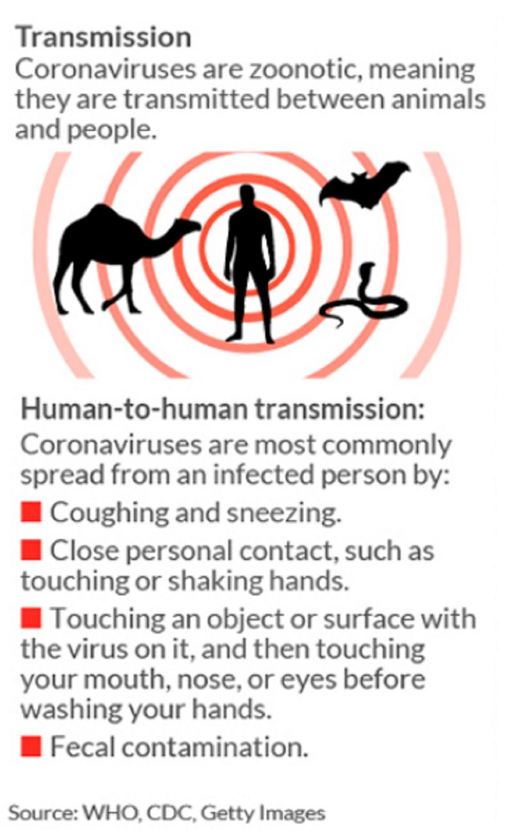

Slide 6
Zoonotic- An infection or disease, resulting from bacteria, virus, or parasite that can be transmitted from an animal to a human being.

Slide 7
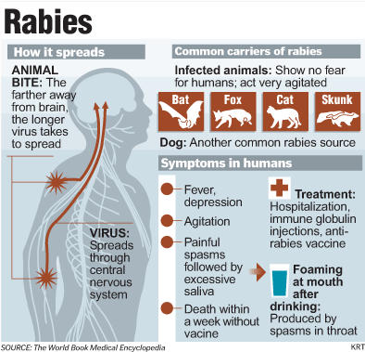

Slide 10
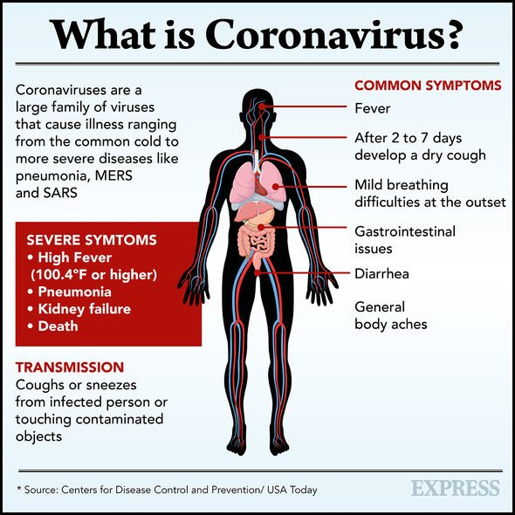

Slide 11
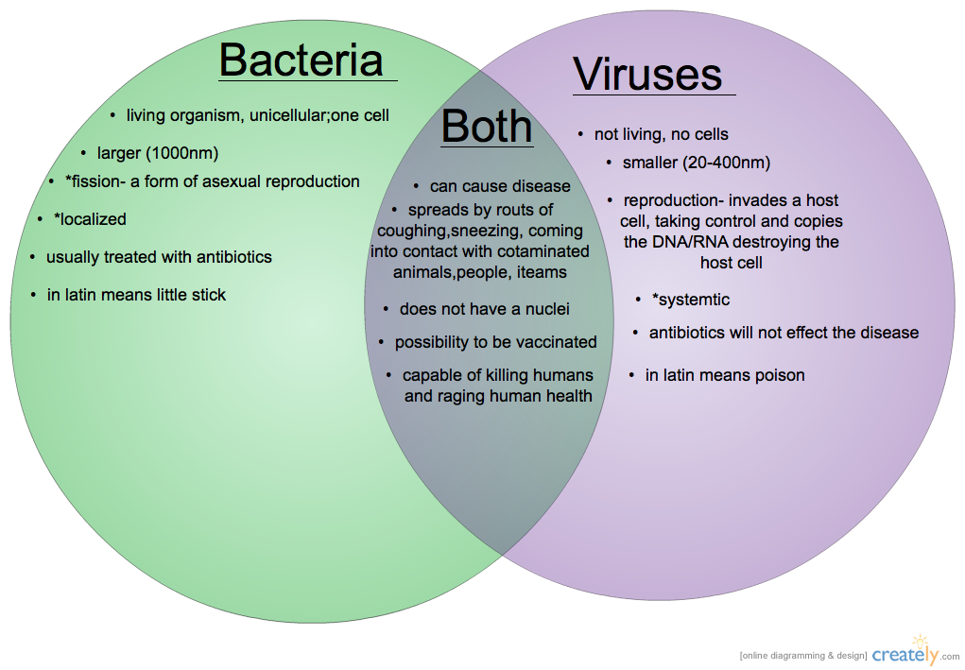

Slide 12
Bloor flow- Volume of blood flowing through a vessel, an organ, or the entire circulation in a given period.
Measured as mml/min
Equivalent to cardiac output (CO) for the entire vascular system
Relatively constant at rest
Varies widely through individual organs, based on need

Slide 13
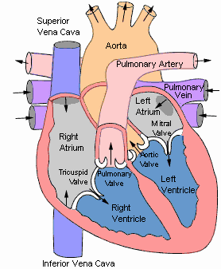
Blood Flow
1. Inferior/Superior Vena Cava
2. Right Atrium
3. Tricuspid Valve
4. Right Ventricle
5. Pulmonary Semilunar Valve
6. Pulmonary Artery
7. Lungs
8. Pulmonary Veins
9. Left Atrium
10. Bicuspid (Mitral) Valve
11. Left Ventricle
12. Aortic Semilunar Valve
13. Aorta to Systemic Circulation

Slide 14
Blood Flow
The volume of blood that flows through any tissue in a given period.
The flow of blood depends on 2 things…
Pressure differences that force blood through tissues
Resistance to blood flow in specific vessels

Slide 15
Blood vessel- a tubular structure carrying blood through the tissues and organs; a vein, artery, or capillary.
Arteries- carry oxygenated blood to parts of body
Veins- carry oxygen poor blood back to heart
Capillaries- any of the fine branching blood vessels that form a network between the arterioles and venules.
Its a tube that has an internal diameter of hair-like thinness.
Site of gas exchange

Slide 17
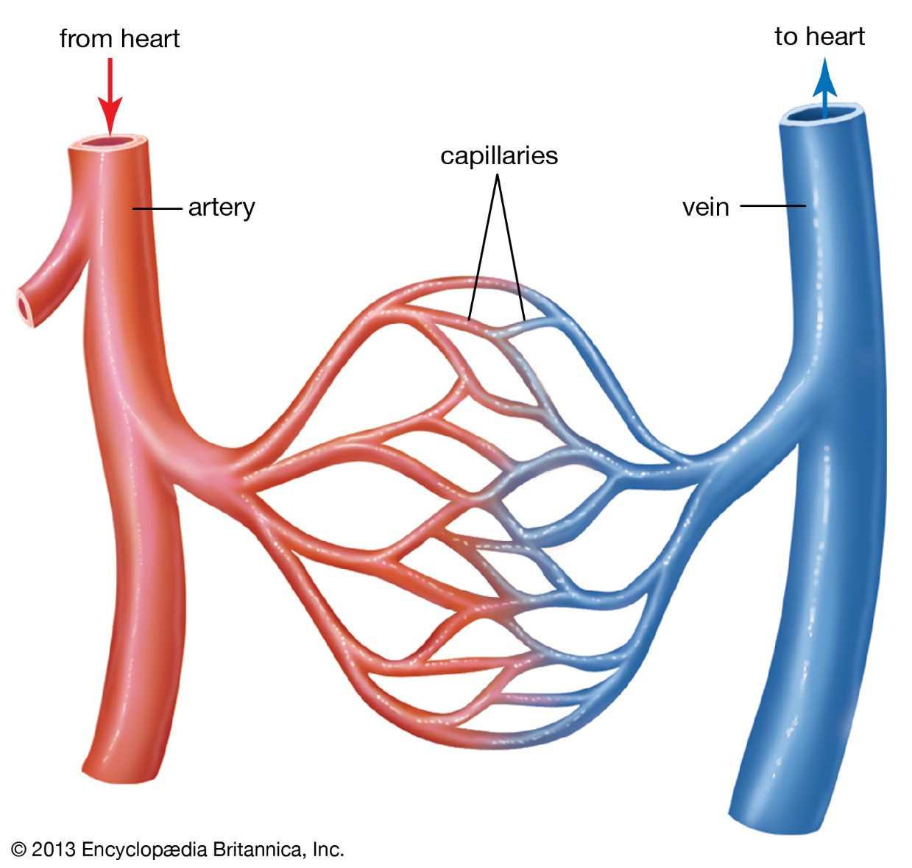

Slide 18
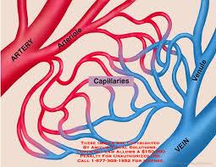
Capillaries (also known as Exchange Vessels)

Slide 19
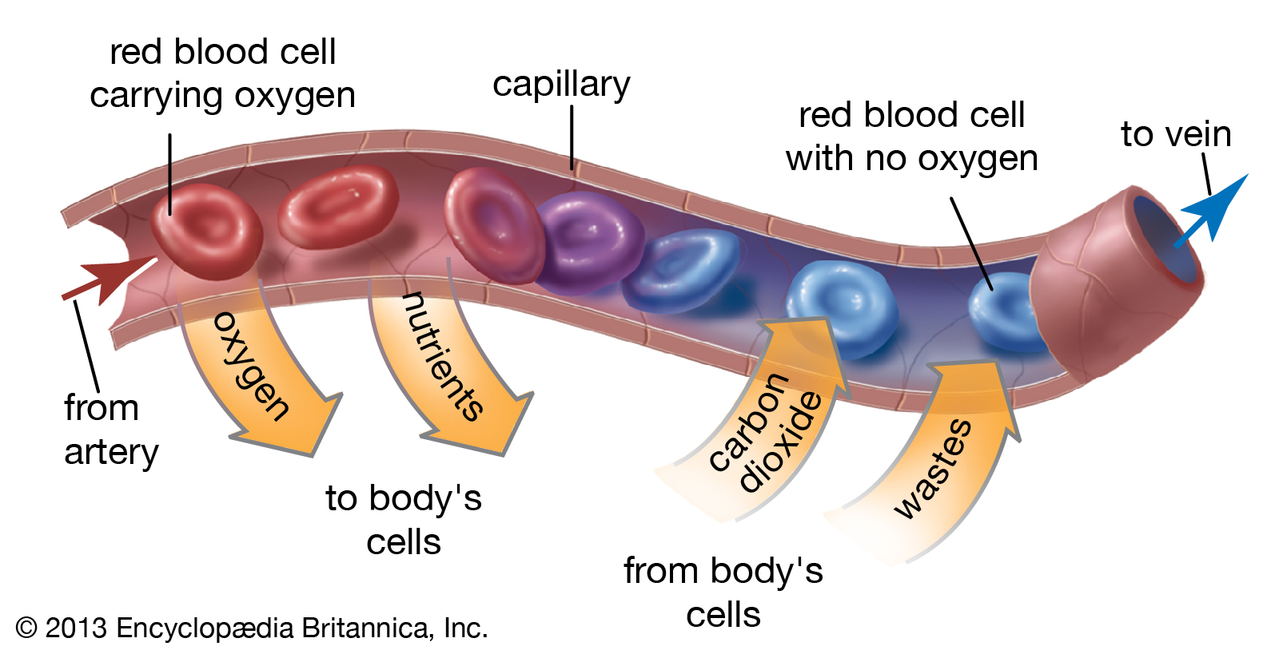

Slide 20
Systemic Circulation
Heart
Arteries
Arterioles
Capillaries
Venules
Veins

Slide 21
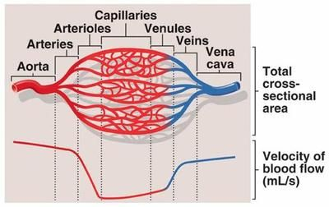
Venule- a very small vein, especially one collecting blood from the capillaries.
Arteriole- a small branch of an artery leading into capillaries.

Slide 22
Arterioles
Small arteries
Smooth muscle regulates blood flow into capillaries
Vasoconstriction decreases blood flow to capillaries, and increases blood pressure

Slide 27
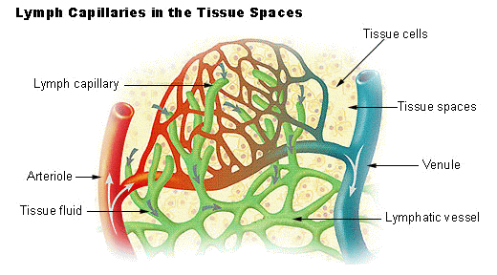

Slide 30
Capillaries-
Oxygen to cells via diffusion, and cells dump carbon dioxide
Helps regulate blood pressure
Nutrient exchange
Role in thermoregulation

Slide 31
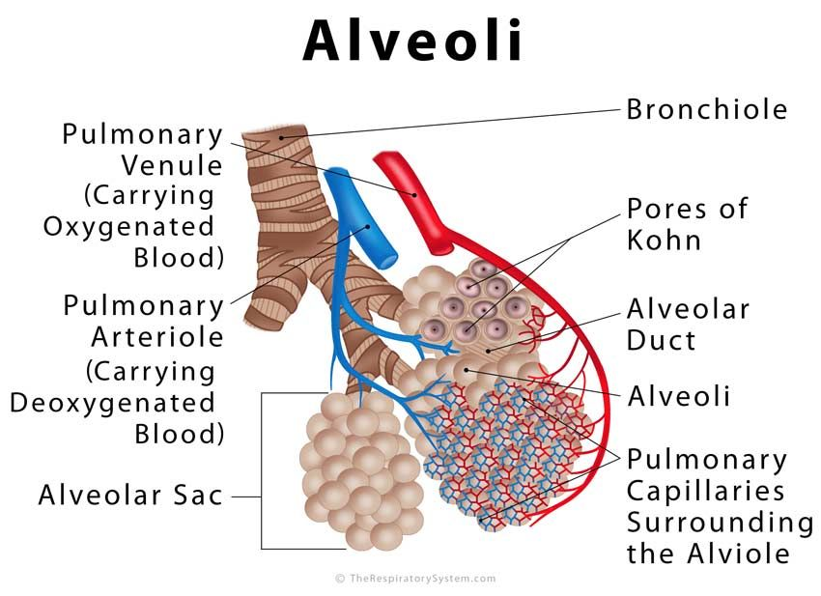

Slide 32
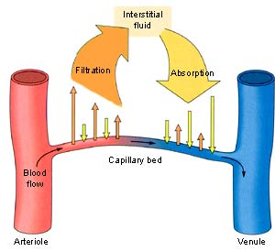

Slide 33
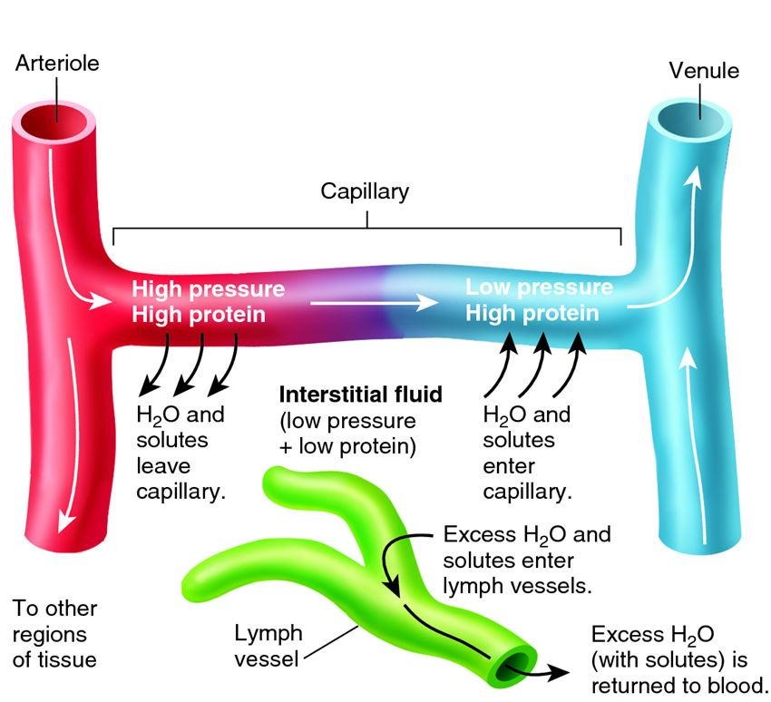

Slide 34
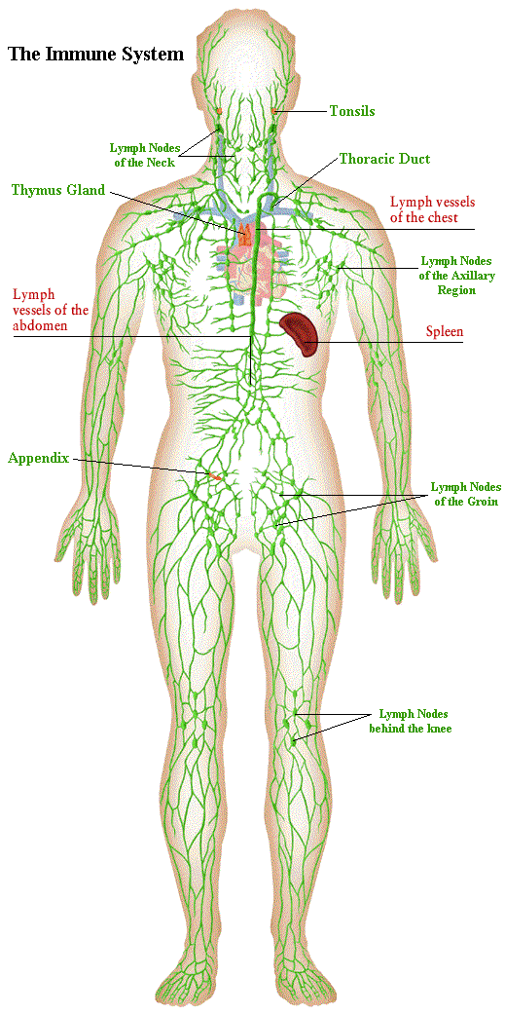

Slide 36
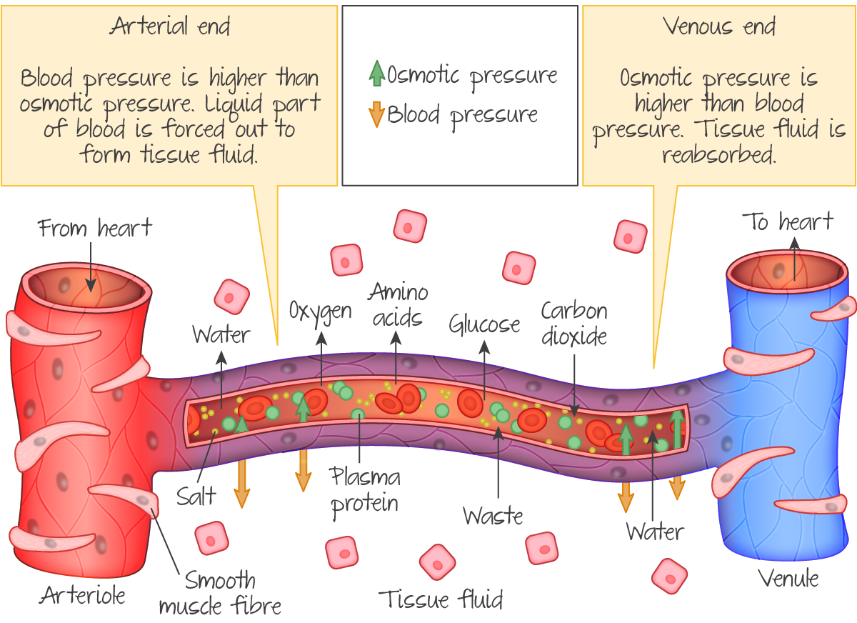

Slide 40
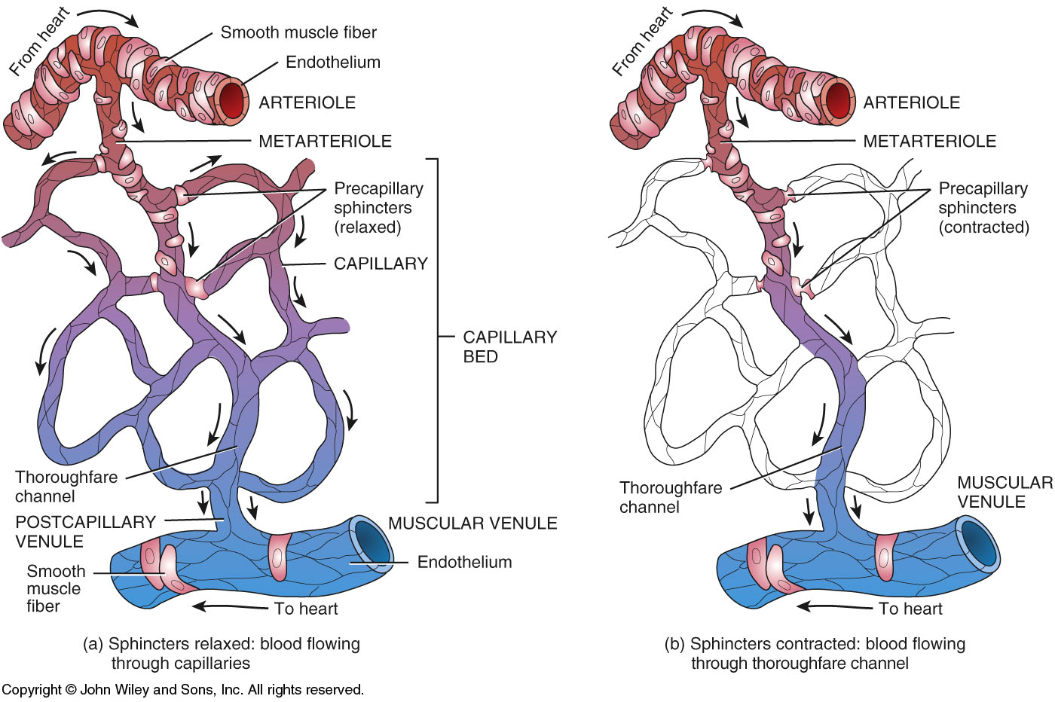
Precapillary sphincters control flow of blood through the capillary bed.

Slide 41
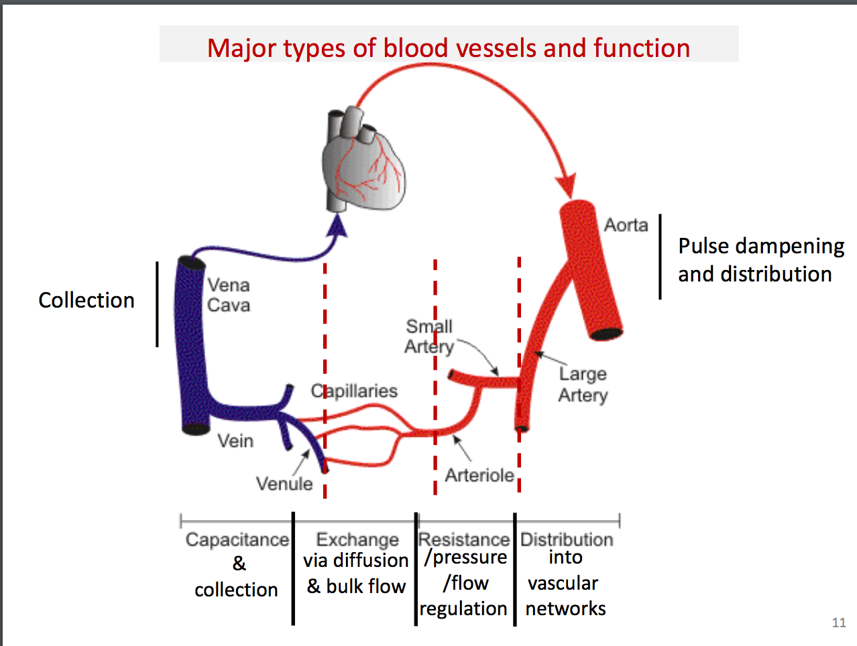

Slide 42
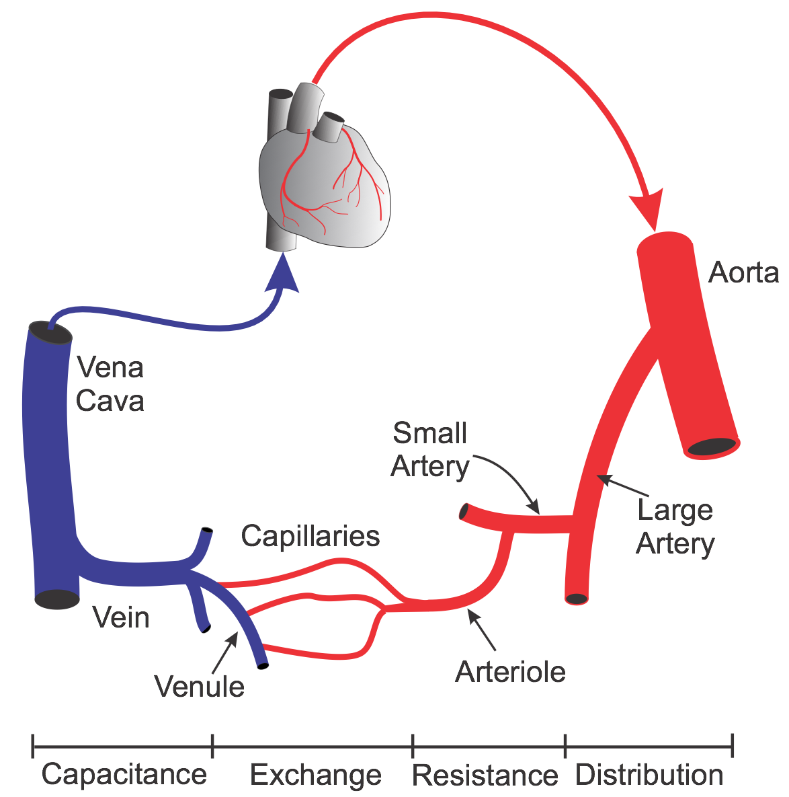

Slide 43
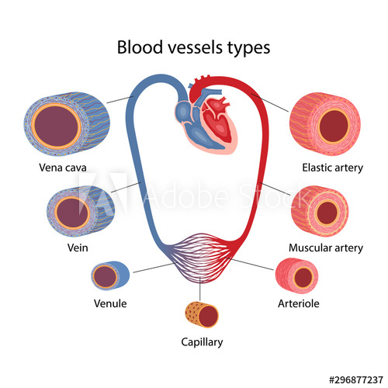

Slide 44
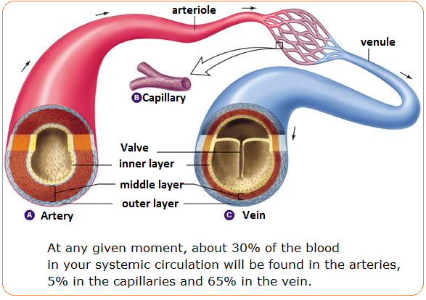

Slide 45
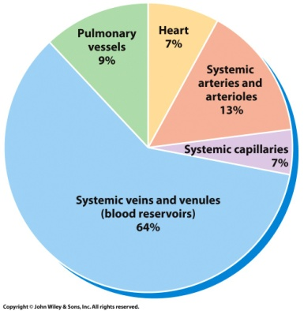
Blood Distribution

Slide 46
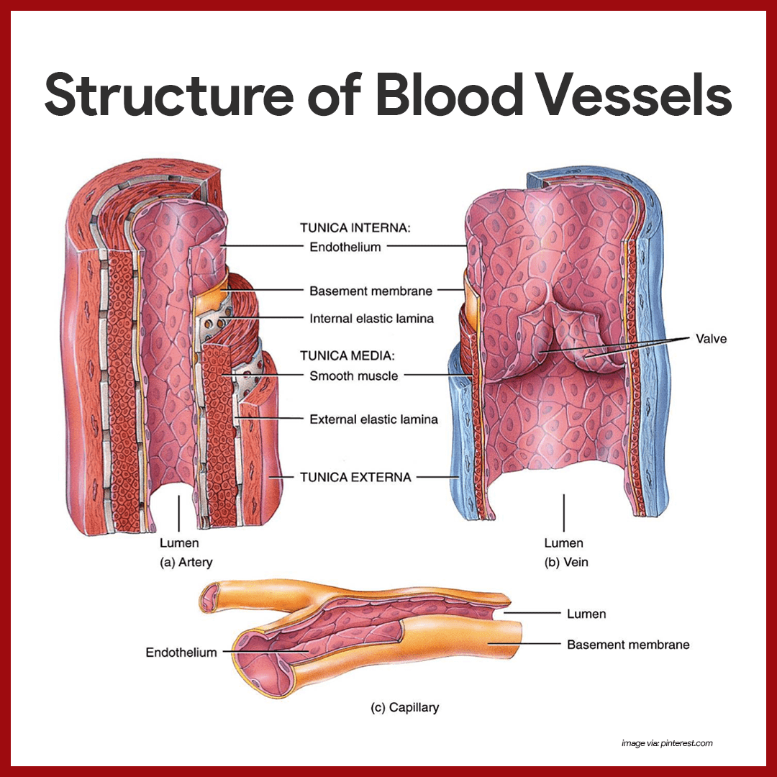

Slide 47
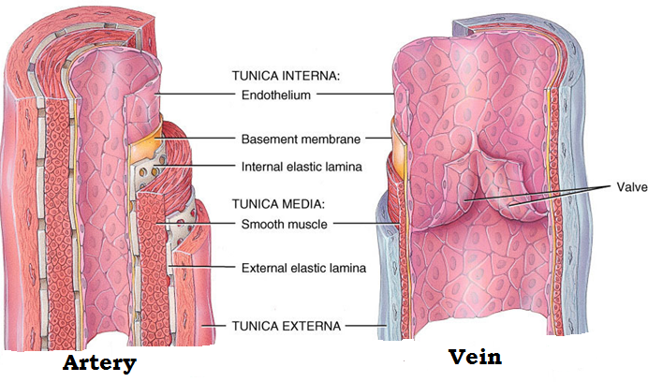
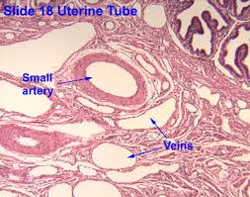
Arteries & Veins
The Tunica Externa is composed of mainly elastic and collagen fibers.
The Tunica Media is responsible for vasoconstriction.

Slide 48
Tunic Functions
Interna-helps blood move through without friction
Media-Key role in blood flow and blood pressure (contraction & expansion)
Externa- Protection and reinforcement (collagen)
Capillaries-only have tunic interna

Slide 49
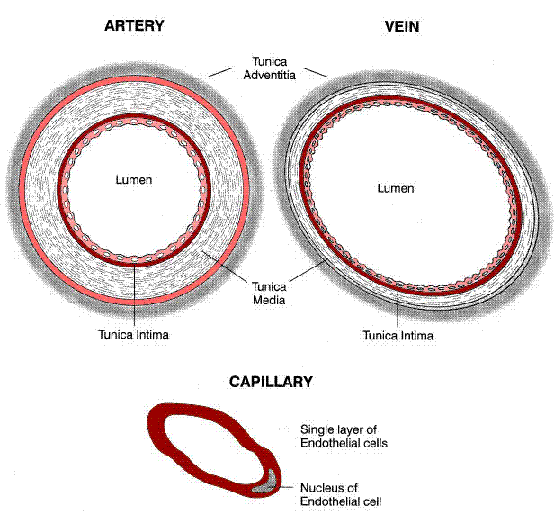
Lumen

Slide 50
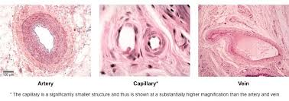

Slide 51
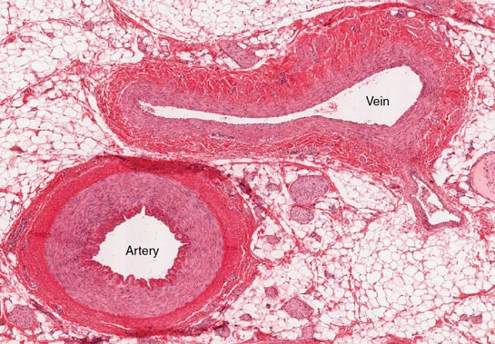

Slide 52
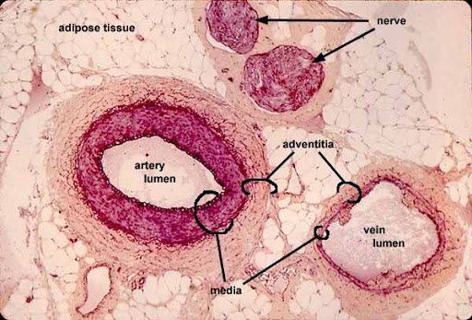

Slide 53
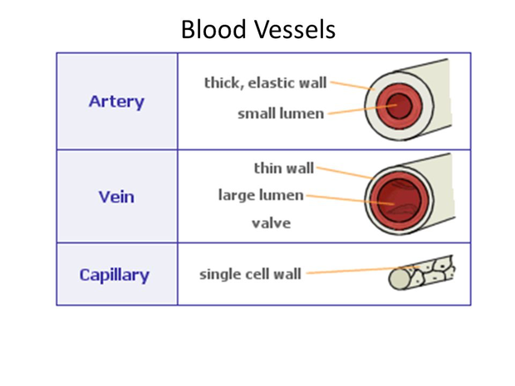

Slide 54
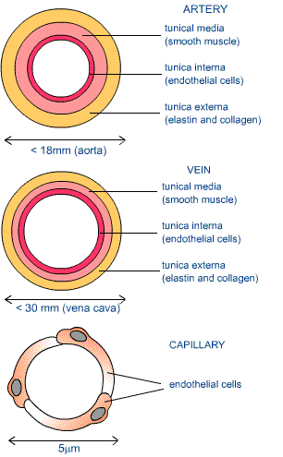

Slide 56
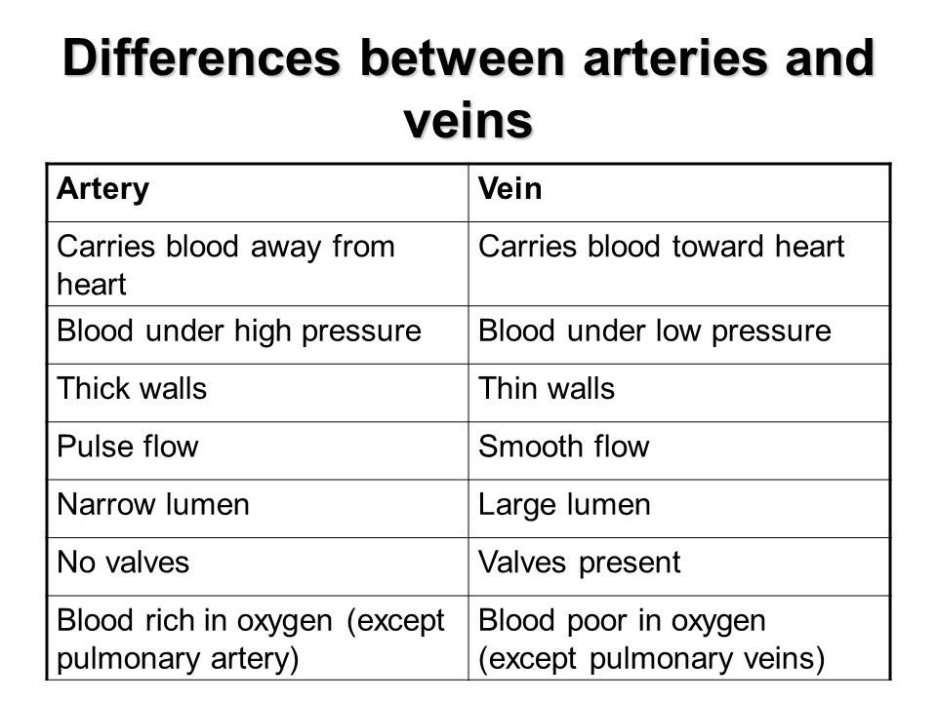

Slide 58
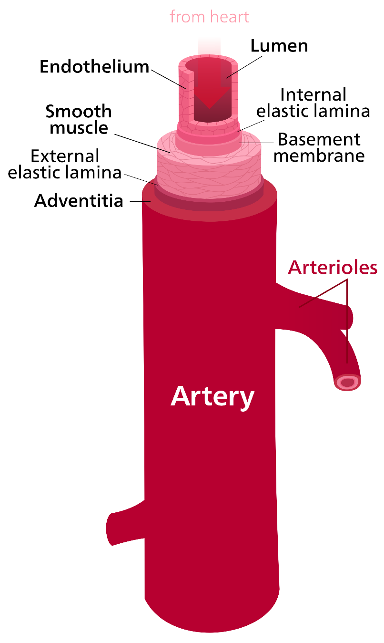

Slide 59
Arteries: Types
Elastic-expand and contract passively to accommodate blood volume.
Muscular –distribution arteries, deliver blood to organs. Less elastic, more muscle (vasoconstriction)
Arterioles- smallest, regulates blood flow to capillary bed

Slide 61
Stretch in response to each pulse
Examples;
aorta & branches
Pulmonary trunk
Common carotid arteries
Subclavian arteries

Slide 62
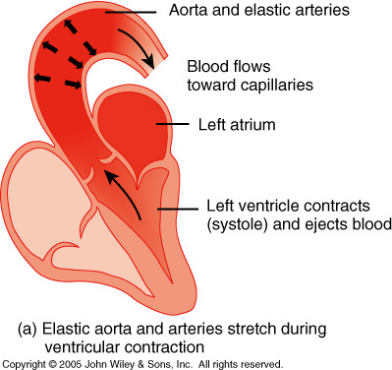
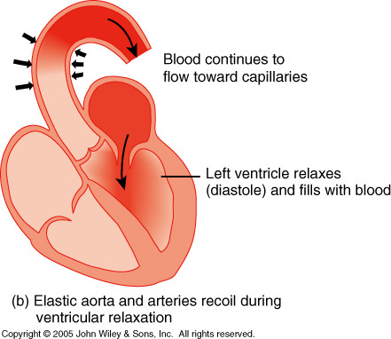
Elastic Arteries or Conducting Arteries Functions as a pressure reservoir

Slide 64
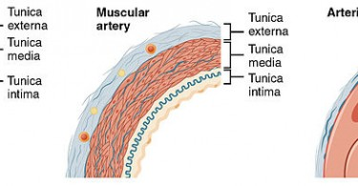

Slide 65
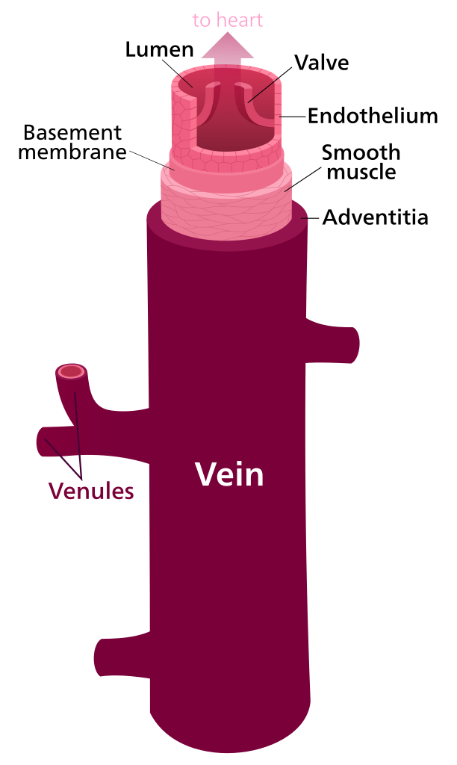

Slide 66
Capillary Exchange
3 types:
Diffusion – Most important capillary exchange method
Transcytosis-Macromolecules captured in vesicles are transported across the interior of a cell
Filtration & Reabsorption-The blood is filtered by nephrons, the functional units of the kidney, Tubular Reabsorption transported into the blood.

Slide 67
Diffusion
O2, CO2, hormones, glucose enter and leave capillaries via diffusion
Move from an area of high concentration to an area of low concentration

Slide 68
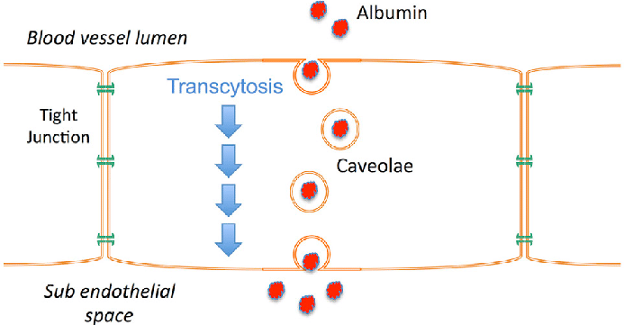

Slide 69
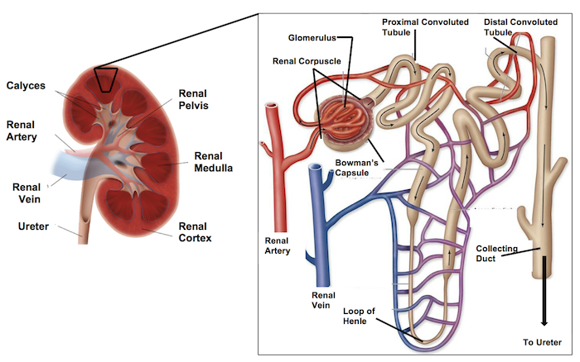

Slide 70
Blood Flow
The volume of blood that flows through any tissue in a given period.
The flow of blood depends on 2 things…
Pressure differences that force blood through tissues
Resistance to blood flow in specific vessels

Slide 71
Blood Pressure
BP depends on…
Heart Rate
Stroke Volume
Blood Volume
Vascular resistance

Slide 75
Lumen Diameter
Smaller lumen = greater resistance
Vasoconstriction increases BP

Slide 76
Blood Viscosity
Depends on the ratio of RBCs to Plasma
Dehydration, polycythemia, etc.
Greater viscosity = greater resistance = increased BP

Slide 77
Total Blood Vessel Length
Resistance is proportional to total length of a vessel
Therefore, the longer the vessel…the greater the resistance

Slide 78
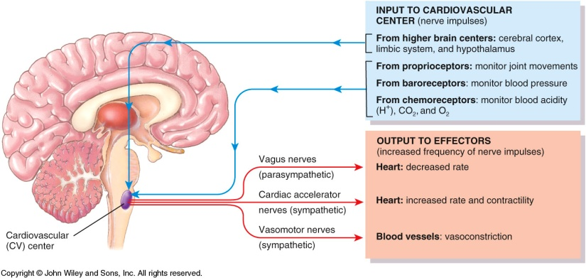
Neural Regulation
The cardio vascular center is located in the Medulla Oblongata.

Slide 79
Venous Return
The amount of blood that returns to the right atrium.
Aided by skeletal muscle pumps, respiratory pump.

Slide 80
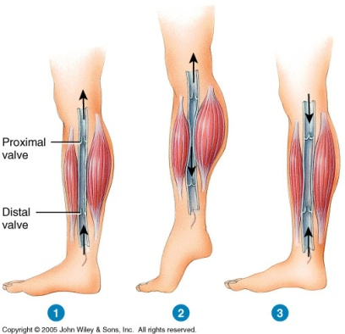
Skeletal Muscle Pumps

Slide 83
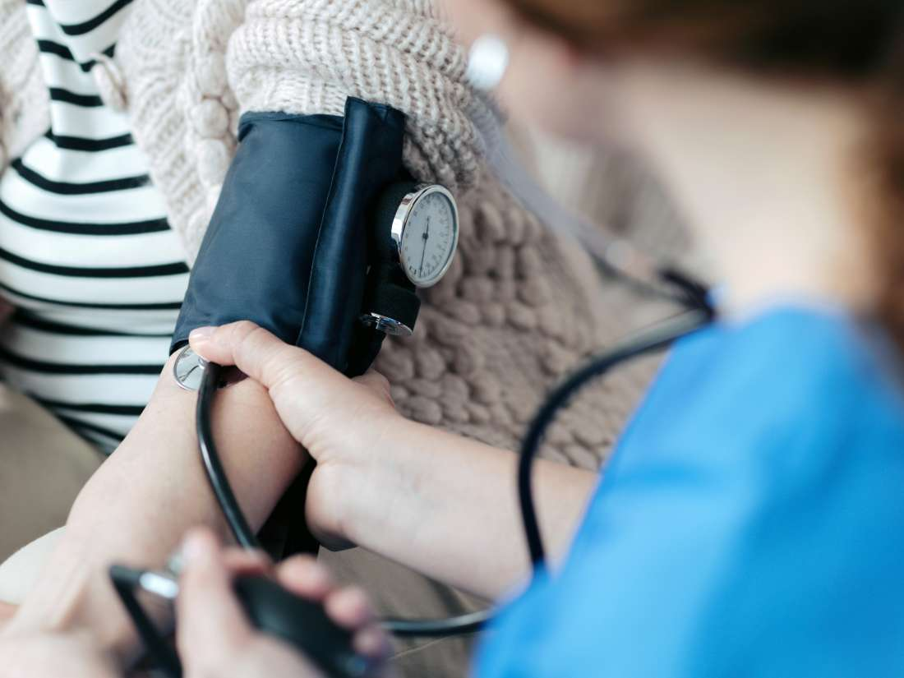

Slide 84
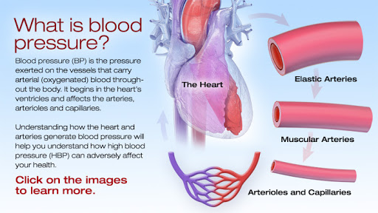

Slide 85
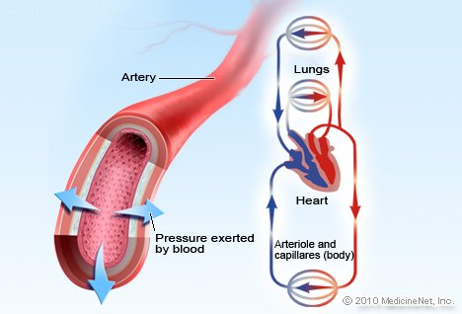

Slide 86
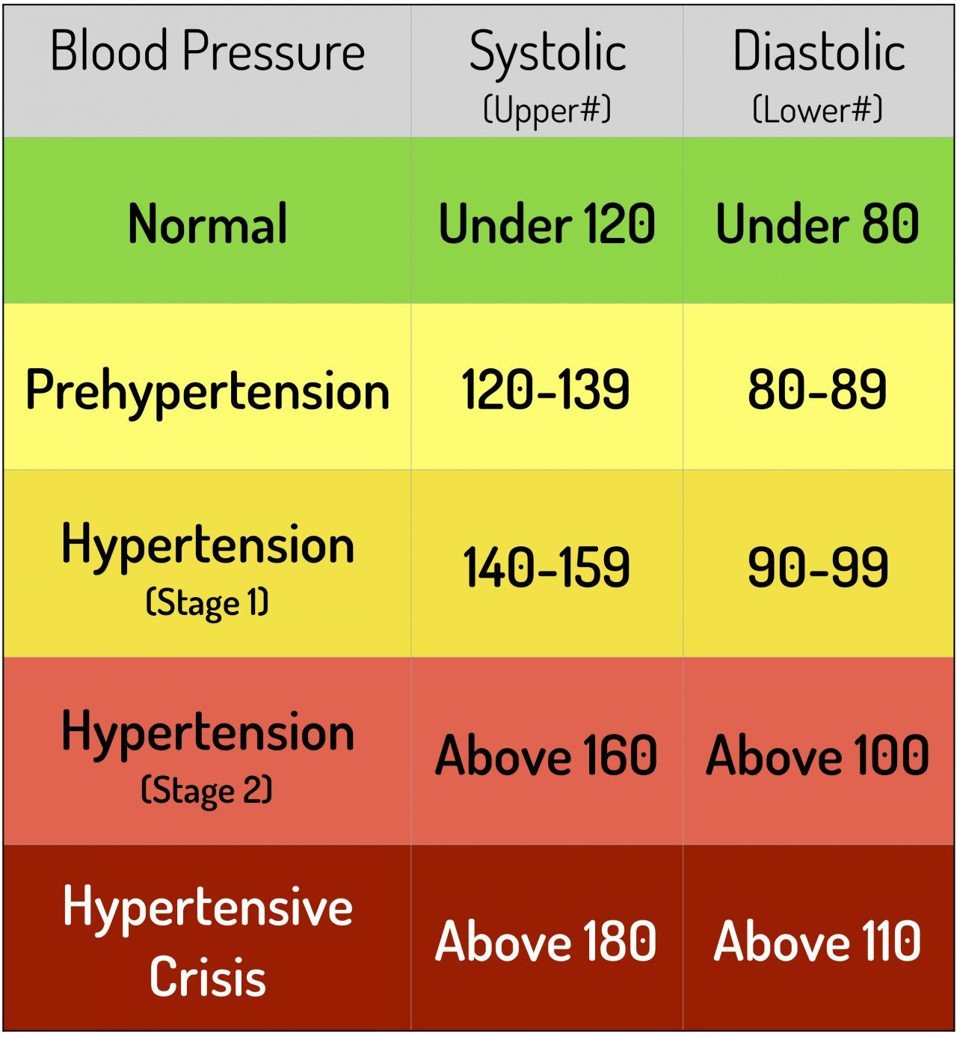

Slide 87
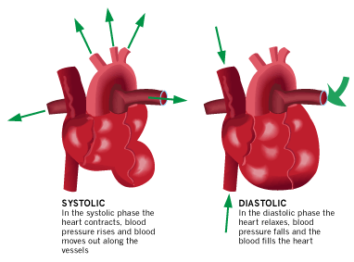

Slide 88
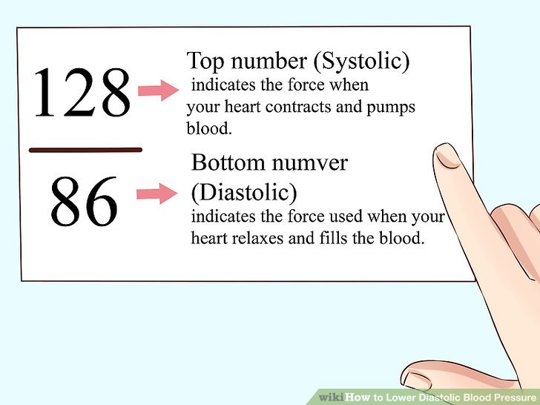

Slide 89
Checking Pulse

Slide 92
Hepatic Portal Circulation
The renal artery supplies blood to the kidneys

Slide 102
ADD VEINS

