Slide 1
Shelly Cashman: Microsoft Access 2019
Module 5: Multiple-Table Forms
© 2020 Cengage Learning. All Rights Reserved. May not be copied, scanned, or duplicated, in whole or in part, except for use as permitted in a license distributed with a certain product or service or otherwise on a password-protected website for classroom use.

Slide 2
Objectives (1 of 2)
Add Yes/No, Long Text, OLE Object, and Attachment fields
Use the Input Mask Wizard
Update fields and enter data
Change row and column size
Create a form with a subform in Design view
Modify a subform and form design

Slide 3
Objectives (2 of 2)
Enhance the form title
Change tab stops and tab order
Use the form to view data and attachments
View object dependencies
Use Date/Time, Long Text, and Yes/No fields in a query
Create a form with a datasheet

Slide 4
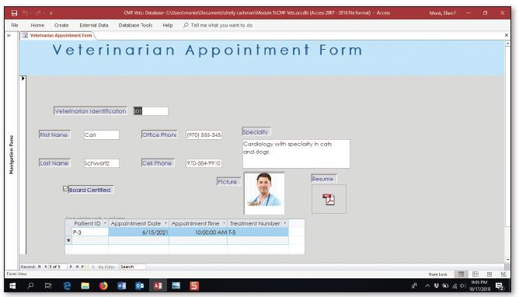
Project—Multiple Table Forms
Notes:
Figure 5-1: Display of multiple appointments for each veterinarian

Slide 5
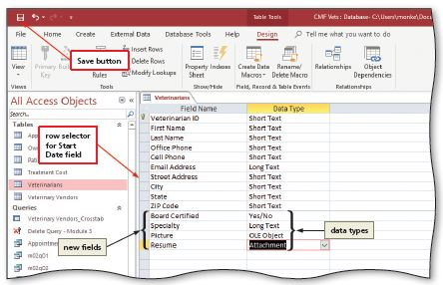
Adding Special Fields (1 of 3)
To Add Fields with New Data Types to a Table
  Open the table in Design view
  Click the first open field to select the position for the first additional field
  Type the desired field name, press the TAB key, and then select the desired data type
  Click the Save button on the Quick Access Toolbar to save the changes
Notes:
Figure 5-4: Display of Save button with row selector for Start Date field

Slide 6
Adding Special Fields (2 of 3)
To Use the Input Mask Wizard
  After adding the new field, click the Input Mask property box
  Click the Build button to use a wizard to enter the input mask
  If necessary, click the Yes button to save the table
  Select the desired input mask in the Input Mask Wizard dialog box
  Click the Next button two times
  If necessary, determine how you want to store the data, and then click the Next button
  Click the Finish button

Slide 7
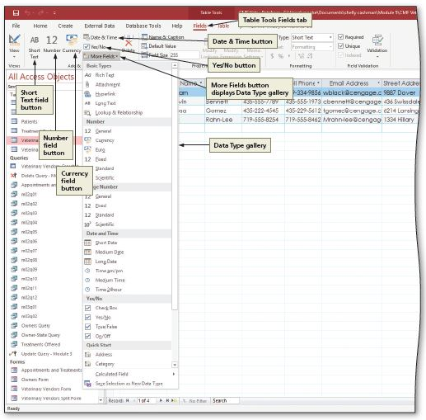
Adding Special Fields (3 of 3)
Adding Fields in Datasheet View
Notes:
Figure 5-9: display of fields in Datasheet view

Slide 8
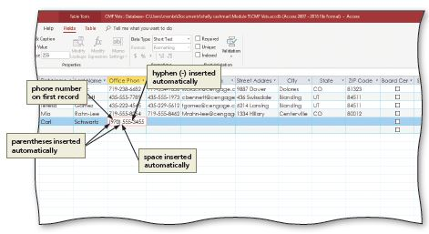
Updating the New Fields (1 of 6)
To Enter Data Using an Input Mask
  Click the beginning of the field in Datasheet view
  Type the field value
Notes:
Figure 5-11: Display of phone number entered

Slide 9
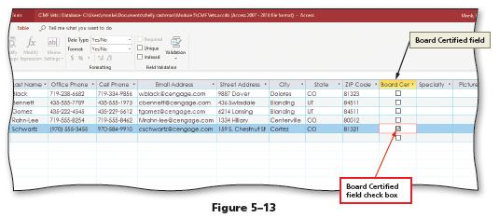
Updating the New Fields (2 of 6)
To Enter Data in Yes/No Fields
  Click the check box in the Yes/No field to place a check mark in the box
Notes:
Figure 5-13: Display of Board Certified field check box

Slide 10
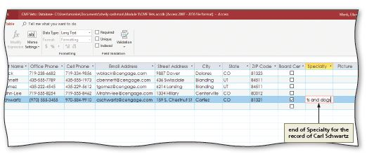
Updating the New Fields (3 of 6)
To Enter Data in Long Text Fields
  Click the desired field and then type the entry
Notes:
Figure 5-14: Display of end of special Specialty for the record of Carl Schwartz

Slide 11
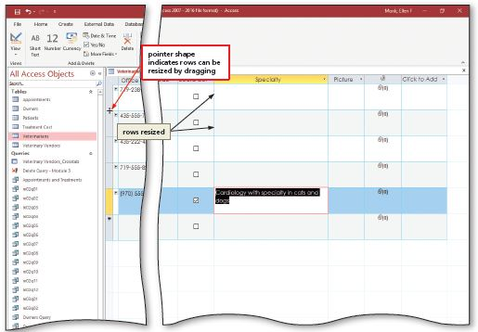
Updating the New Fields (4 of 6)
To Change the Row and Column Size
  Drag the right edge of the field to resize to the right to increase the column size
  Drag the lower edge of the record selector to resize to the desired location
Notes:
Figure 5-16: Display of pointer shape indicating rows can be resized by dragging

Slide 12
Updating the New Fields (5 of 6)
To Enter Data in O L E Object Fields
  Right-click the O L E object field to produce a shortcut menu
  Click Insert Object on the shortcut menu to display the Microsoft Access dialog box
  Click the desired object type
  Click the OK button
  Create the desired object
  Click the “Exit and return to document” command to return to Access and insert the object

Slide 13
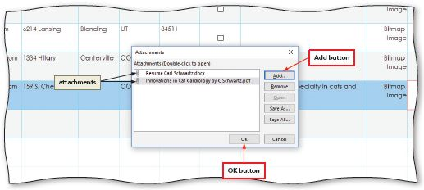
Updating the New Fields (6 of 6)
To Enter Data in Attachment Fields
  Right-click the attachment field
  Click Manage Attachments on the shortcut menu
  Click the Add button to add an attachment
  Navigate to the location containing the file(s) to attach
  Click the file to attach, and then click the Open button
  Click the OK button to close the Attachments dialog box
Notes:
Figure 5-23: Display of attachments with the Add button and OK button

Slide 14
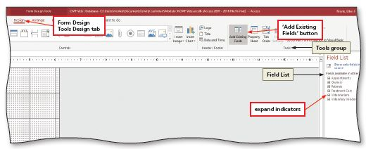
Multiple-Table Form Techniques (1 of 16)
To Create a Form in Design View
  Click CREATE on the ribbon to display the CREATE tab
  Click the Form Design button to create a new form in Design View
  If a field list does not appear, click the “Add Existing Fields” button to display a field list
Notes:
Figure 5-26: Display of Form Design Tools Design tab with “Add Existing Fields” button, Tools group, Field list, and expand indicators

Slide 15
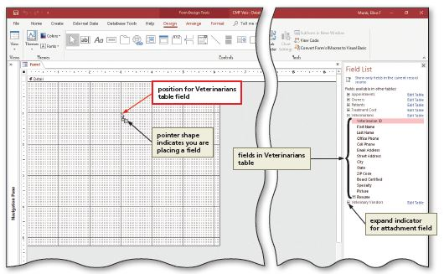
Multiple-Table Form Techniques (2 of 16)
To Add a Control for a Field to the Form
  Drag the field in the field list to the desired location on the form
Notes:
Figure 5-27: Display of position for Veterinarians table field with pointer shape indicating you are placing a field

Slide 16
Multiple-Table Form Techniques (3 of 16)
To Align Controls on the Left
  Click the first control to align
  Hold the SHIFT key down and click the remaining controls to align
  Click the Align button to display the Align menu
  Click the desired alignment option

Slide 17
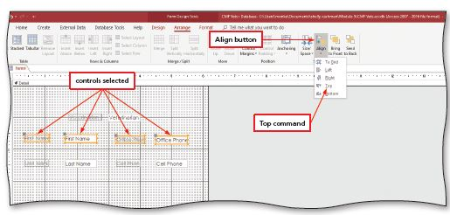
Multiple-Table Form Techniques (4 of 16)
To Align Controls on the Top and Adjust Vertical Spacing
  Select the controls on which to modify the vertical spacing
  Click the Size/Space button to display the Size/Space menu
  Click the desired spacing option to specify the spacing
Notes:
Figure 5-32: Display of Align button with controls selected and Top command

Slide 18
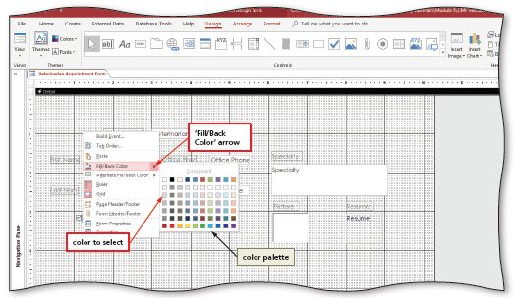
Multiple-Table Form Techniques (5 of 16)
To Use a Shortcut Menu to Change the Fill/Back Color
  Right-click the form to produce a shortcut menu
  Point to the “Fill/Back Color” arrow on the shortcut menu to display a color palette
  Click the desired color
Notes:
Figure 5-39: Display of “Fill/Back Color” arrow and the color to select

Slide 19
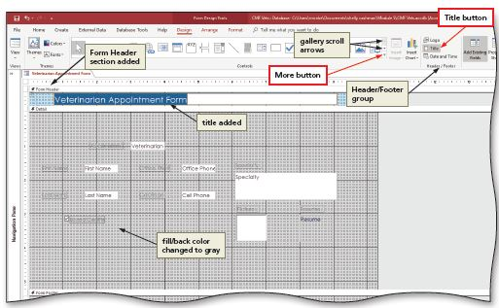
Multiple-Table Form Techniques (6 of 16)
To Add a Title
  Click the Title button to add a title to the form
Notes:
Figure 5-40: Display of More button and Title button with the gallery scroll arrows and Header/Footer group. Finally showing Form Header section added and fill/back color changed to gray

Slide 20
Multiple-Table Form Techniques (7 of 16)
To Place a Subform
  Click the More button to display a gallery of available tools
  Be sure the “Use Control Wizards” button is selected, click the Subform/ Subreport tool on the FORM DESIGN TOOLS DESIGN tab, and move the pointer to and click the position where you want to position the subform
  Ensure the “Use existing Tables and Queries” option button is selected
  Click the Next button

Slide 21
Multiple-Table Form Techniques (8 of 16)
To Place a Subform (cont.)
  Click the Tables/Queries arrow, and then click the table that contains the fields for the subform
  Add the desired fields to the subform
  Click the Next button to move to the next SubForm Wizard dialog box
  Be sure the “Choose from a list” option button is selected
  Click the Next button
  Type the desired name of the subform
  Click the Finish button to place the subform

Slide 22
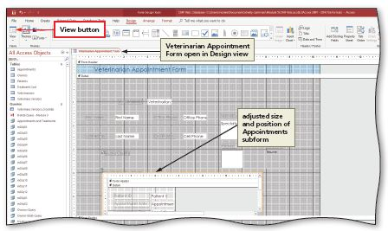
Multiple-Table Form Techniques (9 of 16)
To Modify a Subform and Move the Picture
  Open the form with the subform in Design view
  Click the boundary of the subform to select it
  Make the necessary modifications
Notes:
Figure 5-50: Display of View button with Veterinarian Appointment Form open in Design view with adjusted size and position of Appointments subform

Slide 23
Multiple-Table Form Techniques
(10 of 16)
To Change a Label
  In Design view, click the label two times to produce an insertion point
  Type the new label text
  Click outside the label to deselect it

Slide 24
Multiple-Table Form Techniques
(11 of 16)
To Change Label Effects and Colors
  Click the label(s) to change
  Click the Font Color arrow to display a color palette
  Click the desired color to change the font color for the label(s)
  Click the Property Sheet button to produce the property sheet for the selected labels. If your property sheet still appears on the left side of the screen, drag it back to the right. Make sure the All tab is selected
  Click the Border Style property box to display the Border Style property arrow, and then click the arrow to display a menu of border styles

Slide 25
Multiple-Table Form Techniques
(12 of 16)
To Change Label Effects and Colors (cont.)
  Click the desired border style
  Click the Border Width property box to display the Border Width property arrow, and then click the arrow to display a menu of border widths
  Click the desired border width
  Click the Special Effect property box to display the Special Effect property arrow, and then click the arrow to display a menu of special effects
  Click the desired special effect

Slide 26
Multiple-Table Form Techniques
(13 of 16)
To Modify the Appearance of a Form Title
  Display the form in Design view
  Resize the Form Header section by dragging down the lower boundary of the section to the desired location
  Click the control containing the form title to select the control
  Drag the lower-right sizing handle to resize the control to the desired size
  Click the Property Sheet button to display the control’s property sheet
  Click the Font Size property box, click the Font Size property arrow, and then click the desired font size
  In a similar fashion, change the Text Align property and the Font Weight property
  Close the property sheet by tapping or clicking the Property Sheet button

Slide 27
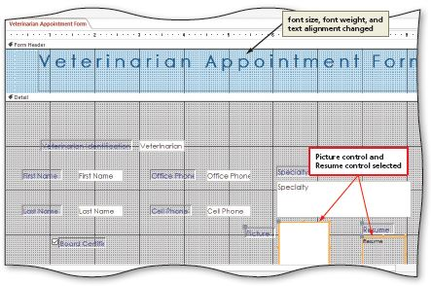
Multiple-Table Form Techniques
(14 of 16)
To Change a Tab Stop
  Select the controls for which you want to omit from the tab stop sequence
  Click the Property Sheet button to display the property sheet
  Make sure the All tab (Property Sheet) is selected, click the down scroll arrow until the Tab Stop property appears, click the Tab Stop property, click the Tab Stop property arrow, and then click No
  Close the property sheet
Notes:
Figure 5-64: Display of Picture control and Resume control selected with font size, font weight, and text alignment changed

Slide 28
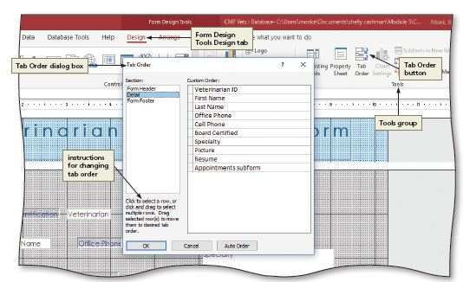
Multiple-Table Form Techniques
(15 of 16)
Changing the Tab Order
Notes:
Figure 5-65: Display of instructions for changing tab order

Slide 29
Multiple-Table Form Techniques
(16 of 16)
To Use the Form
  Right click the desired field to display a shortcut menu
  Click the Manage Attachments command
  Click OK
  Click the form’s Previous record button four times to display the desired data
  Click the subform’s Next record button once to highlight the next area.
  Close the form

Slide 30
Object Dependencies (1 of 2)
To View Object Dependencies
  Open the Navigation Pane and click the desired table
  Click the Object Dependencies button to display the Object Dependencies pane
  If necessary, click the “Objects that depend on me” option button to select it
  Close the Object Dependencies pane by clicking the Object Dependencies button a second time

Slide 31
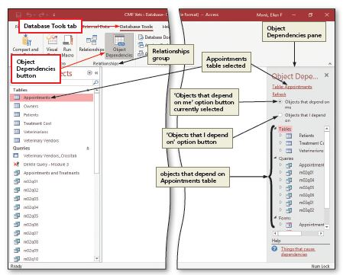
Object Dependencies (2 of 2)
Notes:
Figure 5-70: Display of Object Dependencies button

Slide 32
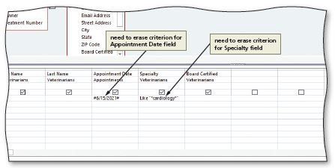
Date/Time, Long Text, and Yes/No Fields in a Query
To Use Date/Time, Long Text, and Yes/No Fields in a Query
Notes:
Figure 5-74: Display of need to erase criterion for Appointment Date field and need to erase criterion for Specialty field

Slide 33
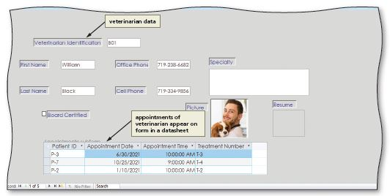
Datasheets in Forms (1 of 2)
Creating a Form with a Datasheet in Layout View
Notes:
Figure 5-77: Display of veterinarian data and appointments of veterinarian appear on form in a datasheet

Slide 34
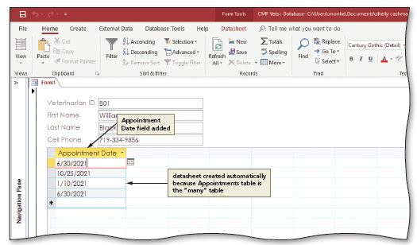
Datasheets in Forms (2 of 2)
Creating a Simple Form with a Datasheet
Notes:
Figure 5-79: Display of Appointment Data field added and datasheet created automatically because Appointments table is the “many” table

Slide 35
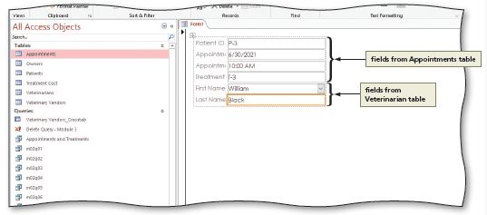
Creating a Multiple-Table Form Based on the Many Table
To Create a Multiple-Table Form Based on the Many Table
Notes:
Figure 5-81: Display of fields from Appointments table and fields from Veterinarian table

