Slide 1
Shelly Cashman: Microsoft Access 2019
Module 7: Advanced Form Techniques
© 2020 Cengage Learning. All Rights Reserved. May not be copied, scanned, or duplicated, in whole or in part, except for use as permitted in a license distributed with a certain product or service or otherwise on a password-protected website for classroom use.

Slide 2
Objectives (1 of 2)
Add combo boxes that include selection lists
Add combo boxes for searching
Format and resize controls
Apply formatting characteristics with the Format Painter
Add command buttons
Modify buttons and combo boxes

Slide 3
Objectives (2 of 2)
Add a calculated field
Use tab controls to create a multipage form
Add and modify a subform
Insert charts
Modify a chart type
Format a chart

Slide 4
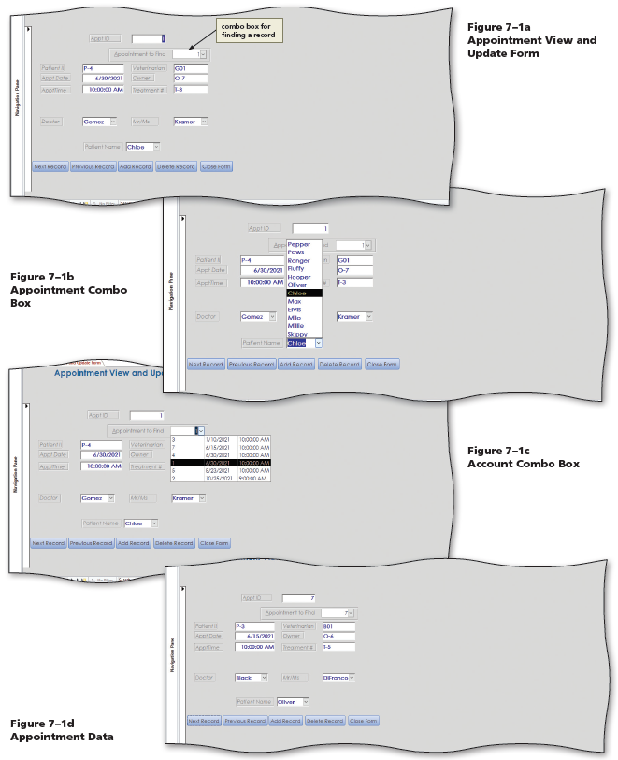
Project: Advanced Form Techniques (1 of 2)
Notes:
Figure 7-1: display of Appointment Table subforms
Appointment View and Update Form
Appointment Combo Box
Account Combo Box
Appointment Data

Slide 5
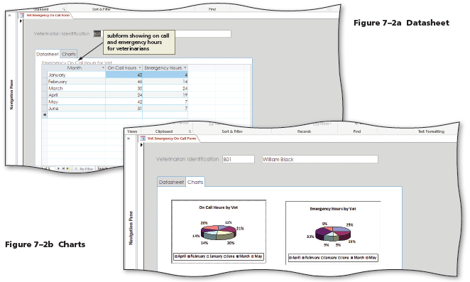
Project: Advanced Form Techniques (2 of 2)
Notes:
Figure 7-2: display of subform
Datasheet subform showing on call and emergency hours for veterinarians
Charts

Slide 6
Creating a Form with Combo Boxes and Command Buttons (1 of 19)
To Create a Form in Design View
  Click the Form Design button to create a new form in Design view
  Click the Property Sheet button to display a property sheet
  With the All tab selected, click the Record Source arrow, and then click the desired table to select it as the record source
  Click the Save button on the Quick Access Toolbar, and then type the desired form name
  Click the OK button to save the form
  Click the Caption property in the property sheet, and then type the desired form caption
  Close the property sheet by clicking the Property Sheet button on the FORM DESIGN TOOLS DESIGN tab
  Click the “Add Existing Fields” button to display the field list

Slide 7
Creating a Form with Combo Boxes and Command Buttons (2 of 19)
To Add Fields to the Form Design
  Drag the desired field from the field list to the desired position
  Click the label once to select it and then click it a second time to produce an insertion point
  Use BACKSPACE or DELETE as necessary to erase the current entry and then type the new label
  Adjust the sizing and alignment as desired
  Close the field list

Slide 8
Creating a Form with Combo Boxes and Command Buttons (3 of 19)
To Add a Combo Box That Selects Values
  Click the FORM DESIGN TOOLS DESIGN tab and then click the More button to display all the available tools in the Controls group
  With the “Use Control Wizards” button in the Controls group on the FORM DESIGN TOOLS DESIGN tab selected, click the Combo Box tool, and then move the pointer, whose shape has changed to a small plus symbol accompanied by a combo box, to the desired position, and then click the position
  If necessary, in the Combo Box Wizard dialog box, click the “I want the combo box to get the values from another table or query.” option button
  Click Next, and then, with the Tables option button selected, click the desired table from which to select the values
  Click Next to display the next Combo Box Wizard screen
  Click the field in the Available Fields list to add, and then click the Add button

Slide 9
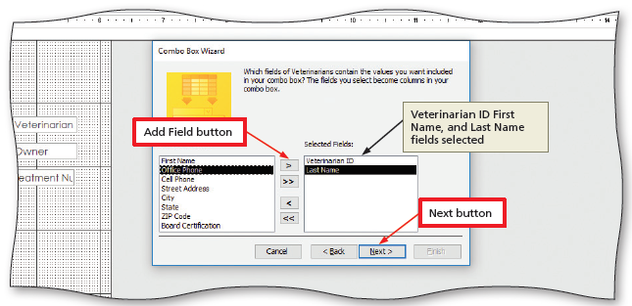
Creating a Form with Combo Boxes and Command Buttons (4 of 19)
Notes:
Figure 7-10: display of Add Field button, Veterinarian ID, First Name, and Last Name fields selected, and Next button

Slide 10
Creating a Form with Combo Boxes and Command Buttons (5 of 19)
To Add a Combo Box That Selects Values (cont.)
  Repeat the previous step to add additional fields
  Click Next to display the next Combo Box Wizard screen
  Click the arrow in the first text box, and then select the field on which to sort
  Click Next to display the next Combo Box Wizard screen
  If desired, click the “Hide key column (recommended)” check box to remove the check mark
  Click Next to display the next Combo Box Wizard screen

Slide 11
Creating a Form with Combo Boxes and Command Buttons (6 of 19)
To Add a Combo Box That Selects Values (cont.)
  Click Next to display the next Combo Box Wizard screen
  Click the “Store that value in this field:” button
  Click the “Store that value in this field:” box arrow, and then click the field in which you wish to store the combo box selected value
  Click Next to display the next Combo Box Wizard screen
  Enter the text for the label, and then click the Finish button to place the combo box
  Move the label to the desired position

Slide 12
Creating a Form with Combo Boxes and Command Buttons (7 of 19)
To Use the Background Color Button
  Click anywhere in the Detail section but outside all the controls to select the section
  Display the FORMAT DESIGN TOOLS FORMAT tab
  Click the Background Color arrow to display a color palette
  Click the desired color

Slide 13
Creating a Form with Combo Boxes and Command Buttons (8 of 19)
To Format a Control
  Display the FORMAT DESIGN TOOLS FORMAT tab
  Click to select the control to format
  Click the Property Sheet button to display the property sheet
  Change the desired properties as necessary
    Font Weight
    Special Effect
    Fore Color

Slide 14
Creating a Form with Combo Boxes and Command Buttons (9 of 19)
To Use the Format Painter
  Display the FORMAT DESIGN TOOLS FORMAT tab
  Click the control to select it, and then double-click the Format Painter button to select the Format Painter
  Point to another control and then click on it to assign it the same formatting as the original control
  Repeat the previous step for all controls to which you want to assign the same formatting
  Click the Format Painter button to deselect the Format Painter

Slide 15
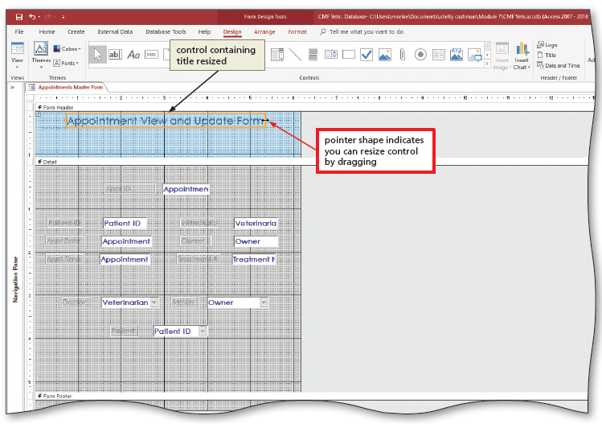
Creating a Form with Combo Boxes and Command Buttons (10 of 19)
To Add a Title and Expand the Form Header Section
  Click the Title button to add a Form Header section and to add a control for the title to the Form Header section
  Drag the lower boundary of the Form Header section down to the desired position
Notes:
Figure 7-21: display of control containing title resized and pointer shape indicating you can resize control by dragging

Slide 16
Creating a Form with Combo Boxes and Command Buttons (11 of 19)
To Add Command Buttons to a Form
  Display the FORMAT DESIGN TOOLS FORMAT tab, and ensure the “Use Control Wizards” button is selected
  Click the Button tool and then move the pointer to the desired position
  Click the desired category in the Categories box
  Click the desired action in the Actions box
  Click Next to display the next Command Button Wizard screen
  Click the Text option button
  If desired, change the text for the button, and then click the Next button
  Type the desired button name
  Click Finish to finish specifying the button

Slide 17
Creating a Form with Combo Boxes and Command Buttons (12 of 19)
To Add a Combo Box for Finding a Record
  Switch to Design view, if necessary
  Select the Property Sheet Data tab and confirm that the selection type is form
  Click the build button to open the desired Query Builder
  Create the query
  Use the Save As button to save the query
  Close the query builder
  Click the More button to display all the controls
  With the “Use Control Wizards” button selected, click the Combo Box tool and then move the pointer, whose shape has changed to a small plus sign with a combo box, to the desired position

Slide 18
Creating a Form with Combo Boxes and Command Buttons (13 of 19)
To Add a Combo Box for Finding a Record (cont.)
  Click the position to display the Combo Box Wizard
  Click the “Find a record on my form based on the value I selected in my combo box.” option button to specify that the user will select from a list of values
  Click Next, click the name of the field from which to load the values, and then click the Add Field button to select the field for the combo box
  Click Next
  Resize the combo box as desired
  Click Next, and then type the desired label
  Click Finish

Slide 19
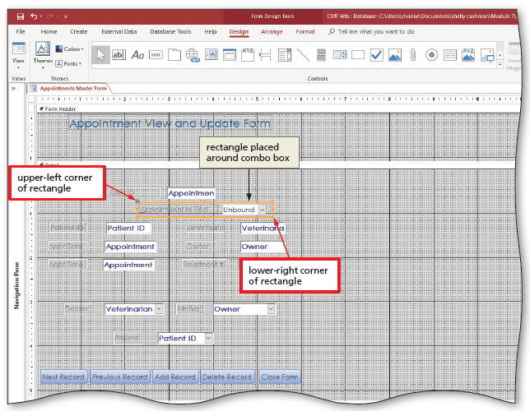
Creating a Form with Combo Boxes and Command Buttons (14 of 19)
To Place a Rectangle
  Click the More button to display all the controls
  Click the Rectangle tool. Move the pointer to the upper-left corner of the desired rectangle position, and drag to the lower-right corner of the rectangle to place the rectangle
  Change the properties as desired
Notes:
Figure 7-35: display of rectangle placed around combo box

Slide 20
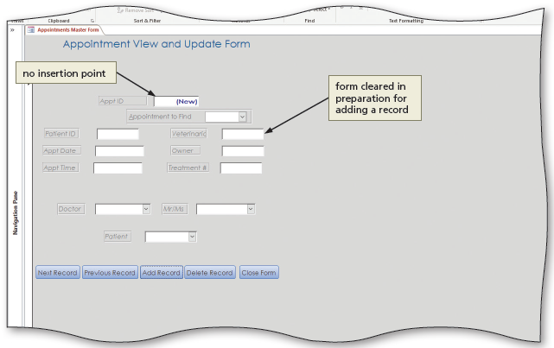
Creating a Form with Combo Boxes and Command Buttons (15 of 19)
To Test the Add Record Button
  Click the Add Record button
Notes:
Figure 7-37: display of no insertion point and form cleared in preparation for adding a record

Slide 21
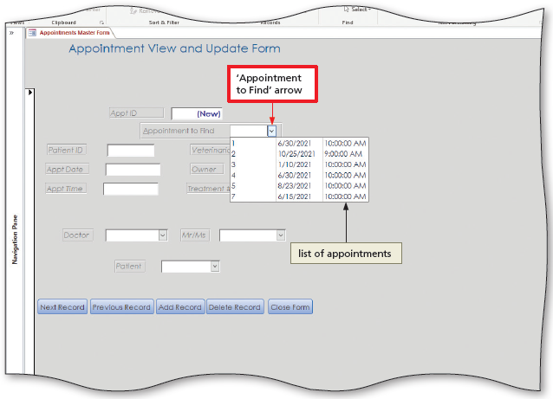
Creating a Form with Combo Boxes and Command Buttons (16 of 19)
To Use the Combo Box
  Click the arrow to display a list of options
  Click the desired option
Notes:
Figure 7-38: display of list of appointments and “Appointment to Find” arrow

Slide 22
Creating a Form with Combo Boxes and Command Buttons (17 of 19)
To Modify the Macro for the Add Record Button
  Right-Click the Add Record button to display a shortcut menu
  Click Build Event on the shortcut menu to display the macro associated with the On Click event that Access created automatically
  If the Action Catalog does not appear, click the Action Catalog button to display the Action Catalog
  In the Action Catalog, if the expand indicator is an open triangle in front of Action, click the triangle to expand all actions
  If the expand indicator in front of Database Objects is an open triangle, click the expand indicator to display all actions associated with Database Objects
  Modify the macro as desired
  Click the Save button to save your changes
  Click the Close button to close the macro and return to the form design

Slide 23
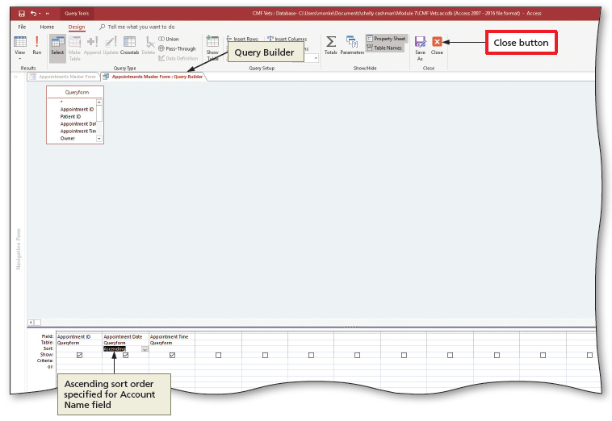
Creating a Form with Combo Boxes and Command Buttons (18 of 19)
To Modify the Combo Box
  Click the combo box to modify, and then click the Property Sheet button
  Change the desired properties and click Save to save your changes
  Close the Query Builder window by clicking the Close button on the DESIGN tab
Notes:
Figure 7-45: display of Query builder, ascending sort order specified for Account Name Field and Close button

Slide 24
Creating a Form with Combo Boxes and Command Buttons (19 of 19)
To Correct Issues with the Combo Box
  Click the form selector (the box in the upper-left corner of the form) to select the form
  If necessary, click the Property Sheet, scroll down until the On Current property appears, and then click the On Current property
  Click the Build button (the three dots) to display the Choose Builder dialog box
  Click Code Builder, and then click the OK button to display the V B A code generated for the form
  Type the desired code
  Click Close for the Microsoft Visual Basic for Applications window
  If desired, change the Tab Stop property in the Property Sheet

Slide 25
Creating a Multipage Form (1 of 11)
To Create a Form in Design View
  Display the CREATE tab, and then click the Form Design button to create a form in Design view
  Ensure the selector for the entire form is selected
  Click the Property Sheet button to display a property sheet
  With the All tab selected, click the Record Source property to display an arrow, click the arrow that appears and then click the desired table as the record source for the new form
  Close the property sheet
  Click the “Add Exiting Fields” button to display a field list and then drag the desired field to the desired location
  Change the label as necessary

Slide 26
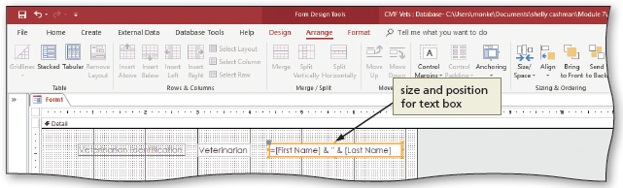
Creating a Multipage Form (2 of 11)
To Use the Text Box Tool with Concatenation
  Click the Text Box tool and then move the pointer, whose shape has changed to a small plus symbol accompanied by a text box, to the desired position, and then click the position to place a text box
  Click in the text box to place an insertion point
  Type the text requiring concatenation (ex. =[First Name] & ‘ ‘ &[Last Name])
Notes:
Figure 7-53: display of size and position text box

Slide 27
Creating a Multipage Form (3 of 11)
To Use Tab Controls to Create a Multipage Form
  Click the Tab Control tool and move the pointer to the desired location for the tab control
  Click the position
  Click the far left tab and then click the Property Sheet button to display a property sheet
  Change the value for the Caption property as desired
  Repeat the previous two steps for the remaining tabs

Slide 28
Creating a Multipage Form (4 of 11)
To Add a Subform
  Click the More button
  With the “Use Control Wizards” button selected, click the Subform/Subreport tool, then move the pointer to the desired location, and click the position
  Be sure the “Use existing Tables and Queries” option button is selected
  Click Next to display the next SubForm Wizard screen
  Click the Tables/Queries arrow and then click the desired table to indicate that the fields for the subform will be selected
  Click the “Add All Fields” button
  Click Next

Slide 29
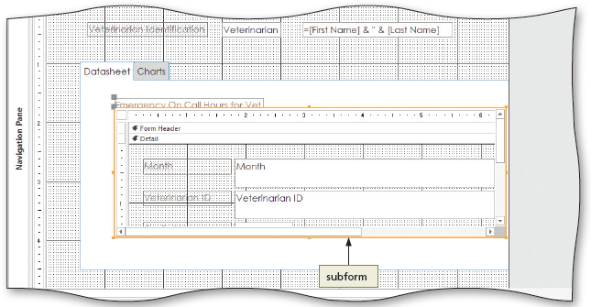
Creating a Multipage Form (5 of 11)
To Add a Subform (cont.)
  Be sure the “Choose from a list” option button is selected
  Click Next
  Type the desired subform name, and then click Finish to complete the creation of the subform
Notes:
Figure 7-59: display of subform

Slide 30
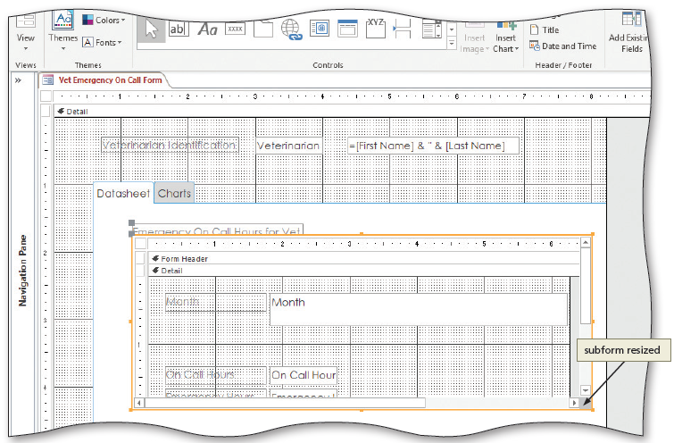
Creating a Multipage Form (6 of 11)
To Resize the Subform
  Display the form containing the subform in Design View
  Drag to resize the subform using the sizing handles
Notes:
Figure 7-61: display of subform resized

Slide 31
Creating a Multipage Form (7 of 11)
To Insert Charts
  Display the FORM DESIGN TOOLS DESIGN tab
  Click the Charts tab on the tab control
  Click the More button
  Click the Chart tool, and then move the pointer to the desired location
  Click the desired location to display the Chart Wizard dialog box
  Click Next
  Add the desired fields from the tables or queries in your database
  Click Next
  Click the desired chart type
  Click Next
  Click Next
  Click Next, type the desired chart title, and then click the Finish button
  Resize the chart as desired

Slide 32
Creating a Multipage Form (8 of 11)
To Modify a Chart Type
  Click the Charts tab to display the charts
  Return to Design view
  Click the Charts tab to display the chart in Design view
  Right-click the chart to modify
  Point to Chart Object on the shortcut menu to display the Chart Object submenu
  Click Edit on the Chart Object submenu to edit the chart. Access will automatically display the underlying chart data in Datasheet view

Slide 33
Creating a Multipage Form (9 of 11)
To Modify a Chart Type (cont.)
  Right-Click the chart to display the shortcut menu for editing the chart
  Click the Chart Type command on the shortcut menu to display the Chart Type dialog box
  Click the desired chart type and chart sub-type
  Click the OK button to change the chart sub-type
  Click outside the chart and the datasheet to deselect the chart

Slide 34
Creating a Multipage Form (10 of 11)
To Format a Chart
  Right-click the chart to format to display a shortcut menu, point to Chart Object on the shortcut menu to display the Chart Object submenu, and then click Edit on the Chart Object submenu
  Right-click the legend to display a shortcut menu, and then click Format Legend on the shortcut menu to display the Format Legend dialog box
  Click the Placement tab
  Click the desired placement option
  Click OK to place the legend in the location you selected

Slide 35
Creating a Multipage Form (11 of 11)
To Format a Chart
  Right-click the chart to display a shortcut menu, and then click Format Data Series on the shortcut menu to display the Format Data Series dialog box
  Click the Data Labels table
  Click the desired components to include in the data labels
  Click OK

