Slide 1
Security Strategies in Windows Platforms and Applications
Lesson 1
Microsoft Windows and the Threat Landscape

Slide 2
Learning Objective(s)
Describe information systems security and the inherent security features of the Microsoft Windows operating system.
Describe threats to Microsoft Windows and applications.

Slide 3
Key Concepts
Information systems security and the C-I-A triad
Microsoft Windows and a typical IT infrastructure
Vulnerabilities of Microsoft Windows systems and their applications

Slide 4
Information Systems Security
Defense in depth
A collection of strategies to make a computer environment safe
Information security
Main goal is to prevent loss
Most decisions require balance between security and usability
Security controls are mechanisms used to protect information

Slide 5
Security Controls
Type of Control
Administrative
Type of Function
Preventive
Detective
Corrective
Technical
Physical

Slide 6
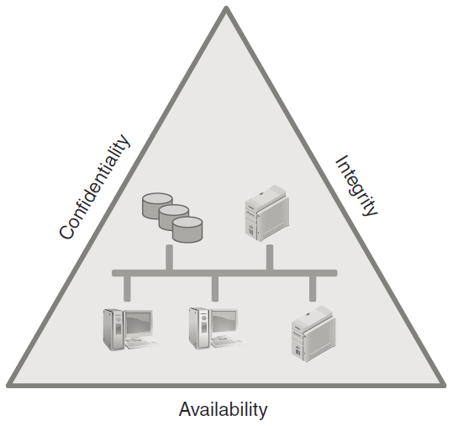
C-I-A Triad
Notes:
The practice of securing information involves ensuring three tenets of information security: confidentiality, integrity, and availability
Known as the C-I-A triad
Also known as the availability, integrity, and confidentiality (A-I-C) triad
Each tenet interacts with the other two and, in some cases, may conflict

Slide 7
Confidentiality
The assurance that the information cannot be accessed or viewed by unauthorized users
Examples of confidential information:
Financial information
Medical information
Secret military plans
Notes:
A successful attack against confidential information enables the attacker to use the information to gain an inappropriate advantage or to extort compensation through threats to divulge the information.

Slide 8
Integrity
The assurance that the information cannot be changed by unauthorized users
Ensuring integrity means applying controls that prohibit unauthorized changes to information
Examples of integrity controls:
Security classification
User clearance

Slide 9
Availability
The assurance that the information is available to authorized users in an acceptable time frame when the information is requested is availability
Examples of attacks that affect availability:
Denial of service (DoS)
Hacktivist

Slide 10
Microsoft Windows and Applications in a Typical IT Infrastructure
IT infrastructure
Collection of computers, devices, and network components that make up an IT environment

Slide 11
Microsoft Windows and Applications in a Typical IT Infrastructure
Common infrastructure components:
Client platforms
Network segments
Network devices
Server instances (often listed by function)
Cloud-based offerings, such as Microsoft Office 365 and Microsoft Azure

Slide 12
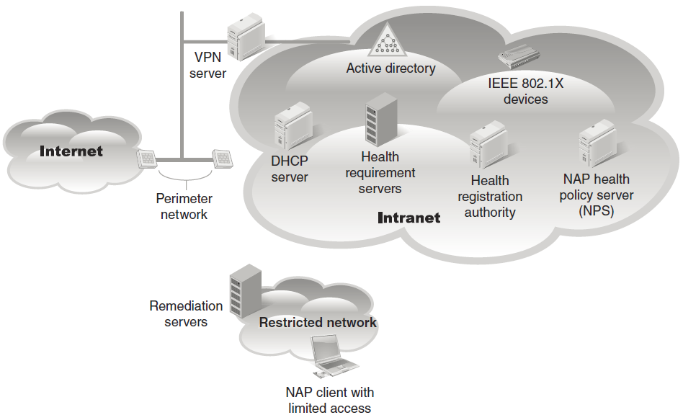
A Sample IT Infrastructure

Slide 13
Windows Clients
Client systems provide functionality to end users; customer-facing systems
Include desktops, laptops, and mobile devices
Each application can be deployed on client systems as either a thin or a thick client
Windows 10
Newest and most popular Windows client operating system

Slide 14
Windows Servers
Server computers provide services to client applications
Common server applications:
Web servers, application servers, and database servers
Windows Server 2019
Essentials, for small businesses
Standard, for most server functions
Datacenter, for large-scale deployments

Slide 15
Microsoft’s End-User License Agreement (EULA)
Software license agreement that contains the Microsoft Software License Terms
Must be accepted prior to installation of any Microsoft Windows product
Located in the Windows install folder or on the Microsoft website

Slide 16
Microsoft EULA Sections
Updates
Additional Notices—Networks, Data, and Internet Usage
Limited Warranty
Exclusions from Limited Warranty

Slide 17
Windows Threats and Vulnerabilities
Risk
Any exposure to a threat
Threat
Any action that could lead to damage, disruption, or loss
Vulnerability
Weakness in an operating system or application software
Successful attack: One that realizes, or carries out, a threat against vulnerabilities

Slide 18
Windows Threats and Vulnerabilities
A threat is not necessarily dangerous
Fire in fireplace = desirable
Fire in data center = dangerous
For damage to occur, there has to be a threat
Attackers look for vulnerabilities, then devise an attack that will exploit the weakness

Slide 19
Anatomy of Microsoft Windows Vulnerabilities
Ransomware
Malicious software that renders files or volumes inaccessible through encryption
Attacker demands payment using cryptocurrency for the decryption key
Well-known ransomware attacks
CryptoLocker
Locky
WannaCry
Notes:
Most ransomware encrypts data and demands a payment using cryptocurrency in exchange for the decryption key.

Slide 20
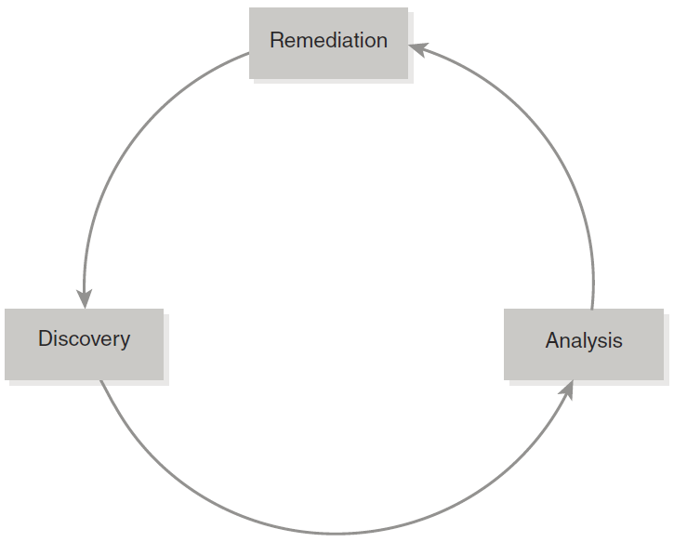
Discovery-Analysis-Remediation Cycle
Notes:
A recurring three-step process for addressing attacks

Slide 21
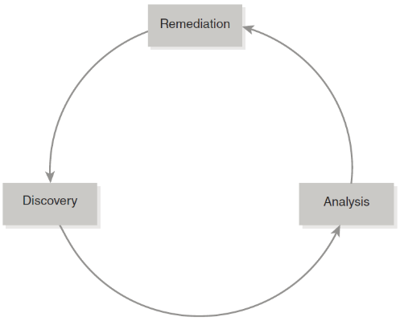
Discovery
Once an attack starts, attackers become as inconspicuous as possible
Need to compare suspect activity baseline (normal activity) to detect anomalies
Common method of accomplishing this is to use activity and monitoring logs

Slide 22
Analysis
Security information and event management (SIEM) tools
Collect and aggregate security-related information from multiple sources and devices
Help prepare data for correlation and analysis
Current vulnerability and security bulletin databases
Help you determine if others are experiencing same activity
Notes:
SIEM tools can often cross-reference known vulnerability databases to help identify suspect behavior.
The analysis phase includes validating suspect activity as abnormal and then figuring out what is causing it.

Slide 23
Remediation
Contain any damage that has occurred, recover from any loss, and implement controls to prevent a recurrence

Slide 24
Common Forms of Attack
Threat | Description
Phishing | Generally start with a message that contains a link or image to click, or a file to open; taking these actions launches malware attacks
Malware | Malicious software designed to carry out tasks that the user would not normally allow
Denial of service (DoS) | Any action that dramatically slows down or blocks access to one or more resources
Injection attack | Depends on ability to send instructions to an application that causes the application to carry out unintended actions; SQL injection is common

Slide 25
Common Forms of Attack (Cont.)
Threat | Description
Unprotected Windows Share | A situation that allows attackers to install tools, including malicious software
Session hijacking and credential reuse | Attempts by attackers to take over valid sessions or capture credentials to impersonate valid users
Cross-site scripting | Specially crafted malicious code used to attack web applications

Slide 26
Common Forms of Attack (Cont.)
Threat | Description
Packet sniffing | The process of collecting network messages as they travel across a network in hopes of divulging sensitive information, such as passwords

Slide 27
Summary
Information systems security and the C-I-A triad
Microsoft Windows and a typical IT infrastructure
Vulnerabilities of Microsoft Windows systems and their applications

