Slide 2
Define important words in this chapter
aspiration
the inhalation of food, fluid, or foreign material into the lungs.
atrophy
weakening or wasting away of muscles.
body mechanics
the way the parts of the body work together when a person moves.
chemical restraint
medications used to control a person’s mood or behavior.
combustion
the process of burning.

Slide 3
Define important words in this chapter
contracture
the permanent and painful shortening of a muscle, tendon, or ligament that can restrict movement.
cyanosis
blue or pale skin and/or mucous membranes due to decreased oxygen in the blood.
dysphagia
difficulty swallowing.
flammable
easily ignited and capable of burning quickly.

Slide 4
Define important words in this chapter
hoarding
collecting and putting things away in a guarded way.
intravenous therapy
the delivery of medication, nutrition, or fluids through a person’s vein.
PASS
acronym for use of a fire extinguisher; stands for Pull-Aim-Squeeze-Sweep.
physical restraint
any method, device, material, or equipment that restricts a person’s freedom of movement.

Slide 5
Define important words in this chapter
RACE
acronym for steps taken during a fire; stands for Rescue-Activate-Contain-Extinguish.
restraint
a physical or chemical way to restrict voluntary movement or behavior.
restraint alternatives
measures used in place of a restraint or that reduce the need for a restraint.
restraint-free care
an environment in which restraints are not kept or used for any reason.

Slide 6
Define important words in this chapter
Safety Data Sheet (SDS)
sheet that provides information on the safe use of and hazards of chemicals, as well as emergency steps to take in the event chemicals are splashed, sprayed or ingested.
scalds
burns caused by hot liquids.
suffocation
the stoppage of breathing from a lack of oxygen or excess of carbon dioxide in the body; may result in unconsciousness or death.

Slide 7
List common accidents in facilities and ways to prevent them
REMEMBER:
There are many types of accidents that can occur in a facility. It is very important that nursing assistants be proactive about preventing accidents from occurring.

Slide 8
List common accidents in facilities and ways to prevent them
Fall Prevention
Remember these guidelines for preventing falls:
Know which residents who may be at risk and report unsteadiness.
Keep frequently-used items close to residents, including call lights. Respond to call lights promptly. Make sure eyeglasses are within reach and that they are not damaged.
Wipe up spills immediately.
Remove clutter from walkways. Keep purse, bag straps, and linens off the floor
Get help when moving residents.
Lock bed wheels before giving care. Lock bed wheels before moving a resident into or out of bed.

Slide 9
List common accidents in facilities and ways to prevent them
Fall Prevention
Guidelines for preventing falls (cont’d):
Lock wheelchair wheels before transferring residents into or out of them.
Return beds to their lowest position when finished with care.
Make sure residents’ clothing fits properly. Make sure residents are wearing sturdy, nonskid shoes with the laces tied.
Report any rugs or mats that move. Use nonskid mats in the shower or bath.
Report loose hand rails immediately. Report cracks or holes anywhere.
Report damage of outdoor furniture, benches, and ramps.

Slide 10
List common accidents in facilities and ways to prevent them
Fall Prevention
Guidelines for preventing falls (cont’d):
Clearly mark areas where floor is uneven.
Keep walkers and canes nearby.
Do not move furniture without an order from the nurse.
Offer trips to the bathroom often. Respond to requests for bathroom assistance promptly.
Report any areas that are not well-lit.
Do not try to catch or stop a falling resident. Use your body to slide him to the floor.
Report all falls to the nurse and always complete an incident report.

Slide 11
List common accidents in facilities and ways to prevent them
REMEMBER:
Most of the accidents in a facility are related to falls. Falls are often caused by unsafe environments, loss of abilities, diseases, muscle weakness, poor vision, or disorientation.

Slide 12
List common accidents in facilities and ways to prevent them
Resident Identification
Remember these guidelines for identifying residents:
Identify residents before providing care or serving food.
Check diet cards against resident’s identification.
Call resident by name.

Slide 13
List common accidents in facilities and ways to prevent them
REMEMBER:
Failure to identify residents can result in illness or even death.

Slide 14
List common accidents in facilities and ways to prevent them
Define the following terms:
scalds
burns caused by hot liquids.
hoarding
collecting and putting things away in a guarded way.
dysphagia
difficulty swallowing.
aspiration
the inhalation of food, fluid, or foreign material into the lungs.

Slide 15
List common accidents in facilities and ways to prevent them
Burn/Scald Prevention
Burns are very painful and can occur quickly. Elderly people and those with loss of sensation are at greater risk for burns.
Remember these guidelines for preventing burns and scalds:
Check water temperature before giving a resident a bath or shower. Temperature should not be over 105°F.
Check for proper temperature of warm water applications.
Use low setting on hair dryers.
Let liquids cool before serving.
Serve drinks when residents are seated.

Slide 16
List common accidents in facilities and ways to prevent them
Burn/Scald Prevention
Guidelines for preventing burns and scalds (cont'd):
Tell residents before pouring or setting down hot drinks.
Use lids on hot liquids.
Pour hot liquids away from residents.
Check plates that have been warmed.
Make sure anything that has been in the sun has cooled before use.
Tell residents about smoking precautions.

Slide 17
List common accidents in facilities and ways to prevent them
Poisoning Prevention
Remember these guidelines for poison prevention:
Keep all items that may be poisonous away from disoriented residents. Do not leave cleaning products in residents’ rooms.
Check expiration dates of foods to ensure that they are fresh.
Check residents’ drawers for hoarded food that has spoiled.
Make sure there is proper ventilation when chemical products are used.

Slide 18
List common accidents in facilities and ways to prevent them
Choking Prevention
Remember these guidelines for choking prevention:
Residents should be sitting upright/90 degrees while eating.
Assist with feeding slowly. Never rush a resident during a meal.
Alternate between food and drink.
Cut food into small pieces.
Report to nurse if you think a resident would be helped by softer foods or thickened liquids.
Make sure dentures are in place and fit properly.
Be aware of residents’ swallowing precautions.

Slide 19
List common accidents in facilities and ways to prevent them
Cuts and Other Injuries
Remember these guidelines for preventing cuts, scrapes, and other injuries:
Do not leave sharp objects out.
Prevent skin tears when dressing residents by guiding clothing over the body.
Approach doors slowly.
When moving residents in wheelchairs, protect their arms, legs, hands, and feet.
Push wheelchairs forward. Wheelchairs should face forward in elevators.

Slide 20
List common accidents in facilities and ways to prevent them
Remember these general safety guidelines:
Do not run in a facility.
Do not put your hand into a bed or anywhere else without looking first.
Ask for help when you need it.
Know which residents are combative and try to learn what triggers this behavior.
Follow facility policy if a skin splash or eye splash occurs.
Report all injuries immediately.

Slide 21
Explain the Safety Data Sheet (SDS)
Define the following term:
Safety Data Sheet (SDS)
sheet that provides information on the safe use of and hazards of chemicals, as well as emergency steps to take in the event chemicals are splashed, sprayed, or ingested.

Slide 22
Explain the Safety Data Sheet (SDS)
REMEMBER:
The Occupational Safety and Health Administration (OSHA) is responsible for the safety of employees at work. OSHA requires that all dangerous chemicals have a Safety Data Sheet (SDS). These sheets are placed where all staff can access them.

Slide 23
Explain the Safety Data Sheet (SDS)
The following important information is found on a Safety Data Sheet (SDS):
Chemical ingredients of the product
Dangers of the product
Protective items to be worn
How to use and clean up the chemical
Emergency response if product is splashed onto skin or ingested
Safe handling, storage, and disposal procedures

Slide 24
Describe safety guidelines for sharps and biohazard containers
Nursing assistants should follow these safety guidelines when using sharps and biohazard containers:
Don gloves before touching a sharps container.
Keep hands clear of the opening of container. Carry the container by the bottom only.
Request that container be replaced when it is ¾ full or according to facility policy.
Remove gloves and wash hands after putting anything into sharps container.

Slide 25
Describe safety guidelines for sharps and biohazard containers
Safety guidelines when using sharps and biohazard containers (cont'd):
Use biohazard container or bag for anything contaminated with infectious waste except for sharps.
Wear gloves when disposing of infectious waste.
Remove gloves and wash hands after putting anything into the biohazard container or bag.

Slide 26
Explain the principles of body mechanics and apply them to daily activities
Define the following term:
body mechanics
the way the parts of the body work together when a person moves.

Slide 27
Explain the principles of body mechanics and apply them to daily activities
REMEMBER:
Nursing assistants face risk of injury. Using proper body mechanics will help prevent these injuries.

Slide 28
Explain the principles of body mechanics and apply them to daily activities
REMEMBER:
Good body mechanics help save energy and prevent injury and muscle strain.
When muscles are used correctly to push and lift objects or people, it reduces the risk of injury.
Basic principles of body mechanics will help keep nursing assistants and their residents safe.

Slide 29
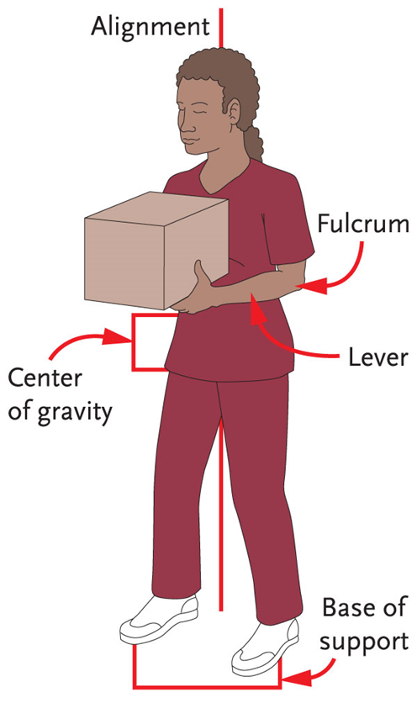
Key Material 7-1: Body Alignment

Slide 30
Explain the principles of body mechanics and apply them to daily activities
Be familiar with these terms associated with body mechanics:
Alignment
Base of support
Center of gravity

Slide 31
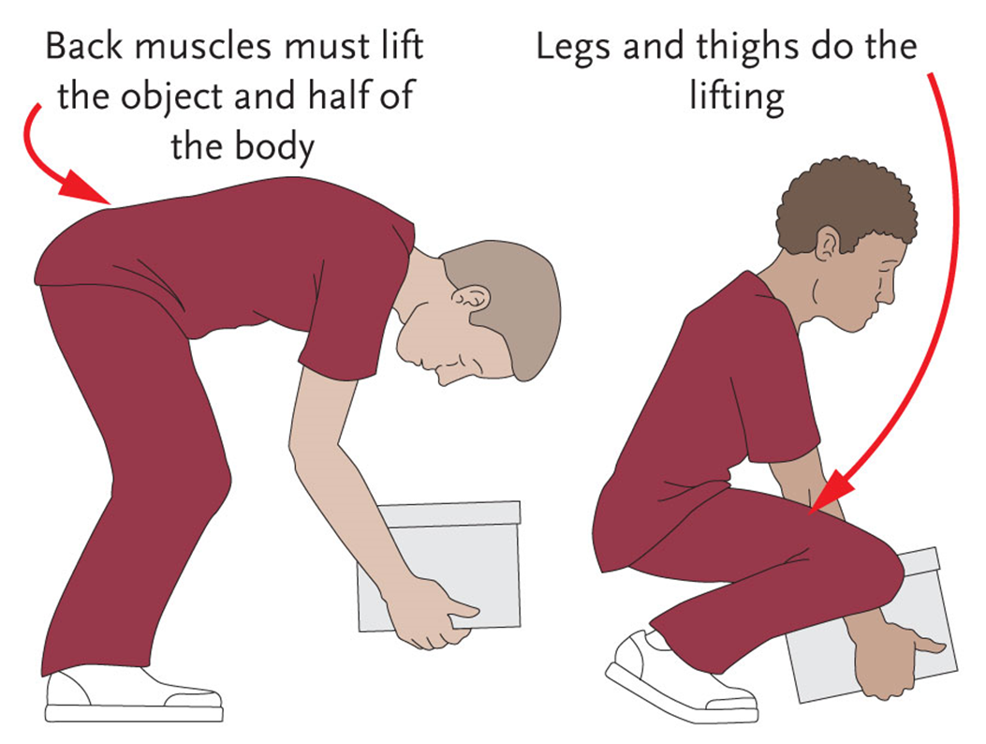
Key Material 7-2: Lifting Heavy Objects from the Floor

Slide 32
Explain the principles of body mechanics and apply them to daily activities
Many of a nursing assistant’s activities on the job require moving or lifting:
Lifting a resident
Picking up a bag of laundry
Carrying new residents’ luggage
Taking heavy trash bags to appropriate site
Cleaning a floor
Moving a bed into another room

Slide 33
Explain the principles of body mechanics and apply them to daily activities
Consider these guidelines when performing your daily activities in order to use good body mechanics:
Raise beds to safe working level.
Stand close to object.
Stand with a wide base of support.
Push or slide objects rather than lifting.
Use the strong muscles in the thighs, upper arms, and shoulders to lift.
Bend at the knees (squat) instead of at the waist.

Slide 34
Explain the principles of body mechanics and apply them to daily activities
Guidelines for performing daily activities using good body mechanics (cont’d):
Avoid twisting or choppy movements. Face the object or person being moved. Pivot the feet instead of twisting at the waist.
Do not lift with one hand.
Hold objects close to your body when lifting.
Avoid bending and reaching.
Get help when you need it.
Talk to residents before moving them. Agree on a signal for moving.

Slide 35
Define two types of restraints and discuss problems associated with restraints
Define the following terms:
restraint
a physical or chemical way to restrict voluntary movement or behavior.
physical restraint
any method, device, material, or equipment that restricts a person’s freedom of movement.
chemical restraint
medications used to control a person’s mood or behavior.

Slide 36
Define two types of restraints and discuss problems associated with restraints
Define the following terms:
suffocation
the stoppage of breathing from a lack of oxygen or excess of carbon dioxide in the body; may result in unconsciousness or death.
atrophy
weakening or wasting away of muscles.
contracture
the permanent and painful shortening of a muscle, tendon, or ligament that can restrict movement.

Slide 37
Define two types of restraints and discuss problems associated with restraints
REMEMBER:
Restraint use has declined in facilities, and laws have been passed restricting their use due to abuse by caregivers.
Side rails and geriatric chairs with tray tables attached may be considered physical restraints.

Slide 38
Define two types of restraints and discuss problems associated with restraints
REMEMBER:
Restraints may never be used without a doctor’s order.

Slide 39
Define two types of restraints and discuss problems associated with restraints
Potential negative effects of restraint use:
Bruises and cuts
Pressure ulcers
Risk of suffocation or strangulation
Entrapment
Pneumonia
Reduced blood circulation
Stress on the heart
Blood clots
Poor appetite and malnutrition
Dehydration

Slide 40
Define two types of restraints and discuss problems associated with restraints
Potential negative effects of restraint use (cont’d):
Incontinence
Urinary tract infection
Constipation
Muscle atrophy and contractures
Loss of bone mass
Nerve injuries
Decreased mobility
Falls
Fractures
Depression and/or withdrawal

Slide 41
Define two types of restraints and discuss problems associated with restraints
Potential negative effects of restraint use (cont’d):
Social isolation
Loss of self-esteem
Sleep disorders
Loss of dignity
Loss of independence
Stress and anxiety
Increased agitation
Confusion
Severe injury
Death

Slide 42
Discuss restraint alternatives
Define the following terms:
restraint-free care
an environment in which restraints are not kept or used for any reason.
restraint alternatives
measures used in place of a restraint or that reduce the need for a restraint.

Slide 43
Discuss restraint alternatives
REMEMBER:
Restraint use has been dramatically reduced in facilities. State and federal agencies encourage facilities to take steps to create restraint-free environments.
Creative ideas that help avoid the need for restraints are being used instead. These creative ideas are called restraint alternatives.

Slide 44
Discuss restraint alternatives
REMEMBER:
Studies have shown that restraints are not truly needed. People tend to respond better to the use of creative ways to reduce tension, pulling at tubes, wandering, and boredom.

Slide 45
Discuss restraint alternatives
Critical Thinking: Conversation Starter
How would it feel to be restrained? Can you think of your own ideas about ways to avoid using restraints?

Slide 46
Handout 7-1: Restraint Alternatives
Make sure call lights are within reach and answer call lights immediately.
• Use fall prevention and other safety techniques, such as improving lighting.
• Certain types of grab bars can assist with moving in bed and getting out of bed.
• Take the resident on a walk. The doctor or nurse may add exercise into the care plan.
• Let confused residents wander in designated safe areas.
• Provide activities for those who wander at night.
• Give frequent help with toileting. Help with cleaning immediately after an episode of incontinence. Make sure residents are clean, dry, and comfortable.
• Encourage independence with all tasks. Provide meaningful activities.

Slide 47
Handout 7-1: Restraint Alternatives (cont’d)
• Encourage participation in social activities. Escort the resident to social activities when needed. Increase visits and social interaction.
• Offer reading materials that the resident enjoys. Read to the resident if needed.
• Increase the number of familiar caregivers with family members and volunteers. Family members may decrease tension just by being with residents.
• Offer food or drink.
• Decrease the noise level. Offer backrubs or use relaxation techniques.
• Listen to soothing music.
• Monitor the resident closely and report complaints of pain to the nurse immediately.

Slide 48
Identify what must be done if a restraint is ordered
Define the following terms:
cyanosis
blue or pale skin and/or mucous membranes due to decreased oxygen in the blood.

Slide 49
Identify what must be done if a restraint is ordered
Remember these guidelines for restraint use:
Follow the care plan’s and the nurse’s instructions for monitoring.
Place call light within resident’s reach and respond immediately to call lights.
Perform care as ordered.
Document appropriately.

Slide 50
List safety guidelines for oxygen use
Define the following terms:
combustion
the process of burning.
flammable
easily ignited and capable of burning quickly.

Slide 51
List safety guidelines for oxygen use
REMEMBER:
Nursing assistants do not turn off or adjust oxygen levels. This is the nurse’s responsibility.

Slide 52
List safety guidelines for oxygen use
Remember these guidelines for safety with oxygen:
Post No Smoking and Oxygen in Use signs.
Remove fire hazards from room.
Remove flammable liquids from the area.
Do not allow candles, lighters, or matches around oxygen.

Slide 53
List safety guidelines for oxygen use
Guidelines for safety with oxygen (cont’d):
Check nasal area, cheeks, and behind the ears for signs of irritation from tubing.
Do not use petroleum-based products on the resident or on any part of the cannula or mask.
Make sure that the resident is not lying on the oxygen tubing and that there are no kinks in it.
Learn how to turn off oxygen in case of fire. Never adjust oxygen levels.

Slide 54
Identify safety guidelines for intravenous (IV) lines
Define the following term:
intravenous therapy
the delivery of medication, nutrition, or fluids through a person’s vein.

Slide 55
Identify safety guidelines for intravenous (IV) lines
REMEMBER:
IV is an abbreviation for intravenous, which means into a vein. A resident with an IV is receiving medication, nutrition, or fluids through a vein.

Slide 56
Identify safety guidelines for intravenous (IV) lines
Critical Thinking: Conversation Starter
Why should you always wear gloves when touching an IV area?

Slide 57
Identify safety guidelines for intravenous (IV) lines
Remember these things that a nursing assistant should not do when caring for a resident with an IV:
Take blood pressure on the arm with the IV
Get the IV site wet
Pull on or catch tubing in anything
Leave tubing kinked
Lower IV bag below IV site
Touch the clamp
Disconnect IV from pump or turn off alarm

Slide 58
Identify safety guidelines for intravenous (IV) lines
Be sure to report any of the following observations to the nurse:
Needle or catheter has fallen out
The armboard or handboard becomes loose
Tubing is disconnected
Blood appears in tubing
IV fluid in bag or container is gone or almost gone
IV fluid is not dripping or is leaking, or bag breaks
IV pump is beeping
Resident complains of pain, has difficulty breathing, or has a fever
Resident pulls out or attempts to pull out IV

Slide 59
Discuss fire safety and explain the RACE and PASS acronyms
Define the following terms:
RACE
acronym for steps taken during a fire; stands for Rescue-Activate-Contain-Extinguish.
PASS
acronym for use of a fire extinguisher; stands for Pull-Aim-Squeeze-Sweep.

Slide 60
Discuss fire safety and explain the RACE and PASS acronyms
REMEMBER:
Heat, fuel, and oxygen must all be present for a fire to occur.

Slide 61
Discuss fire safety and explain the RACE and PASS acronyms
There are many potential causes of a fire in facilities, including the following:
Smoking
Frayed or damaged electrical cords
Electrical equipment in need of repair
Overloaded electrical plugs
Oxygen use
Flammable liquids or rags with oils on them
Stacks of newspapers or other clutter

Slide 62
Discuss fire safety and explain the RACE and PASS acronyms
Critical Thinking: Conversation Starter
Can you think of additional causes of fire within a facility and ways to prevent them?

Slide 63
Discuss fire safety and explain the RACE and PASS acronyms
Know these guidelines for fire prevention:
Stay with a resident who is smoking.
Check ashtrays for lit cigarettes or matches.
Put out burning cigarettes.
Make sure that cigarettes or smoking materials do not fall anywhere.
Make sure there are no hot ashes, matches, or cigarette butts in an ashtray before emptying it.
Follow any policies regarding e-cigarettes and their batteries.
Report unsafe electrical equipment and cords immediately.
Report smell of gas.

Slide 64
Discuss fire safety and explain the RACE and PASS acronyms
Make sure you know the location of fire alarms in your facility. Two acronyms will help you remember what to do.
The first is the RACE acronym, which outlines what to do in case of a fire:
Rescue anyone in danger.
Activate alarm or call 911.
Contain fire by closing all doors and windows.
Extinguish the fire or fire department will extinguish.

Slide 65
Discuss fire safety and explain the RACE and PASS acronyms
The second is the PASS acronym, which explains how to use a fire extinguisher in case of fire. There will be many fire extinguishers in every facility. Learn where they are located. In case you need to use a fire extinguisher, do the following:
Pull the pin.
Aim at the base of the fire.
Squeeze the handle.
Sweep back and forth at the base of the fire.

Slide 66
Discuss fire safety and explain the RACE and PASS acronyms
Know these general procedures to follow in case of fire:
Know the location of the fire evacuation plan.
Remain calm.
Remove all persons in immediate area.
Stay low in room to escape a fire.
Check closed doors for heat before opening them. Use wet towels to block doorways.
Use damp covering over face to reduce smoke inhalation.
Stop, drop, and roll if clothing catches fire.
Never get into an elevator during a fire.
Turn off oxygen and electrical equipment if facility policy allows.

Slide 67
List general safety steps for working in a healthcare facility
REMEMBER:
Living or working in a facility may sometimes put a person at risk of crime. Many people go in and out of a facility during the day. It is best to watch for any suspicious behavior. If a nursing assistant notices any suspicious behavior, she should report it immediately.

Slide 68
List general safety steps for working in a healthcare facility
Remember these guidelines for safety in a facility:
Report anything suspicious.
Keep valuables at home.
Ask nurse to lock up residents’ valuables.
If a visitor or staff member makes you uneasy, do not leave the resident alone with the person.
Follow guidelines for number of visitors allowed in residents’ rooms.
Do not share personal or confidential information with anyone.
Report any situation or person who makes you feel unsafe.

