Slide 2
Define important words in this chapter
absorption
the transfer of nutrients from the intestines to the cells.
anatomy
the study of body structure.
biology
the study of all life forms.
body systems
groups of organs that perform specific functions in the human body.

Slide 3
Define important words in this chapter
bowel elimination
the physical process of releasing or emptying the colon or large intestine of solid waste, called stool or feces.
cells
the basic structural units of all organisms.
chyme
semiliquid substance made as a result of the chemical breakdown of food in the stomach.
colon
the large intestine.

Slide 4
Define important words in this chapter
colostomy
Surgically created opening through the abdominal wall into the large intestine to allow feces to be expelled.
constipation
the inability to eliminate stool, or the infrequent, difficult, and often painful elimination of hard, dry stool.
Crohn’s disease
a disease that causes the lining of the digestive tract to become inflamed (red, sore, and swollen).
defecation
the process of eliminating feces from the rectum through the anus.

Slide 5
Define important words in this chapter
diarrhea
frequent elimination of liquid or semiliquid feces.
digestion
the process of converting food so that it can be absorbed into the blood and used by body tissues.
diverticulitis
inflammation of sacs that develop in the wall of the large intestine due to diverticulosis.
diverticulosis
a disorder in which sac-like pouchings develop in weakened areas of the wall of the large intestine (colon).

Slide 6
Define important words in this chapter
duodenum
the first part of the small intestine, where the common bile duct enters the small intestine.
electrolytes
chemical substances that are essential to maintaining fluid balance and homeostasis in the body.
elimination
the process of expelling wastes.
enema
a specific amount of water or other fluid, with or without an additive, introduced into the colon to stimulate the elimination of stool.

Slide 7
Define important words in this chapter
fecal impaction
a mass of dry, hard stool that remains packed in the rectum and cannot be expelled.
fecal incontinence
an inability to control the muscles of the bowels, which leads to an involuntary passage of stool or gas.
feces
solid body waste excreted through the anus from the large intestine; also called stool.
flatulence
air in the intestine that is passed through the rectum; also called gas or flatus.

Slide 8
Define important words in this chapter
fracture pan
a bedpan that is flatter than a regular bedpan; used for small or thin people or those who cannot lift their buttocks onto a standard bedpan.
gastroesophageal reflux disease (GERD)
a chronic condition in which the liquid contents of the stomach back up into the esophagus.
gastrointestinal tract
a continuous tube from the opening of the mouth all the way to the anus, where solid wastes are eliminated from the body.
heartburn
a condition that results from a weakening of the sphincter muscle which joins the esophagus and the stomach; also known as acid reflux.

Slide 9
Define important words in this chapter
hemorrhoids
enlarged veins in the rectum that can cause itching, burning, pain, and bleeding.
homeostasis
the condition in which all of the body’s systems are balanced and are working at their best.
ileostomy
surgically created opening into the end of the small intestine, the ileum, to allow feces to be expelled.
ingestion
the process of taking food or fluids into the body.

Slide 10
Define important words in this chapter
irritable bowel syndrome (IBS)
a chronic condition of the large intestine that is worsened by stress.
malabsorption
a condition in which the body cannot absorb or digest a particular nutrient properly.
occult
hidden.
organ
a structural unit in the human body that performs a specific function.

Slide 11
Define important words in this chapter
ostomy
surgical creation of an opening from an area inside the body to the outside.
pathophysiology
the study of the disorders that occur in the body.
peristalsis
muscular contractions that push food through the gastrointestinal tract.
physiology
the study of how body parts function.

Slide 12
Define important words in this chapter
portable commode
a chair with a toilet seat and a removable container underneath that is used for elimination; also called bedside commode.
rectal suppository
a medication in a cylindrical shape that is given rectally to cause a bowel movement.
specimen
a sample, such as tissue, blood, urine, stool, or sputum, used for analysis and diagnosis.
stoma
an artificial opening in the body.

Slide 13
Define important words in this chapter
stool
solid body waste excreted through the anus from the large intestine; also called feces.
tissues
a group of cells that performs similar tasks.
ulcerative colitis
a chronic inflammatory disease of the large intestine.
urostomy
surgical creation of an opening for the passage of urine.

Slide 14
Explain key terms related to the body
Define the following terms:
biology
the study of all life forms.
anatomy
the study of body structure.
physiology
the study of how body parts function.
cells
the basic structural units of all organisms.
tissues
a group of cells that performs similar tasks.

Slide 15
Explain key terms related to the body
Define the following terms:
organ
a structural unit in the human body that performs a specific function.
body systems
groups of organs that perform specific functions in the human body.
homeostasis
the condition in which all of the body’s systems are balanced and are working at their best.
pathophysiology
the study of the disorders that occur in the body.

Slide 16
Explain key terms related to the body
These ten systems make up the human body:
Gastrointestinal or digestive
Urinary
Reproductive
Integumentary or skin
Circulatory or cardiovascular
Respiratory
Musculoskeletal
Nervous
Endocrine
Immune and lymphatic

Slide 17
Explain key terms related to the body
REMEMBER:
Homeostasis is the condition in which all of the body’s systems are balanced and are working at their best. Keeping body temperature around 98.6° Fahrenheit, regardless of how cold or hot it is outside, is an example of homeostasis.
Knowing what normal changes of aging are for each body system helps nursing assistants better recognize any abnormal changes in their residents.

Slide 18
Explain the structure and function of the gastrointestinal system
Define the following terms:
gastrointestinal tract
a continuous tube from the opening of the mouth all the way to the anus, where solid wastes are eliminated from the body.
peristalsis
muscular contractions that push food through the gastrointestinal tract.
chyme
semiliquid substance made as a result of the chemical breakdown of food in the stomach.
duodenum
the first part of the small intestine, where the common bile duct enters the small intestine.

Slide 19
Explain the structure and function of the gastrointestinal system
Define the following terms:
absorption
the transfer of nutrients from the intestines to the cells.
feces
solid body waste excreted through the anus from the large intestine; also called stool.
electrolytes
chemical substances that are essential to maintaining fluid balance and homeostasis in the body.
colon
the large intestine.

Slide 20
Explain the structure and function of the gastrointestinal system
Define the following terms:
defecation
the process of eliminating feces from the rectum through the anus.
ingestion
the process of taking food or fluids into the body.
digestion
the process of converting food so that it can be absorbed into the blood and used by body tissues.
elimination
the process of expelling wastes.

Slide 21
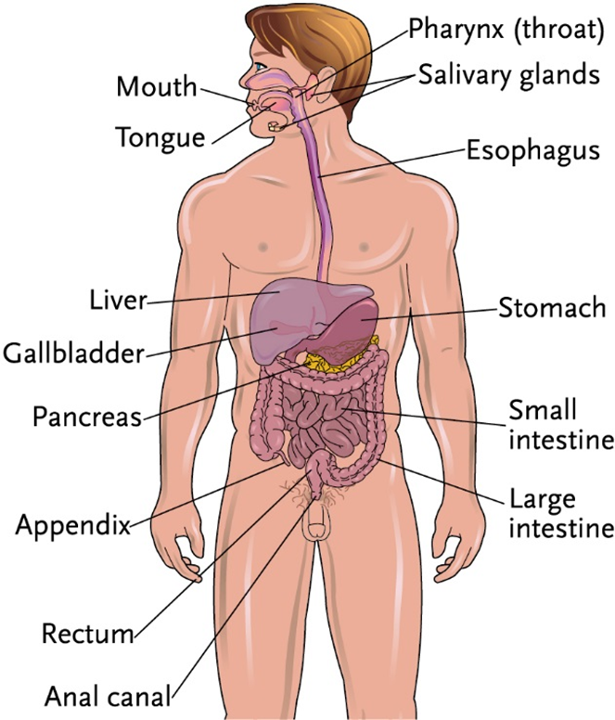
Key Material 15-1: The Gastrointestinal System

Slide 22
Explain the structure and function of the gastrointestinal system
Know these important points about the gastrointestinal, or digestive system:
Digestion prepares food for absorption into cells.
Elimination is expelling solid wastes.

Slide 23
Explain the structure and function of the gastrointestinal system
Here are the functions of the gastrointestinal system:
Ingestion of food and fluids
Digestion of food
Absorption of nutrients
Elimination of waste products from food/fluids

Slide 24
Discuss changes in the gastrointestinal system due to aging
The following are normal changes of aging:
Ability to taste decreases.
Process of digestion takes longer and is less efficient.
Body waste moves more slowly through the intestines, causing more frequent constipation.
Difficulty chewing and swallowing may occur.
Absorption of vitamins and minerals decreases.
Production of saliva and digestive fluids decreases.

Slide 25
List normal qualities of stool and identify signs and symptoms to report about stool
Define the following term:
bowel elimination
the physical process of releasing or emptying the colon or large intestine of solid waste, called stool or feces.
stool
solid body waste excreted through the anus from the large intestine; also called feces.

Slide 26
List normal qualities of stool and identify signs and symptoms to report about stool
Remember these points about normal bowel elimination:
Stool is normally brown, soft, moist, and formed.
There should be no pain with passing stool.
There should not be blood, pus, mucus, or worms in the stool.

Slide 27
List normal qualities of stool and identify signs and symptoms to report about stool
Know these signs and symptoms to report about stool:
Bloody or abnormally-colored stool
Hard, dry stools
Diarrhea
Constipation
Pain with bowel movements
Blood, pus, mucus, or discharge in stool
Fecal incontinence

Slide 28
List factors affecting bowel elimination and describe how to promote normal bowel elimination
Define the following terms:
fracture pan
a bedpan that is flatter than a regular bedpan; used for small or thin people or those who cannot lift their buttocks onto a standard bedpan.
portable commode
a chair with a toilet seat and a removable container underneath that is used for elimination; also called bedside commode.

Slide 29
Key Material 15-2: Factors Affecting Bowel Elimination
• Growth and development
• Psychological factors
• Diet
• Fluid intake
• Physical activity and exercise
• Personal habits
• Medications

Slide 30
List factors affecting bowel elimination and describe how to promote normal bowel elimination
Growth and development may affect bowel elimination in these ways:
Aging affects the regularity of bowel elimination.
Peristalsis slows due to a decrease in muscle tone.
Nutrients are not absorbed as well, making digestion more difficult.

Slide 31
List factors affecting bowel elimination and describe how to promote normal bowel elimination
REMEMBER:
To promote normal elimination, encourage fluids and nutritious meals. Encourage regular exercise and activity as allowed.

Slide 32
List factors affecting bowel elimination and describe how to promote normal bowel elimination
Psychological factors may also influence bowel elimination:
Lack of privacy may affect bowel elimination.
Having a roommate for the first time, being in a place that is not home, and needing help with elimination can disrupt normal elimination patterns.
Anxiety, stress, fear, or anger can increase the frequency of bowel movements, causing watery, loose stools, and may even cause incontinence.
Depression can decrease the frequency of elimination.

Slide 33
List factors affecting bowel elimination and describe how to promote normal bowel elimination
REMEMBER:
To promote normal elimination, nursing assistants should always provide privacy and allow plenty of time for elimination. They must also respond to call lights immediately. If residents want to talk about their concerns, NAs should take the time to listen to them, and report their concerns to the nurse.

Slide 34
List factors affecting bowel elimination and describe how to promote normal bowel elimination
Diet can affect bowel elimination in these ways:
A diet low in fiber may decrease elimination and cause constipation.
Foods high in animal fats, such as dairy products, red meat, and eggs may also cause constipation.
Beans, whole grains, apples, cabbage, onions, dairy products, and carbonated drinks are examples of foods that can cause gas.

Slide 35
List factors affecting bowel elimination and describe how to promote normal bowel elimination
REMEMBER:
To promote normal elimination, nursing assistants should encourage nutritious meals. Increasing fiber intake and decreasing fatty, sugary foods can help if constipation is a problem.

Slide 36
List factors affecting bowel elimination and describe how to promote normal bowel elimination
Fluid intake affects bowel elimination:
The sense of thirst decreases as a person ages.
A decrease in fluids may cause constipation.
A lack of strength or coordination can also lower fluid intake. Some beverages, such as orange or prune juice, can cause an increase in bowel elimination.

Slide 37
List factors affecting bowel elimination and describe how to promote normal bowel elimination
REMEMBER:
To promote normal elimination, nursing assistants should encourage fluid intake. Generally, a healthy person needs at least 64 ounces of fluid each day.

Slide 38
List factors affecting bowel elimination and describe how to promote normal bowel elimination
Physical activity and exercise are factors affecting bowel elimination:
A lack of exercise and mobility can weaken muscles and slow elimination.
Regular physical activity helps bowel elimination by strengthening abdominal and pelvic muscles. This helps peristalsis.

Slide 39
List factors affecting bowel elimination and describe how to promote normal bowel elimination
REMEMBER:
To promote normal elimination, nursing assistants should encourage daily exercise such as regular walks and other types of activities, as allowed.

Slide 40
List factors affecting bowel elimination and describe how to promote normal bowel elimination
Personal habits can affect bowel elimination in these ways:
Certain times of day may be more common for having bowel movements.
Drinking warm fluids can increase bowel movements.
Familiar places, such as the resident’s own bathroom, may encourage bowel elimination.
Positioning in bed also affects elimination. A resident who is lying flat on his back (supine) will have difficulty with elimination because it is difficult to contract the muscles in this position.

Slide 41
List factors affecting bowel elimination and describe how to promote normal bowel elimination
REMEMBER:
To promote normal elimination, nursing assistants can make sure residents are helped to the bathroom at the time of day that is best for each person. Use the bathroom the resident prefers or get a portable commode if the resident cannot make it to the bathroom. Raise the head of the bed for residents who use a bedpan. The best position for elimination is squatting and leaning forward.

Slide 42
List factors affecting bowel elimination and describe how to promote normal bowel elimination
Medications may affect bowel elimination:
Antibiotics can cause diarrhea.
Pain relievers may cause constipation.

Slide 43
List factors affecting bowel elimination and describe how to promote normal bowel elimination
REMEMBER:
To promote normal elimination, laxatives may be ordered. Laxatives can help with elimination, but may cause diarrhea. Nursing assistants should report diarrhea or constipation to the nurse promptly.

Slide 44
Assisting a resident with use of a bedpan
Equipment: bedpan, bedpan cover, disposable bed protector, bath blanket, toilet paper, disposable wipes, 2 towels, supplies for perineal care, 2 pairs of gloves
Identify yourself by name. Identify the resident. Greet the resident by name.
Wash your hands.
Explain procedure to the resident. Speak clearly, slowly, and directly. Maintain face-to-face contact whenever possible.
Provide for the resident’s privacy with a curtain, screen, or door.
Adjust bed to a safe level, usually waist high. Before placing bedpan, lower the head of the bed. Lock bed wheels.
Put on gloves.
Cover the resident with the bath blanket. Ask him to hold it while you pull down the top covers underneath. Do not expose more of the resident than you need to. Keep the resident covered from the chest down except when placing or removing the bedpan.

Slide 45
Assisting a resident with use of a bedpan
Place the bed protector under the resident’s buttocks and hips. To do this, have the resident turn toward the raised bed rail. If the resident cannot do this, you must turn him (see Chapter 11). Be sure the resident cannot roll off the bed. Place bed protector on the empty side of the bed, on the area where the resident will lie on his back. The side of the protector nearest the resident should be fanfolded (folded several times into pleats) and tucked under the resident.

Slide 46
Assisting a resident with use of a bedpan
(cont’d) Ask resident to roll onto his back, or turn him as you did before. Unfold the rest of bed protector so it completely covers the area under and around the resident’s buttocks and hips.
Keeping him covered, ask the resident to remove his undergarments or help him do so.
Place the bedpan near his hips in correct position. A standard bedpan should be positioned with the wider end aligned with resident’s buttocks. A fracture pan should be positioned with handle toward the foot of the bed.

Slide 47
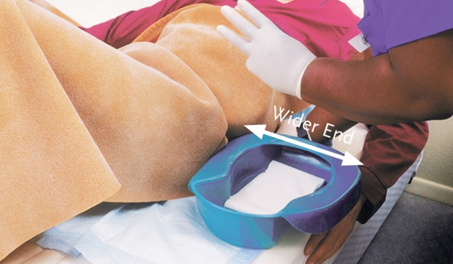
Assisting a resident with use of a bedpan
If resident is able, ask him to raise his hips by pushing with his feet and hands at the count of three. Slide the bedpan under his hips. If a resident cannot help you in any way, keep the bed flat and roll the resident away from you toward the raised bed rail. Slip the bedpan under the hips and gently roll him back onto the bedpan, Keep the bedpan centered underneath.
remove and discard gloves properly. Wash your hands.

Slide 48
Assisting a resident with use of a bedpan
Raise the head of the bed. Prop the resident into a semi-sitting position using pillows. Make sure both bed rails are up, and return the bed to its lowest position.
Make sure the bath blanket is still covering the resident. Place toilet paper and wipes within the resident’s reach. Ask the resident to clean his hands with a wipe when finished if he is able.
Leave the call light within resident’s reach. Wash your hands. Ask the resident to signal when finished. Leave the room and close the door.
When called by the resident, return and wash your hands. Put on clean gloves.
Raise the bed to a safe level. Lower the head of the bed. Make sure the resident is still covered. Do not overexpose the resident. Lower the bed rail on the near/working side.
Remove the bedpan carefully and gently. Cover the bedpan.
Give perineal care if help is needed. Wipe from front to back. Dry the perineal area with a towel. Help the resident put on undergarment. Cover the resident and remove the bath blanket.

Slide 49
Assisting a resident with use of a bedpan
Place the towel and bath blanket in a hamper or bag, and discard disposable supplies.
Take bedpan to the bathroom. Note color, odor, amount, and consistency of contents. Empty contents into the toilet unless a specimen is needed, urine is being measured for intake/output monitoring, or the nurse needs to check the contents. If you notice anything unusual about the stool or urine (for example, the presence of blood), do not discard it. You will need to inform the nurse.
Turn the faucet on with a paper towel. Rinse the bedpan with cold water and empty it into the toilet. Flush the toilet. Place the bedpan in the proper area for cleaning or clean and store it according to policy.
Remove and discard gloves properly. Wash your hands.
Make the resident comfortable.
Return bed to lowest position. Remove privacy measures.

Slide 50
Assisting a resident with use of a bedpan
Leave call light within the resident’s reach.
Wash your hands.
Be courteous and respectful at all times.
Report any changes in the resident to the nurse. Document procedure using facility guidelines.

Slide 51
Assisting a male resident with a urinal
Equipment: urinal, disposable bed protector, disposable wipes, 2 pairs of gloves
Identify yourself by name. Identify the resident. Greet the resident by name.
Wash your hands.
Explain procedure to the resident. Speak clearly, slowly, and directly. Maintain face-to-face contact whenever possible.
Provide for the resident’s privacy with a curtain, screen, or door.
Adjust the bed to a safe level, usually waist high. Lock bed wheels.
Put on gloves.
Place the bed protector under the resident’s buttocks and hips.

Slide 52
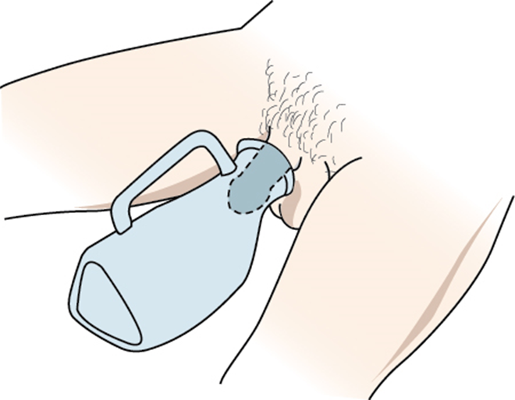
Assisting a male resident with a urinal
Hand the urinal to the resident. If the resident is not able to do this himself, place urinal between his legs and position the penis inside the urinal. Replace the covers.
Remove and discard gloves properly. Wash your hands.

Slide 53
Assisting a male resident with a urinal
Raise the head of the bed. Make sure both bed rails are up. Place wipes within resident’s reach. Ask the resident to clean his hands with a wipe when finished if he is able. Leave the call light within reach. Wash your hands. Ask resident to signal when done. Leave the room and close the door.
When called by the resident, return and wash your hands. Put on clean gloves.
Have resident hand urinal to you, or gently remove urinal. Remove the bed protector. Discard disposable supplies.
Take urinal to the bathroom. Note color, odor, amount, and qualities (for example, cloudiness) of contents. Empty contents into the toilet unless a specimen is needed, urine is being measured for intake/output monitoring, or the nurse needs to check the contents.
Turn the faucet on with a paper towel. Rinse the urinal with cold water and empty rinse water into the toilet. Flush the toilet. Place urinal in proper area for cleaning or clean and store it according to policy.

Slide 54
Assisting a male resident with a urinal
Remove and discard gloves properly. Wash your hands.
Leave the bed in its lowest position. Remove privacy measures.
Make resident comfortable.
Leave call light within the resident’s reach.
Wash your hands.
Be courteous and respectful at all times.
Report any changes in the resident to the nurse. Document procedure using facility guidelines.

Slide 55
Helping a resident use a portable commode
Equipment: portable commode with basin, toilet paper, disposable wipes, nonskid footwear, towel, bath blanket, supplies for perineal care, 3 pairs of gloves
Identify yourself by name. Identify the resident. Greet the resident by name.
Wash your hands.
Explain procedure to resident. Speak clearly, slowly, and directly. Maintain face-to-face contact whenever possible.
Provide for the resident’s privacy with a curtain, screen, or door.
Lock commode wheels. Adjust the bed to its lowest position. Lock bed wheels.
Put on gloves.
Make sure resident is wearing nonskid footwear that is securely fastened. Help the resident out of bed and to the portable commode.

Slide 56
Helping a resident use a portable commode
If needed, help resident remove clothing and sit comfortably on the toilet seat. Place bath blanket over resident’s legs. Place toilet tissue and washcloths or wipes within the resident’s reach. Ask the resident to clean his hands with a wipe when finished if he is able.
Leave the call light within resident’s reach. remove and discard gloves properly. Wash your hands. Ask resident to signal when finished. Leave the room and close the door.
When called by the resident, return and wash your hands. Put on clean gloves.
Give perineal care if help is needed. Wipe from front to back. Dry the perineal area with a towel. Help the resident put on undergarments. Place the towel in a hamper or bag, and discard disposable supplies.
Remove and discard gloves properly. Wash your hands.
Help resident back to bed. Leave bed in lowest position. Remove privacy measures.

Slide 57
Helping a resident use a portable commode
Make the resident comfortable.
Put on clean gloves.
Remove the waste basin. Note color, odor, amount, and consistency of contents. Empty contents into toilet unless a specimen is needed, urine is being measured for intake/output monitoring, or the nurse needs to check the contents.
Turn the faucet on with a paper towel. Rinse the container with cold water and empty it into the toilet. Flush the toilet. Place container in proper area for cleaning or clean and store it according to policy.
Remove and discard gloves properly. Wash your hands.
Leave the call light within the resident’s reach.
Wash your hands.
Be courteous and respectful at all times.
Report any changes in the resident to the nurse. Document procedure using facility guidelines.

Slide 58
Discuss common disorders of the gastrointestinal system
Define the following term:
heartburn
a condition that results from a weakening of the sphincter muscle which joins the esophagus and the stomach; also known as acid reflux.

Slide 59
Discuss common disorders of the gastrointestinal system
Remember these points about heartburn:
Cause: weakening of the sphincter muscle which joins the esophagus and the stomach
Symptoms: burning feeling in the esophagus, chest pain, bitter taste in the mouth, feeling of food coming back up into the throat or the mouth
Pain usually occurs directly after a meal and may worsen when person is lying down.
Treatment: medication, change in diet or sleep position

Slide 60
Discuss common disorders of the gastrointestinal system
Define the following term:
gastroesophageal reflux disease (GERD)
a chronic condition in which the liquid contents of the stomach back up into the esophagus.

Slide 61
Discuss common disorders of the gastrointestinal system
Remember these points about gastroesophageal reflux disease (GERD):
Cause: liquid contents of the stomach back up into the esophagus; can inflame and damage lining of the esophagus and cause bleeding, ulcers, or difficulty swallowing
Symptoms: frequent heartburn, chest pain, hoarseness in the morning, difficulty swallowing, tightness in the throat, coughing, bad breath
Possible causes: obesity, hiatal hernia, weak lower esophageal sphincter, slow digestion, diets high in acidic and spicy foods, smoking, alcohol use

Slide 62
Discuss common disorders of the gastrointestinal system
Remember these points about GERD (cont’d):
Treatment: losing weight; stopping smoking and drinking alcohol; wearing loose-fitting clothing; serving frequent, small meals throughout the day; serving last meal of the day three to four hours before bedtime; sitting up for at least two to three hours after eating; elevation of the head of the bed; and using extra pillows

Slide 63
Discuss common disorders of the gastrointestinal system
Remember these points about ulcers:
They are raw sores in the stomach or small intestine
Cause: excessive acid
Symptoms: dull or burning pain after eating, belching, vomiting
Treatment: antacids and medications, change in diet
Avoid alcohol, caffeine, and cigarette use

Slide 64
Discuss common disorders of the gastrointestinal system
Remember these points about gallbladder disorders:
Types of disorders include gallstones, pancreatic disorders, and tumors
Disorders cause decreased or stopped bile flow
Gallstones are formed when the substances in the bile solidify
Treatment: medications, dietary changes, surgery

Slide 65
Discuss common disorders of the gastrointestinal system
Remember these points about cirrhosis:
Cause: liver damage from alcohol abuse, hepatitis, and fatty liver syndrome
Symptoms: fatigue, bruising easily, itchy skin, jaundice, ascites in the abdomen, and edema in the legs
Treatment: eliminating alcohol, maintaining a healthy weight, medications, liver transplant (depends on the cause)

Slide 66
Discuss common disorders of the gastrointestinal system
Remember these points about hernia:
Cause: pressure pushing a body cavity out through a muscle or tissue due to heavy lifting or constipation
Symptoms: swelling in the area of the abdomen or the groin and discomfort in the abdominal area or groin when lifting
Treatment: surgery

Slide 67
Discuss common disorders of the gastrointestinal system
Define the following term:
Crohn’s disease
a disease that causes the lining of the digestive tract to become inflamed (red, sore, and swollen).

Slide 68
Discuss common disorders of the gastrointestinal system
Remember these points about Crohn’s disease:
Causes the wall of the intestines to become inflamed
Symptoms: diarrhea, abdominal cramping and pain, rectal bleeding, fever, weight loss
Treatment: Medication, dietary changes, stopping smoking, surgery

Slide 69
Discuss common disorders of the gastrointestinal system
Define the following term:
ulcerative colitis
a chronic inflammatory disease of the large intestine.

Slide 70
Discuss common disorders of the gastrointestinal system
Remember these points about ulcerative colitis:
Symptoms: diarrhea, abdominal pain, cramping, rectal bleeding, poor appetite, fever, weight loss
Can cause intestinal bleeding and death, if not treated
Treatment: Medication, dietary changes, stopping smoking, surgery

Slide 71
Discuss common disorders of the gastrointestinal system
Define the following terms:
diverticulosis
a disorder in which sac-like pouchings develop in weakened areas of the wall of the large intestine (colon).
diverticulitis
inflammation of sacs that develop in the wall of the large intestine due to diverticulosis.

Slide 72
Discuss common disorders of the gastrointestinal system
Remember these points about diverticulosis and diverticulitis:
Diverticulosis causes sac-like pouches to develop in weakened areas of the intestinal wall.
Some people with diverticulosis will develop diverticulitis, or inflammation inside the pouchings.
Cause: low-fiber diet
Treatment: rest, medications, special diets, surgery

Slide 73
Discuss common disorders of the gastrointestinal system
Define the following terms:
flatulence
air in the intestine that is passed through the rectum; also called gas or flatus.
malabsorption
a condition in which the body cannot absorb or digest a particular nutrient properly.
irritable bowel syndrome (IBS)
a chronic condition of the large intestine that is worsened by stress.

Slide 74
Discuss common disorders of the gastrointestinal system
Remember these points about flatulence:
Presence of excessive air in the digestive tract
Causes: high-fiber foods, intolerance of foods, swallowing air when eating, antibiotics, malabsorption, IBS
May be relieved by positioning, rectal tube

Slide 75
Discuss common disorders of the gastrointestinal system
Define the following terms:
constipation
the inability to eliminate stool, or the infrequent, difficult, and often painful elimination of hard, dry stool.
enema
a specific amount of water or other fluid, with or without an additive, introduced into the colon to stimulate the elimination of stool.
rectal suppository
a medication in a cylindrical shape that is given rectally to cause a bowel movement.

Slide 76
Handout 15-1: Giving a Rectal Suppository
Equipment: 2 pairs of gloves, suppository, lubricant, bath blanket, toilet paper, supplies for perineal care
Identify yourself by name. Identify the resident. Greet the resident by name.
Wash your hands.
Explain procedure to resident. Speak clearly, slowly, and directly. Maintain face-to-face contact whenever possible.
Provide for the resident’s privacy with a curtain, screen, or door.
Adjust bed to safe working level, usually waist high. Lock bed wheels.
Help the resident to left-lying (Sims’) position. Cover with a bath blanket.
Fold back linens to expose only the rectal area.
Unwrap the suppository.
Put on gloves.
Lubricate suppository as needed.
Spread buttocks to expose anal area.
Insert the suppository, using your index finger. Place the suppository past the rectal sphincter, against the wall of the colon.
Ask the resident to take deep breaths, as it will help him or her relax and retain the suppository.

Slide 77
Handout 15-1: Giving a Rectal Suppository (cont’d)
Withdraw the finger and hold toilet paper against the anus briefly.
remove and discard gloves properly.
Wash your hands.
Remove bath blanket and cover the resident. Ask the resident to retain the suppository as long as possible. Make resident comfortable.
Don clean gloves to provide a bedpan or assistance to the bathroom if needed.
Return bed to lowest position. Remove privacy measures.
Make resident comfortable.
Place call light and fresh water within resident’s reach.
Wash your hands.
Be courteous and respectful at all times.
Report any changes in the resident to the nurse. Document procedure using facility guidelines.

Slide 78
Discuss common disorders of the gastrointestinal system
Remember these points about constipation:
Inability to eliminate stool, or the infrequent, difficult and often painful elimination of a hard, dry stool
Causes: changes of aging, poor diet, lack of exercise, decrease in fluid intake, medication, disease, or ignoring urge to eliminate
Signs include abdominal swelling, gas, irritability
Treatment: increasing fiber, physical activity, and medication

Slide 79
Discuss common disorders of the gastrointestinal system
Define the following term:
diarrhea
frequent elimination of liquid or semiliquid feces.

Slide 80
Discuss common disorders of the gastrointestinal system
Remember these points about diarrhea:
It is the frequent elimination of liquid or semiliquid feces.
Causes: infections, microorganisms, irritating foods, medication
Treatment: medication, change of diet

Slide 81
Discuss common disorders of the gastrointestinal system
Define the following term:
fecal incontinence
an inability to control the muscles of the bowels, which leads to an involuntary passage of stool or gas.

Slide 82
Discuss common disorders of the gastrointestinal system
Remember these points about fecal incontinence:
It is an inability to control the bowels.
Causes: muscle and nerve damage, disorders of the spinal cord or anus, fecal impaction, constipation, tumors
Treatment: changes in diet, medication, bowel training, surgery

Slide 83
Discuss common disorders of the gastrointestinal system
Define the following term:
fecal impaction
a mass of dry, hard stool that remains packed in the rectum and cannot be expelled.

Slide 84
Discuss common disorders of the gastrointestinal system
Remember these points about fecal impaction:
Buildup of dry, hardened feces in the rectum
Signs: no stool for several days, cramping, abdominal and rectal pain, abdominal swelling, nausea, and vomiting.
Nurse or doctor will break mass into fragments.
Can be fatal if complete bowel obstruction occurs

Slide 85
Discuss common disorders of the gastrointestinal system
Define the following term:
hemorrhoids
enlarged veins in the rectum that can cause itching, burning, pain, and bleeding.

Slide 86
Discuss common disorders of the gastrointestinal system
Remember these points about hemorrhoids:
Enlarged veins in the rectum
Causes: constipation, obesity, pregnancy, diarrhea, overuse of enemas and laxatives, straining during bowel movements
Symptoms: rectal itching, burning, pain, and bleeding
Treatment: changes in diet, surgery

Slide 87
Discuss common disorders of the gastrointestinal system
REMEMBER:
Obesity increases the risk for certain gastrointestinal diseases or disorders, including GERD, gallbladder disease, fatty liver syndrome, and cancers of the gastrointestinal system.

Slide 88
Discuss how enemas are given
There are different types of enemas:
Tap water enema
Soapsuds enema
Saline enema
Commercial enema

Slide 89
Discuss how enemas are given
REMEMBER:
Residents must be in Sims’ position to receive an enema.

Slide 90
Discuss how enemas are given
REMEMBER:
An enema should be stopped immediately if the resident complains of pain or if you feel resistance. This must be reported to the nurse.

Slide 91
Discuss how enemas are given
Nursing assistants should remember these guidelines about enemas:
Provide plenty of privacy for the resident.
Place the resident in the Sims’ position.
When giving a cleansing enema, remove the air from the enema tubing before inserting the tube into the rectum.
Give the enema slowly, holding the tubing in place.
Be reassuring and gentle during the procedure.
Observe for cramping, pain or discomfort, bleeding, ability to retain the fluid, and any change in the resident’s condition during and after the enema.

Slide 92
Giving a cleansing enema
Equipment: bath blanket, IV pole, enema solution, additive (if needed), tubing and clamp, disposable bed protector, bedpan, bedpan cover, lubricating jelly, bath thermometer, tape measure, toilet paper, disposable wipes, towel, robe, nonskid footwear, paper towel, supplies for perineal care, 2 pairs of gloves
Identify yourself by name. Identify the resident. Greet the resident by name.
Wash your hands.
Explain procedure to the resident. Speak clearly, slowly, and directly. Maintain face-to-face contact whenever possible.
Provide for the resident’s privacy with a curtain, screen, or door.
Adjust bed to safe working level, usually waist high. Lock bed wheels.
Put on gloves.
Place bed protector under the resident. Ask the resident to remove his undergarments or help him do so.

Slide 93
Giving a cleansing enema
Help the resident into left-sided Sims’ position. Place the bedpan close to resident’s body. Cover with a bath blanket.
Place the IV pole beside the bed.
Clamp the enema tube. Prepare the enema solution. Add specific additive if ordered. Fill bag with 500 to 1000 mL of warm water (105°F) and swish fluid to mix well. Check water temperature with the water thermometer.
Unclamp the tube. Let a small amount of solution run through the tubing to release the air. Re-clamp the tube.

Slide 94
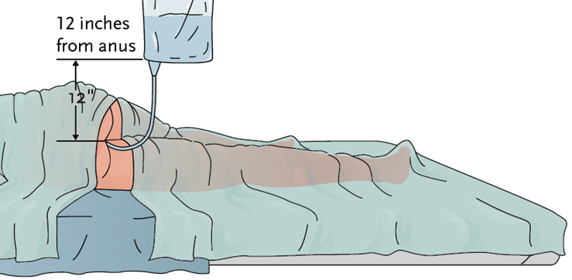
Giving a cleansing enema
Hang the bag on the IV pole. Using the tape measure, make sure bottom of enema bag is not more than 12 inches above the resident’s anus.
Uncover the resident enough to expose the anus only.
Lubricate two to four inches of the tip of the tubing with lubricating jelly.
Ask resident to breathe deeply. This relieves cramps during procedure.

Slide 95
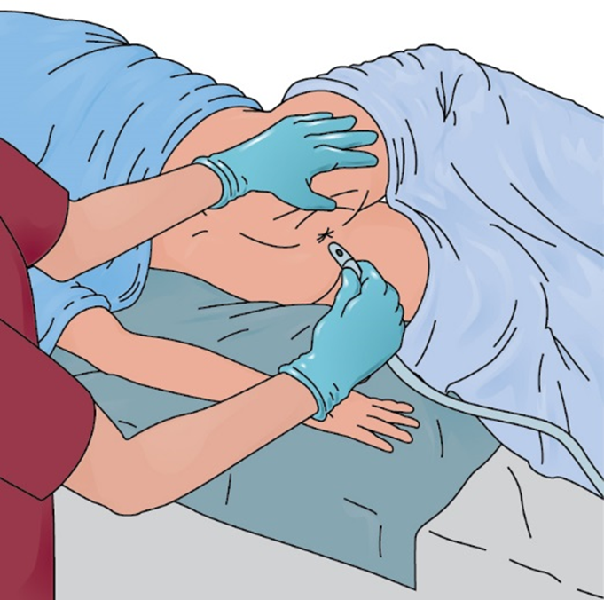
Giving a cleansing enema
Place one hand on the upper buttock. Lift to expose the anus. Ask the resident to take a deep breath and exhale. Using other hand, gently insert the tip of the tubing two to four inches into the rectum. Stop immediately if you feel resistance or if the resident complains of pain. If this happens, clamp the tubing. Tell the nurse immediately.

Slide 96
Giving a cleansing enema
Unclamp the tubing. Allow the solution to flow slowly into the rectum. Ask resident to take slow, deep breaths. If resident complains of cramping, clamp the tubing and stop for a couple of minutes. Encourage him or her to take as much of the solution as possible. The resident should let you know when he cannot take any more fluid.
Clamp the tubing before the bag is empty, when the solution is almost gone. Gently remove the tip from the rectum. Place the tip into the enema bag. Do not contaminate yourself, resident, or bed linens.
Ask the resident to hold the solution inside for as long as possible.
Help the resident to use the bedpan or commode or to get to the bathroom. If the resident is using the bedpan, raise the head of the bed. Make sure both bed rails are up, and return the bed to its lowest position before you leave the room. If the resident uses a commode or toilet, put on a robe and nonskid footwear. Lower the bed to its lowest position before the resident gets up.

Slide 97
Giving a cleansing enema
Remove and discard gloves properly. Wash your hands.
Place toilet paper and wipes within resident’s reach. Ask the resident to clean his hands with a hand wipe when finished if he is able. If the resident is using the toilet, ask him not to flush it when finished.
Leave the call light within the resident’s reach. Wash your hands. Ask the resident to signal when finished. Leave the room and closet the door.
When called by the resident, return and wash your hands. Put on clean gloves.
Raise the bed to a safe level. Lower the head of the bed. Make sure the resident is still covered. Do not overexpose the resident. Lower the bed rail on the near/working side if you raised it for the resident to use a bedpan.
Remove bedpan carefully and gently. Cover the bedpan
Give perineal care if help is needed. Wipe from front to back. Dry the perineal area with a towel. Remove and discard the bed protector. Help the resident put on undergarment. Cover the resident and remove the bath blanket.

Slide 98
Giving a cleansing enema
Place the towel and bath blanket in a hamper or bag and discard disposable supplies.
Take bedpan to the bathroom. Call the nurse to observe enema results, whether in bedpan or in toilet. Empty contents into toilet.
Turn the faucet on with a paper towel. Rinse the bedpan with cold water and empty it into the toilet. Flush the toilet. Place bedpan in area for cleaning or clean and store it according to policy.
Remove and discard gloves properly. Wash your hands.
Make resident comfortable.
Return bed to its lowest position. Remove privacy measures.
Leave the call light within the resident’s reach.
Wash your hands.
Be courteous and respectful at all times.
Report any changes in the resident to the nurse. Document procedure using facility guidelines.

Slide 99
Giving a commercial enema
Equipment: bath blanket, standard or oil retention commercial enema kit, disposable bed protector, bedpan, bedpan cover, lubricating jelly, toilet paper, disposable wipes, towel, robe, nonskid footwear, supplies for perineal care, 2 pairs of gloves
Identify yourself by name. Identify the resident. Greet the resident by name.
Wash your hands.
Explain procedure to resident. Speak clearly, slowly, and directly. Maintain face-to-face contact whenever possible.
Provide for the resident’s privacy with a curtain, screen, or door.
Adjust bed to safe working level, usually waist high. Lock bed wheels.
Put on gloves.
Place the bed protector under the resident. Ask resident to remove his undergarments or help him do so.

Slide 100
Giving a commercial enema
Help resident into left-sided Sims’ position. Place the bedpan close to the resident’s body. Cover with a bath blanket.
Uncover the resident enough to expose the anus only.
Add extra lubricating jelly to the tip of bottle if needed.
Ask resident to breathe deeply to relieve cramps during procedure.
Place one hand on the upper buttock. Lift to expose the anus. Ask the resident to take a deep breath and exhale. Using other hand, gently insert the tip of the tubing about one and a half inches into the rectum. Stop immediately if you feel resistance or if the resident complains of pain. If this happens, tell the nurse immediately.
Slowly squeeze and roll the enema container so that the solution runs inside the resident. Stop when the container is almost empty.

Slide 101
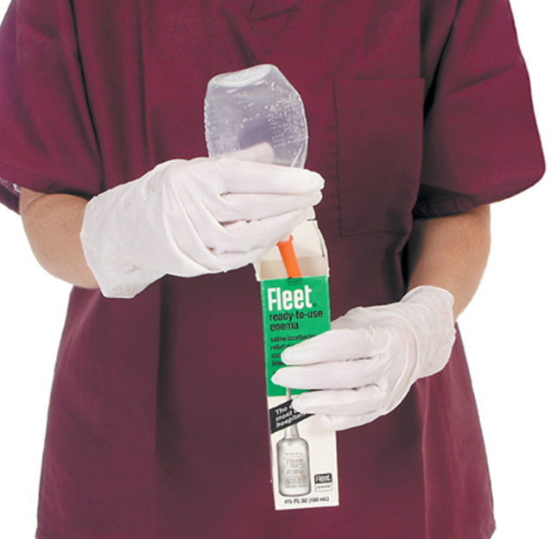
Giving a commercial enema
Gently remove tip from the rectum, continuing to keep pressure on the container until you place bottle inside the box upside down.
Ask the resident to hold the solution inside as long as possible.
Help resident to use bedpan or commode or go to the bathroom. If the resident is using the bedpan raise the head of the bed. If the resident uses a commode or toilet, put on a robe and nonskid footwear. Lower the bed to its lowest position before the resident gets up.

Slide 102
Giving a commercial enema
Remove and discard gloves properly. Wash your hands.
Place toilet paper and wipes within resident’s reach. Ask the resident to clean his hands with a hand wipe when finished if he is able. If the resident is using the bathroom, ask him not to flush it when finished.
Leave the call light within resident’s reach. Wash your hands. Ask resident to signal when finished. Leave the room and close the door.
When called by the resident, return and wash your hands. Put on clean gloves.
Raise the bed to a safe level. Lower the head of the bed. Make sure resident is still covered. Do not overexpose the resident. Lower the bed rail on the near/working side if you raised it for the resident to use the bedpan.
Remove the bedpan carefully and gently. Cover the bedpan.

Slide 103
Giving a commercial enema
Give perineal care if help is needed. Wipe from front to back. Dry the perineal area with a towel. Help the resident put on undergarment. Cover the resident and remove the bath blanket.
Place the towel and bath blanket in a hamper or bag, and discard disposable supplies.
Take bedpan to the bathroom. Call the nurse to observe enema results, whether in bedpan or in toilet. Empty contents into toilet.
Turn the faucet on with a paper towel. Rinse the bedpan with cold water and empty it into the toilet. Flush the toilet. Place the bedpan in the proper area for cleaning or clean and store it according to policy.
Remove and discard gloves properly. Wash your hands.
Make the resident comfortable.
Return bed to lowest position. Remove privacy measures.
Leave the call light within the resident’s reach.

Slide 104
Giving a commercial enema
Wash your hands.
Be courteous and respectful at all times.
Report any changes in the resident to the nurse. Document procedure using facility guidelines.

Slide 105
Discuss how enemas are given
REMEMBER:
These procedures should only be performed by nursing assistants if allowed by the facility and if they are trained to perform the procedure.

Slide 106
Demonstrate how to collect a stool specimen
Define the following term:
specimen
a sample, such as tissue, blood, urine, stool, or sputum, used for analysis and diagnosis.

Slide 107
Demonstrate how to collect a stool specimen
Remember these points about stool specimens:
Stool is tested for blood, pathogens, and other things, such as ova and parasites.
Stool must be warm if being tested for ova and parasites, so these specimens must be taken to the lab immediately.
Urine or tissue in a stool sample can ruin the sample.

Slide 108
Collecting a stool specimen
Equipment: specimen container and lid, completed label (labeled with resident’s name, date of birth, doctor’s name, room number, date, and time), biohazard specimen bag, 2 tongue blades, 2 pairs of gloves, bedpan (if resident cannot use portable commode or toilet), hat for toilet (if resident uses portable commode or toilet), plastic bag, toilet paper, disposable wipes, supplies for perineal care, lab slip
Identify yourself by name. Identify the resident. Greet the resident by name.
Wash your hands.
Explain procedure to the resident. Speak clearly, slowly, and directly. Maintain face-to-face contact whenever possible.
Provide for the resident’s privacy with a curtain, screen, or door.
Put on gloves.

Slide 109
Collecting a stool specimen
Fit hat to toilet or commode, or provide resident with bedpan.
When the resident is ready to move bowels, ask him not to urinate at the same time and not to put toilet paper in with the sample. Provide a plastic bag to discard toilet paper separately.
Make sure both bed rails are up and the bed is in its lowest position. Place toilet paper and wipes within resident’s reach. Ask the resident to clean his hands with a hand wipe when finished if he is able.
Ask the resident to signal when he is finished with the bowel movement. Make sure the call light is within reach.
Remove and discard gloves properly. Wash your hands. Leave the room and close the door.
When called by the resident, return and wash your hands. Put on clean gloves.

Slide 110
Collecting a stool specimen
Give perineal care if help is needed.
Using the two tongue blades, take about two tablespoons of stool and put it in the container. Without touching the inside of the container, cover it tightly. Apply label and place specimen in a clean biohazard specimen bag. Seal the bag.
Wrap the tongue blades in toilet paper and place them in plastic bag with used toilet paper. Discard bag in the proper container.
Turn the faucet on with a paper towel. Rinse the bedpan with cold water and empty it into the toilet. Flush the toilet. Place bedpan in area for cleaning or clean and store it according to policy.
Remove and discard gloves properly. Wash your hands.
Make resident comfortable.
Return bed to lowest position. Remove privacy measures.

Slide 111
Collecting a stool specimen
Leave call light within the resident’s reach.
Wash your hands.
Be courteous and respectful at all times.
Report any changes in the resident to the nurse. Document procedure using facility guidelines. Take specimen and lab slip to designated place promptly.

Slide 112
Explain occult blood testing
Define the following term:
occult
hidden.

Slide 113
Explain occult blood testing
REMEMBER:
Hidden, or occult, blood is found inside stool with a microscope or a special chemical test. This may be a sign of a serious physical problem, such as cancer.

Slide 114
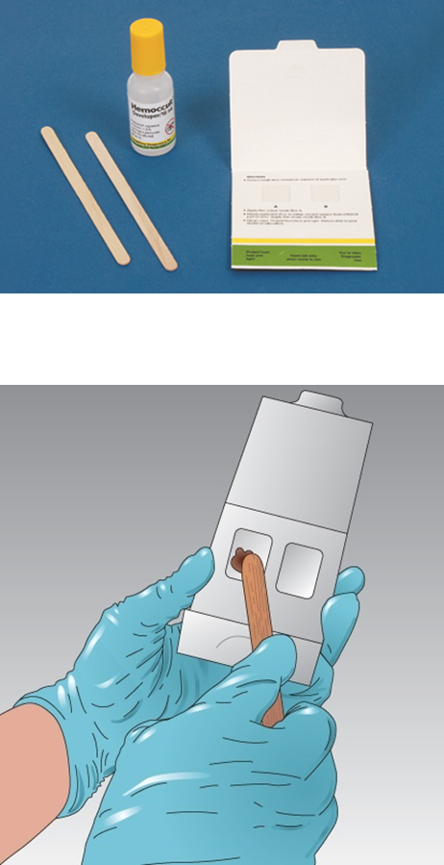
Testing a stool specimen for occult blood
Equipment: labeled stool specimen, occult blood test kit, 2 tongue blades, plastic bag, gloves
Wash your hands.
Put on gloves.
Open the test card.
Pick up a tongue blade. Get a small amount of stool from the specimen container.
Using a tongue blade, smear a small amount of stool onto Box A of the test card.

Slide 115
Testing a stool specimen for occult blood
Flip tongue blade (or use new tongue blade). Get some stool from another part of specimen. Smear small amount of stool onto Box B of test card.
Close the test card. Turn over to other side.
Open the flap.
Open the developer. Apply developer to each box. Follow manufacturer’s instructions.
Wait the amount of time listed in instructions, usually between 10 and 60 seconds.
Watch the squares for any color changes. Record color changes. Follow instructions.
Place tongue blade(s) and test packet in the plastic bag.
Dispose of the plastic bag properly in a biohazard container.
Remove and discard gloves properly.

Slide 116
Testing a stool specimen for occult blood
Wash your hands.
Document procedure using facility guidelines. Report results to the nurse.

Slide 117
Define ostomy and identify the difference between ileostomy and colostomy
Define the following terms:
ostomy
surgical creation of an opening from an area inside the body to the outside.
stoma
an artificial opening in the body.
ileostomy
surgically created opening into the end of the small intestine, the ileum, to allow feces to be expelled.

Slide 118
Define ostomy and identify the difference between ileostomy and colostomy
Define the following terms:
colostomy
Surgically created opening through the abdominal wall into the large intestine to allow feces to be expelled.
urostomy
surgical creation of an opening for the passage of urine.

Slide 119
Define ostomy and identify the difference between ileostomy and colostomy
REMEMBER:
When a resident has an ostomy, stool, or feces, is eliminated through the ostomy rather than through the anus. Residents who have had an ostomy wear a disposable drainage bag, or appliance, that fits over the stoma to collect the feces. Proper care of the skin and stoma are very important.

Slide 120
Define ostomy and identify the difference between ileostomy and colostomy
REMEMBER:
Many people with ostomies feel embarrassed or angry. They often feel they have lost control of a basic bodily function. Ostomies can cause odor, discomfort, and fear of the bag falling off.
Nursing assistants can do a great deal to help residents with ostomies feel better about themselves. They must be sensitive and supportive and always provide privacy for ostomy care.

Slide 121
Define ostomy and identify the difference between ileostomy and colostomy
Know these guidelines for ostomy care:
Follow Standard and/or Transmission-Based Precautions.
Provide good skin care and hygiene.
Remove ostomy pouches carefully.
Before removing pouches, allow a little air out of the bag.
Observe contents of pouch.
Empty, clean, and replace the ostomy pouch whenever stool is eliminated.

Slide 122
Define ostomy and identify the difference between ileostomy and colostomy
Guidelines for ostomy care (cont’d):
Assist residents to wash hands.
Observe for skin irritation, rashes, swelling or bleeding around stoma.
Use skin barriers as ordered.
Make sure bottom of pouch is securely clamped before applying to stoma.
Make sure pouch is attached securely before completing care and before residents go out or receive visitors.
Be supportive, empathetic, and caring.

Slide 123
Define ostomy and identify the difference between ileostomy and colostomy
REMEMBER:
A urostomy is the general term used for any surgical procedure that diverts the passage of urine by re-directing the ureters. A ureterostomy is a type of urostomy in which an opening from a ureter is brought through the abdomen for urine to be eliminated.

Slide 124
Caring for an ostomy
Equipment: disposable bed protector, bath blanket, clean ostomy pouching system, belt (if needed), disposable wipes (made for ostomy care), basin of warm water, washcloth, 2 towels, plastic disposable bag, gloves, special deodorant (if used)
Identify yourself by name. Identify the resident. Greet the resident by name.
Wash your hands.
Explain procedure to resident. Speak clearly, slowly, and directly. Maintain face-to-face contact whenever possible.
Provide for the resident’s privacy with a curtain, screen, or door.
Adjust bed to safe working level, usually waist high. Lock bed wheels.
Put on gloves.

Slide 125
Caring for an ostomy
Place the bed protector under resident. Cover resident with a bath blanket. Pull down the top sheet and blankets. Expose only the ostomy site. Offer the resident a towel to keep clothing dry.
Undo the ostomy belt if used. Pull gently on one edge of ostomy pouch to release air.
Remove ostomy bag carefully. Place it in the plastic bag. Note the color, odor, consistency, and amount of stool in the bag.
Wipe the area around stoma with disposable wipes for ostomy care. Discard wipes in the plastic bag.

Slide 126
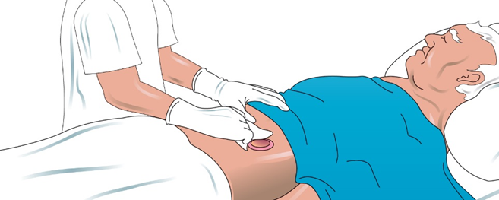
Caring for an ostomy
Using a washcloth and warm water, wash the area gently in one direction, away from the stoma. Rinse. Pat dry with another towel. Temporarily cover stoma opening with a wipe.
Apply deodorant to bag (if used). Remove the wipe and place in the plastic bag. Put the clean ostomy pouch on the resident. Hold in place and seal securely. Make sure the bottom of the pouch is clamped. Attach to ostomy belt if used.

Slide 127
Caring for an ostomy
Remove and discard the bed protector. Place soiled linens in the proper container. Discard the plastic bag in the proper container.
Remove and discard gloves properly.
Wash your hands.
Make the resident comfortable.
Return bed to its lowest position. Remove privacy measures.
Leave the call light within resident’s reach.
Wash your hands.
Be courteous and respectful at all times.
Report any changes in the resident to the nurse. Document procedure using facility guidelines.

Slide 128
Explain guidelines for assisting with bowel retraining
REMEMBER:
Residents who have had an illness, injury, or a period of inactivity may need assistance in re-establishing a regular routine and normal bowel function. Retraining is the process of assisting residents to regain control of their bowels. Nursing assistants may be asked to help residents with this.

Slide 129
Explain guidelines for assisting with bowel retraining
REMEMBER:
Keeping a positive attitude when residents struggle with bowel retraining can make a huge difference.

Slide 130
Explain guidelines for assisting with bowel retraining
Nursing assistants may assist with bowel retraining in the following ways:
Explain the schedule to the resident. Follow the schedule.
Follow Standard Precautions. Wear gloves.
Observe resident’s elimination habits.
Keep a record of elimination.
Offer bedpan or trip to the bathroom at specific times each day.
Answer call lights promptly.

Slide 131
Explain guidelines for assisting with bowel retraining
Ways in which NAs assist with bowel retraining (cont'd):
Provide privacy. Do not rush resident.
Help with perineal care.
Encourage fluids and proper diet.
Dispose of wastes properly.
Praise attempts and successes in controlling bowels.
Never show frustration or anger.

Slide 132
Explain guidelines for assisting with bowel retraining
Critical Thinking: Conversation Starter
How would it feel if you were unable to control elimination?
Why is it important to use proper terms for bodily functions and not treat residents like children?

Slide 133
13. Discuss bariatrics and related care
People who are obese may require special equipment, such as the following:
Larger beds that are lower to the floor
Stronger bed rails
Oversized chairs
Extra-capacity wheelchairs
Bariatric stretchers
Larger gowns
Bariatric transfer equipment and scales
Bariatric elimination equipment
Oversized shower areas and shower chairs
Bariatric vital signs equipment

Slide 134
13. Discuss bariatrics and related care
People who are obese may require considerations, such as the following:
At least two caregivers are needed for transfers
Careful skin care should be performed; the skin should be rinsed thoroughly, dried, and observed closely.
Obesity is a risk factor for obstructive sleep apnea, which may require a CPAP machine.
Regarding surgery, the ability to intubate may be compromised. The patient may need intubation longer and may be more prone to respiratory depression postoperatively.

Slide 135
13. Discuss bariatrics and related care
Critical Thinking: Conversation Starter
Are there any special considerations a person who is obese may require?

Slide 136
13. Discuss bariatrics and related care
Critical Thinking: Conversation Starter
Studies have shown that people who are overweight and obese are often discriminated against in the medical setting. Medical providers have viewed patients who are obese as “less self-disciplined and more ‘annoying’ and reported less desire to help them than to help thinner patients.” https://journalofethics.ama-assn.org/article/weight-bias-health-care/2010-04
How can the nursing assistant show professionalism and the same high quality of care to someone who is obese as she does to the other residents for whom she cares?

