Slide 2
Define the important words in this chapter
bony prominences
areas of the body where the bone lies close to the skin.
bruise
a purple, black, or blue discoloration on the skin caused by the leakage of blood from broken blood vessels into the surrounding tissues; also called a contusion.
cellulitis
a skin infection caused by bacteria moving into the tissues due to a break in the skin.
closed wound
a type of wound in which the skin’s surface is not broken.

Slide 3
Define the important words in this chapter
dermatitis
inflammation of the skin.
dermis
the inner layer of the two main layers of tissue that make up the skin.
epidermis
the outer layer of the two main layers of tissue that make up the skin.
gangrene
death of tissue caused by infection or lack of blood flow.
integument
natural protective covering.

Slide 4
Define the important words in this chapter
lesion
an area of abnormal tissue or an injury or wound.
melanin
the pigment that gives skin its color.
melanocyte
cell in the skin that produces and contains the pigment called melanin.
necrosis
the death of living cells or tissues caused by disease or injury.

Slide 5
Define the important words in this chapter
open wound
a type of wound in which the skin’s surface is not intact.
pressure injury
localized damage to the skin (and possibly the underlying soft tissue) that occurs due to shearing or to continued pressure over time; also known as pressure ulcer, pressure sore, decubitus ulcer, or bed sore.
pressure points
areas of the body that bear the greatest amount of weight.
psoriasis
a chronic skin condition caused by skin cells growing too quickly that results in red, white, or silver patches, itching, and discomfort.

Slide 6
Define the important words in this chapter
scabies
a contagious skin infection caused by mites burrowing into the skin that results in pimple-like irritations, rashes, intense itching, and sores.
shingles
a viral infection caused by the same virus that causes chickenpox; results in pain, itching, and rashes.
sitz bath
a warm soak of the perineal area to clean perineal wounds and reduce inflammation and pain.

Slide 7
Define the important words in this chapter
skin cancer
the growth of abnormal skin cells.
tinea
a fungal infection that causes red, scaly patches to appear in a ring shape, generally on the upper body or on the hands and feet.
wart
contagious hard bump caused by a virus.

Slide 8
Explain the structure and function of the integumentary system
Define the following terms:
integument
natural protective covering.
epidermis
the outer layer of the two main layers of tissue that make up the skin.
melanocyte
cell in the skin that produces and contains the pigment called melanin.

Slide 9
Explain the structure and function of the integumentary system
Define the following terms:
melanin
the pigment that gives skin its color.
dermis
the inner layer of the two main layers of tissue that make up the skin.

Slide 10
Explain the structure and function of the integumentary system
The integumentary system consists of the following parts:
Skin
Hair
Nails
Sebaceous (oil) glands
Sweat glands
Subcutaneous tissue
Nerve endings

Slide 11
Explain the structure and function of the integumentary system
REMEMBER:
The skin is a natural protective covering, or integument. It is the largest organ in the human body.

Slide 12
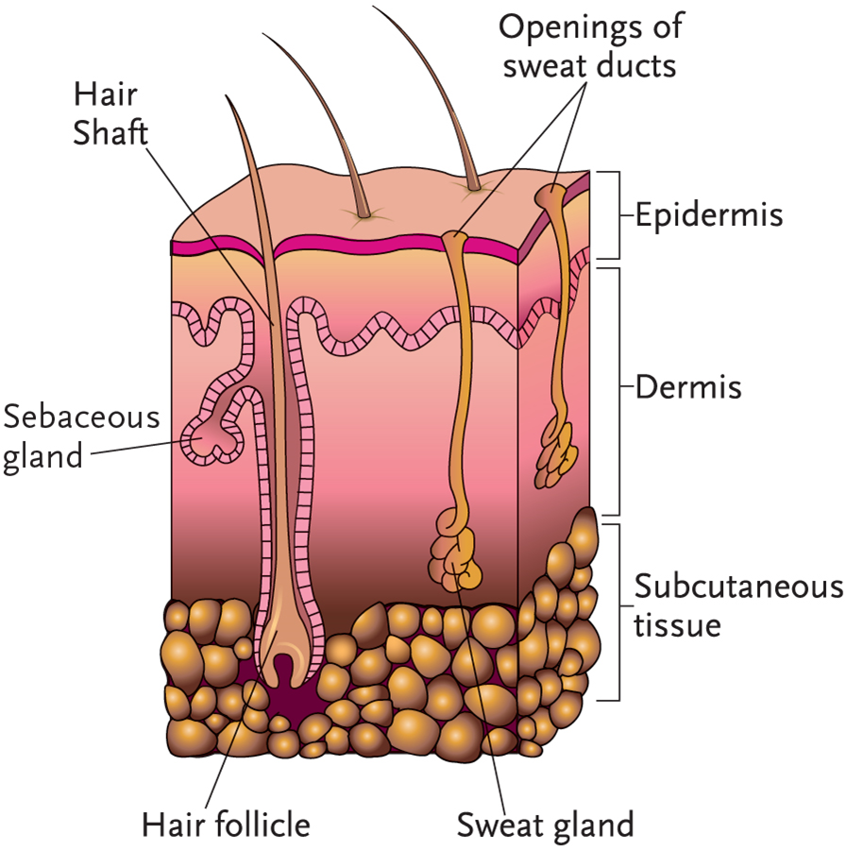
Key Material 18-1: The Integumentary System

Slide 13
Explain the structure and function of the integumentary system
Remember these points about the integumentary system:
Natural, protective covering
Largest organ and system
Covers and protects the body
Skin is a sense organ

Slide 14
Explain the structure and function of the integumentary system
The functions of the integumentary system are as follows:
Protects internal organs from injury
Protects body against bacteria
Prevents loss of too much water
Regulates body temperature
Responds to heat, cold, pain, pressure, and touch
Excretes waste products in sweat
Helps with production of vitamin D

Slide 15
Discuss changes in the integumentary system due to aging
Normal changes of aging in the integumentary system include
Amount of fat and collagen decreases.
Elastic fibers lose elasticity.
Hair and nail growth slows.
Skin becomes drier.
Skin becomes thinner and more fragile.
Protective fatty layer thins.
Hair thins and turns gray.
Brown spots may appear on the skin.

Slide 16
Discuss common disorders of the integumentary system
Remember these points about burns and scalds:
Causes: fire, hot liquids, warm water applications, electrical equipment, hot objects, certain chemicals
First-degree, or superficial, burns affect the epidermis and cause redness and pain.
Second-degree, or partial-thickness, burns affect the dermis and cause some skin damage, redness, pain, swelling and blistering.
Third-degree, or full-thickness, burns affect the epidermis, dermis and underlying tissue and cause serious scarring, which may affect muscle and bone; white or charred skin; pain, swelling, and peeling skin.
Very painful

Slide 17
Discuss common disorders of the integumentary system
Points about burns and scalds (cont’d):
May require surgery
Can cause resident’s condition to deteriorate rapidly
Offer pain medication before beginning care.
Be gentle with moving and positioning.
Report pus or other fluids around burn area or complaints of pain.

Slide 18
Discuss common disorders of the integumentary system
Define the following term:
scabies
a contagious skin infection caused by mites burrowing into the skin that results in pimple-like irritations, rashes, intense itching, and sores.

Slide 19
Discuss common disorders of the integumentary system
Remember these points about scabies:
Cause: mites that burrow into the skin to lay eggs
Symptoms: rash, intense itching, sores that may become infected
Usually transmitted by person-to-person contact
Elderly and those with weak immune systems at higher risk
Treatment: special lotions

Slide 20
Discuss common disorders of the integumentary system
Define the following term:
shingles
a viral infection caused by the same virus that causes chickenpox; results in pain, itching, and rashes.

Slide 21
Discuss common disorders of the integumentary system
Remember these points about shingles:
Cause: viral infection (varicella-zoster virus, same virus that causes chickenpox)
Can occur in anyone who has had chickenpox
Symptoms: begins with pain or itching where rash will appear; fever, chills
Pain may last for many years.
Virus is spread when in blister form.
Keep rash covered at all times.
Treatment: medication

Slide 22
Discuss common disorders of the integumentary system
Define the following terms:
closed wound
a type of wound in which the skin’s surface is not broken.
bruise
a purple, black, or blue discoloration on the skin caused by the leakage of blood from broken blood vessels into the surrounding tissues; also called a contusion.
open wound
a type of wound in which the skin’s surface is not intact.

Slide 23
Discuss common disorders of the integumentary system
Remember these points about wounds:
Types of open wounds: abrasion, avulsion, incision, laceration, puncture wound
A common type of closed wound is a contusion, or bruise.
Symptoms: pain, tissue damage, discoloration, bleeding, fever, chills, trouble breathing
New wounds require immediate attention.
Treatment: stopping bleeding, cleaning wound, applying dressing

Slide 24
Discuss common disorders of the integumentary system
Define the following term:
lesion
an area of abnormal tissue or an injury or wound.

Slide 25
Discuss common disorders of the integumentary system
Know these types of skin lesions:
Macules are the simplest skin lesion. They are flat spots that can be seen but not felt. They are visible because they change the color of the skin. Freckles are an example.
Papules are skin lesions that are raised, little round bumps on the skin. They do not contain pus. Contact dermatitis is an example.
Pustules are raised spots filled with pus, such as acne or infected boils.
Vesicles are small blisters that contain fluid. They can occur on the skin or inside the mouth. Chickenpox is an example.

Slide 26
Discuss common disorders of the integumentary system
Types of skin lesions (cont’d):
Wheals are large raised, irregular areas, that are usually itchy. Hives from an allergic reaction are an example.
Hematoma is a collection of blood in one area. The spot can be visible as a bruise, but may also occur on internal organs. Hematomas can become larger over time. They may also change color.
Purpura are small, purplish spots caused by bleeding under the skin. In elderly people, these spots are called senile purpura. Senile purpura occurs because blood vessels become more fragile with age.

Slide 27
Discuss common disorders of the integumentary system
Define the following term:
gangrene
death of tissue caused by infection or lack of blood flow.

Slide 28
Discuss common disorders of the integumentary system
Remember these points about gangrene:
Means death of tissue
Caused by lack of blood flow
Must be treated immediately
Causes: burns, diabetes, injuries, circulatory disorders, weakened immune system, complications from surgery
Symptoms: discoloration of skin, sores that do not heal, pain, loss of feeling, foul-smelling discharge, chills, change in vital signs
Report elevated temperature, pulse, or respiration rate; changes in blood pressure or difficulty breathing.
Treatment: antibiotics, surgery, amputation, hospitalization

Slide 29
Discuss common disorders of the integumentary system
Define the following term:
dermatitis
inflammation of the skin.

Slide 30
Discuss common disorders of the integumentary system
Remember these points about dermatitis:
Different types include atopic dermatitis (eczema) and contact dermatitis
Causes: stress, allergies, family history, irritating agents in environment
Treatment: topical steroid creams, soothing or drying lotions
Report: worsening of eczema, severe itching or pain, signs of infection

Slide 31
Discuss common disorders of the integumentary system
Define the following term:
cellulitis
a skin infection caused by bacteria moving into the tissues due to a break in the skin.

Slide 32
Discuss common disorders of the integumentary system
Remember these points about cellulitis:
Caused by bacteria moving deep into the tissues due to a break in the skin
Diabetes, edema, obesity, and a weakened immune system also put a person at a higher risk for cellulitis.
Antibiotics are common treatment.

Slide 33
Discuss common disorders of the integumentary system
Define the following term:
psoriasis
a chronic skin condition caused by skin cells growing too quickly that results in red, white, or silver patches, itching, and discomfort.

Slide 34
Discuss common disorders of the integumentary system
Remember these points about psoriasis:
Chronic skin condition in which skin cells grow too fast
Symptoms: white or silver patches on skin, itching and discomfort, arthritis, pain
Causes: usually inherited; may be caused by dry climate, cold weather, stress, or weakened immune system
Treatment: topical creams, shampoos, lotions, medication, phototherapy, dietary changes, sun therapy

Slide 35
Discuss common disorders of the integumentary system
Define the following term:
tinea
a fungal infection that causes red, scaly patches to appear in a ring shape, generally on the upper body or on the hands and feet.

Slide 36
Discuss common disorders of the integumentary system
Remember these points about fungal infections:
Commonly occur in moist areas of the body
Symptoms: red scaly patches, itching, rawness, pain
Examples: jock itch, vaginal yeast infections, athlete’s foot, tinea
Causes: overgrowth of fungus due to overuse of antibiotics and reduced immune system function
Treatment: topical antifungal creams, medications
Report: skin changes, skin abrasions, flaking, redness, sores, scratching

Slide 37
Discuss common disorders of the integumentary system
Define the following term:
wart
contagious hard bump caused by a virus.

Slide 38
Discuss common disorders of the integumentary system
Remember these points about warts:
Rough, hard bump on the skin
Cause: contagious virus enters skin through cut or tear
Treatment: medication, removal with laser or special instrument

Slide 39
Discuss common disorders of the integumentary system
Define the following term:
skin cancer
the growth of abnormal skin cells.

Slide 40
Discuss common disorders of the integumentary system
Remember these points about skin cancer:
Most serious form is malignant melanoma.
Symptoms: changes in a mole, wart, or spot on the skin, sores that do not heal, itching, pain, and skin that is oozing or bleeding.
Causes: sun exposure
Treatment: removing cancerous area and tissue, as well as interferon

Slide 41
Discuss common disorders of the integumentary system
REMEMBER:
Obesity increases the risk for certain integumentary diseases or disorders, including the following:
pressure injuries
Skin infections such as cellulitis
Excess facial and body hair
Slow wound healing

Slide 42
Discuss pressure injuries and identify prevention guidelines
Define the following terms:
pressure points
areas of the body that bear the greatest amount of weight.
bony prominences
areas of the body where the bone lies close to the skin.
necrosis
the death of living cells or tissues caused by disease or injury.
pressure injury
localized damage to the skin (and possibly the underlying soft tissue) that occurs due to shearing or to continued pressure over time; also known as pressure ulcer, pressure sore, decubitus ulcer, or bed sore.

Slide 43
Discuss pressure injuries and identify prevention guidelines
REMEMBER:
When a person is confined to bed for long periods of time, the amount of blood that circulates to the skin is reduced and the risk of skin breakdown increases. This breakdown usually occurs at the points of the body that bear much of the body’s weight.
These points are called pressure points, and there are many on the human body. They are mainly located at bony prominences, which are areas of the body where the bone lies close to the skin.

Slide 44
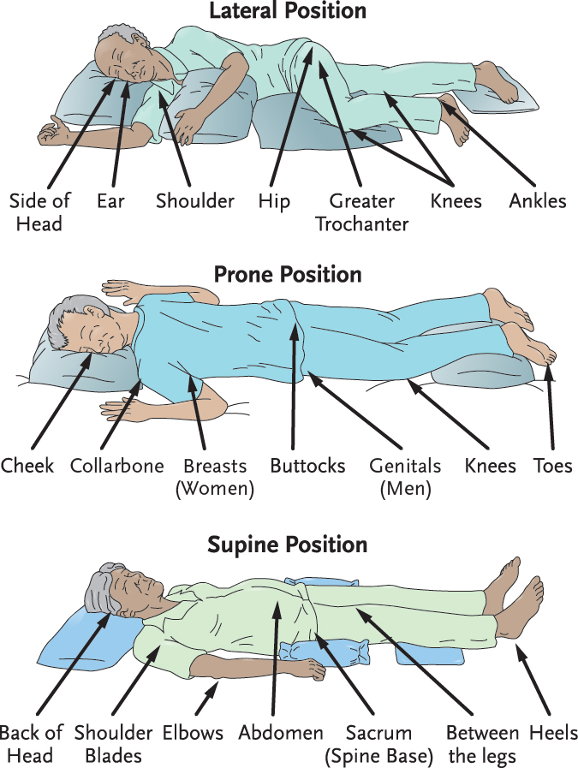
Key Material 18-2: Pressure Injury Danger Zones

Slide 45
Discuss pressure injuries and identify prevention guidelines
There are four stages of pressure injuries:
Stage I
Skin is intact, but reddens or appears blue or gray
May appear purple or darker than the skin surrounding the area in dark complexions
Skin may be swollen or feel warm or firm
Redness or discoloration is not relieved after removing pressure
Can be reversed if discovered promptly and treated
If not treated promptly, the pressure injury will worsen and progress into other stages

Slide 46
Discuss pressure injuries and identify prevention guidelines
Stages of pressure injuries (cont’d):
Stage II
Partial-thickness skin loss involving the epidermis and the dermis
Ulcer is superficial and looks like a blister or shallow crater
Accompanied by pain and tenderness
Skin around the pressure injury may be discolored
No dead (necrotic) tissue in the site at this stage

Slide 47
Discuss pressure injuries and identify prevention guidelines
Stages of pressure injuries (cont’d):
Stage III
Full-thickness skin loss (both the epidermis and dermis will be gone)
Ulcer looks like a shallow or deep crater
Bottom of the wound may have yellow, dead tissue
Damage may extend to the tissue that covers muscle
Require weeks or months to fully heal

Slide 48
Discuss pressure injuries and identify prevention guidelines
Stages of pressure injuries (cont’d):
Stage IV
Full-thickness skin loss extending through all layers of the skin, tissue, and possibly, muscle, bone, and other structures, such as joints or tendons
Ulcer will look like a deep crater and will have some necrotic tissue
Healing process extends over months
Serious infections can result
May require a skin graft

Slide 49
Discuss pressure injuries and identify prevention guidelines
Critical Thinking: Conversation Starter
Why should every resident’s skin be inspected each time that care is provided?

Slide 50
Key Material 18-3: Observing the Skin
Observe the skin carefully for signs of skin breakdown, including the following:
Pale, white, reddened, gray, or purple skin
Dry, cracked, or flaking skin
Torn skin
Blisters, bruises, or wounds on the skin
Rashes or any discoloration
Tingling, warmth, or burning of skin
Itching or scratching
Swelling of skin
Wet skin
Broken skin anywhere on the body
Changes in existing wounds or ulcers

Slide 51
Discuss pressure injuries and identify prevention guidelines
Risk factors for pressure injuries include the following:
Immobility
Wrinkled linens that do not lie flat
Crumbs or other irritating objects in bed
Malnutrition or dehydration
Urinary and fecal incontinence

Slide 52
Discuss pressure injuries and identify prevention guidelines
Remember these guidelines for prevention of pressure injuries:
Report changes in skin.
Perform regular skin care and closely observe skin.
Keep skin clean and dry.
Assist immobile residents to change position often, at least every two hours.
Ask residents in wheelchairs to change position at least every 15 minutes.
Avoid rubbing skin against surfaces during transfers or repositioning.

Slide 53
Discuss pressure injuries and identify prevention guidelines
Guidelines for prevention of pressure injuries (cont’d):
Keep linens dry, clean, and wrinkle-free.
Perform ROM exercises as ordered.
Use special positioning devices.
Use pillows to separate skin surfaces.
Follow diet and fluid orders.

Slide 54
Discuss pressure injuries and identify prevention guidelines
Define the following term:
sitz bath
a warm soak of the perineal area to clean perineal wounds and reduce inflammation and pain.

Slide 55
Explain the benefits of warm and cold applications
Know these points about warm and cold applications:
Heat relieves pain and muscular tension, decreases swelling, elevates temperature in the tissues, increases waste removal, and brings more oxygen and nutrients to tissues for healing.
Cold helps stop bleeding, prevents swelling, reduces pain and brings down high temperatures.
Moisture strengthens the effect of heat and cold.
It is important to observe for excessive redness, pain, blisters, or numbness

Slide 56
Applying warm moist compresses
Equipment: washcloth or compress, plastic wrap, towel, basin, water thermometer
Identify yourself by name. Identify the resident. Greet the resident by name.
Wash your hands.
Explain procedure to the resident. Speak clearly, slowly, and directly. Maintain face-to-face contact whenever possible.
Provide for the resident’s privacy with a curtain, screen, or door.
Fill basin one-half to two-thirds with warm water. Test water temperature with thermometer or against the inside of your wrist to ensure it is safe. Water temperature should be no higher than 105°F. Have the resident check the water temperature. Adjust if necessary.

Slide 57
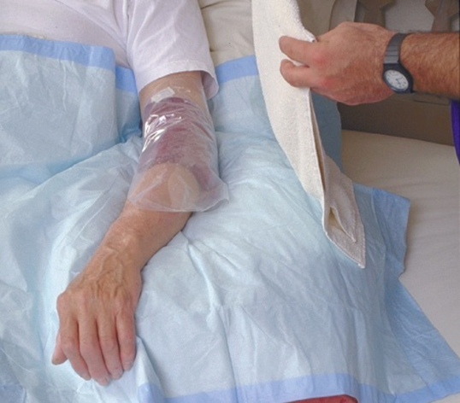
Applying warm moist compresses
Soak the washcloth in the water and wring it out. Immediately apply it to the area. Note the time. Quickly cover the washcloth with plastic wrap and the towel to keep it warm.
Check the area every five minutes. Remove the compress if the area is red or numb or if the resident complains of pain or discomfort. Change the compress if cooling occurs. Remove the compress after 20 minutes.
Remove privacy measures. Make the resident comfortable

Slide 58
Administering warm soaks
Discard the plastic wrap. Empty, rinse and dry the basin. Place the basin in area for cleaning or clean and store it according to policy.
Place soiled clothing and linens in the proper containers.
Leave call light within resident’s reach.
Wash your hands.
Be courteous and respectful at all times.
Report any changes in the resident to the nurse. Document procedure using facility guidelines.

Slide 59
Administering warm soaks
Equipment: towel, basin, water thermometer, bath blanket, disposable absorbent pad
Identify yourself by name. Identify the resident. Greet the resident by name.
Wash your hands.
Explain procedure to the resident. Speak clearly, slowly, and directly. Maintain face-to-face contact whenever possible.
Provide for the resident’s privacy with a curtain, screen, or door.
Fill the basin one-half to two-thirds full with warm water. Test water temperature with the thermometer or against the inside of your wrist to ensure it is safe. Water temperature should be no higher than 105°F. Have the resident check the water temperature. Adjust if necessary.
Place the basin on a disposable absorbent pad (protective barrier), at a comfortable position for the resident.

Slide 60
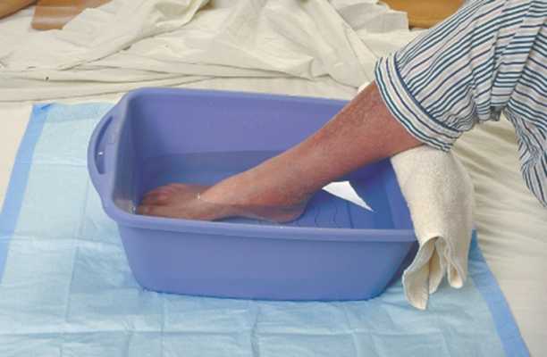
Administering warm soaks
Immerse the body part in the basin. Pad the edge of the basin with a towel. Use a bath blanket to cover the resident if needed for extra warmth.
Check water temperature every five minutes. Add warm water as needed to maintain the temperature, but never add water warmer than 105°F. To prevent burns, ask the resident not to add warm water. Observe the area for redness. Discontinue the soak if the resident has pain or discomfort.
Soak for 15-20 minutes or as ordered.

Slide 61
Administering warm soaks
Remove basin. Use the towel to dry the resident.
Remove privacy measures. Make resident comfortable.
Empty, rinse and dry the basin. Place basin in the area for cleaning or clean and store it according to policy.
Discard the disposable pad. Place soiled clothing and linens in the proper containers.
Leave call light within the resident’s reach.
Wash your hands.
Be courteous and respectful at all times.
Report any changes in the resident to the nurse. Document procedure using facility guidelines.

Slide 62
Applying an Aquamatic K-Pad
Equipment: K-Pad and control unit, covering for pad, distilled water
Identify yourself by name. Identify the resident. Greet the resident by name.
Wash your hands.
Explain procedure to the resident. Speak clearly, slowly, and directly. Maintain face-to-face contact whenever possible.
Provide for the resident’s privacy with a curtain, screen, or door.

Slide 63
Applying an Aquamatic K-Pad
Make sure the surface on the bedside table is dry. Place the control unit on the bedside table. Make sure cords are not frayed or damaged. Check that the tubing between the pad and unit is intact.
Remove the cover of the control unit to check the water level. If it is low, fill it with distilled water to the fill line.
Put the cover of control unit back in place.
Plug the unit in and turn pad on. Temperature should have been preset. If it was not, check with the nurse for proper temperature. If you need to set the temperature, you must remove the key after doing so. Place key in proper place.
Place the pad in the cover. Do not pin the pad to the cover.
Uncover area to be treated. Place the covered pad on the area. Note the time. Make sure the tubing is not hanging below the bed. It should be coiled on the bed. Make sure tubing has no kinks.

Slide 64
Applying an Aquamatic K-Pad
Return and check area every five minutes. Remove the pad if the area is red or numb or if the resident reports pain or discomfort.
Check water level and refill with distilled water to the fill line when necessary.
Turn off the unit and remove the pad after 20 minutes.
Remove privacy measures. Make the resident comfortable.
Clean and store supplies.
Place soiled linen in the proper container.
Leave call light within resident’s reach.
Wash your hands.
Be courteous and respectful at all times.
Report any changes in the resident to the nurse. Document procedure using facility guidelines.

Slide 65
Explain the benefits of warm and cold applications
REMEMBER:
These procedures should only be performed if allowed by your facility and if you are trained to perform the procedure.

Slide 66
Explain the benefits of warm and cold applications
Remember these guidelines about sitz baths:
Sitz baths cause circulation to be increased to the pelvic area, which means blood flow to other parts of the body decreases. Residents may feel weak, faint, or dizzy after a sitz bath.
Stop the bath if the resident complains of feeling dizzy or faint. Sitz baths may cause the urge to void.
Always wear gloves when helping with a sitz bath.

Slide 67
Assisting with a sitz bath
Equipment: disposable sitz bath, water thermometer, towels, gloves
Identify yourself by name. Identify the resident. Greet the resident by name.
Wash your hands.
Explain procedure to the resident. Speak clearly, slowly, and directly. Maintain face-to-face contact whenever possible.
Provide for the resident’s privacy with a curtain, screen, or door.
Put on gloves.
Fill the sitz bath container two-thirds full with warm water. Place the sitz bath on the toilet seat. Check the water temperature using the water thermometer. Water temperature should be no higher than 105°F.
Help the resident undress and sit on the sitz bath. A valve on the tubing connected to the bag allows the resident or you to refill the sitz bath with warm water.

Slide 68
Assisting with a sitz bath
You may be required to stay with the resident during the bath for safety reasons. If you leave the room, check on the resident every five minutes to make sure she is not dizzy or weak. Make sure the resident knows how to use the emergency pull cord in the bathroom if it is needed. Stay with a resident who seems unsteady.
Help the resident off of the sitz bath after 20 minutes. Provide towels and help with dressing if needed.
Empty and rinse sitz bath container. Place container in area for cleaning or clean and store it according to policy.
Place soiled clothing and linens in proper containers.
Remove and discard gloves properly. Wash your hands.
Make the resident comfortable. Remove privacy measures.
Leave call light within the resident’s reach.
Wash your hands.

Slide 69
Assisting with a sitz bath
Be courteous and respectful at all times.
Report any changes in the resident to the nurse. Document procedure using facility guidelines.

Slide 70
Applying ice packs
Equipment: cold pack or sealable plastic bag and crushed ice, towels to cover pack or bag
Identify yourself by name. Identify the resident. Greet the resident by name.
Wash your hands.
Explain procedure to the resident. Speak clearly, slowly, and directly. Maintain face-to-face contact whenever possible.
Provide for the resident’s privacy with a curtain, screen, or door.

Slide 71
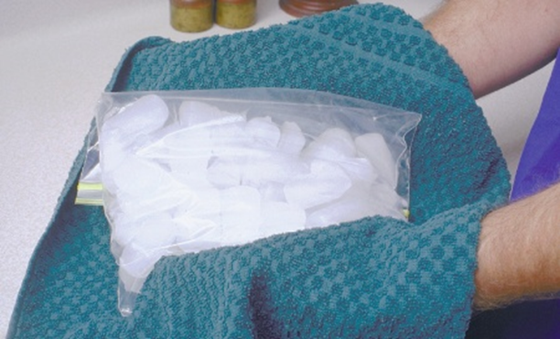
Applying ice packs
Fill plastic bag or ice pack one-half to two-thirds full with crushed ice. Seal bag. Remove excess air. Cover bag or ice pack with the towel.
Apply pack or bag to the area as ordered. Note the time. Use another towel to cover bag or pack if it is too cold.
Check the area after five minutes for blisters or pale, white, or gray skin. Stop treatment if resident reports numbness, tingling, burning, or pain.

Slide 72
Applying ice packs
Remove ice pack or bag after 20 minutes or as ordered.
Remove privacy measures. Make the resident comfortable.
Discard supplies or store in freezer if ordered.
Place used linen in the proper container.
Leave call light within resident’s reach.
Wash your hands.
Be courteous and respectful at all times.
Report any changes in the resident to the nurse. Document procedure using facility guidelines.

Slide 73
Discuss nonsterile and sterile dressings
Remember these points about sterile and nonsterile dressings:
Open wounds increase risk of infection.
nonsterile dressings are applied to wounds that have less chance of infection.
Sterile dressings are required when the wound is new, open or draining, or when there is a higher risk of infection.

Slide 74
Assisting the nurse with changing a nonsterile dressing
Equipment: package of square gauze dressings, adhesive tape, scissors, 2 pairs of gloves, plastic bag
Identify yourself by name. Identify the resident. Greet the resident by name.
Wash your hands.
Explain procedure to the resident. Speak clearly, slowly, and directly. Maintain face-to-face contact whenever possible.
Provide for the resident’s privacy with a curtain, screen, or door.
The nurse will prepare a clean, flat, dry surface for the dressing materials. Keep the plastic bag close by for immediate disposal of old dressing materials.
You may be asked to open packages for the nurse or cut strips of tape. Cut pieces of tape long enough to secure the dressing. Open the square gauze packages without touching the insides or the gauze.
Put on gloves.

Slide 75
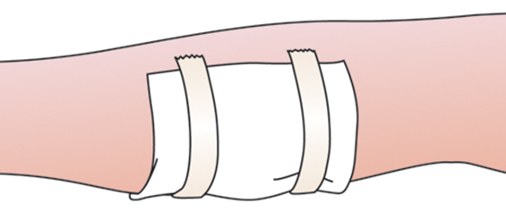
Assisting the nurse with changing a nonsterile dressing
Only expose the area where the dressing will be changed. The nurse will remove the soiled dressing. Discard used dressing in the proper container.
Remove your gloves and discard them in the plastic bag.
Wash your hands.
Put on new gloves. The nurse will observe the wound and then apply the fresh gauze over the wound and tape it in place. Assist as directed.

Slide 76
Assisting the nurse with changing a nonsterile dressing
Remove and discard gloves properly. Wash your hands.
Make the resident comfortable. Remove privacy measures.
Leave call light within the resident’s reach.
Wash your hands.
Be courteous and respectful at all times.
Report any changes in the resident to the nurse. Document procedure using facility guidelines.

Slide 77
Discuss nonsterile and sterile dressings
Remember these points about sterile dressing care:
Sterile field is created.
These supplies are considered sterile:
Sterile dressings
Sterile drapes or pads
Tubing and catheters
If any part of the sterile field becomes contaminated, the entire process must be restarted.

Slide 78
Applying sterile gloves
Equipment: 2 pairs of sterile gloves in correct size
Wash your hands.
Using a clean, flat, dry surface, remove the outer wrapper from the gloves. Place the inner wrapper on the clean surface. The word Left should be on your left side, and the word Right should be on your right side.
Slowly open the inner wrapper, only touching the small flaps of the wrapper.

Slide 79
Applying sterile gloves
The gloves will have been placed palm-side up with cuffs in place. Pick up the first glove by the bottom end of the cuff. Slip your fingers into the glove without touching the outside of the glove. If you touch the outside of the glove, it will be contaminated. You will have to start over with a new pair of gloves. Wait to adjust the glove until the second glove is on your other hand.

Slide 80
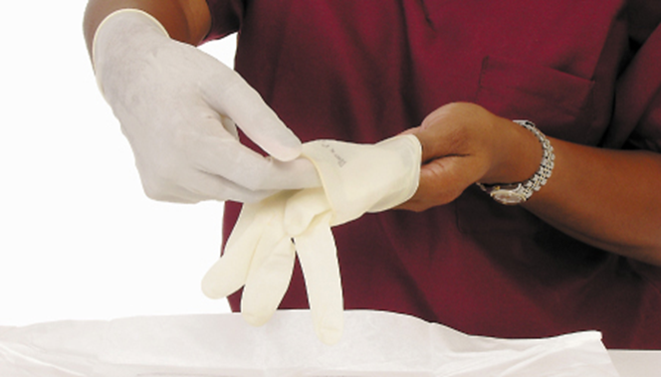
Applying sterile gloves
Slip your gloved hand into the second glove in the area under the cuff.
Slowly slip the fingers of your ungloved hand into the second glove, and pull it completely over your hand and wrist.
With your gloved second hand, finish pulling the first glove up and over the wrist. Adjust the fingers now if any adjustment is necessary.

Slide 81
Applying sterile gloves
If either glove has a tear in it, stop and start again with the second set of sterile gloves.
Keep your gloved hands in front of you and above the level of your waist at all times during the procedure.
Assist the nurse with sterile procedure.

Slide 82
Discuss nonsterile and sterile dressings
Critical Thinking: Conversation Starter
Why must the entire process be restarted if any part of the sterile field becomes contaminated?

